Slide 1
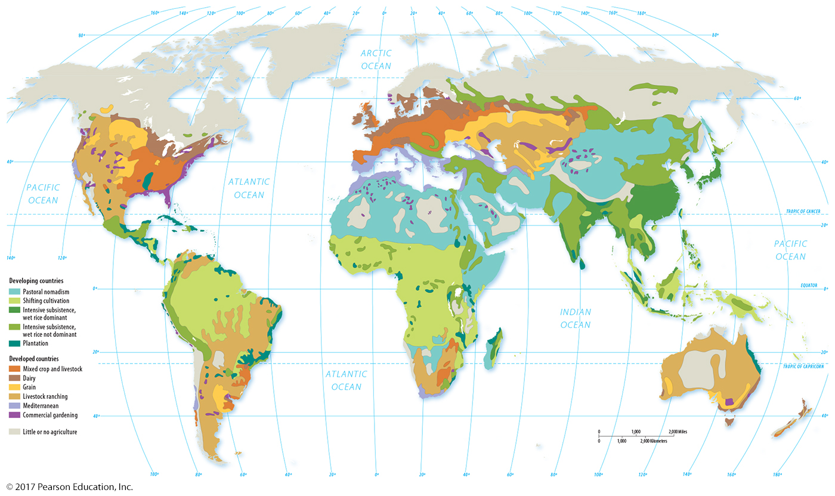
3.1 Agricultural Regions and Climate
Figure 9-13: Agriculture around the world can be classified into 11 regions based on the commercial/subsistence divide and other characteristics.

