Slide 1
The Law of the Primate City and the Rank-Size Rule
“If all the settlements of a country are ranked according to population size, the sizes of the settlements will be inversely proportional to their rank”
Zipf
The primate city is commonly at least twice as large as the next largest city and more than twice as significant.
Mark Jefferson, 1939
Notes:
Primate Cities Geography 6/111/2002
‹#›
Introducing today’s topic. Main Case Study today will be Bangkok.

Slide 2
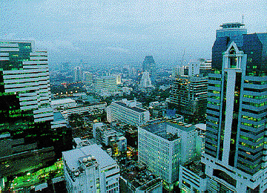
Bangkok Thailand,
The City of Angels
FACTS
The capital city of Thailand for more than 200 years
One of the world's most populated cities
Registered population of over 5.5 million (Estimated actual population of up to 8 million)
1,568 sq km
Recently has seen explosive growth of urbanization
Major growth started in the 1950’s & 60’s
Notes:
Primate Cities Geography 6/111/2002
‹#›
Some more examples of Countries With Primate Cities - can you think of any areas near you? The rule also applies to regions as well as countries.
Paris (2.2 million) is definitely the focus of France while Marseilles has a population of 800,000.
Similarly, the United Kingdom has London as its primate city (6.9 million) while the second largest city, Birmingham, is home to a mere one million people.
Mexico City, Mexico (9.8 million in the city; 16.6 million in the metropolitan area) outshines Guadalajara (1.7 million).

Slide 3
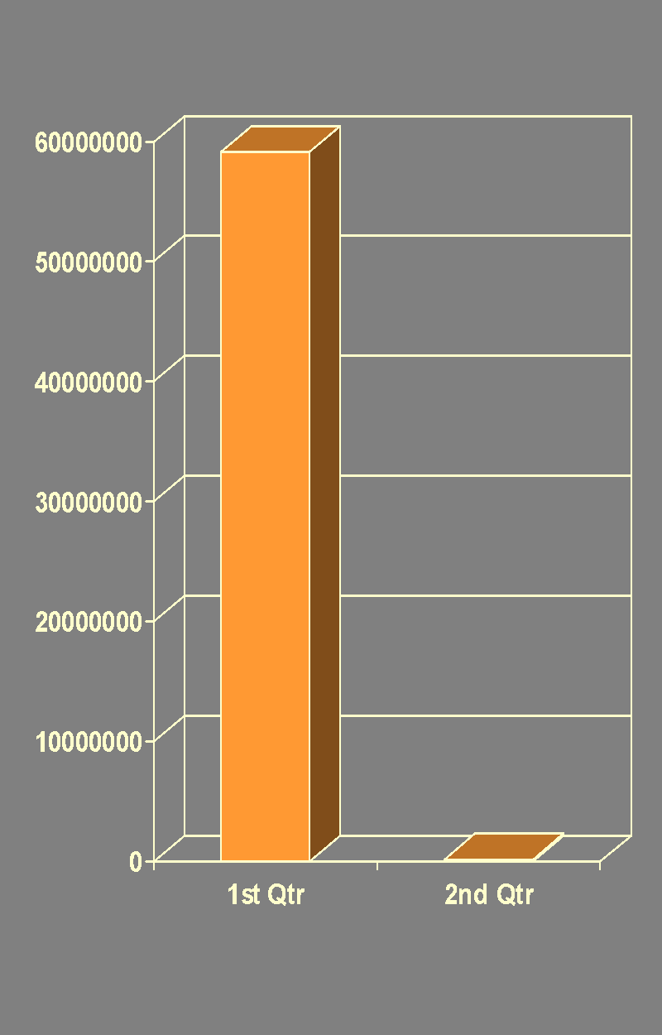
Bangkok – Example of a Primate City
Urban Primacy - where the largest city is a many times larger than the second city.
A huge dichotomy exists between Bangkok (5.9 million) and Thailand's second city, Nakhon Ratchasima (278,000).
Notes:
Primate Cities Geography 6/111/2002
‹#›
Examples of Countries that Lack Primate Cities
India’s most populous city is Mumbai (formerly Bombay) with 9.9 million; second is Delhi with 7 million, third is Kolkata (formerly Calcutta) with 4.4 million, and fourth is Chennai (formerly Madras) with 3.8 million.
China, Canada, Australia, and Brazil are additional examples of non-primate-city countries.
Utilizing the metropolitan area population of urban areas in the United States, we find that the U.S. lacks a true primate city. With the New York City metropolitan area population at approximately 20.1 million, second ranked Los Angeles at 15.8 million, and even third ranked Chicago at 8.8 million, America lacks a primate city.
This may be down to the huge size of the country, which isolates areas letting them to grow or decrease at a natural rate.

Slide 4
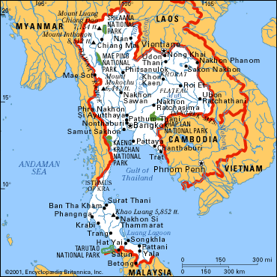
Examples of Countries With Primate Cities
France
UK
Mexico
Thailand
Notes:
Primate Cities Geography 6/111/2002
‹#›
In 1949, George Zipf devised his theory of rank-size rule to explain the size cities in a country. He explained that the second and subsequently smaller cities should represent a proportion of the largest city. For example, if the largest city in a country contained one million citizens, Zipf stated that the second city would contain 1/2 as many as the first, or 500,000. The third would contain 1/3 or 333,333, the fourth would house 1/4 or 250,000, and so on, with the rank of the city representing the denominator in the fraction.
While some countries' urban hierarchy somewhat fits into Zipf's scheme, later geographers argued that his model should be seen as a probability model and that deviations are to be expected.

Slide 5
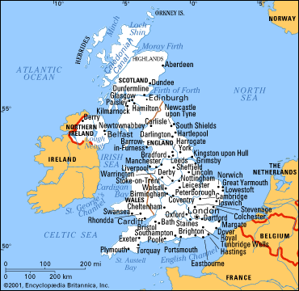
The United Kingdom
Notes:
Primate Cities Geography 6/111/2002
‹#›
Is Norwich a regional primate city? (Students contribute this information - students discuss in groups and answer, justifying their conclusions)

Slide 6
Factors Encouraging Primacy
Favourable initial advantages for site
Advantages maintained and enhanced
Magnetic attraction for businesses, services and people (cumulative effect)
Disproportionate growth increases attractiveness
Has a parasitic effect, sucking wealth, natural and human resources.
Notes:
Primate Cities Geography 6/111/2002
‹#›
The relative sizes of the top five cities in Germany. Example of Zipf’s Rule.

Slide 7
For & Against Primate Cities in an LDC like Bangkok
FOR
They attract overseas investment and benefits that will eventually benefit the whole country
AGAINST
They are unstoppable monsters that create serious problems, shortages and escalating land prices that make them less attractive places to live in.
Notes:
Primate Cities Geography 6/111/2002
‹#›
INTRODUCTION
QUESTIONS:
WHERE IS THIS?
WHAT COUNTRY IS THIS?
WHAT’S THE CLIMATE LIKE?
WHAT’S IT LIKE TO LIVE HERE - IN GROUPS, WRITE DOWN YOUR THOUGHTS ON WHAT IT WOULD BE LIKE TO LIVE HERE.
Bangkok has been the capital city of Thailand for more than 200 years. The metropolis of Bangkok has gradually grown up into one of the world's populated cities with a registered population of over 5.5 million and estimated actual population of up to 8 million on the 1,568 sqkm area. The explosive growth of the urbanisation of Bangkok started in the fifties and sixties. The quick rising of industrialisation and economic development together with the centralisation of the national government's activities are the main origins of its primacy. Until present, Bangkok continues to be the major centre of economic activities, which mainly rely on industry, trade and services.

Slide 8
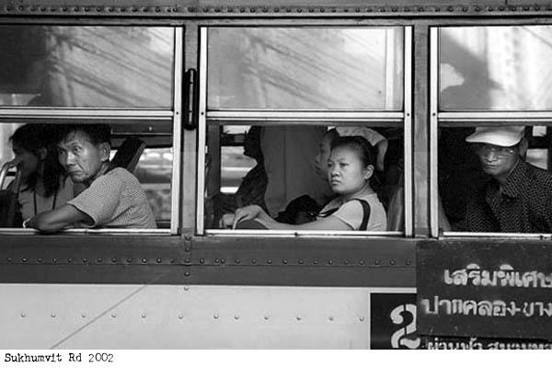
Urban Problems In Bangkok
Flooding
Refuse
Transport
Recreation
Pollution
Poor Planning
Finance
Conflicting demands
Rapid urbanization
Notes:
Primate Cities Geography 6/111/2002
‹#›
PROBLEMS
disorderly urban settlements, shanty towns
Heavy demands on infrastructure, public utilities and public services.
Bangkok has permanent traffic congestion
Flooding
Pressure for land use means few recreation areas, cramped, squalid conditions

Slide 9
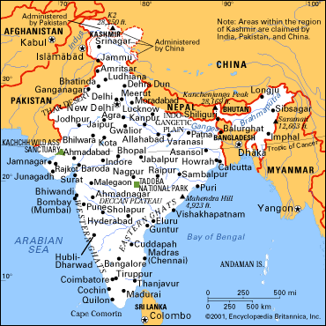
Examples of Countries that Lack Primate Cities
India
U.S.A.
China
Canada
Australia
Brazil
Notes:
Primate Cities Geography 6/111/2002
‹#›
What are the Pull factors that encourage people to move to a primate city?
In groups, discuss and write answers around a circle
Why do people travel to a big city, even though it’s dirty and congested? Draw a city in a circle and the pull factors around the outside. Use London, Norwich or Bangkok as an example.
Possible answers:
centre of government, media
financial, economic centres
Often they are ports - legacy from world sea trade.
Geographer Mark Jefferson developed the law of the primate city to explain the phenomenon of huge cities that capture such a large proportion of a country's population as well as its economic activity. An excellent example of a primate city is London, which truly represents and serves as the focus of England. They dominate the country in influence and are the national focal-point. Their sheer size and activity becomes a strong pull factor.

Slide 10
Rank Size Rule - Zipf
If all cities in a country are placed in order from the largest to the smallest, each one will have a population half the size of the preceding city.
Notes:
Primate Cities Geography 6/111/2002
‹#›
Summary of Zipf Rule

Slide 11
Theory of Rank-Size Rule
George Zipf – 1949
“The second and subsequently smaller cities represent a proportion of the largest city”.
(Explains the size cities in a country)
Notes:
Primate Cities Geography 6/111/2002
‹#›
TASK: Students work in groups. What are the pros and cons of living in a Primate City - discuss in groups.

Slide 12
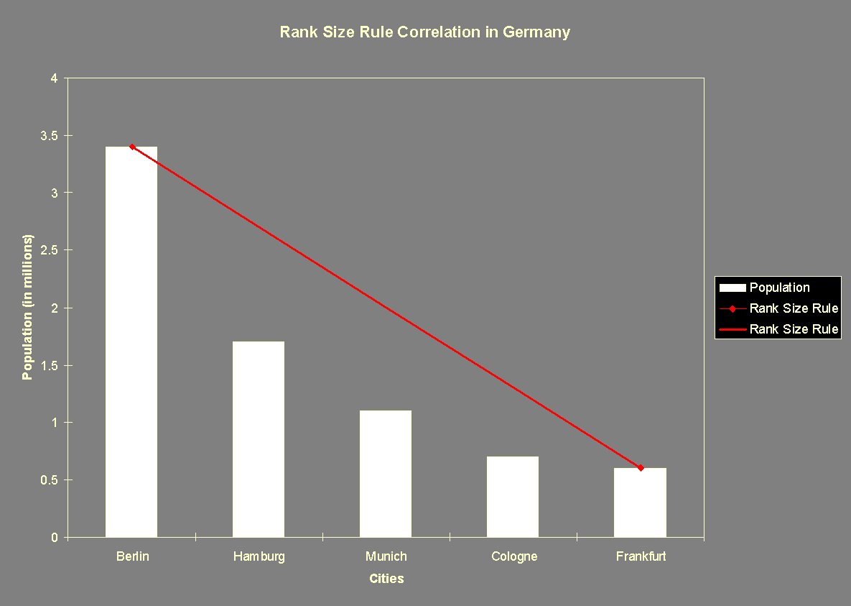
Notes:
Primate Cities Geography 6/111/2002
‹#›
You are an Urban Planner in Norwich - what are the advantages and disadvantages of encouraging or reducing urban growth?

Slide 13
Megalopolises
The world’s largest and most continuous urban areas are in MDCs. They are known as Megalopolises.
Shenzhen (China) was a fishing village in 1982 with a population of 30,000. The government hopes that in less than 10 years it will be the biggest city on earth, with an estimated population of 40 million people.
Notes:
Primate Cities Geography 6/111/2002
‹#›
Read the article on Shenzhen for your homework.

