Slide 1
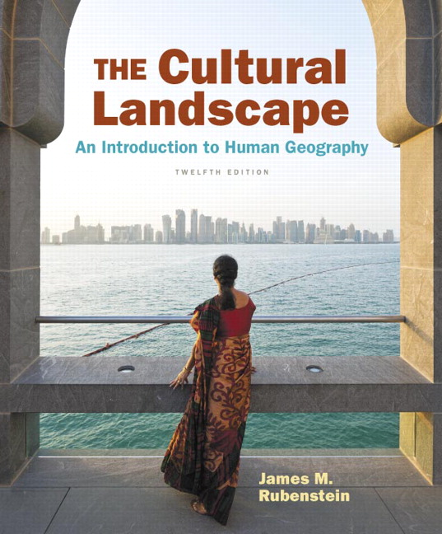
Chapter 5 Lecture
Chapter 5 Languages
Tim Scharks Green River College

Slide 2
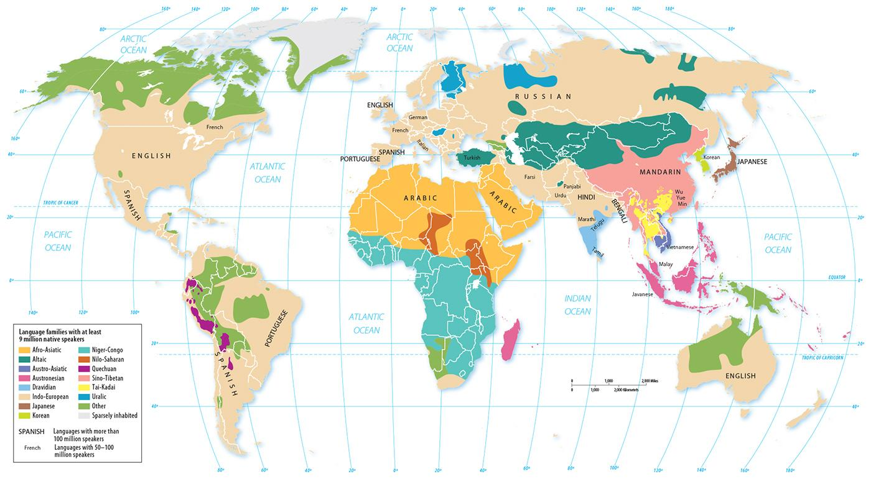
1.3 Distribution of Language Families
Figure 5-6: The Indo-European family has the largest spatial extent. All families with at least nine million native speakers are shown with a color.

Slide 3
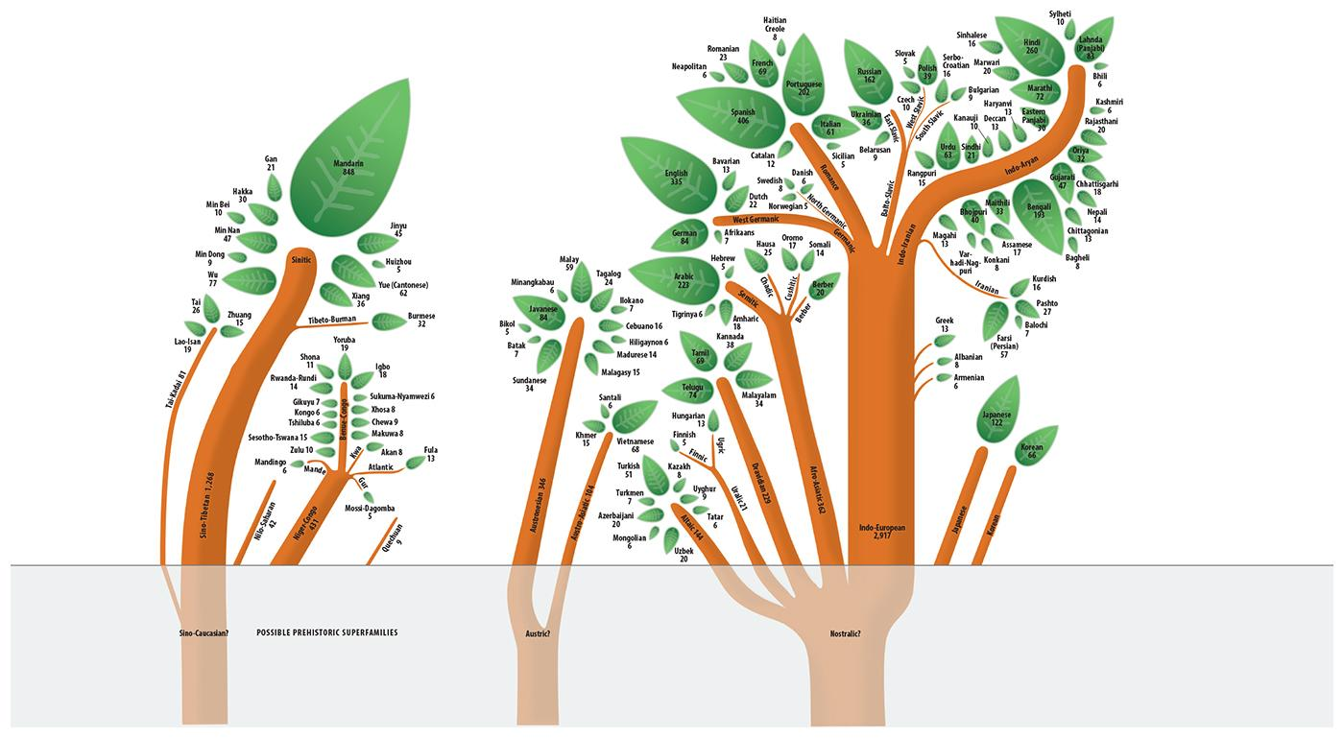
1.2 Language Family Trees
Figure 5-3: If language families are visualized as tree trunks, the branches are branches, the sub-branches are groups, and the leaves are individual languages.

