Slide 1
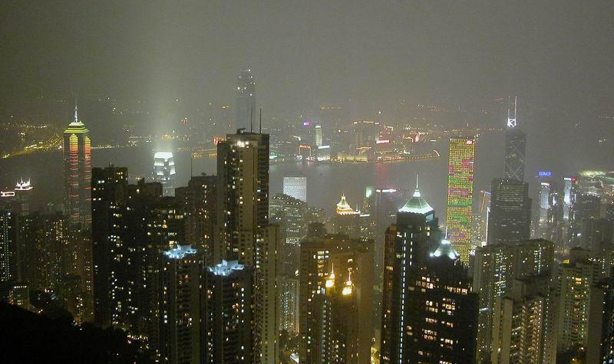
Cities and Urban Geography
Historic Cities and City Functions
Geographic Observations of City Location and Size
The World’s Largest Cities
Suburbanization and Edge Cities
Urban Problems

Slide 2
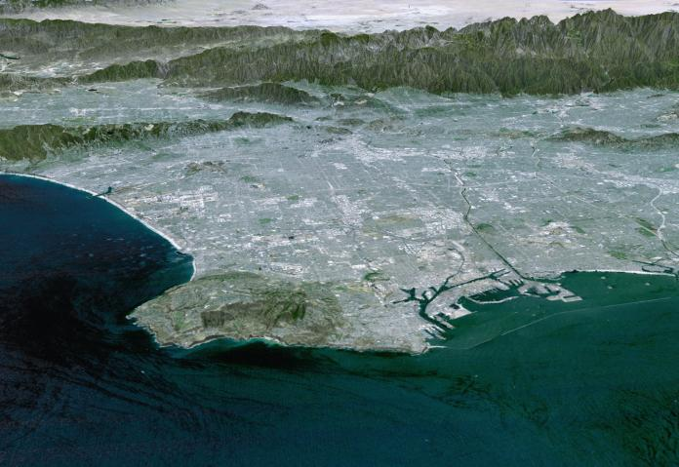
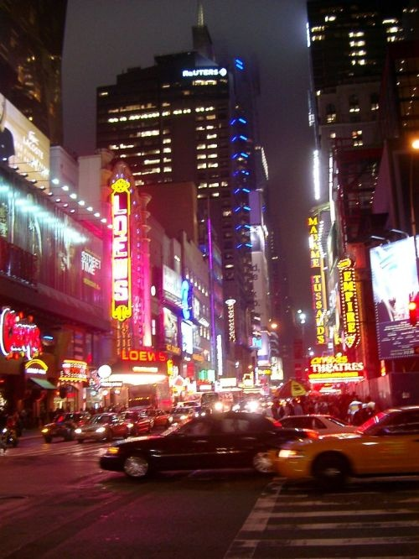
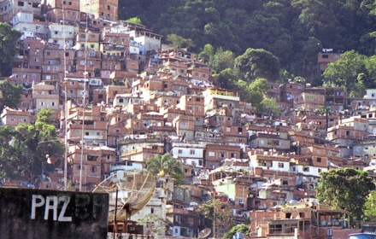
Cities and Urban Geography
In 1950 1/3 of the world lived in a city.
Today 1/2 of us live in cities and the number is increasing.

Slide 3
Historic Cities and City Functions
Cities as location of industry and services
Cities as centers of social and technological innovation and freedom

Slide 4
Historic City Functions
Commercial Centers - Fresno, Venice, New York
Industrial Cities - Manchester, Detroit, Los Angeles
Primary Resources - Scotia, Minas Gerais, Nevada City
Resort Cities - Santa Barbara, Las Vegas, Marseille
Government / Religious Centers - Monterey, D.C., Brasilia
Education Centers - Palo Alto, Berkeley

Slide 5
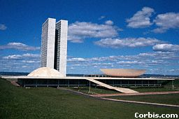
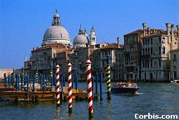
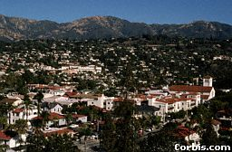
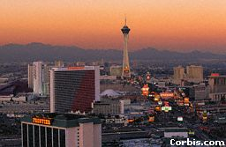
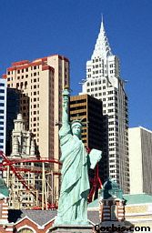

Slide 6
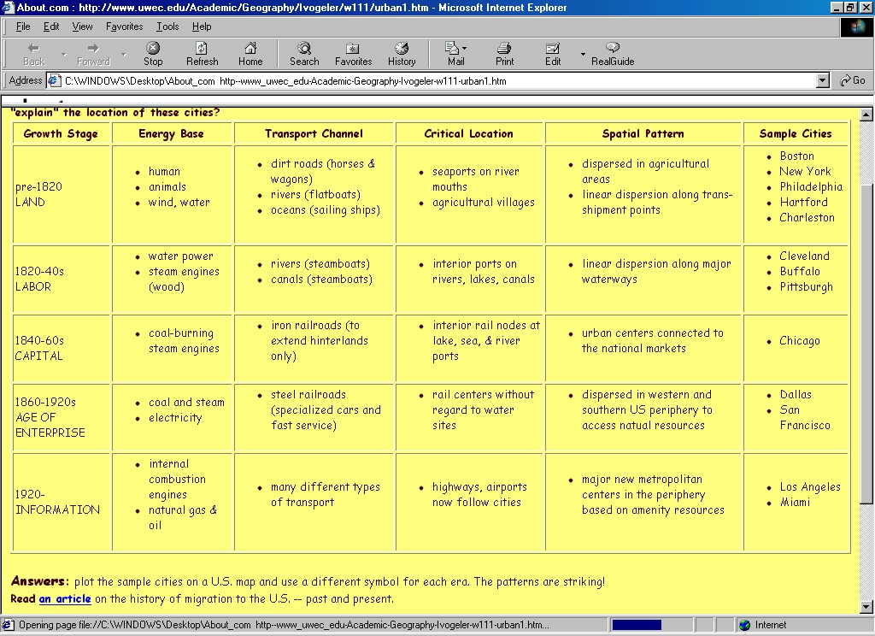
U.S. Urban Growth Stages

Slide 7
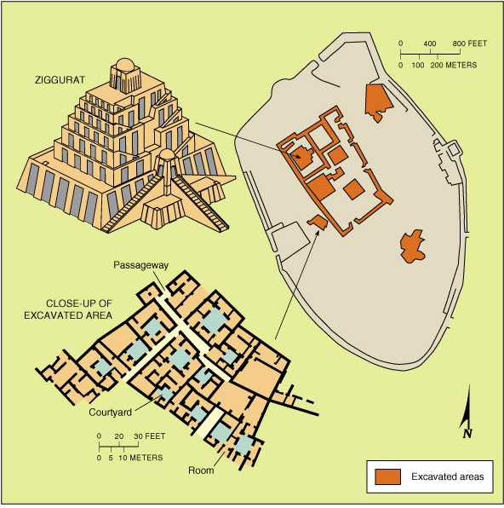
Ancient World Cities
Oldest cities are found in Mesopotamia, Egypt, China and Indus Valley.
Mesopotamia (Jordan/Iraq)
Jericho 10,000 B.C.
Ur 3,000 B.C. (Iraq)
Walled cities based on agricultural trade
Ziggurat (stepped temple)
Ancient Ur in Iraq

Slide 8
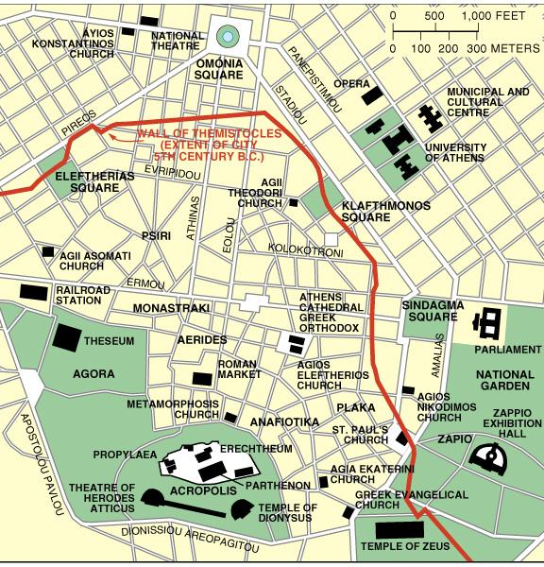
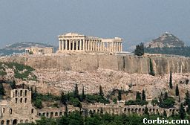
Ancient World Cities
Oldest cities are found in Mesopotamia, Egypt, China and Indus Valley.
E. Mediterranean
Athens 2,500 B.C.
1st city to exceed 100,000
Many cities organized into City-States
Ancient Athens

Slide 9
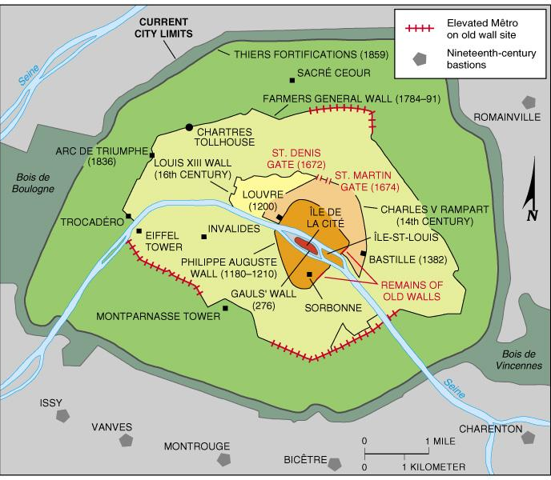
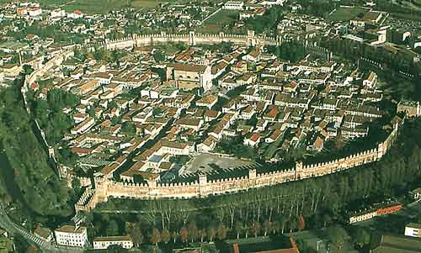
Medieval World Cities
After collapse of Roman Empire in 5th Century, Europe’s cities were diminished or abandoned.
European Feudal Cities
Begin in 11th Century
Independent cities formed in exchange for military service to feudal lord.
Improved roads encouraged trade
Dense and compact within defensive walls
Paris, France
Cittadella, Italy

Slide 10
Medieval World Cities
Cittadella, Italy
Cittadella, Italy

Slide 11
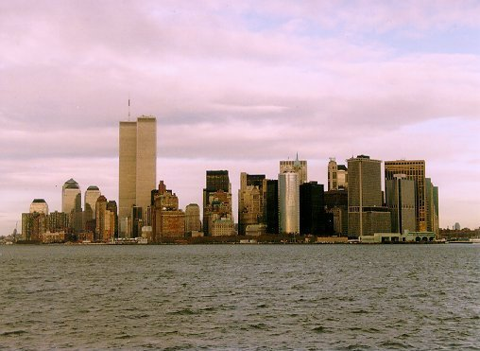
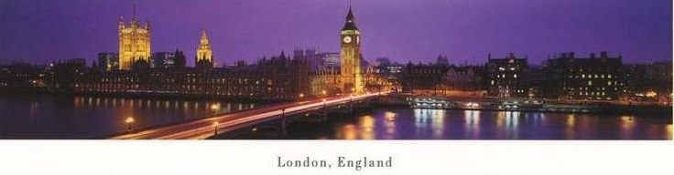
Modern World Cities
A high percentage of world’s business is transacted and political power is concentrated in these cities.
Headquarters of large businesses
Media control centers
Access to political power
London, New York, Tokyo
Chicago, Los Angeles, Washington, Brussels, Frankfurt, Paris, Zurich, Sao Paulo, and Singapore

Slide 12
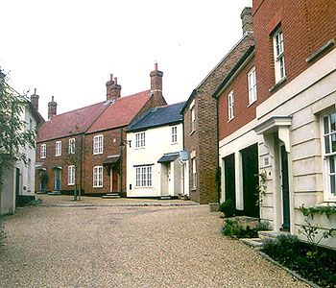
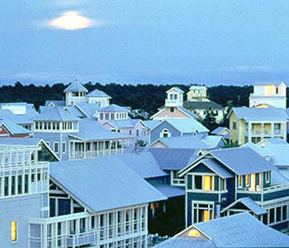
Urban Planning Building Better Cities
How to Make a Great City
Famous Planned Cities
Canberra, Australia
Brasilia, Brazil
Washington, D.C.
Irvine, CA
Seaside, FL
Poundbury, England
Smart Growth
Pedestrian Friendly
Increase Density
Mix Ethnic and Income Groups

Slide 13
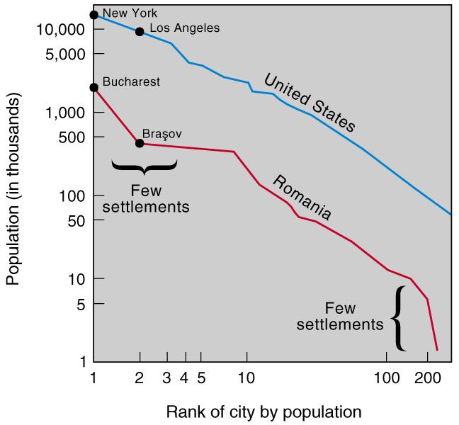
Rank-Size Rule
Rank-Size Rule: n th-largest settlement is 1/n the population of the largest settlement. In other words, 2nd largest is 1/2 the size of largest. Works best in most developed countries that have full distribution of services.

Slide 14
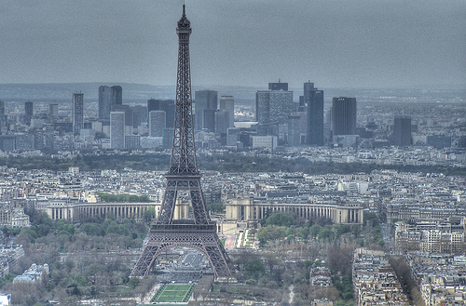
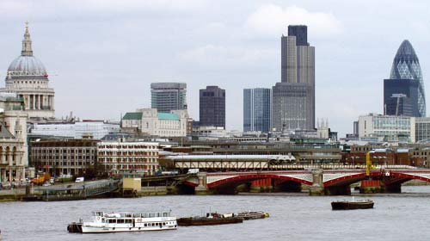
Primate City Rule
Largest settlement in a country has more than twice the number as the second ranking city. These cities tend to represent the perceived culture of the country.

Slide 15
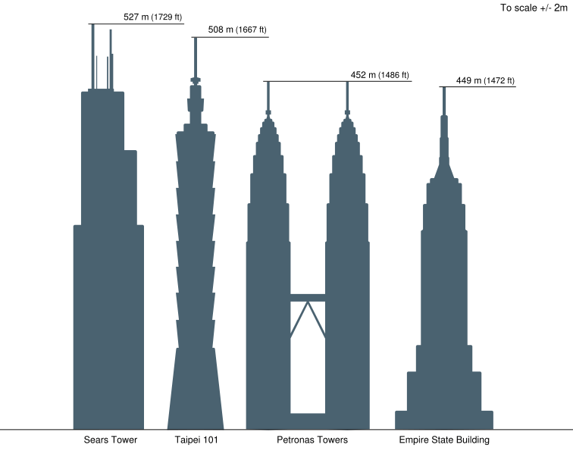
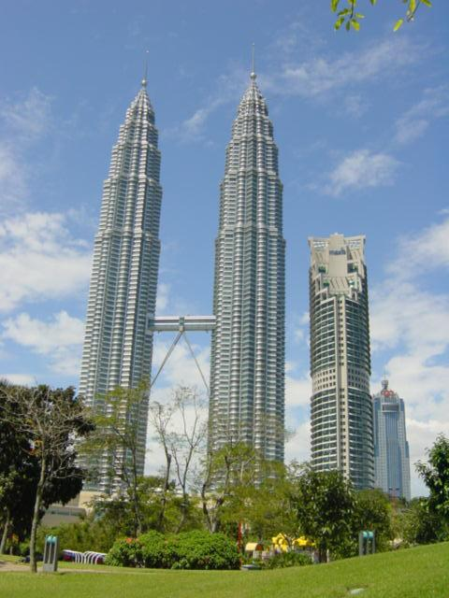
Skyscrapers
Why build up?
Why copy Western model?
Where are the world’s tallest buildings?

Slide 16
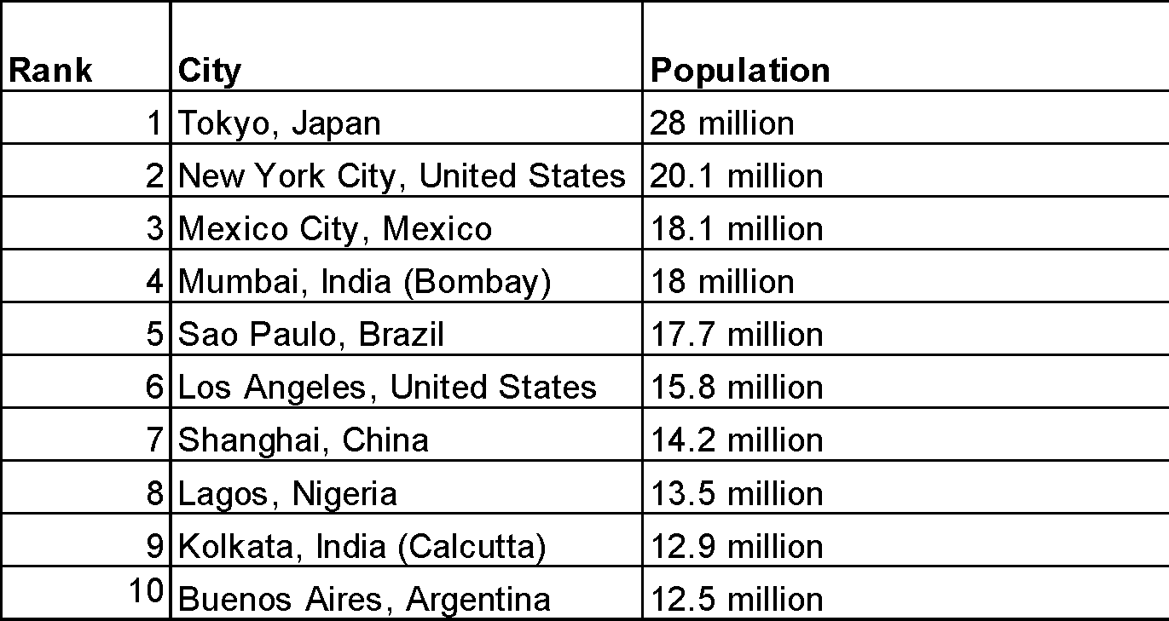
Largest World Cities
Ten Most Populous Today

Slide 17
Largest World Cities
Ten Most Populous in A.D. 1975
1. Tokyo 19.8 million
2. New York 15.9 million
3. Shanghai 11.4 million
4. México 11.2 million
5. São Paulo 9.9 million
6. Osaka 9.8 million
7. Buenos Aires 9.1 million
8. Los Angeles 8.9 million
9. Paris 8.9 million
10. Beijing 8.5 million
Source: U.N., 2001
* Note that five of these cities are in the Core or more developed world.

Slide 18
Largest World Cities
Ten Most Populous by A.D. 2015
1. Tokyo 28.7 million
2. Bombay 27.4 million
3. Lagos 24.4 million
4. Shanghai 23.4 million
5. Jakarta 21.2 million
6. São Paulo 20.8 million
7. Karachi 20.6 million
8. Beijing 19.4 million
9. Dhaka, Bangladesh 19.0 million
10. México 18.8 million
Source: U.N., 2001
* Note that only one of these cities is in the Core of the more developed world!

Slide 19
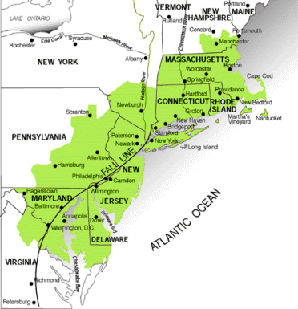
Megalopolis
Illustrates the difference between strict city proper definitions and broader urban agglomerations.
To define urbanized areas, the U.S. Census Bureau uses the term Metropolitan Statistical Area (MSA) or Consolidated MSA (CMSA) if two of them overlap.

Slide 20
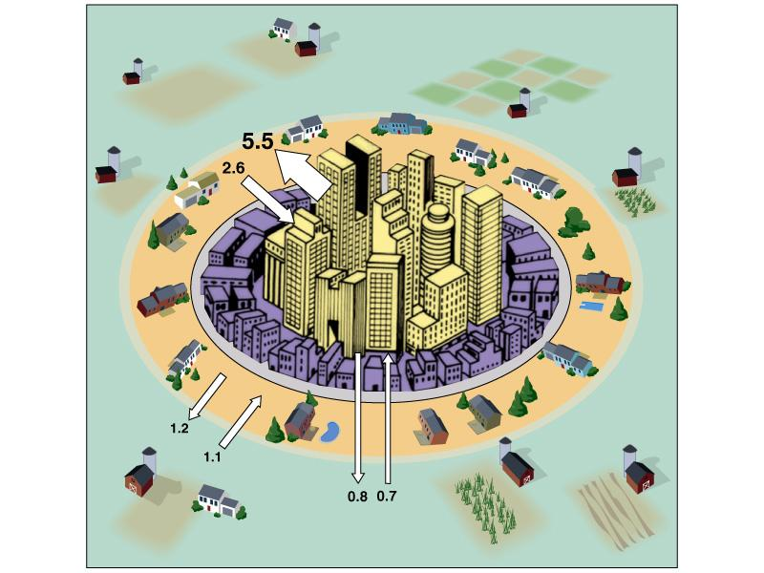
Changes in Cities in the U.S.
U.S. population has been moving out of the city centers to the suburbs: suburbanization and counterurbanization
Developed Countries: suburbanization
wealthy move to suburbs
automobiles and roads; ‘American Dream’
better services
wealthy move to suburbs
counterurbanization
idyllic settings
cost of land for retirement
slow pace, yet high tech connections to services and markets
U.S. intraregional migration during 1990s.

Slide 21
Cities in Crisis, Urban Problems
U.S. City Problems
Sprawl
commutes
environmental problems
tax flight
Racial and Economic Segregation
schools
taxes
democracy

Slide 22
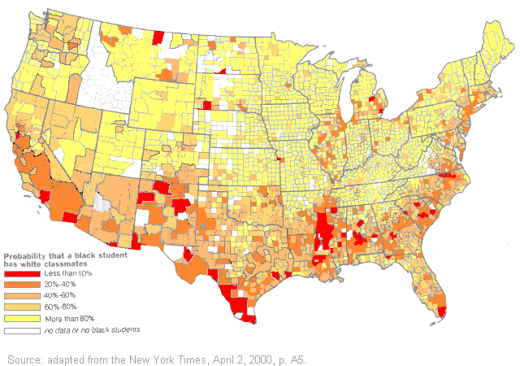
School Segregation

Slide 23
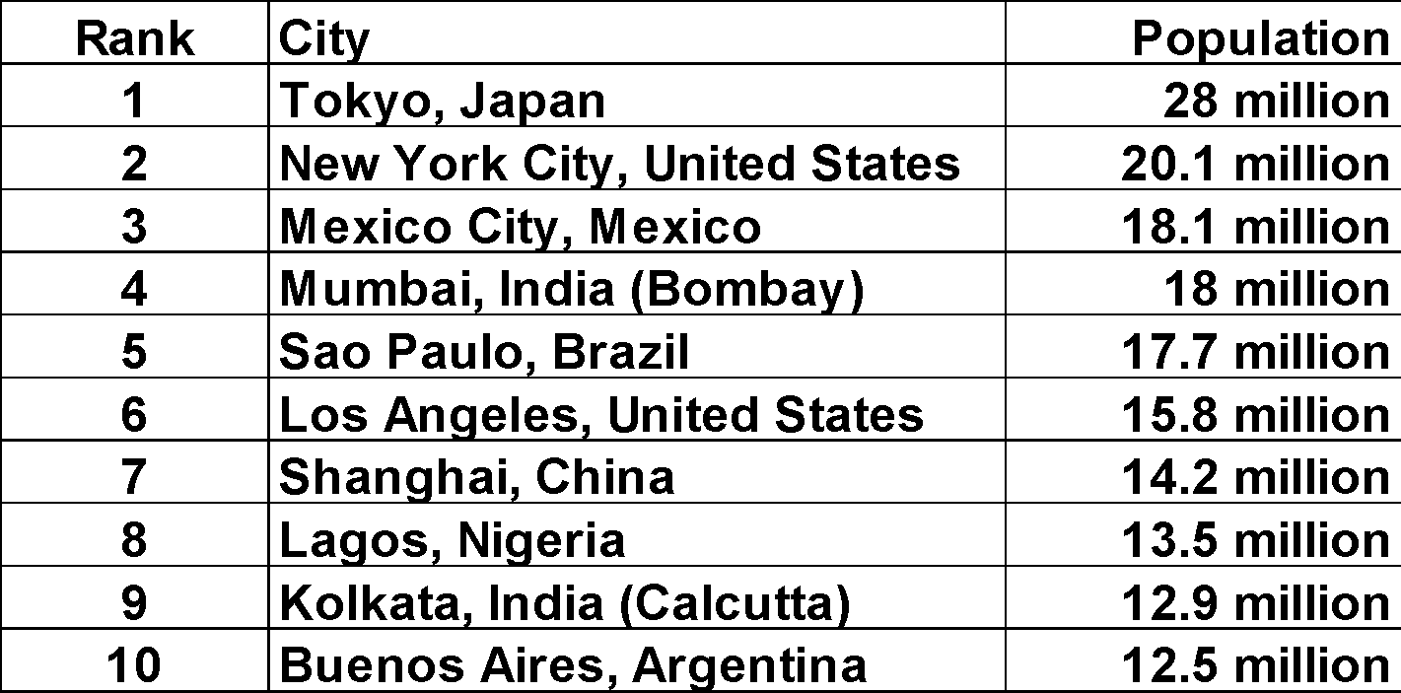
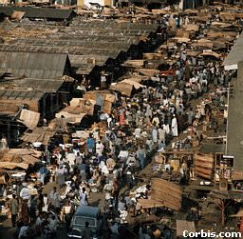
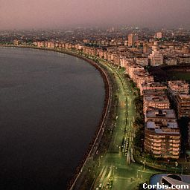
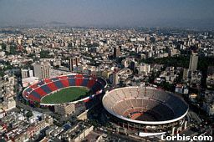
Intraregional Migrations in LDCs
Populations in the less developed world are rushing to cities in search of work and income.
Urbanization
migration from rural areas
lack of jobs in countryside
lack of services in cities
Tokyo, Los Angeles, and New York only MDC cities on top 10 list
Lagos, Nigeria
Mumbai, India
Mexico City, Mexico

Slide 24
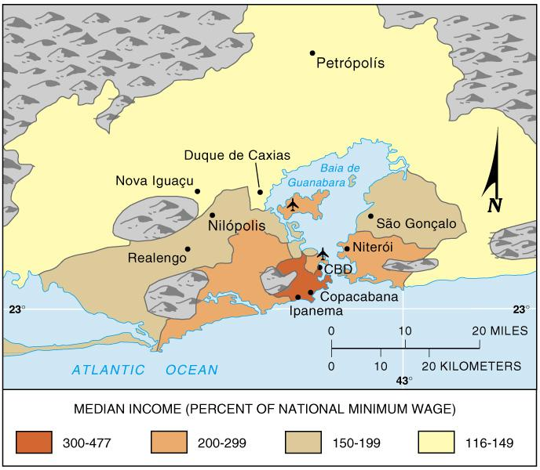
Changes in Cities in LDCs
Populations of cities in the less developed world have been surging: urbanization, migration, natural increase
Urbanization in LDCs:
driven by changes in global economy that make farming more challenging
the poor live in the suburbs, rich live in CBD
cities struggle to provide jobs and housing
services overtaxed
squatter settlements common
crime on the rise
Rio De Janeiro, Brazil

Slide 25
European Cities: result of very long histories
Complex street patterns - prior to automobile, weird angles
Plazas and Squares - from Greek, Roman, Medieval
High density and compact form - wall around city or low-growth zoning
Low skylines - many built before elevators, others required cathedral or monument to be highest structure
Lively downtowns - center of social life, not just office work
Neighborhood stability - Europeans moved less frequently than we do.
Scars of War - many wars , many cities originally defensive
Symbolism - gothic cathedrals, palaces, and castles
Municipal Socialism - many residents live in buildings that are owned by city gov’t. Some of these are massive housing projects, others small scale apartment buildings.

Slide 26
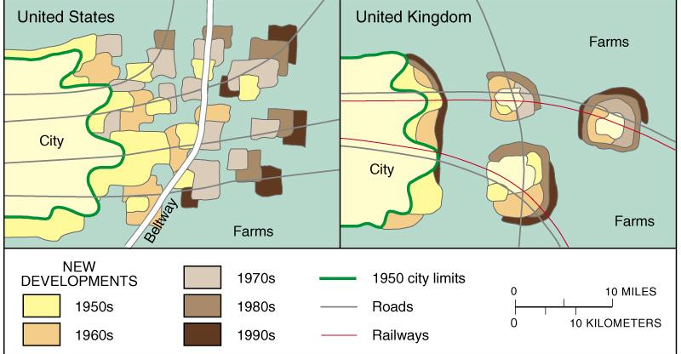
Europe versus U.S. Cities: Sprawl
European cities, including this hypothetical U.K. example, tend to restrict suburban development, thereby concentrating new development in and around existing concentrations. This leaves large rings of open space, so-called greenbelts.
What are the social costs of sprawl?

Slide 27
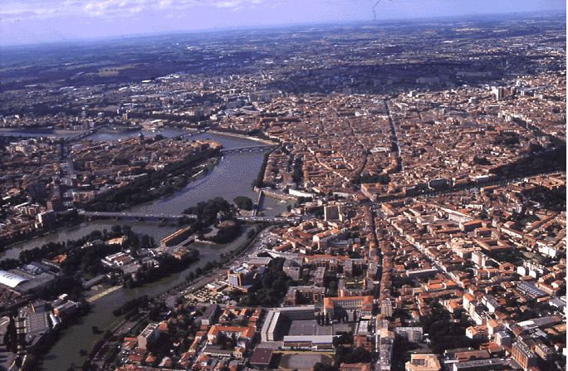
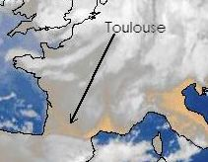
Toulouse, France

Slide 28
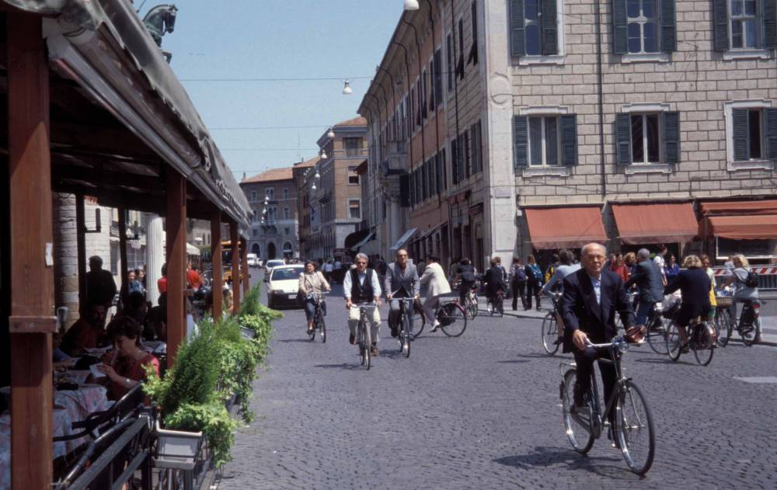
Ferrara, Italy
Notes:
‹#›

Slide 29
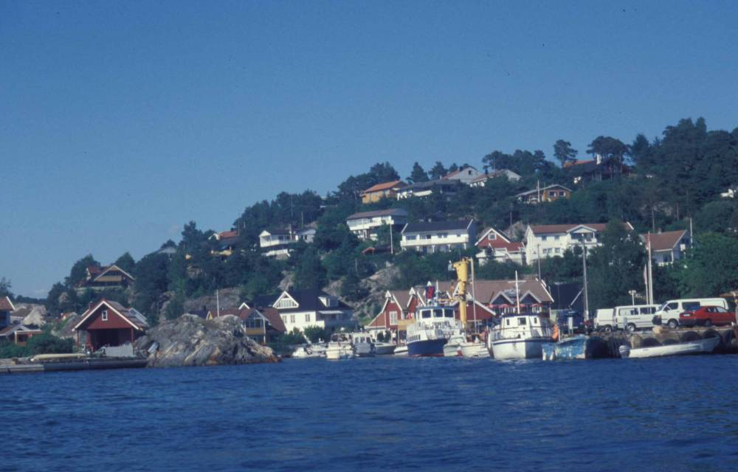
Sogne, Norway
Notes:
‹#›

Slide 30
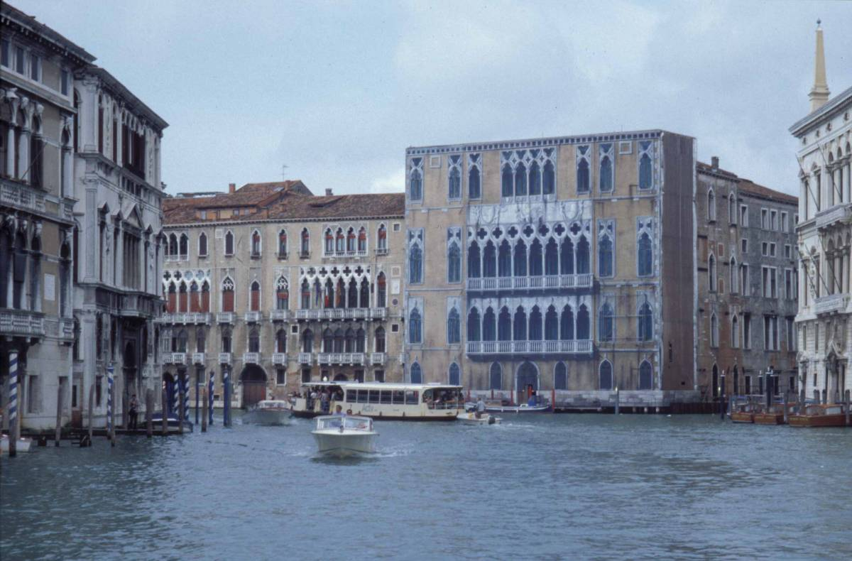
Venice, Italy

Slide 31
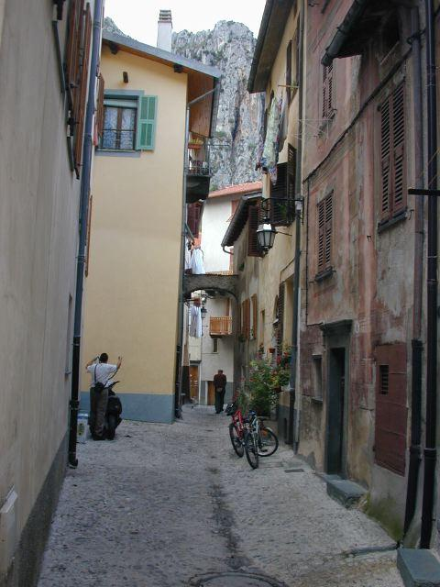
Somewhere in France

Slide 32
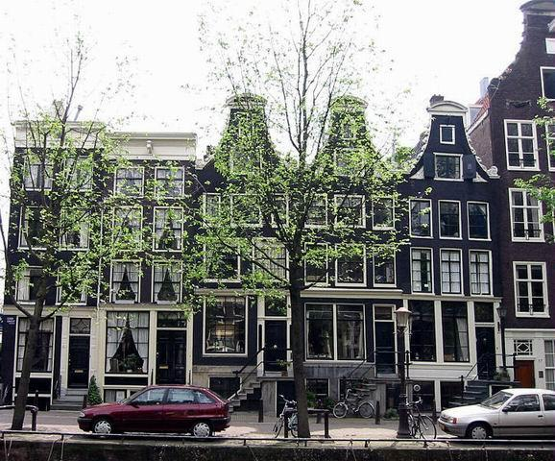
Amsterdam, The Netherlands
Notes:
‹#›

Slide 33
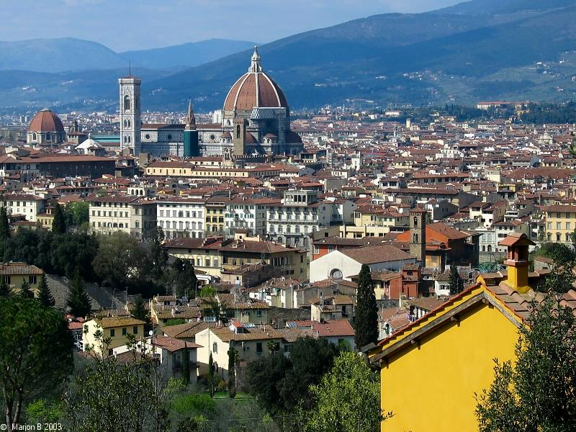
Florence, Italy
Notes:
‹#›

Slide 34
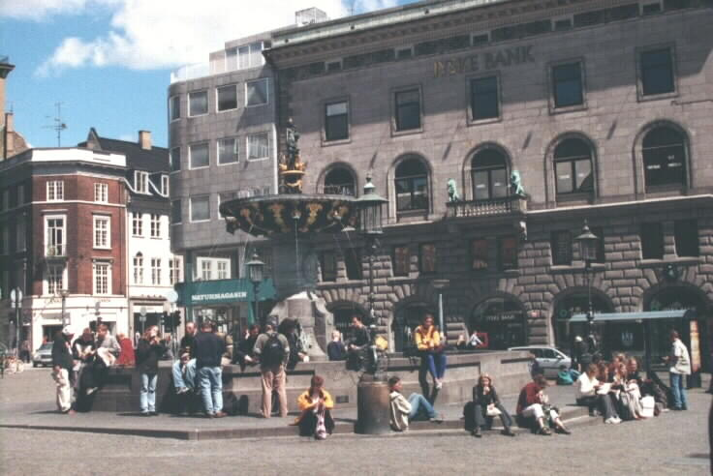
Copenhagen, Denmark
Notes:
‹#›

