Slide 1
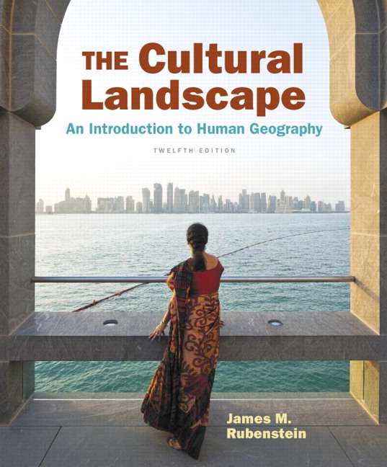
Chapter 9 Lecture
Chapter 9
Food and Agriculture
Tim Scharks Green River College

Slide 2
Food and Agriculture: Key Issues
Where Did Agriculture Originate?
Why Do People Consume Different Foods?
Where Is Agriculture Distributed?
Why Do Farmers Face Sustainability Challenges?

Slide 3
Key Issue 1: Where Did Agriculture Originate?
1.1 Introducing Food and Agriculture
1.2 Subsistence and Commercial Agriculture

Slide 4
1.1 Introducing Food and Agriculture
Agricultural Revolution
Environmental and cultural factors: end of ice age, preference for settlement
Agriculture hearths developed from local plants and animals.

Slide 5
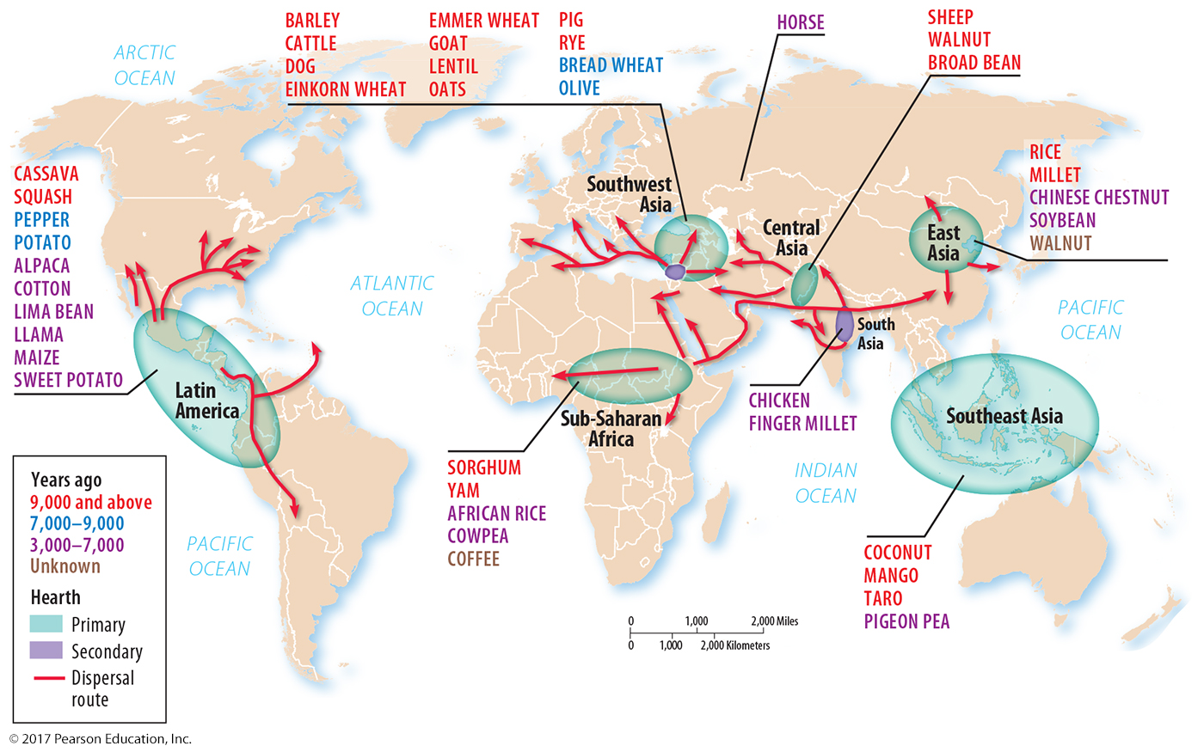
1.1 Agriculture Hearths
Figure 9-2: Multiple hearths emerged from locally available plants and animals.

Slide 6
1.2 Subsistence and Commercial Agriculture
Percentage of farmers: high in subsistence, low in commercial
Role of machinery, science, technology: low in subsistence, high in commercial
Farm size: commercial generally much larger than subsistence

Slide 7
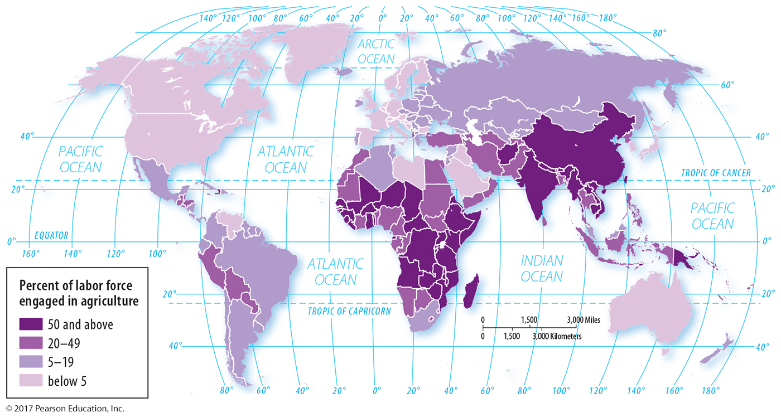
1.2 Agricultural Workers
Figure 9-3: Developing countries have a higher percentage of the labor force engaged in agriculture, primarily subsistence.

Slide 8
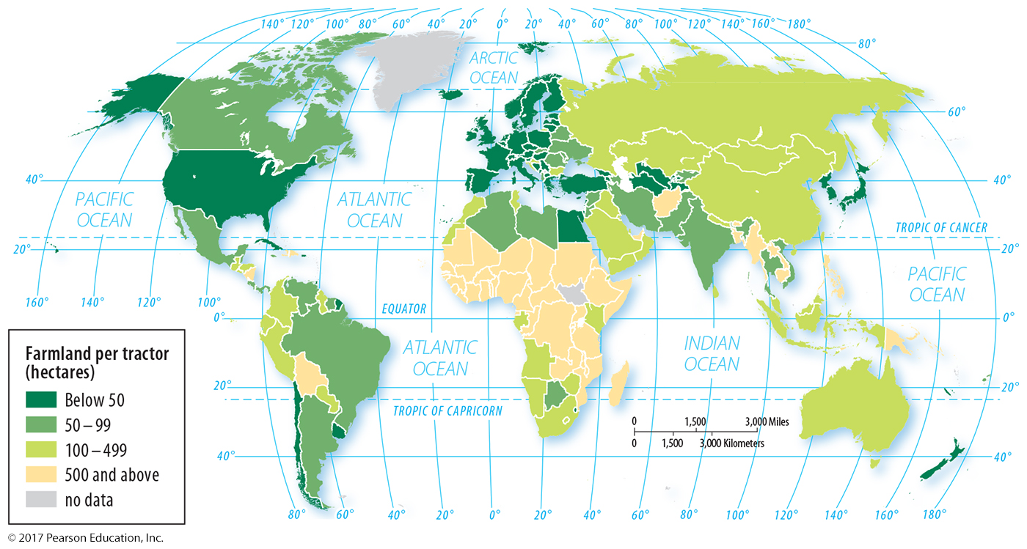
1.2 Farmland Per Tractor
Figure 9-4: Small amounts of farmland per tractor indicate a strong role of machinery in agriculture.

Slide 9
Key Issue 2: Why Do People Consume Different Foods?
2.1 Diet and Nutrition
2.2 Source of Nutrients

Slide 10
2.1 Diet and Nutrition
People in developed countries eat more from different sources than people in developing countries.
Climate affects what can be grown.
Culture determines food choices too.

Slide 11
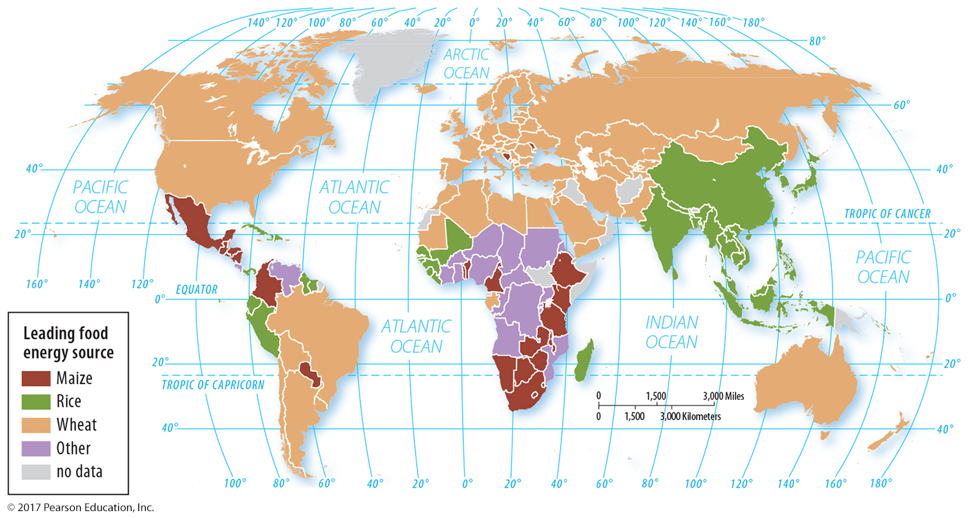
2.1 Dietary Energy by Source
Figure 9-6: The largest source of calories varies by country, with maize, rice, and wheat being the most important. Maize is called corn in the United States and Canada.

Slide 12
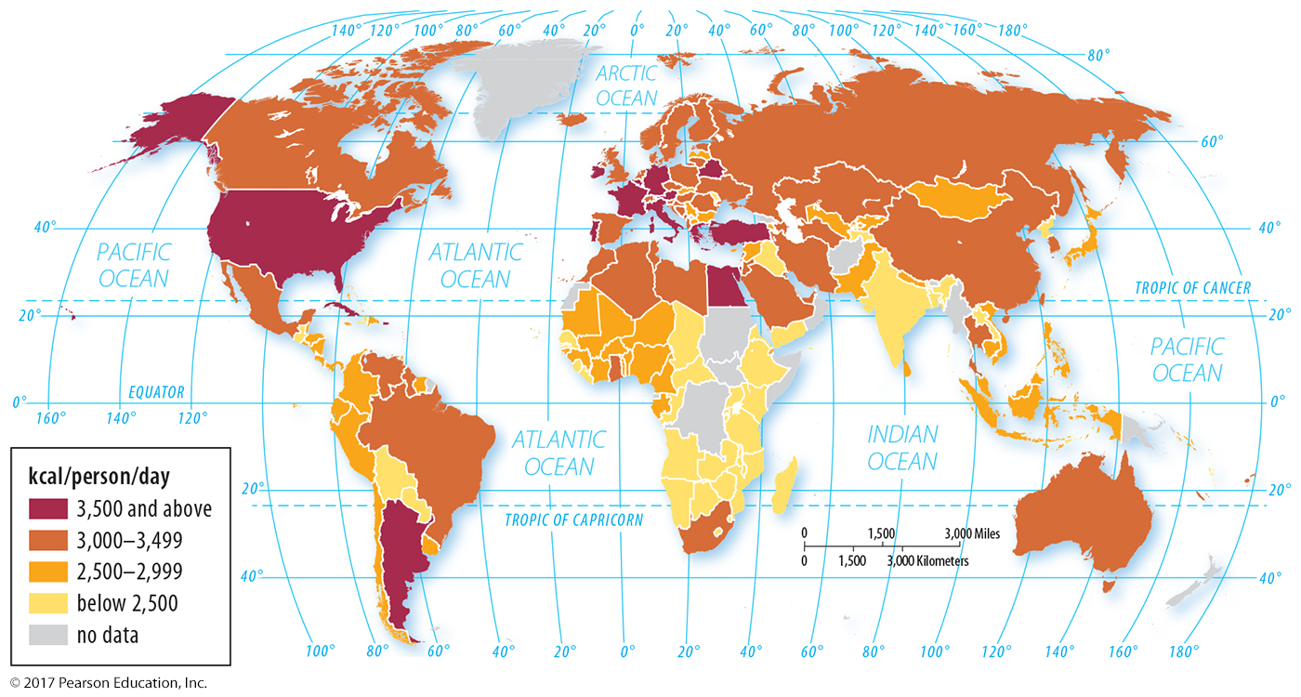
2.1 Dietary Energy Consumption
Figure 9-7: Developed countries consume more calories per person on average than many developing countries.

Slide 13
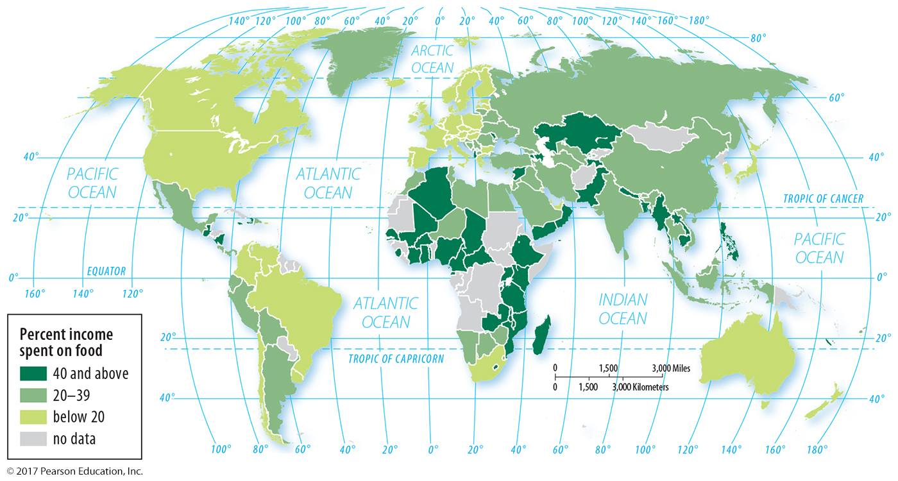
2.1 Income Spent on Food
Figure 9-8: A greater percentage of income is spent on food in developing countries.

Slide 14
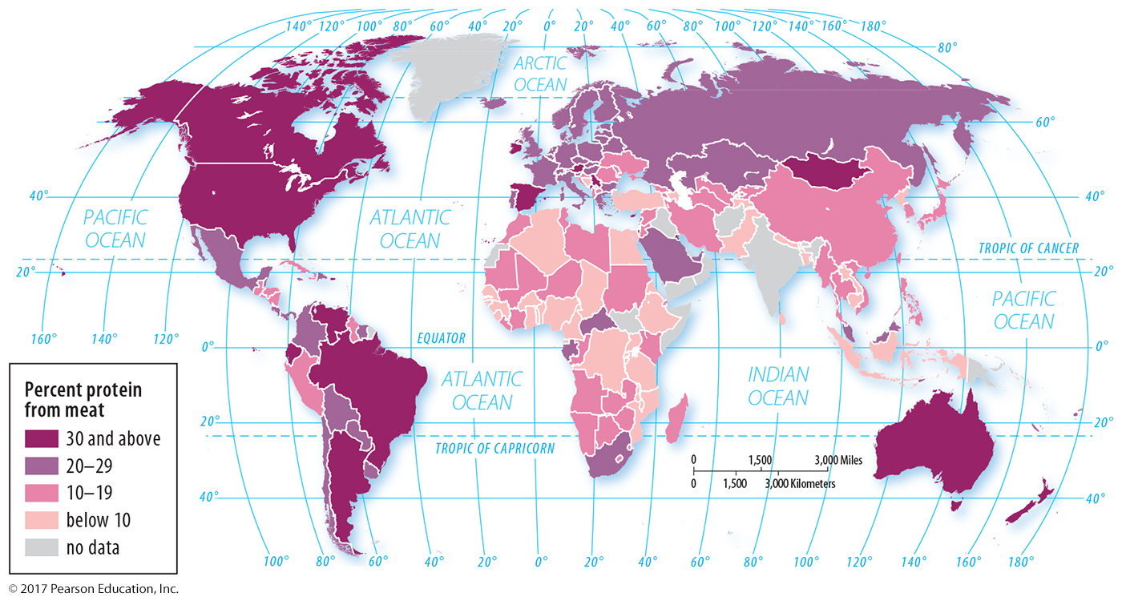
2.2 Protein from Meat
Figure 9-11: A greater percentage of protein comes from meat for people in developed countries.

Slide 15
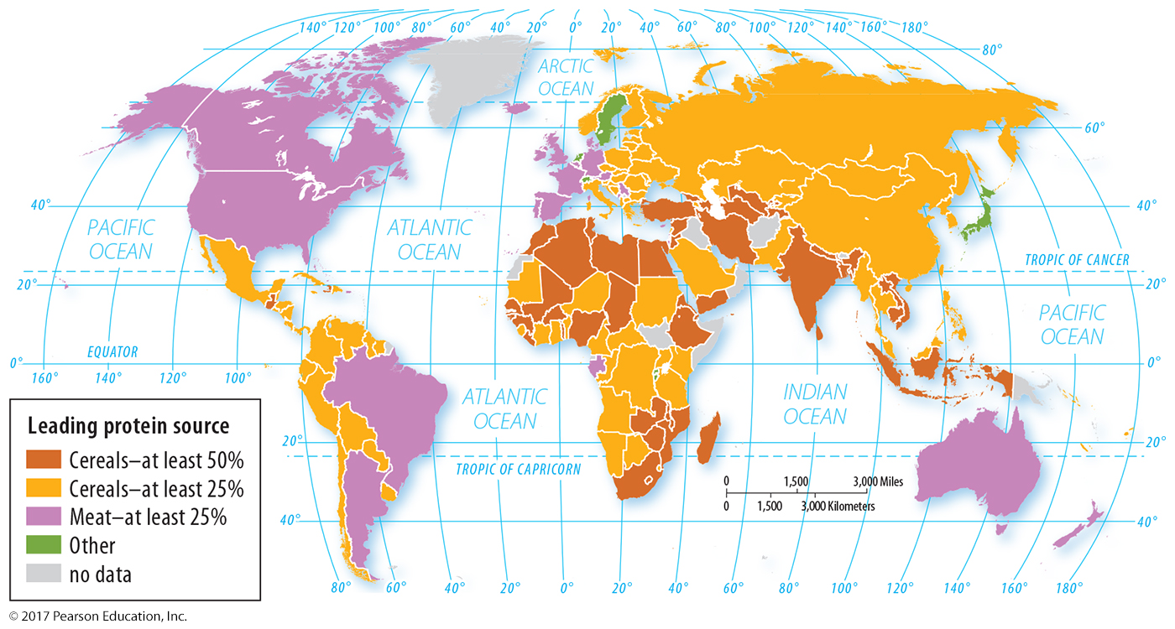
2.2 Protein by Source
Figure 9-12: Cereals are the leading source of protein in developing countries.

Slide 16
Key Issue 3: Where Is Agriculture Distributed?
3.1 Agricultural Regions and Climate
3.2 Subsistence Agriculture in Dry Regions
3.3 Subsistence Agriculture in Tropical Regions
3.4 Subsistence Agriculture in Population Concentrations
3.5 Fishing
3.6 Commercial Agriculture: Crop-based
3.7 Commercial Agriculture: Mixed Crop and Livestock
3.8 Commercial Agriculture: Animal-based

Slide 17
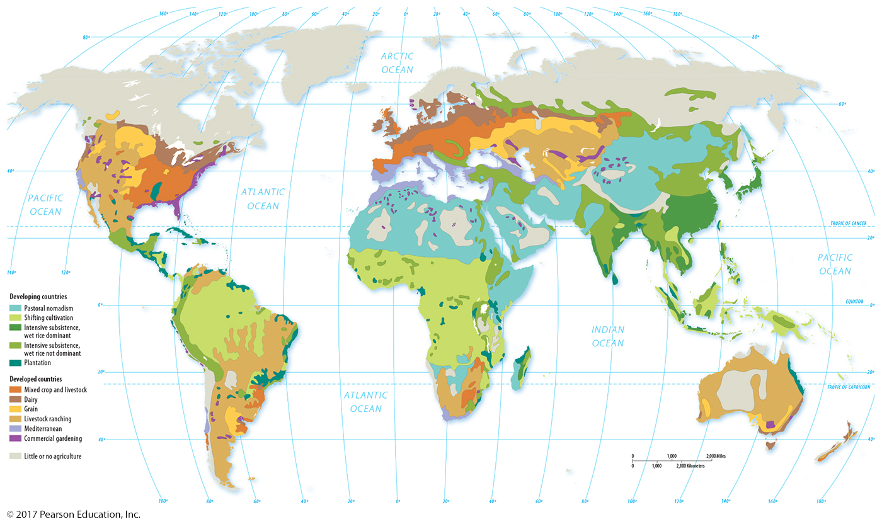
3.1 Agricultural Regions and Climate
Figure 9-13: Agriculture around the world can be classified into 11 regions based on the commercial/subsistence divide and other characteristics.

Slide 18
3.2 Agricultural Regions in Developing Countries
Intensive subsistence, wet-rice dominant
Intensive subsistence, crops other than rice
Pastoral nomadism
Shifting cultivation
Plantation: an exception because it is commercial

Slide 19
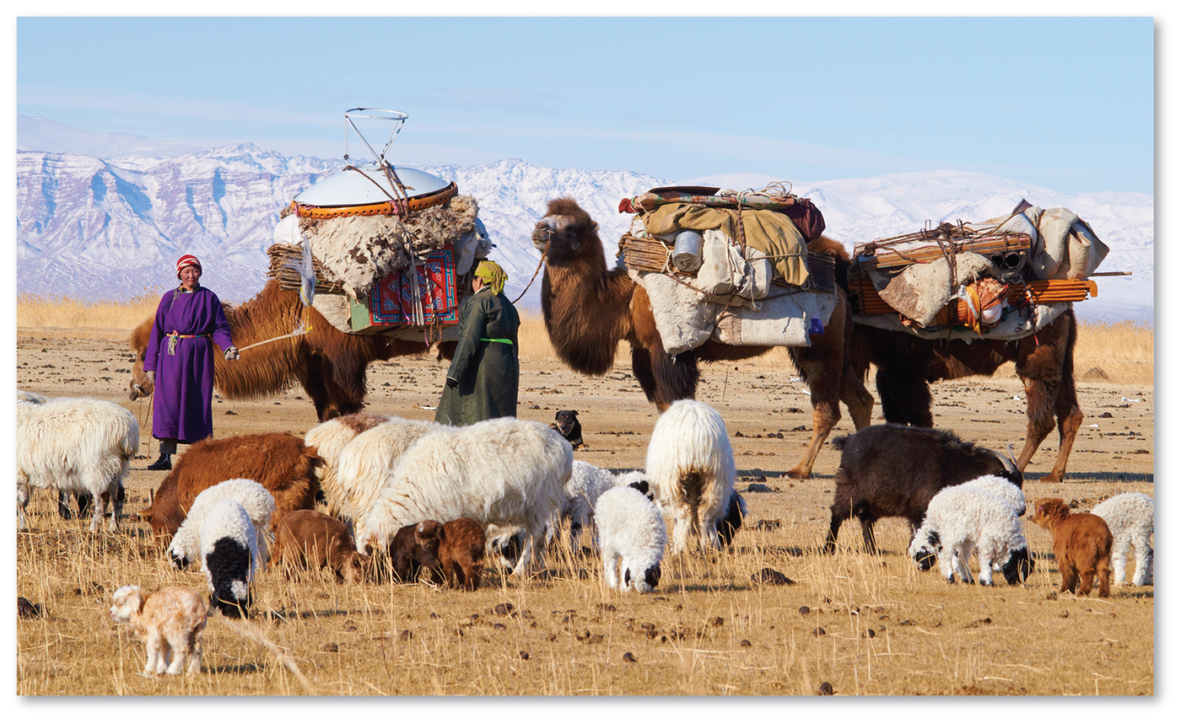
3.2 Subsistence Agriculture in Dry Regions
Figure 9-16: Pastoral nomadism is a subsistence agricultural practice where animals are herded across lands too dry to grow crops.

Slide 20
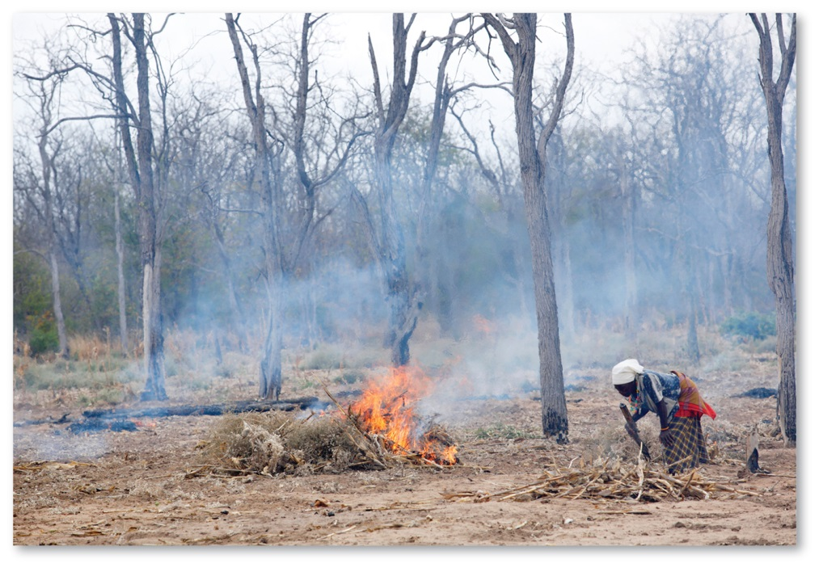
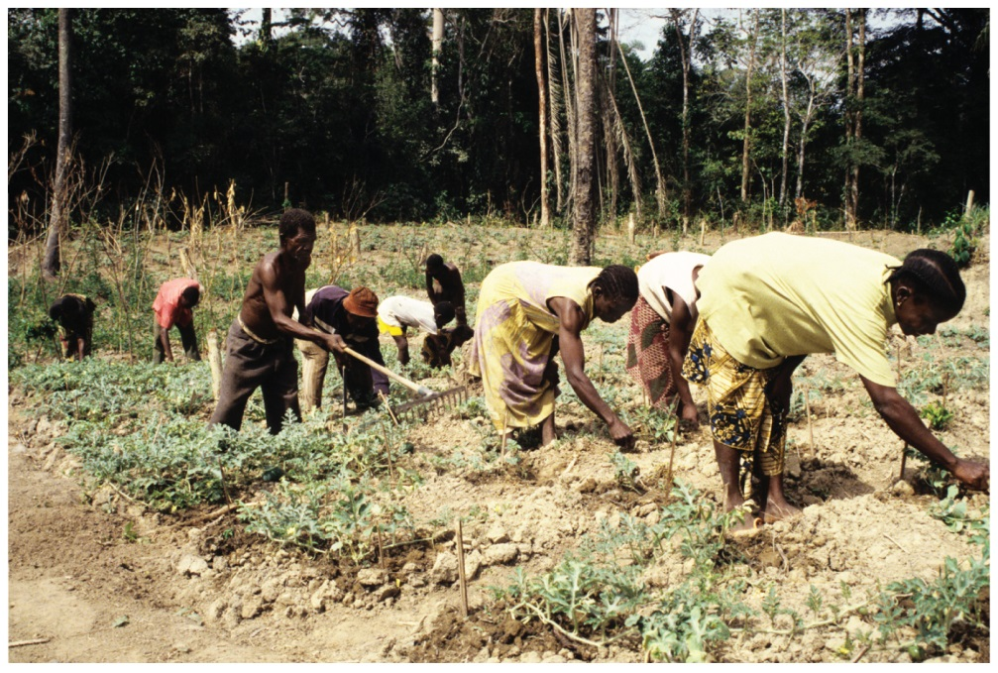
3.3 Subsistence Agriculture in the Tropics
Figures 9-17 and 9-18: Found in tropical climates where soils are usually low in nutrients, shifting cultivation involves slashing and burning the forest (left, in Mozambique) before planting crops for a few years (right, in Côte d’Ivoire).

Slide 21
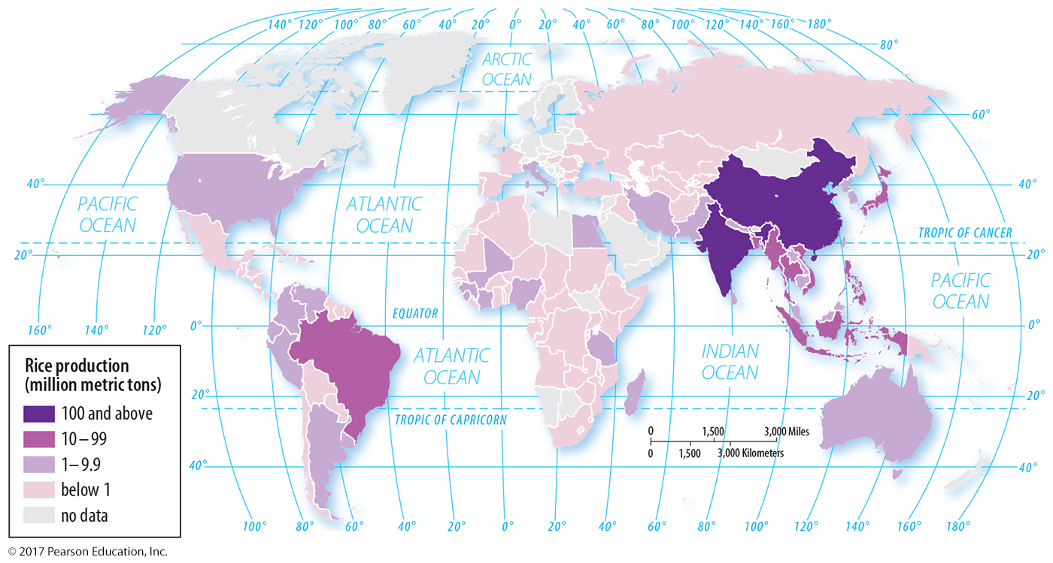
3.4 Subsistence Agriculture in Population Concentrations
Figure 9-19: Rice is an especially popular crop in Asia to grow with intensive subsistence. Other crops may be grown with intensive subsistence based on climate or cultural preferences.

Slide 22
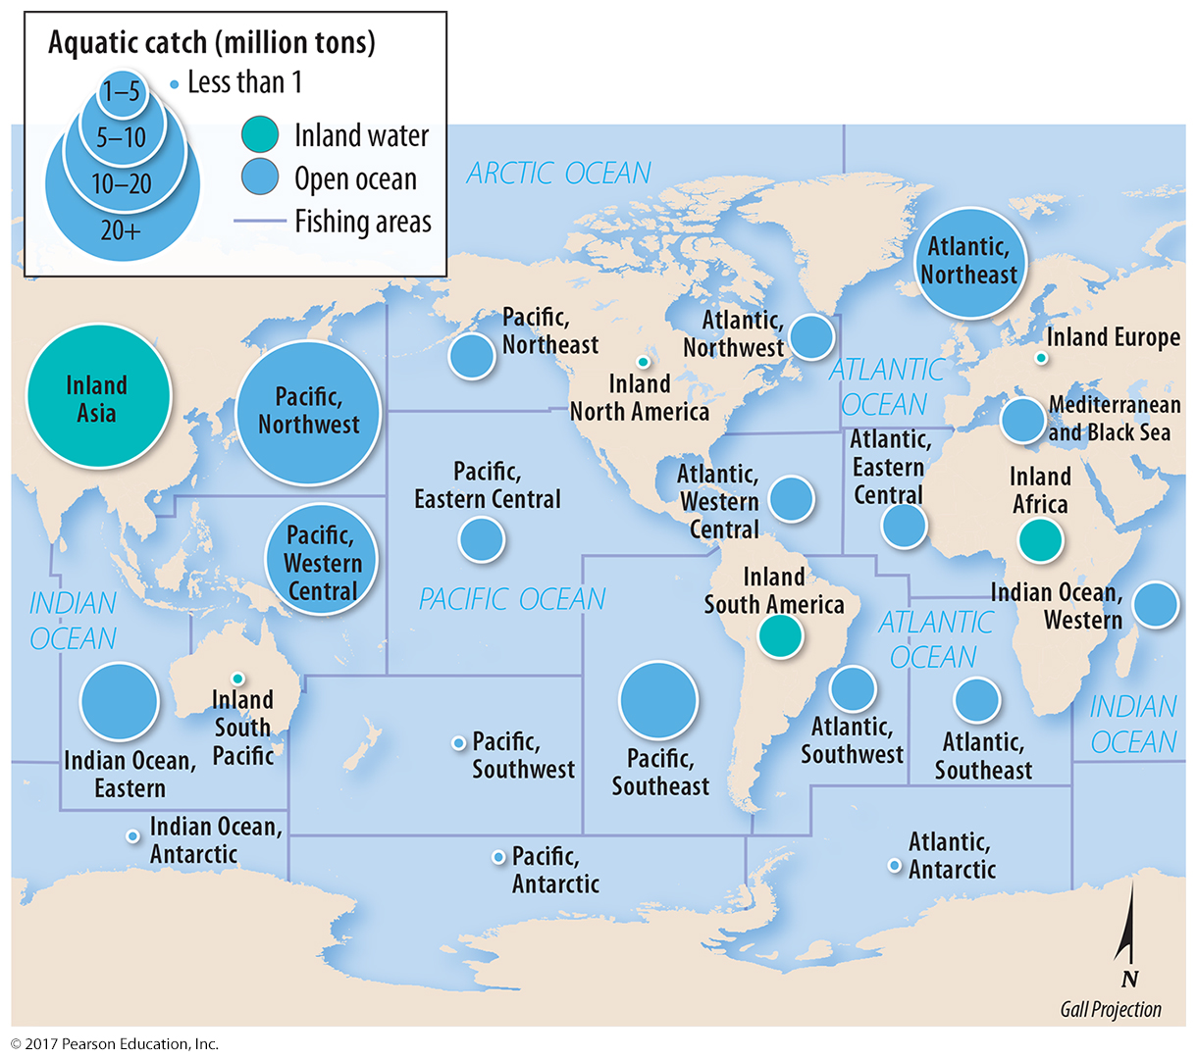
3.5 Major Fishing Regions
Figure 9-24: Fishing is practiced both commercially and in subsistence.

Slide 23
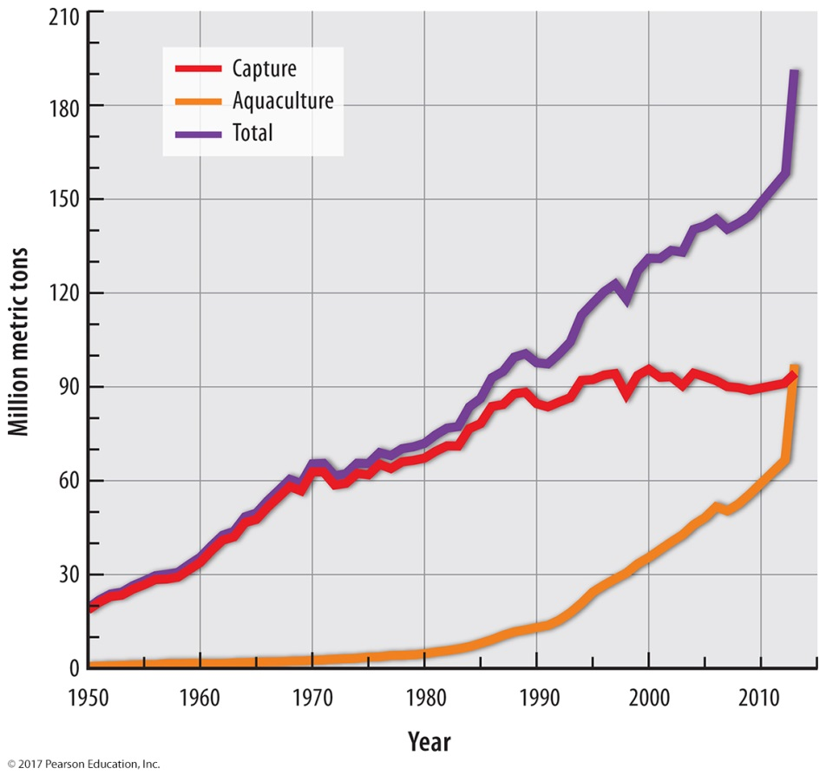
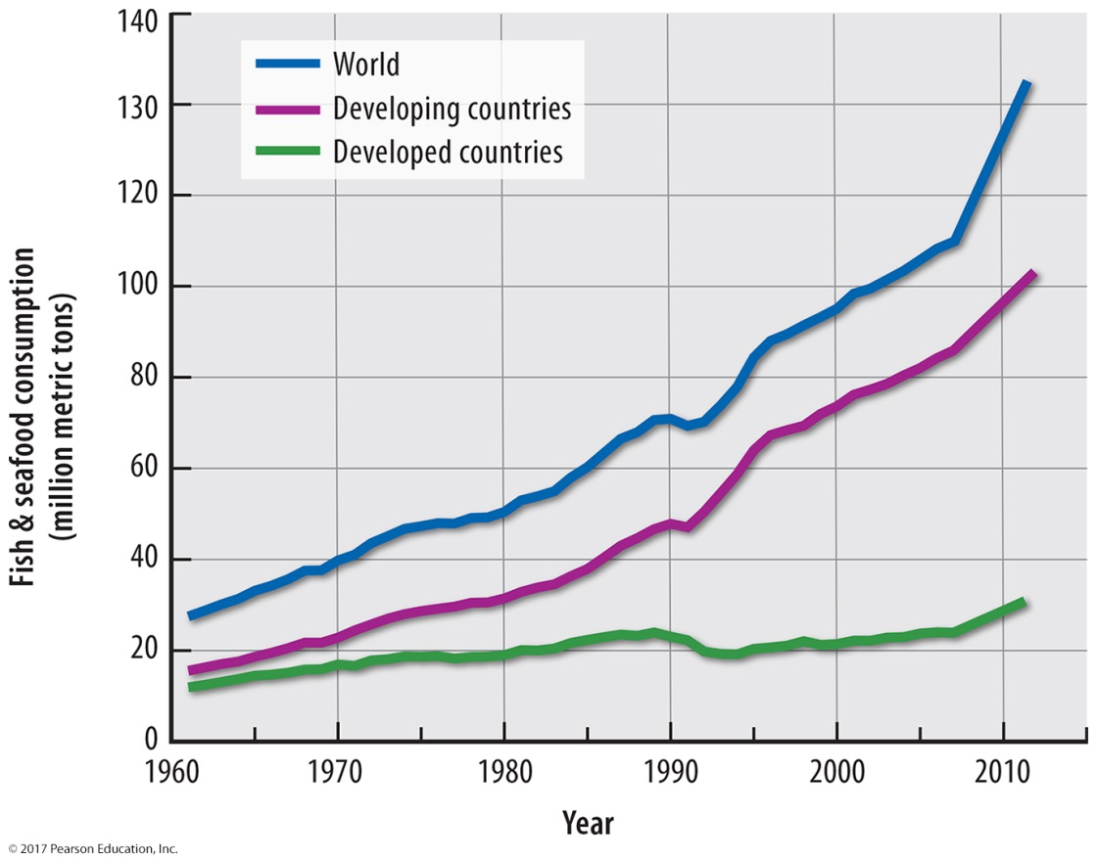
3.5 Growth in Fishing
Figures 9-26 and 9-27: Fish production (left) and human consumption of fish (right) have increased dramatically. Increases since 1990 are from aquaculture, raising concerns about overfishing.

Slide 24
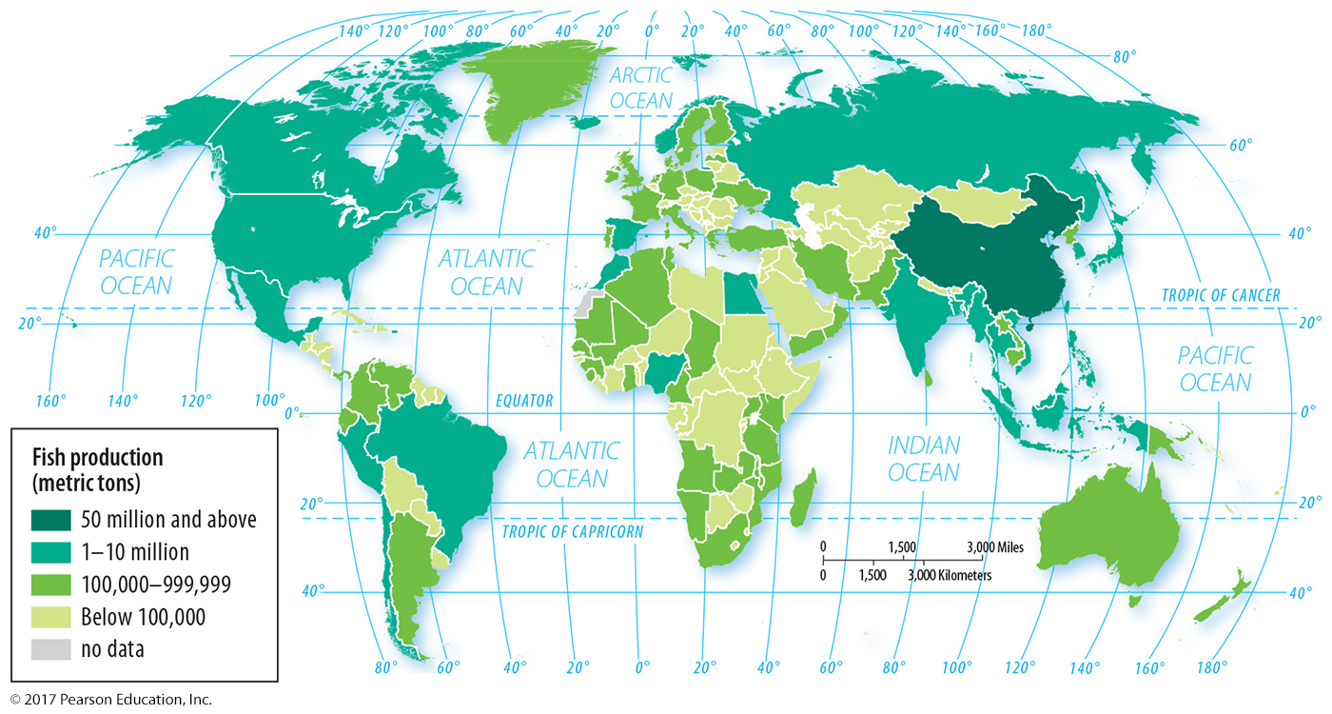
3.5 Fish Production
Figure 9-29: China accounts for one-third of fish production in the world.

Slide 25
3.6 Agricultural Regions in Developed Countries
Mixed crop and livestock
Dairying
Grain
Ranching
Mediterranean
Commercial gardening

Slide 26
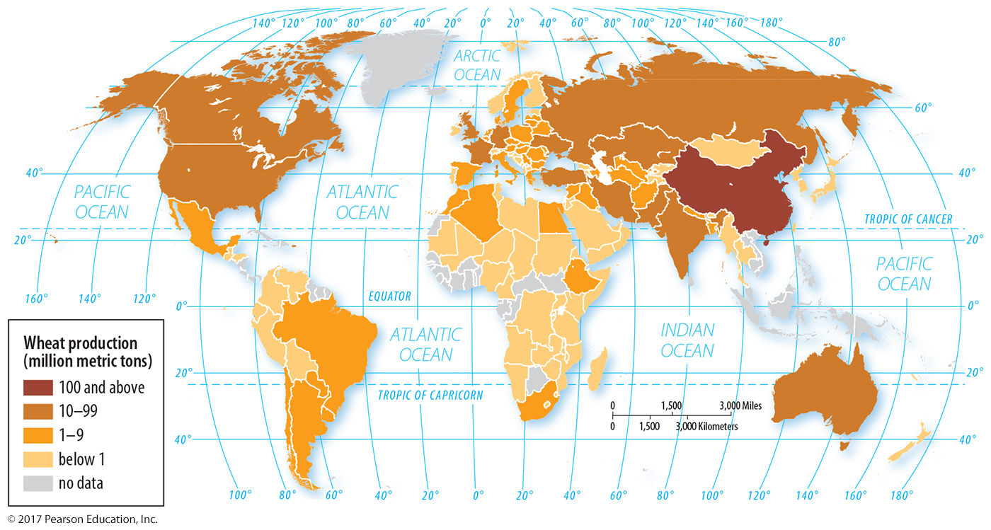
3.6 Commercial Agriculture: Crop-based
Figure 9-30: Commercial grain farming includes the production of wheat in developed countries. Developing countries also produce wheat through intensive subsistence.

Slide 27
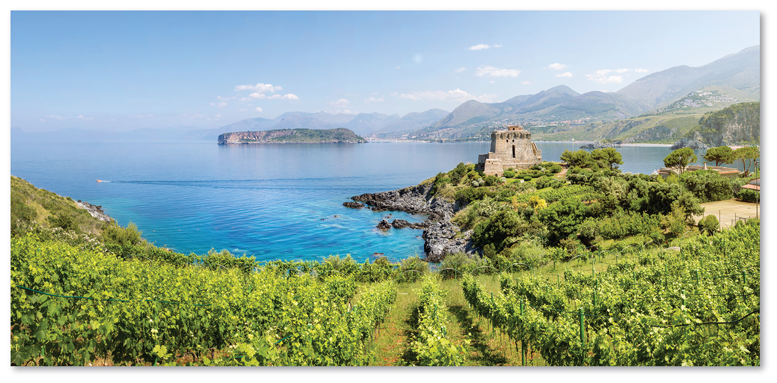
3.6 Commercial Agriculture: Crop-based: Mediterranean
Figure 9-31: The Mediterranean climate region and agricultural type features extensive production of crops like grapes (here pictured in Italy), olives, and tree nuts.

Slide 28
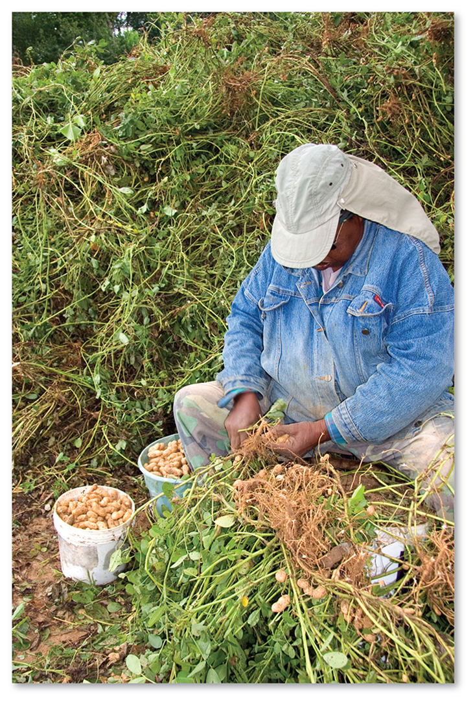
3.6 Commercial Agriculture: Crop-based: Commercial Gardening and Fruit Farming
Figure 9-32: Commercial gardening and fruit farming, also known as truck farming, includes peanut farming.

Slide 29
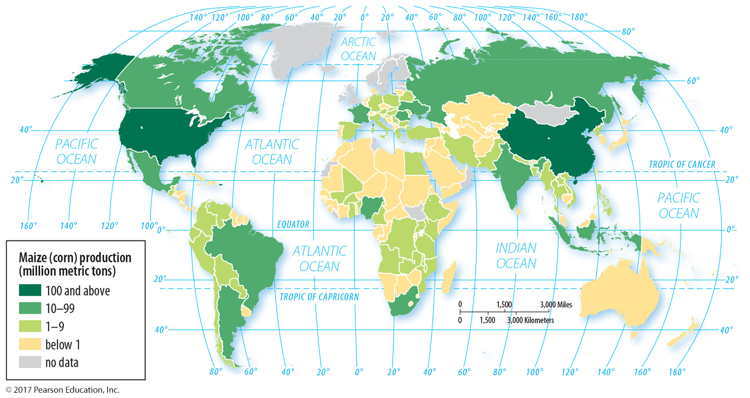
3.7 Commercial Agriculture: Mixed Crop and Livestock
Figure 9-33: In many countries, corn is grown to feed livestock more often than for direct human consumption.

Slide 30
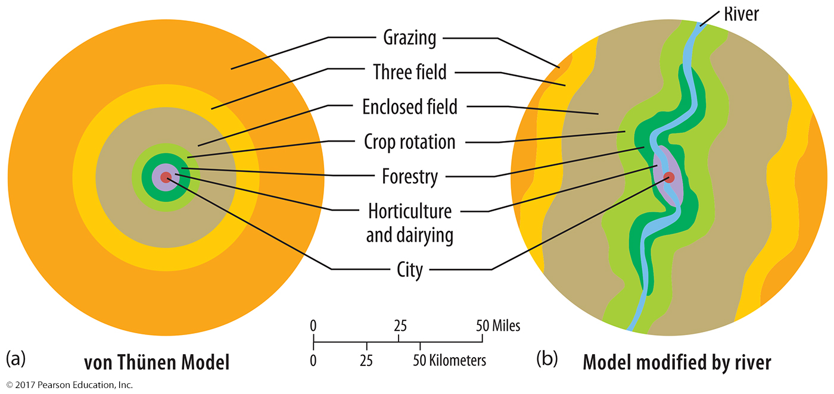
3.7 The Von Thünen Model
Figure 9-35: Von Thünen modeled the location of agricultural activities based on the value of products and their transportation cost.

Slide 31
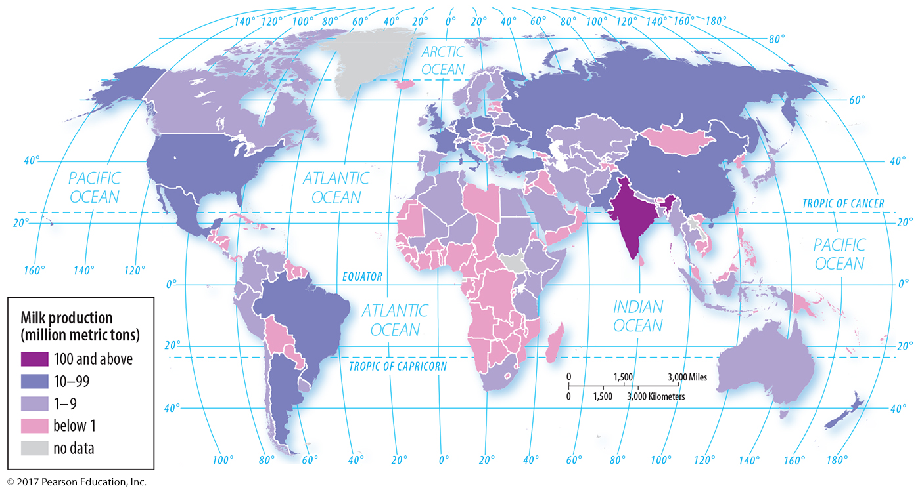
3.8 Commercial Agriculture: Animal-based Dairy
Figure 9-36: India is the world’s leading milk producer, but dairy is an important commercial agricultural practice in developed regions, especially North America and Europe.

Slide 32
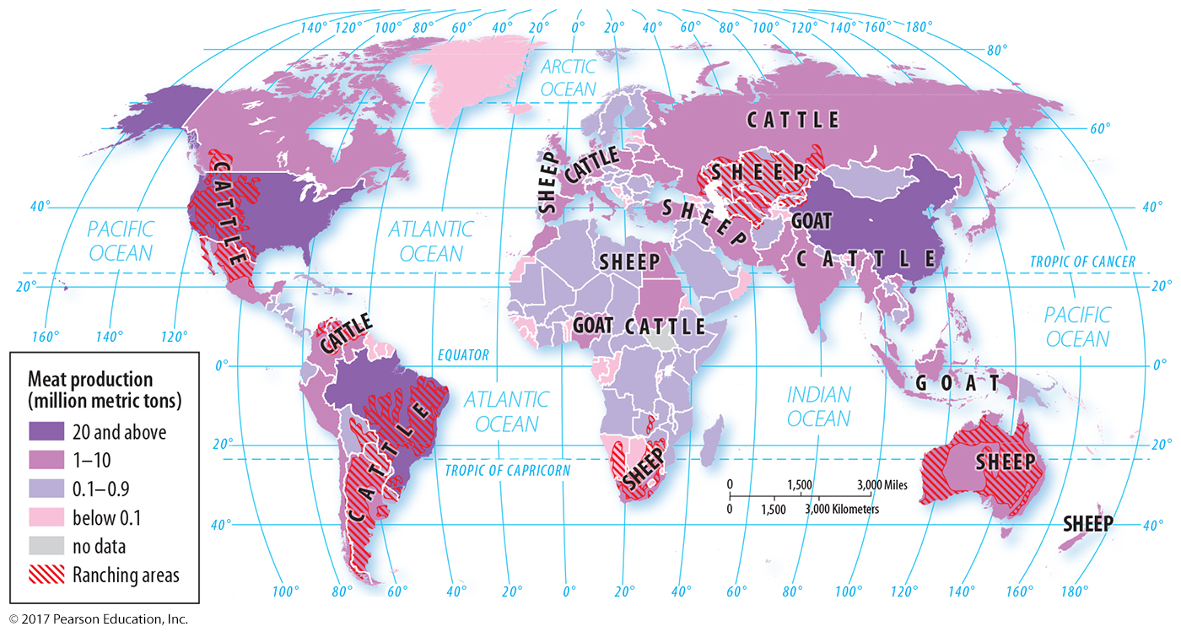
3.8 Commercial Agriculture: Animal-based Livestock Ranching
Figure 9-38: The type of animal raised depends on cultural preferences and climate. Developing countries are increasing meat production; China is the world’s largest meat producer.

Slide 33
Key Issue 4: Why Do Farmers Face Sustainability Challenges?
4.1 Losing Agricultural Land
4.2 Improving Agricultural Productivity
4.3 Conserving Agricultural Resources
4.4 Applying Biotechnology to Agriculture
4.5 Global Food Trade
4.6 Global Agriculture and Undernourishment
4.7 Sustainable Agriculture

Slide 34
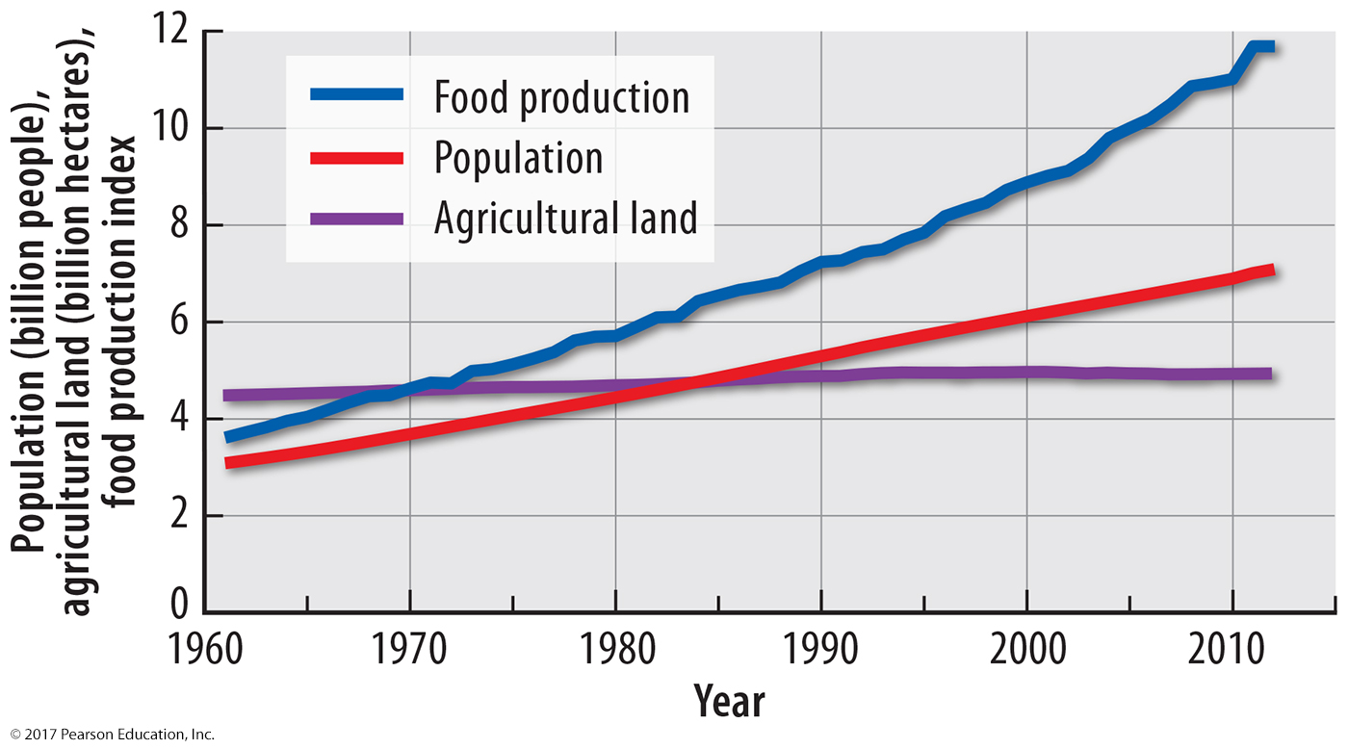
4.1 Losing Agricultural Land
Figure 9-39: Food production has kept up with population growth despite very little increase in agricultural land. Agricultural land is threatened by urbanization and desertification.

Slide 35
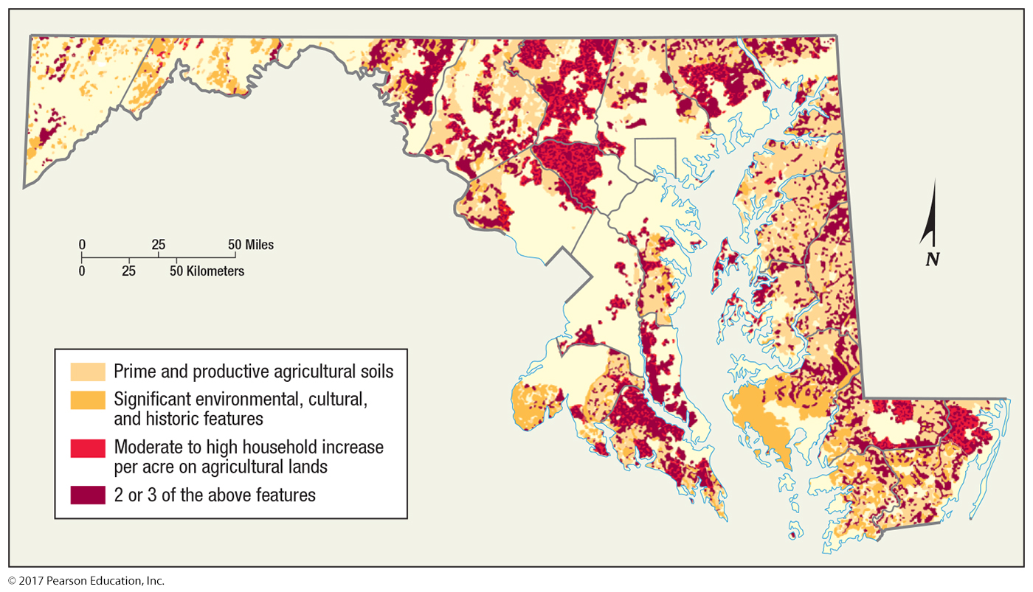
4.1 Threats to Farmland in Maryland
Figure 9-40: Considerable amounts of Maryland’s prime farmland is threatened by urbanization.

Slide 36
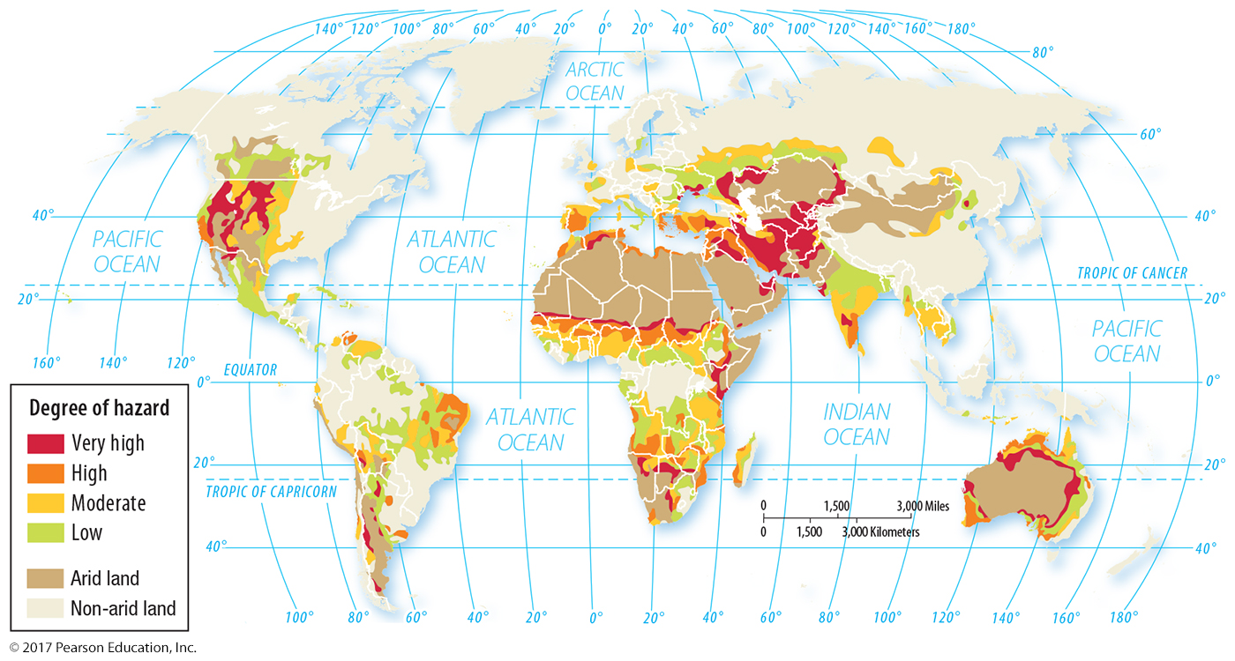
4.1 Desertification Hazard
Figure 9-41: Dry lands are at high risk of desertification.

Slide 37
4.2 Improving Agricultural Productivity
Agricultural production has increased faster than farmland.
Subsistence intensification: land worked more intensively
Green revolution: selective breeding, fertilizers
Increased technology in commercial agriculture

Slide 38
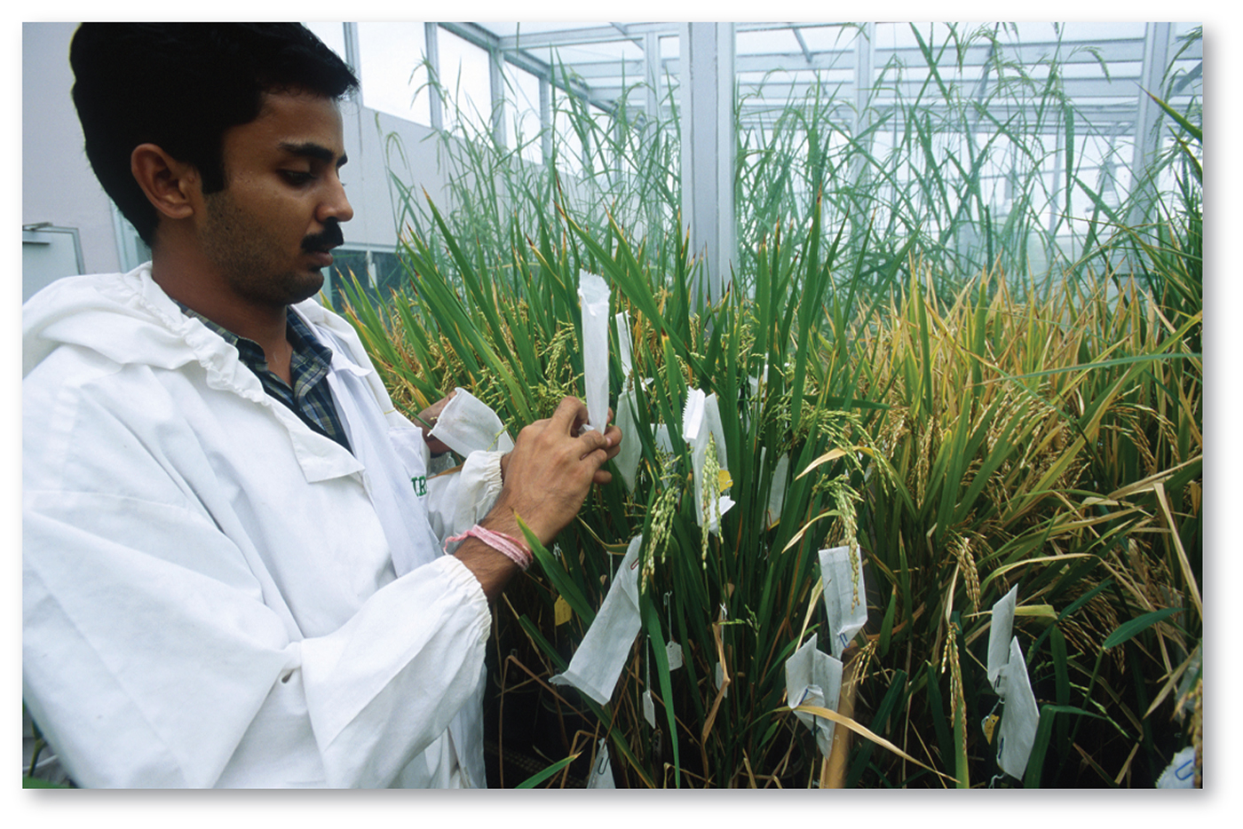
4.2 Green Revolution
Figure 9-43: The International Rice Research Institute’s selective breeding programs have developed high-yielding varieties of rice.

Slide 39
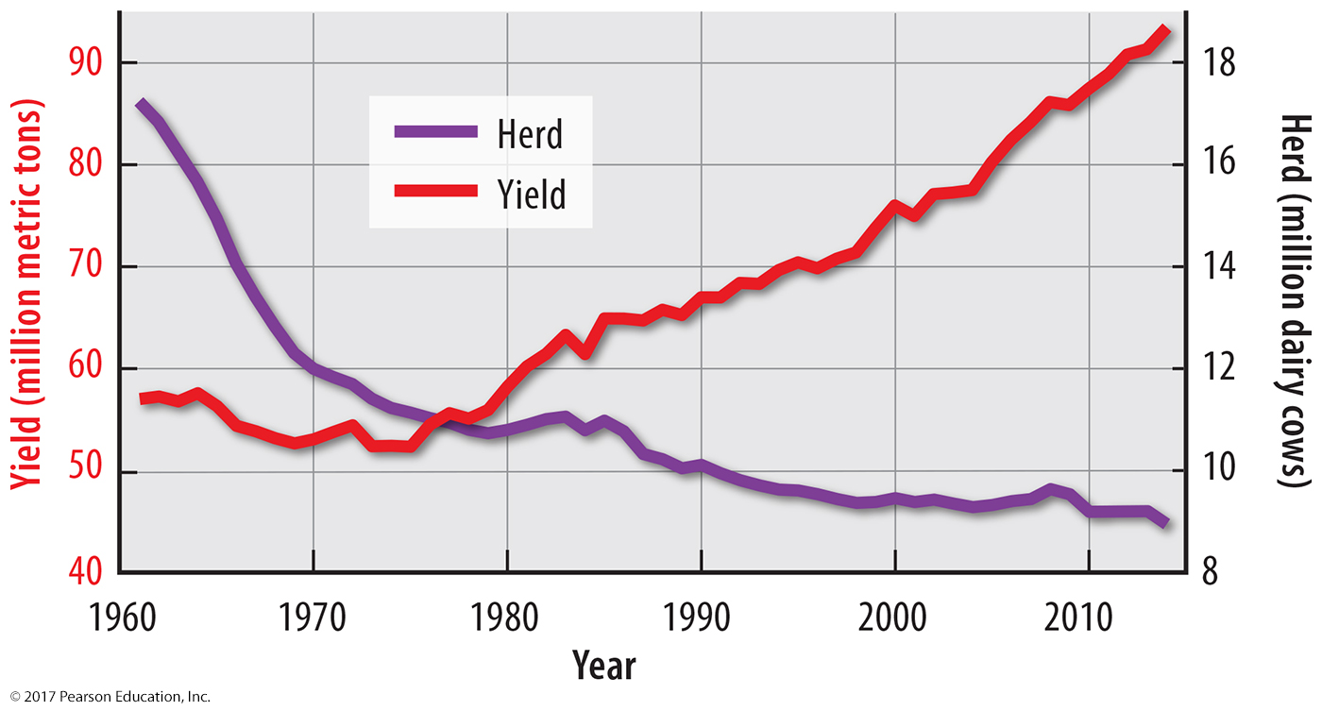
4.2 U.S. Dairy Productivity
Figure 9-44: The amount of milk per cow has increased in the United States.

Slide 40
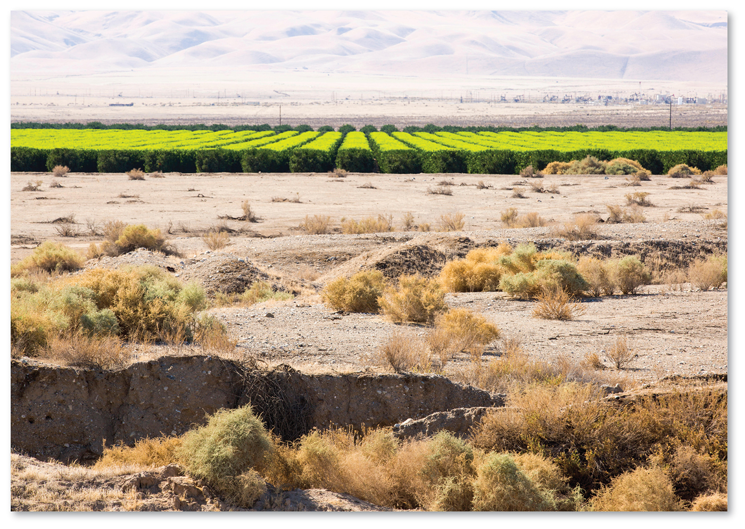
4.3 Agriculture and Water in California
Figure 9-45: California’s use of irrigation for agriculture is especially apparent after several years of drought.

Slide 41
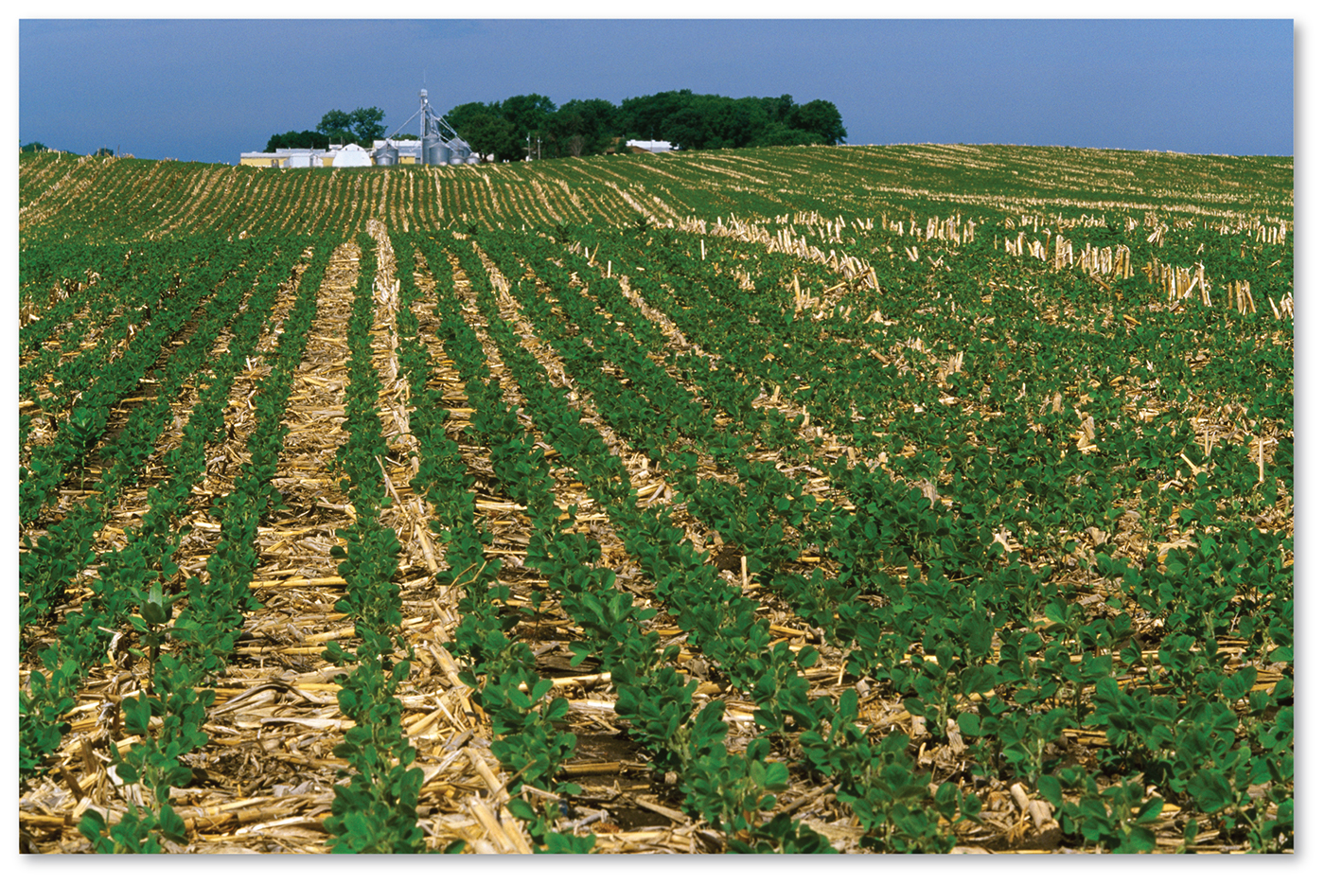
4.3 Sustainable Land Management
Figure 9-46: Alternatives to traditional commercial agriculture practices include “no tillage,” shown here, in which harvest residue is not removed before planting a new crop.

Slide 42
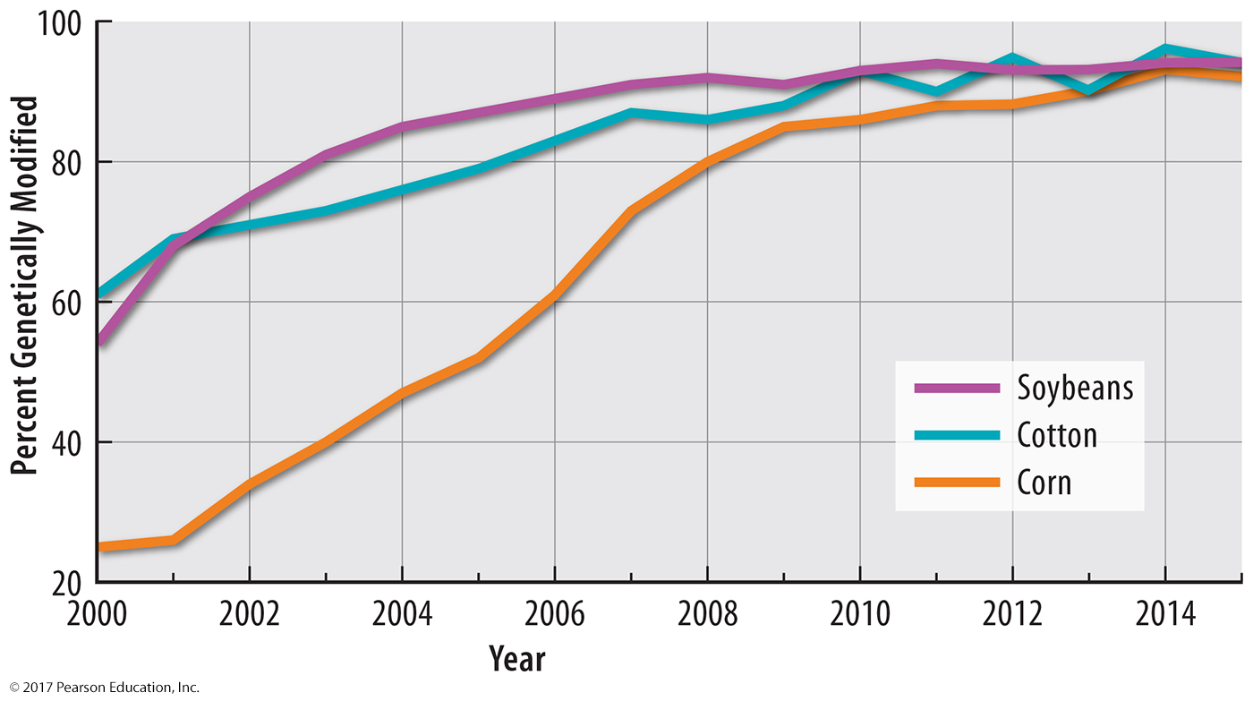
4.4 Biotechnology: Genetically Modified Crops
Figure 9-47: In the United States, an increasing percentage of grains are genetically modified.

Slide 43
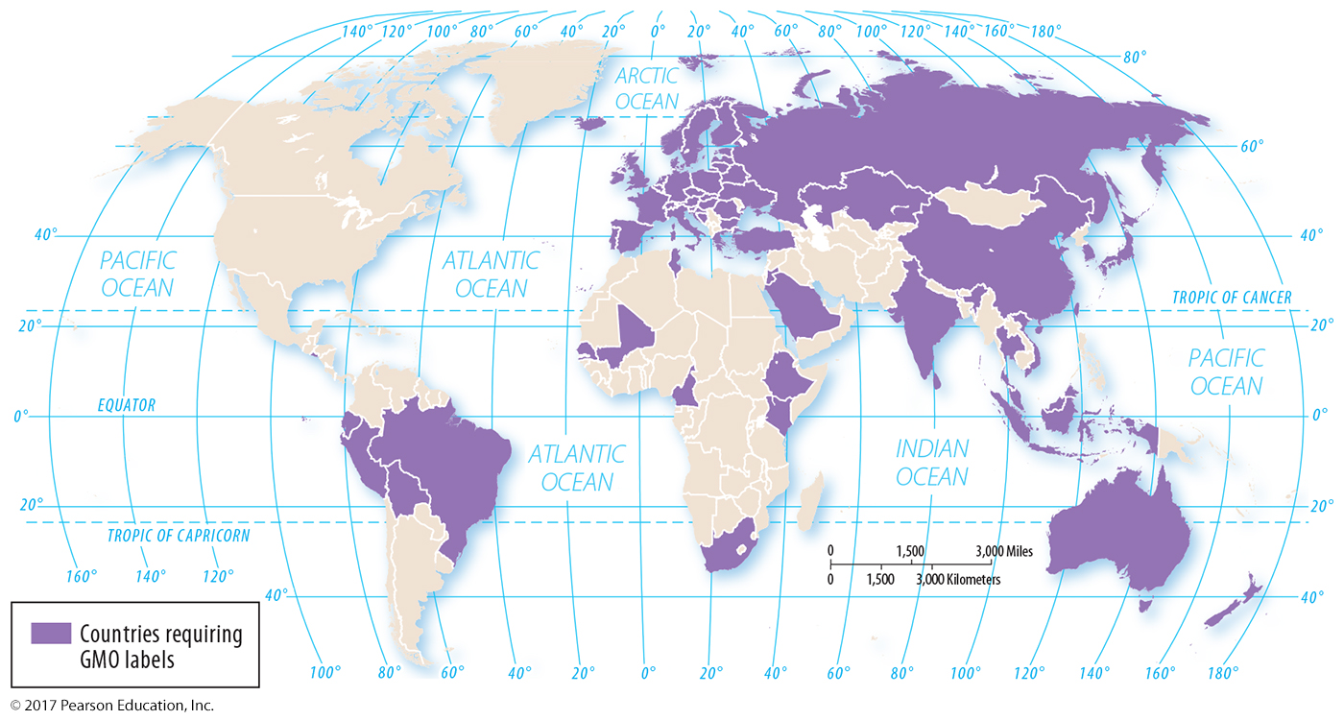
4.4 Biotechnology: GMOs
Figures 9-48 and 9-49: Many countries require genetically modified organisms (GMOs) to be labeled, as in the European label shown inset.

Slide 44
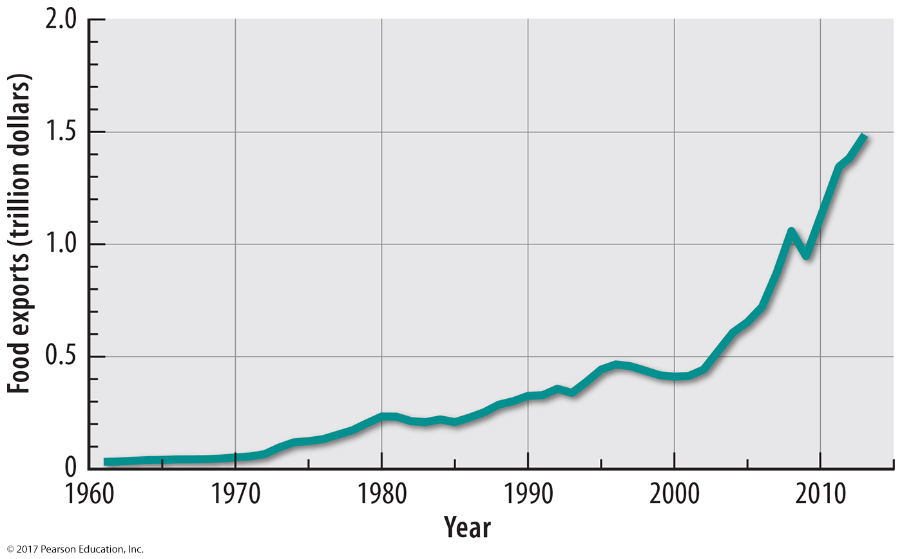
4.5 Global Food Trade
Figure 9-51: The value of agricultural exports has increased to $1.3 trillion in 2012.

Slide 45
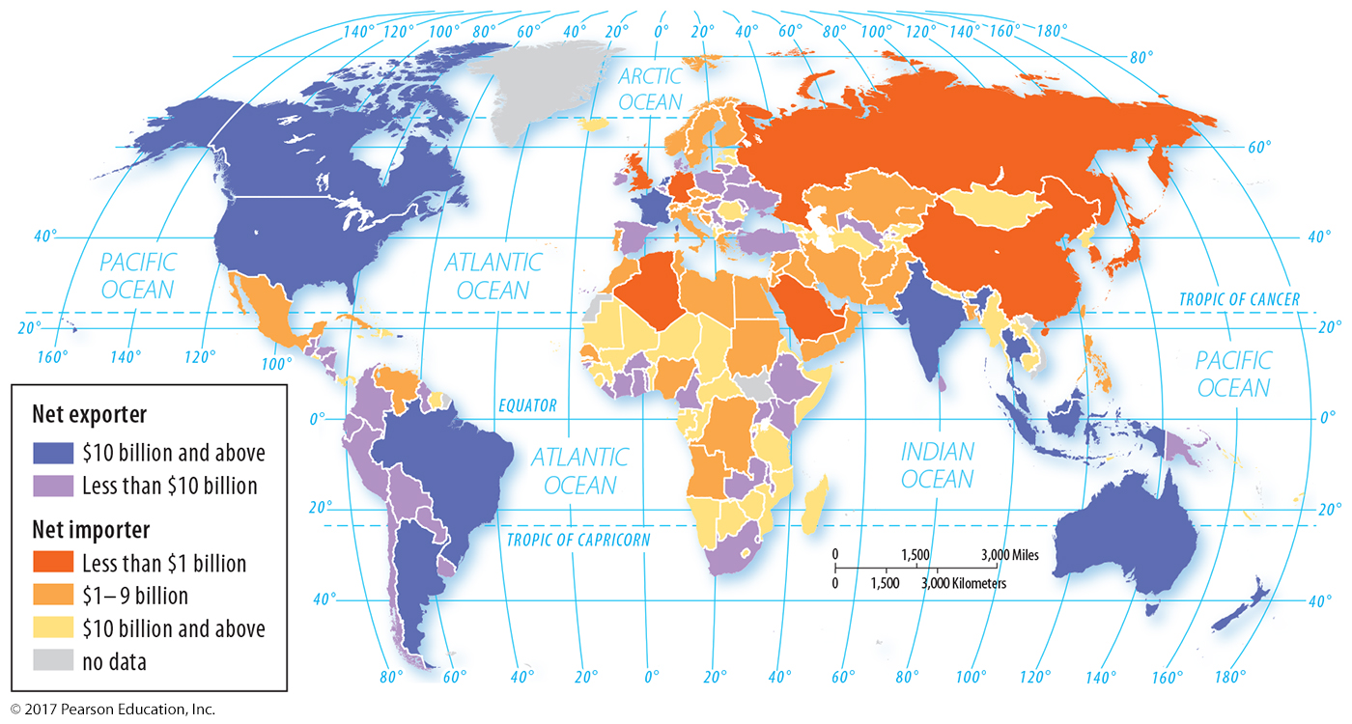
4.5 Global Food Trade
Figure 9-52: The Western Hemisphere has many states that export food, while Europe and Asia have many importers.

Slide 46
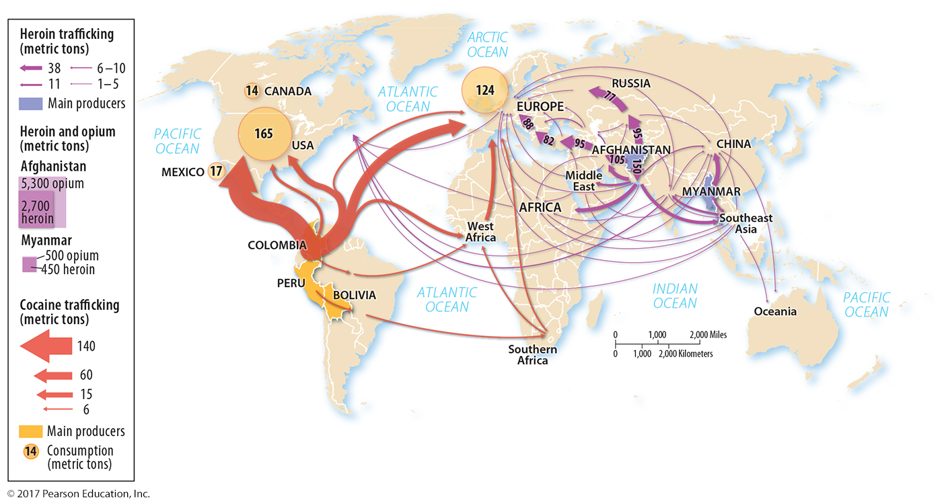
4.5 Global Drug Trade
Figure 9-53: Drug crops grown in the developing world are trafficked (illegally traded) to developed countries in North America and Europe.

Slide 47
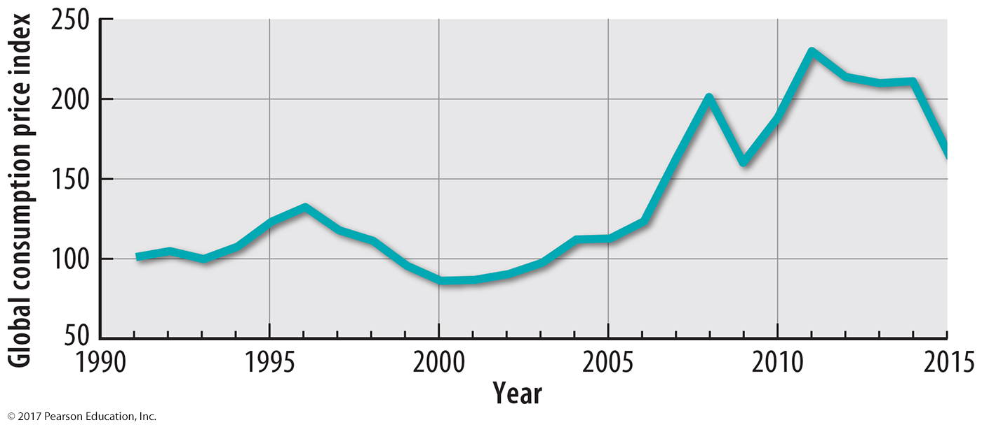
4.6 Agriculture and Undernourishment
Figure 9-54: Increasing food prices represent a challenge to food supply, especially for people who spend a significant percentage of their income on food.

Slide 48
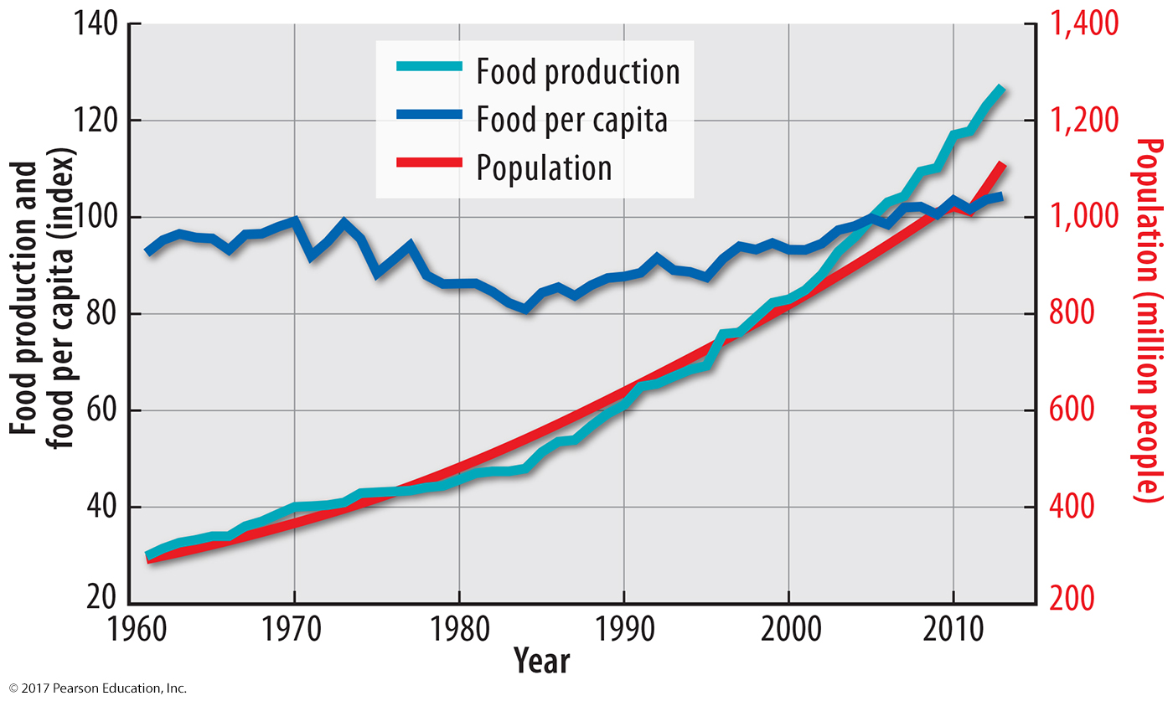
4.6 Population and Food in Africa
Figure 9-55: In Africa, increases in food supply have barely kept up with population growth.

Slide 49
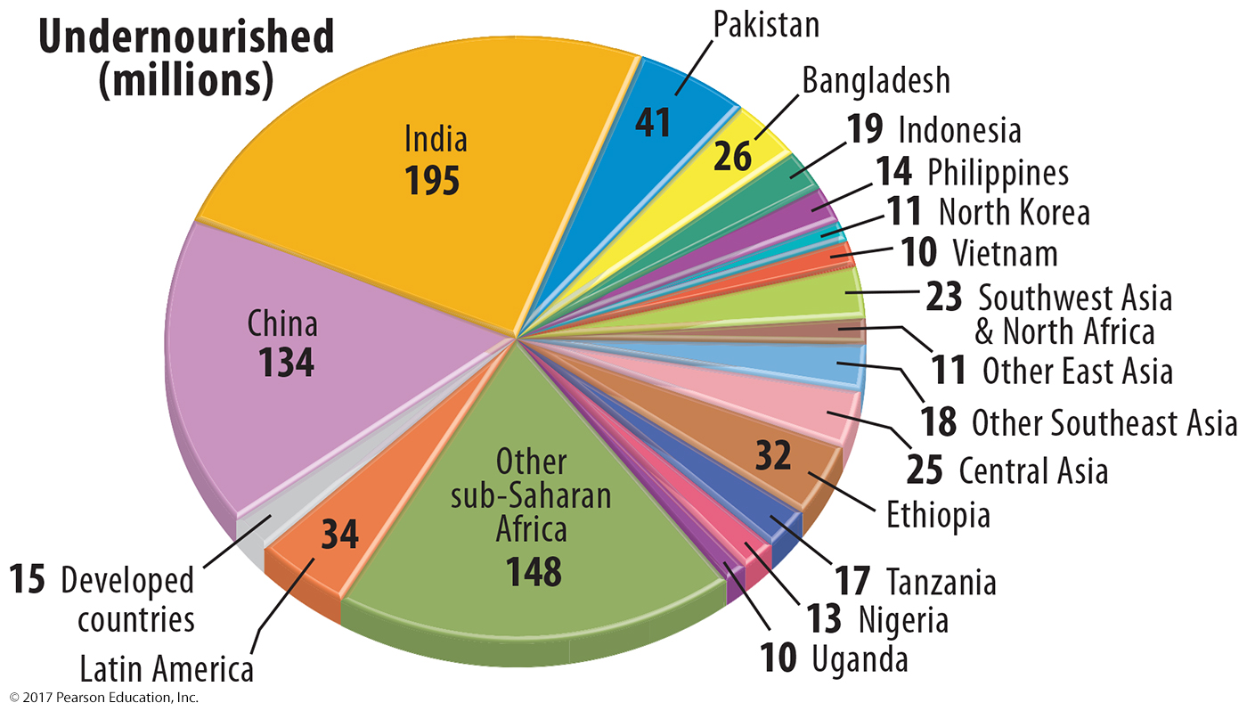
4.6 Undernourishment by Country
Figure 9-56: India and China have the largest numbers of undernourished people.

Slide 50
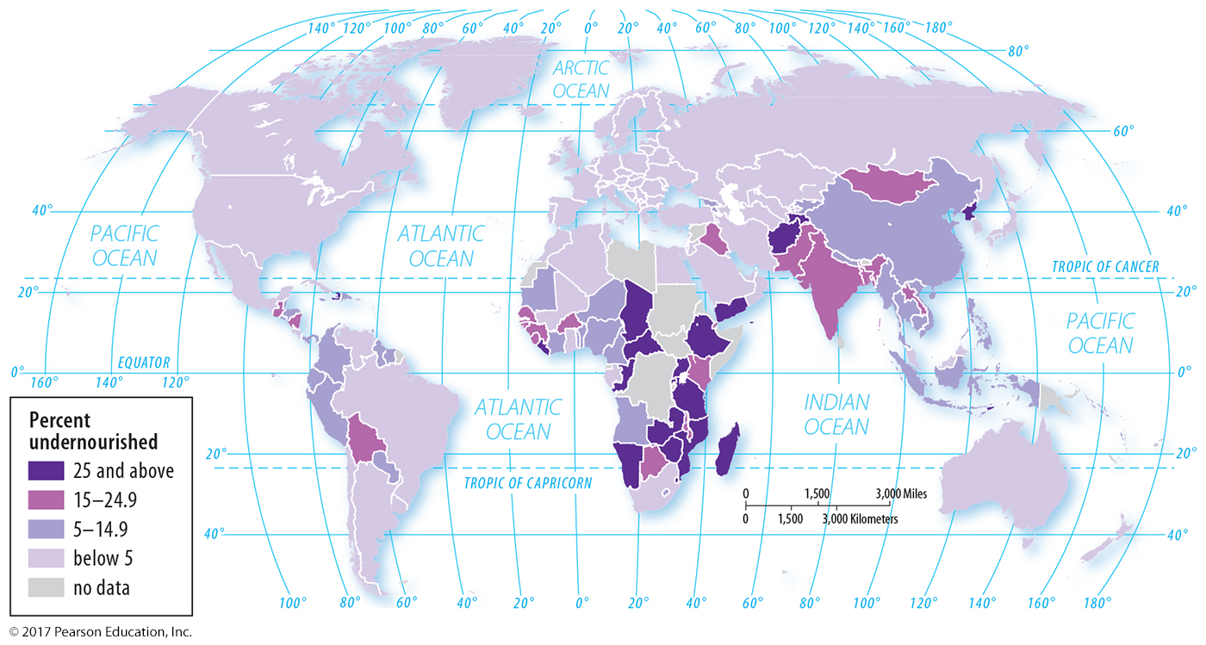
4.6 Undernourishment by Country
Figure 9-57: The highest rates of undernourishment are in sub-Saharan Africa and South Asia.

Slide 51
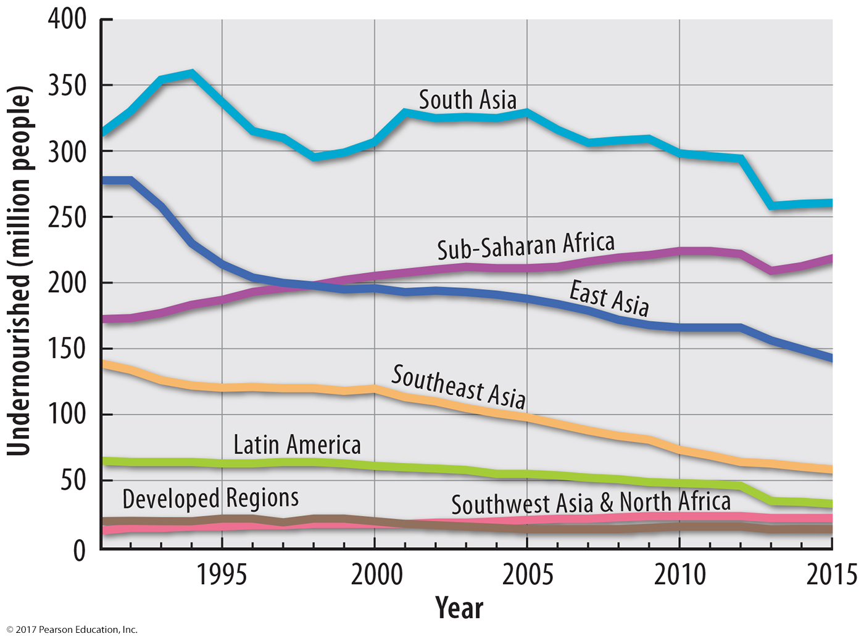
4.6 Change in Undernourishment
Figure 9-58: Undernourishment has decreased since 1990 in every world region except sub-Saharan Africa.

Slide 52
4.7 Sustainable Agriculture
Concerns over environment and health leading to:
Organic farming: reduced herbicides, pesticides, antibiotics; no GMOs
Pesticides on produce may present health threat.
Government policies to help farmers may affect sustainability too.

Slide 53
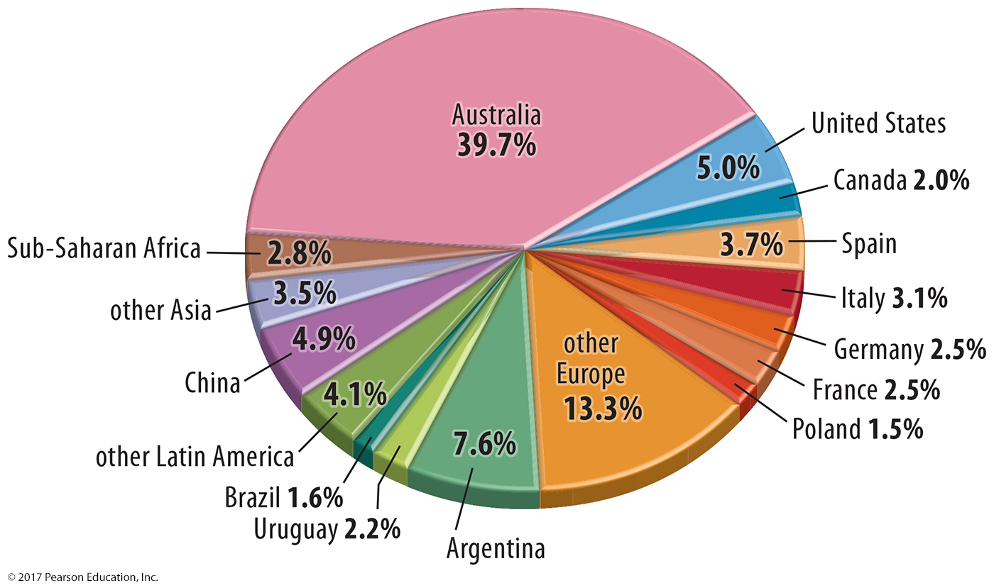
4.7 Organic Farming
Figure 9-59: Australia has a large share of the world’s organic farming; Europe is also an important region.

Slide 54
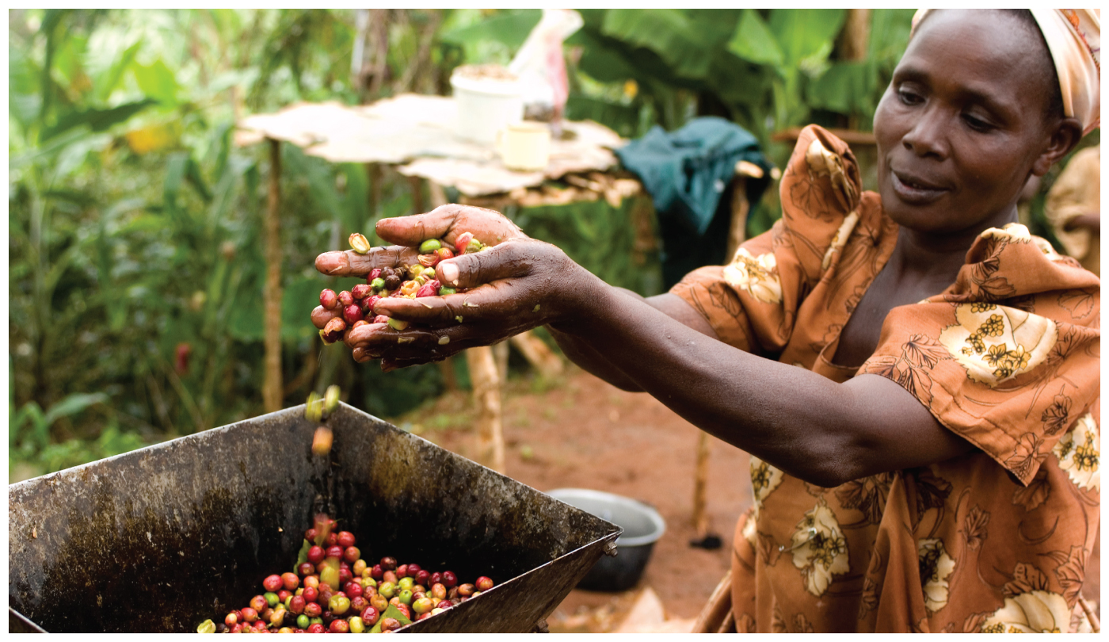
Chapter 9 End

