Slide 1
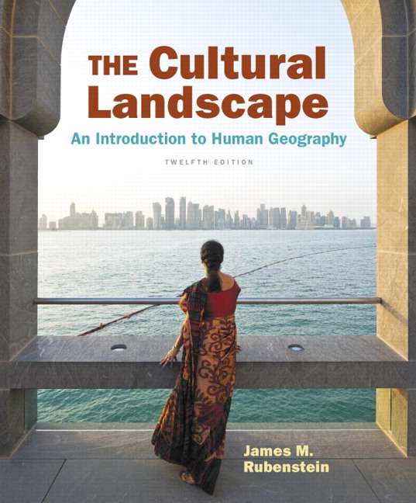
Chapter 8 Lecture
Chapter 8
Political Geography
Tim Scharks Green River College

Slide 2
Political Geography: Key Issues
Where Are States Distributed?
Why Are Nation-States Difficult to Create?
Why Do Boundaries Cause Problems?
Where Do States Face Threats?

Slide 3
Key Issue 1: Where Are States Distributed?
1.1 Introducing Political Geography
1.2 Challenges in Defining States

Slide 4
1.1 Introducing Political Geography
State is a synonym for country: political unit with control over internal and external affairs
Estimating number of sovereign states complicated:
North and South Korea
China and Taiwan
Senkaku/Diaoyu Islands
Sahrawi Republic (Western Sahara)

Slide 5
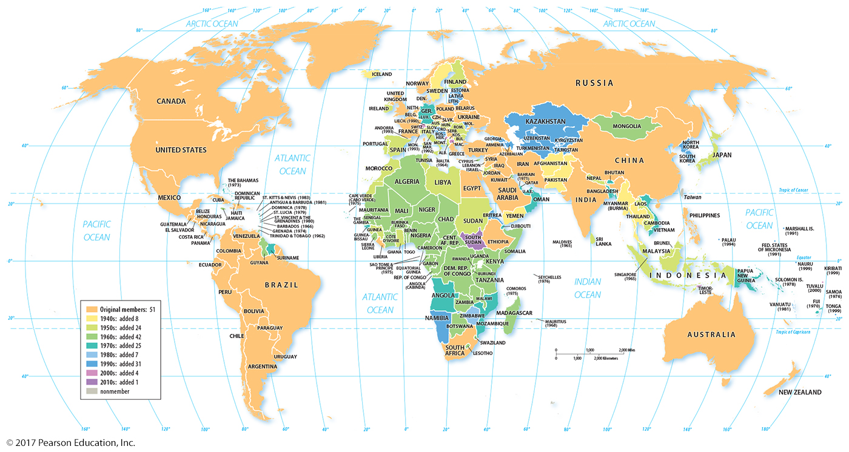
1.1 States of the World
Figure 8-1: Colors indicate date of United Nations membership; nearly every state is a member of the UN.

Slide 6
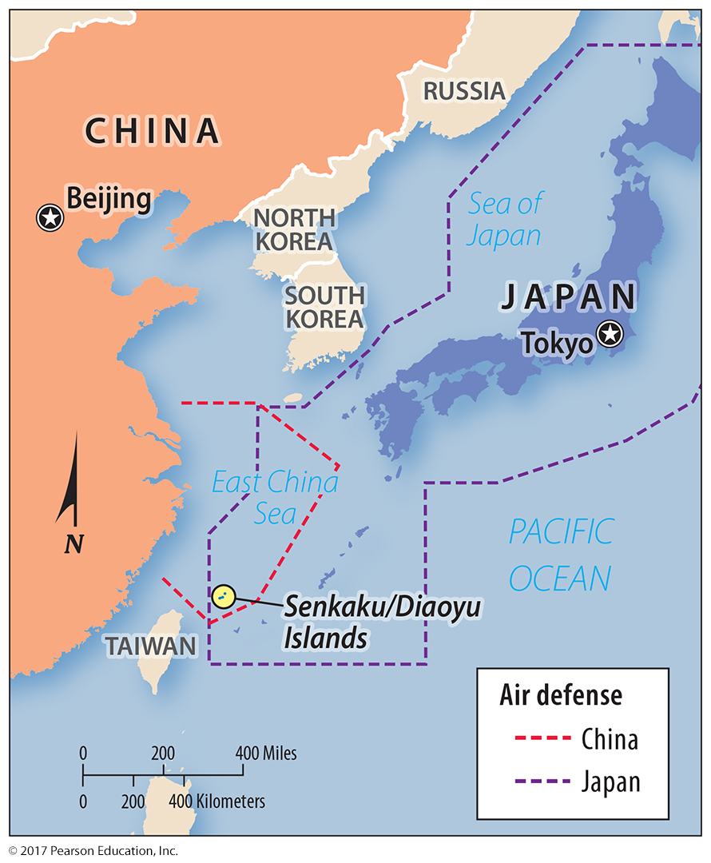
1.2 Disputed Territory
Figure 8-4: The Senkaku/Diaoyu Islands are claimed by both China and Japan.

Slide 7
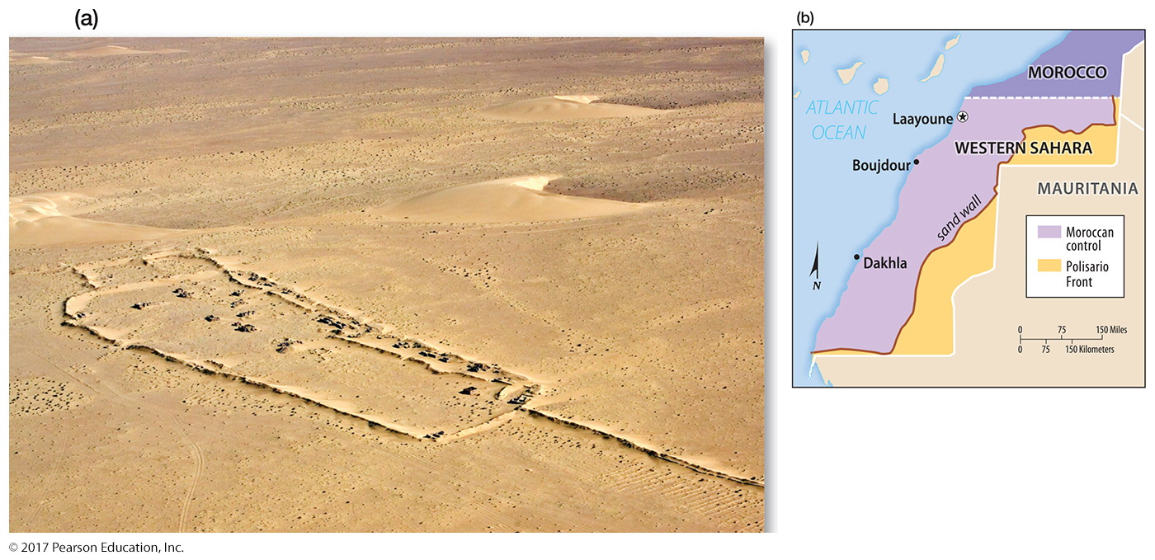
1.2 Western Sahara
Figure 8-6: Western Sahara is claimed by Morocco, which controls most of the territory. The Polisario Front controls the far eastern portion, behind a sand berm built by the Moroccan government.

Slide 8
Key Issue 2: Why Are Nation-States Difficult to Create?
2.1 Development of States
2.2 Nation-States and Multinational States
2.3 Russia: The Largest Multiethnic State
2.4 Nation-States in the Former Soviet Union
2.5 Colonies

Slide 9
2.1 Development of States
Nation-state: ethnicity with sovereign territory
Ancient states: Fertile Crescent city-states
Medieval states: European realms
Twentieth-century Europe: boundaries matched to ethnicities

Slide 10
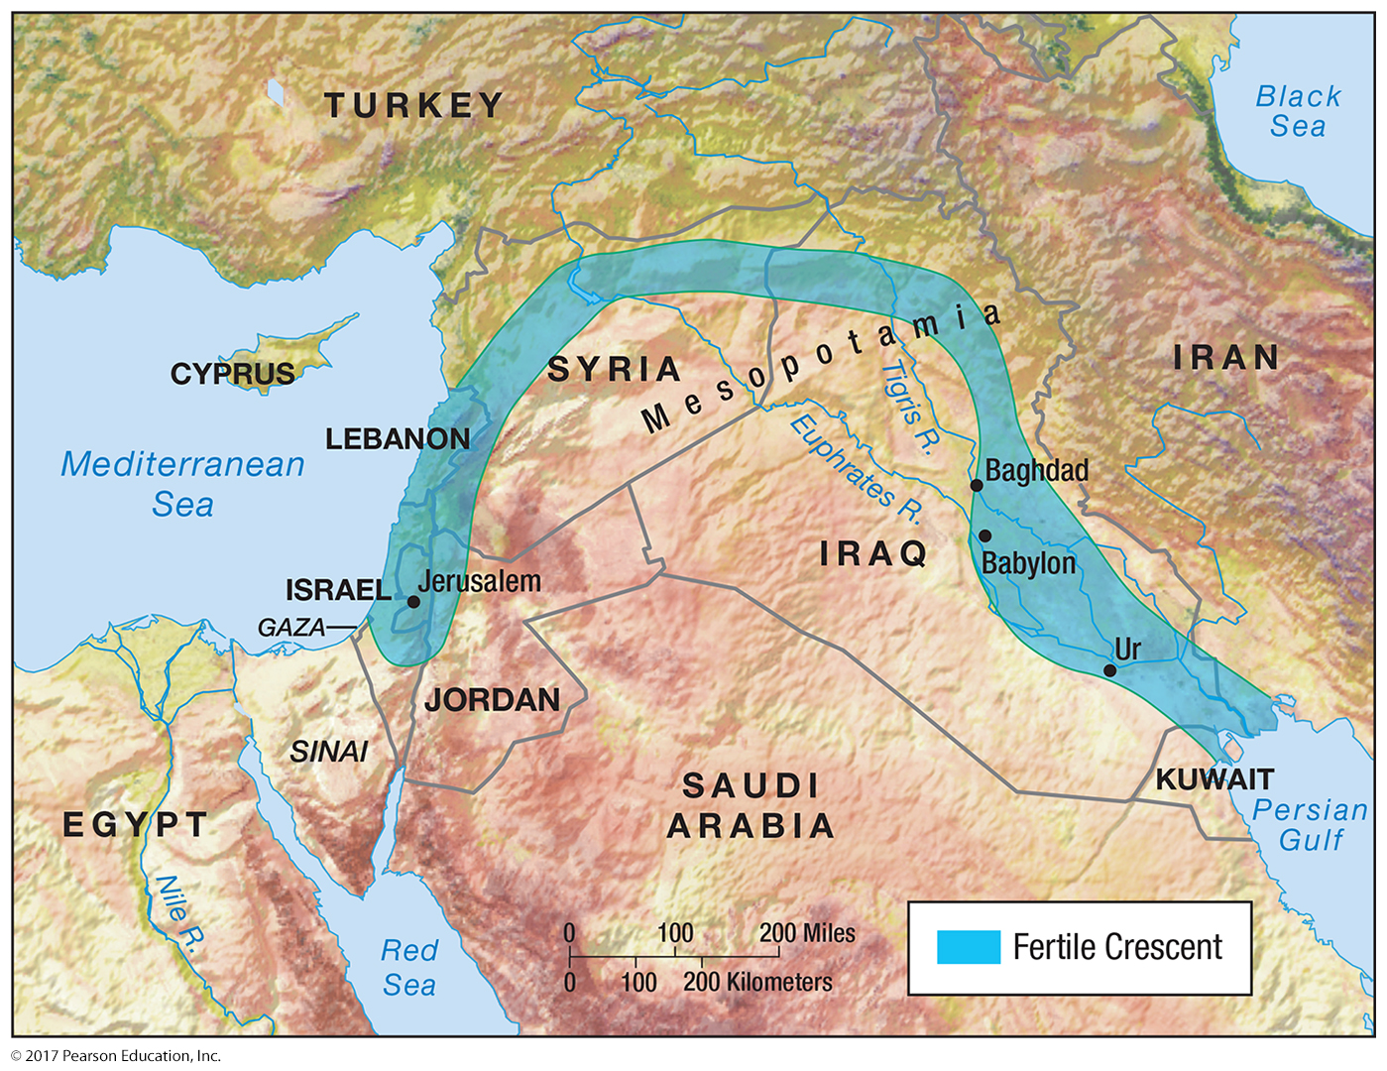
2.1 Fertile Crescent
Figure 8-7: This region was home to some of the earliest known city-states.

Slide 11
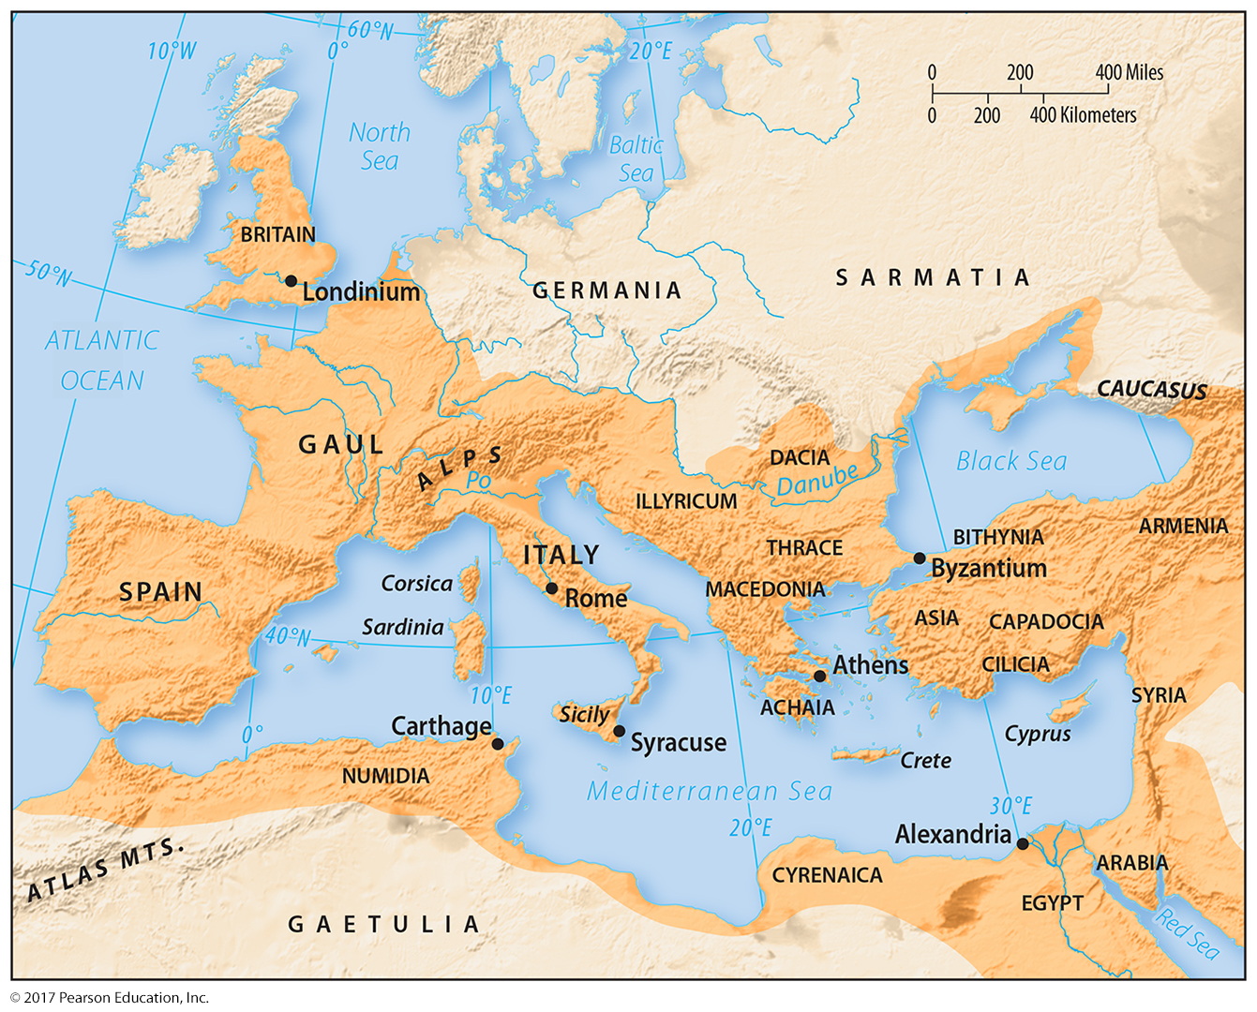
2.1 Roman Empire
Figure 8-8: The Roman Empire represented a unified political body over many disparate ethnicities.

Slide 12
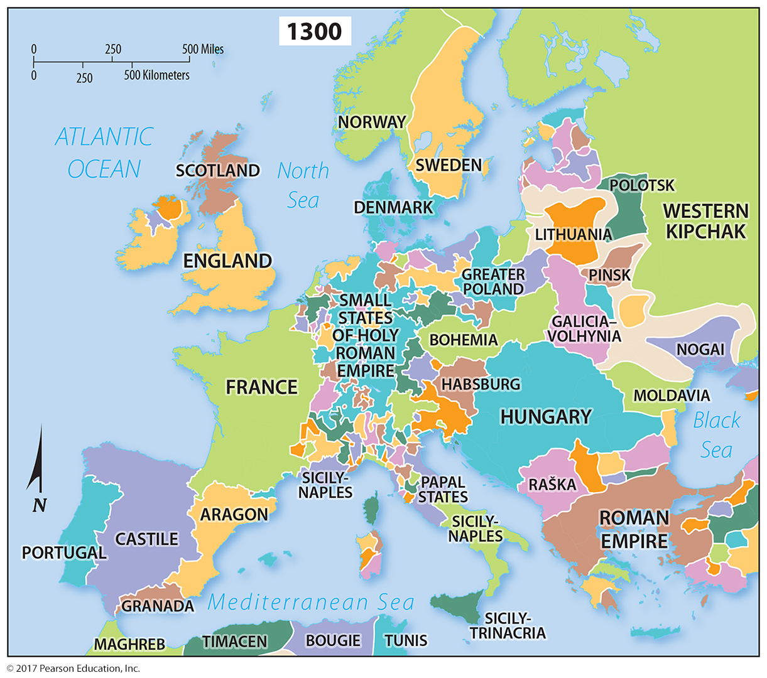
2.1 Europe, 1300
Figure 8-9: After the fall of the Roman Empire, Europe had many small political units.

Slide 13
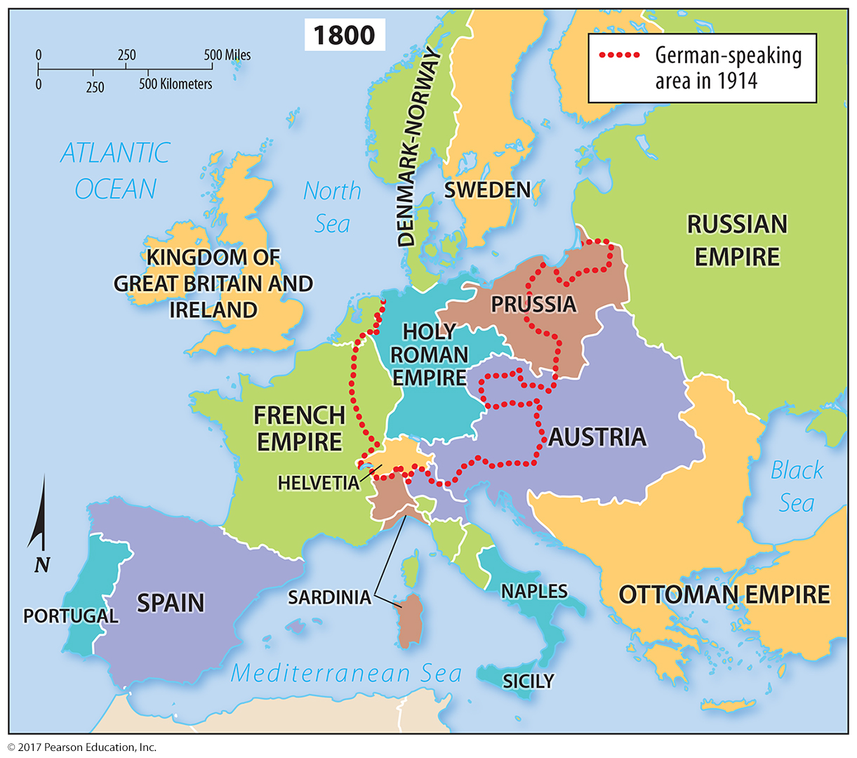
2.1 Europe, 1800
Figure 8-10: Smaller political units became part of larger empires by 1800.

Slide 14
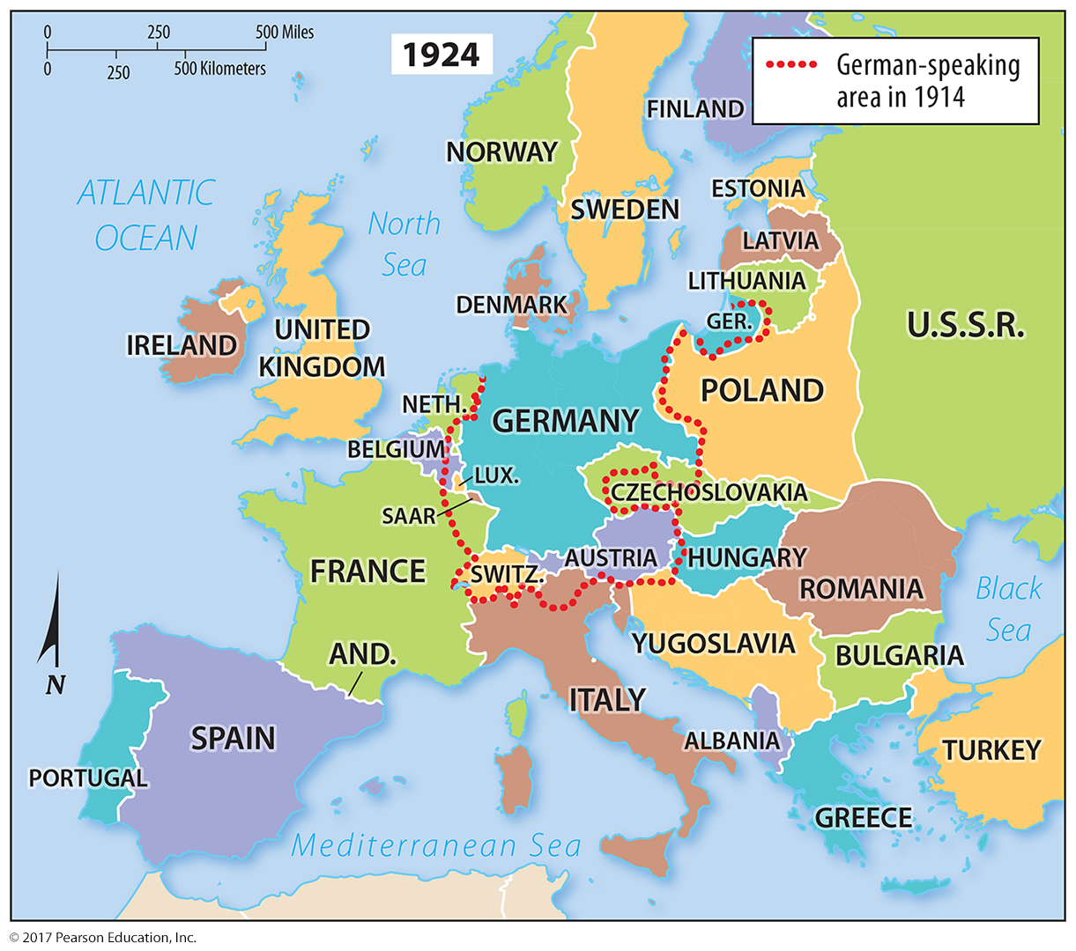
2.1 Europe, 1924
Figure 8-11: After World War I, the victors redrew boundaries on the basis of language.

Slide 15
2.2 Nation-States and Multinational States
Self-determination: right for an ethnicity to govern itself
Multiethnic state: more than one ethnicity, shared nationality
Multinational state: more than one ethnicity with histories of self-determination

Slide 16
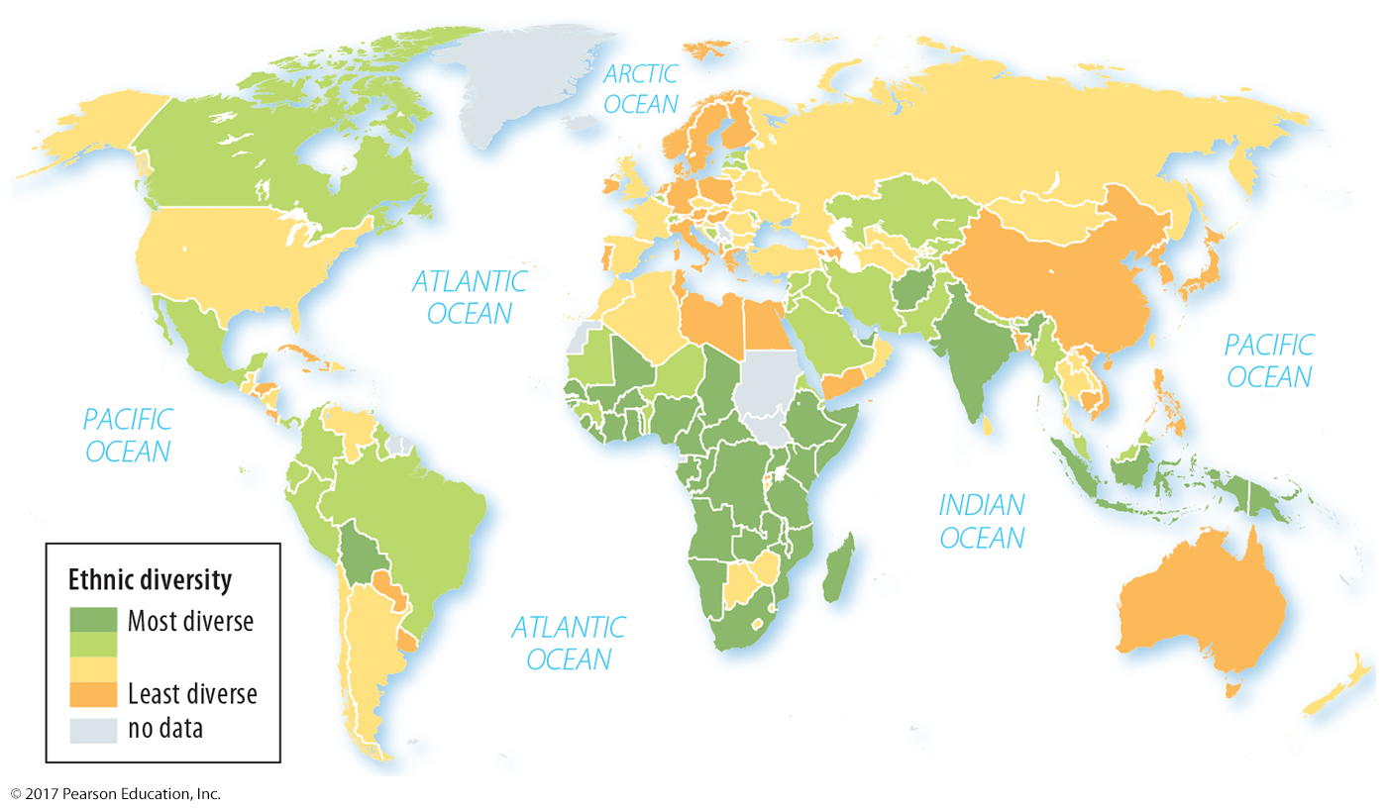
2.2 Ethnic Diversity
Figure 8-12: Ethnic diversity by state varies throughout the world, with Africa having the most ethnically diverse states.

Slide 17
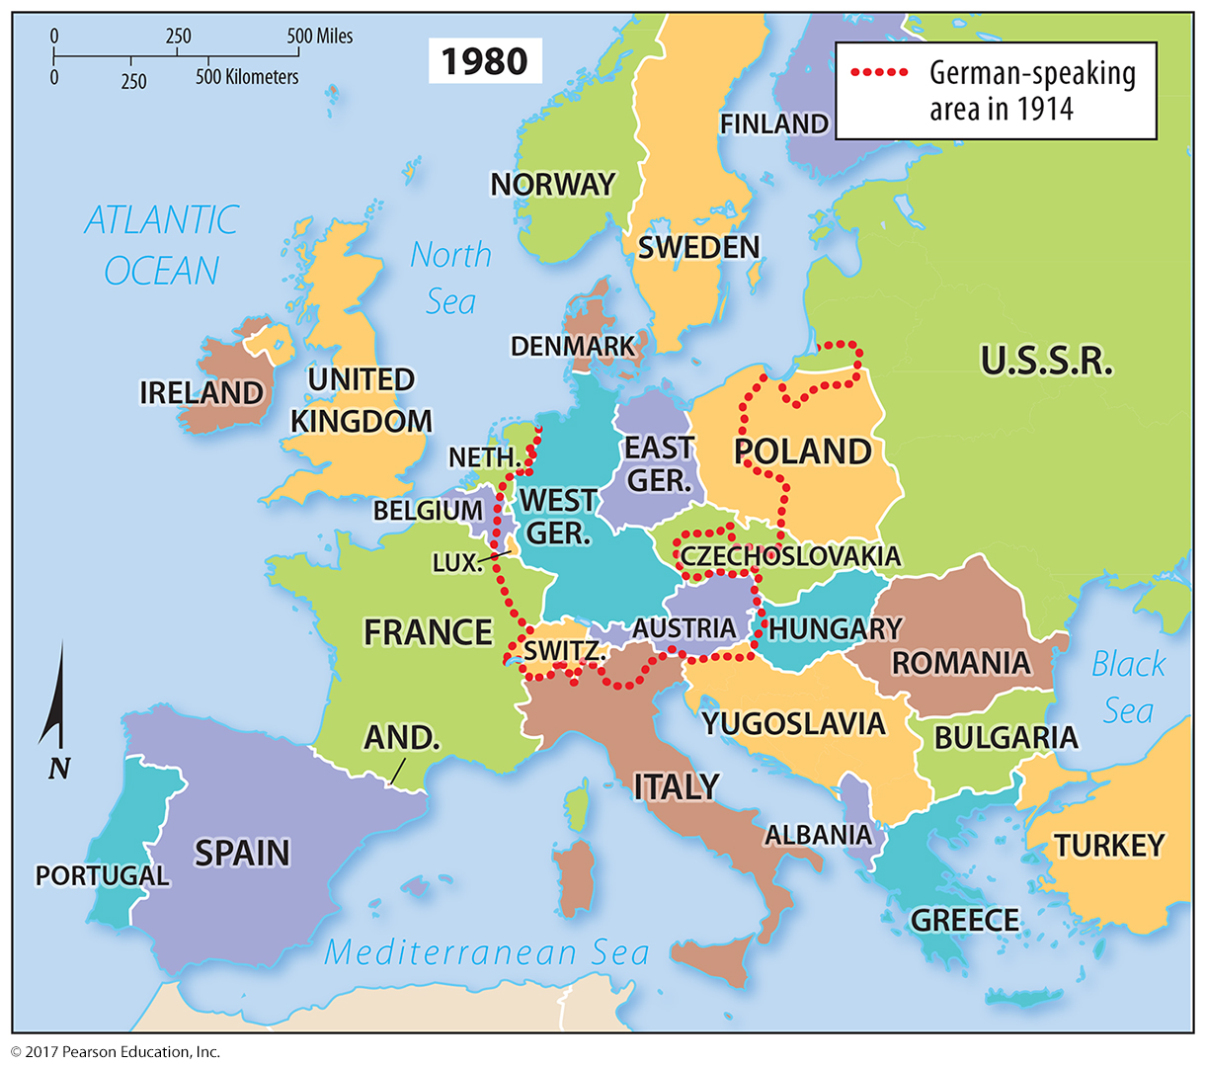
2.2 Europe, 1980
Figure 8-13: Multinational states like Yugoslavia and Czechoslovakia eventually divided, and a largely German population divided between East and West Germany was reunited.

Slide 18
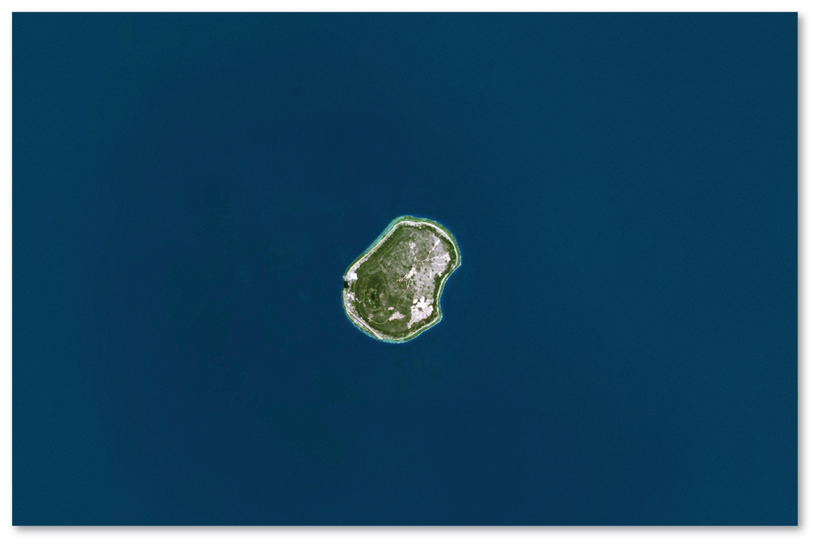
2.2 Nauru
Figure 8-16: Nauru and other microstates are extremely susceptible to rising oceans.

Slide 19
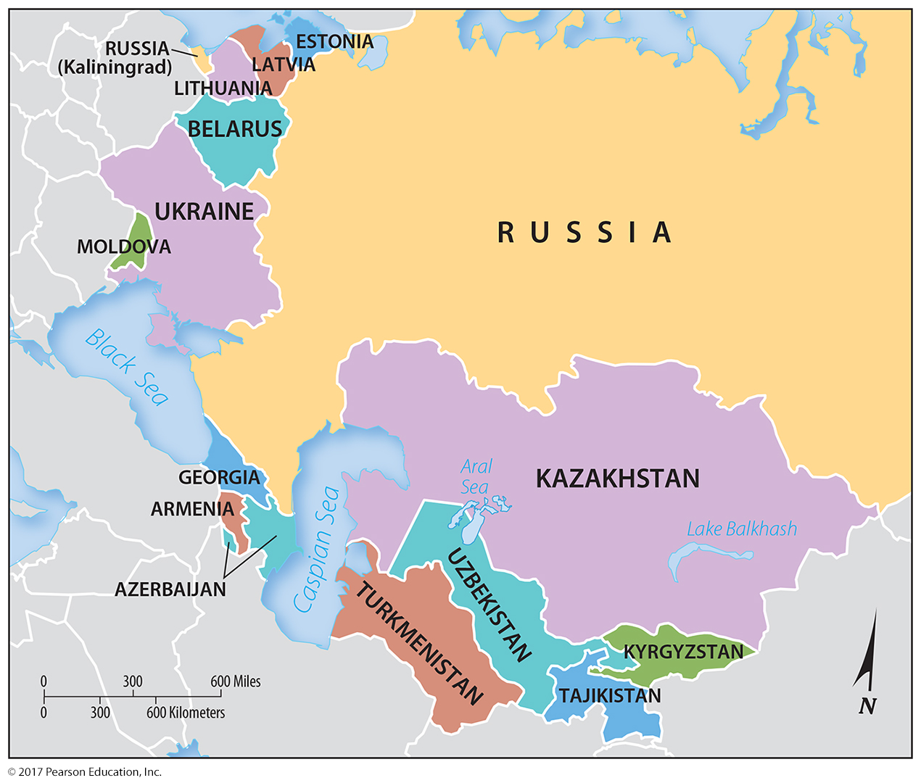
2.3 Soviet Union
Figure 8-17: The former Soviet Union was a multinational state with 15 republics that are now independent states.

Slide 20
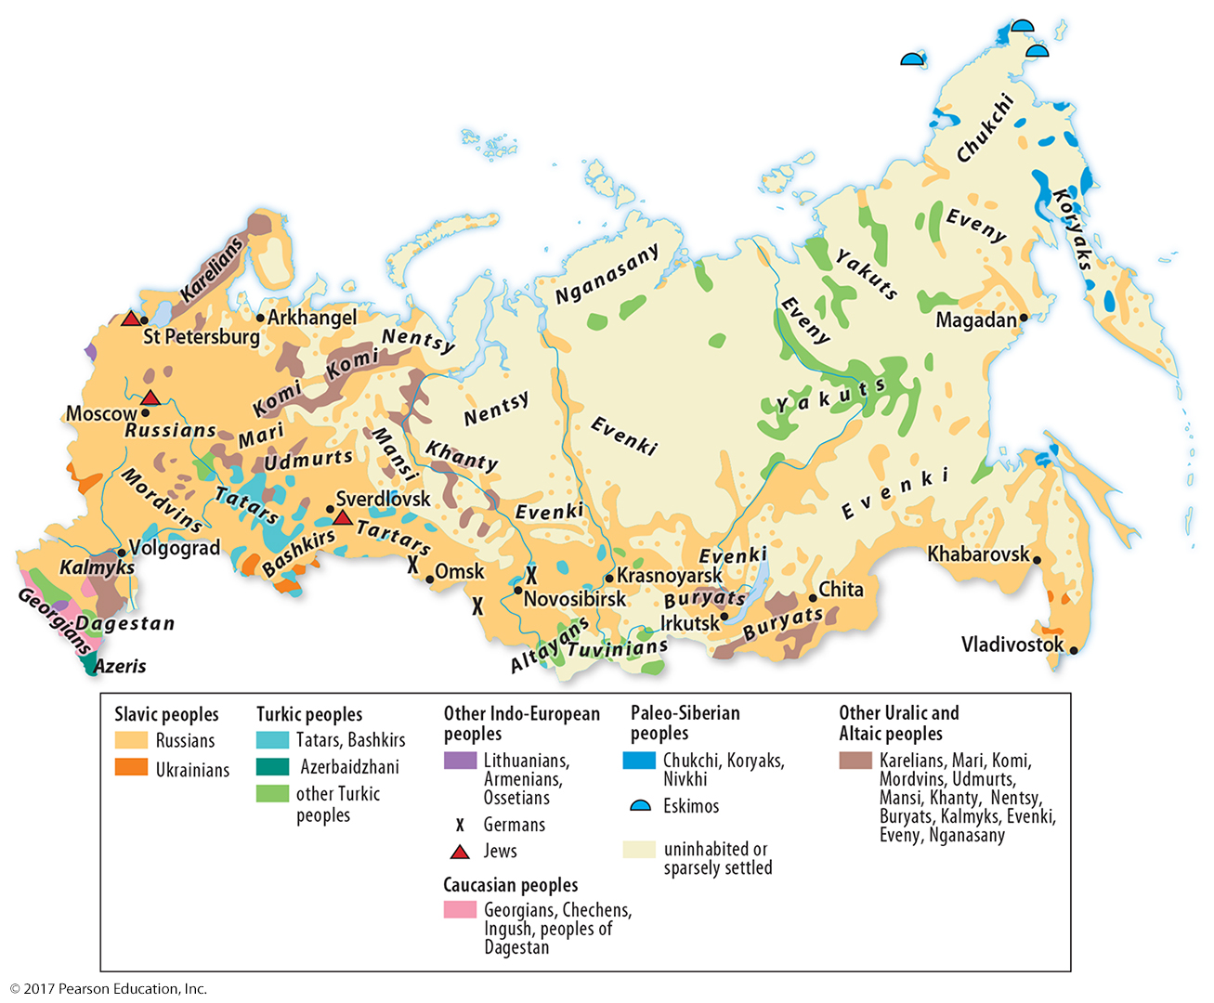
2.3 Ethnicities in Russia
Figure 8-18: The majority population is ethnically Russian, but there are diverse groups along Russia’s borders and in its center; some have histories of self-determination.

Slide 21
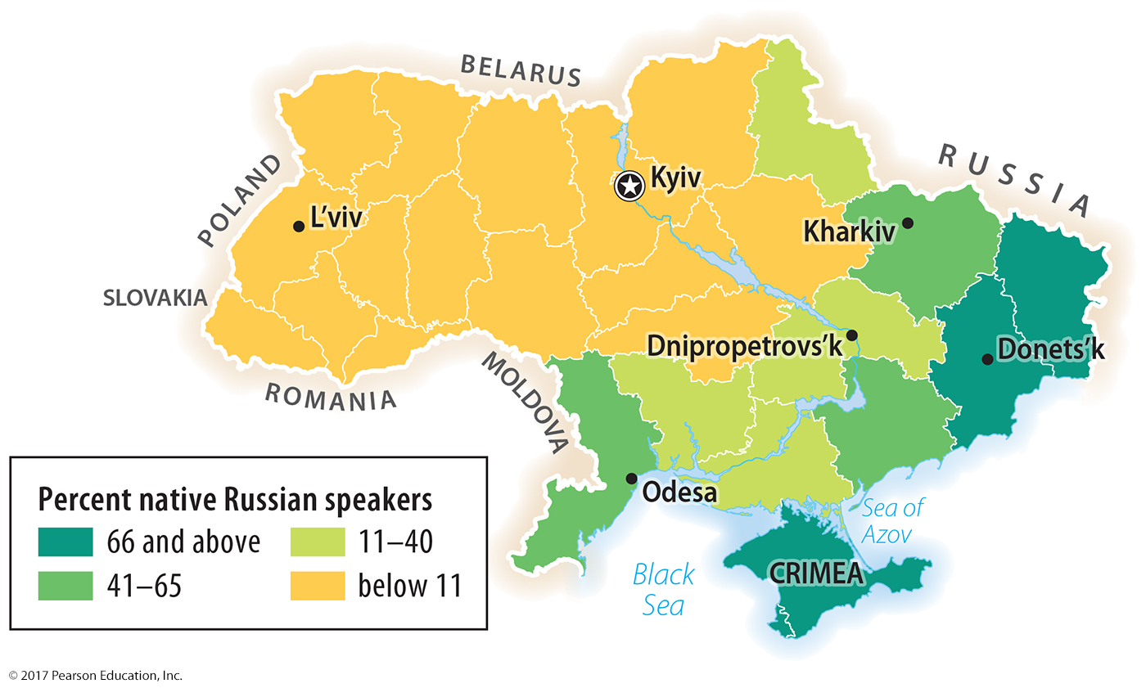
2.3 Ethnicities in Ukraine
Figure 8-19: Ukraine’s eastern region is home to more ethnic Russians. Crimea was occupied by Russian forces in 2014.

Slide 22
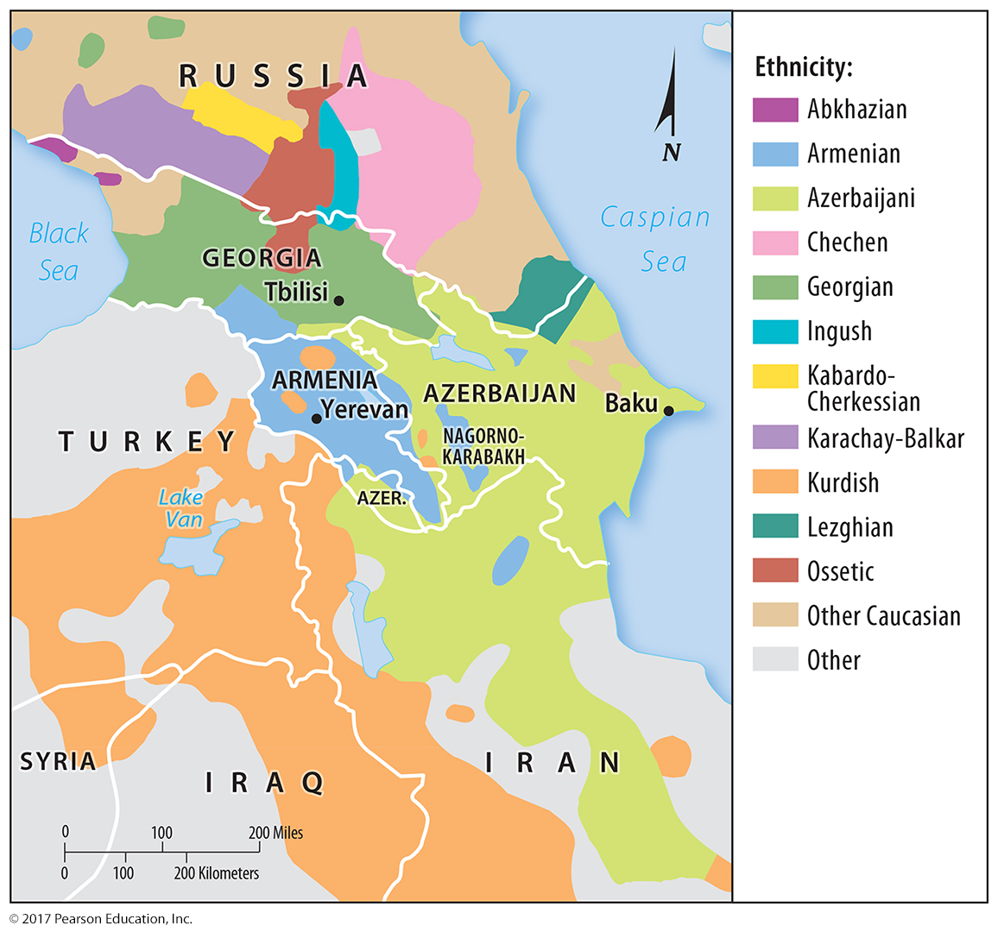
2.4 Ethnicities in the Caucasus
Figure 8-21: The Caucasus region’s three nation-states of Georgia, Armenia, and Azerbaijan also have non-majority ethnic populations that seek independence or changes to borders.

Slide 23
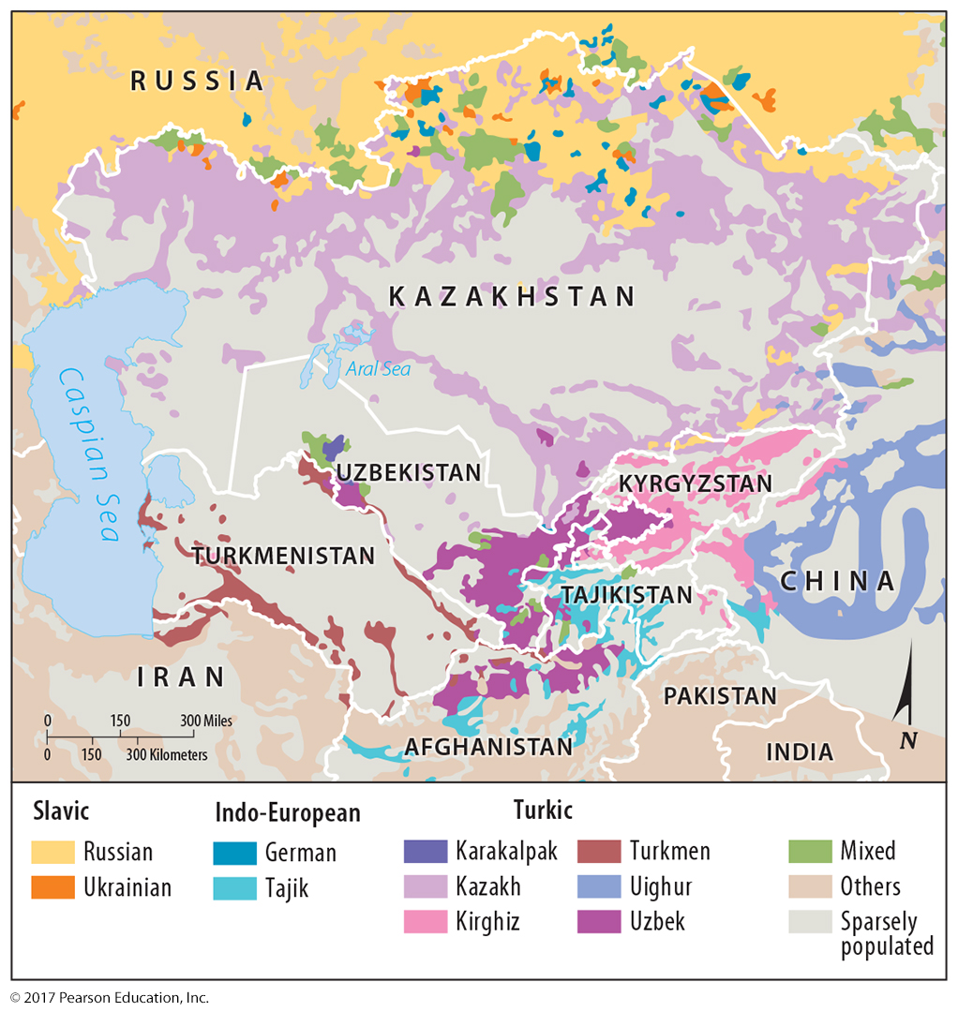
2.4 Ethnicities in Central Asia
Figure 8-22: The five states of Central Asia that were once part of the Soviet Union have experienced varying levels of conflict without correlation to ethnic diversity.

Slide 24
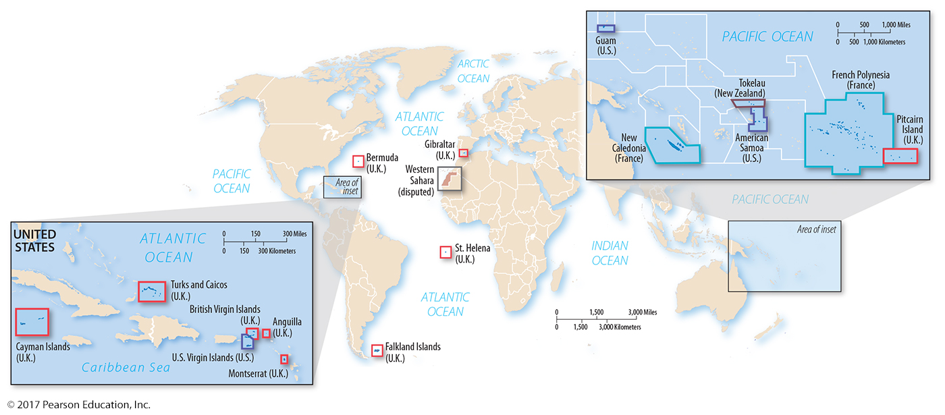
2.5 Colonies
Figure 8-23: Present-day colonies are mostly small, isolated islands or island groups.

Slide 25
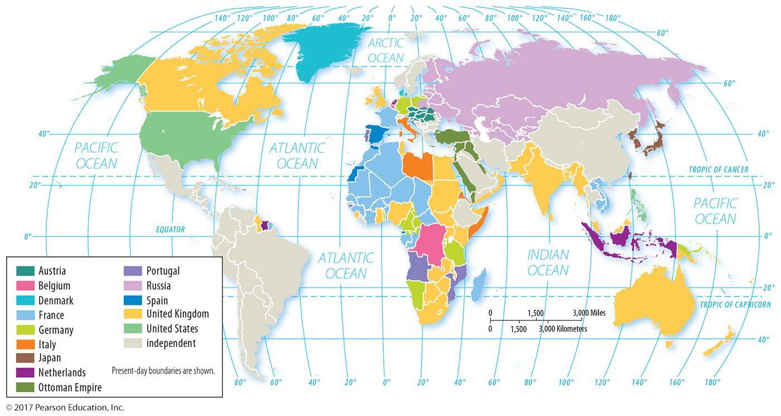
2.5 Colonies, 1914
Figure 8-24: Much of the world was in the colonial possession of European powers at the start of World War I.

Slide 26
Key Issue 3: Why Do Boundaries Cause Problems?
3.1 Cultural Boundaries
3.2 Geometric Boundaries
3.3 Physical Boundaries
3.4 Shapes of States
3.5 Governing States
3.6 Electoral Geography
3.7 Geography of Gerrymandering

Slide 27
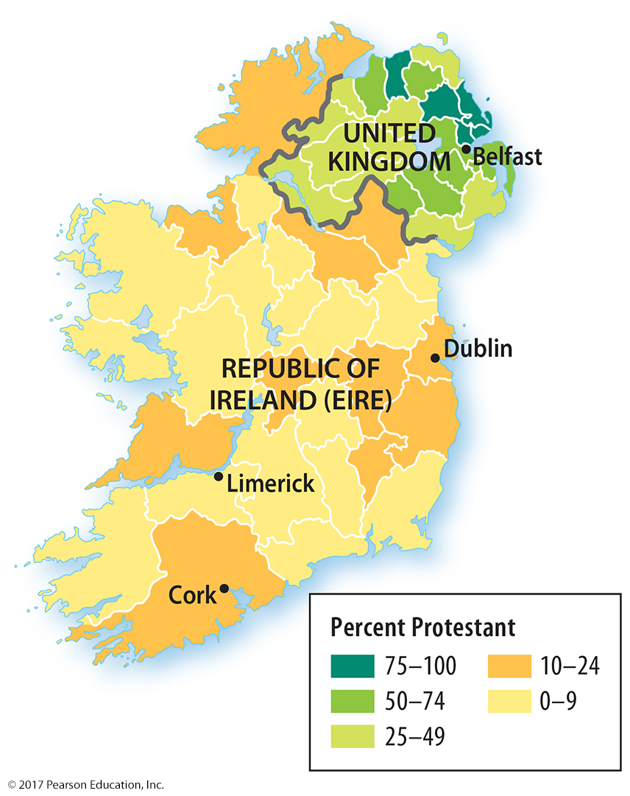
3.1 Religious Cultural Boundary: Ireland
Figure 8-26: The island of Ireland is divided between the Catholic-majority Republic of Eire and the Protestant-majority Northern Ireland, part of the United Kingdom.

Slide 28
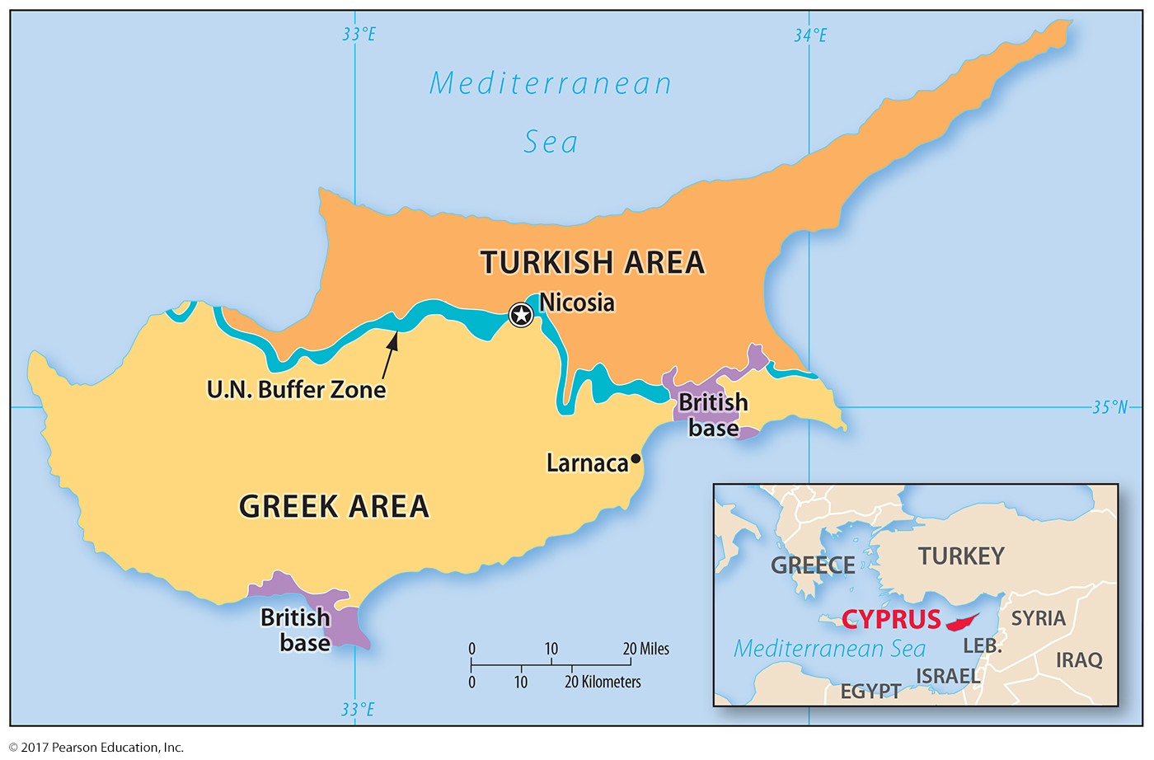
3.1 Ethnic Cultural Boundary: Cyprus
Figure 8-27: Cyprus is divided between Greek and Turkish nationalities that face difficulty in creating a unified state.

Slide 29
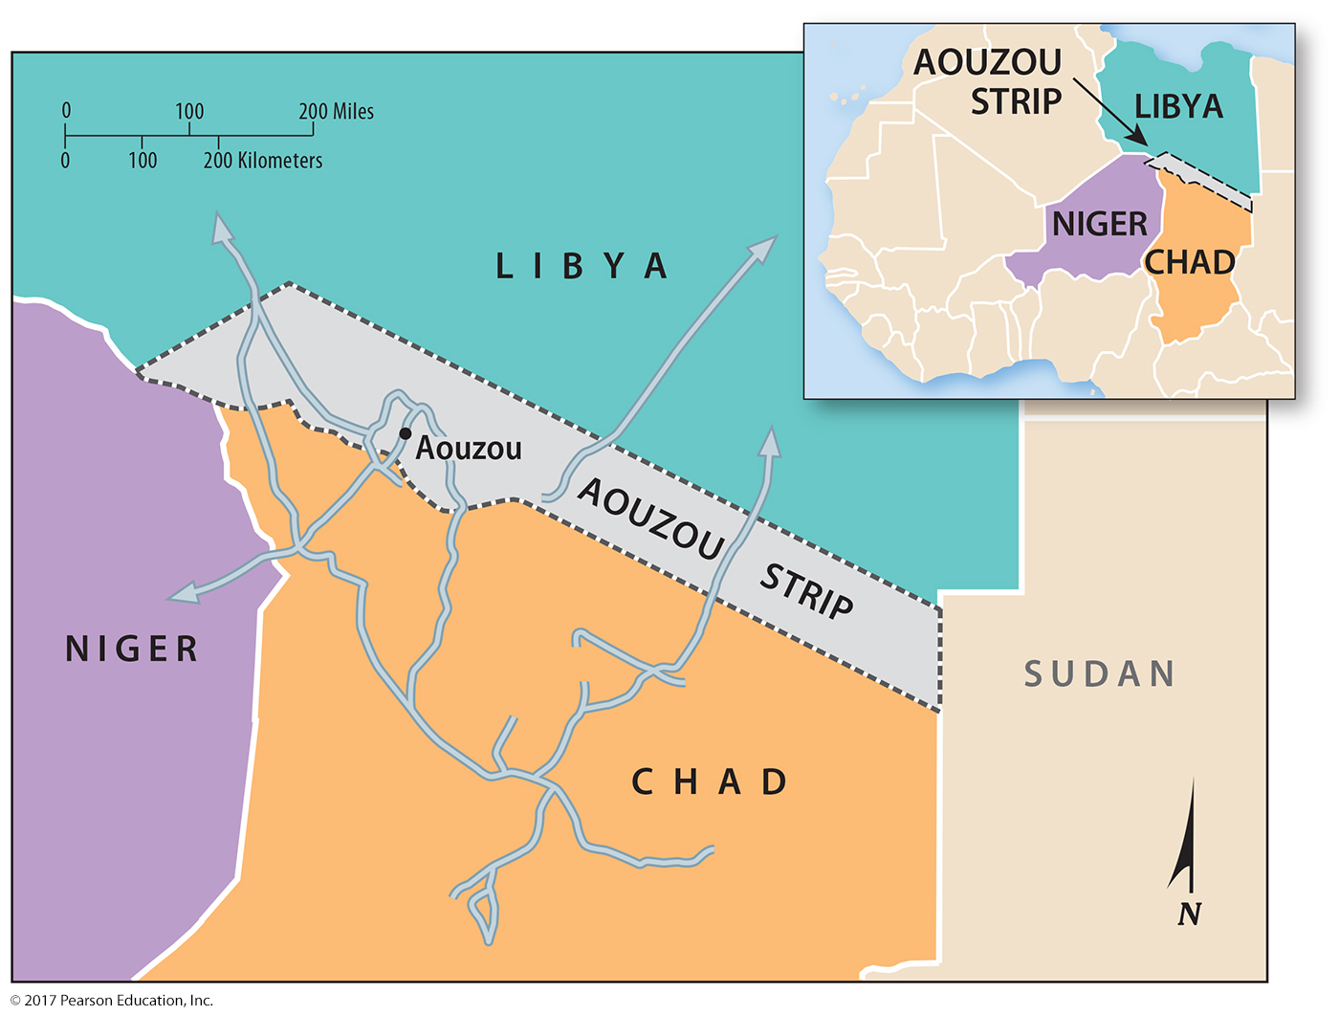
3.2 Geometric Boundary: North Africa
Figure 8-30: The Aouzou Strip is a once-disputed geometric boundary between Libya and Chad.

Slide 30
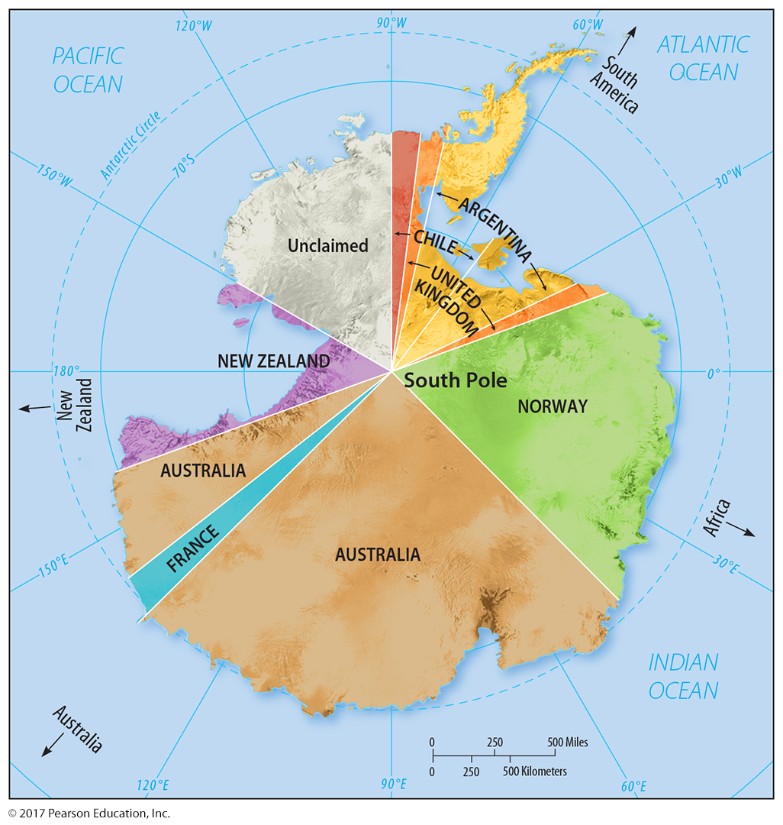
3.2 Geometric Boundary: South Pole
Figure 8-31: Signatories to the Antarctic Treaty do not recognize claims to Antarctica.

Slide 31
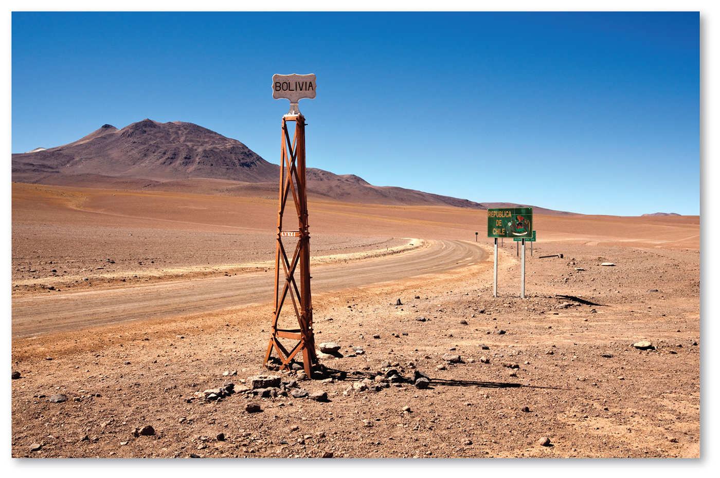
3.3 Physical Boundaries: Desert
Figure 8-33: The border between Bolivia and Chile is a largely uninhabited desert.

Slide 32
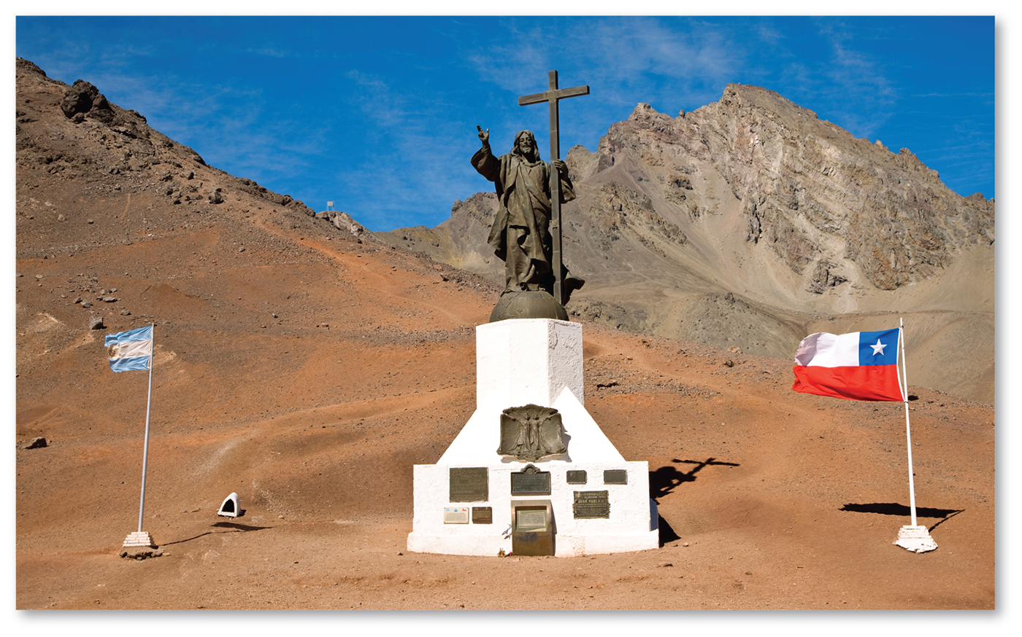
3.3 Physical Boundaries: Mountain
Figure 8-34: The Andes Mountains are the border between Argentina and Chile.

Slide 33
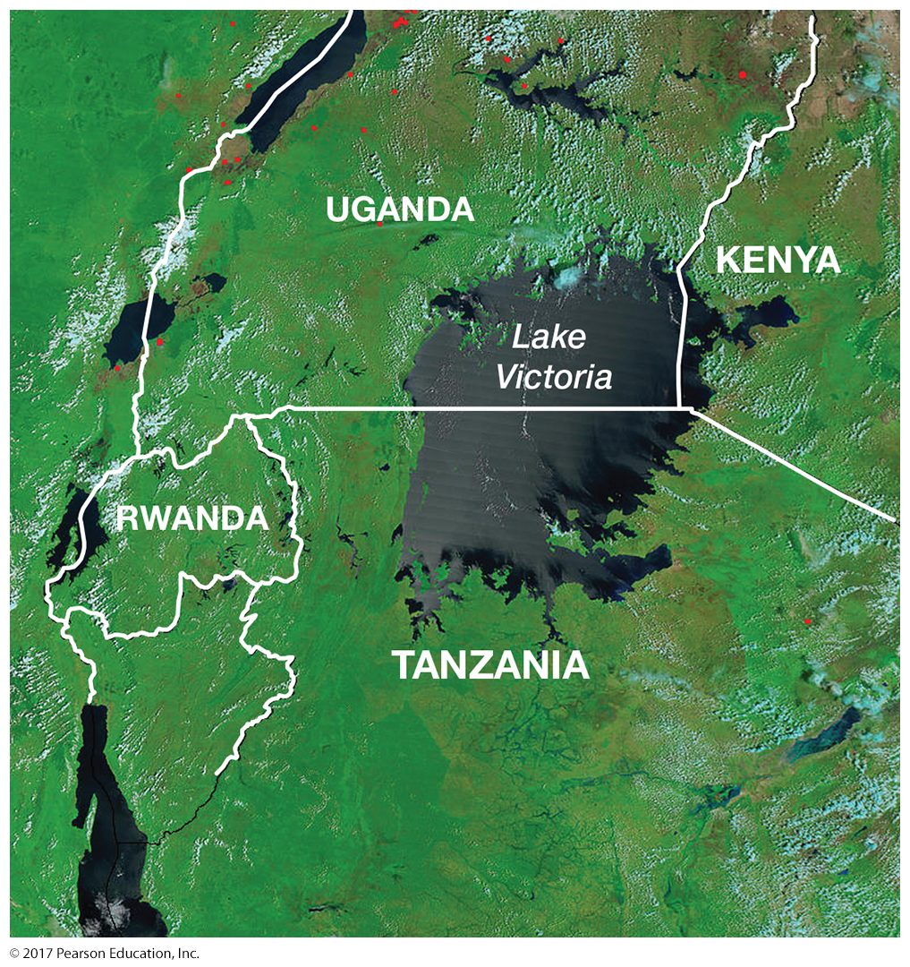
3.3 Physical Boundaries: Water
Figure 8-35: Lake Victoria is a water boundary between Uganda, Kenya, and Tanzania.

Slide 34
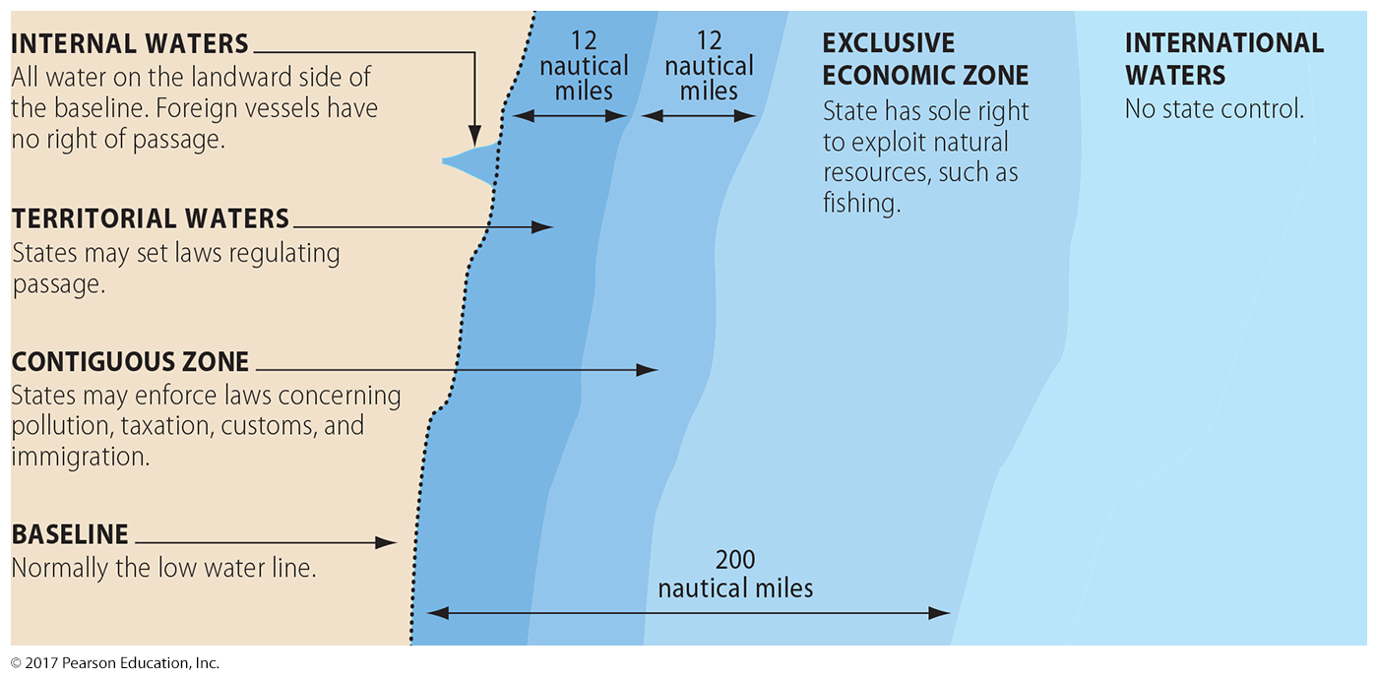
3.3 Physical Boundaries: Law of the Sea
Figure 8-36: The Law of the Sea guarantees countries different levels of control over the waters near their shores.

Slide 35
3.4 Shapes of States
Compact: efficient
Elongated: isolation
Prorupted: access or disruption
Perforated: South Africa
Fragmented: by water or another state, problematic

Slide 36
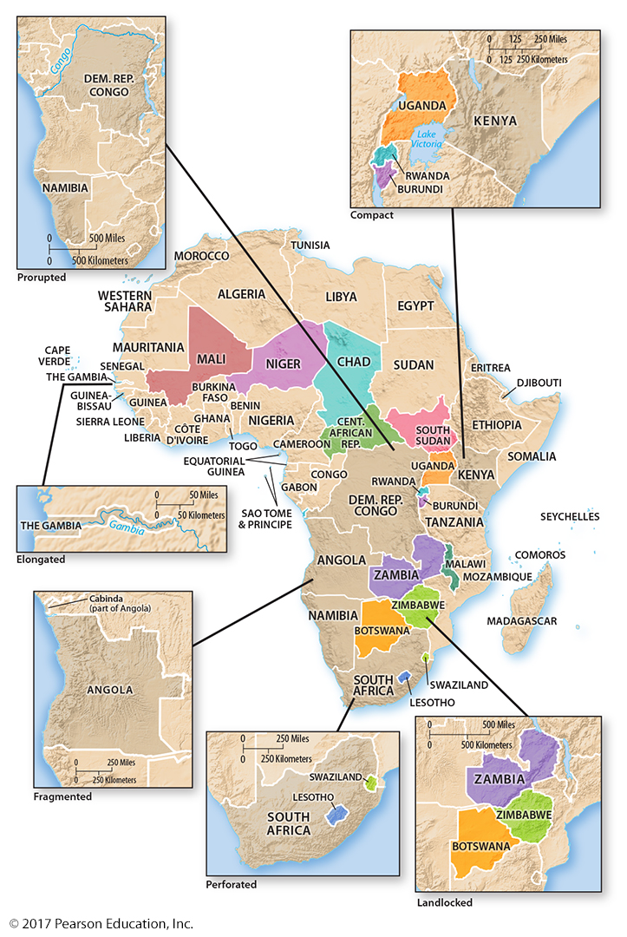
3.4 Shapes of States: Examples from Africa
Figure 8-37: All five shapes are represented by different countries in Africa. Counterclockwise from top right: Uganda, Rwanda, and Burundi are compact. Democratic Republic of Congo and Namibia have proruptions. The Gambia is elongated. Angola is fragmented (by the DRC). South Africa is perforated by Lesotho.
Countries in bright color are landlocked with no ocean boundaries.

Slide 37
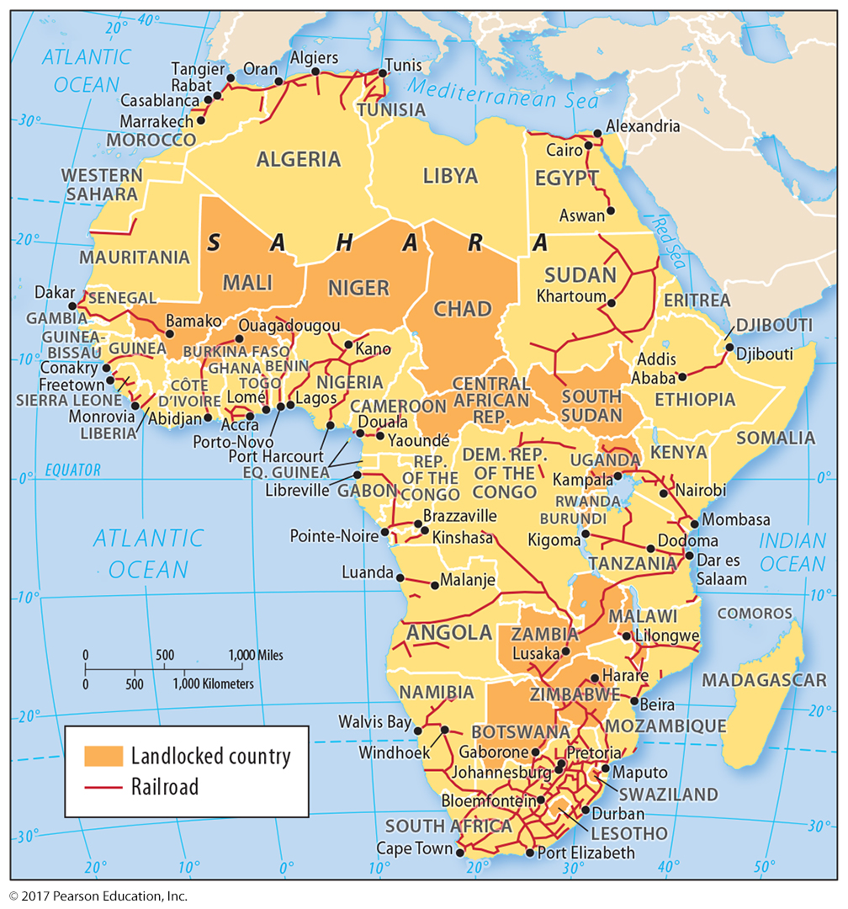
3.4 Landlocked States in Africa
Figure 8-38: Rail is the most cost-effective way to transport goods to and from landlocked states, but not all states have good access to oceanic trade.

Slide 38
3.5 Governing States
Regime types:
Democracy: citizens elect leaders
Autocracy: interest of ruler(s) dominant
Anocracy: somewhere between democracy and autocracy
Government organization:
Unitary state: strong central government
Federal state: strong local/regional governments

Slide 39
3.5 Comparing Democracy and Autocracy

Slide 40
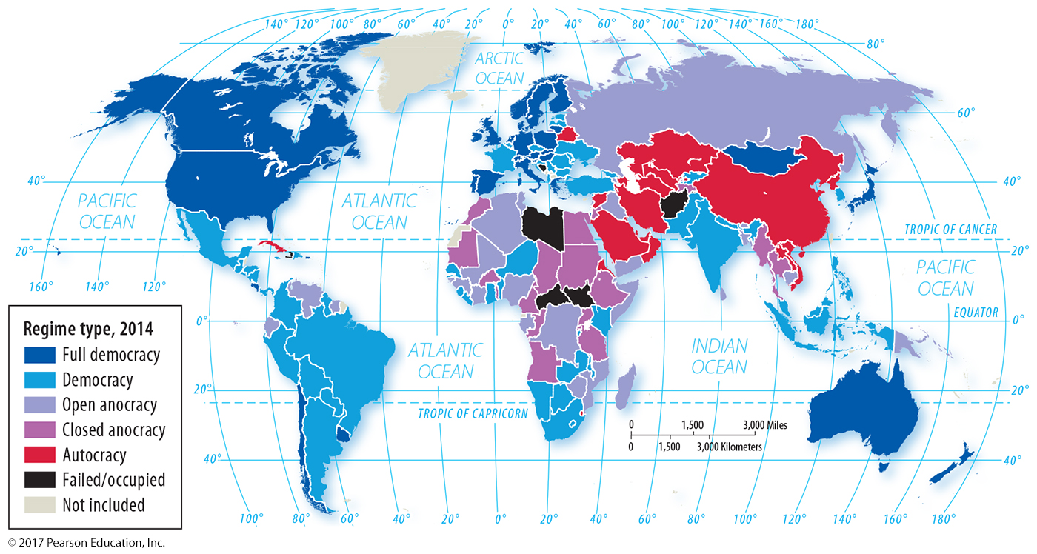
3.5 Regime Type, 2014
Figure 8-39: Governance regimes vary between full democracies and autocracies. A few countries are considered “failed states” because they effectively have no government.

Slide 41
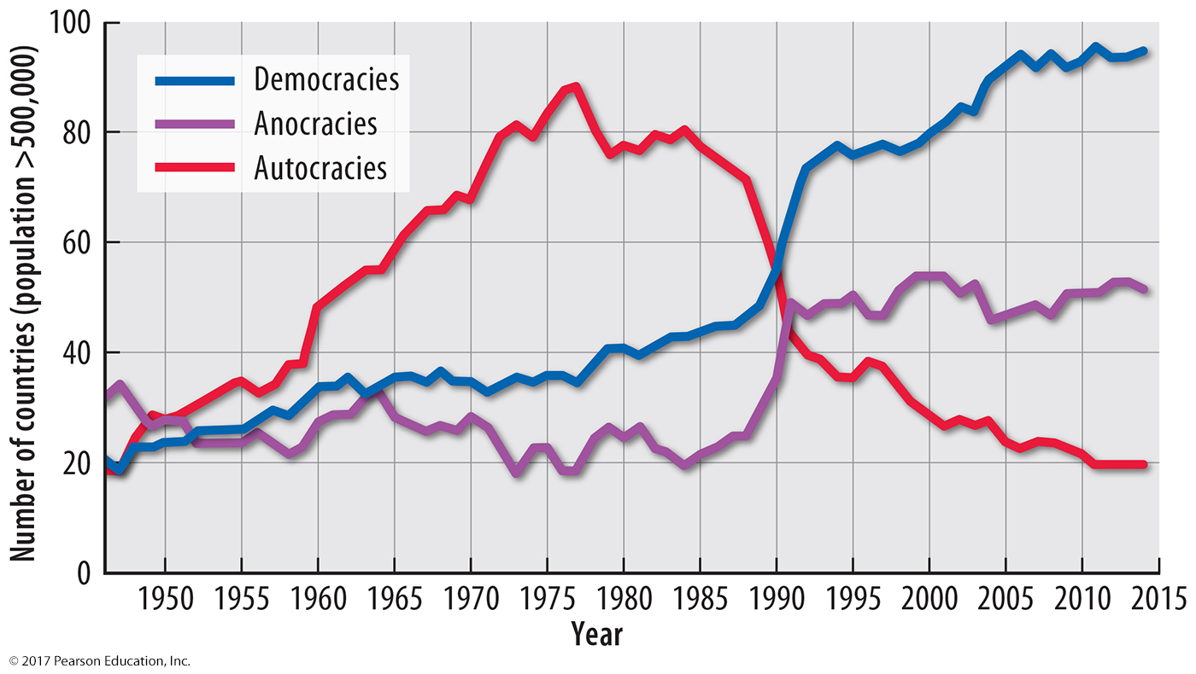
3.5 Trend Toward Democracy
Figure 8-40: Governments have become more democratic and less autocratic, especially since the 1980s.

Slide 42
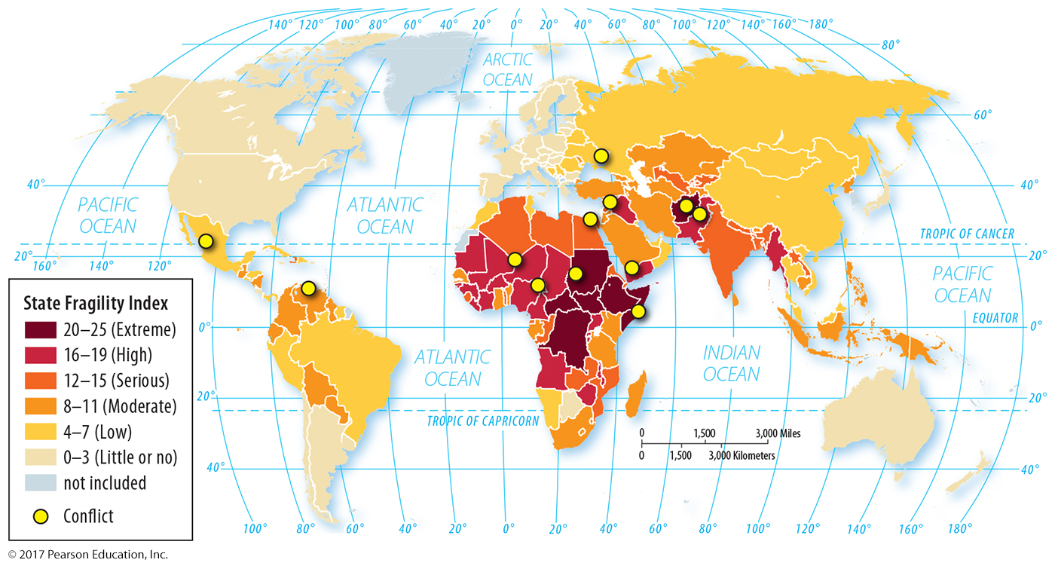
3.5 State Fragility Index
Figure 8-41: The most fragile states are clustered in Africa, especially south of the Sahara.

Slide 43
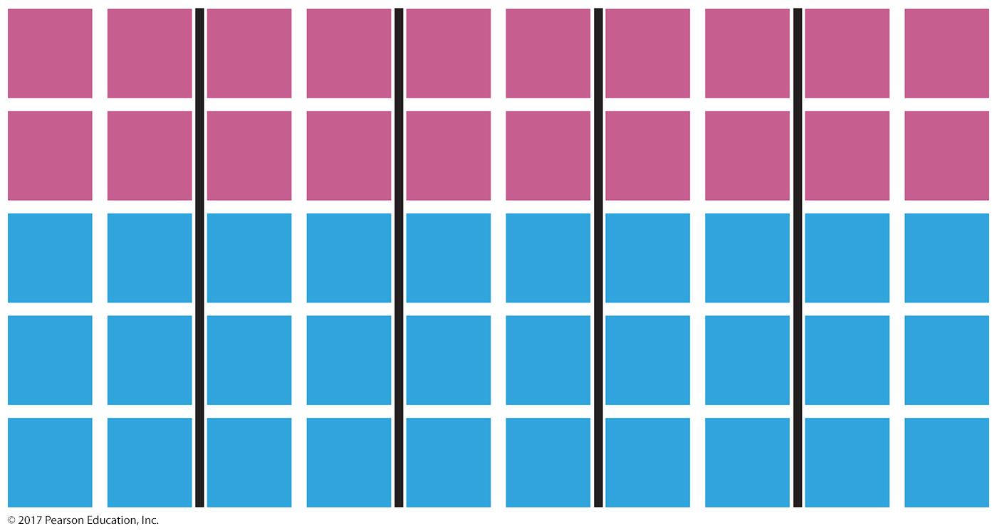
3.6 Wasted Vote Gerrymandering
Figure 8-42: All 5 districts have a slight majority of Blue Party voters (6 to 4 in each).

Slide 44
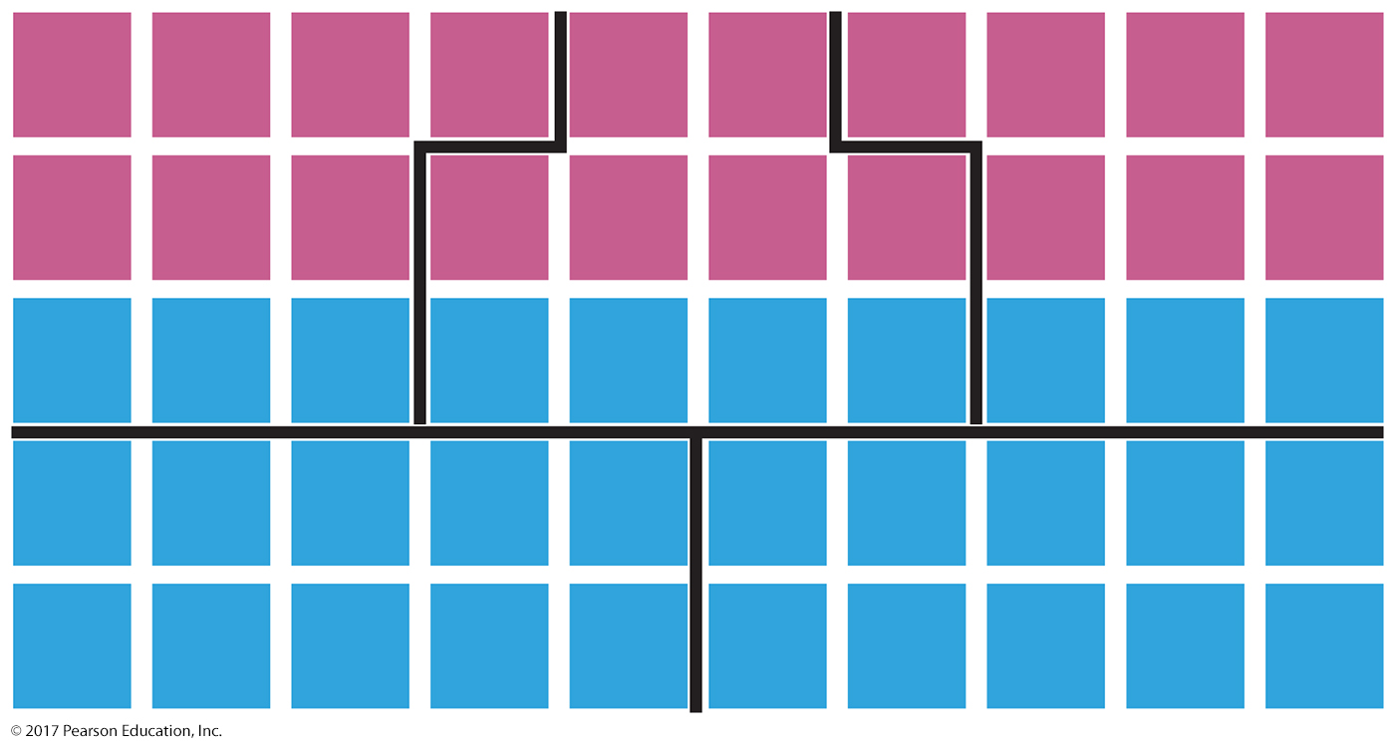
3.6 Excess Vote Gerrymandering
Figure 8-43: Even though the Red Party has fewer total voters, concentrating Blue Party voters into two districts gives the Red Party a majority in 3 of 5 districts.

Slide 45
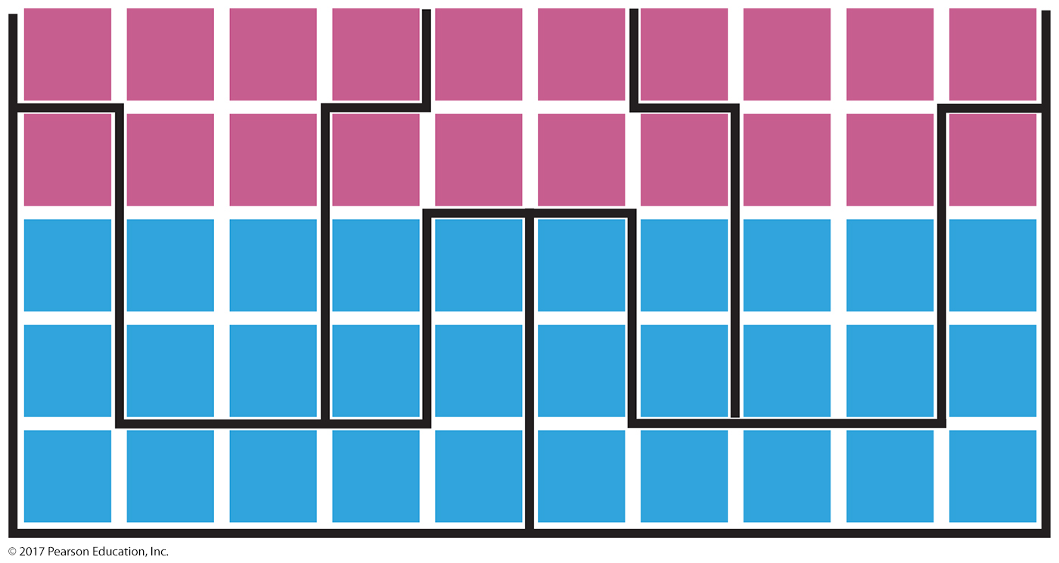
3.6 Stacked Vote Gerrymandering
Figure 8-44: Boundaries can be drawn to connect distant groups of voters, in this case giving the Red Party a majority in 3 of 5 districts despite being smaller in number than the Blue Party.

Slide 46
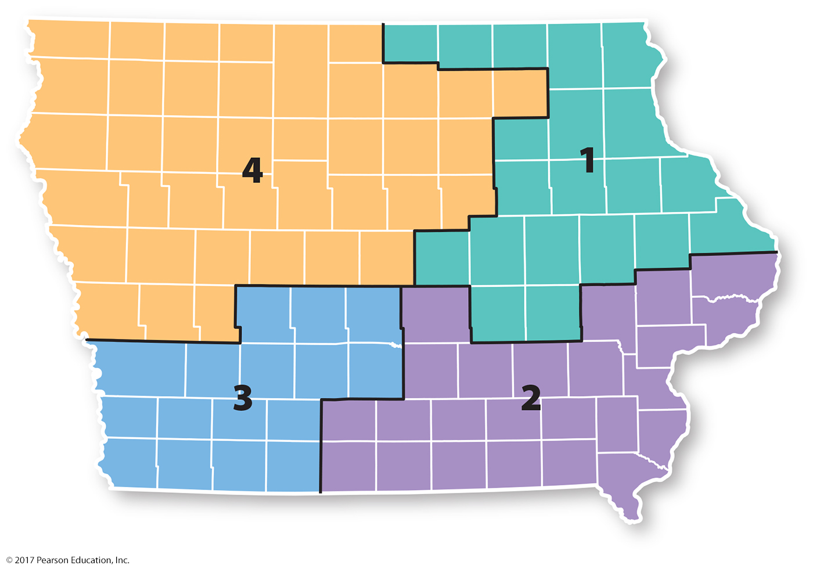
3.6 Iowa’s Congressional Districts
Figure 8-46: Iowa’s district boundaries are set by a nonpartisan commission following county boundaries.

Slide 47
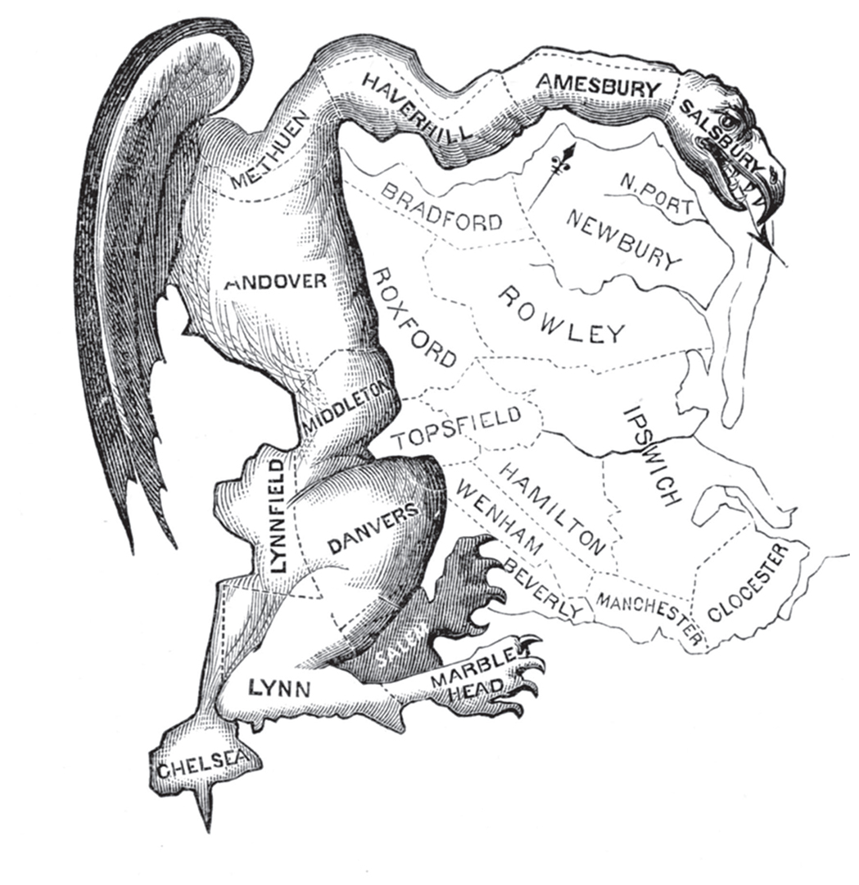
3.6 Origin of Gerrymander Term
Figure 8-47: A political cartoon lampooned the odd shape of an electoral district in Massachusetts after Governor Elbridge Gerry approved oddly-shaped districts in a stacked vote strategy.

Slide 48
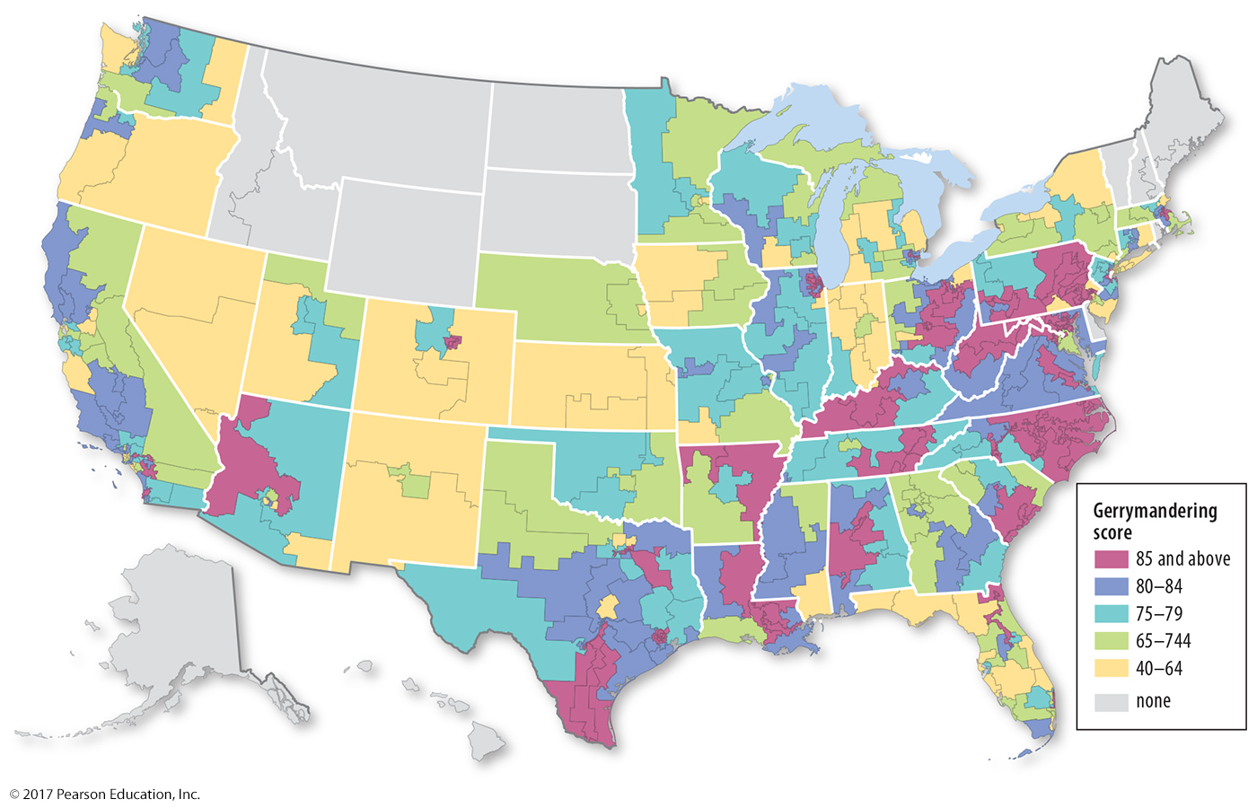
3.7 Geography of Gerrymandering
Figure 8-48: The Washington Post estimated the amount of gerrymandering in a district’s shape; more compact districts have lower scores.

Slide 49
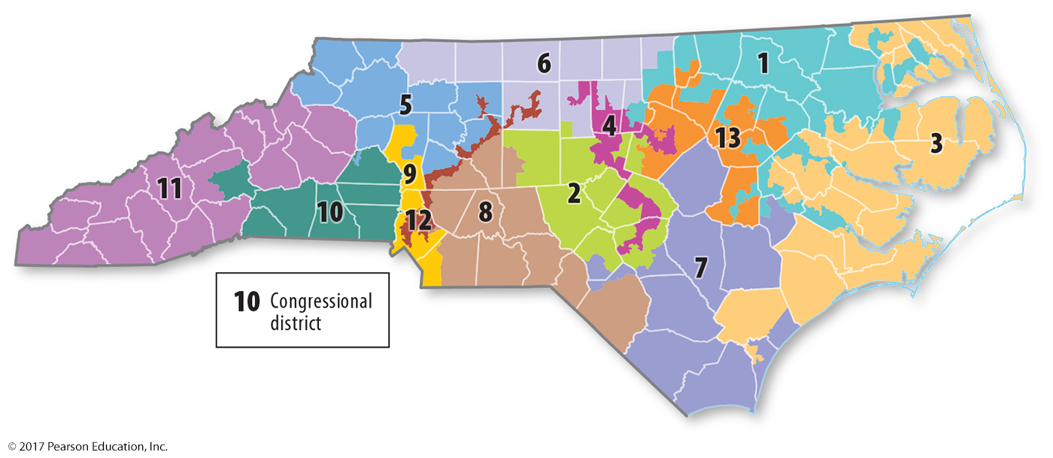
3.7 Geography of Gerrymandering
Figure 8-49: North Carolina has many congressional districts with oddly shaped boundaries.

Slide 50
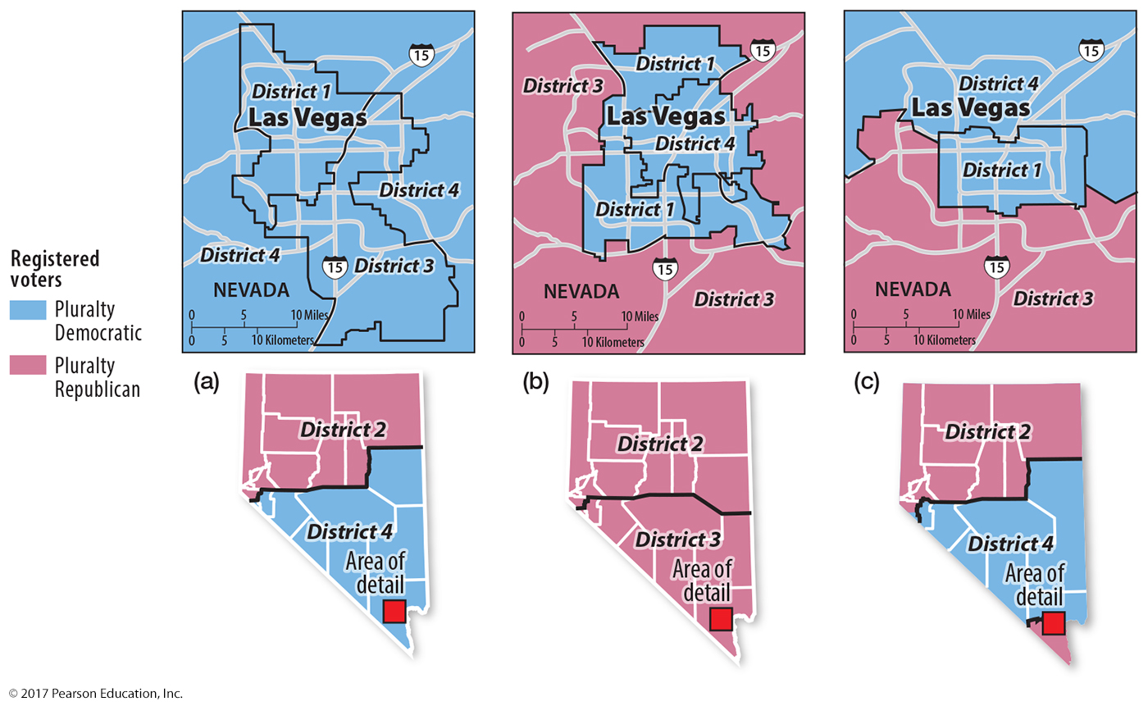
3.7 Redistricting Nevada
Figure 8-50: Nevada’s new congressional district boundaries as proposed by: (a) Democrats, in a wasted vote and stacked vote strategy; (b) Republicans, in an excess vote and stacked vote strategy; and (c) the nonpartisan decision by the court.

Slide 51
Key Issue 4: Where Do States Face Threats?
4.1 Global Cooperation and Competition
4.2 Competition and Cooperation in Europe
4.3 Terrorist Attacks Against the United States
4.4 Terrorist Organizations
4.5 State Support for Terrorism

Slide 52
4.1 Global Cooperation and Competition
United Nations
Important forum of global cooperation
Membership has grown dramatically
Forum for United States and Soviet Union to negotiate during Cold War

Slide 53
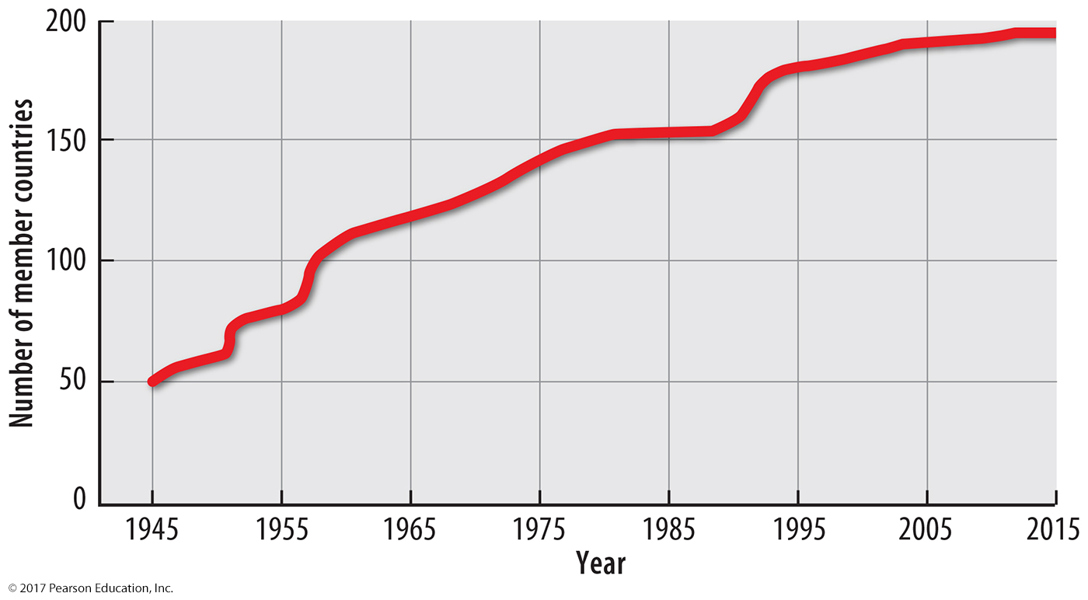
4.1 Growth in UN Membership
Figure 8-51: The UN reached 193 members in 2011.

Slide 54
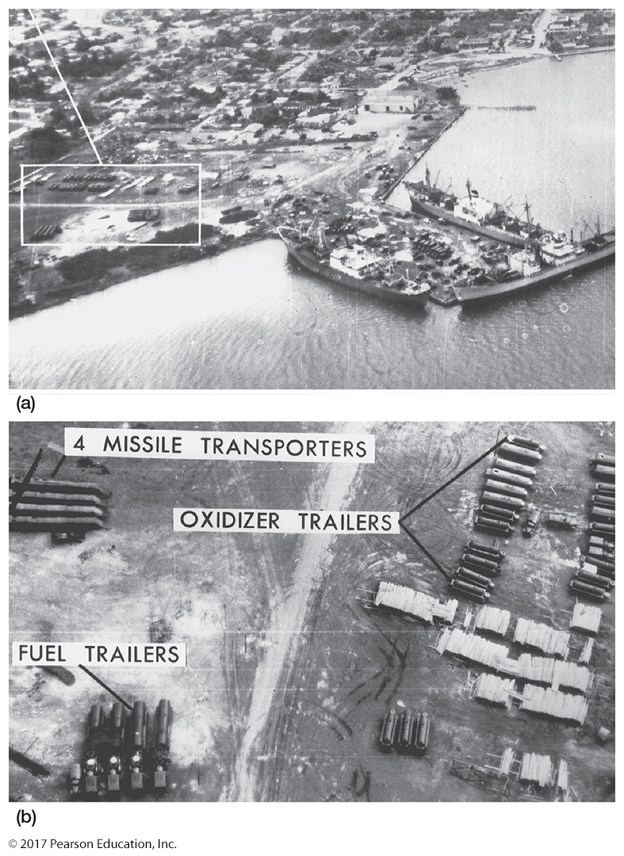
4.1 Cuban Missile Crisis
Figure 8-53: At the United Nations, the United States presented aerial photographic evidence of the Soviet Union threatening the balance of power. (a) Soviet ships unloading and (b) staging missiles in Cuba, threatening the United States.

Slide 55
4.2 Competition and Cooperation in Europe
Cold War Military Alliances:
North Atlantic Treaty Organization (NATO)
Warsaw Pact
Cold War Economic Alliances:
European Union (EU)
Council for Mutual Economic Assistance (COMECON)
NATO and EU expanded after Cold War.

Slide 56
4.2 Cooperation in Other Regions
Organization for Security and Cooperation in Europe (OSCE)
Organization of American States (OAS)
African Union (AU)
Commonwealth

Slide 57
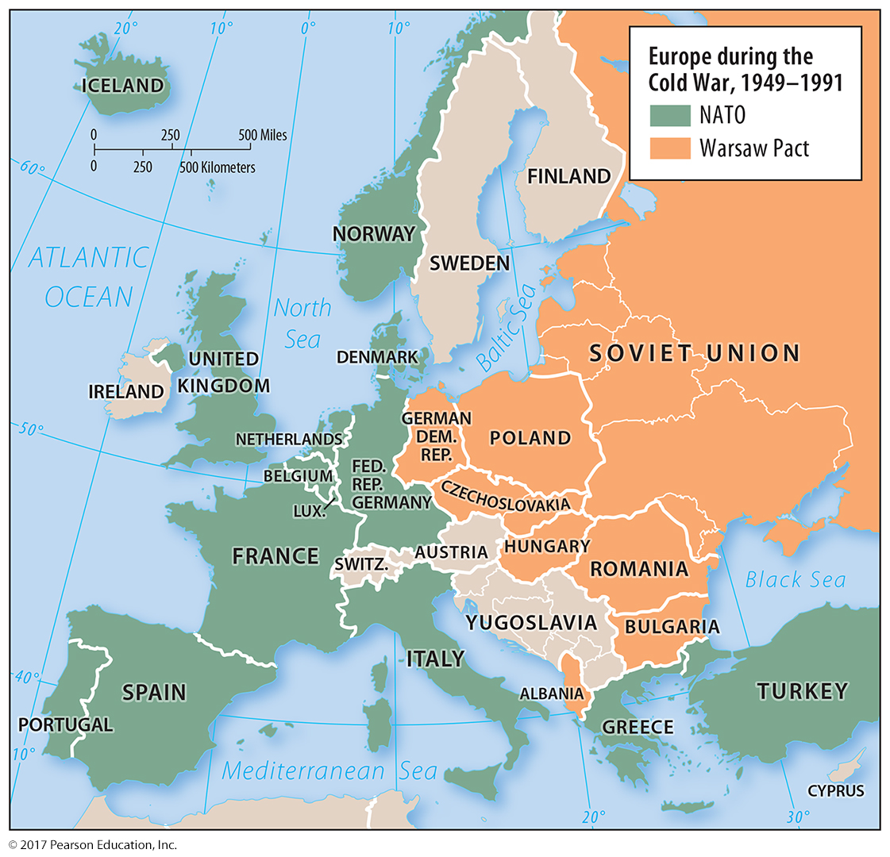
4.2 NATO and Warsaw Pact, 1949–1991
Figure 8-54: NATO and the Warsaw Pact represented the balance of power between the United States and the Soviet Union.

Slide 58
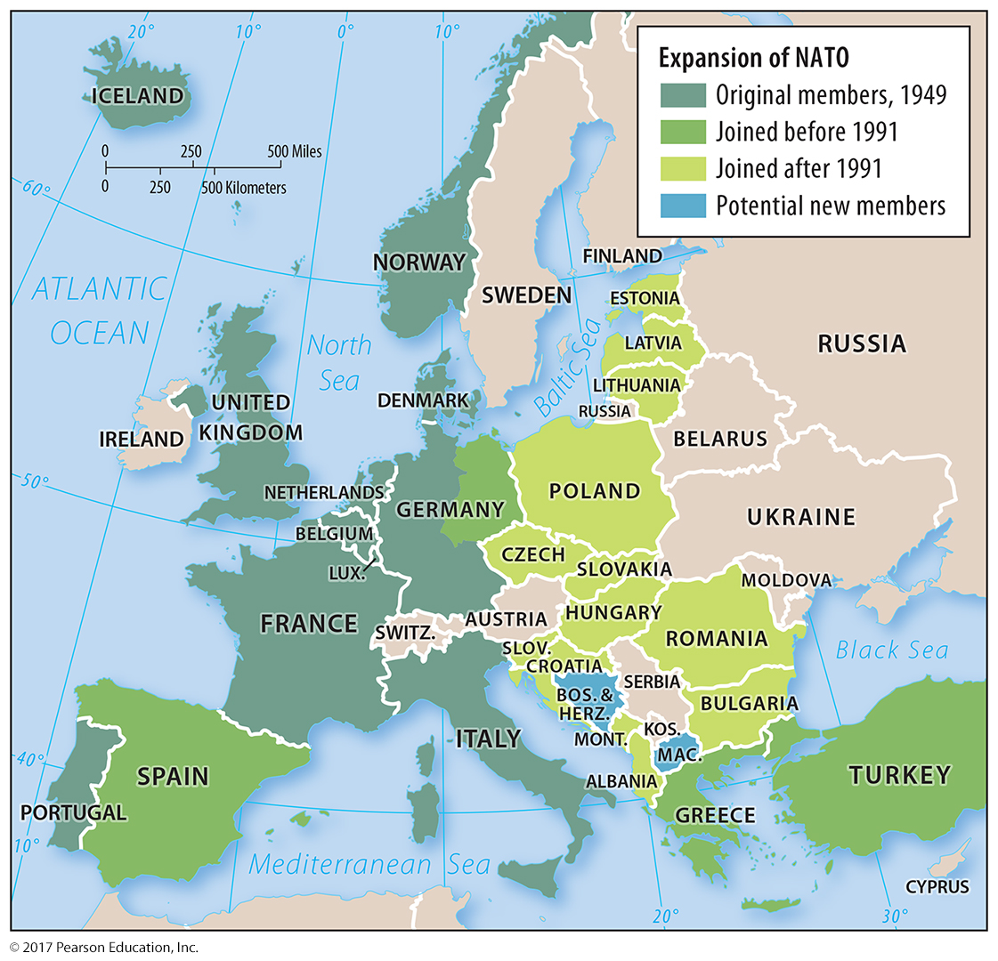
4.2 NATO Post–Cold War
Figure 8-55: NATO has expanded to most Warsaw Pact countries.

Slide 59
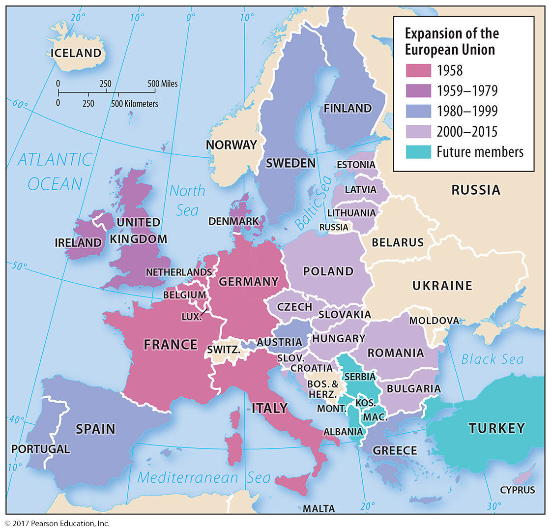
4.2 European Union
Figure 8-56: The European Union has most recently expanded to the east.

Slide 60
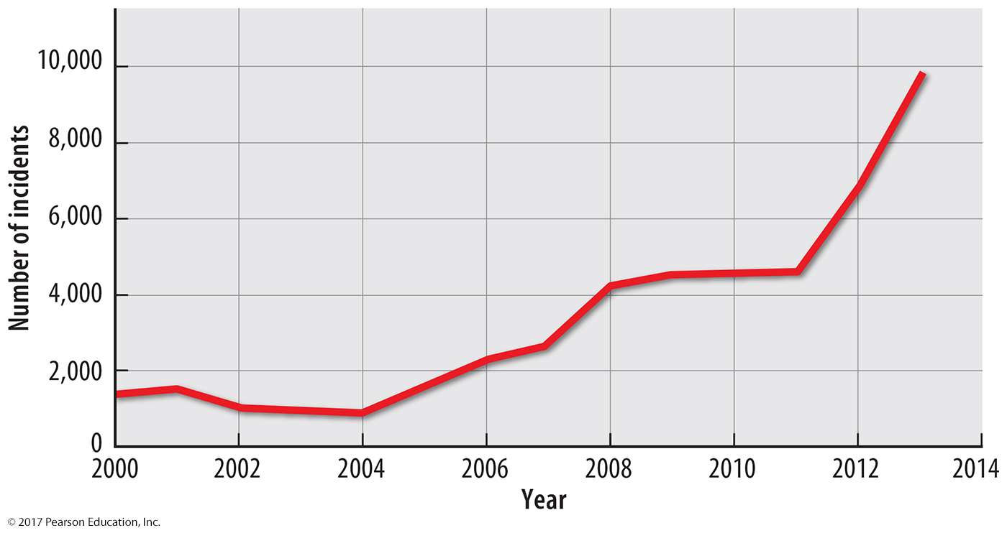
4.3 International Terrorist Attacks
Figure 8-57: The number of terrorist attacks has increased in the last decade, especially in Iraq, Afghanistan, Pakistan, Nigeria, and Syria.

Slide 61
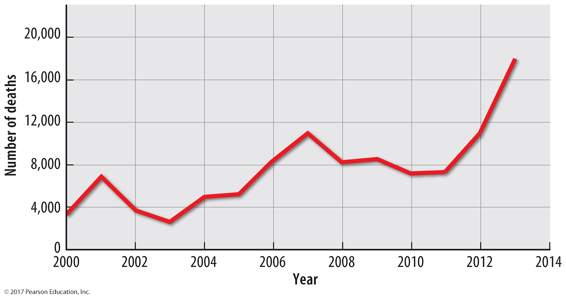
4.3 Deaths from International Terrorism
Figure 8-58: The number of deaths from terrorist attacks has also increased in the last decade, especially in Iraq, Afghanistan, Pakistan, Nigeria, and Syria.

Slide 62
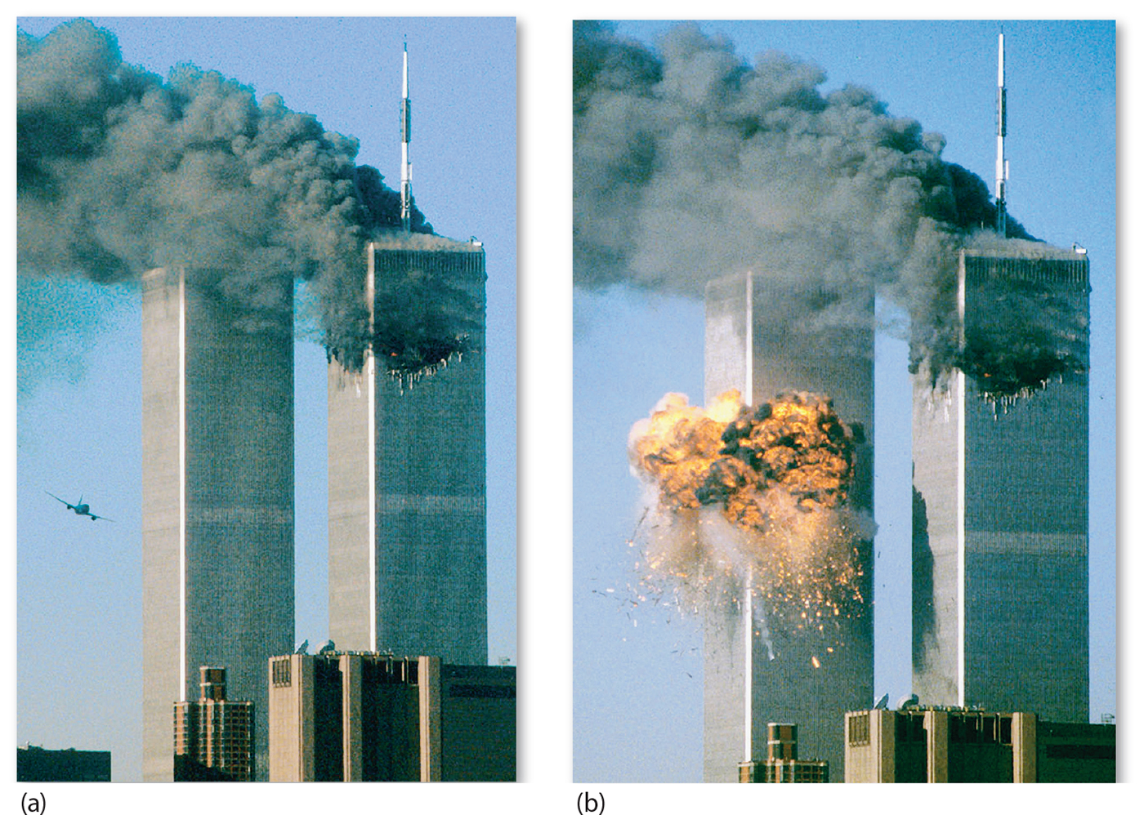
4.3 September 11, 2001, Terrorism
Figure 8-60: The attacks of September 11, 2001, were the most dramatic and deadly attacks on Americans.

Slide 63
4.4 Terrorist Organizations
Al-Qaeda
Founded by Osama bin Laden
Several attacks against U.S., including 9/11
Islamic State (ISIS/ISIL)
Branched from Al-Qaeda
Controls territory in Iraq and Syria
Boko Haram
Northern Nigeria
Allied with Islamic State

Slide 64
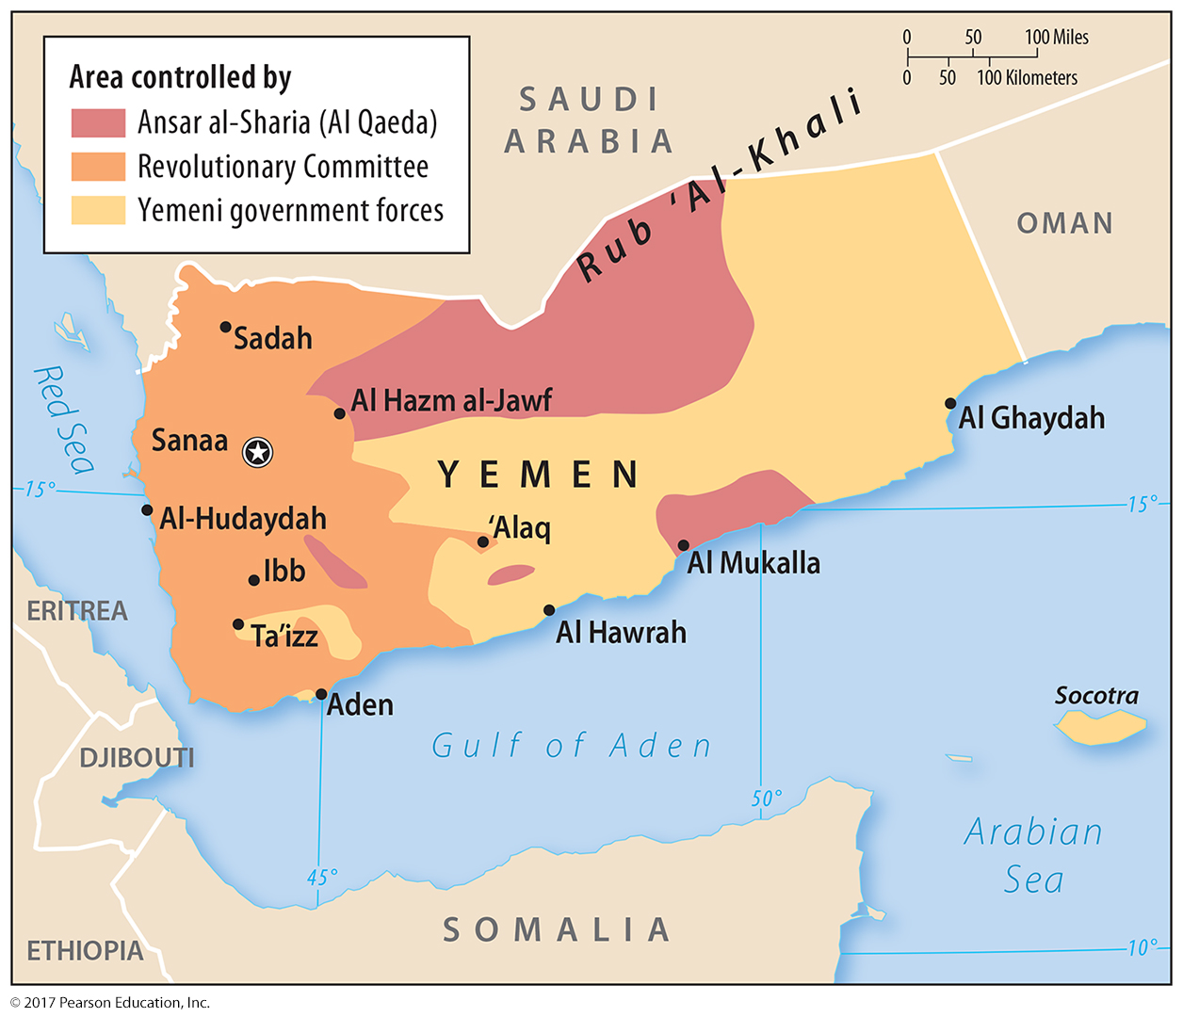
4.4 Al-Qaeda in Yemen
Figure 8-61: A branch of Al-Qaeda controls parts of Yemen in a complex civil war there.

Slide 65
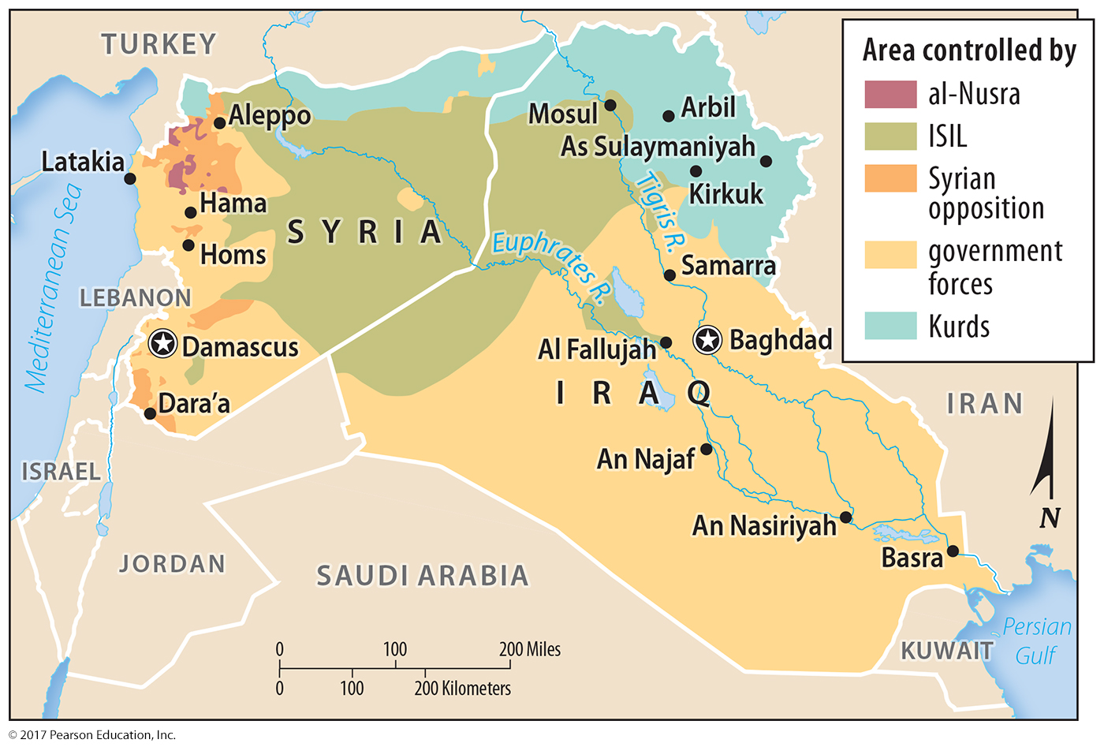
4.4 Islamic State
Figure 8-64: The Islamic State controls much of eastern Syria and portions of western Iraq.

Slide 66
4.5 State Support for Terrorism
States may support terrorism:
Sanctuary for terrorists: Pakistan
Supplying terrorists: Iraq and Iran
Sponsoring terror attacks: Libya

Slide 67
4.5 Osama bin Laden’s Compound
Figure 8-65: Osama bin Laden lived in this compound in Abbottabad, Pakistan for many years, only 6 km (4 mi) from the Pakistan Military Academy.

Slide 68
4.5 Iran’s Nuclear Facilities
Figure 8-67: Iran has insisted on its right to develop nuclear power, but several countries including the United States are concerned the program includes building nuclear weapons.

Slide 69
Chapter 8 End

