Slide 1
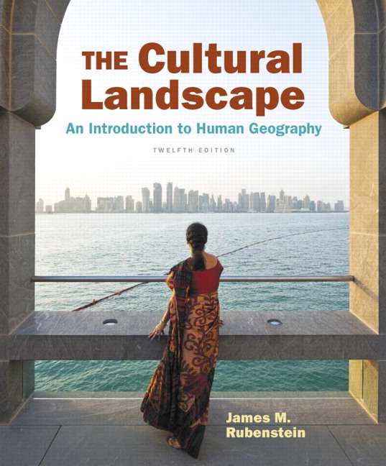
Chapter 7 Lecture
Chapter 7
Ethnicities
Tim Scharks Green River College

Slide 2
Ethnicities: Key Issues
Where Are Ethnicities Distributed?
Why Do Ethnicities Have Distinctive Distributions?
Why Might Ethnicities Face Conflicts?
Why Do Ethnic Cleansing and Genocide Occur?

Slide 3
Key Issue 1: Where Are Ethnicities Distributed?
1.1 Introducing Ethnicities
1.2 Ethnicity and Race
1.3 Distribution of U.S. Ethnicities
1.4 Ethnic Enclaves
1.5 Ethnically Complex Brazil

Slide 4
1.1 Introducing Ethnicities
Ethnicity: identity with group sharing cultural traditions of homeland or hearth
Race: identity with group perceived to share physiological (biological) trait like skin color
Nationality: identity with group sharing legal attachment to a country

Slide 5
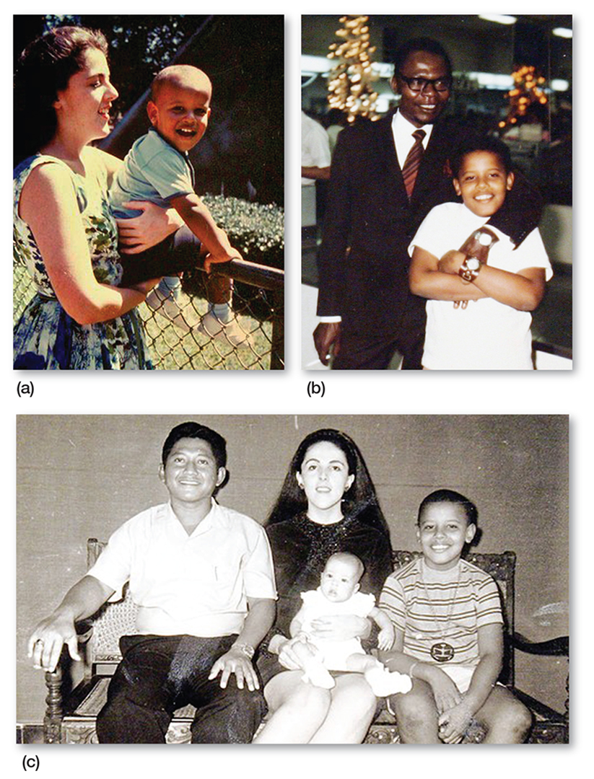
1.1 Ethnic Diversity
Figure 7-1: Barack Obama’s family illustrates the complexity of race, ethnicity, and nationality.

Slide 6
1.1 Ethnicities in the United States
Hispanic American: 17%
African American: 12%
Asian American: 5%

Slide 7
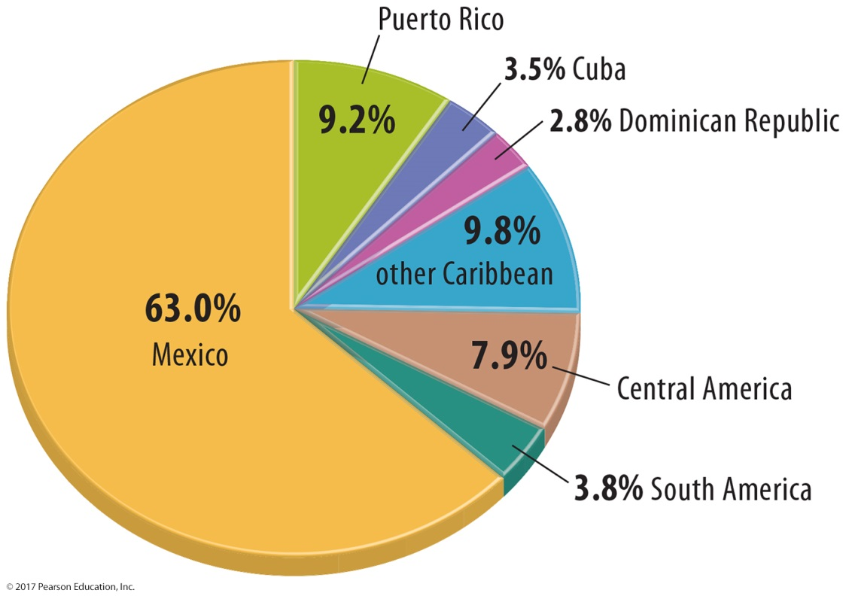
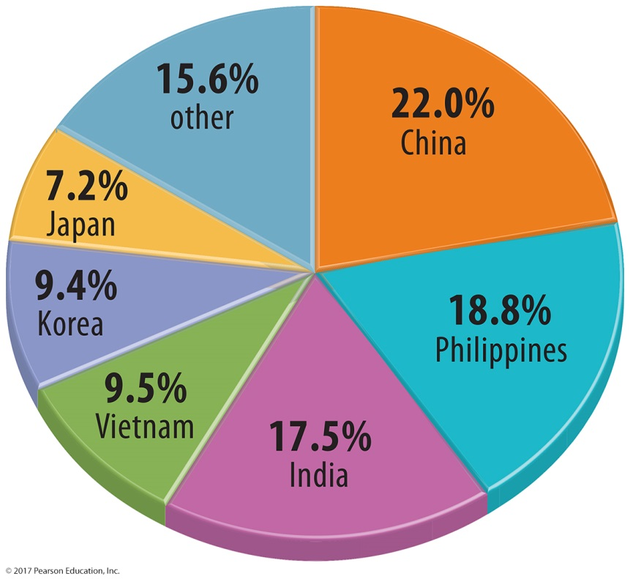
1.1 Ethnicities in the United States
Figures 7-2 and 7-3: Country of origin for Hispanic Americans (left) and Asian Americans (right).

Slide 8
1.2 Race and Ethnicity in the United States
The U.S. Census reflects complicated nature of racial and ethnic identity.
Questions include both racial and ethnic terms. E.g. “Black” and “Japanese”

Slide 9
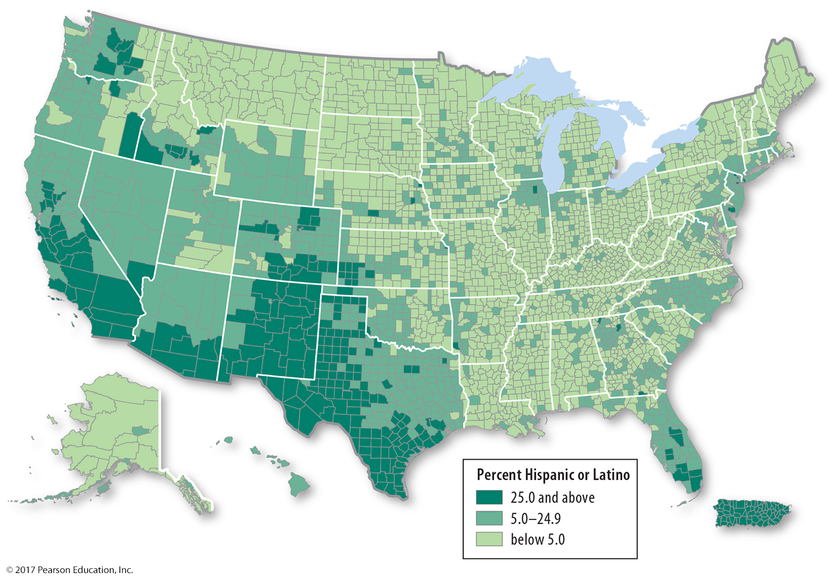
1.3 Distribution of U.S. Ethnicities
Figure 7-6: Hispanics are clustered in the Southwest.

Slide 10
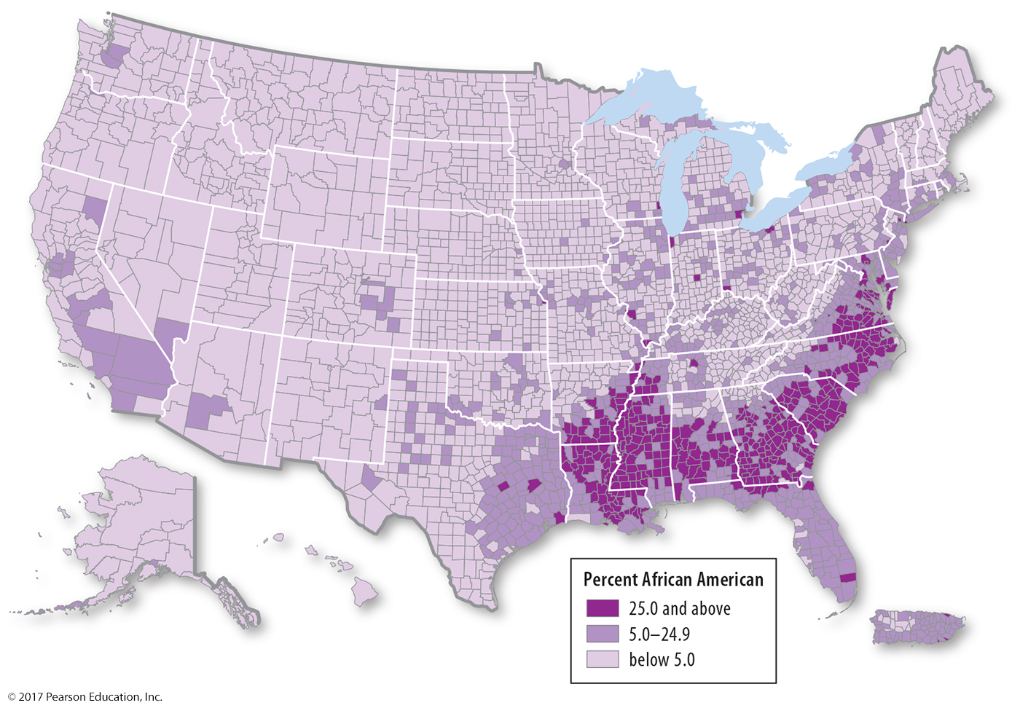
1.3 Distribution of U.S. Ethnicities
Figure 7-7: African Americans are clustered in the Southeast.

Slide 11
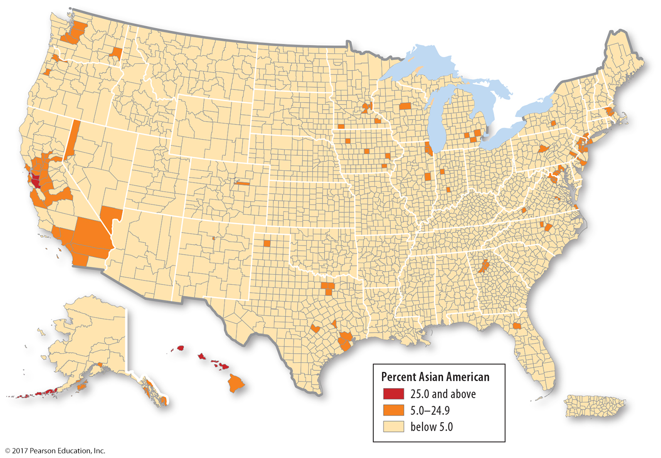
1.3 Distribution of U.S. Ethnicities
Figure 7-8: Asian Americans are clustered in the West.

Slide 12
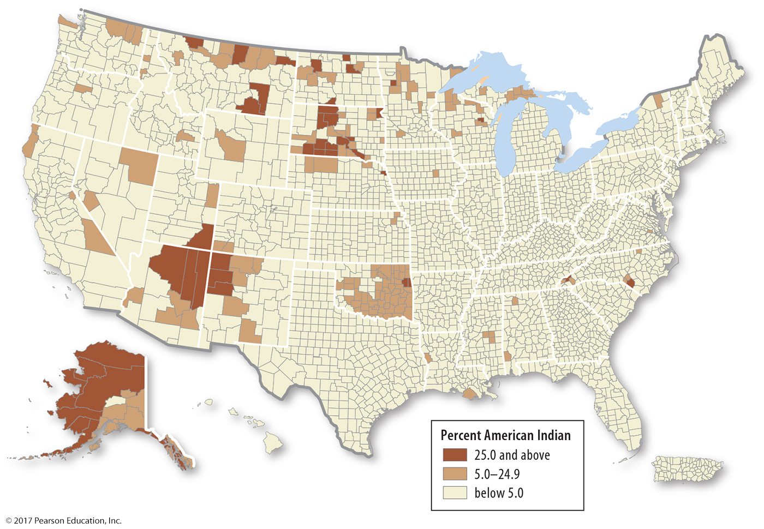
1.3 Distribution of U.S. Ethnicities
Figure 7-9: Native Americans are clustered in the Southwest and north-central states.

Slide 13
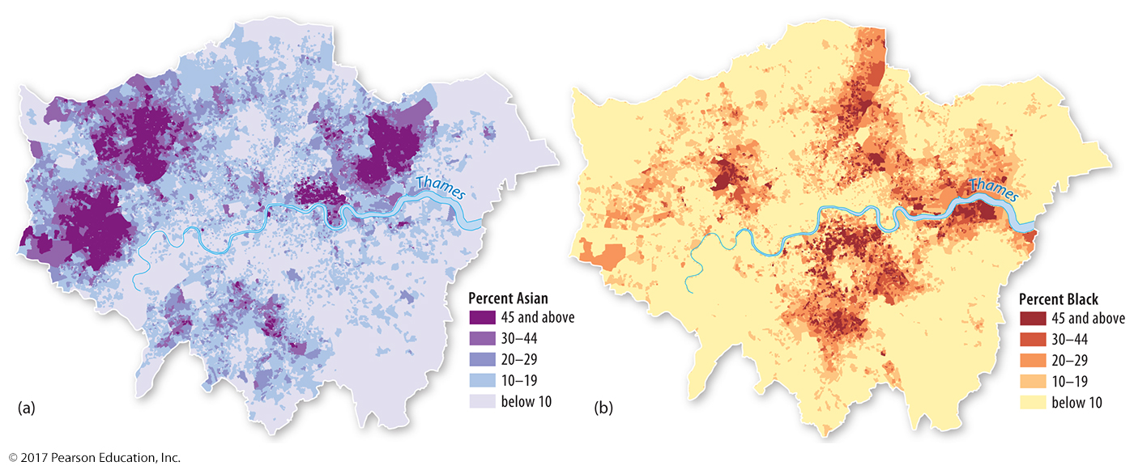
1.4 Ethnic Enclaves in London
Figure 7-11: These maps show Asian enclaves (left) and Black enclaves (right) in London.

Slide 14
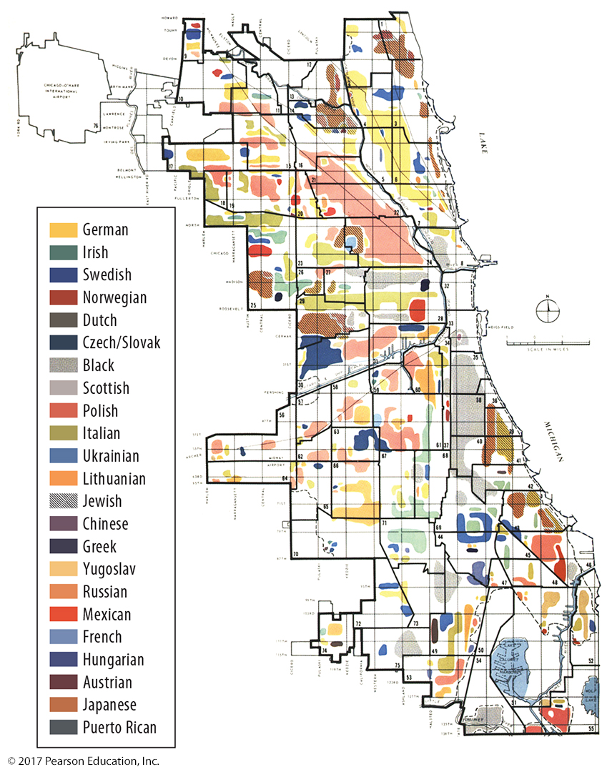
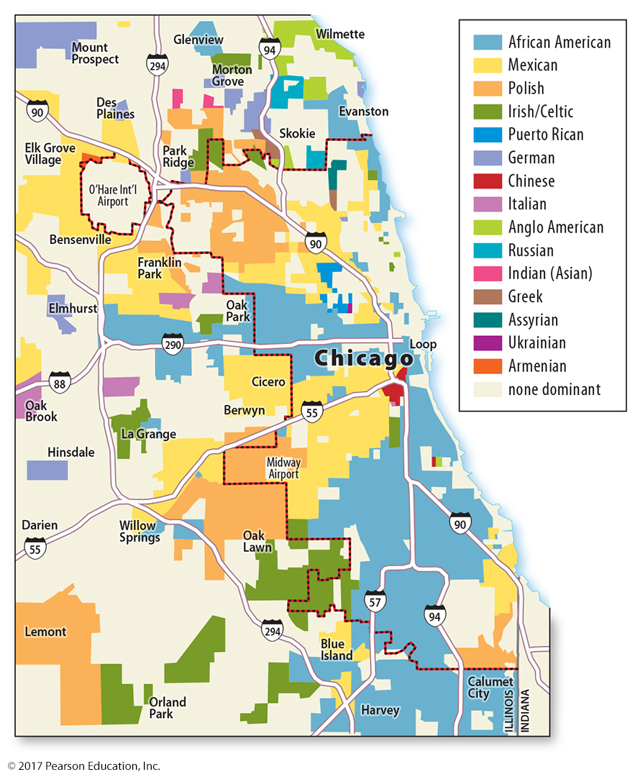
1.4 Ethnic Enclaves in Chicago
Figures 7-13 and 7-12: Ethnic enclaves in Chicago in 1950 (left) were largely European; by 2000 (right), there were increasing numbers of African American, Asian, and Hispanic ethnicities.

Slide 15
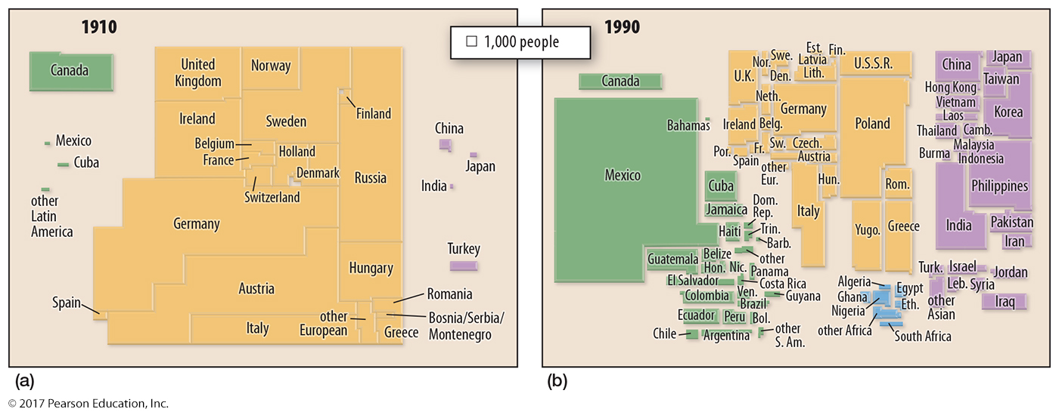
1.4 Ethnic Enclaves in Chicago
Figure 7-14: Cartograms reveal the changes in Chicago’s ethnic groups from 1910 to 1990 (compare to Figures 7-12 and 7-13).

Slide 16
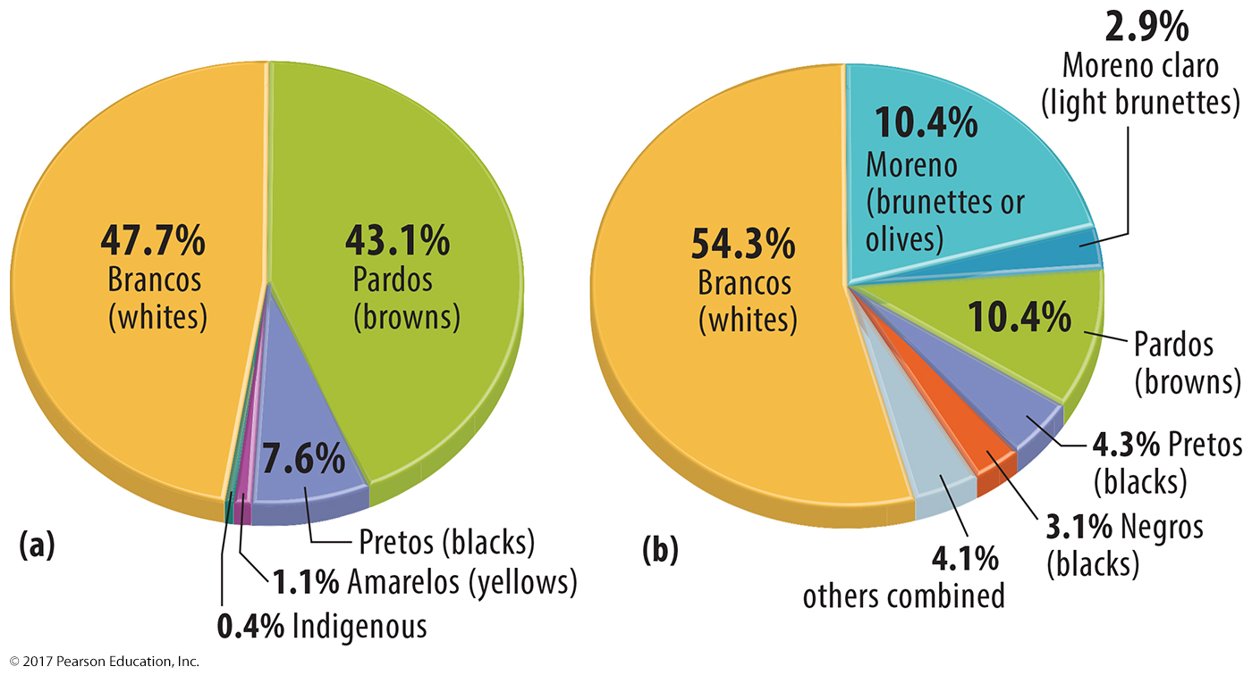
1.5 Ethnically Complex Brazil
Figure 7-15: The Brazilian census, which limits the choice of race categories (left), differs from an independent survey where respondents could write their own race in (right).

Slide 17
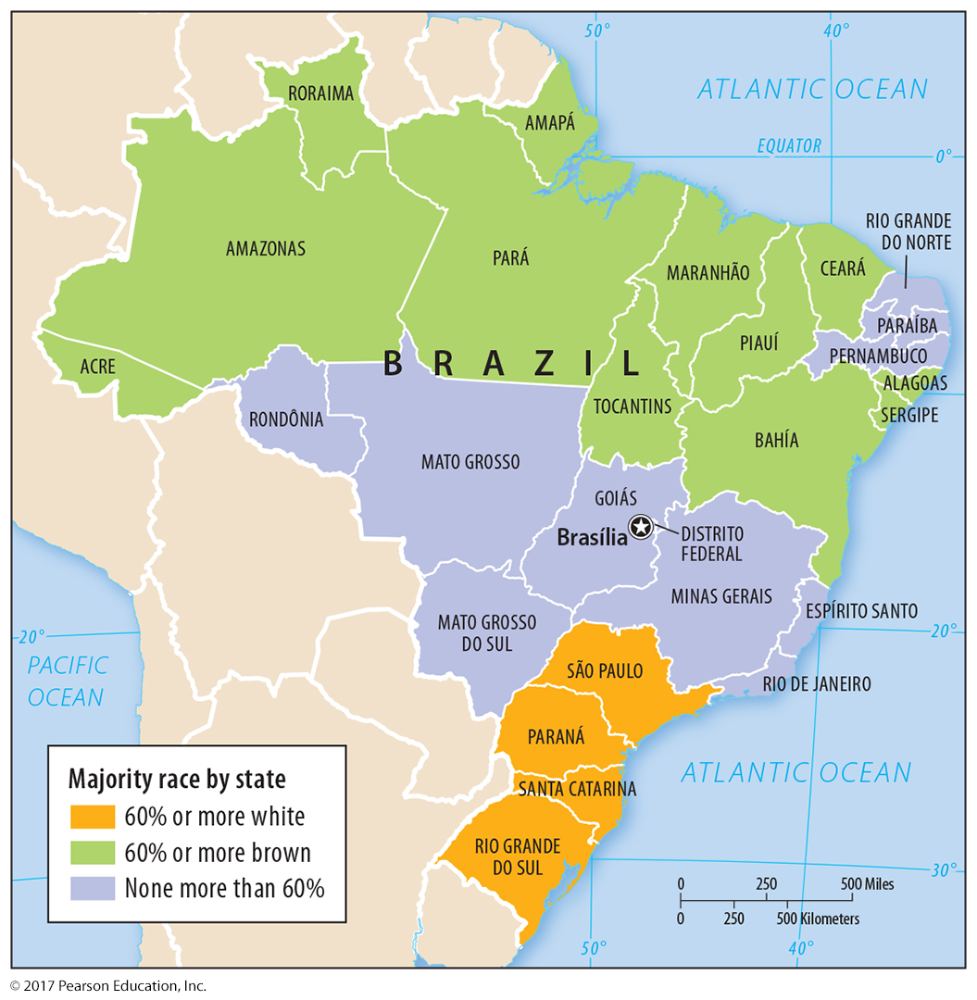
1.5 Distribution of Races in Brazil
Figure 7-17: Northern Brazil is majority brown (pardo); the south is majority white (branco). The area in between and a small coastal region are a mix without a large majority.

Slide 18
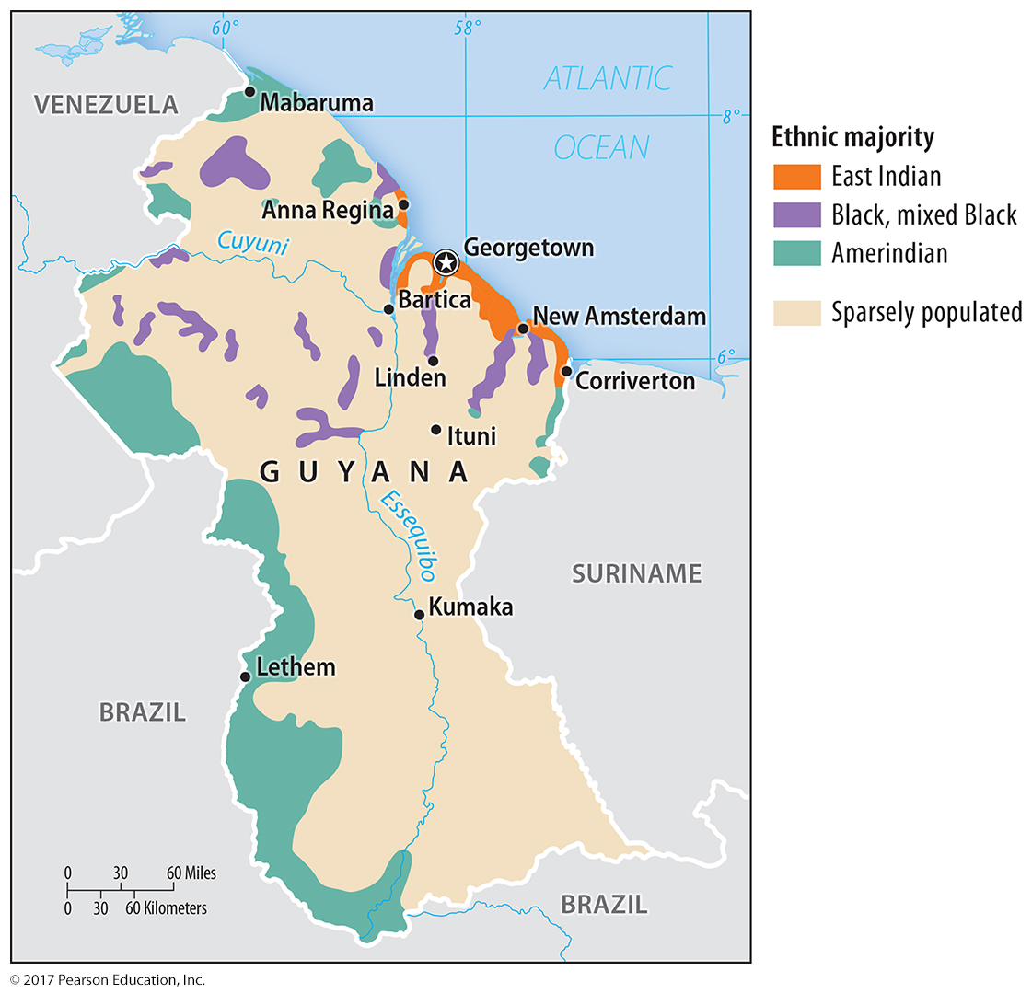
1.5 Distribution of Ethnicities in Guyana
Figure 7-18: Guyana’s ethnic diversity reveals the indigenous population, the forced migration of African slaves as a Dutch colony, and indentured servants brought from India as a British colony.

Slide 19
Key Issue 2: Why Do Ethnicities Have Distinctive Distributions?
2.1 International Migration of Ethnicities
2.2 Internal Migration of African Americans
2.3 Segregation by Race

Slide 20
2.1 International Migration of Ethnicities
Slavery: forced from Africa to South America, Caribbean, North America
1960s on: voluntary to North America from Asia and Latin America

Slide 21
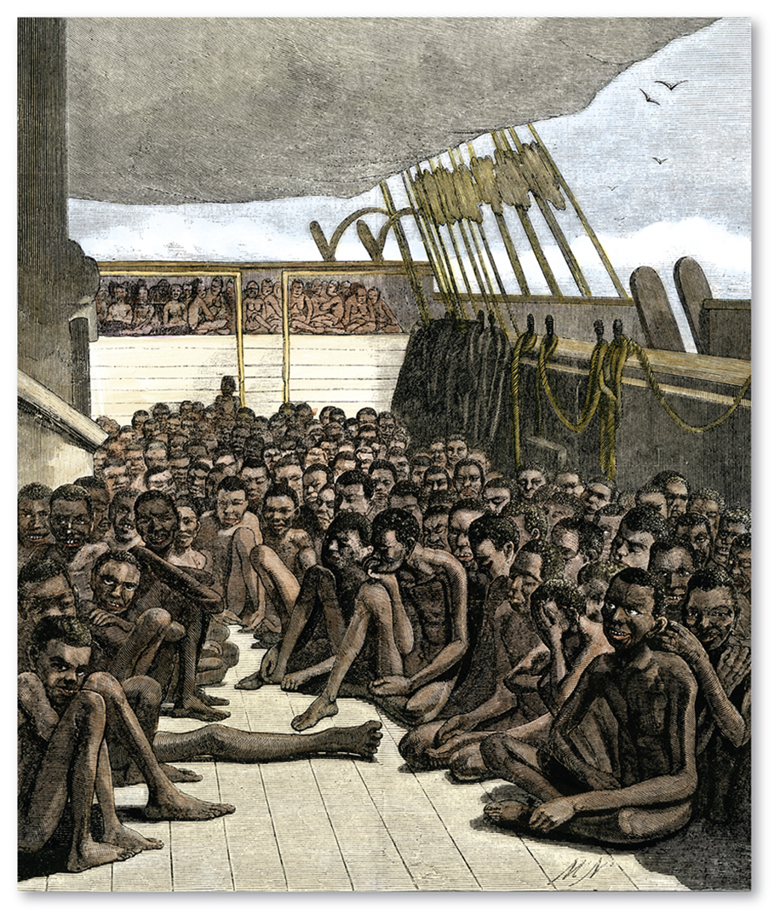
2.1 Forced Migration: Slavery
Figure 7-19: Africans were enslaved and brought in poor conditions to the Western Hemisphere.

Slide 22
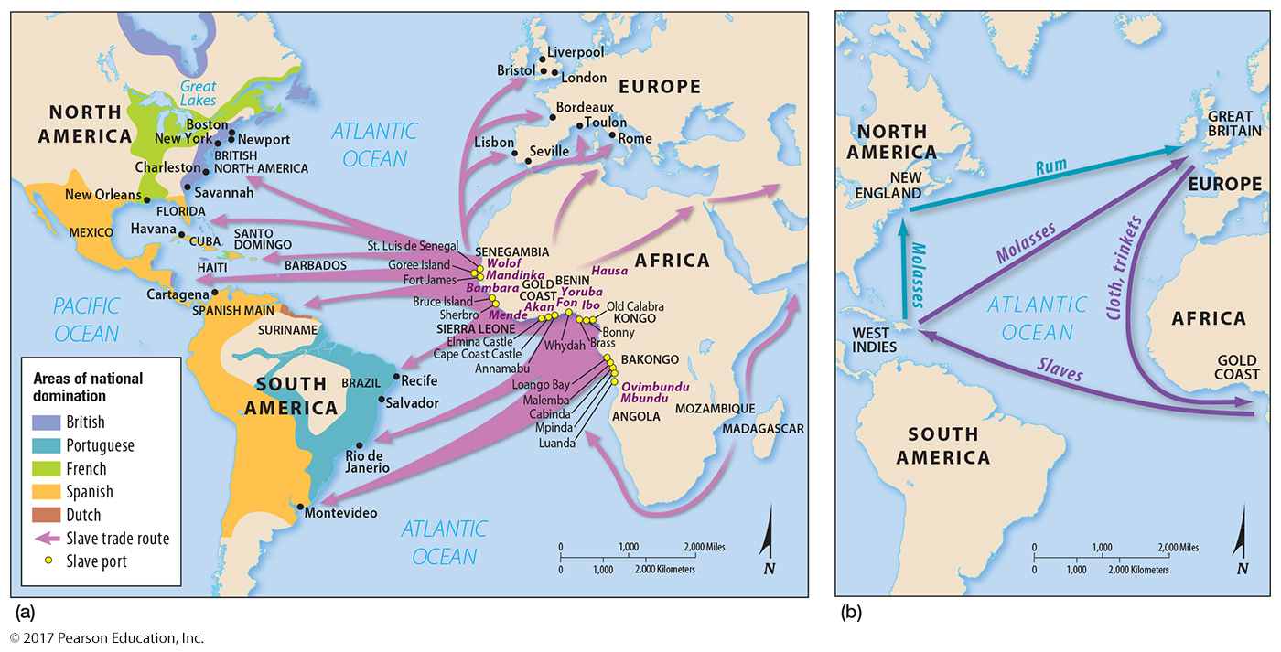
2.2 Triangular Slave Trade
Figure 7-20: The forced migration of slaves was one of three legs in the triangular slave trade.

Slide 23
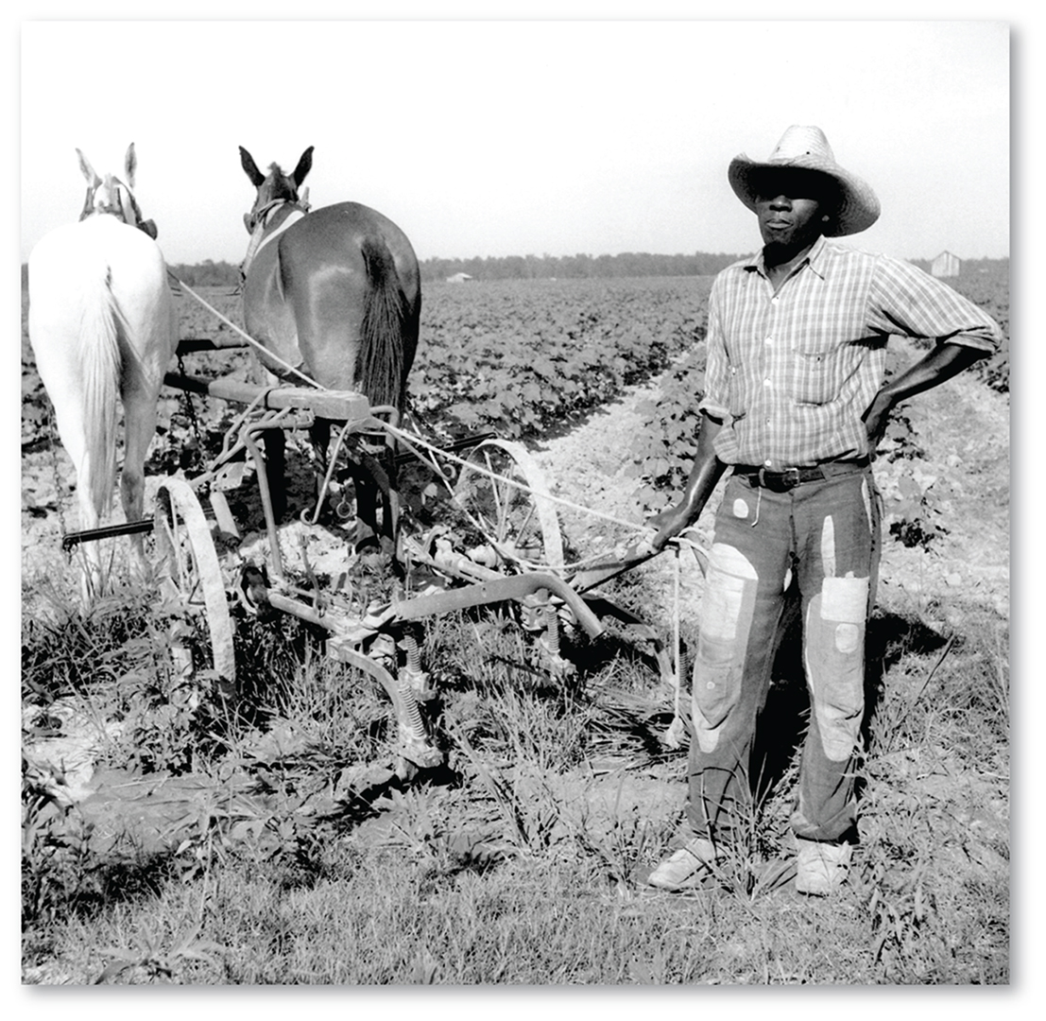
2.2 Sharecropper
Figure 7-22: The decline of sharecropping in the early 20th century was a push factor out of the South for African Americans.

Slide 24
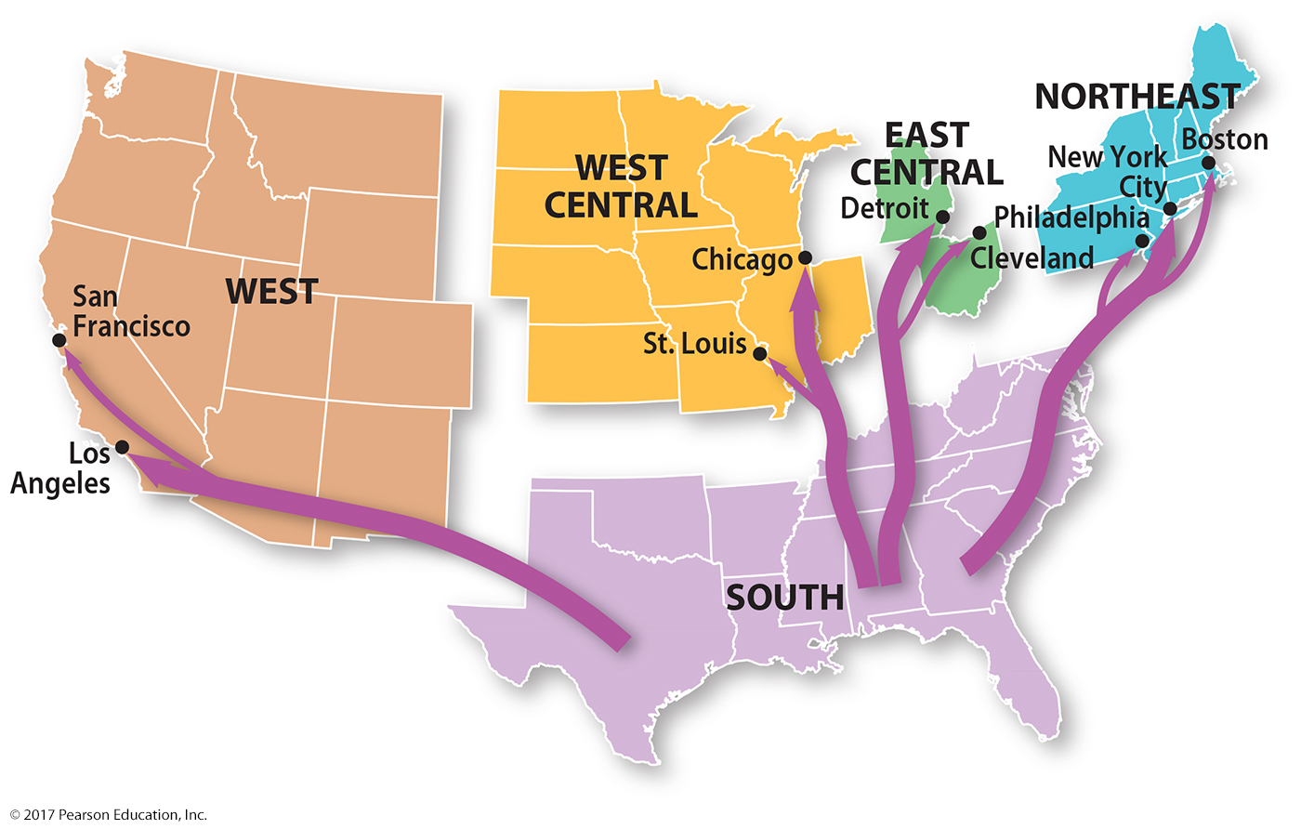
2.2 Interregional Migration of African Americans
Figure 7-23: African Americans migrated out of agricultural lands in the South to large cities in the North and West in the 1910s and 1920s and again in the 1940s and 1950s.

Slide 25
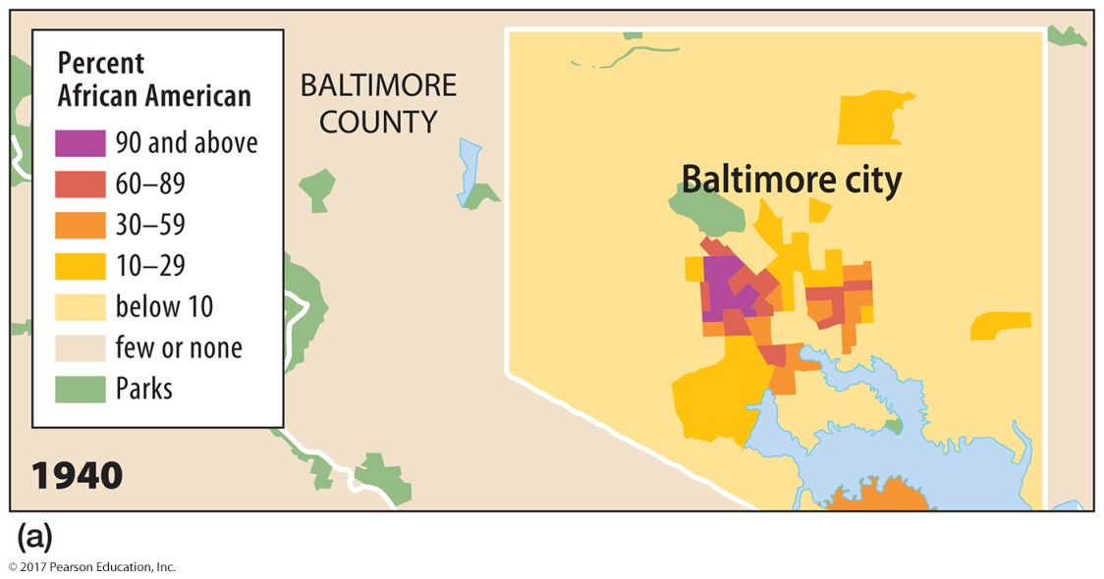
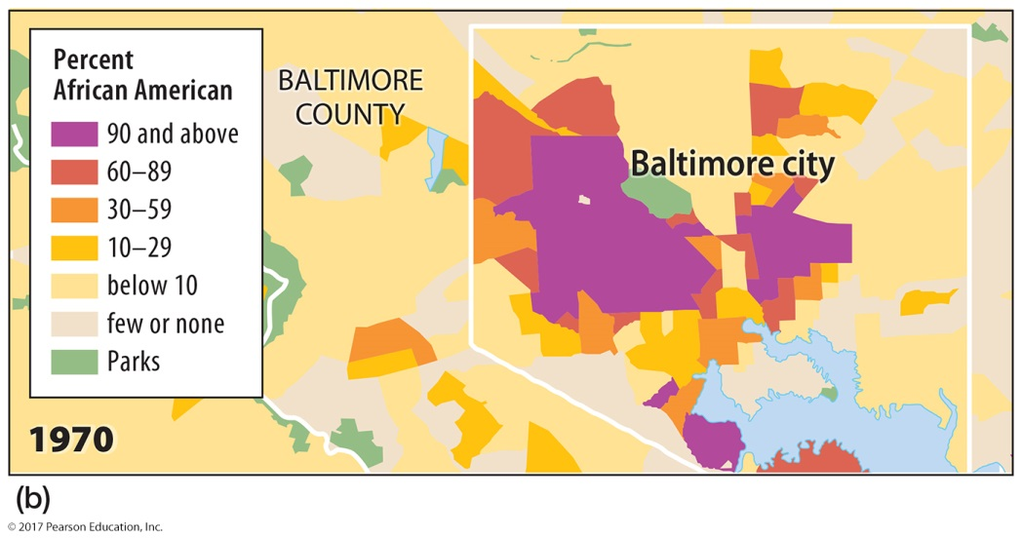
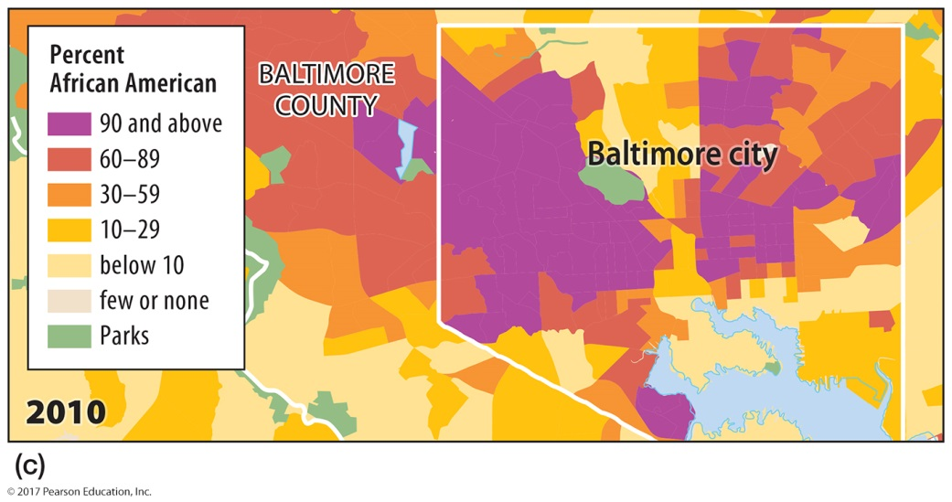
2.2 Expansion of the African American Ghetto
Figure 7-24: African Americans moved into the center of Baltimore and other northern cities, then expanded outward.

Slide 26
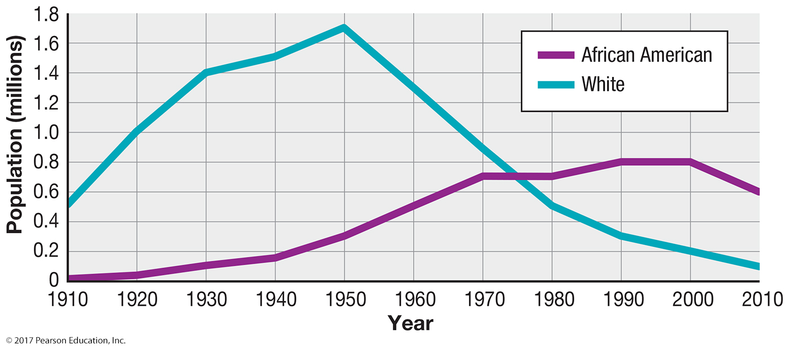
2.2 Population Change in Detroit
Figure 7-25: The decrease in racially white residents was much larger than the increase in African American residents, evidence of white flight.

Slide 27
2.3 Segregation by Race
South Africa and the United States: history of laws enforcing spatial segregation
United States: “separate but equal” doctrine supported by law until 1954
South Africa: segregated until 1991

Slide 28
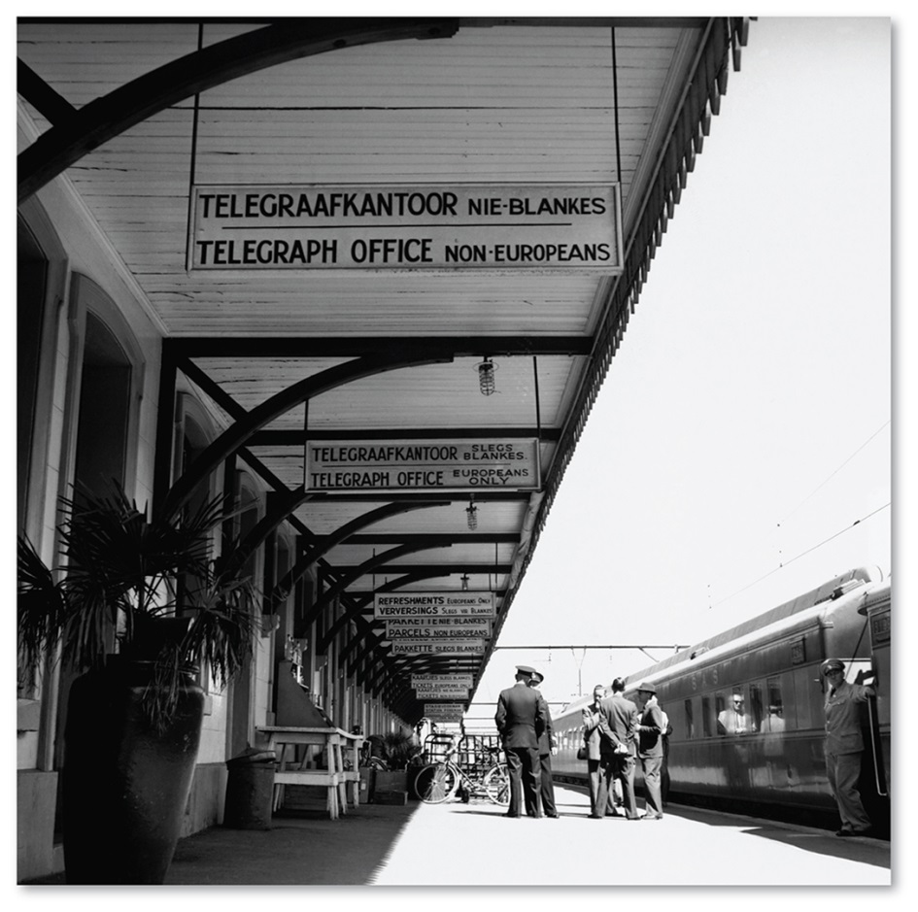
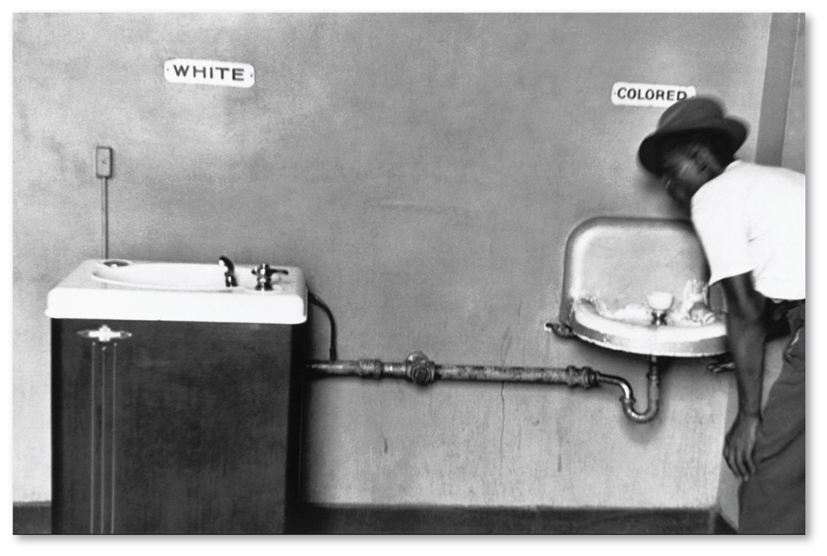
2.3 Segregation by Race
Figures 7-26 and 7-29: Segregation in U.S. drinking fountains (left) and a South African train station (right).

Slide 29
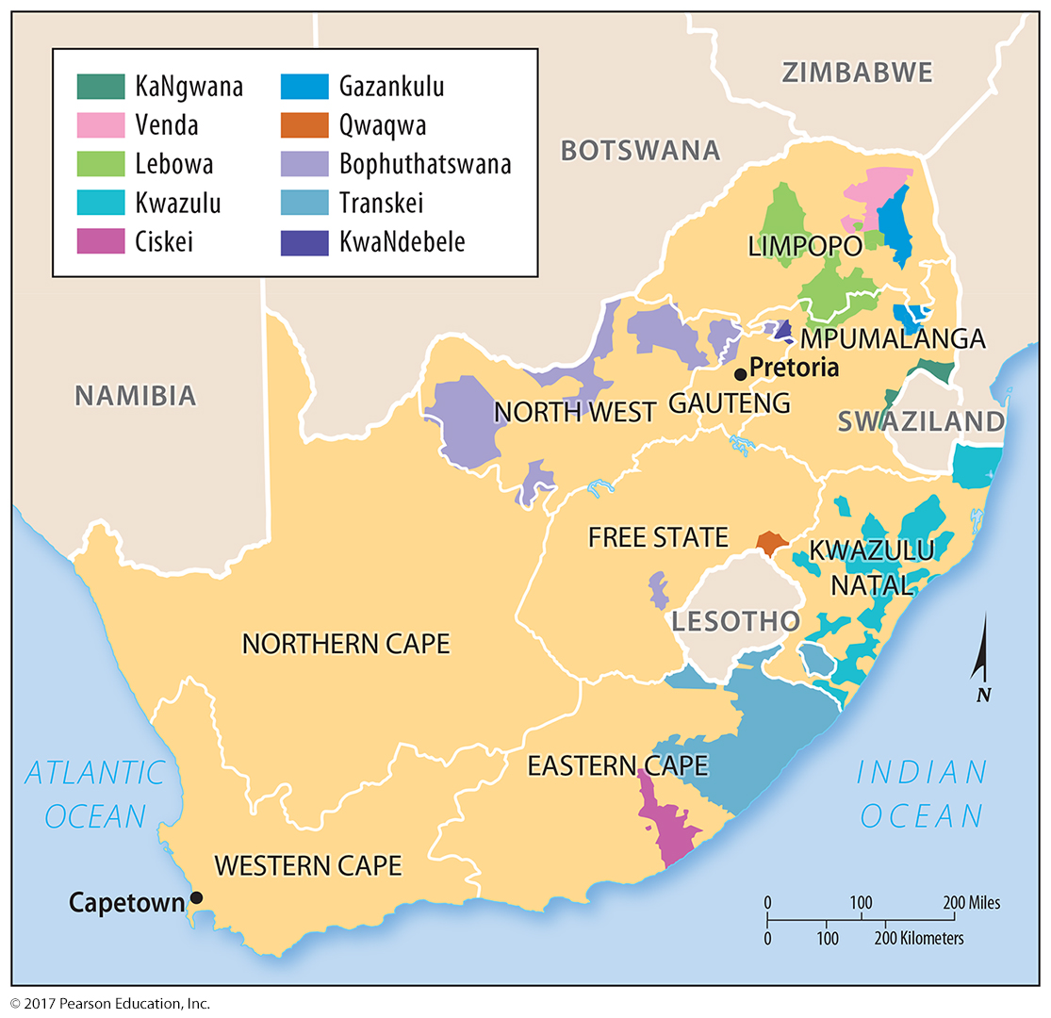
2.3 South Africa’s Apartheid Homelands
Figure 7-28: South Africa attempted to justify racial segregation (apartheid) by creating “homelands” for its black population.

Slide 30
Key Issue 3. Why Might Ethnicities Face Conflicts?
3.1 Ethnicities and Nationalities
3.2 Dividing Ethnicities
3.3 Ethnic Diversity in Asia

Slide 31
3.1 Ethnicities and Nationalities
Ethnicity does not always correspond to nationality.
United States: shared nationality by many different ethnicities
Canada: question of Québécois as nationality or ethnicity
United Kingdom: one British nationality or several?

Slide 32
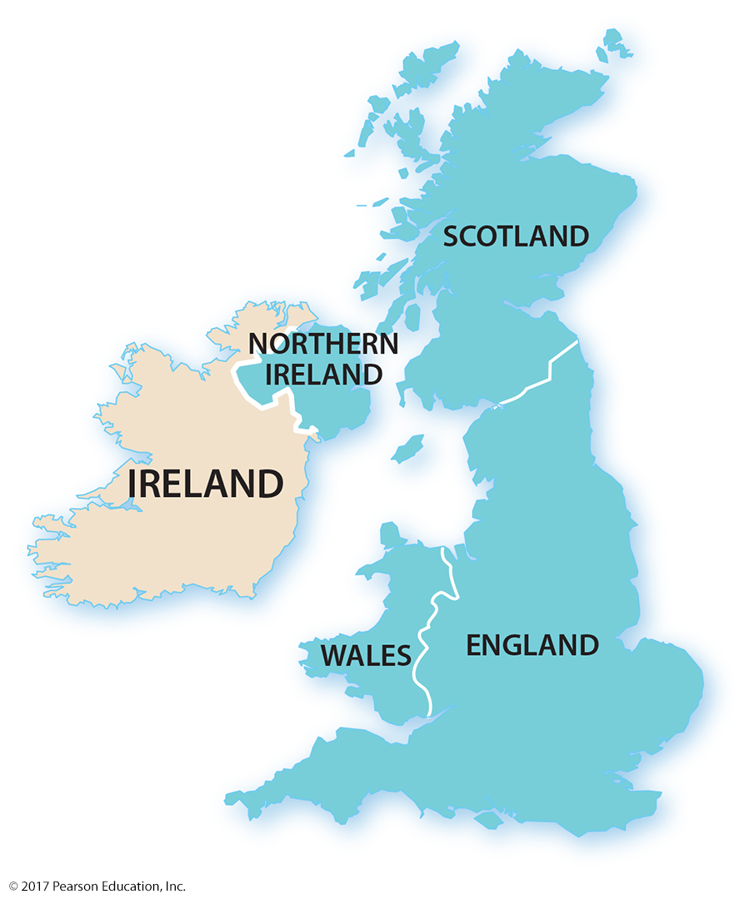
3.1 Ethnicities and Nationalities of the British Isles
Figure 7-32: Most people in Ireland have an Irish ethnicity and nationality. But the labeled ethnicities of the United Kingdom may also identify as their own nationalities instead of British.

Slide 33
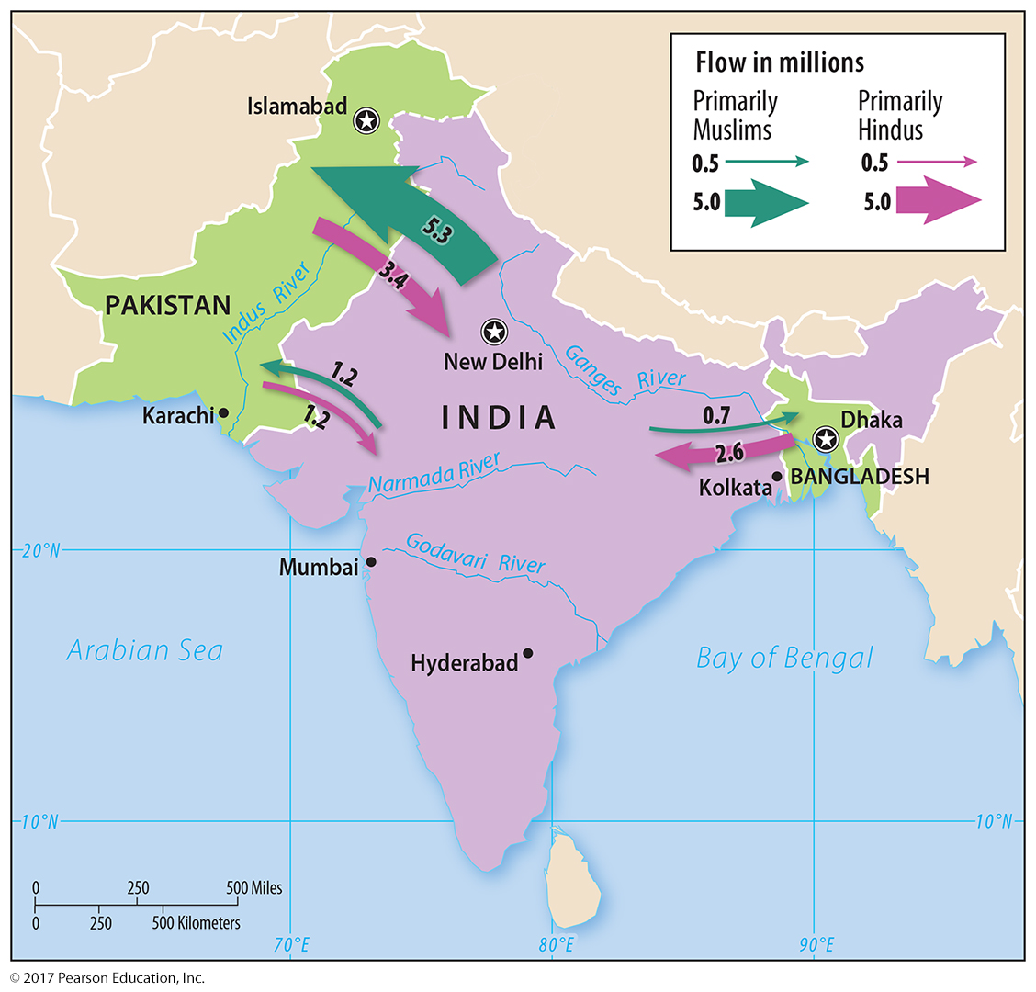
3.2 Ethnic Division of South Asia
Figure 7-34: The British partition of South Asia into Pakistan and India resulted in the migration of many Hindus to India and Muslims to West Pakistan and East Pakistan (now Bangladesh).

Slide 34
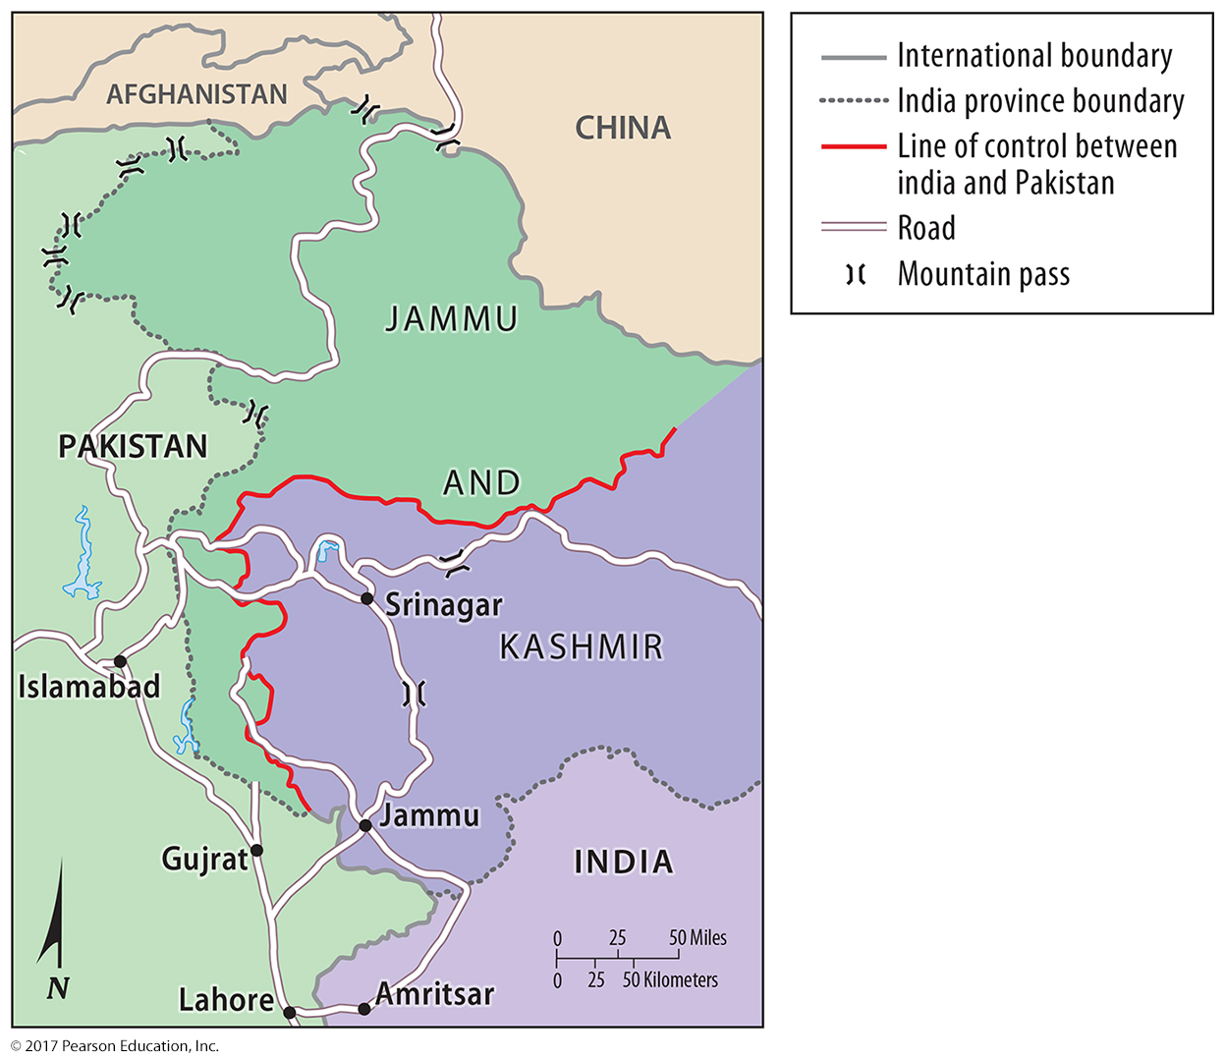
3.2 Ethnic Division of South Asia
Figure 7-35: Jammu and Kashmir in northern India is disputed territory.

Slide 35
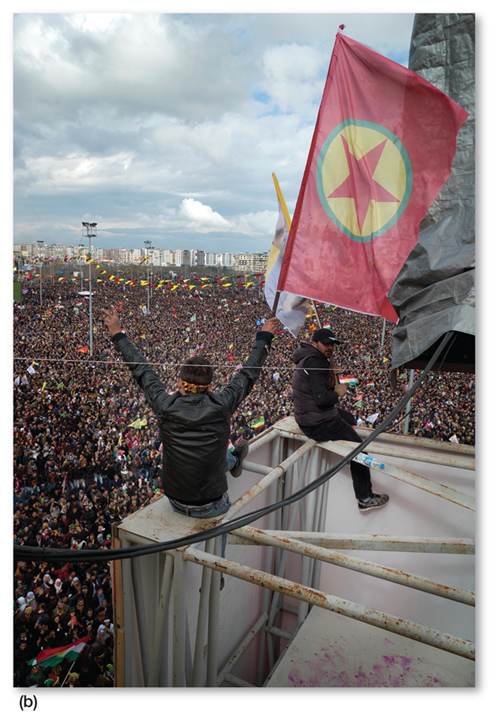
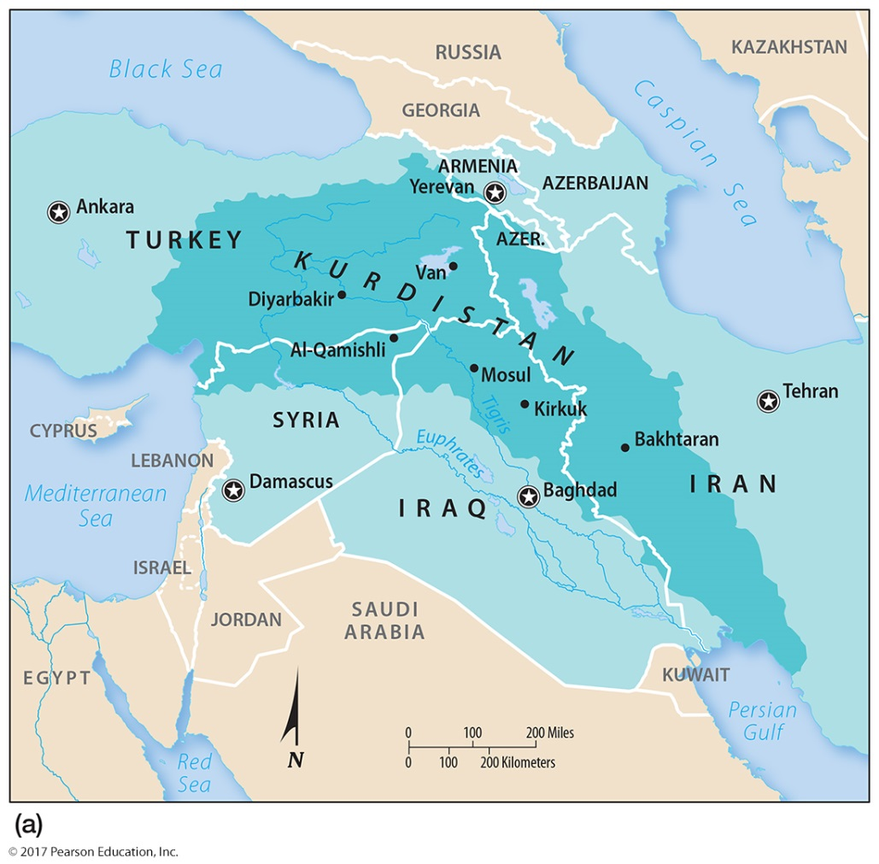
3.2 Kurdistan
Figure 7-36: Many ethnic Kurds identify as a Kurdish nationality, yet there is no Kurdish country (left). Kurds in Turkey celebrate the Kurdish New Year (right).

Slide 36
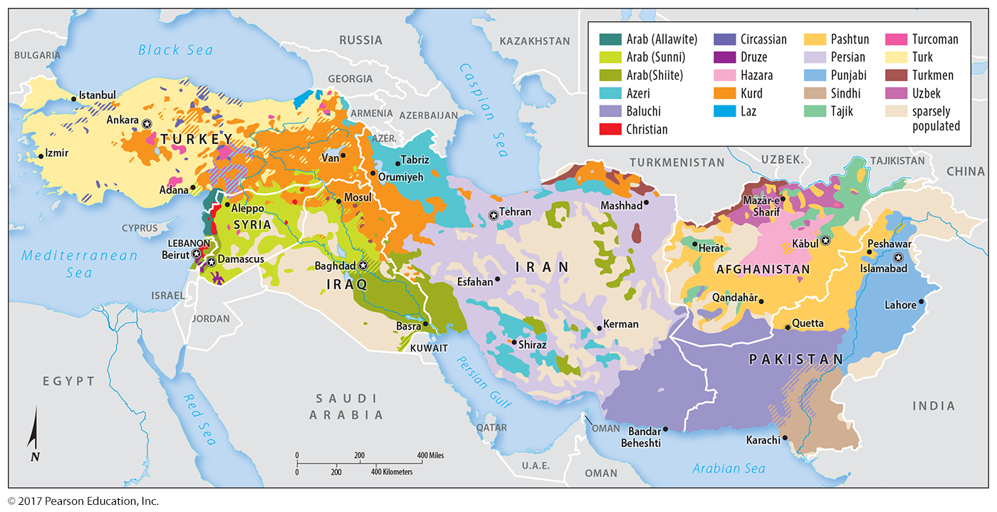
3.3 Ethnic Diversity in Asia
Figure 7-37: Western Asia is a complex mosaic of different ethnic groups, sometimes identified by differences in religion as well as other cultural factors.

Slide 37
Key Issue 4: Why Do Ethnic Cleansing and Genocide Occur?
4.1 Forced Migration in Europe
4.2 Ethnic Cleansing in Bosnia & Herzegovina
4.3 Ethnic Cleansing Elsewhere in the Balkans
4.4 Ethnic Cleansing and Genocide in Africa
4.5 Ethnic Cleansing and Genocide in Central Africa

Slide 38
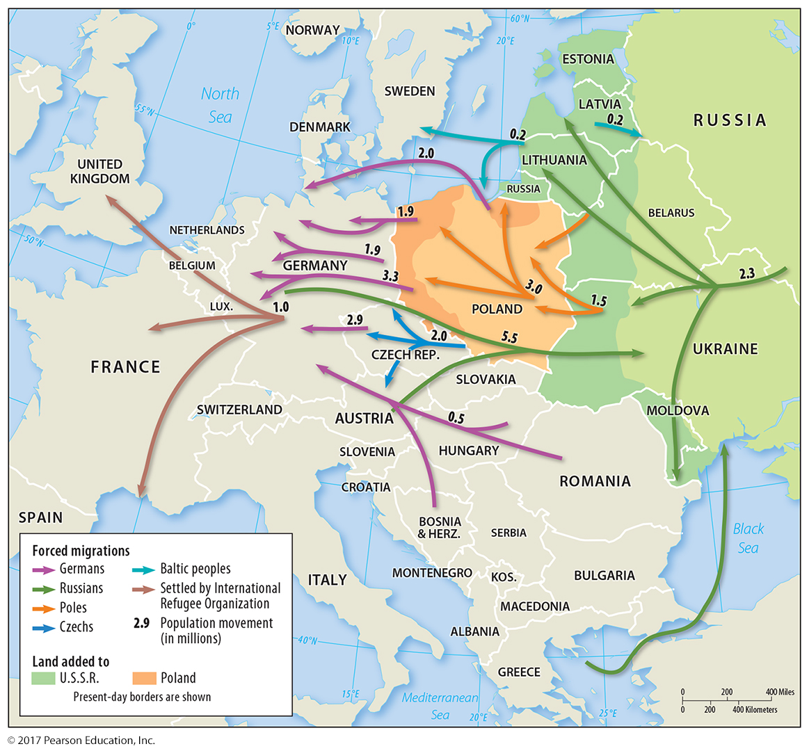
4.1 Forced Migration in Europe
Figure 7-40: The end of World War II saw boundary changes and forced migration of many ethnicities.

Slide 39
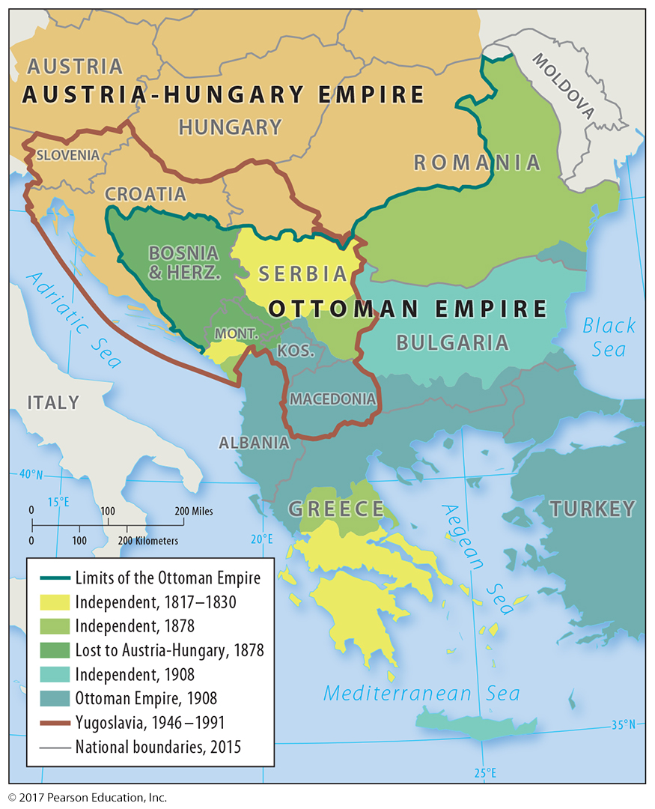
4.1 The Balkans in 1914
Figure 7-41: The Balkans have a varied history of changing borders with complex ethnic and national identities.

Slide 40
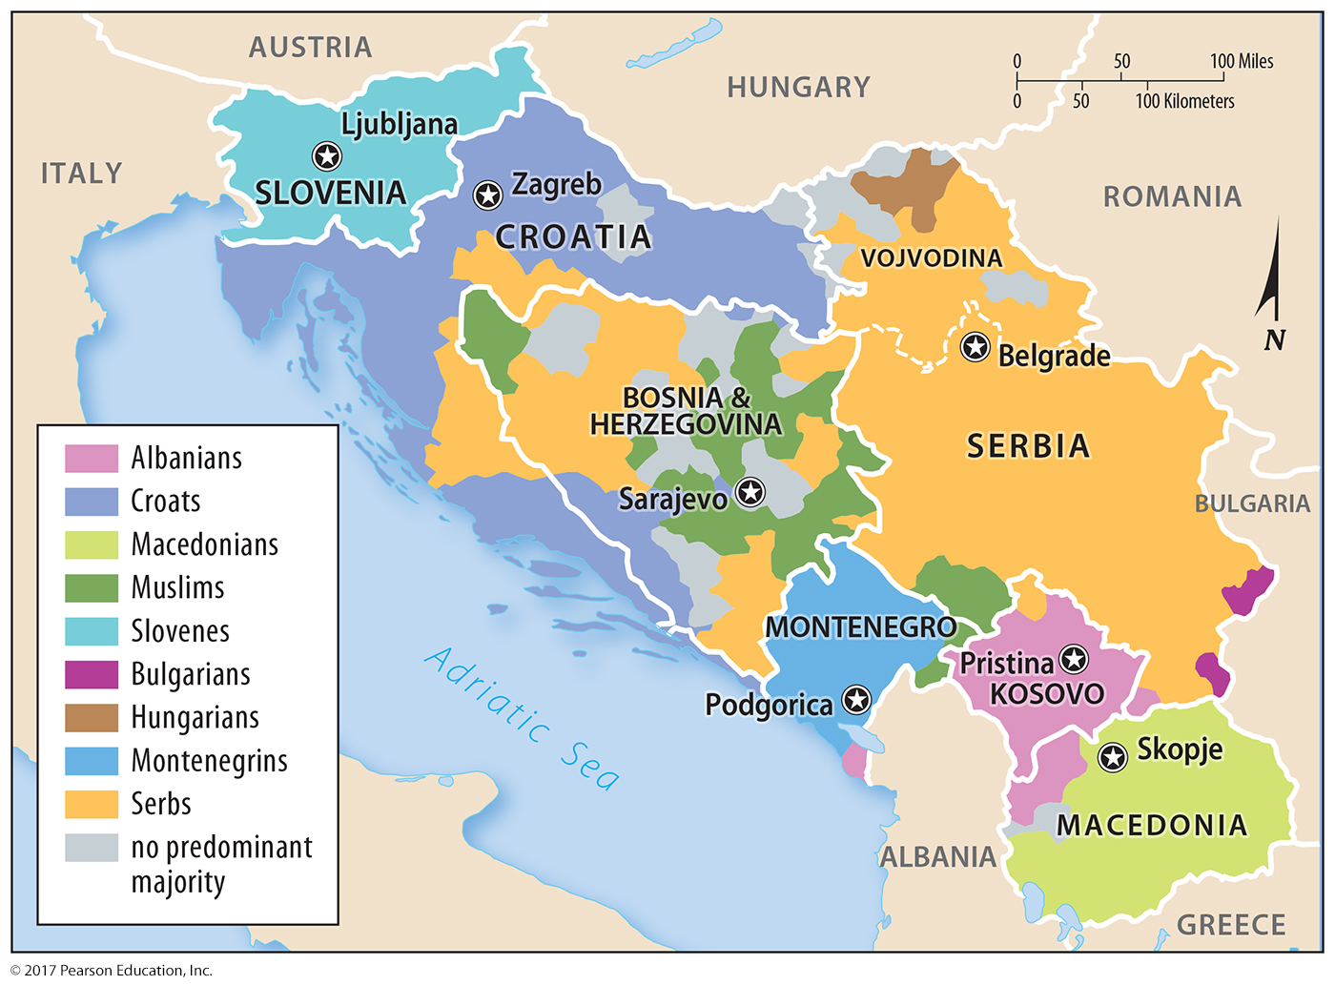
4.1 Former Yugoslavia’s Seven Countries
Figure 7-42: Yugoslavia was unified until its president’s death, after which it divided, and ethnicities fought for control in several of the territories.

Slide 41
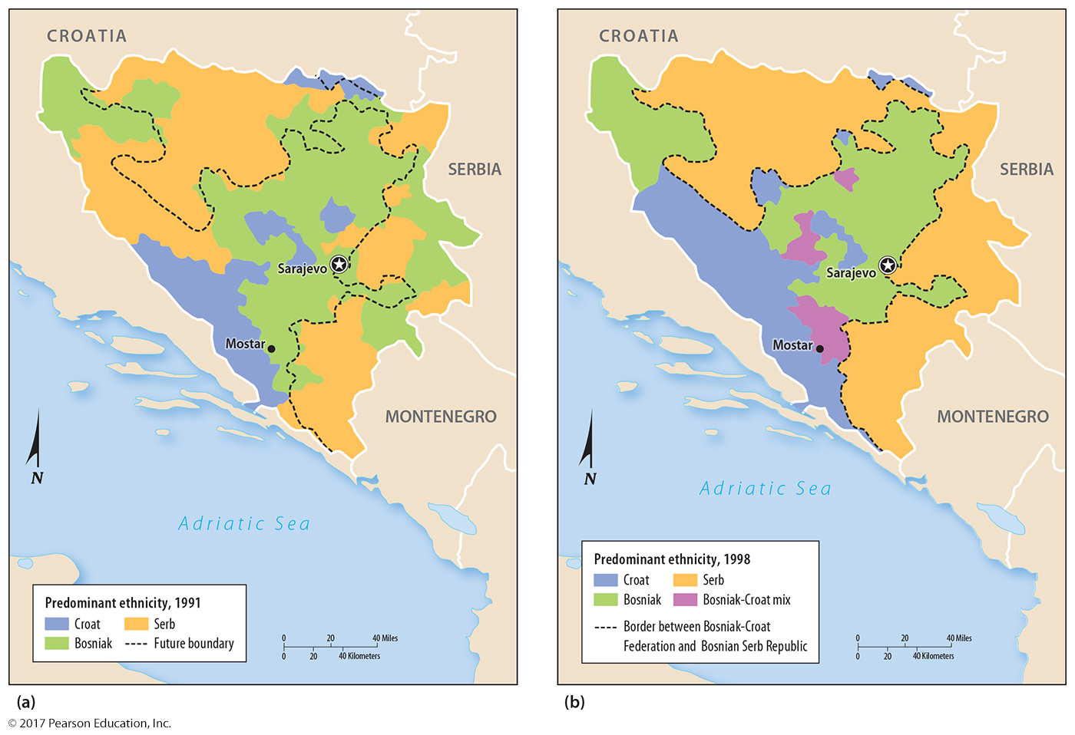
4.2 Ethnic Cleansing in Bosnia & Herzegovina
Figure 7-44: Ethnic cleansing changed the distribution of ethnicities in Bosnia & Herzegovina.

Slide 42
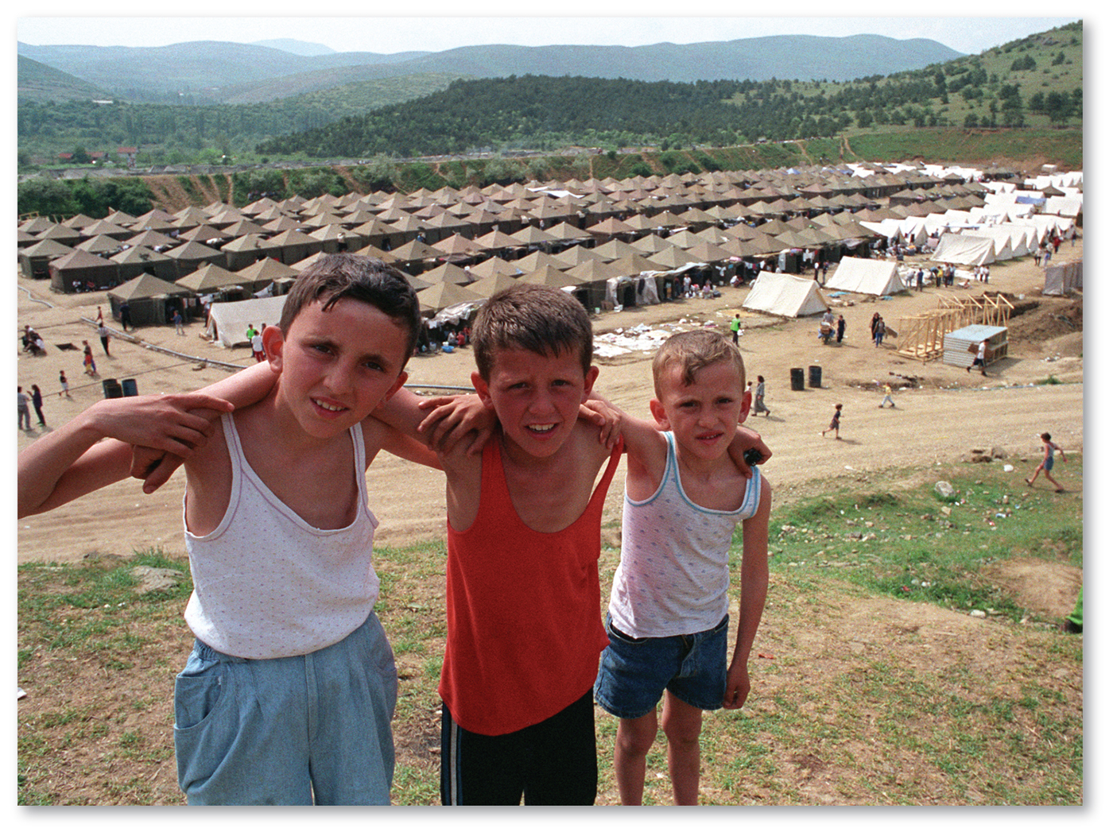
4.3 Ethnic Cleansing Elsewhere in the Balkans
Figure 7-46: Refugee Kosovar children stand outside a camp after being ethnically cleansed from Kosovo.

Slide 43
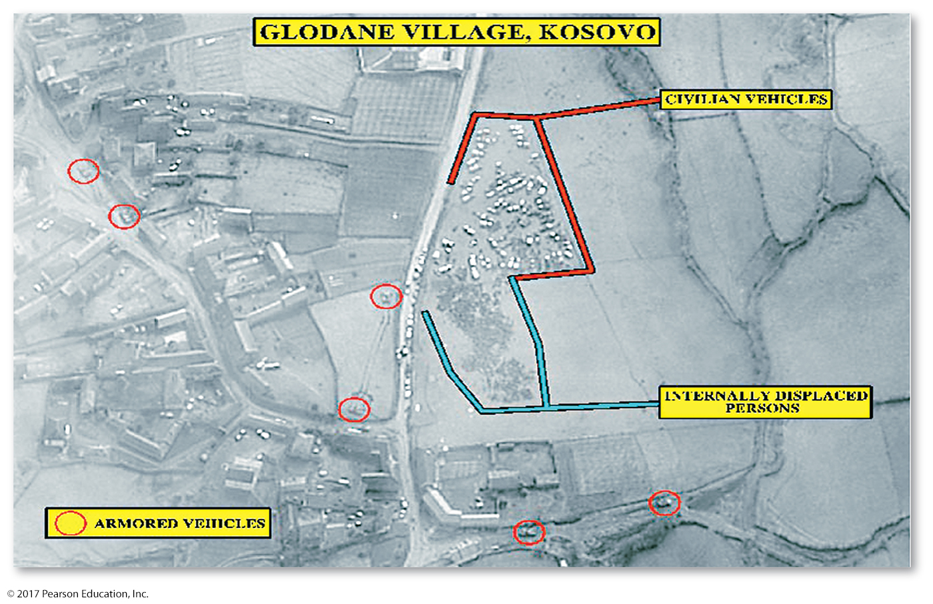
4.3 Evidence of Ethnic Cleansing in Kosovo
Figure 7-47: Air photos document the forced removal of Albanian villagers from Kosovo by Serbs.

Slide 44
4.4 & 4.5 Ethnic Cleansing and Genocide in Africa
Africa is extremely ethnically diverse.
Colonial boundaries: many ethnicities into single nationalities
Ethnic cleansing and genocide in:
Sudan: Arab majority on peripheral regions
Rwanda and Burundi: Hutus on Tutsis
Democratic Republic of Congo: spillover violence from Rwanda, continued conflict

Slide 45
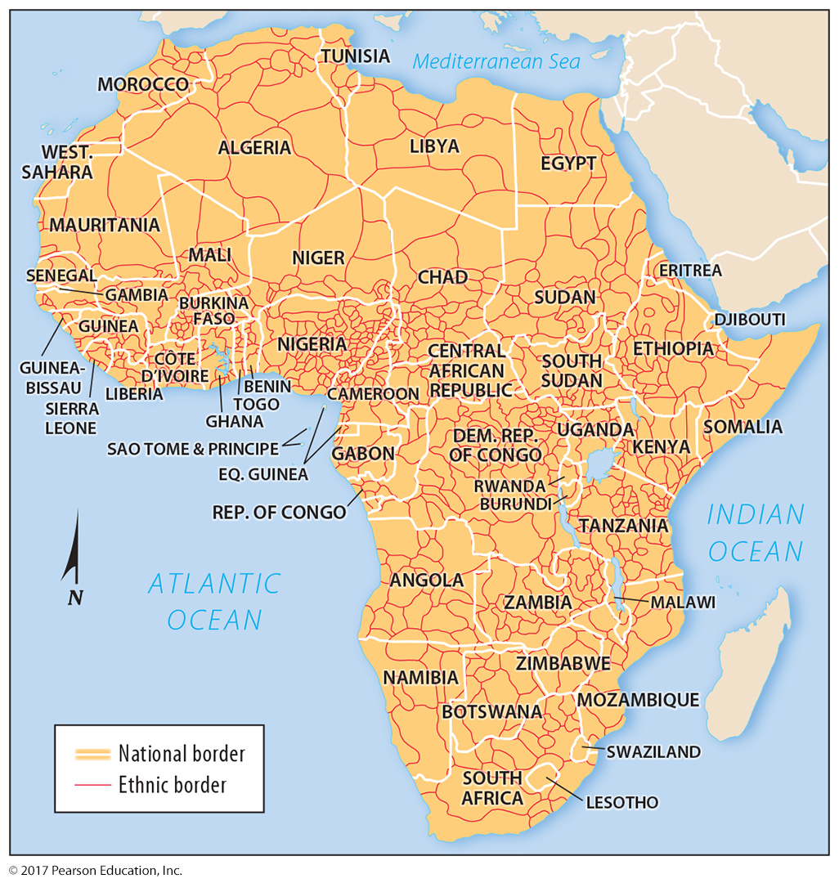
4.4 Africa’s Many Ethnicities
Figure 7-48: National boundaries do not match the distribution of Africa’s many ethnic groups.

Slide 46
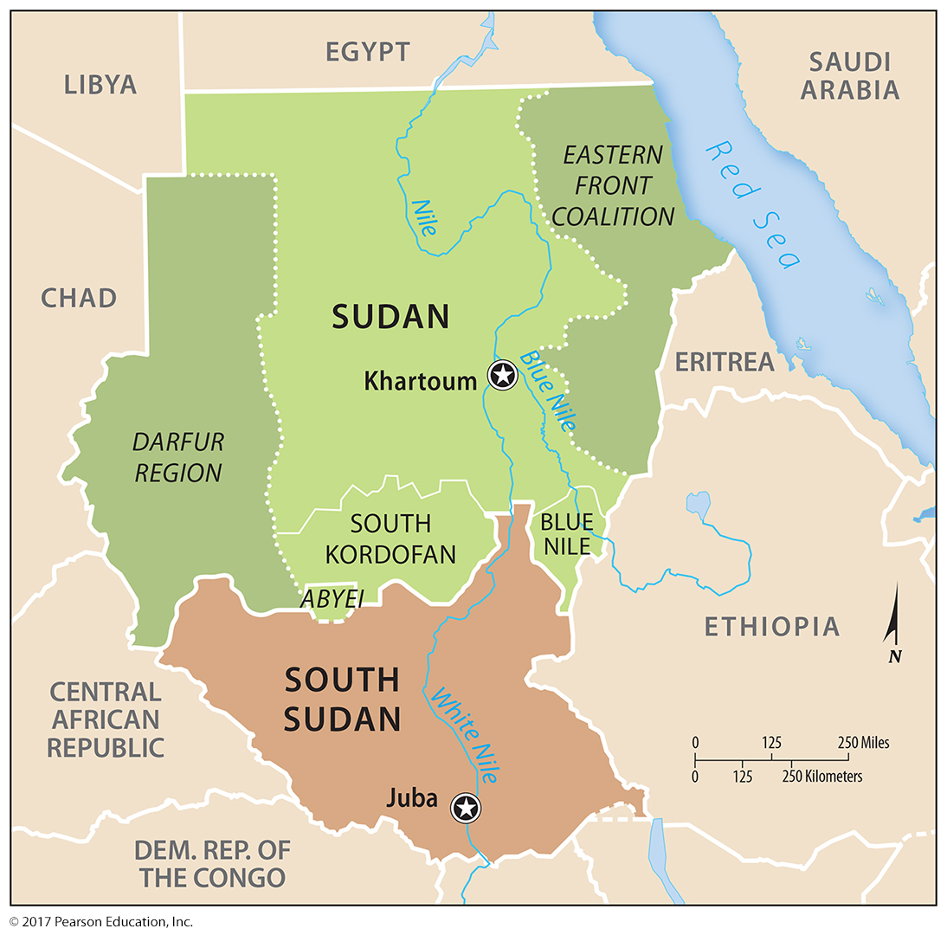
4.4 Africa’s Many Ethnicities
Figure 7-50: Ethnic groups in the south, east, and west of the Arab majority of Sudan have been subject to ethnic cleansing and genocide.

Slide 47
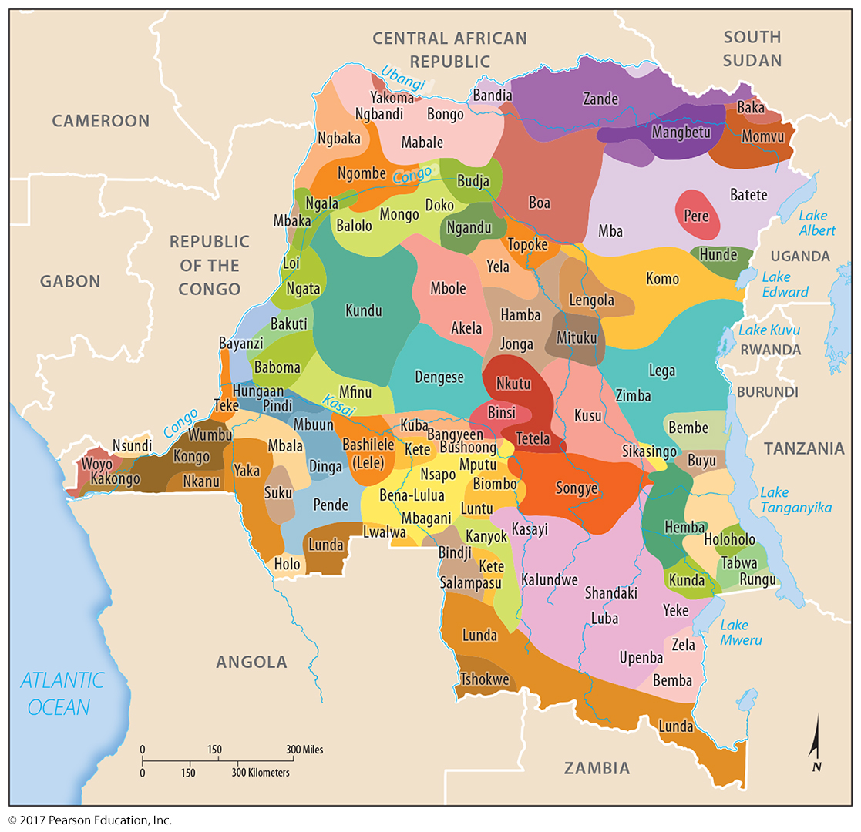
4.5 Ethnicities in the Democratic Republic of Congo
Figure 7-51: Congo has experienced long-running and deadly civil wars.

Slide 48
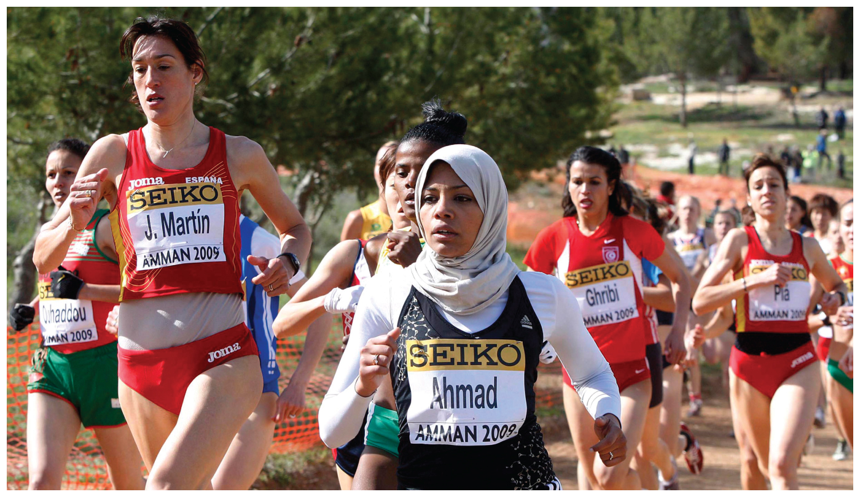
Chapter 7 End

