Slide 1
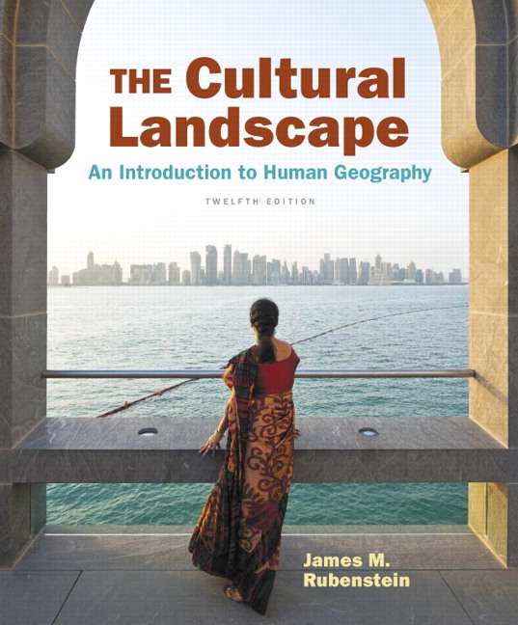
Chapter 6 Lecture
Chapter 6 Religions
Tim Scharks Green River College

Slide 2
Religions: Key Issues
Where Are the World’s Religions Distributed?
Why Do Religions Have Distinctive Distributions?
Why Do Religions Organize Space in Distinctive Patterns?
Why Do Territorial Conflicts Arise Among Religious Groups?

Slide 3
Key Issue 1: Where Are the World’s Religions Distributed?
1.1 Introducing Religions
1.2 Global Distribution of Religions
1.3 Distribution of Christians
1.4 Distribution of Muslims and Buddhists
1.5 Distribution of Ethnic Religions
1.6 Distribution of Other Religions

Slide 4
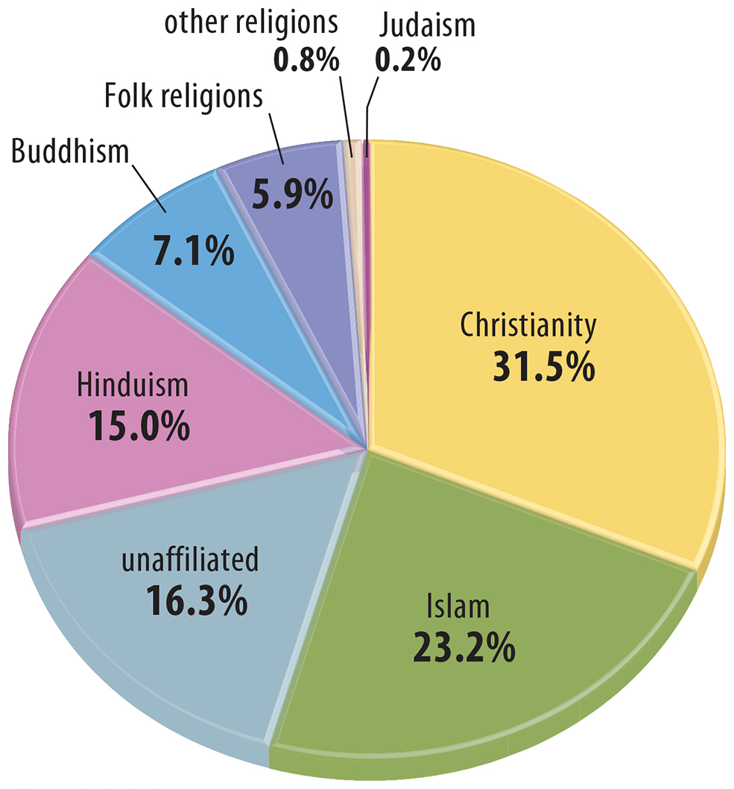
1.1 Percentage of Adherents by Religion
Figure 6-1: 77 percent of the world follows a branch of Christianity, Islam, Hinduism, or Buddhism, the four largest religions.

Slide 5
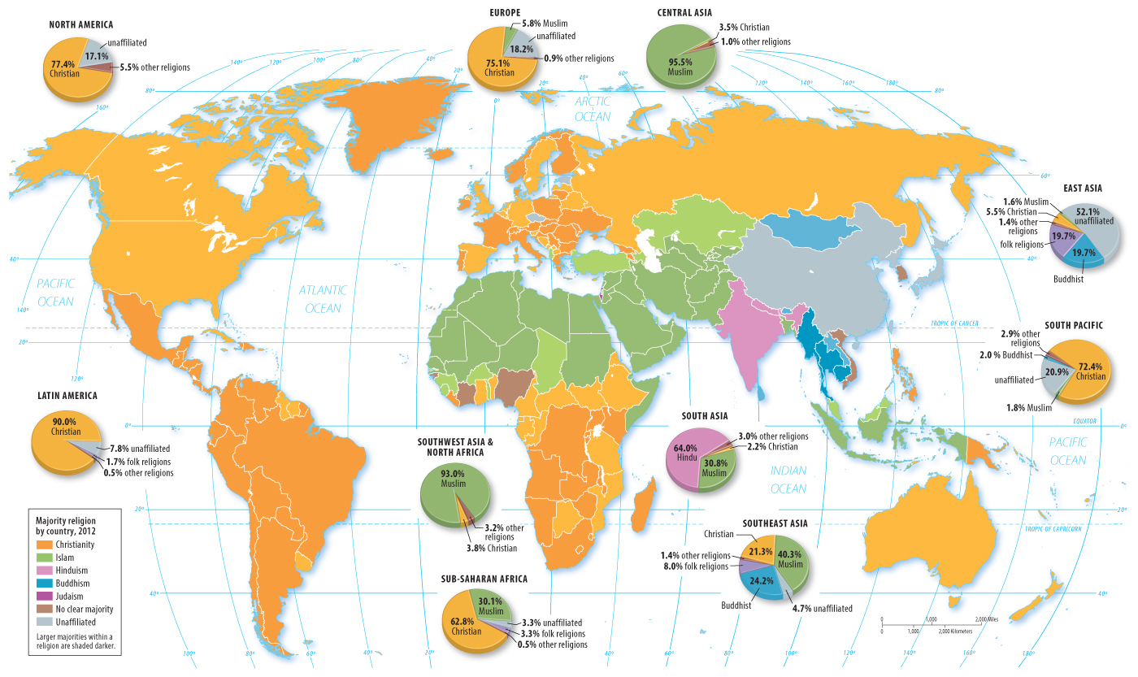
1.2 Most Numerous Religions by Country
Figure 6-5: The Western Hemisphere, Europe, and sub-Saharan Africa are predominantly Christian; Southwest Asia and North Africa are majority Muslim.

Slide 6
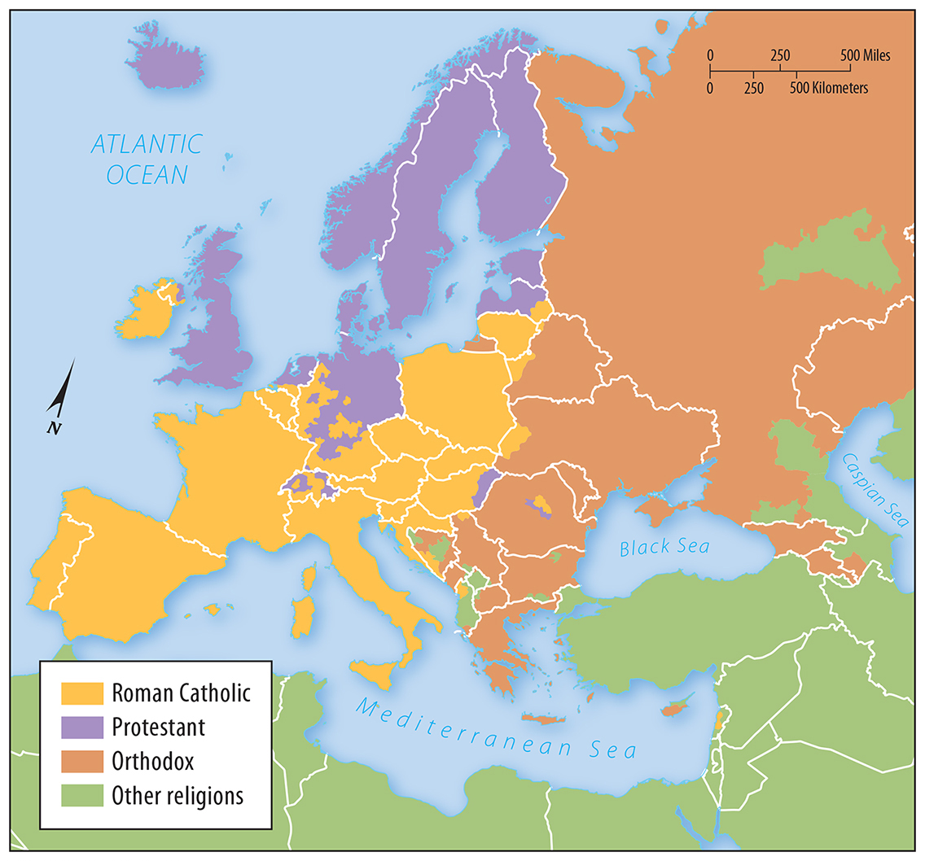
1.3 Branches of Christianity in Europe
Figure 6-6: Christianity is divided into Roman Catholic, predominantly in the south, Protestant in the north, and Orthodox in the east.

Slide 7
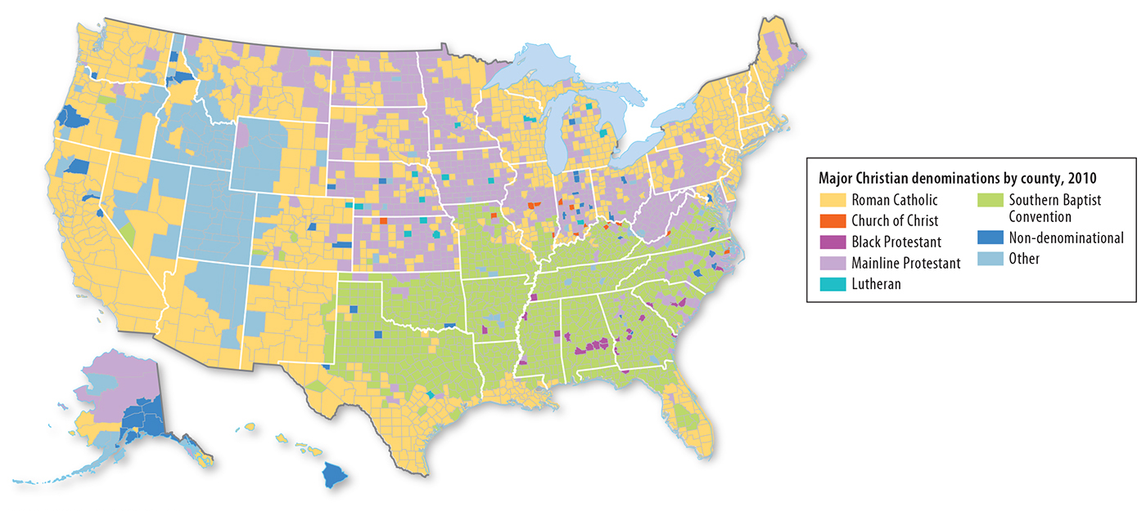
1.3 Most Numerous Faiths by U.S. County
Figure 6-7: American Christianity has a diversity of distinct faiths with regional distributions.

Slide 8
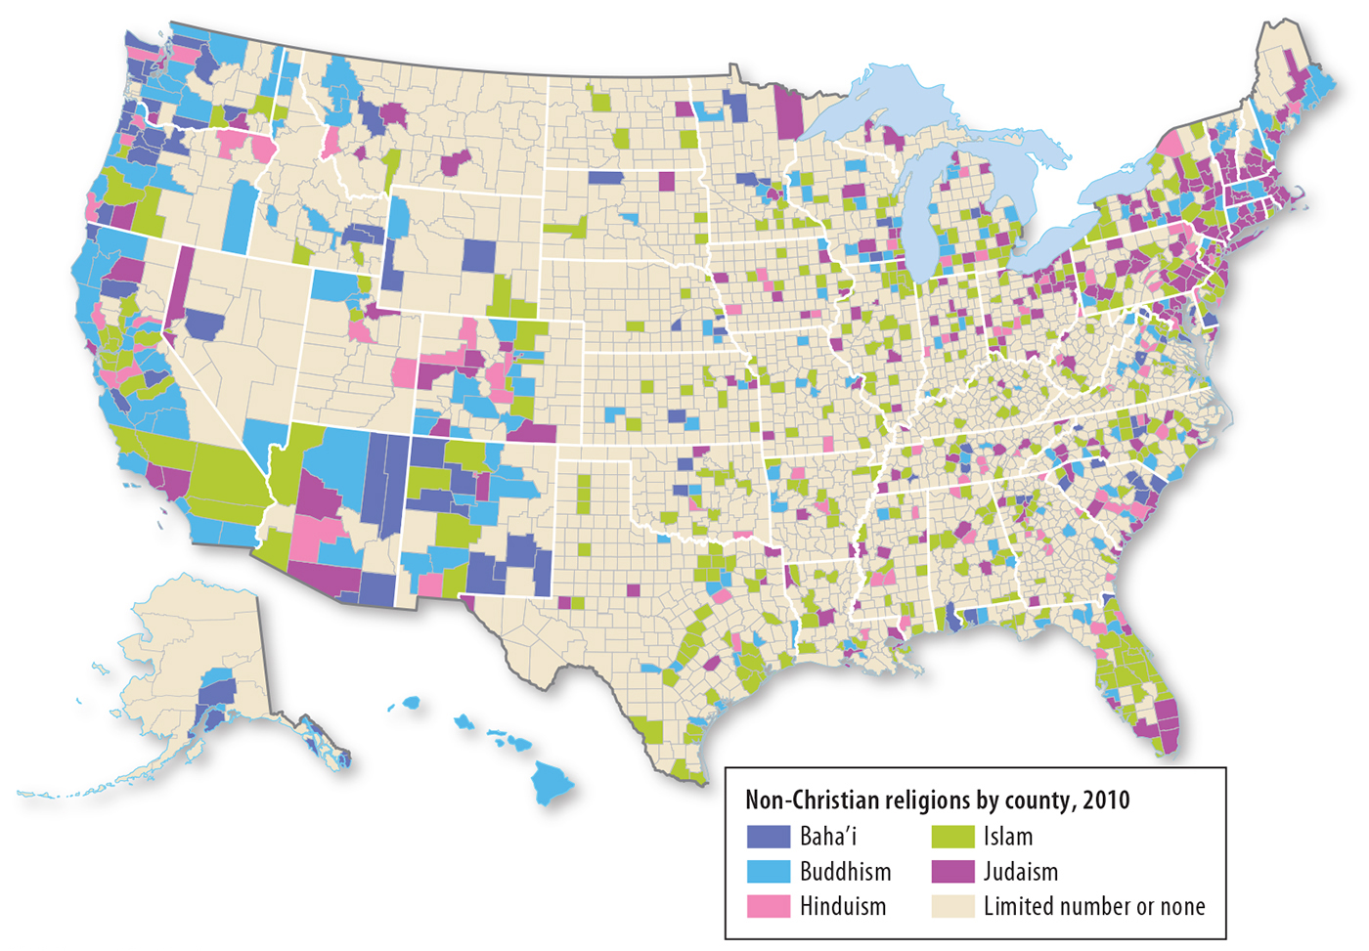
1.3 Most Numerous Non-Christian Faiths by U.S. County
Figure 6-8: Non-Christian faiths tend to be more common closer to the coast and in urban areas.

Slide 9
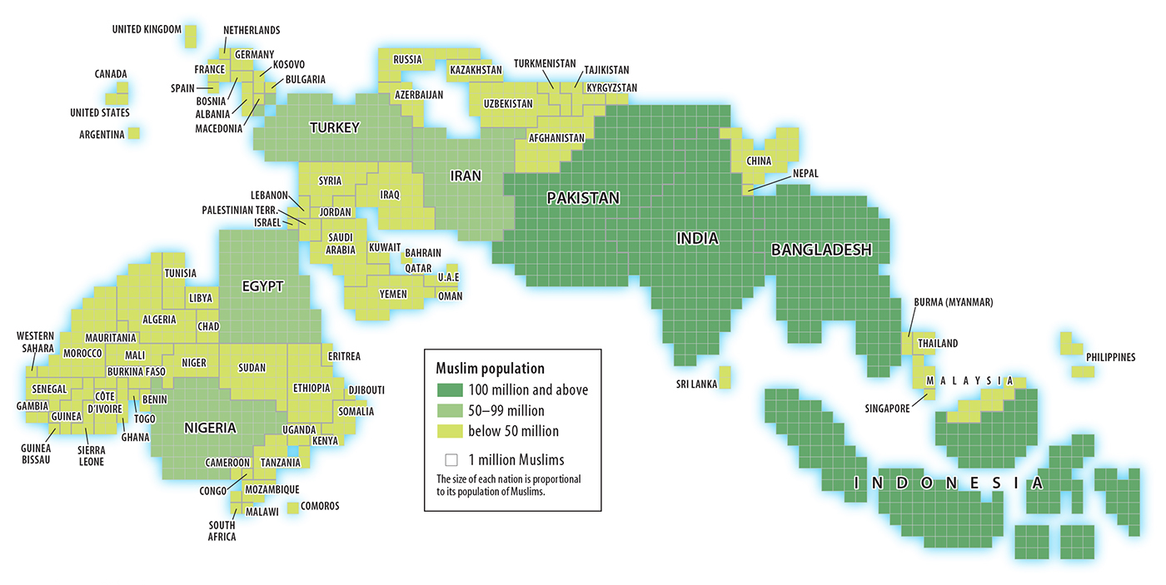
1.4 Cartogram of Muslim Adherents
Figure 6-9: Muslim populations are very large in South Asia and Indonesia.

Slide 10
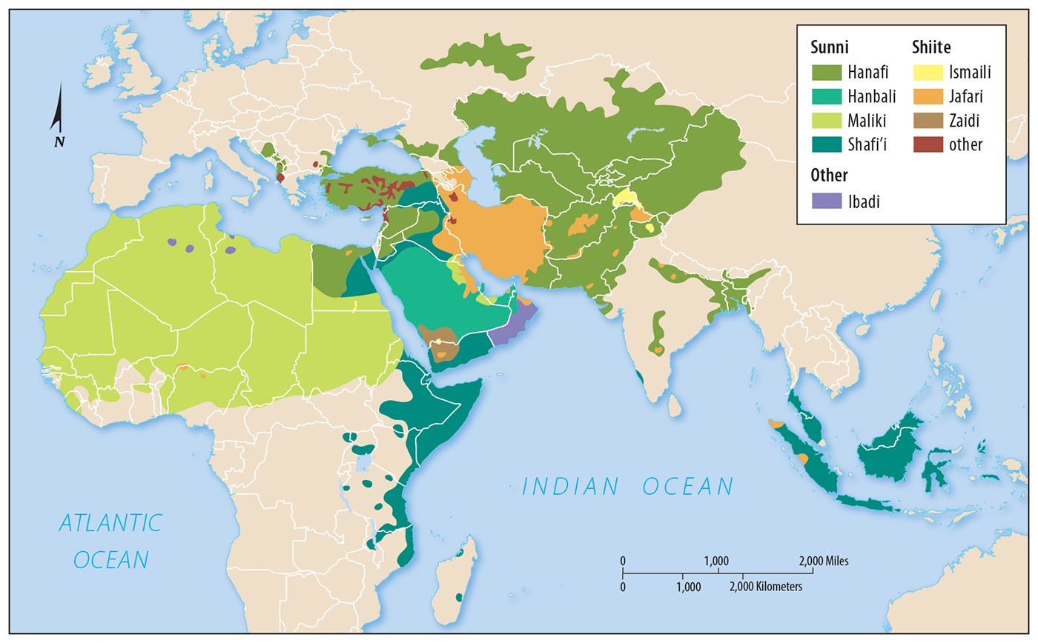
1.4 Distribution of Branches of Islam
Figure 6-10: Islam’s two main branches, Sunni and Shiite, are based on a disagreement on the line of succession from Muhammad.

Slide 11
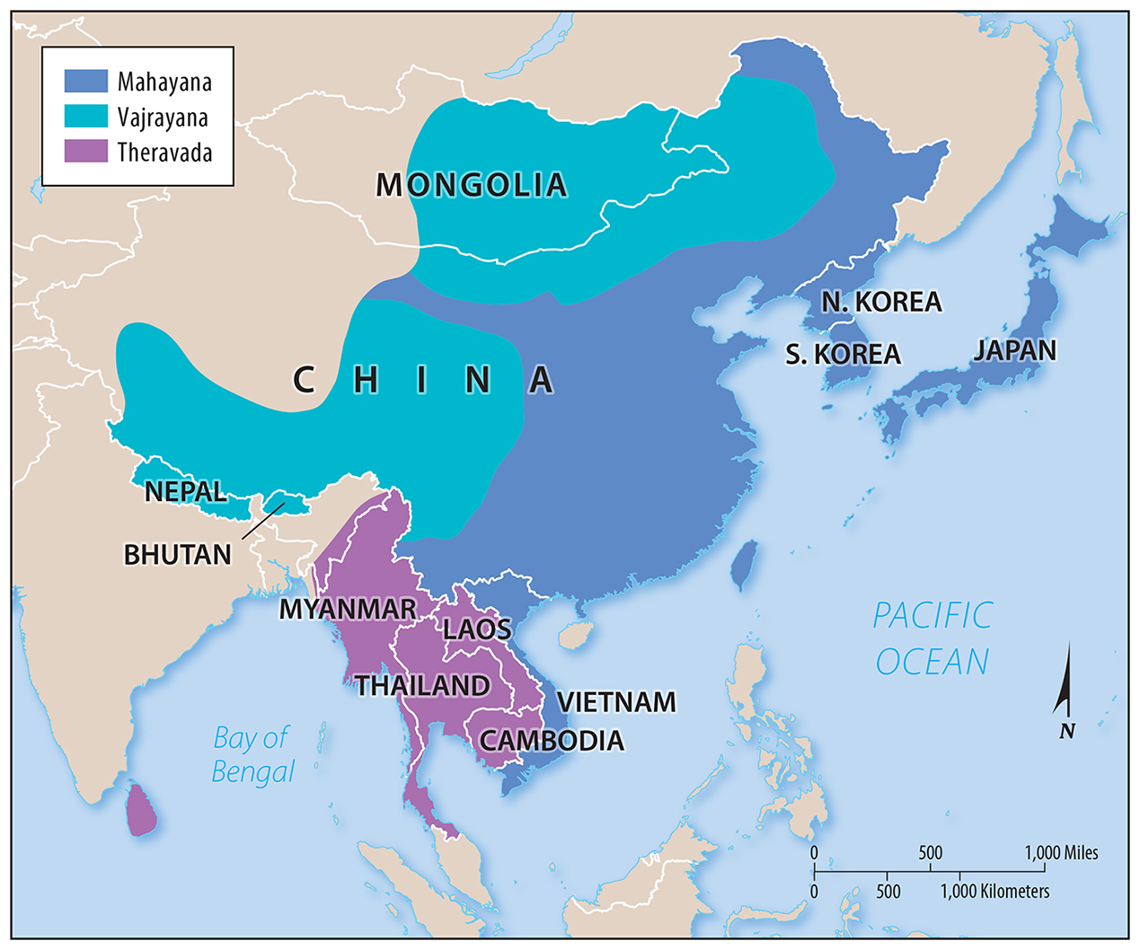
1.4 Distribution of Branches of Buddhism
Figure 6-11: Buddhism is practiced throughout East and Southeast Asia.

Slide 12
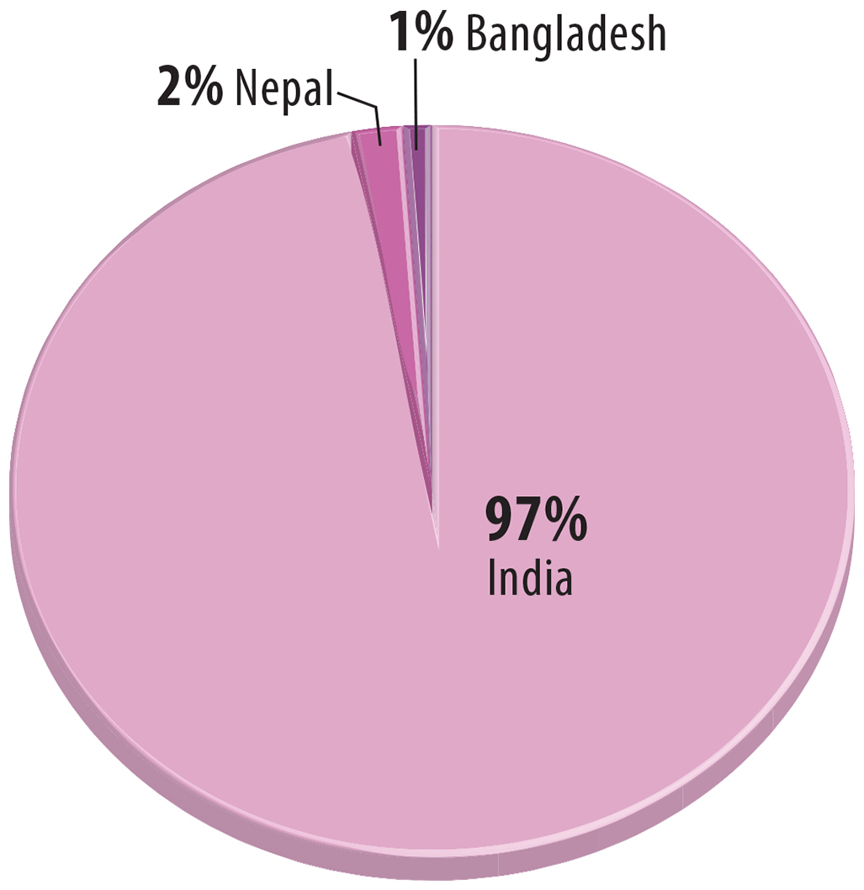
1.5 Distribution of Hindus
Figure 6-12: Hindus are concentrated nearly entirely in India.

Slide 13
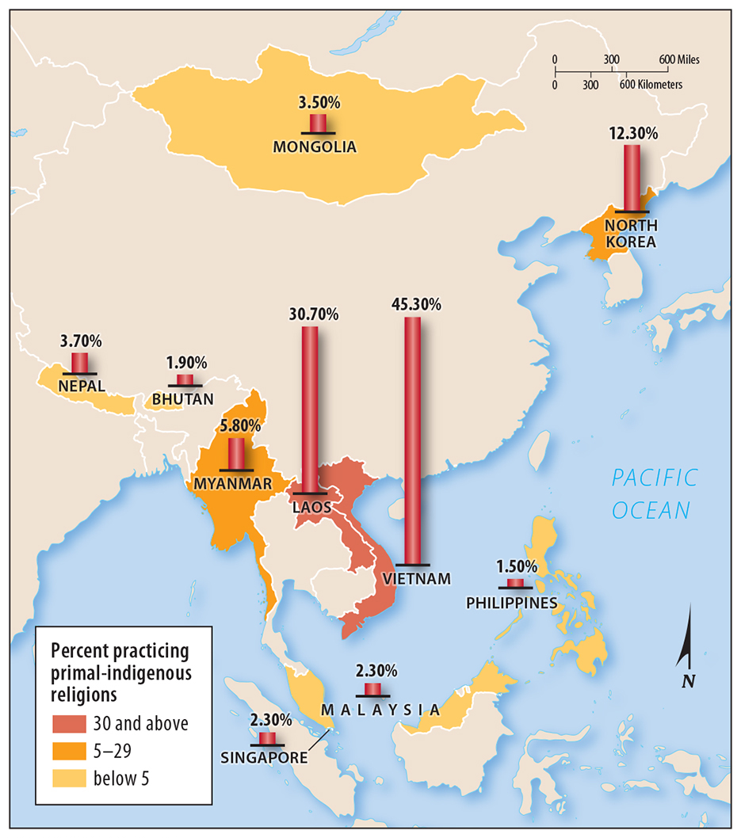
1.5 Distribution of Primal-Indigenous Religions in Southeast Asia
Figure 6-14: Primal-indigenous ethnic religions are relatively common in Southeast Asia.

Slide 14
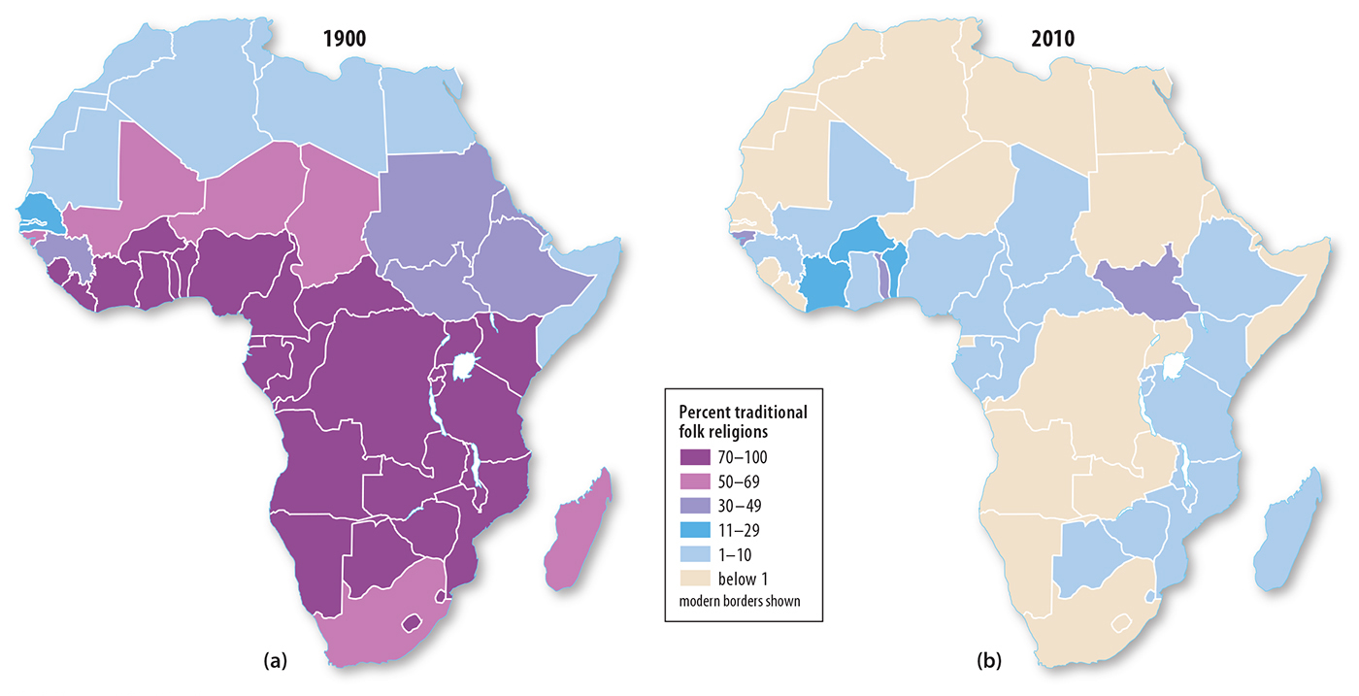
1.5 Distribution of African Traditional Religions, 1900 and 2010
Figure 6-15: Traditional folk religions in Africa have become less common in part because of the activity of Christian and Muslim missionaries.

Slide 15
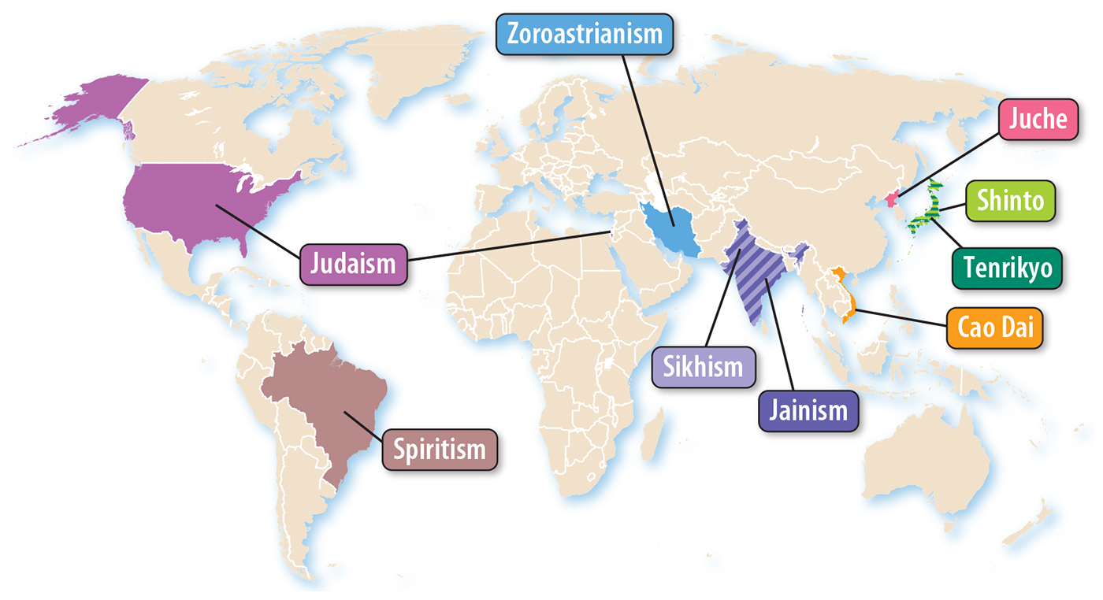
1.6 Clustered Religions With at Least 1 Million Adherents
Figure 6-16: Most of the adherents to clustered religions are in Asia.

Slide 16
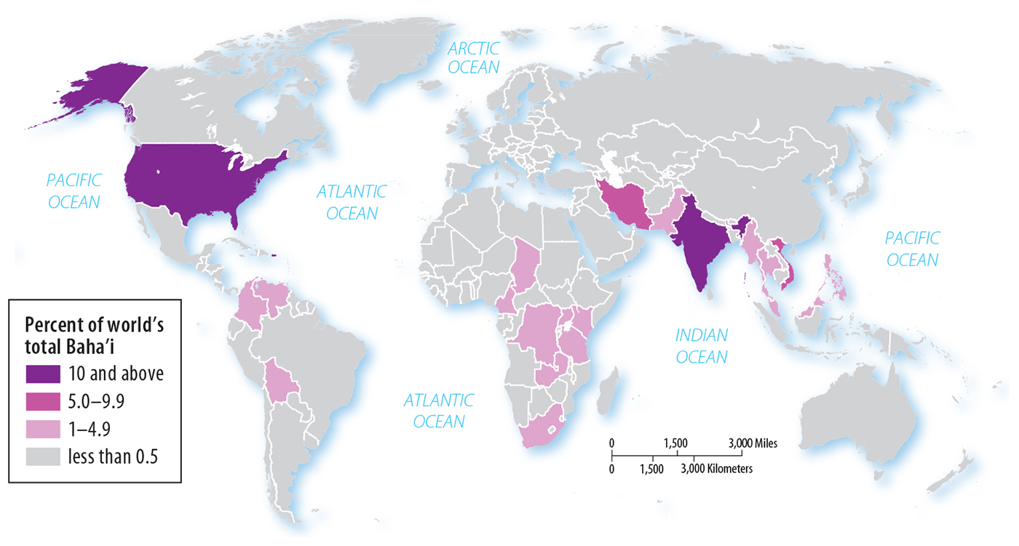
1.6 Distribution of Bahá’ís
Figure 6-18: In contrast to Figure 6-15, the universalizing religion Bahá’í is relatively dispersed in its distribution.

Slide 17
Key Issue 2: Why Do Religions Have Distinctive Distributions?
2.1 Origin of Christianity and Islam in Southwest Asia
2.2 Origin of Buddhism and Hinduism in South Asia
2.3 Historical Diffusion of Religions
2.4 Recent Migration of Christians
2.5 Migration of Muslims and Jews

Slide 18
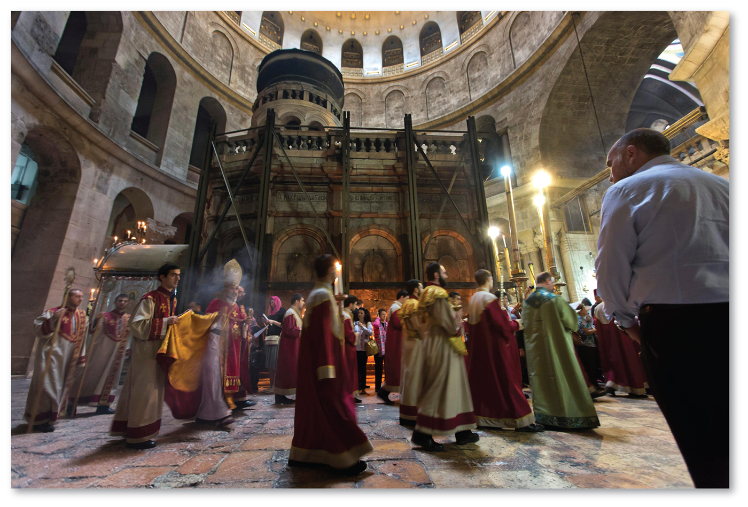
2.1 Origin of Christianity
Figure 6-19: The Church of the Holy Sepulchre in Jerusalem, Israel is a historic site in the origin of Christianity as the site of Jesus’s resurrection.

Slide 19
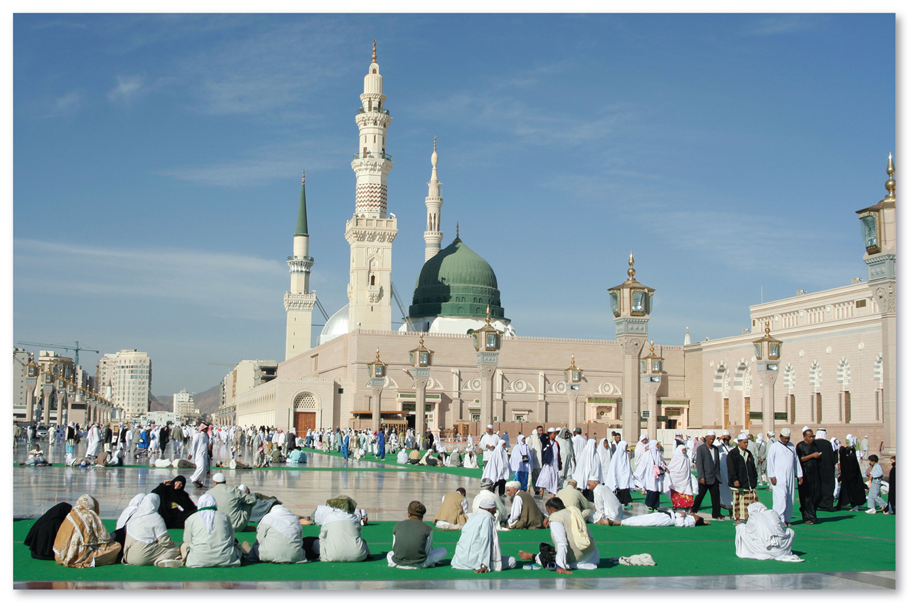
2.1 Origin of Islam
Figure 6-20: The Mosque of the Prophet in Madinah, Saudi Arabia marks the burial place of Muhammad, the Prophet of Islam.

Slide 20
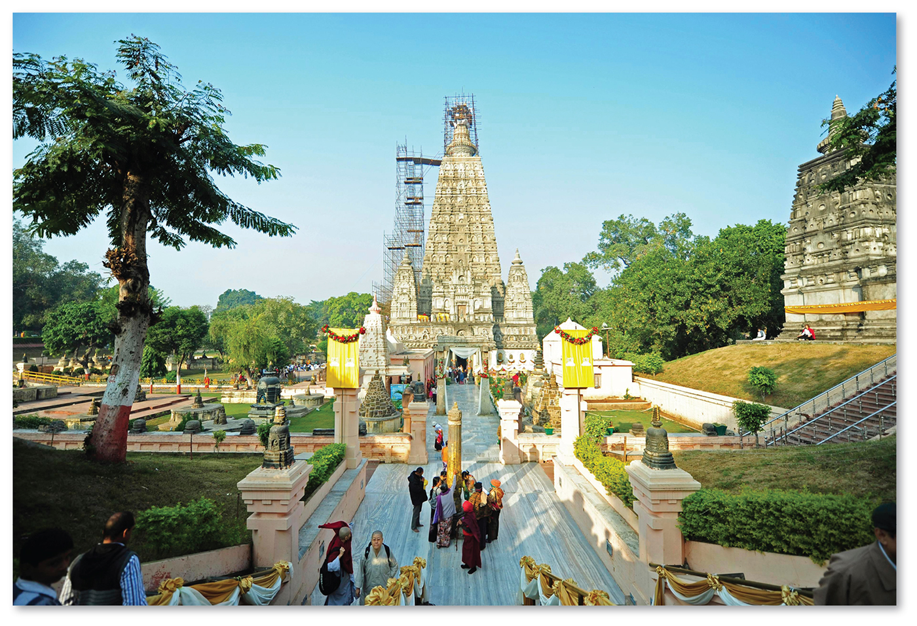
2.2 Origin of Buddhism
Figure 6-21: The Mahabodhi (Great Awakening) Temple represents the place where Buddha attained enlightenment.

Slide 21
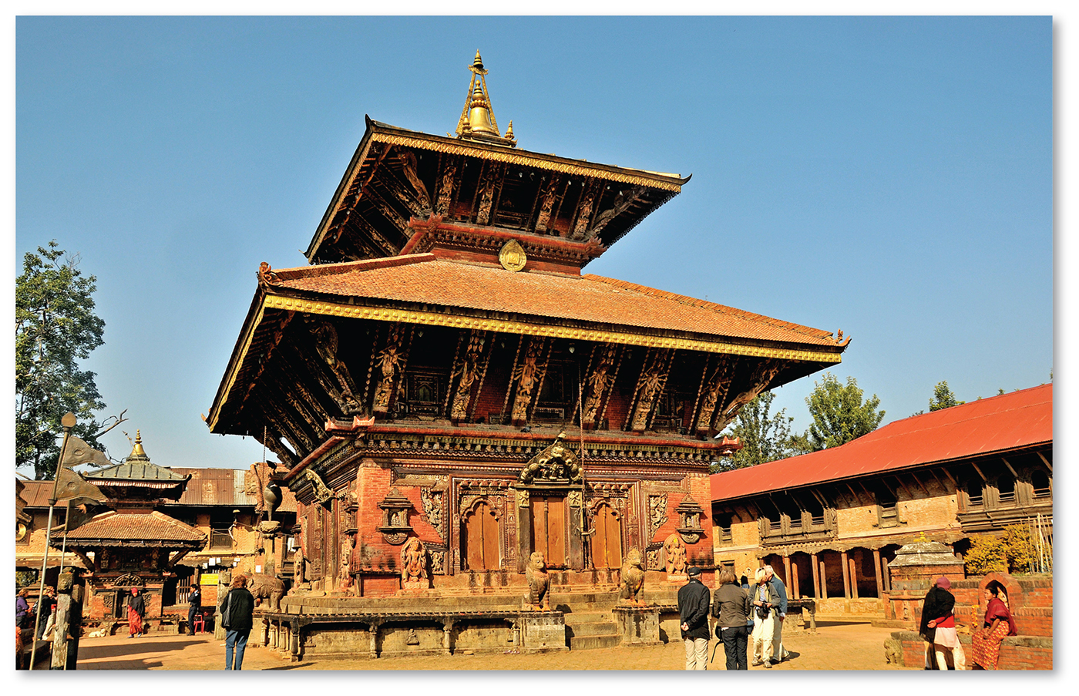
2.2 Unknown Origin of Hinduism
Figure 6-23: Changu Narayan, from around A.D. 325, is the oldest surviving Hindu temple in Nepal, but there is not a known single origin of Hinduism.

Slide 22
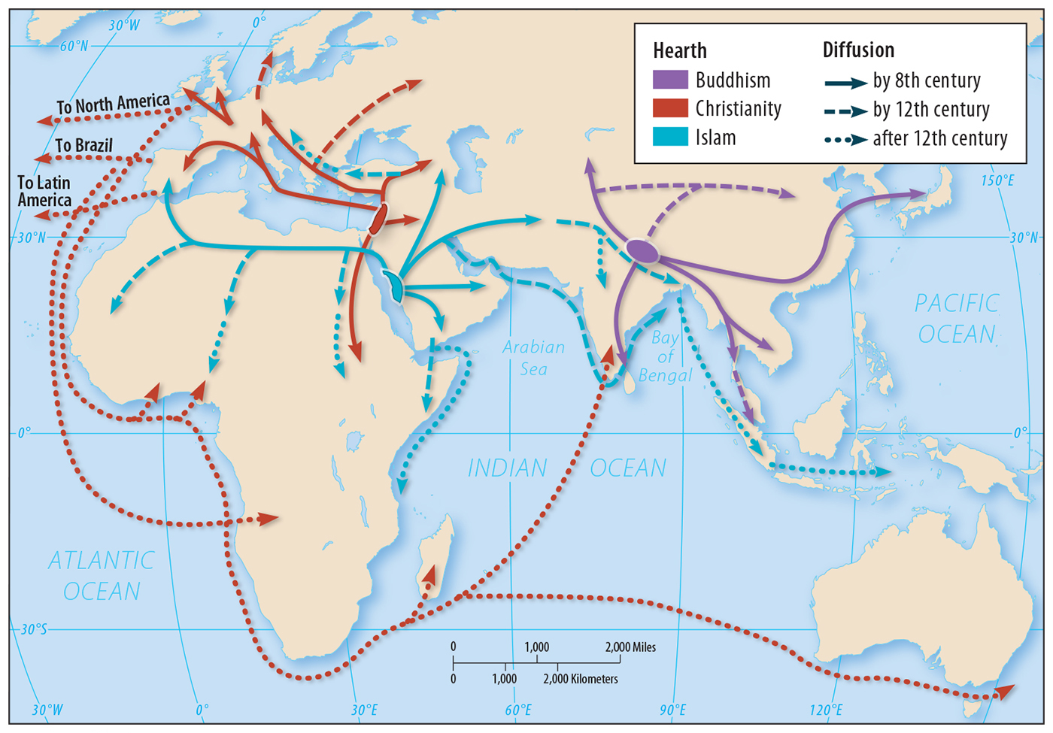
2.3 Diffusion of Universalizing Religions
Figure 6-24: Universalizing religions have diffused around the world. Note overlaps for consideration in discussion of territorial conflicts (Key Issue 4).

Slide 23
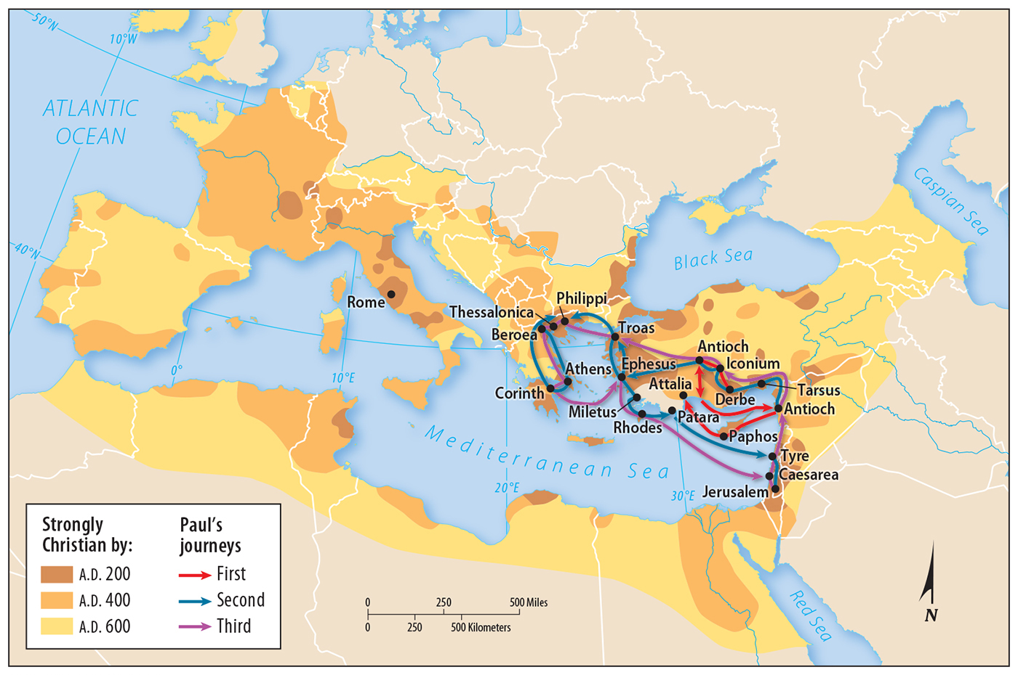
2.3 Early Diffusion of Christianity
Figure 6-25: Christianity was spread around the Mediterranean by missionaries and the conversion of rulers.

Slide 24
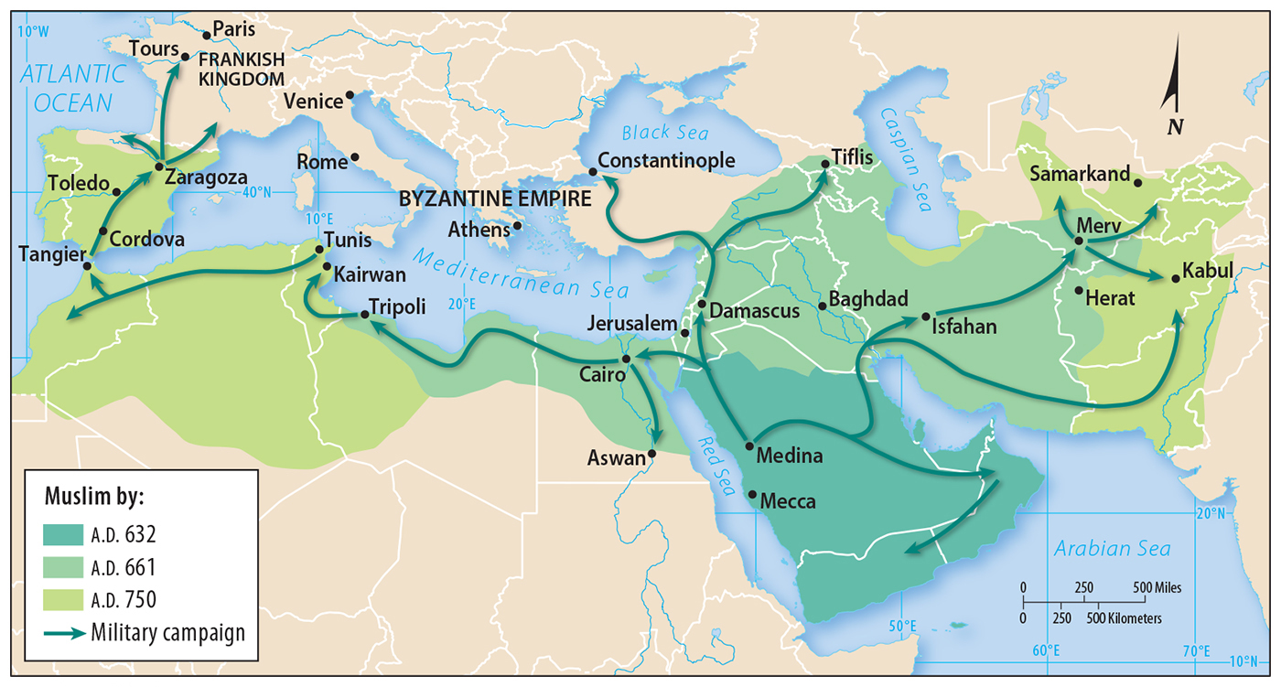
2.3 Diffusion of Islam
Figure 6-26: Islam diffused through a combination of military campaigns and missionary activity.

Slide 25
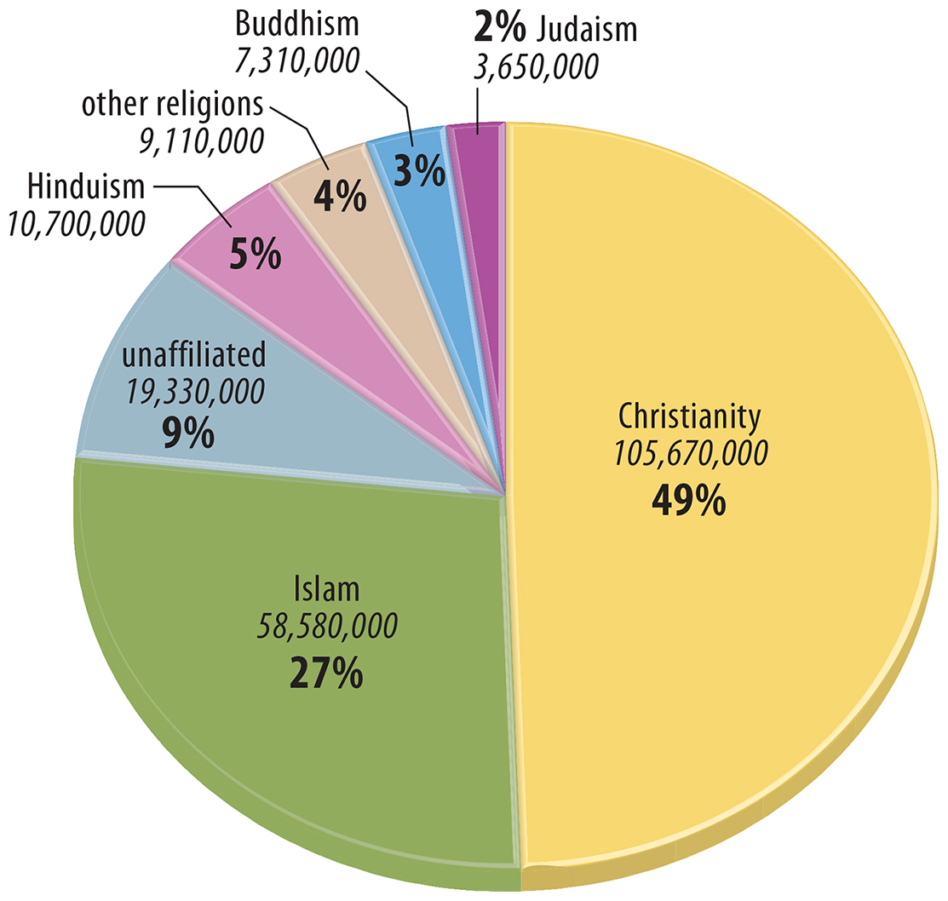
2.4 Religion of International Migrants
Figure 6-27: Christians make up a disproportionate share of migrants (less than one-third of the world’s population is Christian).

Slide 26
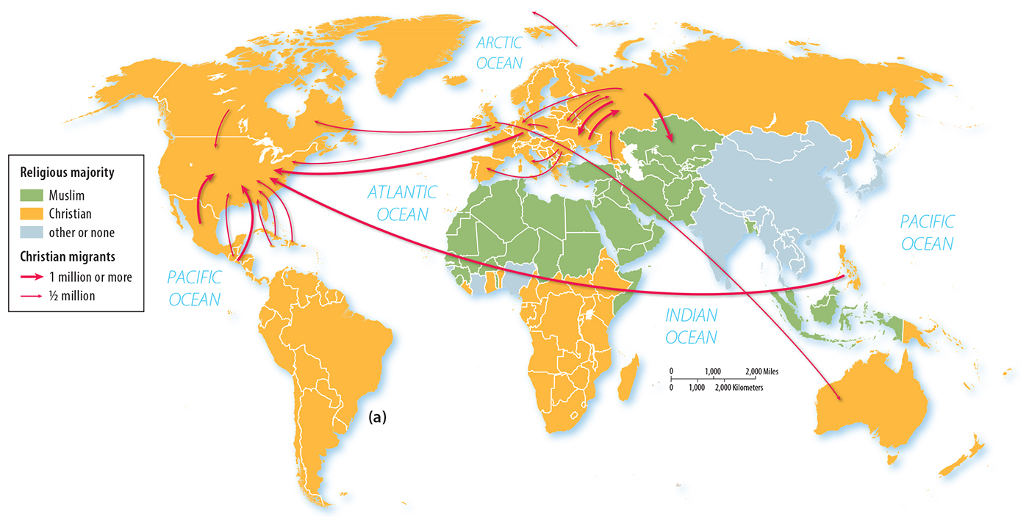
2.4 Migration of Christians
Figure 6-29(a): Large flows of Christians are from countries with Christian majorities into other countries with Christian majorities.

Slide 27
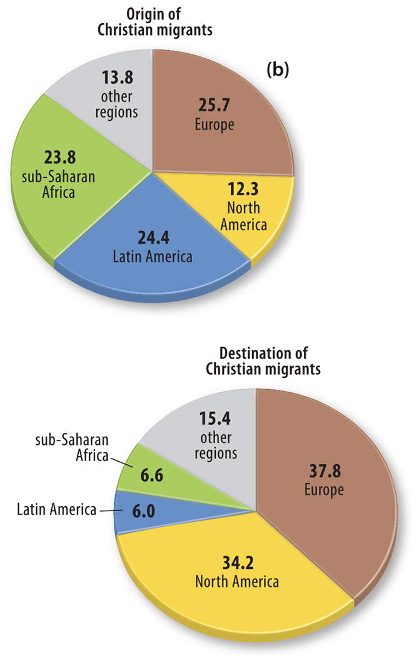
2.4 Origin and Destination of Christian Migrants
Figure 6-29(b): Europe and North America are popular destinations for Christian migrants.

Slide 28
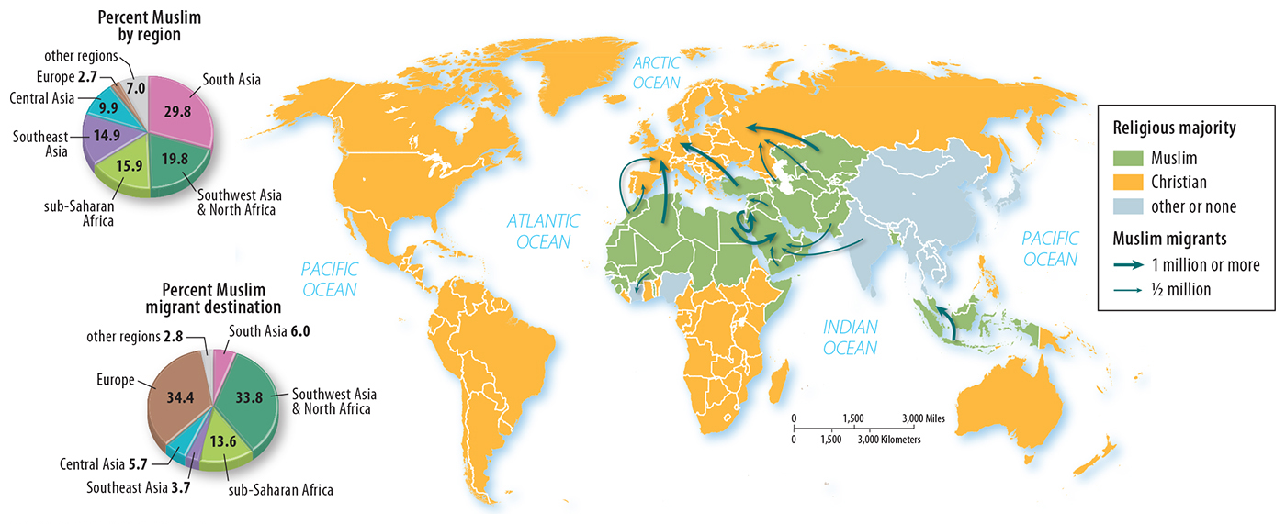
2.5 Largest Flows of Muslim Migrants
Figure 6-33: Some large flows of Muslim migrants are from Muslim-majority countries to other Muslim-majority countries. There are also large flows of Muslims into Christian-majority Europe.

Slide 29
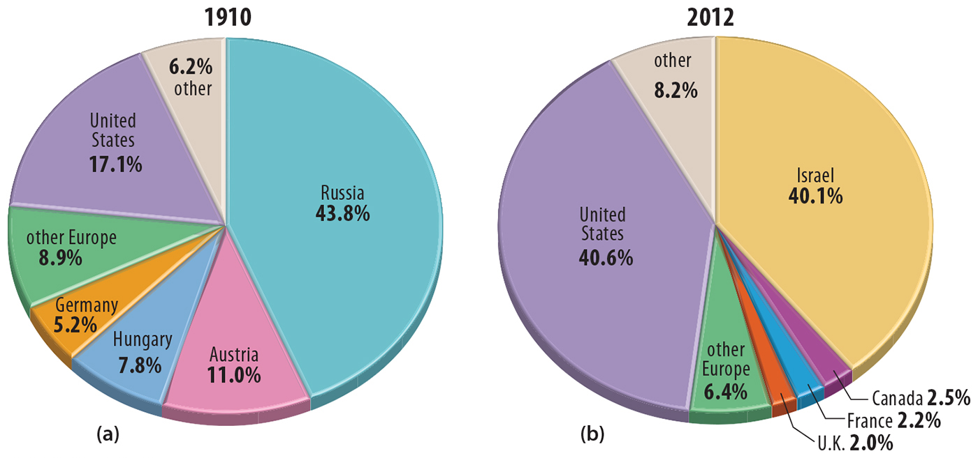
2.5 Distribution of Jews, 1910 and 2012
Figure 6-36: The Jewish population has undergone a major change in distribution from being mostly in Europe to mostly in the United States and Israel.

Slide 30
Key Issue 3: Why Do Religions Organize Space in Distinctive Patterns?
3.1 Places of Worship
3.2 Religious Settlements and Toponyms
3.3 Administration of Space
3.4 Sacred Space in Universalizing Religions
3.5 The Landscape in Ethnic Religions
3.6 Religious Calendars

Slide 31
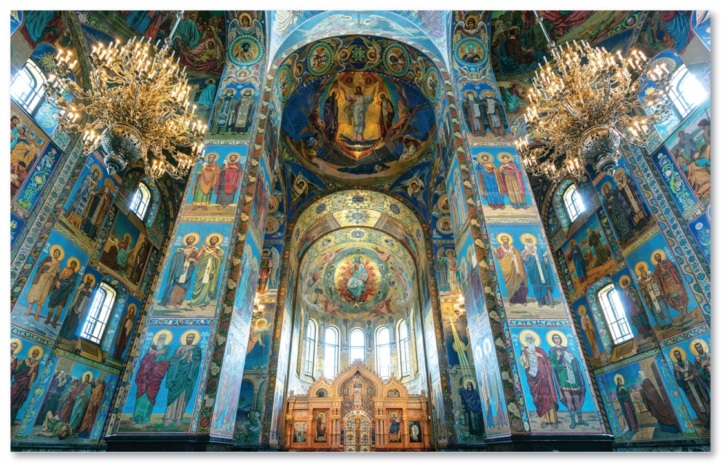
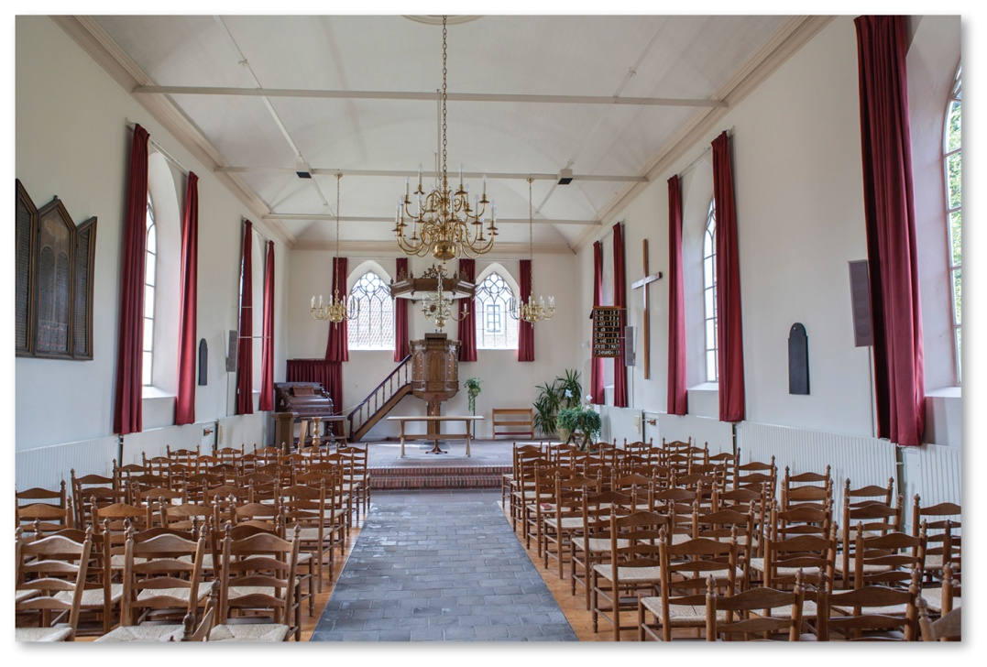
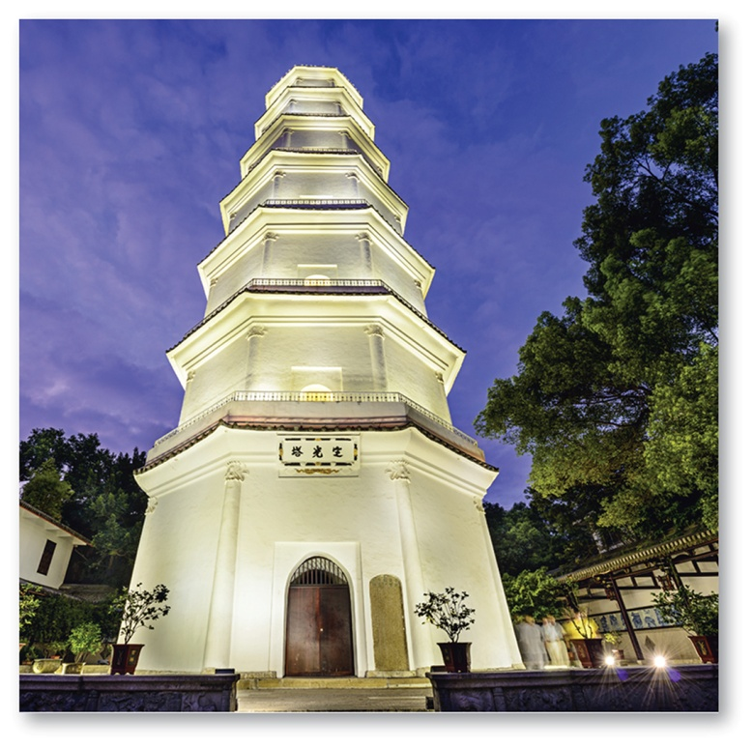
3.1 Places of Worship
Figures 6-37, 6-38, and 6-39: An Orthodox church (above), Protestant church (top right), and Buddhist pagoda (bottom right) are sacred structures to adherents of each religion.

Slide 32
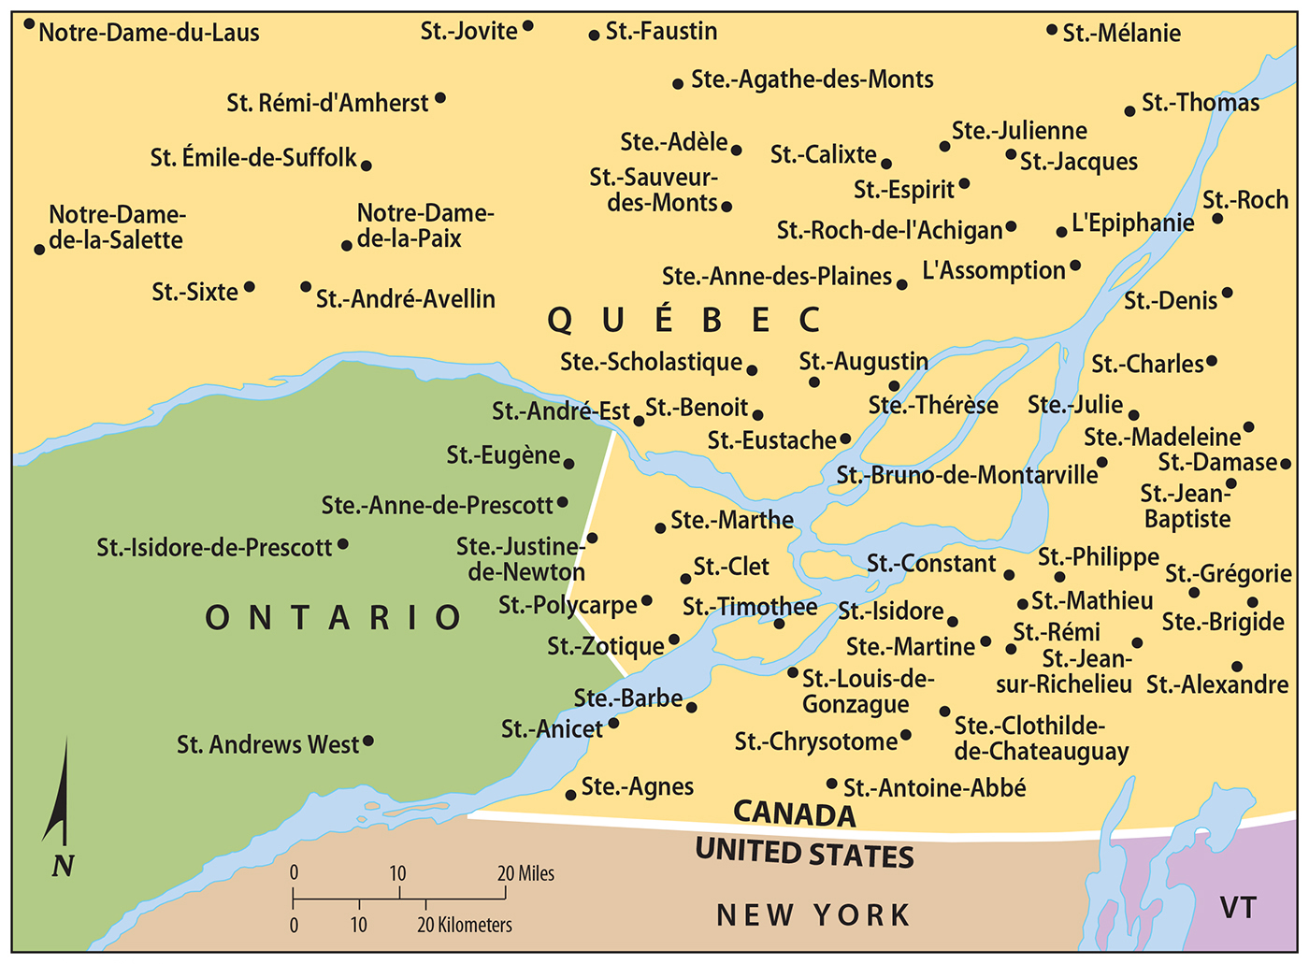
3.2 Religious Toponyms in Canada
Figure 6-41: Places named after saints reflect the influence of Roman Catholicism.

Slide 33
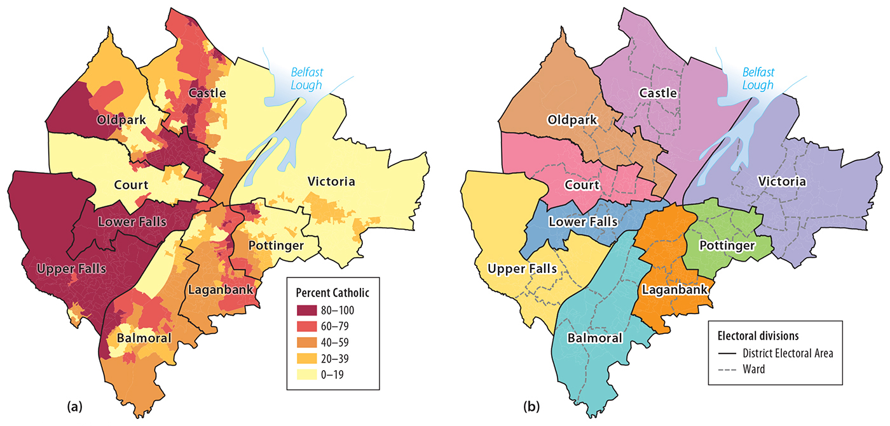
3.2 Mapping Religious Segregation
Figure 6-42: Electoral divisions in Northern Ireland show concentrations of Irish Catholics in certain electoral divisions and concentrations of Protestants in others.

Slide 34
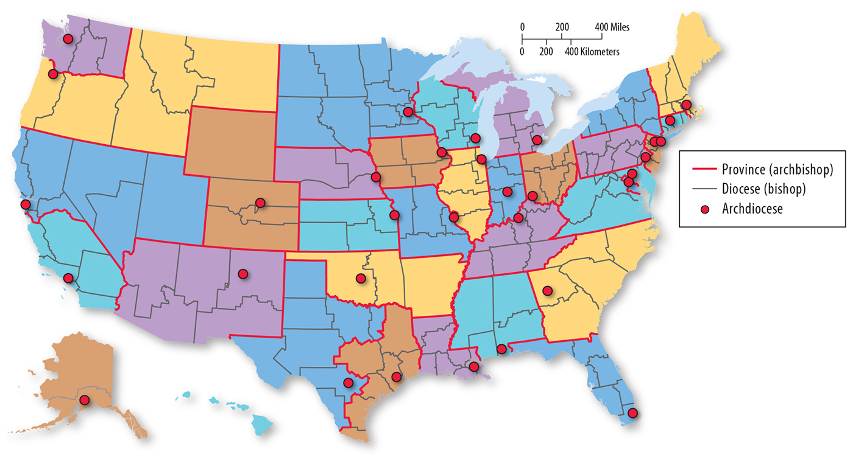
3.3 Roman Catholic Hierarchy in the U.S.
Figure 6-43: The Catholic Church divides space into provinces and dioceses with administrative clergy over each level of the hierarchy.

Slide 35
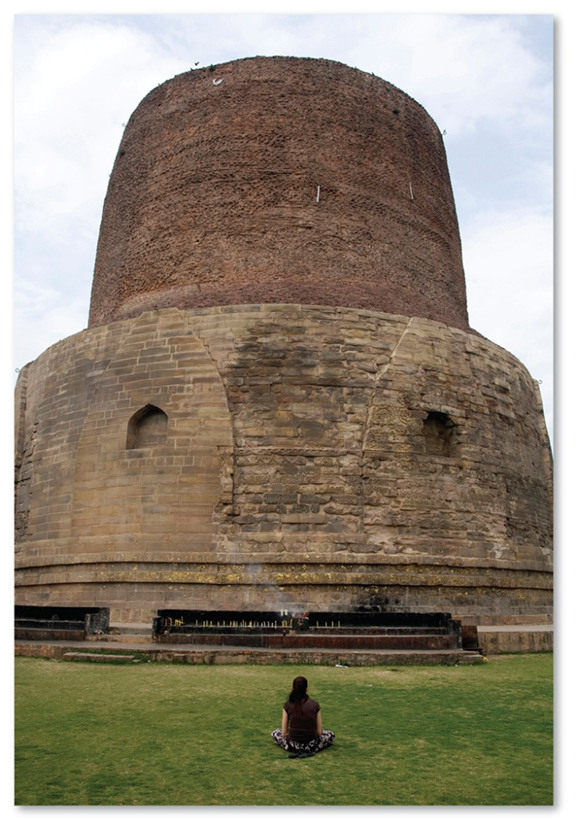
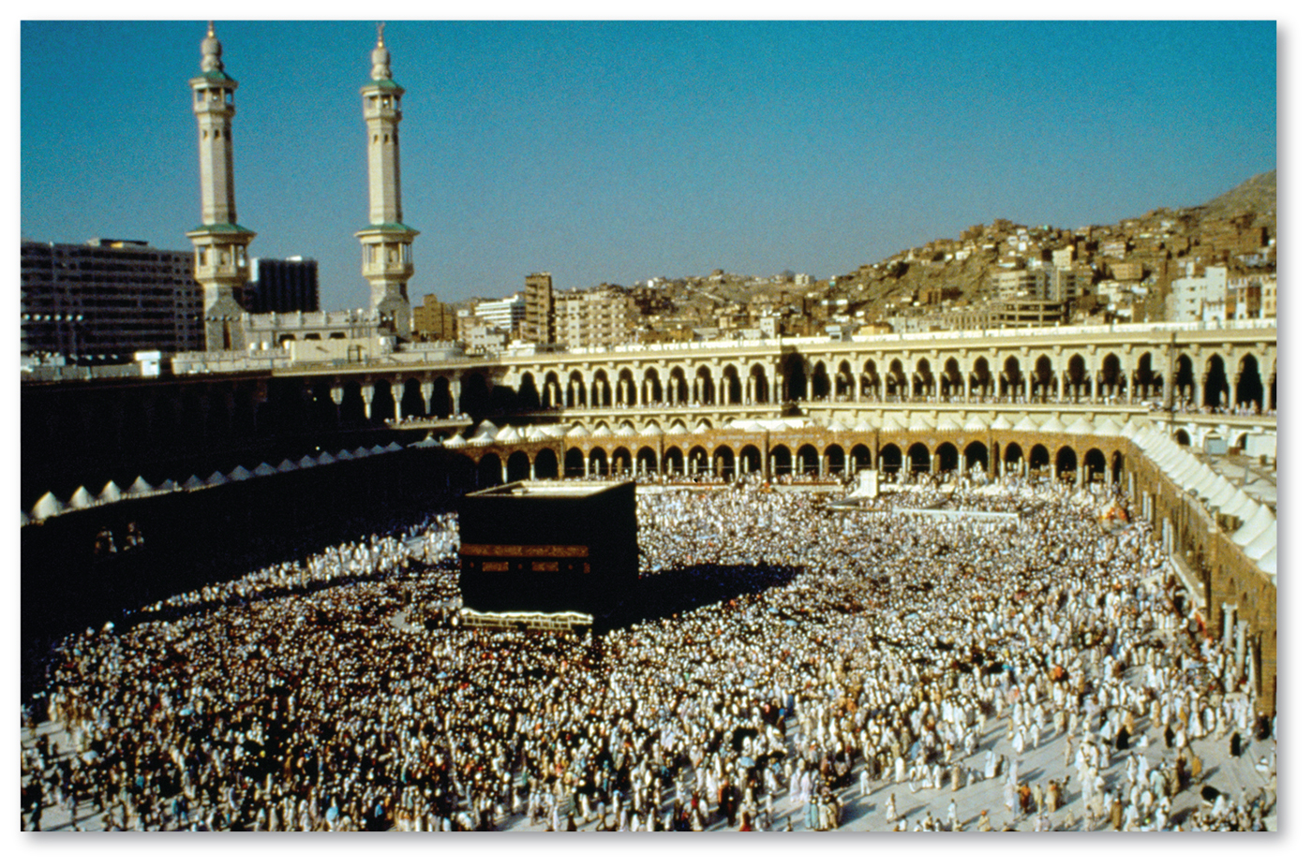
3.4 Sacred Space in Universalizing Religions
Figures 6-47 and 6-48: Dhamek Stupa (left) in Sarnath, India is sacred to Buddhists. The Masjid al-Haram (Great Mosque) in Makkah, Saudi Arabia is sacred to Muslims.

Slide 36
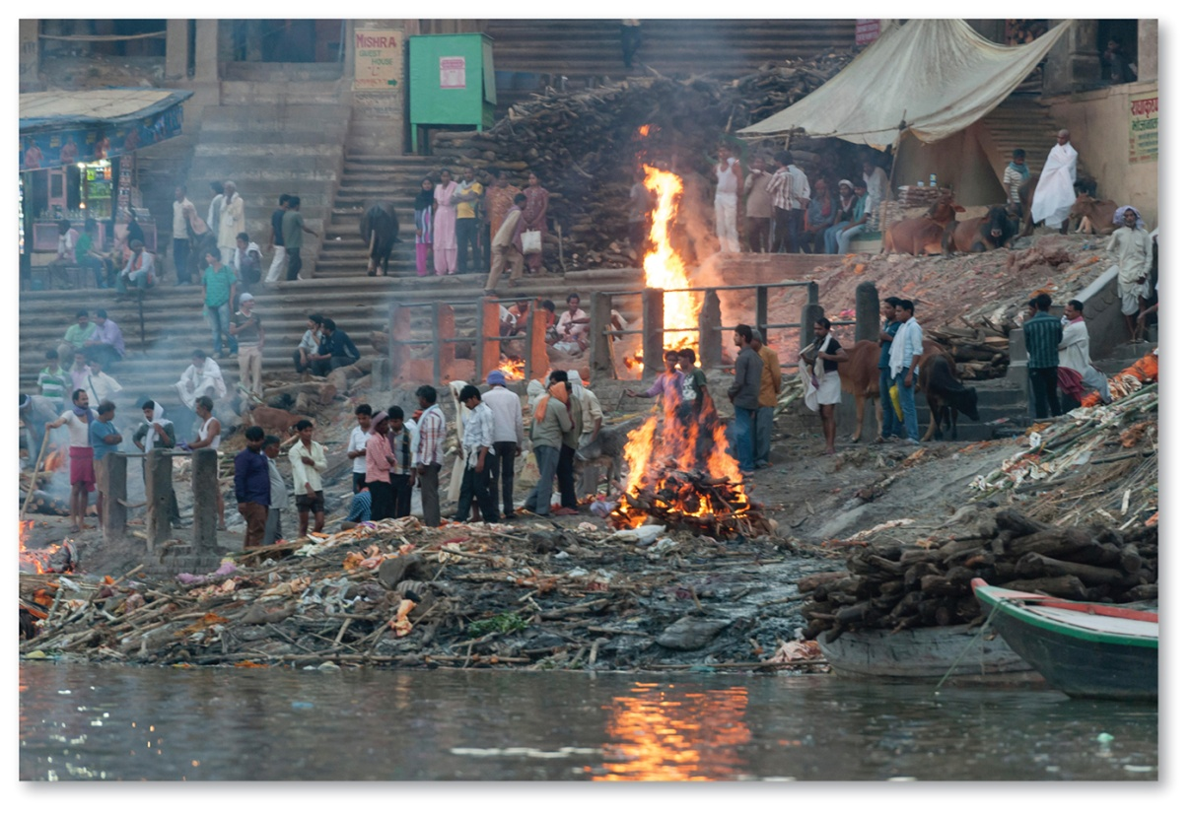
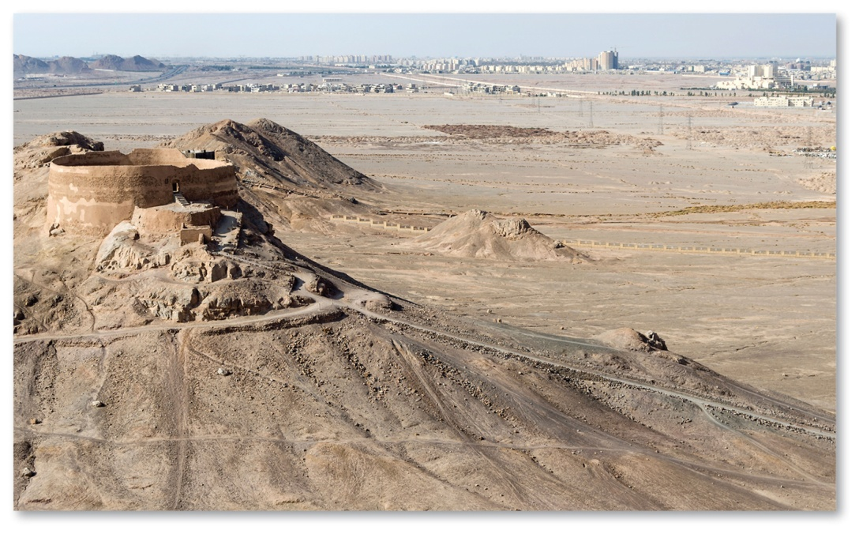
3.5 The Landscape in Ethnic Religions
Figures 6-49 and 6-50: Ethnic religions differ in views of disposal of the dead. Hindus favor cremation at Varanasi (left), while Zoroastrians historically preferred open exposure (right).

Slide 37
3.6 Religious Calendars
Universalizing religions tend to recognize dates in the life of the founder.
Ethnic religions’ calendars are more organized around seasons.

Slide 38
Key Issue 4: Why Do Territorial Conflicts Arise Among Religious Groups?
4.1 Challenges for Religions in South and East Asia
4.2 Challenges for Religions in Central and Southwest Asia
4.3 Geographic Perspectives in the Middle East
4.4 Jerusalem’s Challenging Geography

Slide 39
4.1 Challenges for Religions in South and East Asia
Hindu’s traditional caste system—conflict with social equality
Religious revival after Soviet Communist era ended
Continued conflict between religion and communism in China

Slide 40
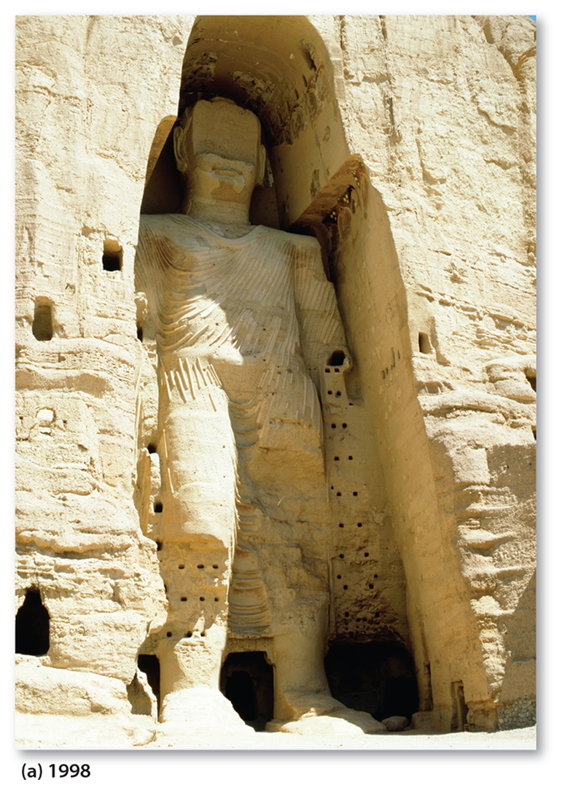
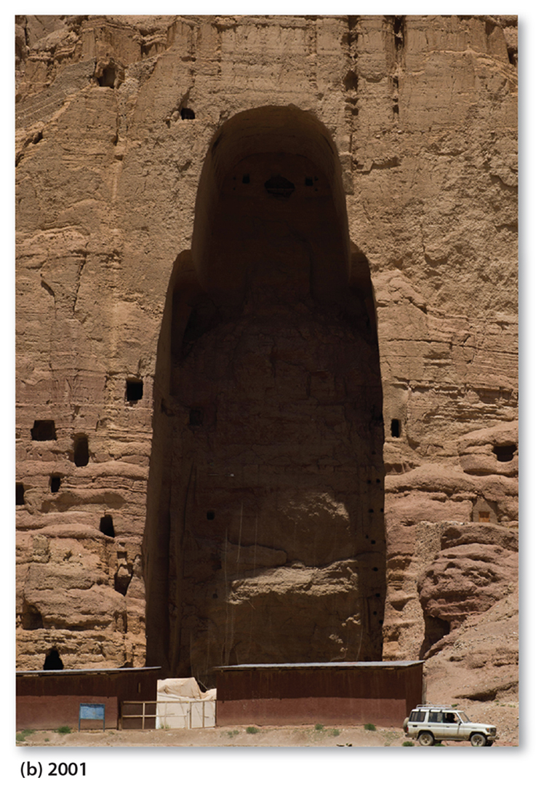
4.2 Taliban vs. Western Values
Figure 6-55: The Taliban, in Afghanistan’s strict interpretation of Islamic values, led to laws and actions counter to many Western values, including the destruction of this statue of Buddha.

Slide 41
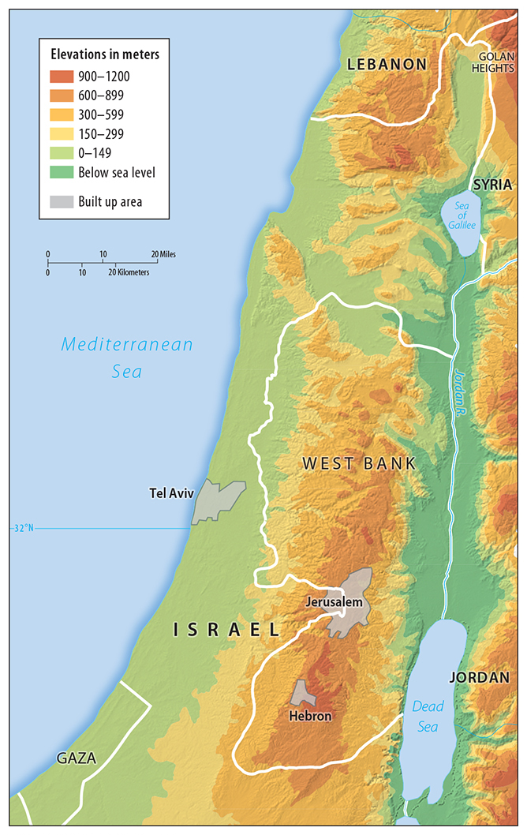
4.2 Conflict in the Middle East
Figure 6-56: The area of present-day Israel has a long history of conflicting Jewish, Christian, and Muslim claims.

Slide 42
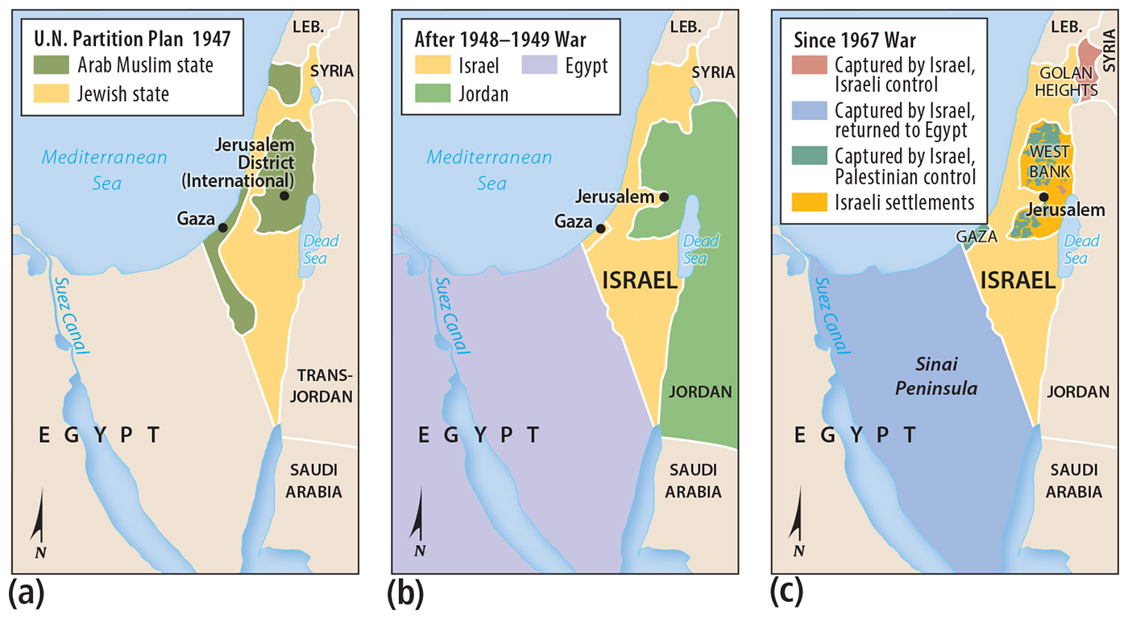
4.3 Territorial Changes in Israel and its Neighbors
Figure 6-57: Israel’s territory has expanded since 1947. Israel’s possession of territory dedicated to Palestinians remains controversial.

Slide 43
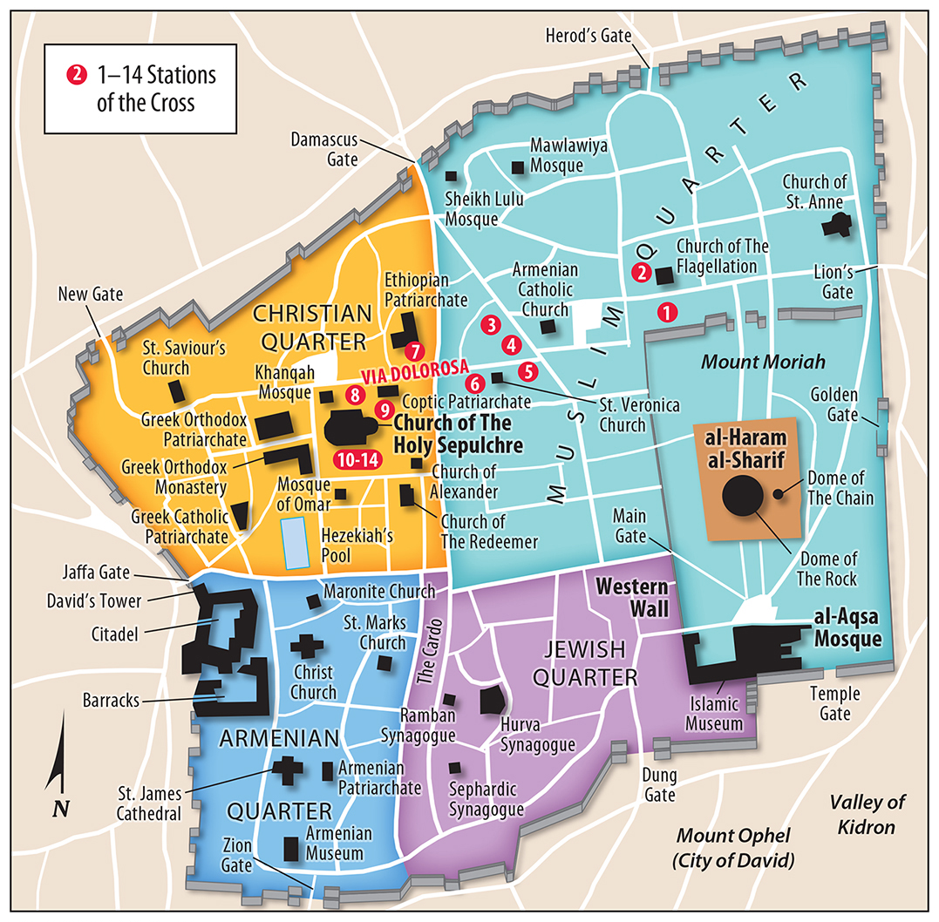
4.4 Jerusalem’s Challenging Geography
Figure 6-58: The Old City of Jerusalem is divided into quarters due to competing religious claims.

Slide 44
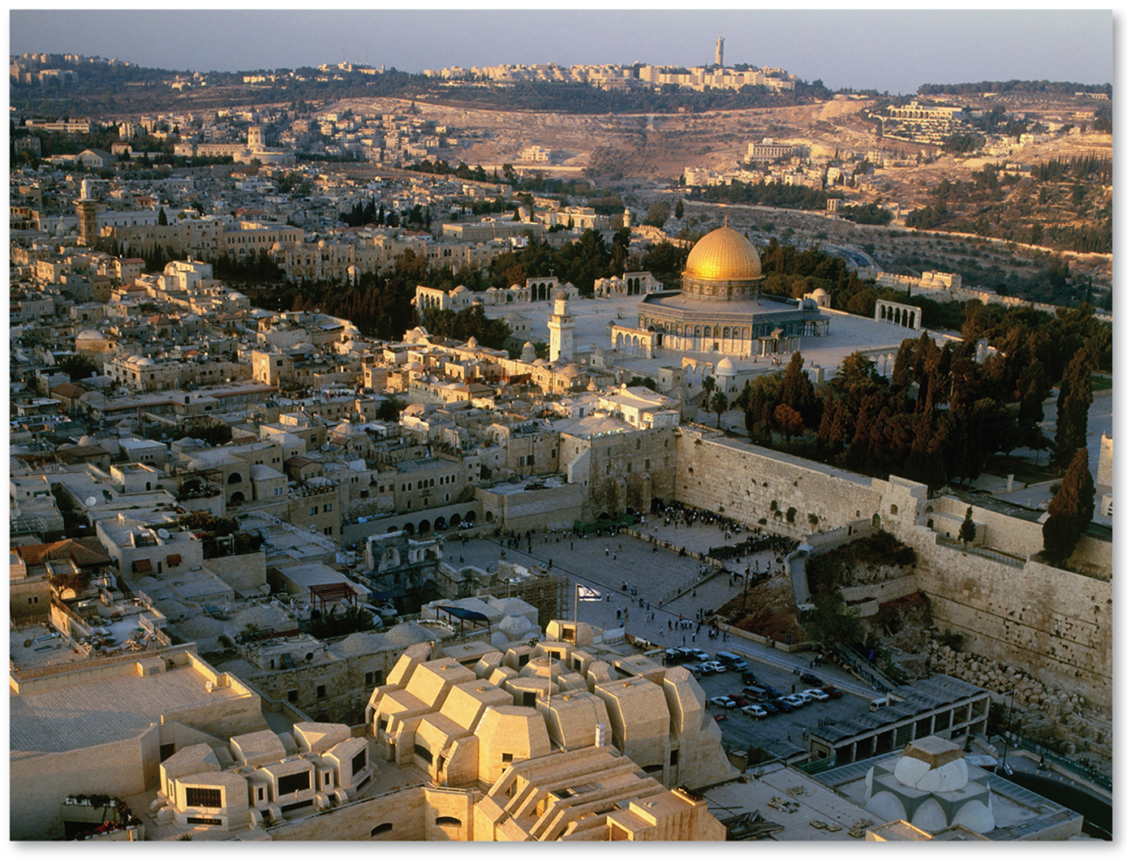
4.4 Jerusalem’s Challenging Geography
Figure 6-59: The Dome of the Rock, a holy site to Muslims, is next to the Western Wall, a site sacred to Jews.

Slide 45
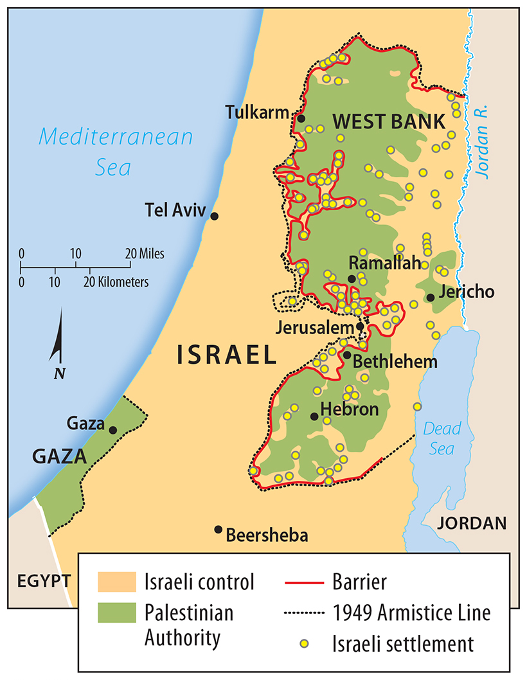
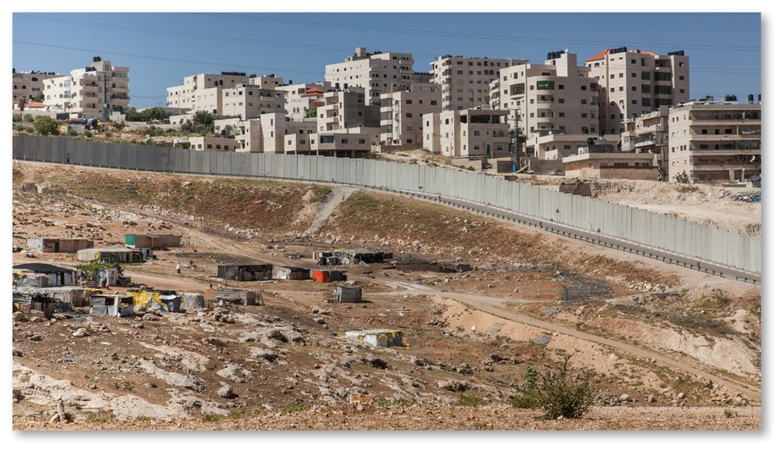
4.4 Jerusalem’s Challenging Geography
Figures 6-60 and 6-61: Israel is building a security fence on the boundary with the West Bank.

Slide 46
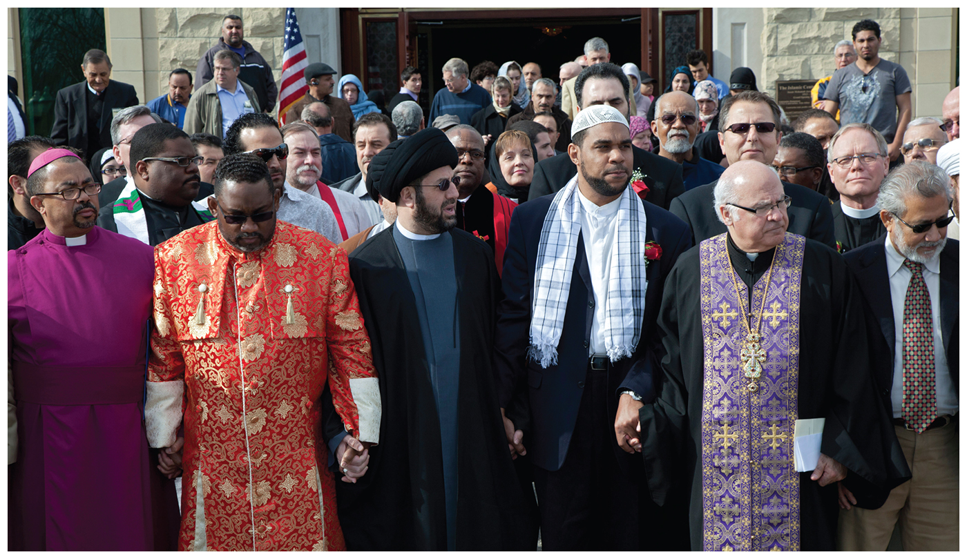
Chapter End

