Slide 1
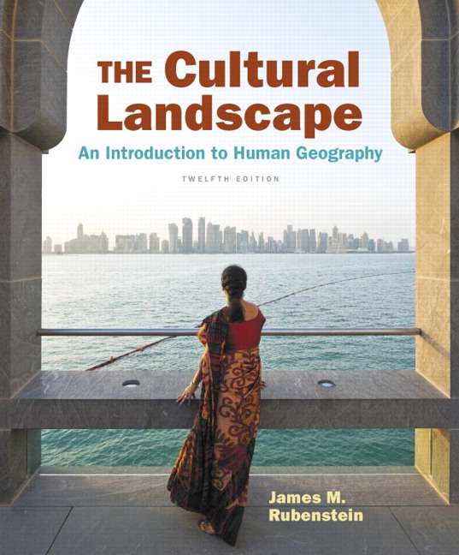
Chapter 5 Lecture
Chapter 5 Languages
Tim Scharks Green River College

Slide 2
Languages: Key Issues
Where Are the World’s Languages Distributed?
Where Did English and Related Languages Originate and Diffuse?
Why Do Individual Languages Vary Among Places?
Why Do Local Languages Survive?

Slide 3
Key Issue 1: Where Are the World’s Languages Distributed?
1.1 Introducing Languages
1.2 Language Families
1.3 Two Largest Language Families
1.4 Other Large Language Families

Slide 4
1.1 Introducing Languages
Language moves with speakers; new languages develop in isolation.
May be institutional, developing, vigorous, in trouble, or dying, depending on number of speakers and use.
Organized into families, branches, groups

Slide 5
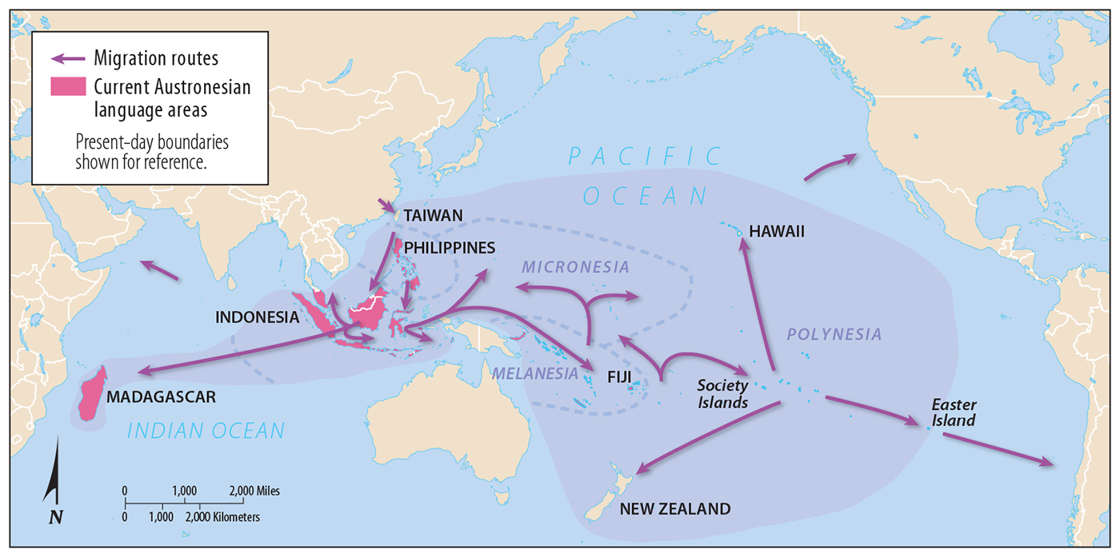
1.1 Language and Migration
Figure 5-1: Austronesian languages are related to one another but have diverged with the isolation of groups after migration.

Slide 6
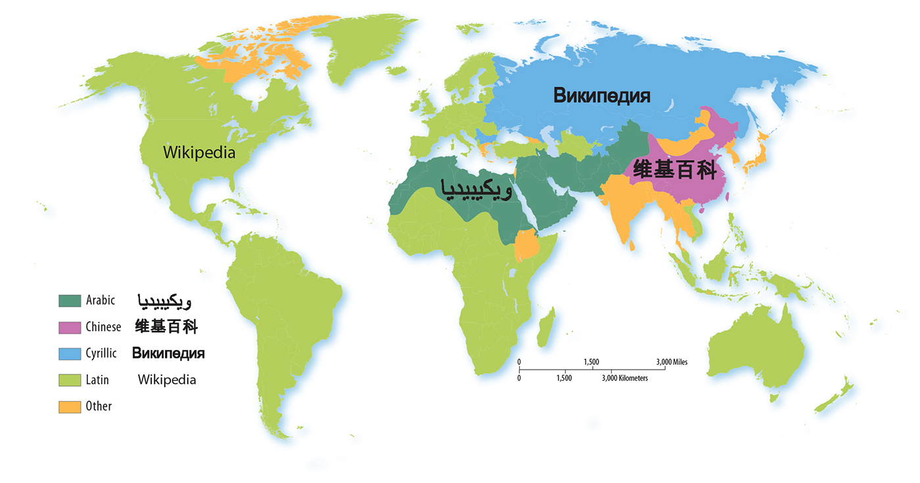
1.1 Writing Systems
Figure 5-2: Institutional and developing languages have literary traditions. The system of writing used for different languages varies across the world.

Slide 7
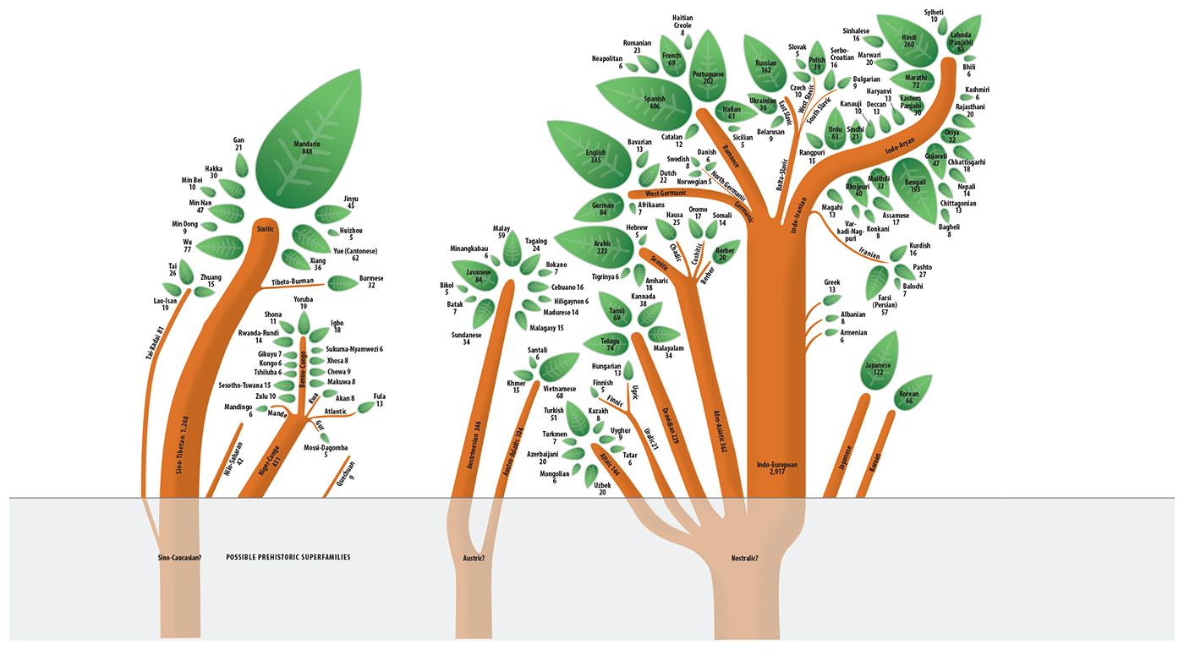
1.2 Language Family Trees
Figure 5-3: If language families are visualized as tree trunks, the branches are branches, the sub-branches are groups, and the leaves are individual languages.

Slide 8
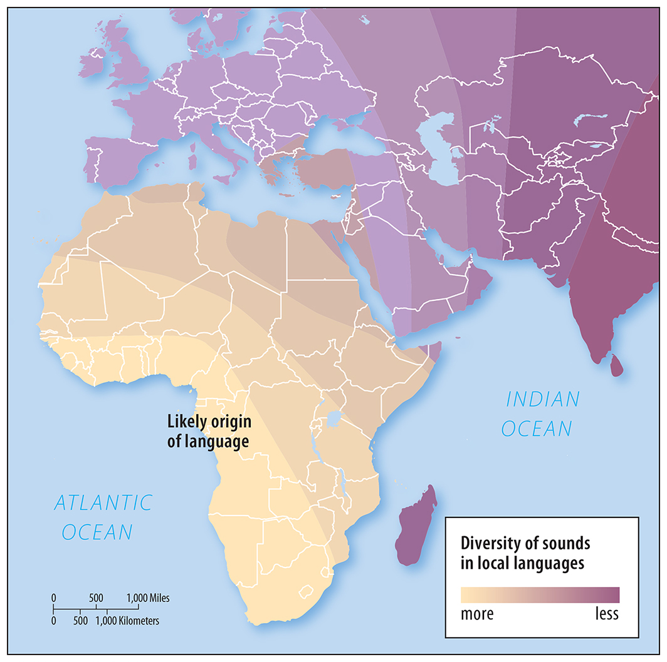
1.2 Origin of Language
Figure 5-4: The most diverse sounds in languages are found in western Africa, implying language originated there and became less diverse with diffusion.

Slide 9
1.2 World’s Major Language Families
Figure 5-5: Nearly half the world’s people speak a language in the Indo-European family, and another fifth speak a Sino-Tibetan language.

Slide 10
1.3 Two Largest Language Families
Indo-European: largest
nearly half of all people
includes Indo-Iranian, Germanic, Romance, Balto-Slavic branches
Sino-Tibetan: second-largest
Mandarin majority of this family

Slide 11
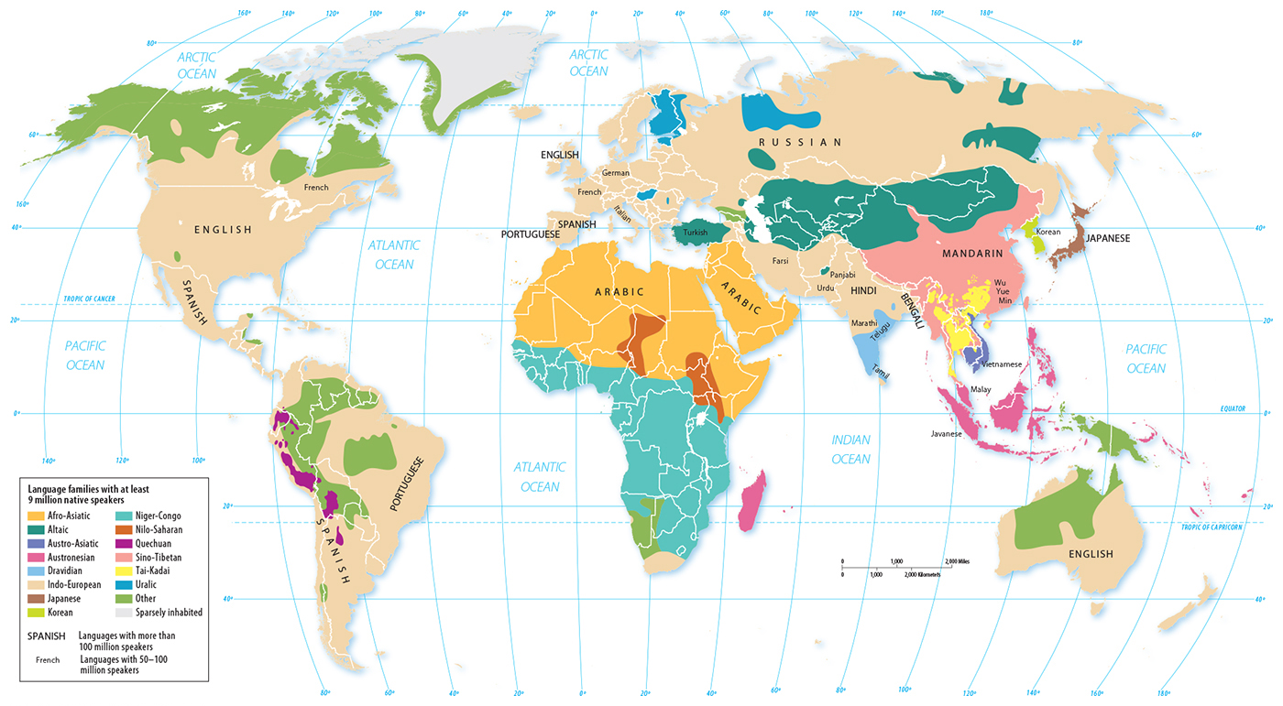
1.3 Distribution of Language Families
Figure 5-6: The Indo-European family has the largest spatial extent. All families with at least nine million native speakers are shown with a color.

Slide 12
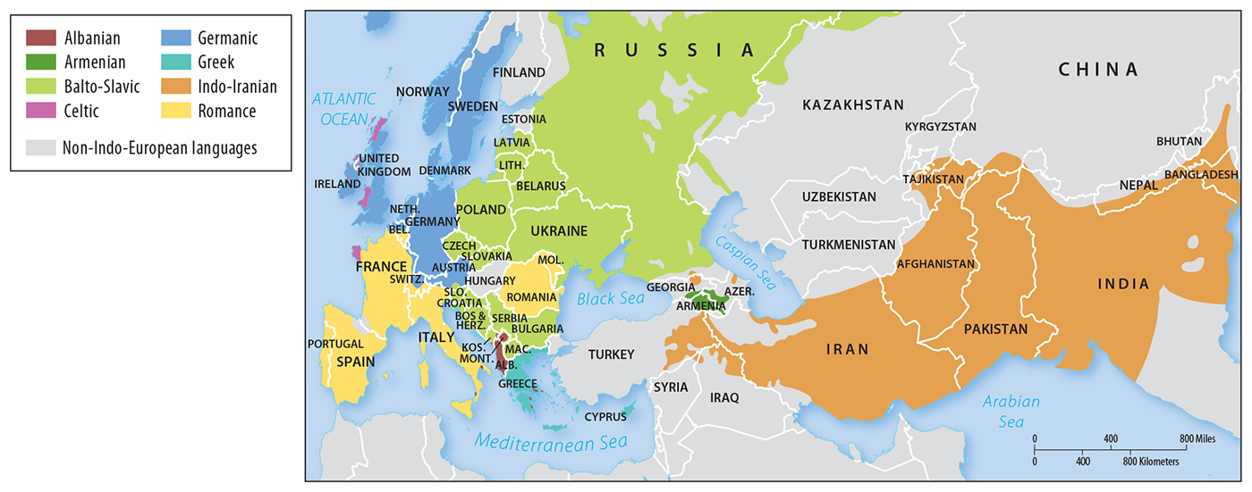
1.3 Branches of Indo-European
Figure 5-7: The largest language groups in Indo-European are Germanic, Balto-Slavic, Indo-Iranian, and Romance.

Slide 13
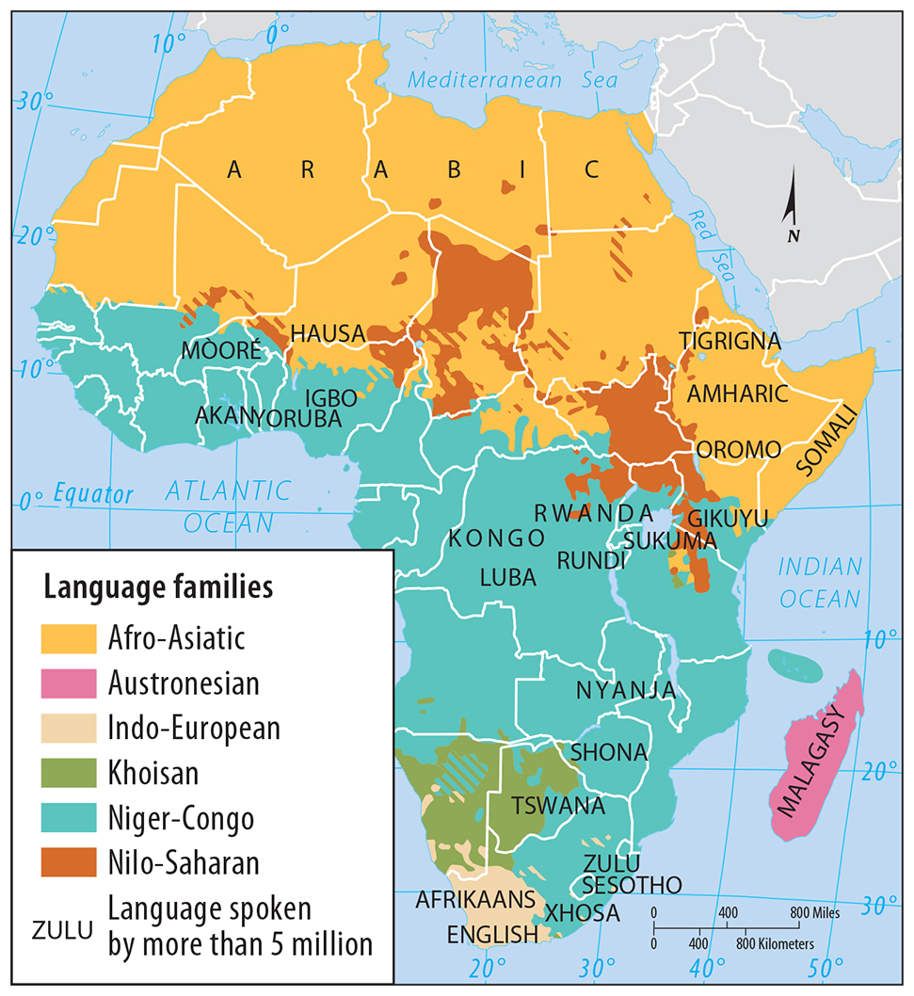
1.4 Africa’s Language Families
Figure 5-9: Africa displays a great diversity of languages. This map displays language families, which can be subdivided into language groups and then individual languages.

Slide 14
Key Issue 2: Where Did English and Related Languages Originate and Diffuse?
2.1 Distribution of Indo-European Branches
2.2 Origin and Distribution of Indo-European
2.3 Origin and Diffusion of English
2.4 Global Importance of English
2.5 Official Languages

Slide 15
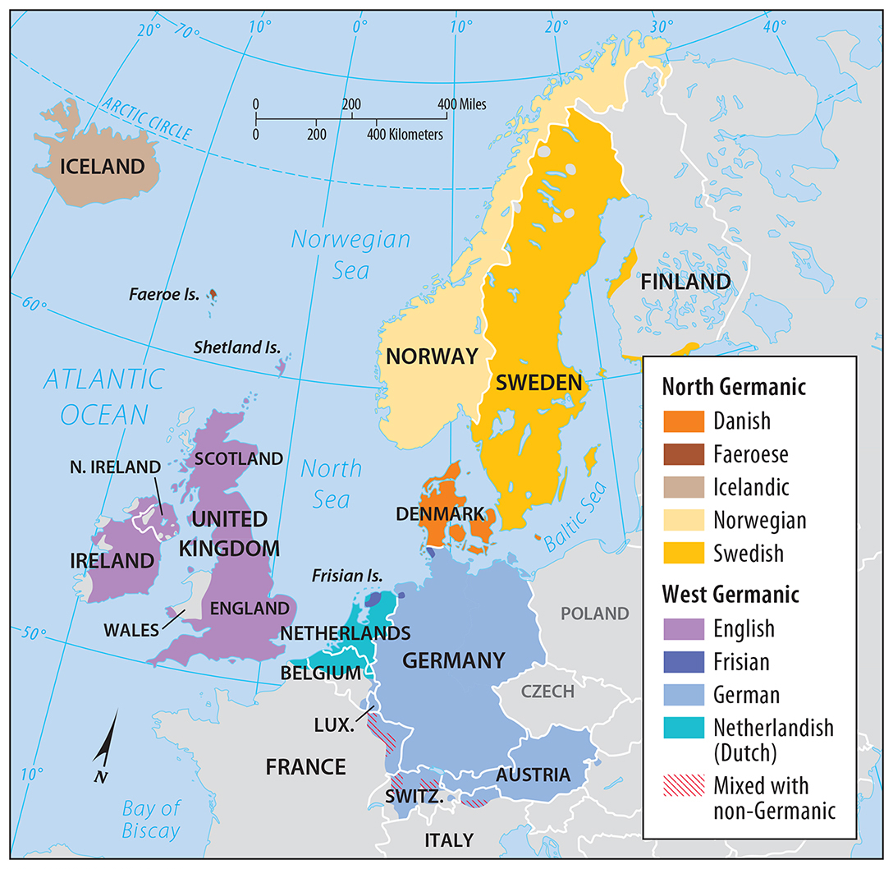
2.1 Germanic Branch of Indo-European
Figure 5-10: The Germanic branch is subdivided into North and West Germanic language groups. English is part of the West Germanic group.

Slide 16
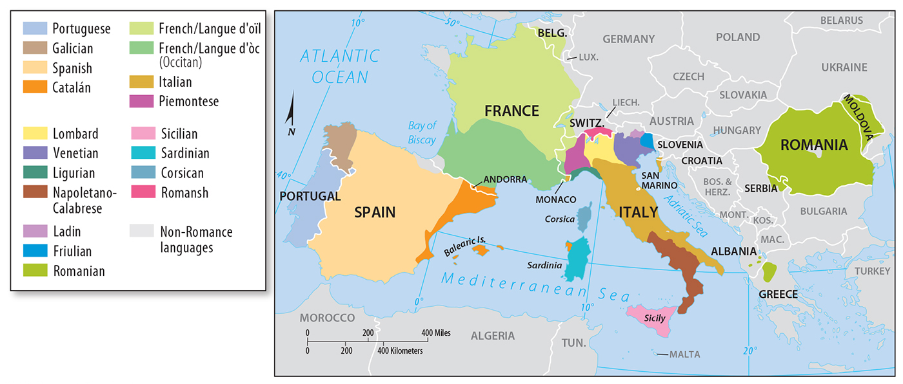
2.1 Romance Branch of Indo-European
Figure 5-11: Romance languages developed from Latin, the language of the Roman empire. The most widely used are Spanish, Portuguese, French, and Italian.

Slide 17
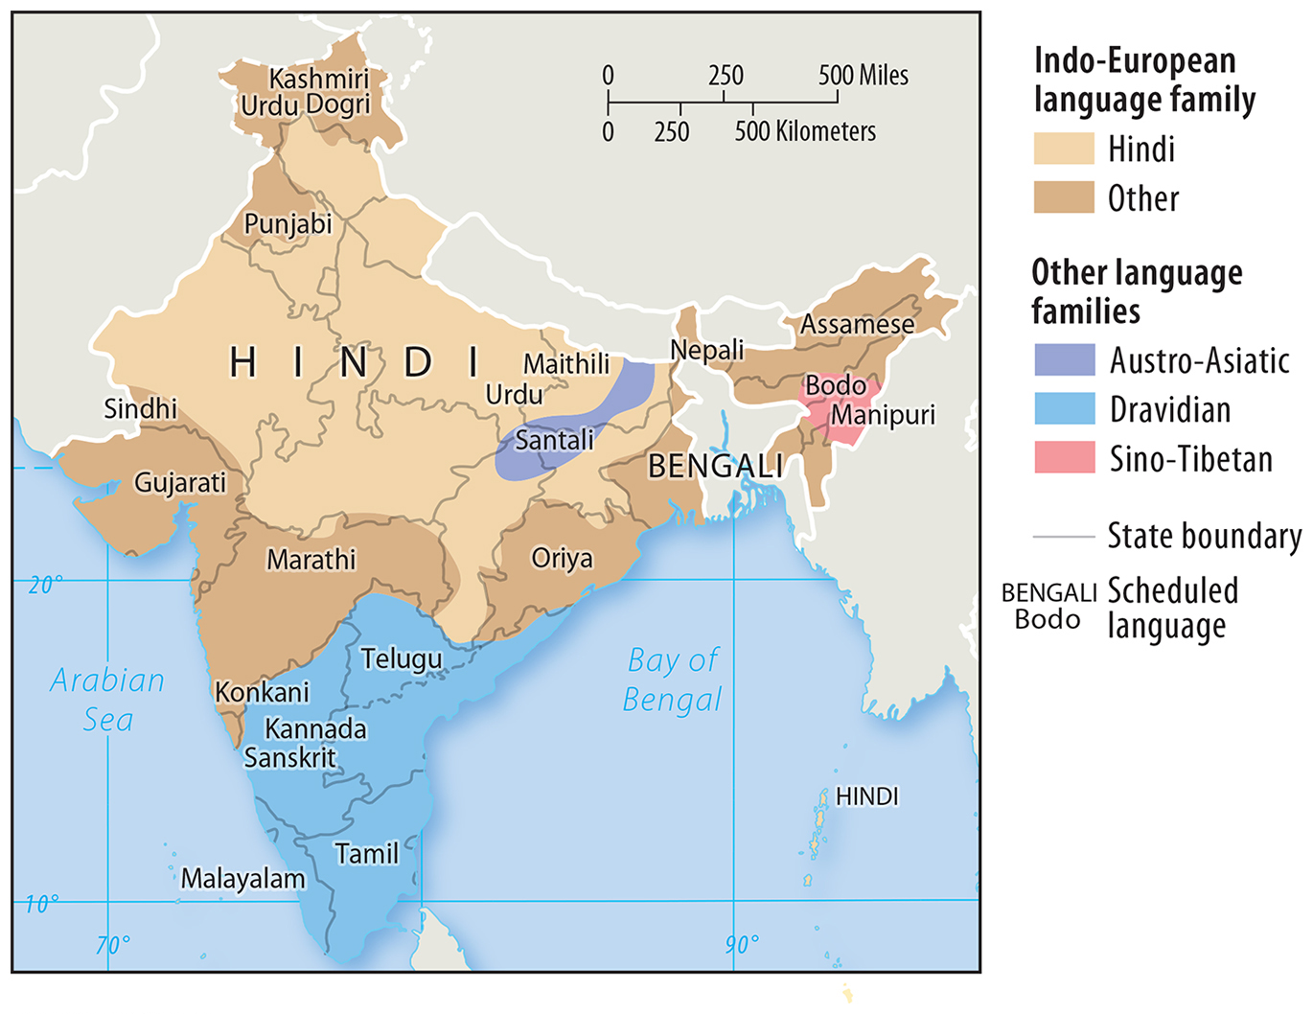
2.1 Language Families in India
Figure 5-12: India’s principal language is Hindi, but there are 22 other scheduled languages.

Slide 18
2.2 Origin and Diffusion of Indo-European
Indo-European is a family of related languages.
Linguists suspect the earliest speakers lived inland near the Europe/Asia boundary.
Two theories:
nomadic warrior
sedentary farmer

Slide 19
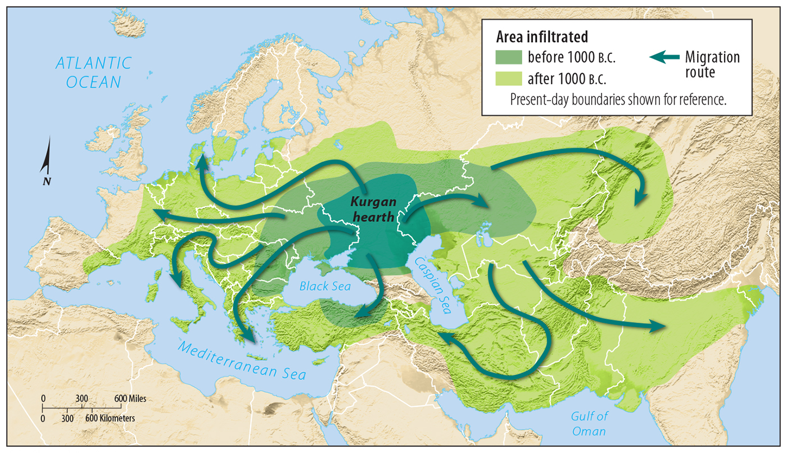
2.2 Origin and Diffusion of Indo-European
Figure 5-14: The nomadic warrior theory proposes a group known as the Kurgans were the original speakers of an Indo-European language.

Slide 20
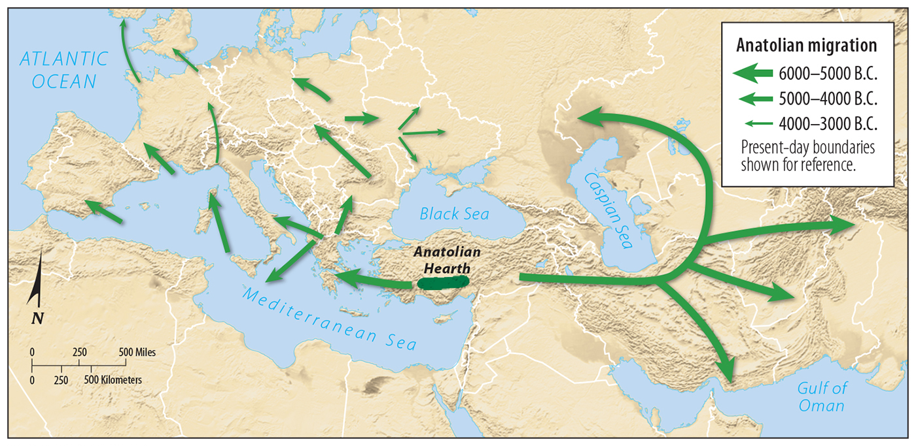
2.2 Origin and Diffusion of Indo-European
Figure 5-15: The sedentary farmer theory proposes original speakers of an Indo-European language were farmers from present-day Turkey.

Slide 21
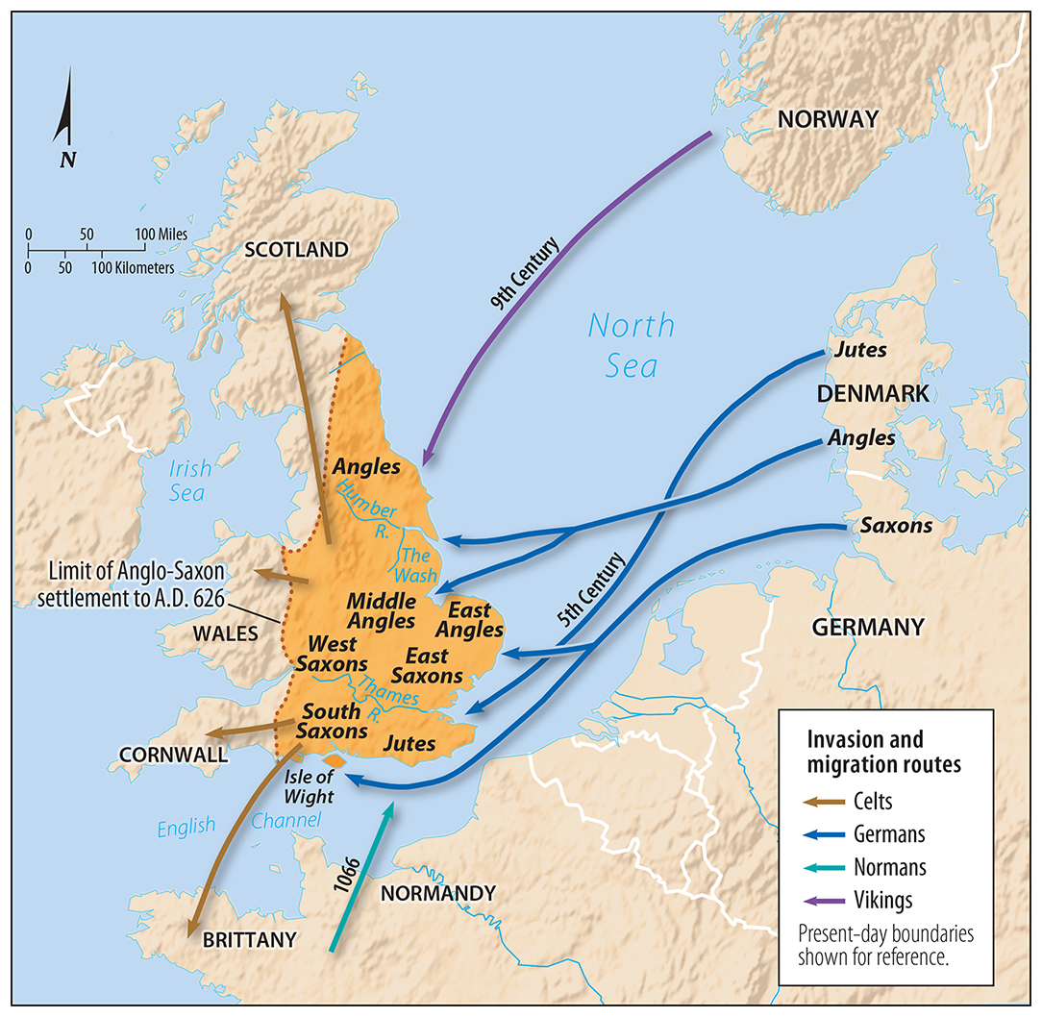
2.3 Invasions of England
Figure 5-16: English has developed from a mix of different language influences from earlier languages already present and those spoken by repeated invasions of different groups.

Slide 22
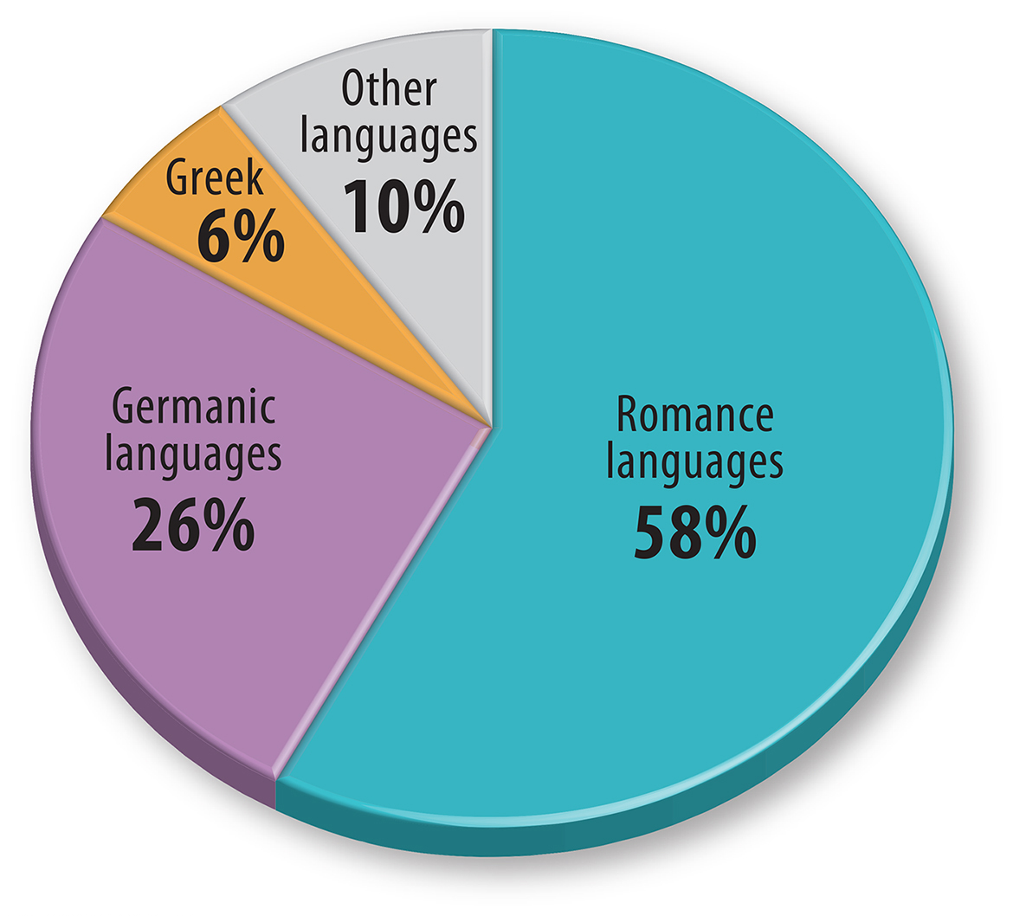
2.3 Origin of English Words
Figure 5-17: Even though it is classified as a member of the Germanic branch, most English words are from Romance languages.

Slide 23
2.3 Combining English with Other Languages
Figure 5-18: English is sometimes combined with French (Franglais, shown here), Spanish (Spanglish), or German (Denglish).

Slide 24
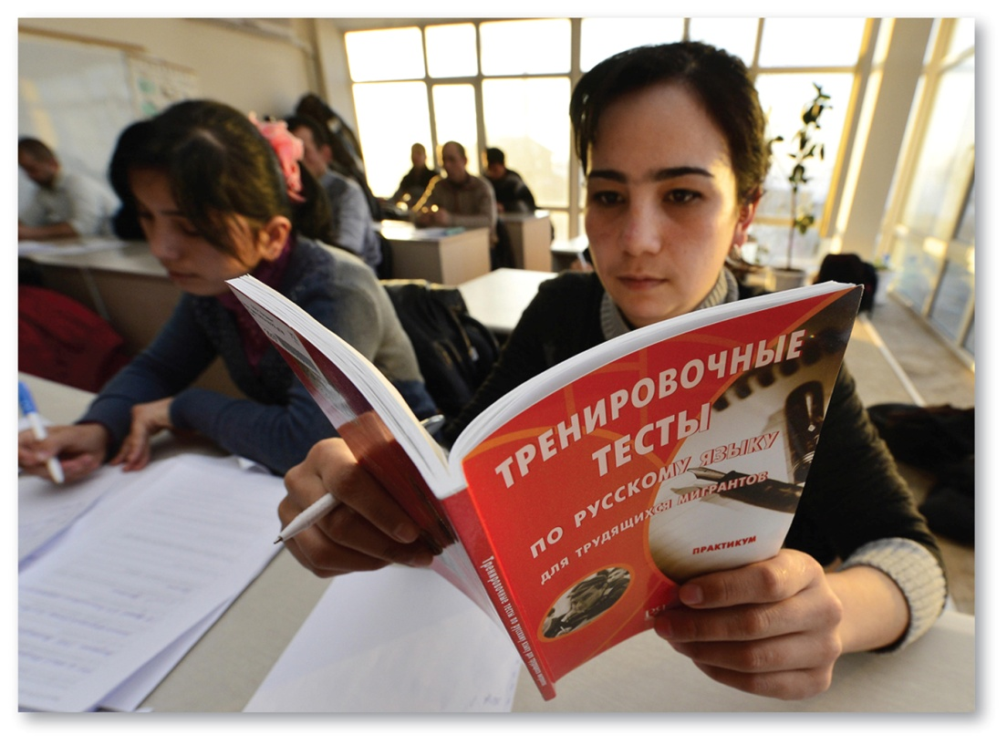
2.4 Learning Lingua Franca Languages
Figures 5-19 and 5-20: A lingua franca allows speakers to communicate in a common language; English (above) and Russian (right) are studied for their use as lingua franca.

Slide 25
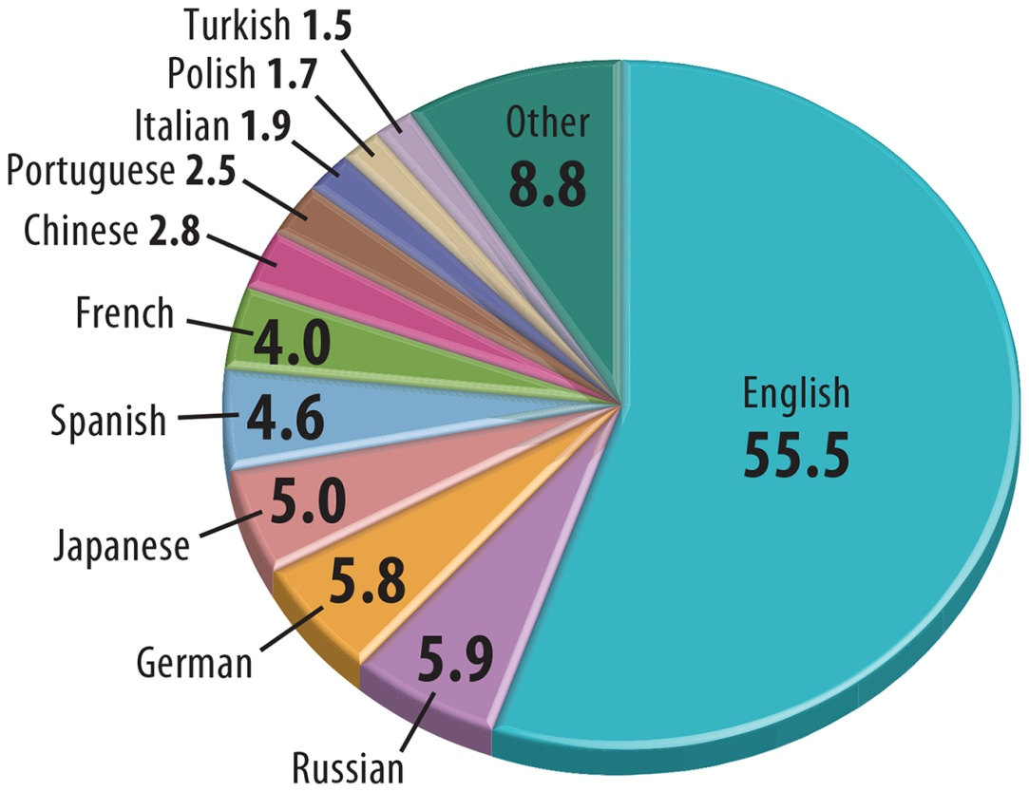
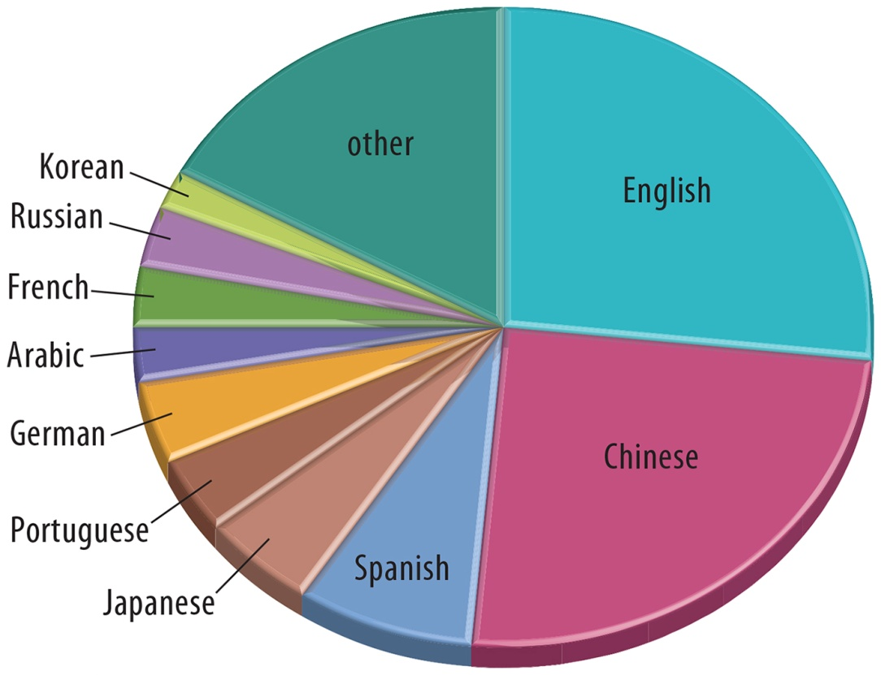
2.4 Languages of Websites and Users
Figures 5-21 and 5-22: More than one-half of websites are written in English (left), but English speakers make up only about a quarter of Internet users (right).

Slide 26
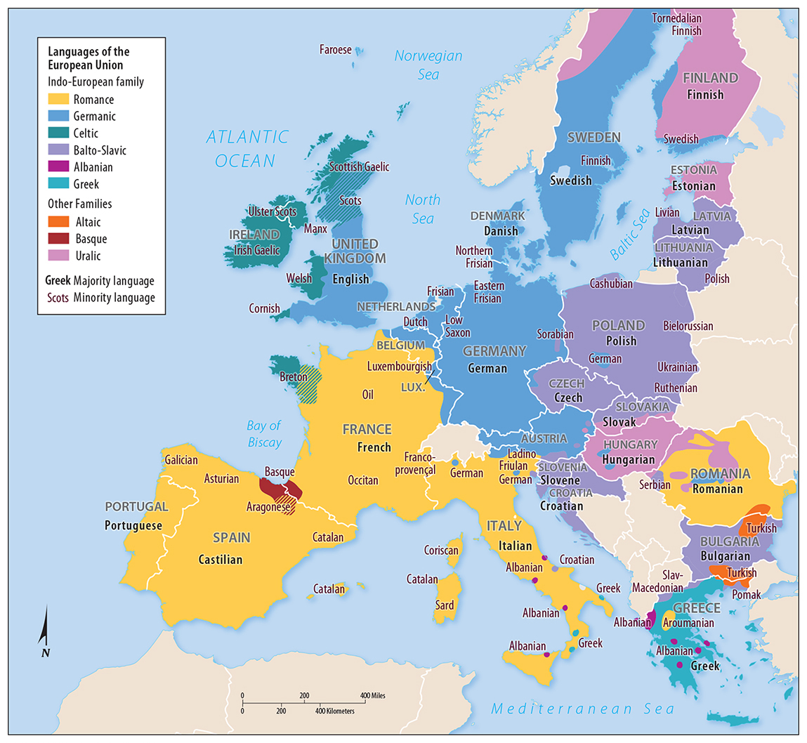
2.5 Europe’s Official and Minority Languages
Figure 5-23: Official EU languages are written in black, bolder font. Purple lettering denotes protected minority languages.

Slide 27
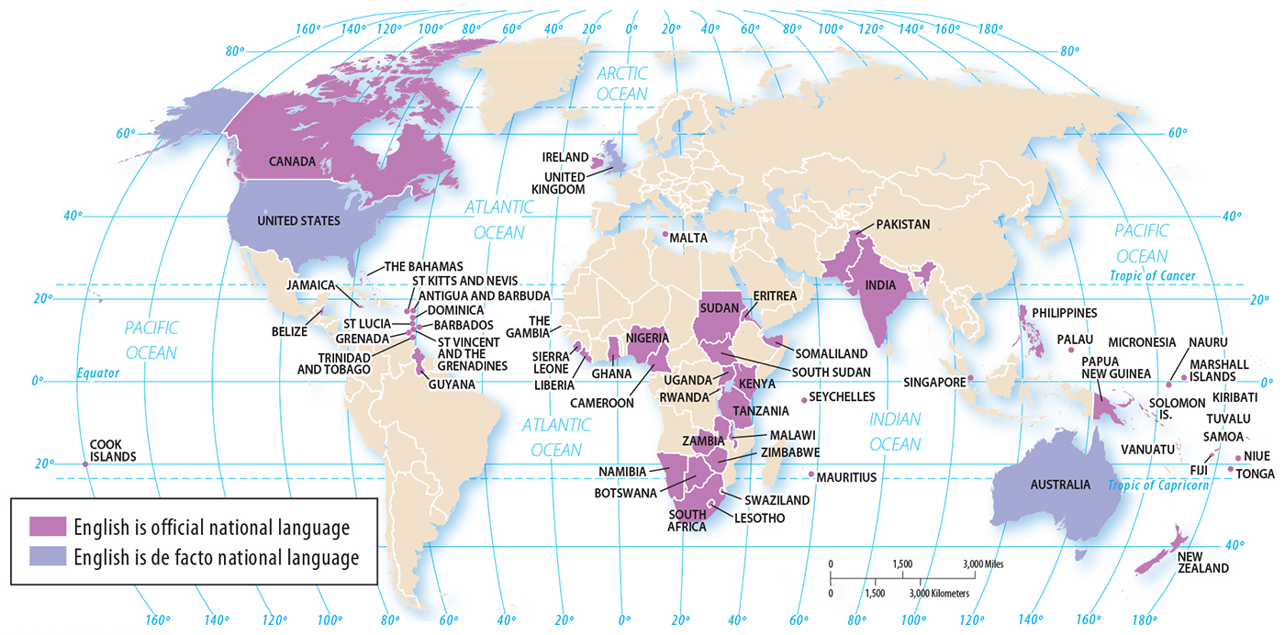
2.5 English-Speaking Countries
Figure 5-24: English is an official language in 58 countries and widely spoken in several others.

Slide 28
Key Issue 3: Why Do Individual Languages Vary Among Places?
3.1 English Dialects
3.2 U.S. Dialects
3.3 Dialect or Language?
3.4 Multilingual Places

Slide 29
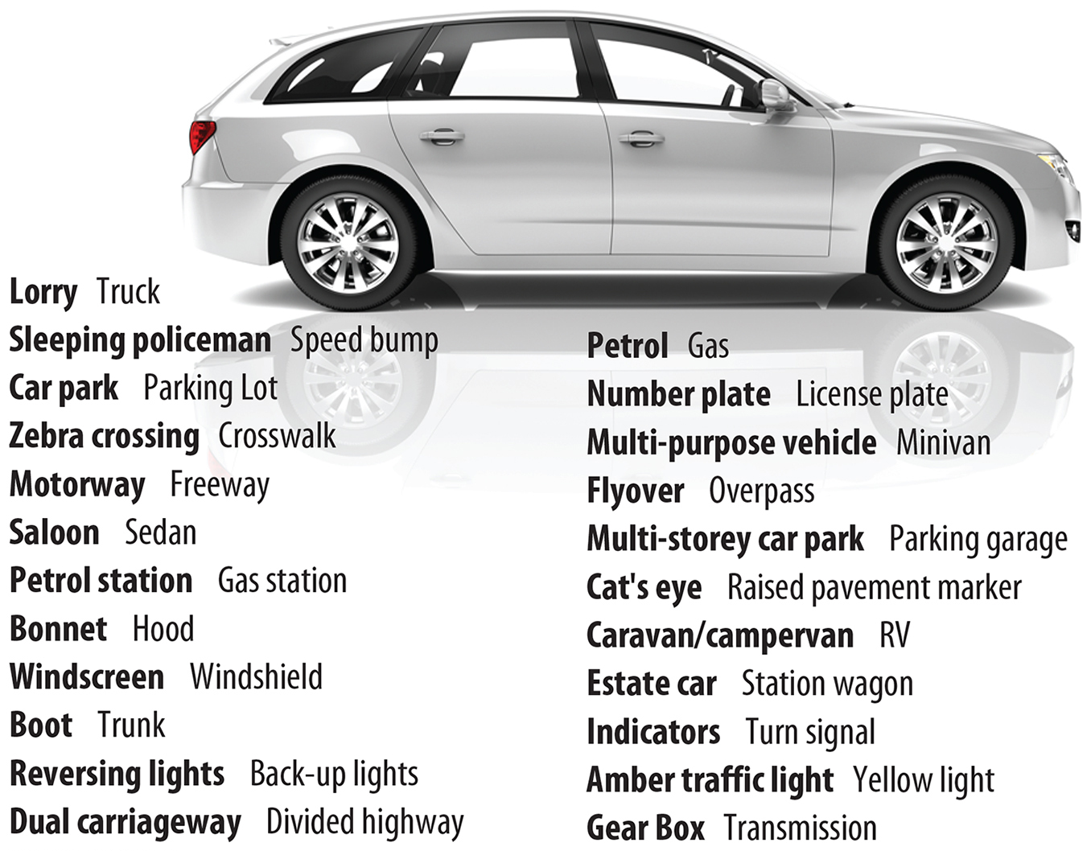
3.1 U.S. and U.K. Dialects
Figure 5-26: Car- and driving-related terms indicate dialectical differences between English spoken in the United States and United Kingdom.

Slide 30
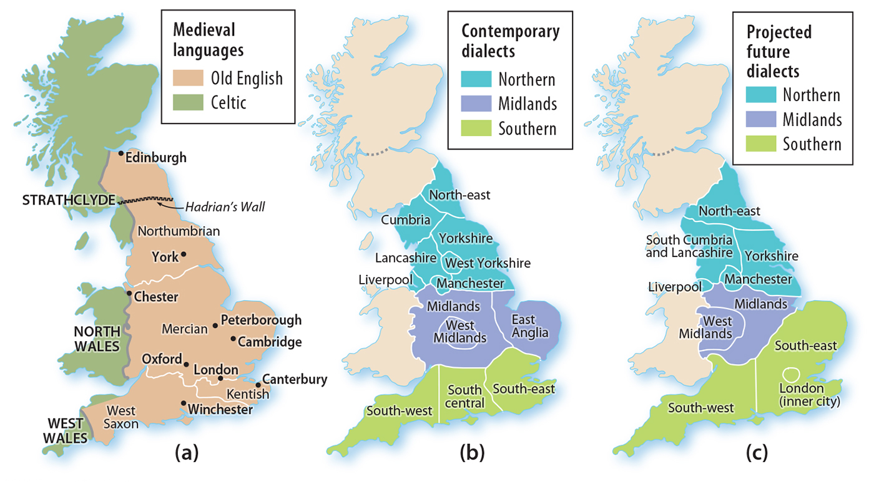
3.1 Dialects and Subdialects in England
Figure 5-28: England’s dialects today (b) are expected to change (c) based on demography and migration.

Slide 31
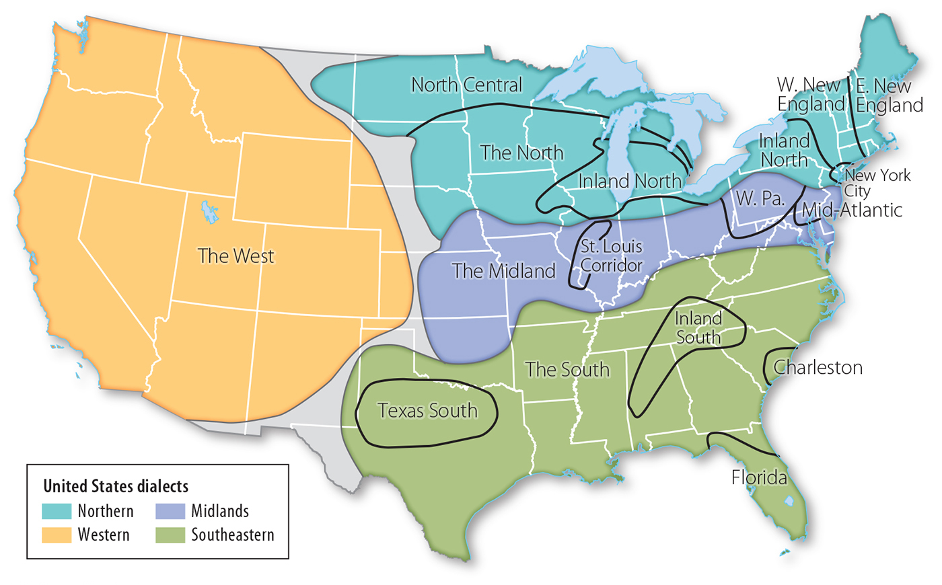
3.2 U.S. Dialects and Subdialects
Figure 5-29: The United States has four major dialect regions and several subdialects.

Slide 32
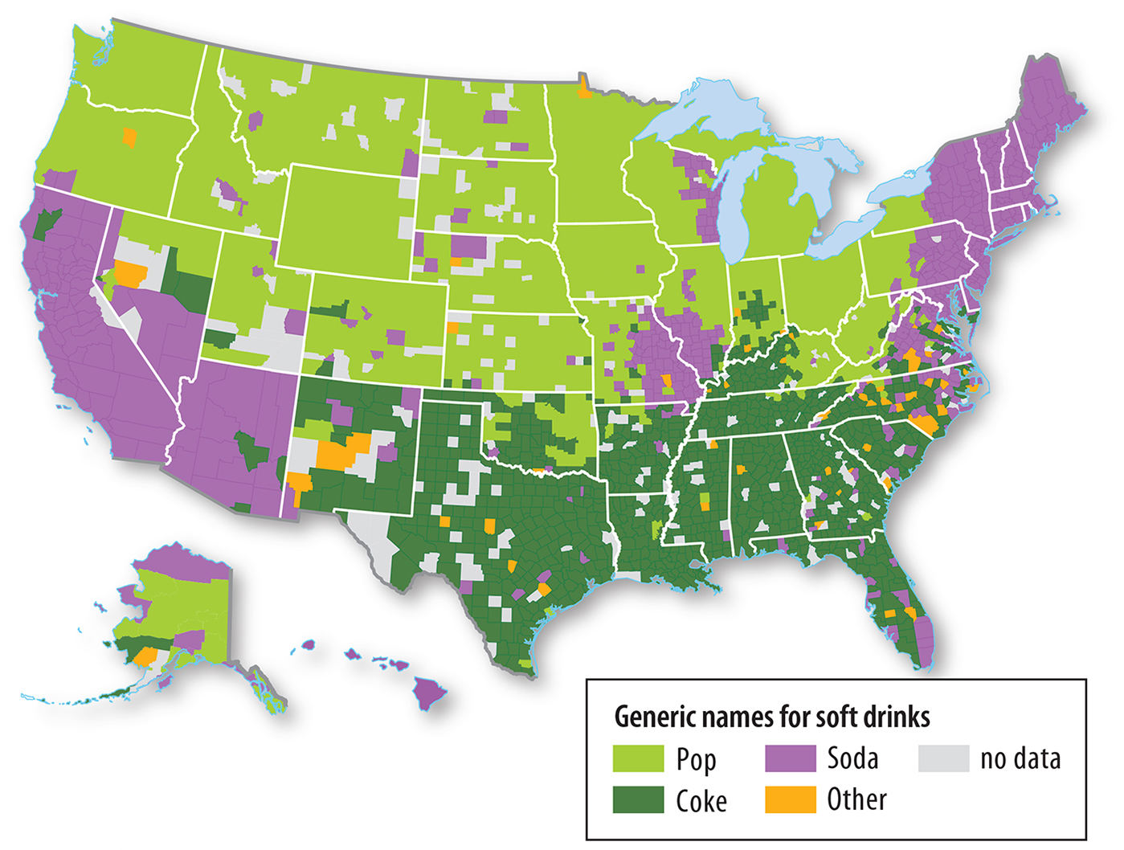
3.2 Soft Drink Dialects
Figure 5-30: The names used for soft drinks represent regional dialectical differences in the United States.

Slide 33
3.2 Example of Haitian Creole
Figure 5-31: A Miami-Dade County election pamphlet is written in three languages: English (top), Spanish (middle), and Haitian Creole (bottom).

Slide 34
3.3 Dialect or Language?
Challenge: Is a language distinct or a dialect?
Dialects may become distinct languages over time.
Cultural identity plays a role.
Some governments standardize language for unity.

Slide 35
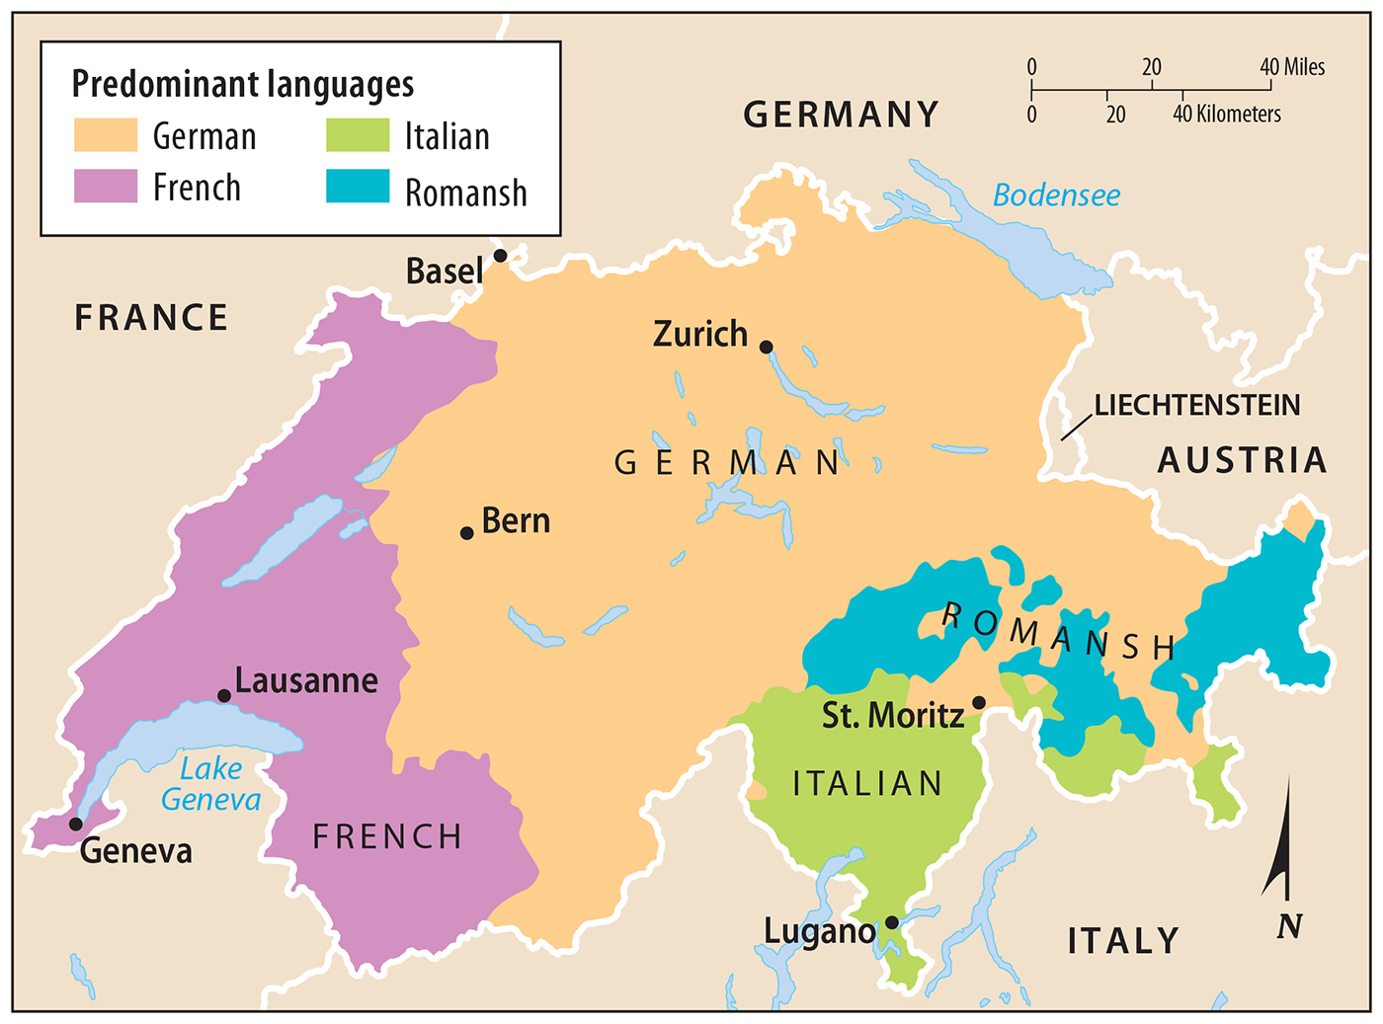
3.4 Language Diversity in Switzerland
Figure 5-33: Switzerland has four official languages.

Slide 36
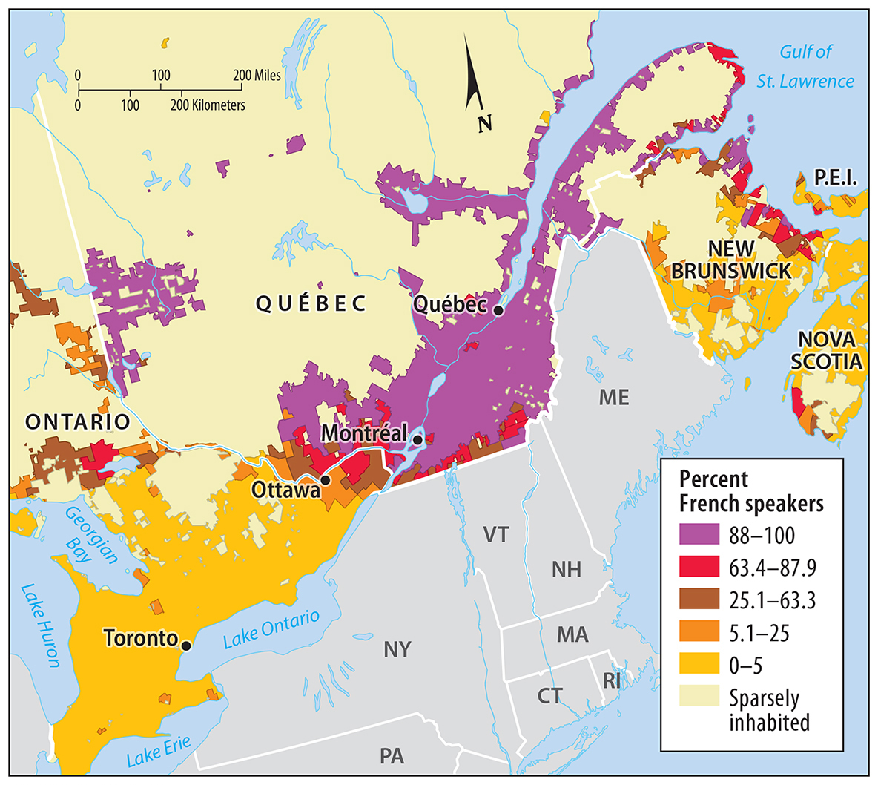
3.4 Language Diversity in Canada
Figure 5-34: Canada’s French speakers are concentrated along the St. Lawrence and Great Lakes.

Slide 37
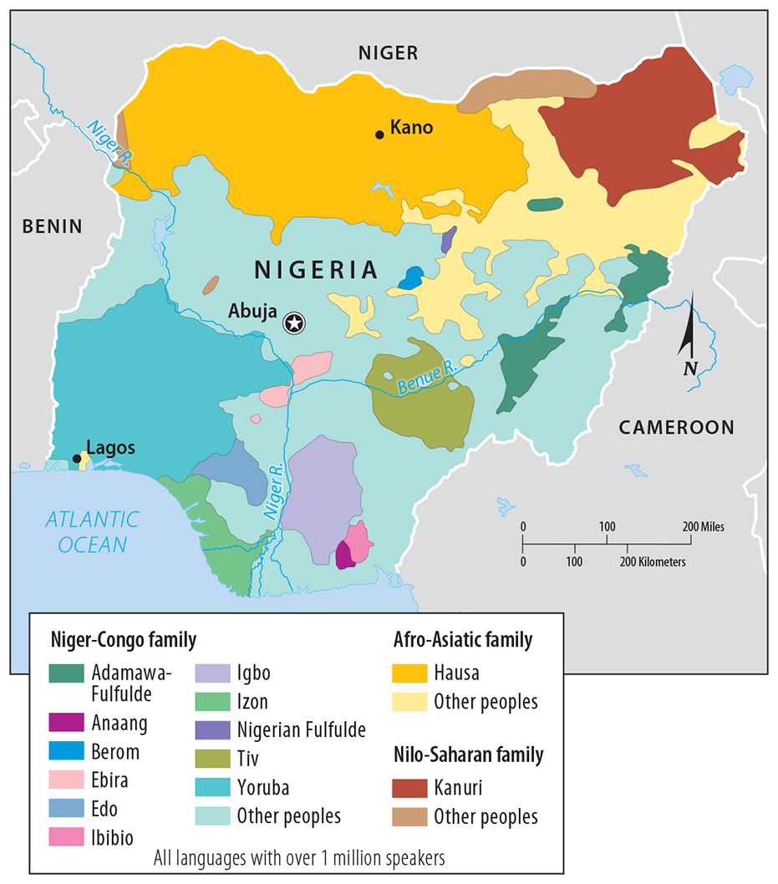
3.4 Language Diversity in Nigeria
Figure 5-35: Nigeria has 529 languages among several families. Hausa, Igbo, and Yoruba are the most common.

Slide 38
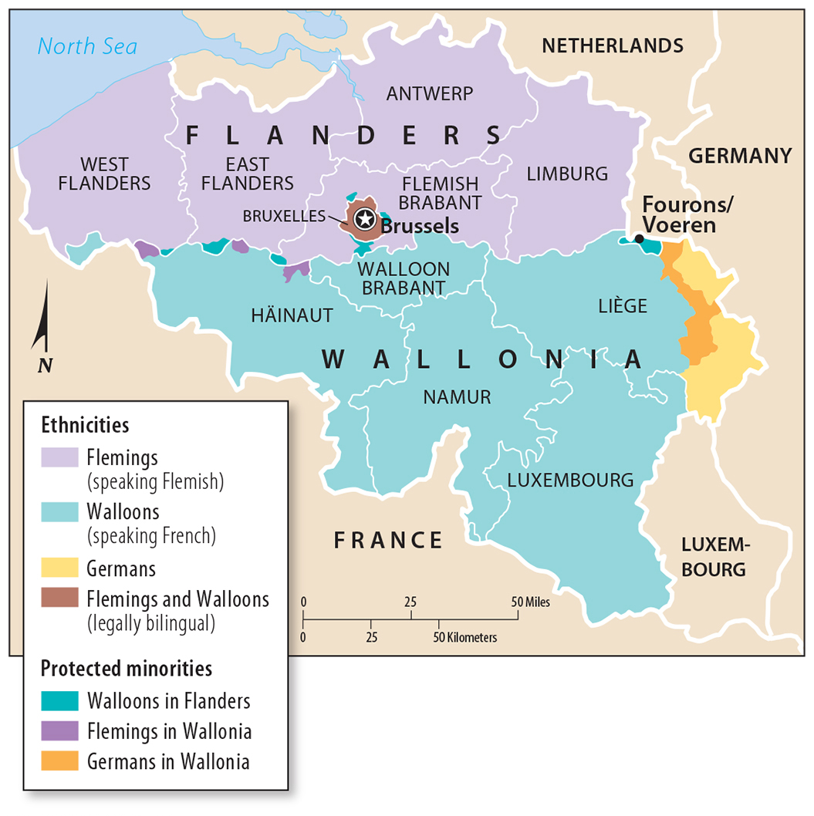
3.4 Language Diversity in Belgium
Figure 5-36: Belgium is divided regionally between the Flemish north and French south, with protected minorities in border areas and a bilingual capital.

Slide 39
Key Issue 4: Why Do Local Languages Survive?
4.1 Endangered Languages
4.2 Preserving Languages
4.3 Isolated and Extinct Languages
4.4 New and Growing Languages

Slide 40
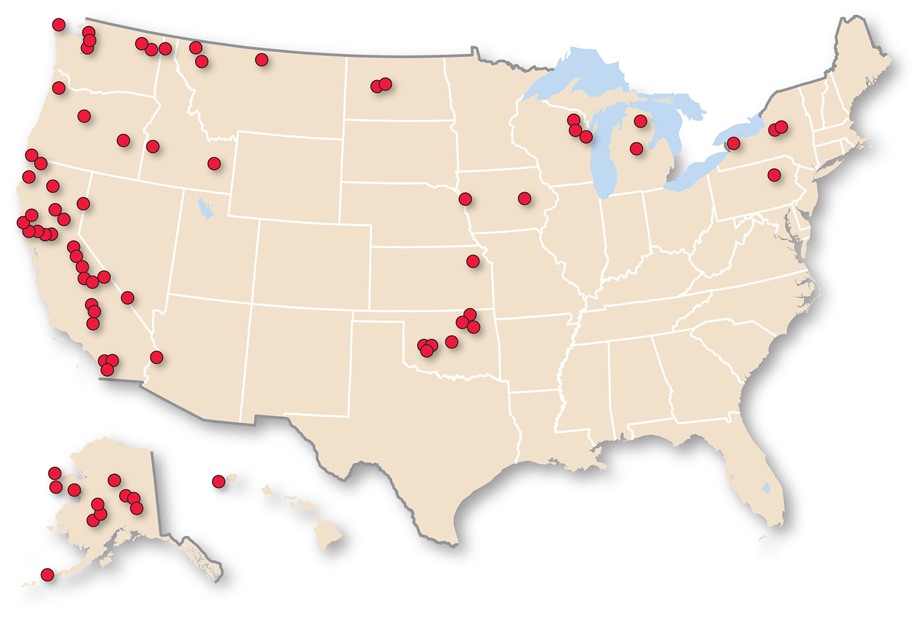
4.1 Critically Endangered U.S. Languages
Figure 5-38: Dots are located approximately where recently extinct languages were last spoken.

Slide 41
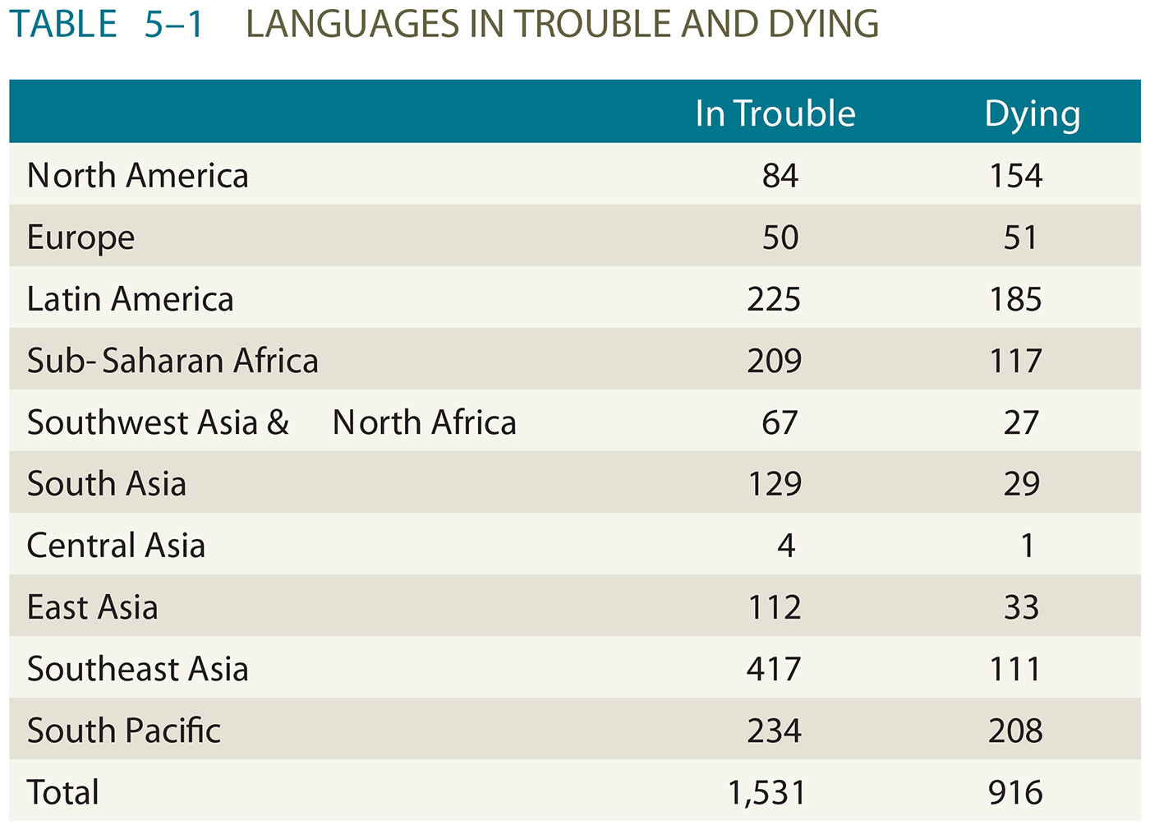
4.1 Why Do Local Languages Survive?

Slide 42
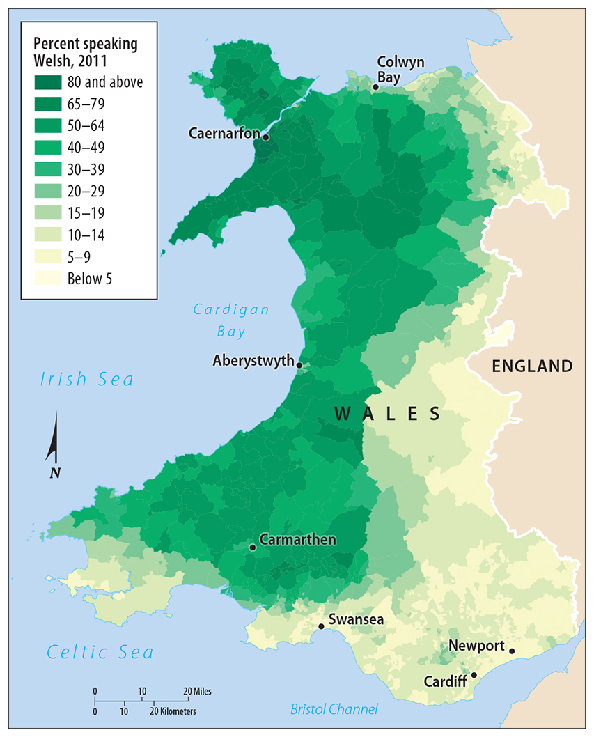
4.2 Welsh Language Distribution
Figure 5-40: Welsh becomes less spoken closer to the English-Wales border.

Slide 43
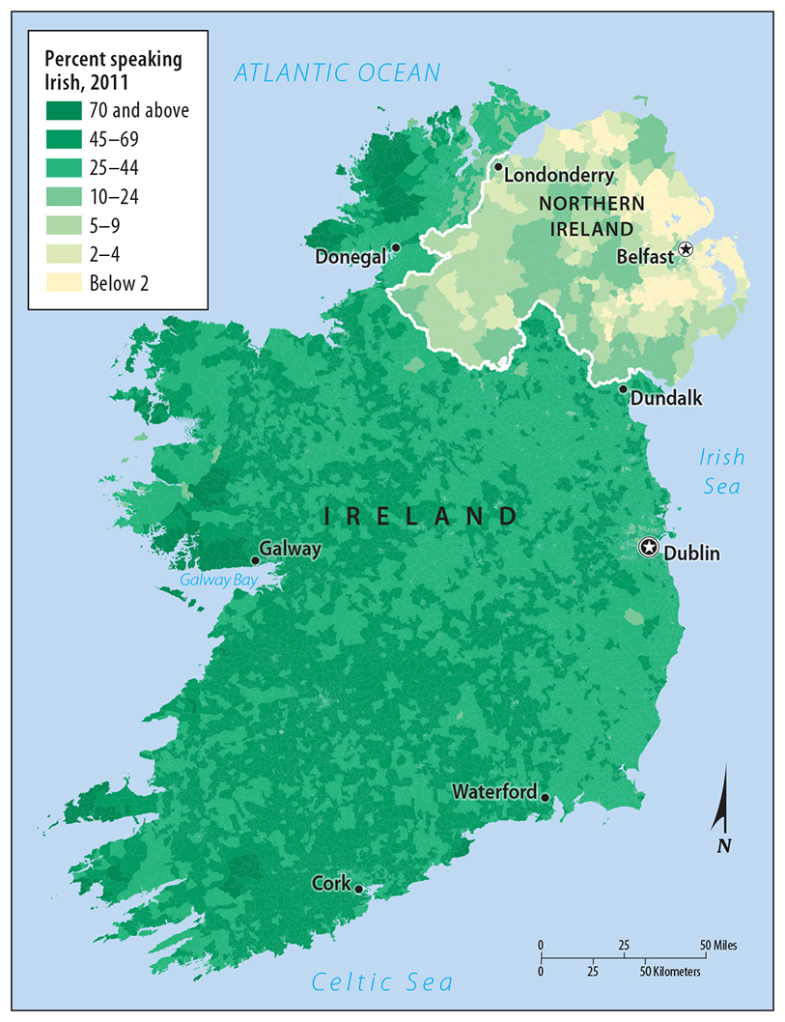
4.2 Irish Language Distribution
Figure 5-43: Irish is far less common in Northern Ireland than in Ireland. Remote areas have the highest proportion of Irish speakers.

Slide 44
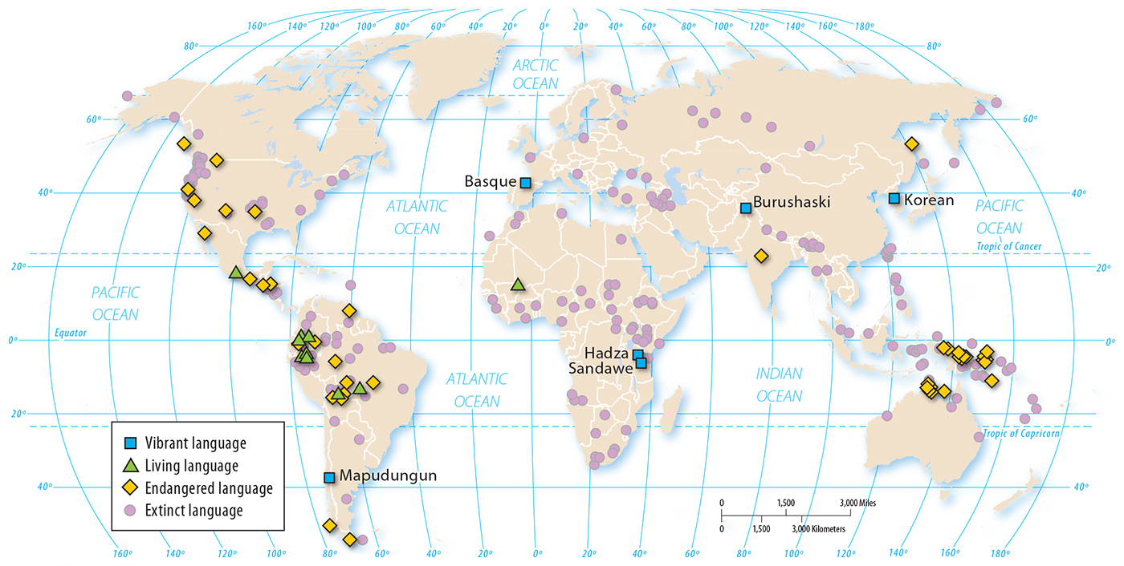
4.3 Isolated Languages
Figure 5-45: Isolated languages cannot be tied to any language families. Many isolated languages are endangered or have gone extinct.

Slide 45
4.3 Basque: An Isolated Language
Figure 5-46: Basque is an isolated language considered vigorous because it is used in daily life.

Slide 46
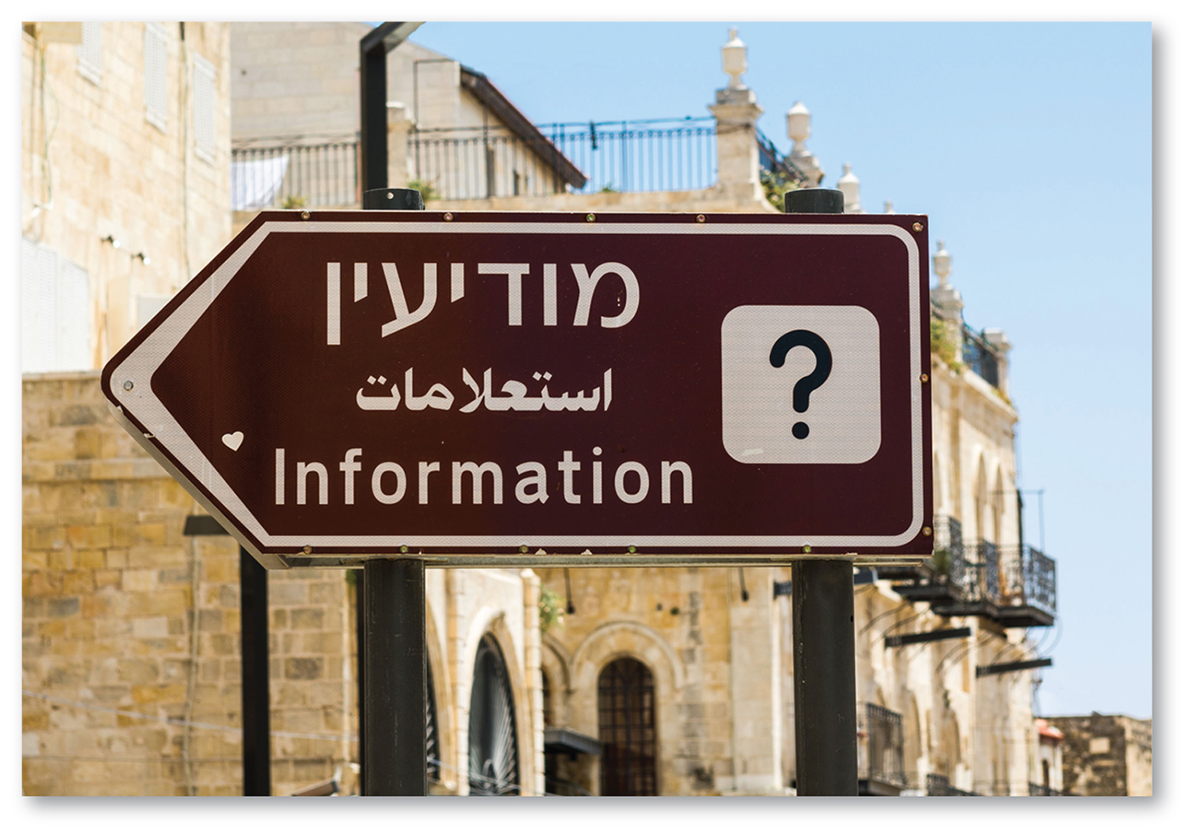
4.4 Hebrew: A Growing Language
Figure 5-48: Hebrew became more widely spoken after 1948 with the creation of Israel.

Slide 47
Chapter End

