Slide 1
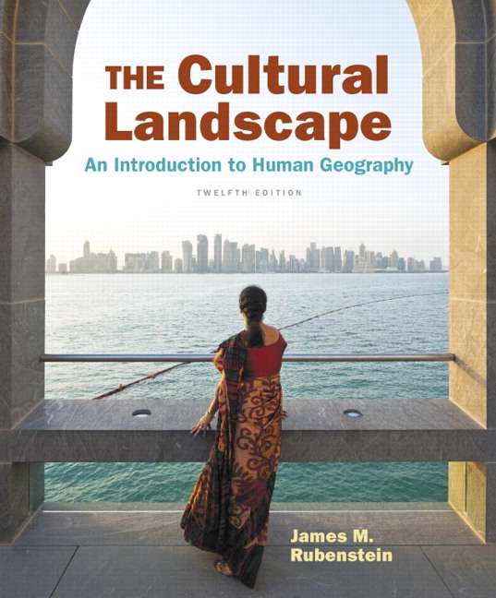
Chapter 4 Lecture
Chapter 4
Folk and Popular Culture
Tim Scharks Green River College

Slide 2
Folk and Popular Culture: Key Issues
Where Are Folk and Popular Leisure Activities Distributed?
Where Are Folk and Popular Material Culture Distributed?
Why Is Access to Folk and Popular Culture Unequal?
Why Do Folk and Popular Culture Face Sustainability Challenges?

Slide 3
Key Issue 1: Where are Folk and Popular Leisure Activities Distributed?
1.1 Introducing Folk and Popular Culture
1.2 Origin, Diffusion, and Distribution of Folk and Popular Culture
1.3 Geographic Differences Between Folk and Popular Culture
1.4 Origin and Diffusion of Folk and Popular Music
1.5.Origin and Diffusion of Folk and Popular Sports

Slide 4
1.1 Introducing Folk and Popular Culture
Folk culture: small, homogenous groups, relative isolation
Popular culture: large, heterogeneous groups, widespread
Both types have daily necessities (food, clothing, shelter) and leisure (arts and recreation).

Slide 5
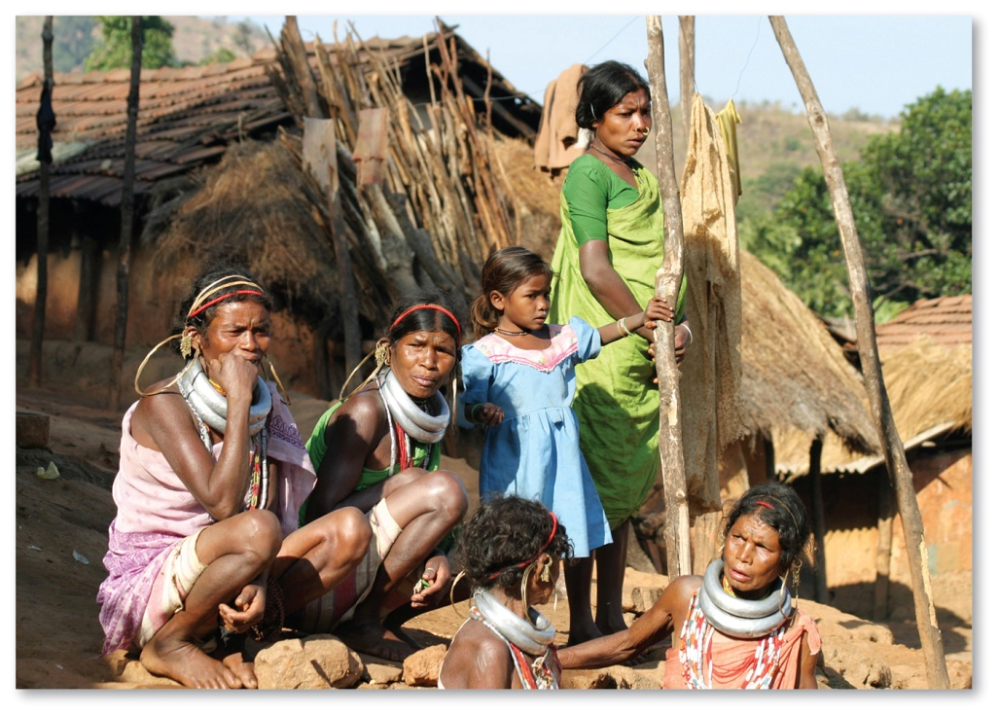
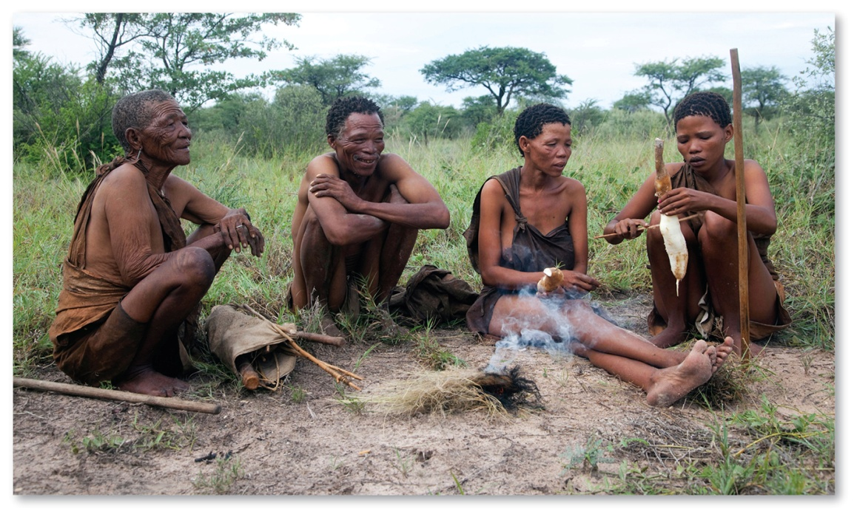
1.1 Elements of Folk Culture
Figures 4-2 and 4-4: Jewelry, clothing, and food customs are all elements of culture.

Slide 6
1.2 Origin, Diffusion, and Distribution of Folk and Popular Culture
Folk culture
Popular culture
Origin: anonymous, sometimes multiple hearths
Diffusion: slowly, through migration diffusion
Distribution: spatially isolated, influenced by local factors
Origin: specific point of origin, usually developed country
Diffusion: rapidly through hierarchical diffusion
Distribution: widespread wherever technology allows

Slide 7
1.2 Distribution of Folk Culture
Figure 4-6: Distribution of different folk cultural painting traditions from four different parts of the Himalaya Mountains.

Slide 8
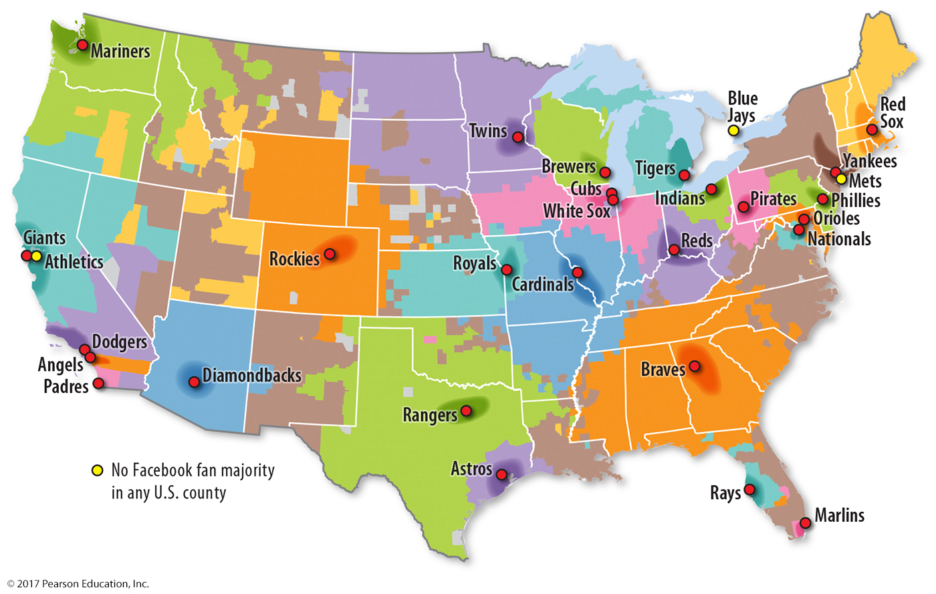
1.3 Regions and Connections
Figure 4-7: Some popular sports, like baseball, display large functional regions of fans.

Slide 9
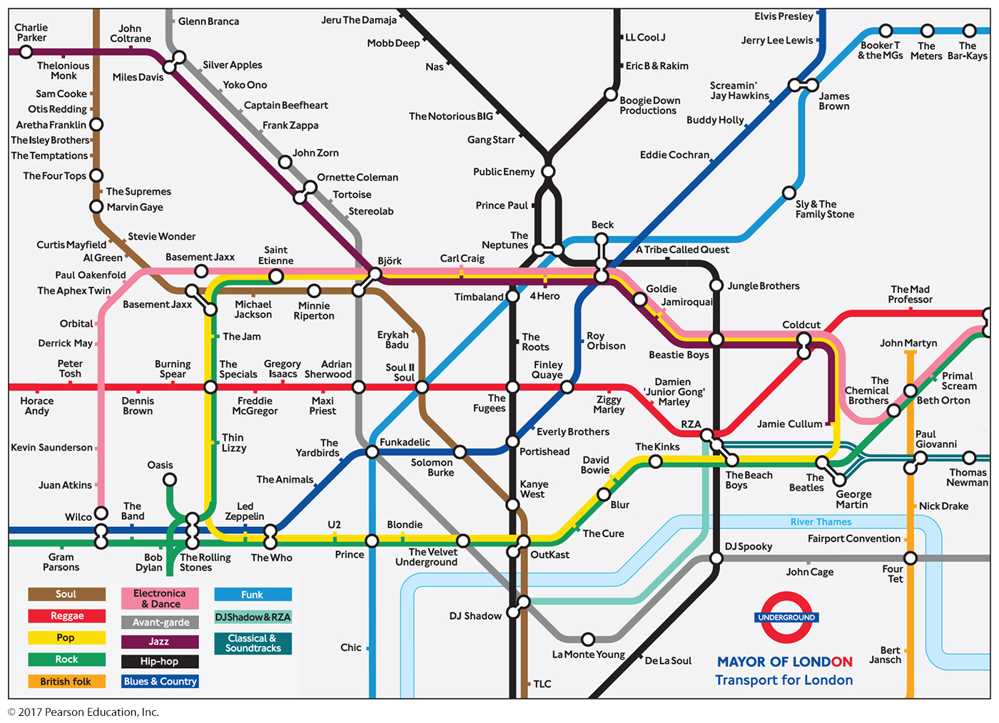
1.3 Regions and Connections
Figure 4-9: Popular musicians may have more in common with similar styles far across the world than with different styles in the same city.

Slide 10
1.4 Origin and Diffusion of Folk and Popular Music
Folk music often anonymous origin, tells traditional story
Popular music from known authors, produced for sale

Slide 11
1.4 Folk Music: Vietnam
Figure 4-10: Vietnamese singers perform songs with a 500-year tradition.

Slide 12
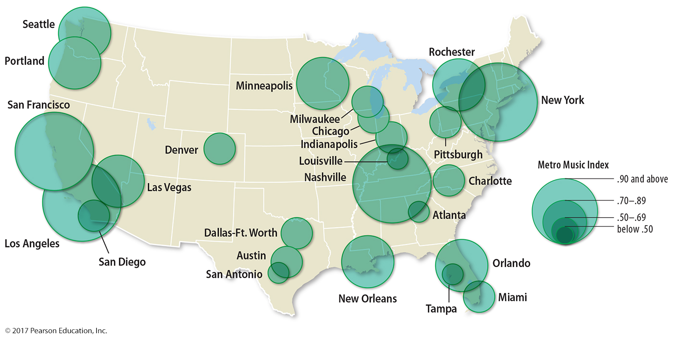
1.4 Popular Music: U.S. Clusters
Figure 4-11: Musicians and studios cluster in cities for access to music services and employment.

Slide 13
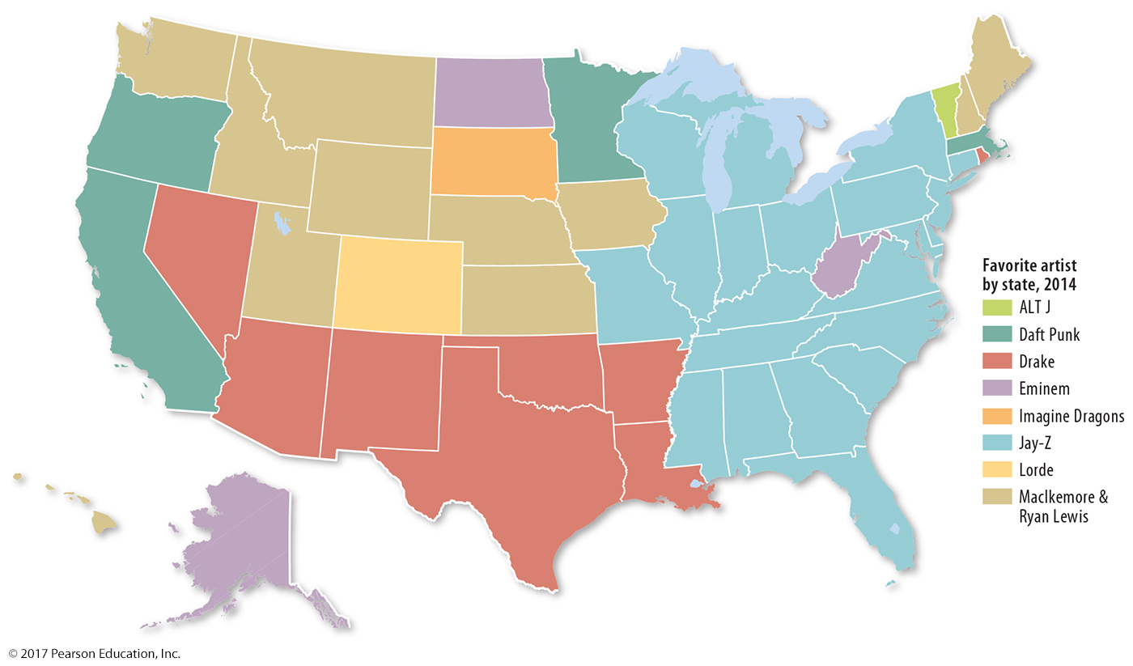
1.4 Favorite Artist by U.S. State
Figure 4-12: Popular music is spatially widespread yet displays regional variations in popularity.

Slide 14
1.5 Origin and Diffusion of Folk and Popular Sports
Soccer: example of global popular sport with folk origins
Sports must be widely practiced to be considered for Olympics.
Some sports have more distinct regional appeal—cricket, wushu, lacrosse.

Slide 15
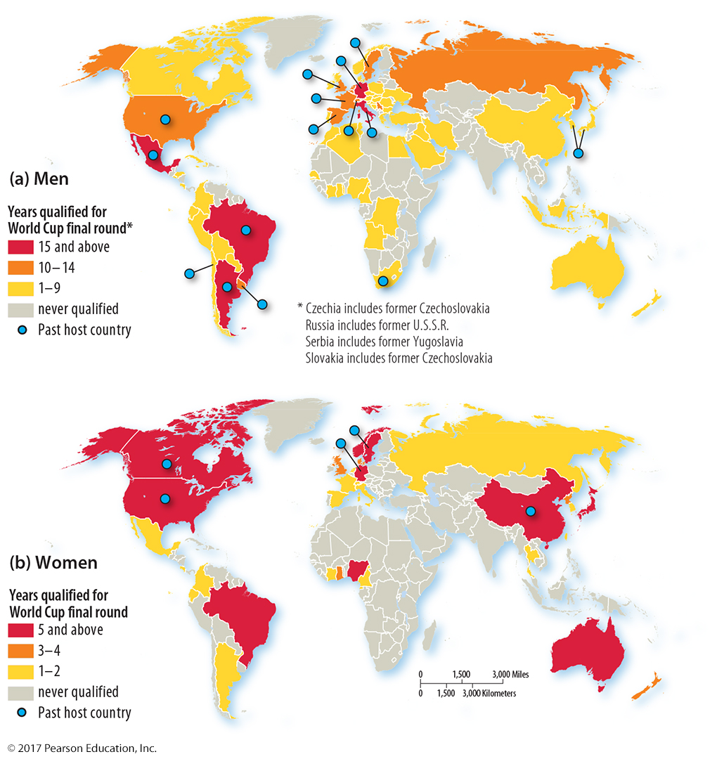
1.5 Popular Sports: World Cup Soccer
Figure 4-13: Soccer’s popularity extends to countries that have not fielded a World Cup team.

Slide 16
Key Issue 2: Where Are Folk and Popular Material Culture Distributed?
2.1 Elements of Material Culture
2.2 Folk and Popular Clothing
2.3 Folk Food Customs
2.4 Popular Food Preferences
2.5 Folk and Popular Housing

Slide 17
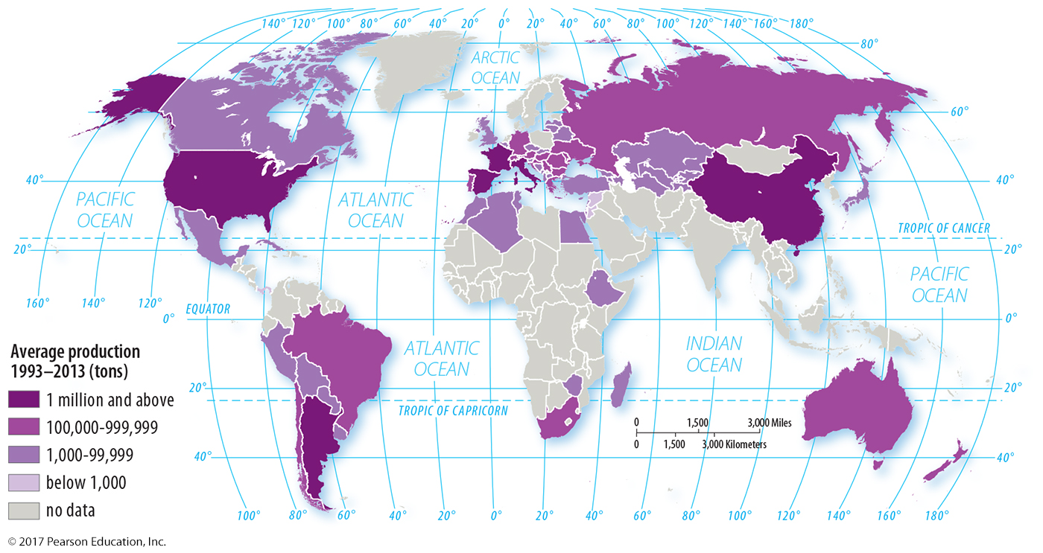
2.1 Wine Production
Figure 4-16: Wine production is influenced by favorable climate and soils for grapes as well as cultural factors.

Slide 18
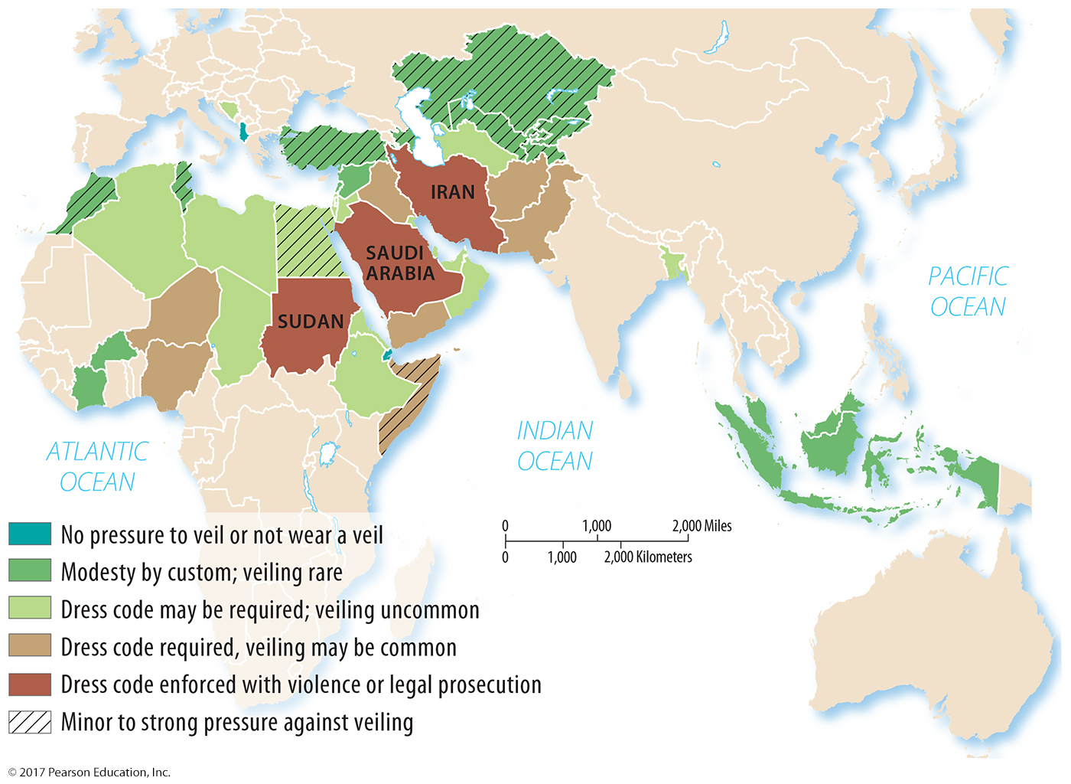
2.1 Folk Clothing: Women’s Dress Codes
Figure 4-17: Traditional clothing customs of women in North Africa and Southwest Asia vary with respect to cultural views of modesty, including the wearing of a veil.

Slide 19
2.2 Folk and Popular Clothing
Folk clothing may reflect environmental or cultural factors, including religious tradition.
Popular clothing reflects occupation and income.

Slide 20
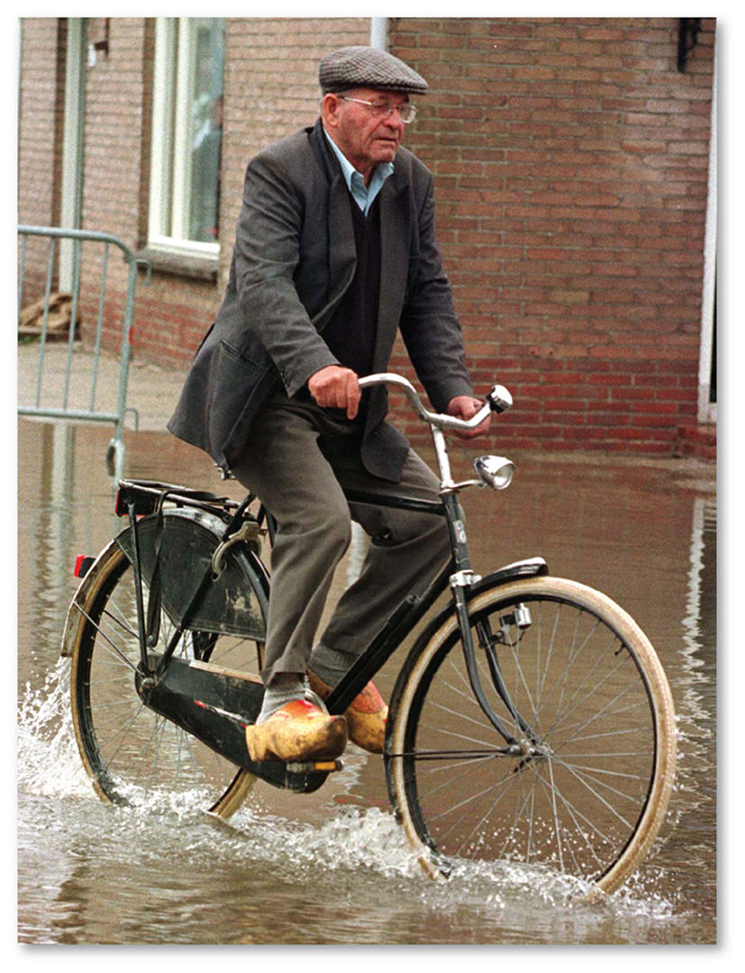
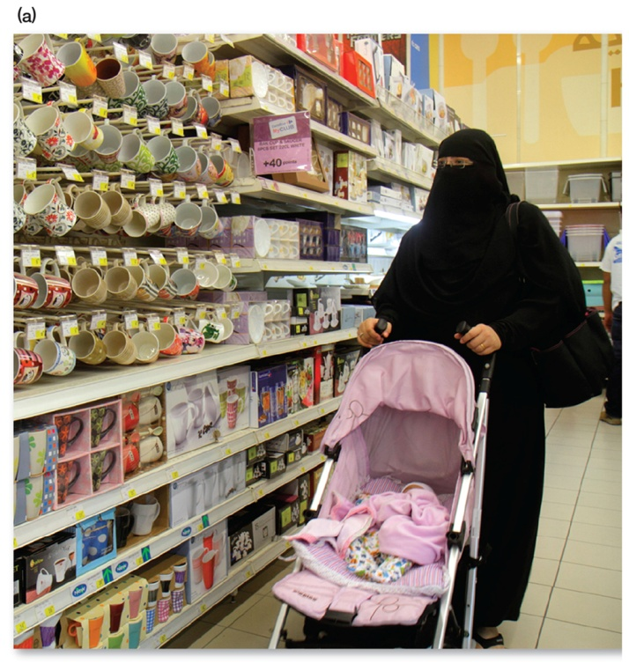
2.2 Folk Clothing
Figures 4-18 and 4-19: Wooden shoes are a Dutch folk clothing custom (left). Muslims (center, top) and Jews (right) may customarily wear modest black clothes.

Slide 21
2.3 Folk Food Customs
Local environmental conditions influence what can be grown.
Food taboos may protect the local environment or serve other functions.

Slide 22
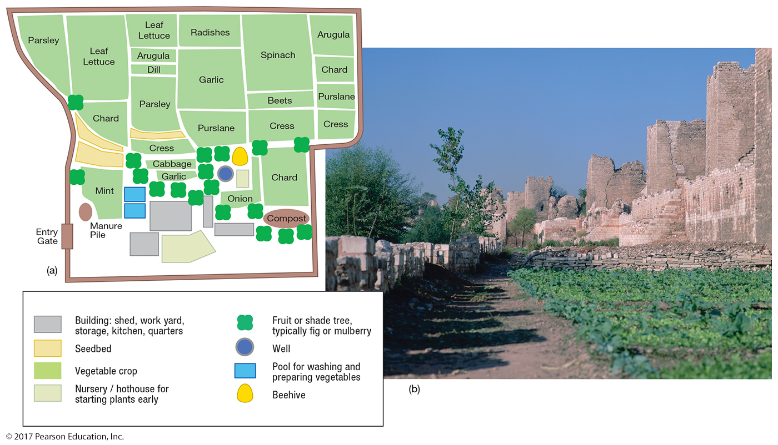
2.3 Istanbul Vegetable Garden
Figure 4-23: Bostans in Istanbul provide fresh vegetables that do well in Turkey’s climate.

Slide 23
2.4 Popular Food Preferences
Popular foods vary globally and regionally in preference.
Coca-Cola and Pepsi have different regional distributions.
U.S. preferences for popular foods vary by region.

Slide 24
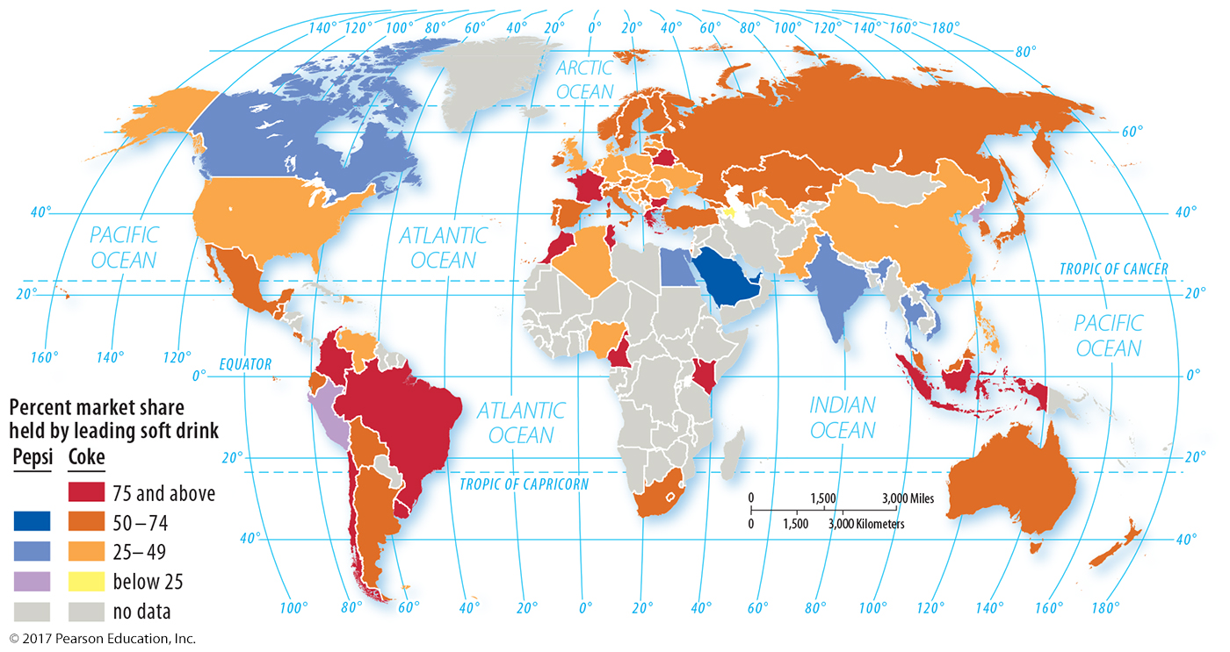
2.4 Popular Food Preferences: Coke vs. Pepsi
Figure 4-25: Pepsi is more popular in Canada, Peru, and a few countries from Egypt to Vietnam.

Slide 25
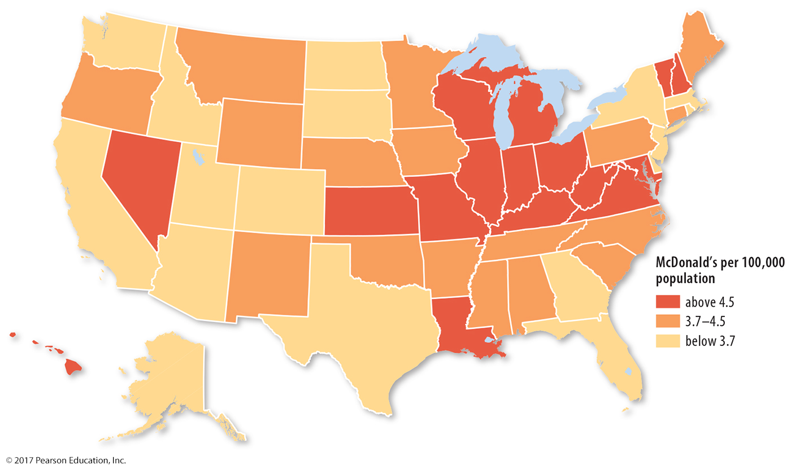
2.4 Regional Variation: Concentration of McDonald’s
Figure 4-26: McDonald’s has the highest concentration of restaurants per capita in the Great Lakes region.

Slide 26
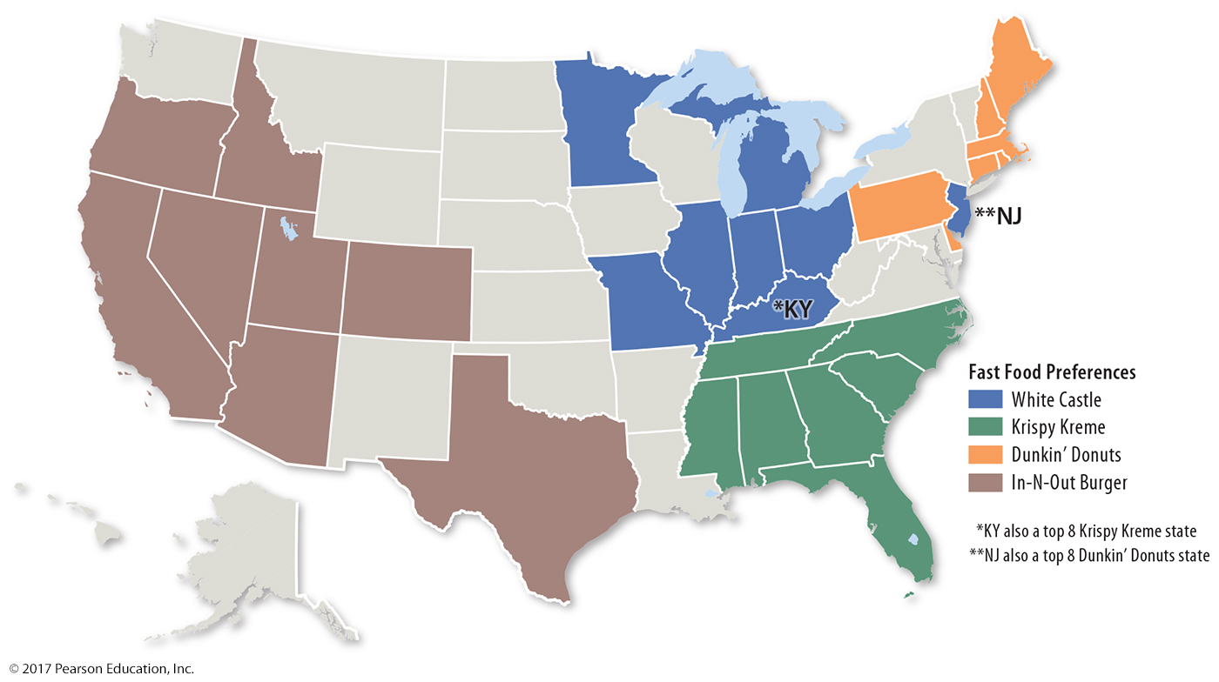
2.4 Regional Variation: Fast-Food Restaurant Preferences
Figure 4-27: Regional factors influence the popularity of fast food brands, here displaying the eight most popular states of four franchises.

Slide 27
2.5 Folk and Popular Housing
Folk housing can have
environmental influences: choice of building materials, climate considerations
cultural influences: beliefs about shape and orientation of house
U.S. folk housing styles diffused from three hearths on Atlantic coast.

Slide 28
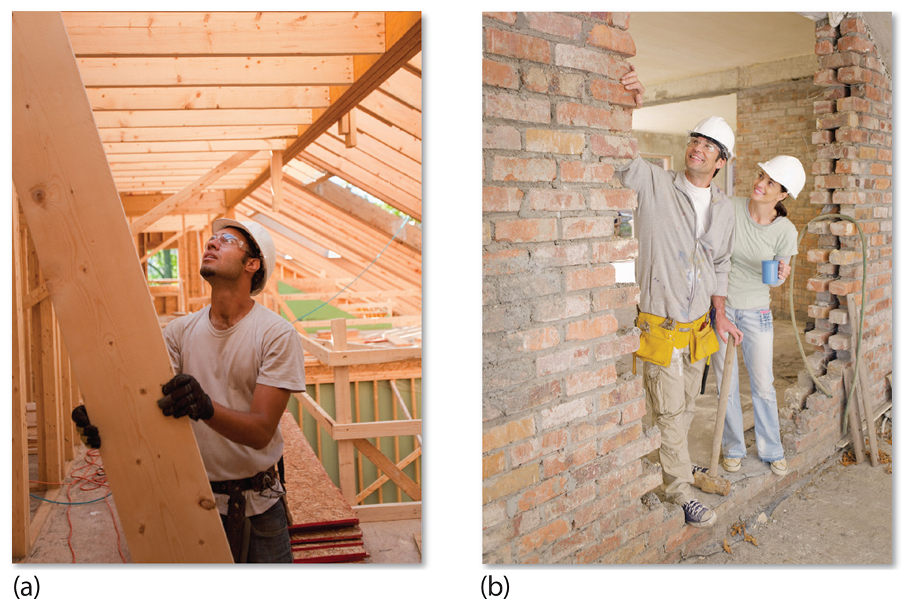
2.5 Building Materials
Figure 4-28: Local availability can influence the choice of building materials.

Slide 29
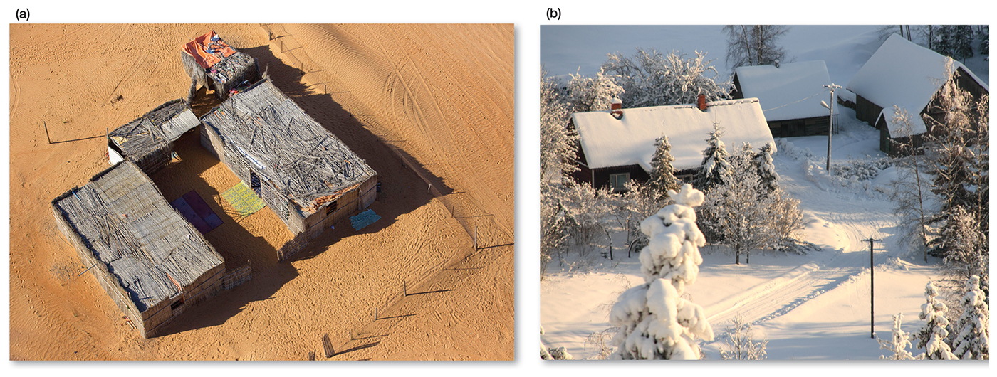
2.5 Environmental Influences
Figure 4-29: Different environmental conditions influence the preferred style of house in Oman (left) and Estonia (right).

Slide 30
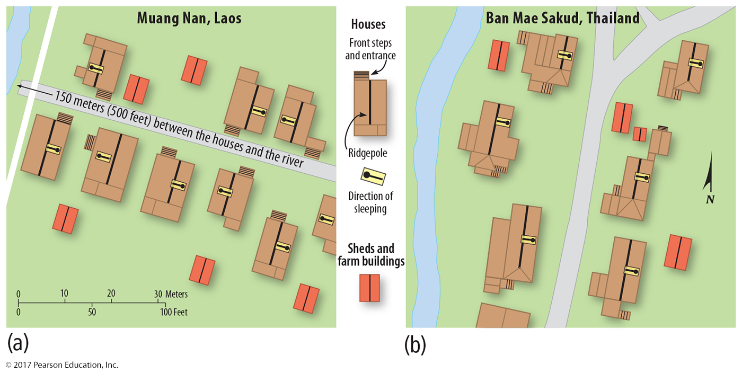
2.5 Cultural Influences
Figure 4-30: Different beliefs affect the form and position of houses in Laos (left) and Thailand (right).

Slide 31
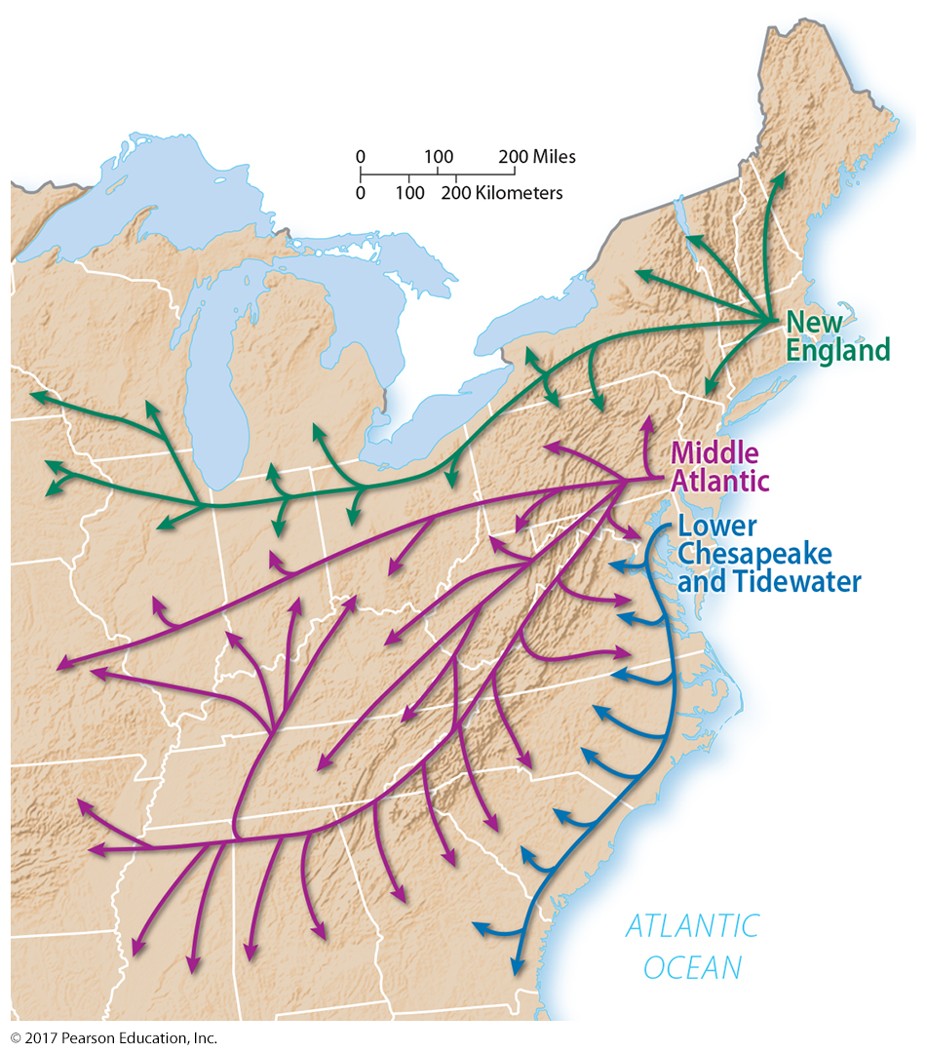
2.5 U.S. Folk Housing Hearths
Figure 4-31: Three styles of folk housing can be traced from their origin on the Atlantic coast.

Slide 32
Key Issue 3: Why Is Access to Folk and Popular Culture Unequal?
3.1 Diffusion of TV and Internet
3.2 Diffusion of Social Media
3.3 Challenges in Accessing Electronic Media

Slide 33
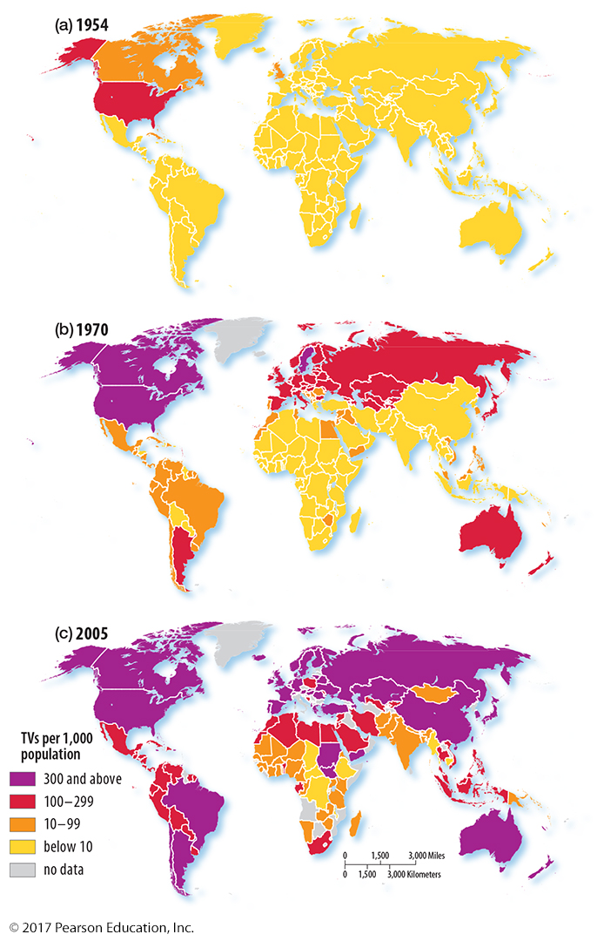
3.1 Diffusion of TV
Figure 4-32:
(a) Television ownership was relatively high in the United States in the 1950s.
(b) By 1970, ownership had increased and diffused to the developed world and many developing countries.
(c) By 2005, TV ownership was widespread in all but the least developed countries; in the United States there were 882 TVs per 1,000 population.

Slide 34
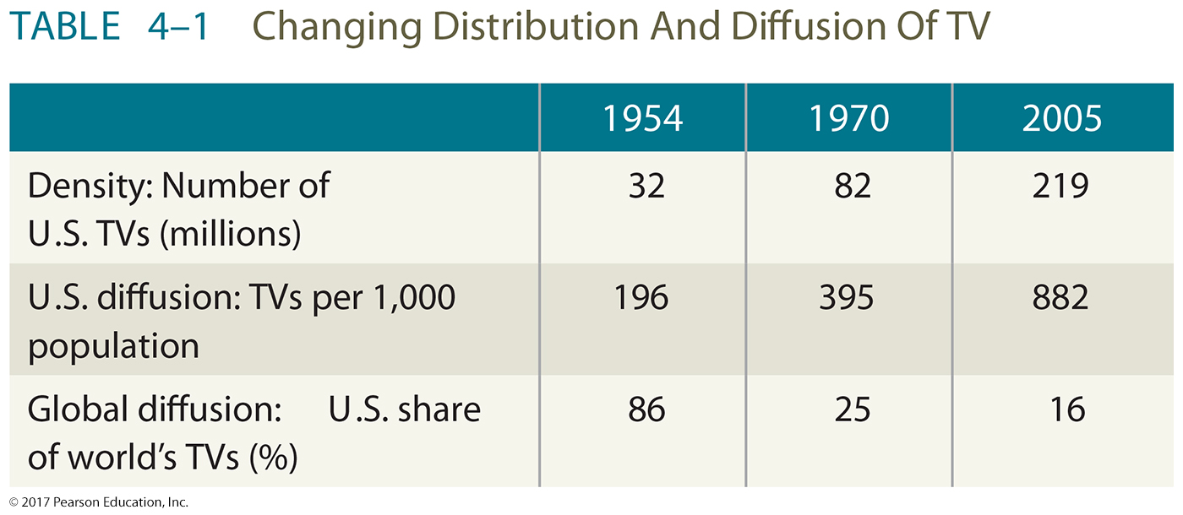
3.1 Diffusion of TV

Slide 35
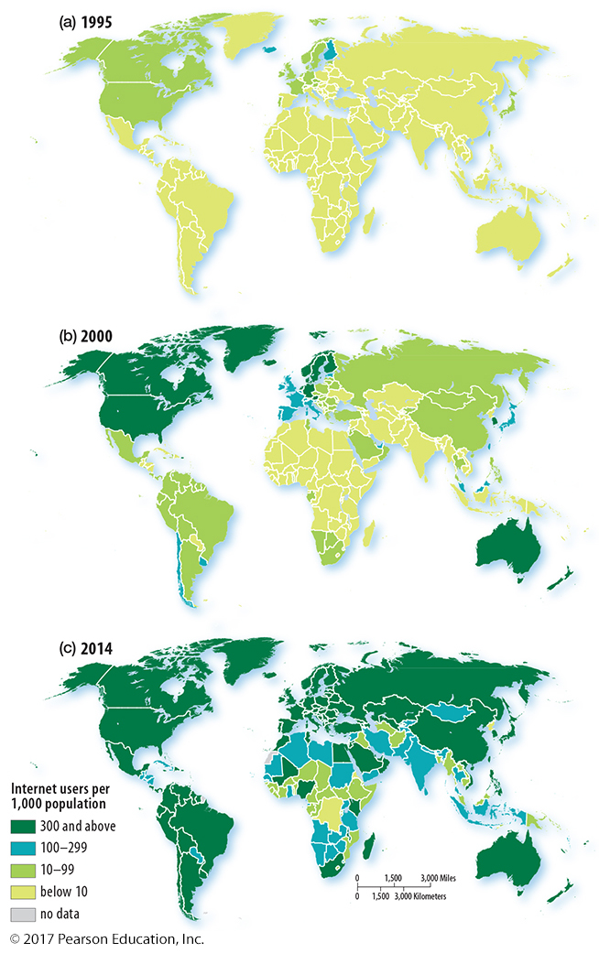
3.1 Diffusion of Internet
Figure 4-33:
(a) Internet users were concentrated in North America and Europe in 1995.
(b) By 2000, users were common in most of the developed world and some more highly developed locations.
(c) By 2014, internet access was common in most developed and high developing countries.
Compare to Figure 4-32.

Slide 36
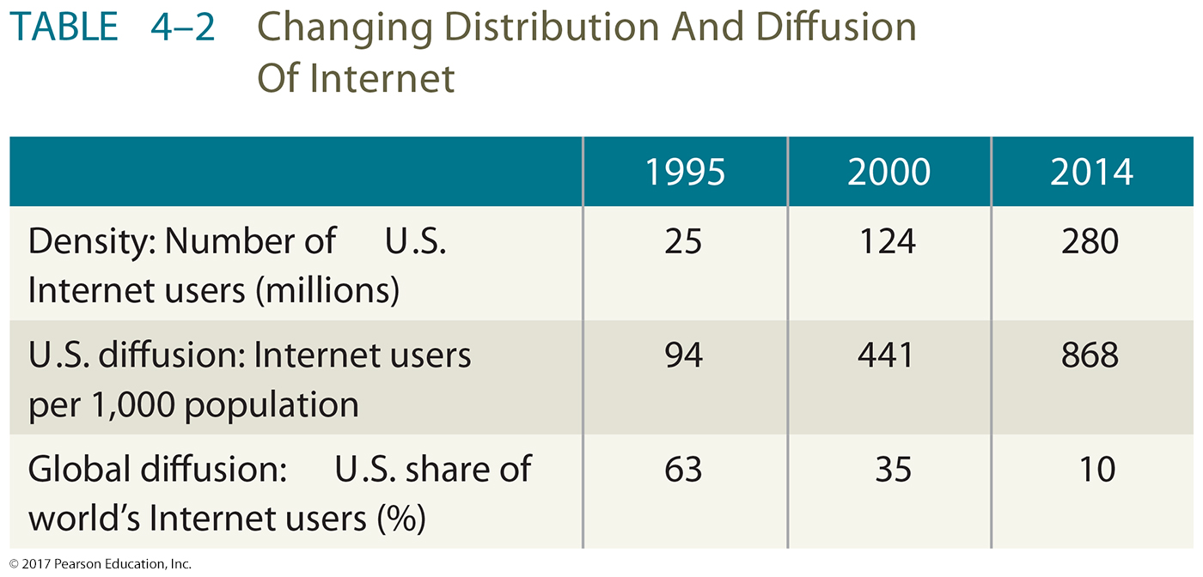
3.1 Diffusion of Internet

Slide 37
3.2 Diffusion of Social Media
Figure 4-36(a): Most popular social network, 2009. A wide variety of social media were in use globally, especially in Eastern Europe and Southeast Asia.

Slide 38
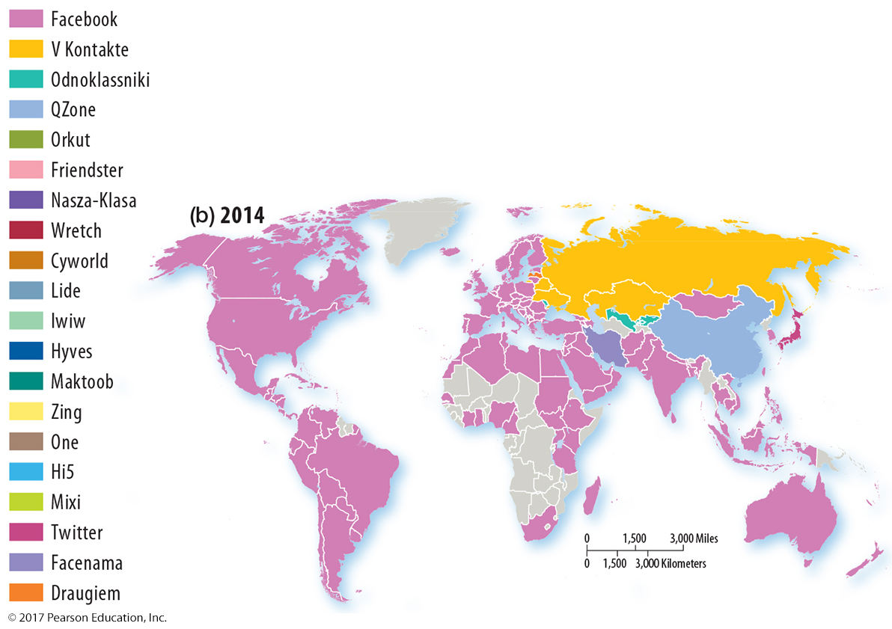
3.2 Diffusion of Social Media
Figure 4-36(b): Most popular social network, 2014. Facebook is the global leader in social media; many of the social media shown in Figure 4-36 (a) are no longer present.

Slide 39
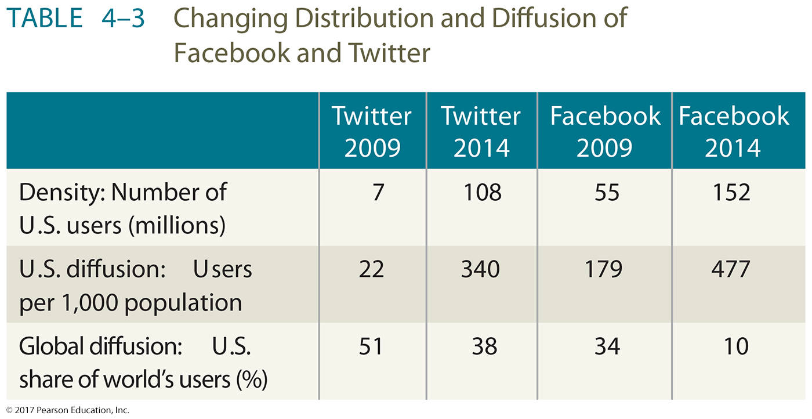
3.2 Diffusion of Social Media

Slide 40
3.3 Challenges in Accessing Electronic Media
Some governments concerned with citizen’s use of social media:
Control use by banning or limiting technology
Censor or filter Internet content
Surveil and harass or punish users

Slide 41
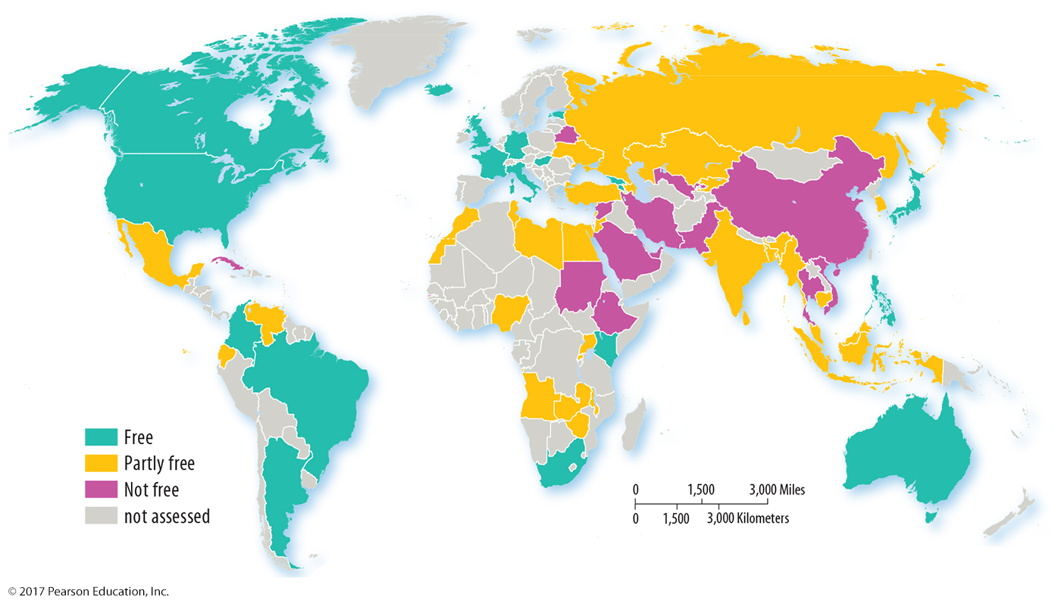
3.3 Internet Freedom 2014
Figure 4-38: Different governments around the world limit user’s use and access to technology, or violate their personal rights with respect to electronic media.

Slide 42
Key Issue 4: Why Do Folk and Popular Culture Face Sustainability Challenges?
4.1 Sustainability Challenges for Folk Culture
4.2 Sustainability Challenges for Popular Culture

Slide 43
4.1 Sustainability Challenges for Folk Culture
Some folk cultures are threatened by popular culture.
Unexpected interactions with popular culture
status of women
dowries

Slide 44
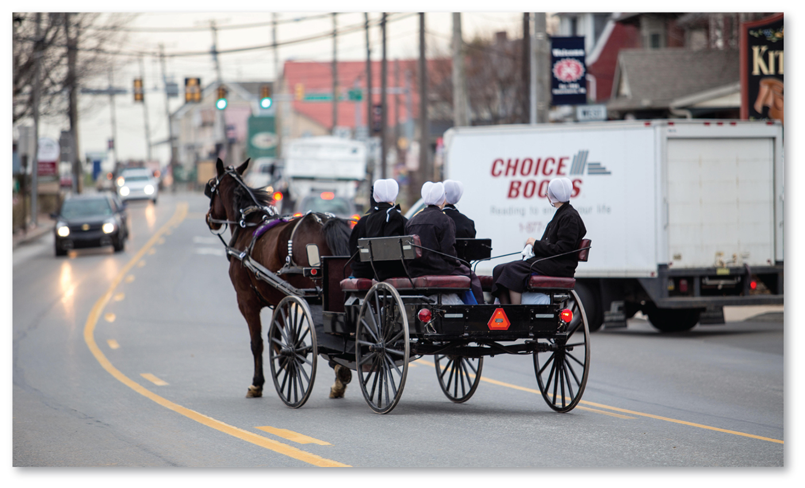
4.1 Amish Cultural Identity
Figure 4-41: The Amish maintain a distinctive folk culture despite being surrounded by elements of popular culture.

Slide 45
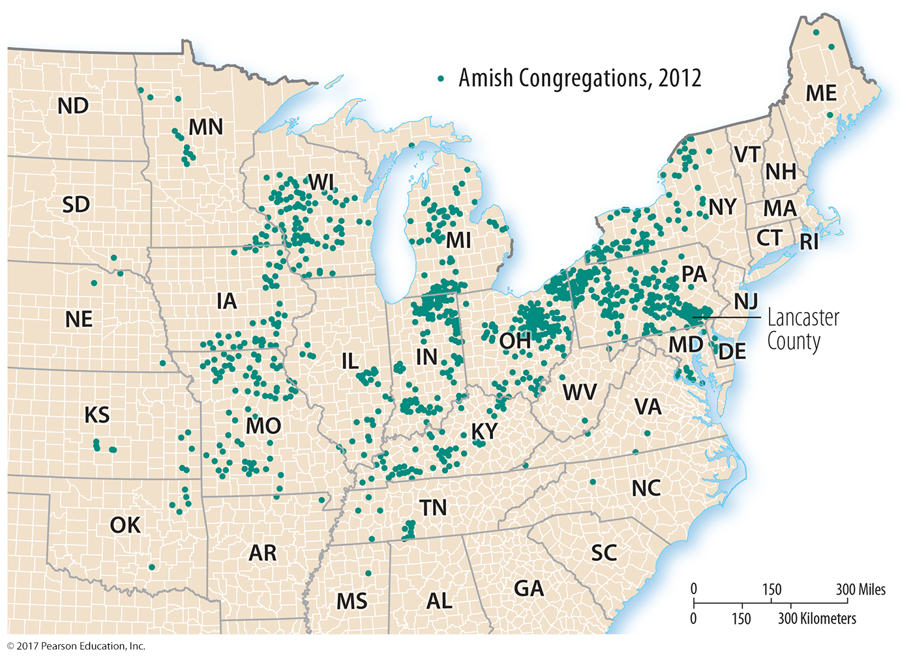
4.1 Distribution of Amish
Figure 4-42: Influenced by the price of land, Amish settlements have diffused from the culture’s hearth in Pennsylvania.

Slide 46
4.2 Sustainability Challenges for Popular Culture
Popular culture creates uniform landscapes.
Demands of popular culture can strain resources.

Slide 47
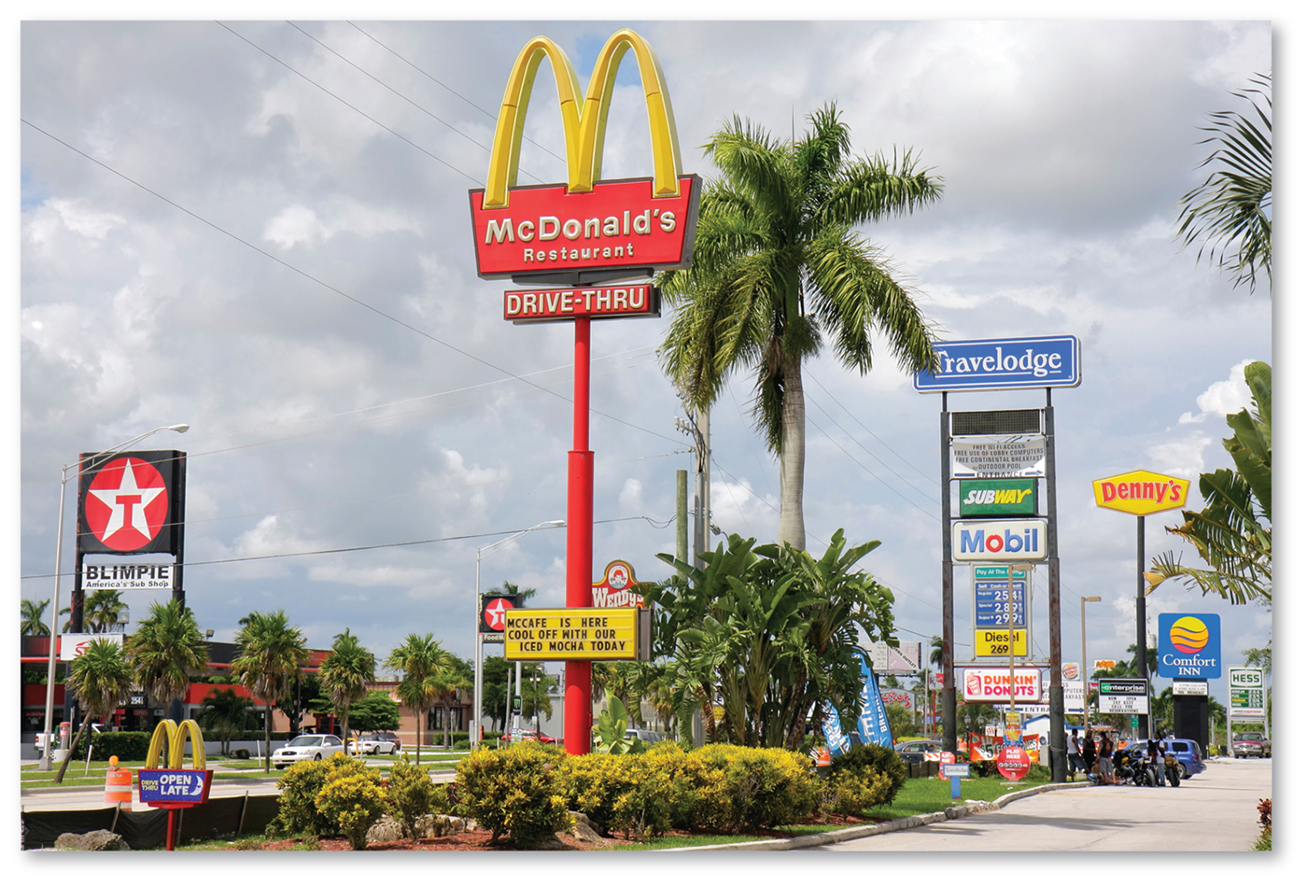
4.2 Uniform Landscape
Figure 4-45: This uniform landscape from Florida is visually similar to many other places in the United States.

Slide 48
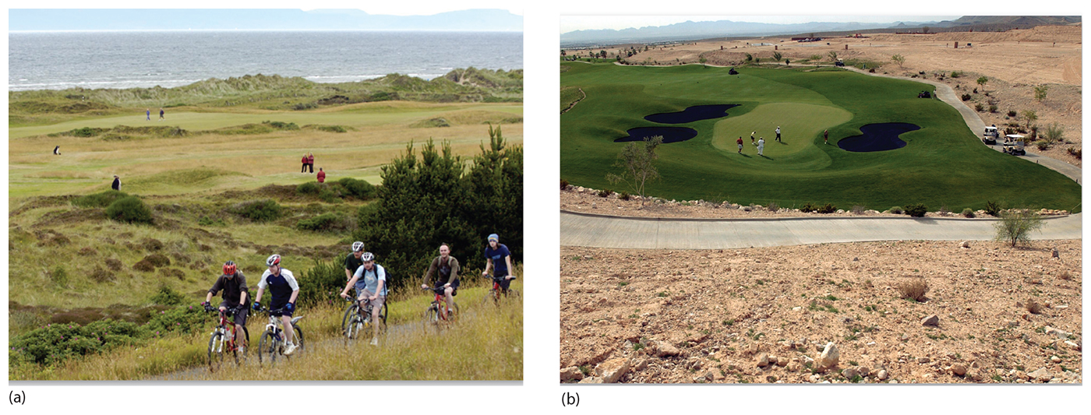
4.2 Scotland and U.S. Golf Courses
Figure 4-46: In Scotland (left), a golf course makes relatively few modifications of the natural landscape. In the U.S., a golf course in Nevada (right) requires extensive use of water resources.

Slide 49
Chapter End

