Slide 1
Chapter 3 Lecture
Chapter 3
Migration
Tim Scharks Green River College

Slide 2
Migration: Key Issues
Where Are the World’s Migrants Distributed?
Where Do People Migrate Within a Country?
Why Do People Migrate?
Why Do Migrants Face Challenges?

Slide 3
Key Issue 1: Where Are the World’s Migrants Distributed?
1.1 Introducing Migration
1.2 International Net Migration
1.3 International and Internal Migration
1.4 Changing U.S. Immigration

Slide 4
1.1 Introducing Migration
Migration: permanent move to new location
emigration: moving from a location
immigration: moving to a location
net migration: immigration minus emigration
Mobility: one’s ability to move from place to place
Not all mobility is migration.

Slide 5
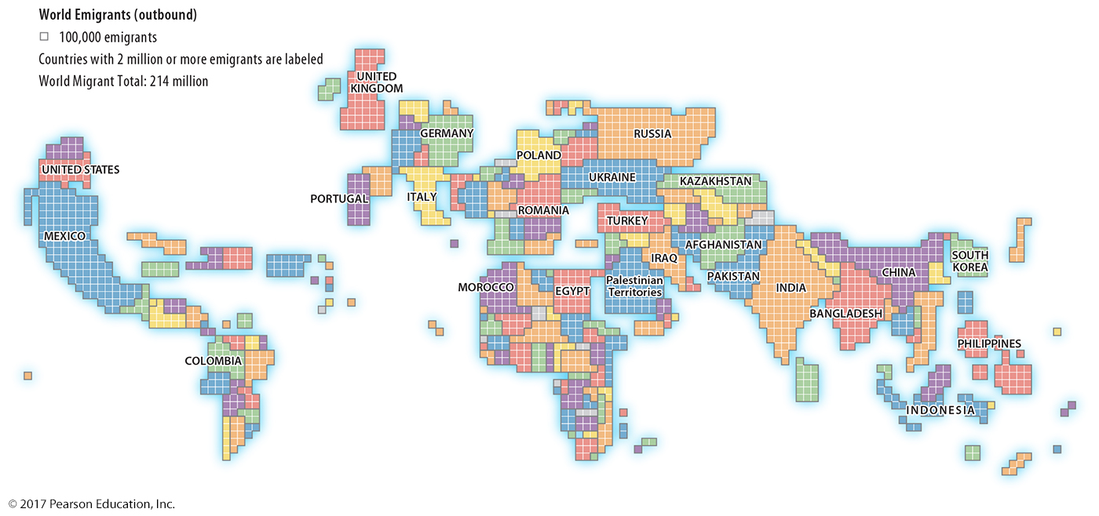
1.1 World Emigrants
Figure 3-2: Each square of this cartogram equals 100,000 people leaving the country.

Slide 6
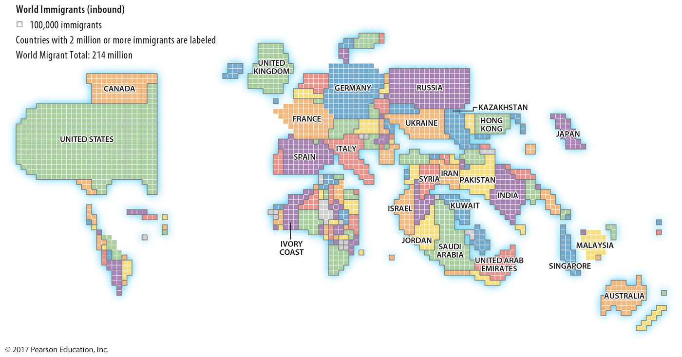
1.1 World Emigrants
Figure 3-3: Each square of this cartogram equals 100,000 people entering the country. Compare to Figure 3-2; the difference between the figures represents net migration.

Slide 7
1.2 International Net Migration
International migration: movement between two countries
Migration transition: migration patterns change with demographic transition (Zelinsky)

Slide 8
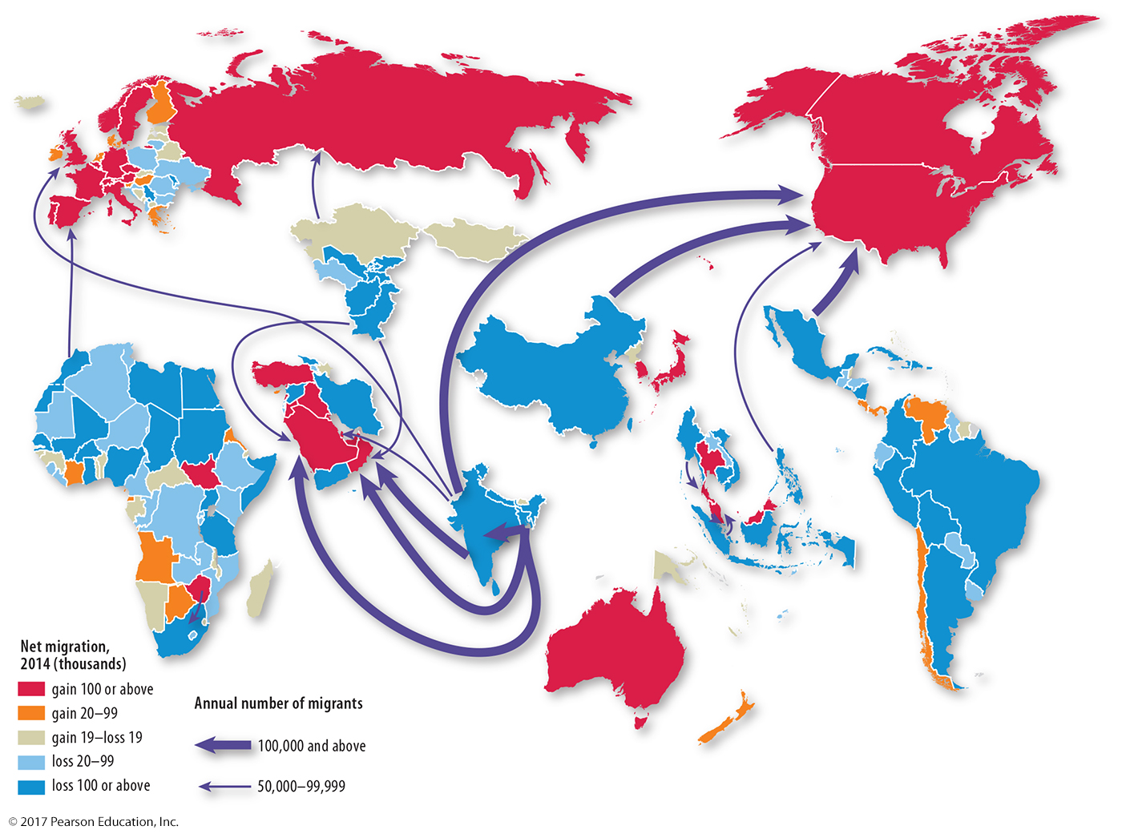
1.2 International Net Migration
Figure 3-4: Major international flows in 2014 were out of South Asia, East Asia, and Latin America and into North America and Southwest Asia.

Slide 9
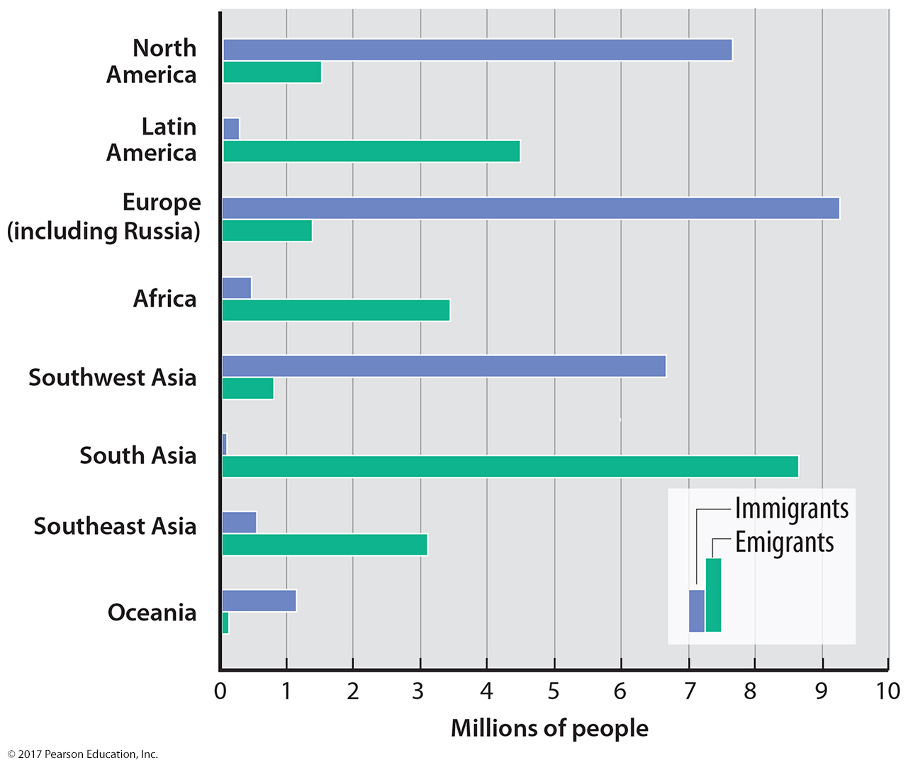
1.2 Immigrants and Emigrants
Figure 3-6: Every region has a large difference between its immigration and emigration.

Slide 10
1.2 Migration Transition
Table 3-1: Wilbur Zelinsky’s migration transition model observes the type of migration changes with stages of the demographic transition.

Slide 11
1.3 International and Internal Migration
International migration can be
voluntary
forced
Internal migration: movement within one country
Interregional: movement from one region to a different one
Intraregional: movement within one region

Slide 12
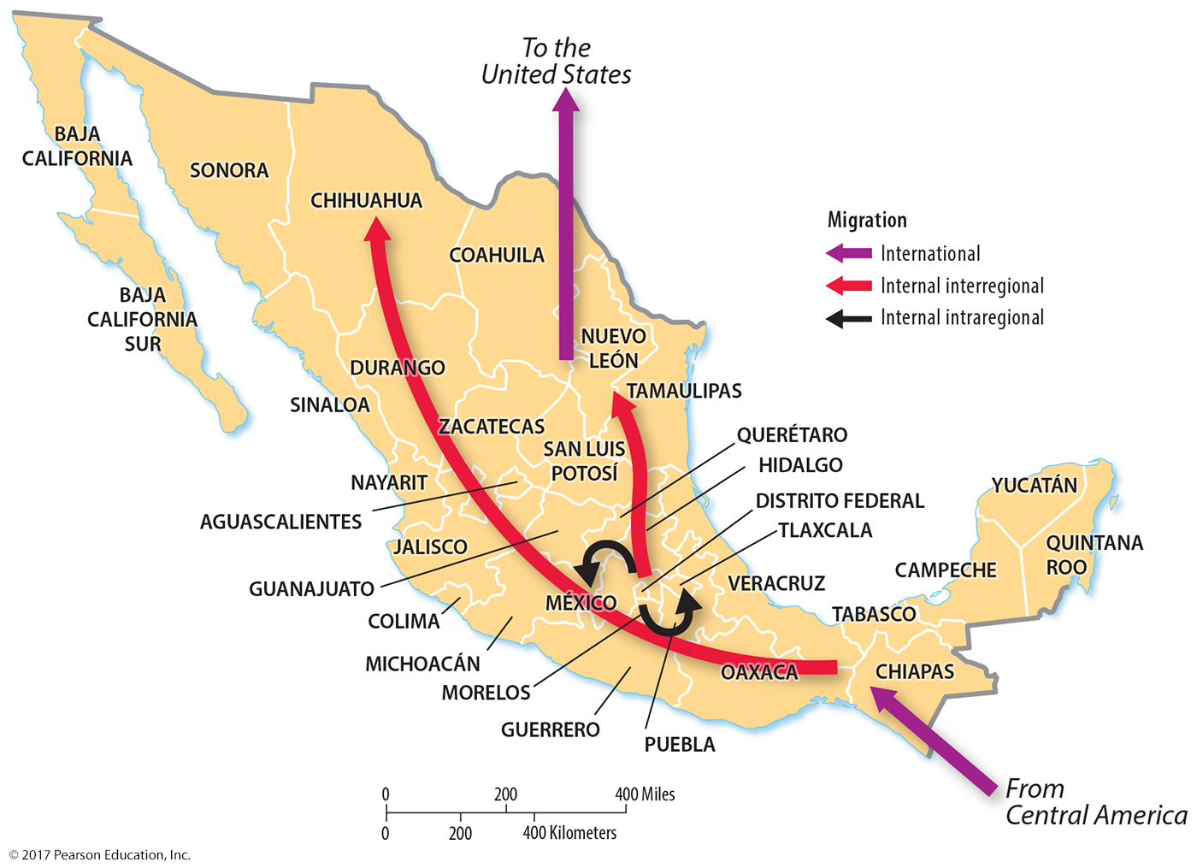
1.3 International and Internal Migration
Figure 3-7: Mexico’s migration flows are both international and internal. Internal flows are both intra- and interregional.

Slide 13
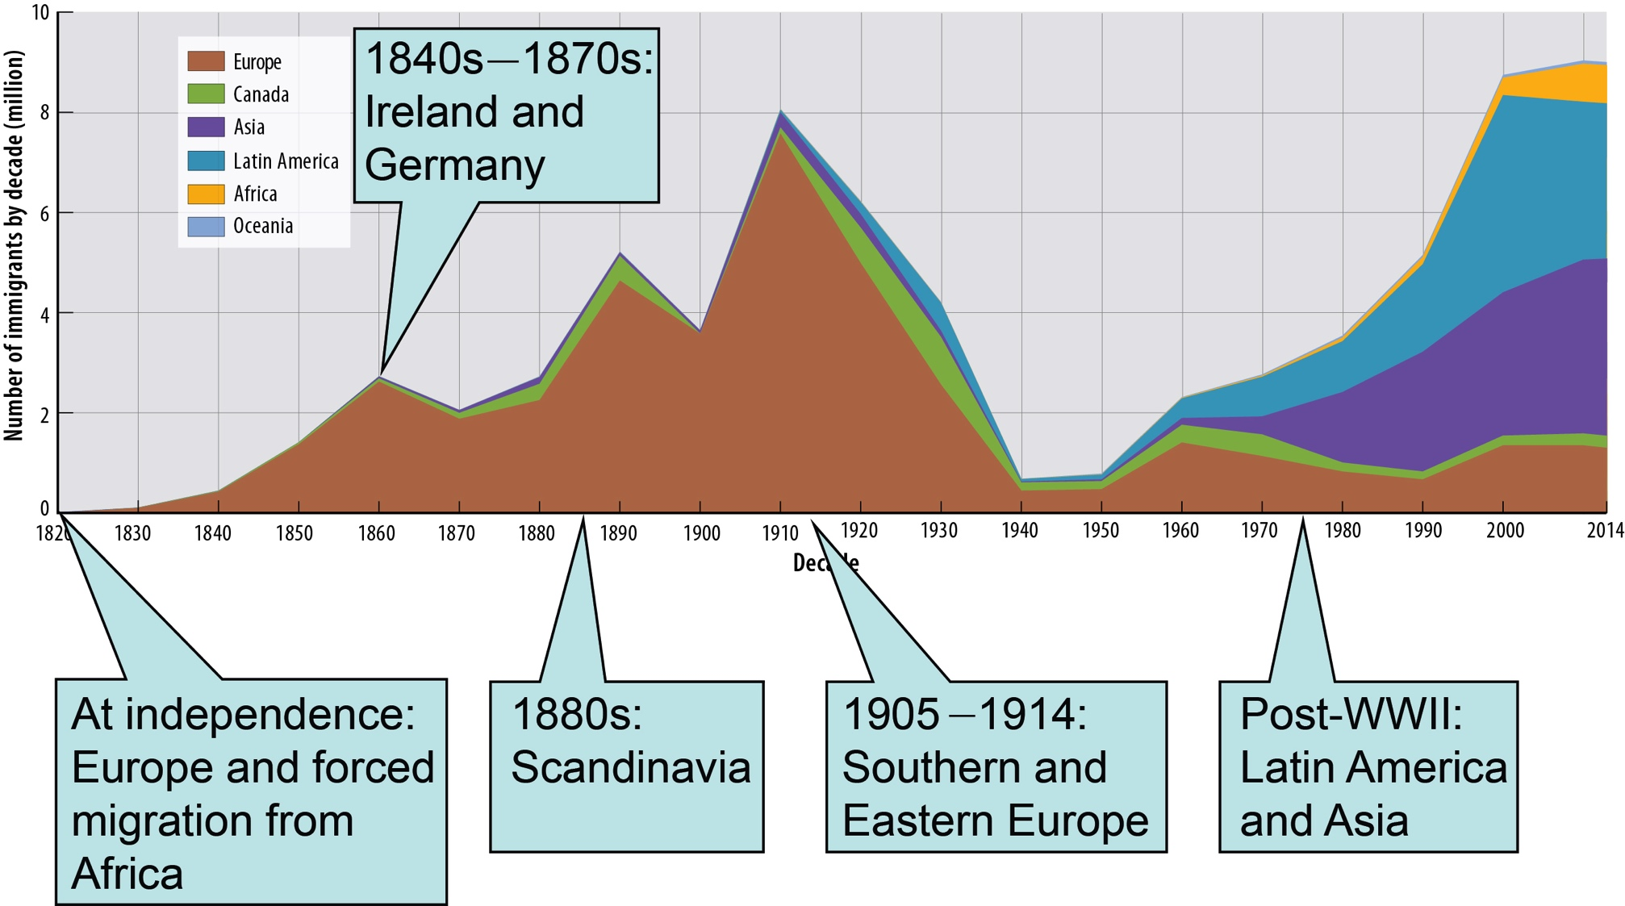
1.4 Changing U.S. Immigration
Figure 3-10: Two centuries of immigration to the United States.

Slide 14
Key Issue 2: Where do People Migrate Within a Country?
2.1 Interregional Migration in the United States
2.2 Interregional Migration in Other Large Countries
2.3 Intraregional Migration

Slide 15
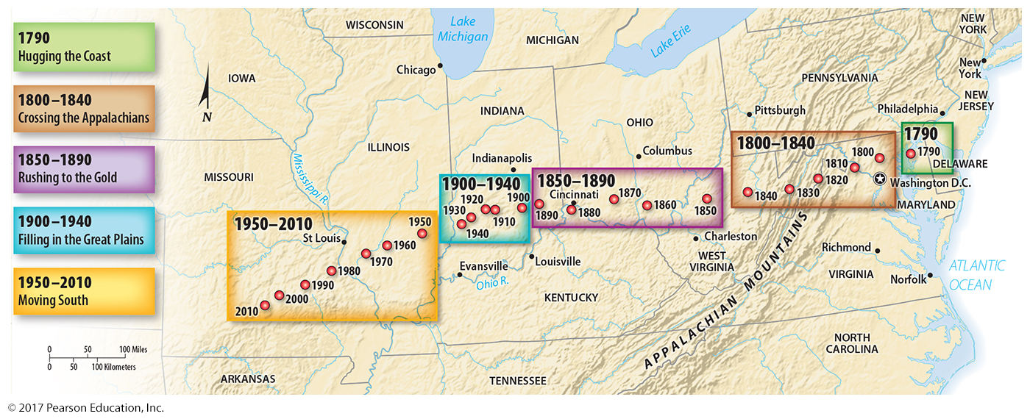
2.1 Changing Center of U.S. Population
U.S. center of population has moved westward and south.
Movement reflects changing transportation and economics.
Figure 3-12: Changing Center of U.S. Population

Slide 16
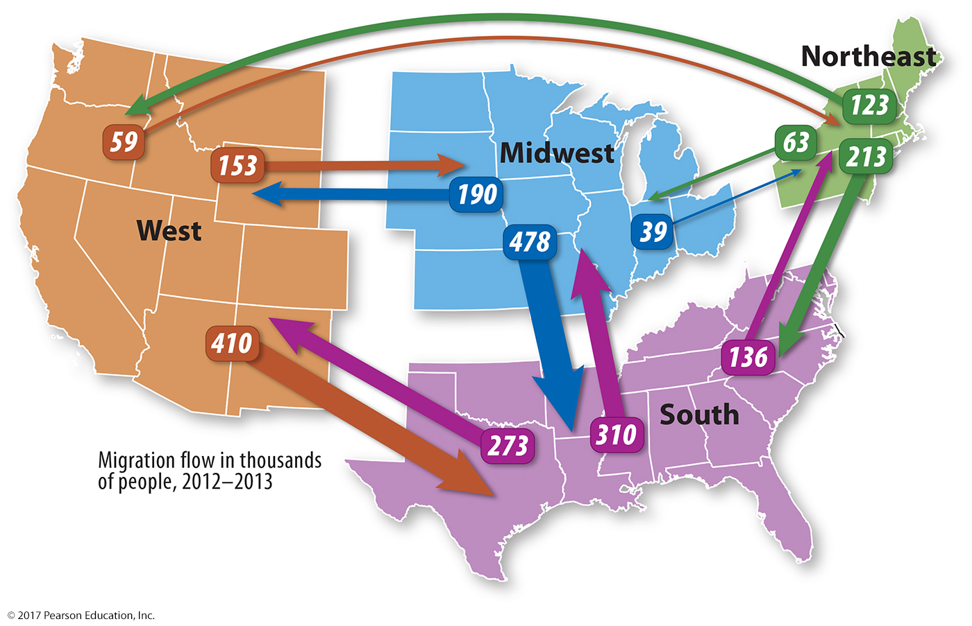
2.1 Interregional Migration in the U.S.
Figure 3-13: Recent net migration trends are to the South.

Slide 17
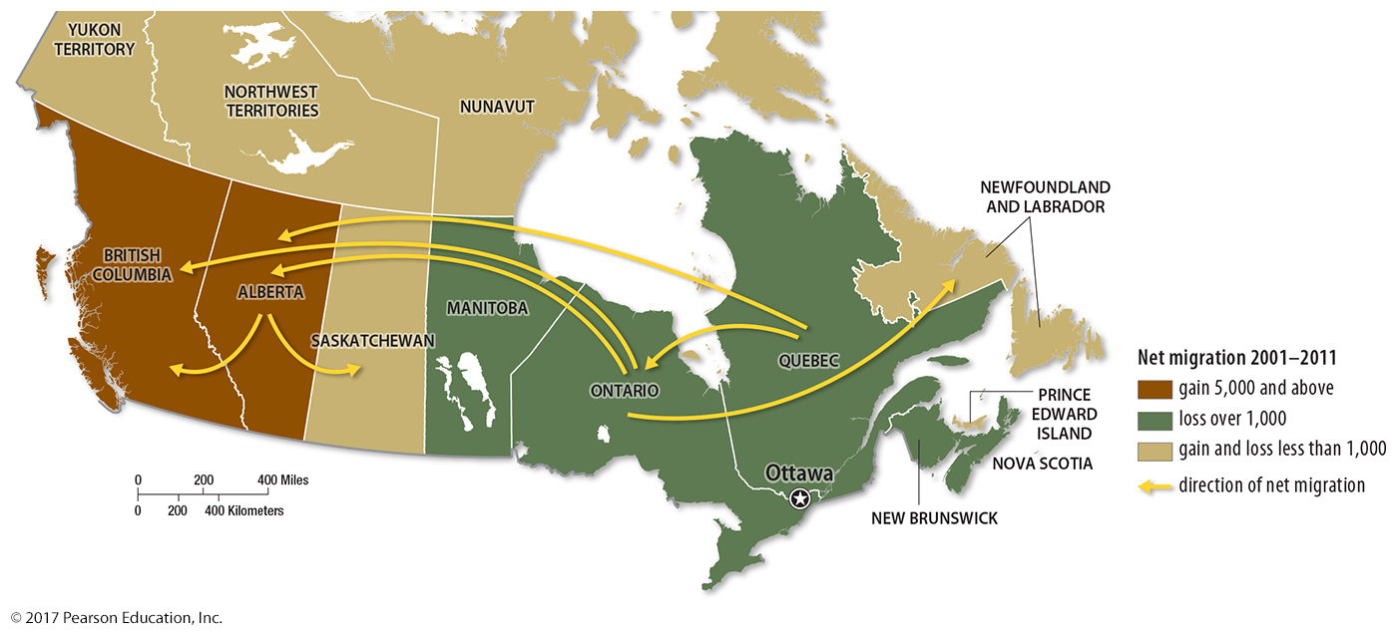
2.2 Interregional Migration in Canada
Figure 3-14: Canada’s interregional migration patterns are to the west, like U.S. historical trend.

Slide 18
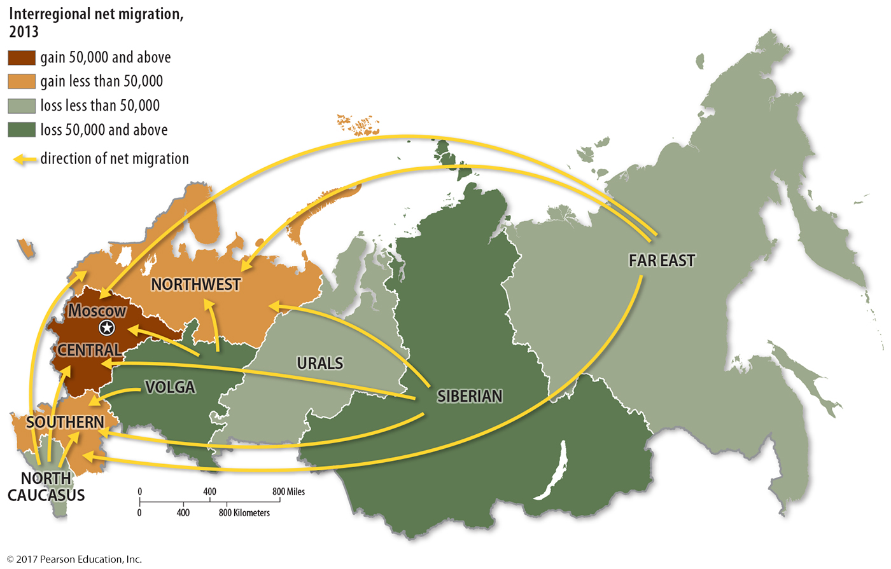
2.2 Interregional Migration in Russia
Figure 3-15: Russia’s interregional migration patterns show the reversal of earlier attempts to populate its Asian regions.

Slide 19
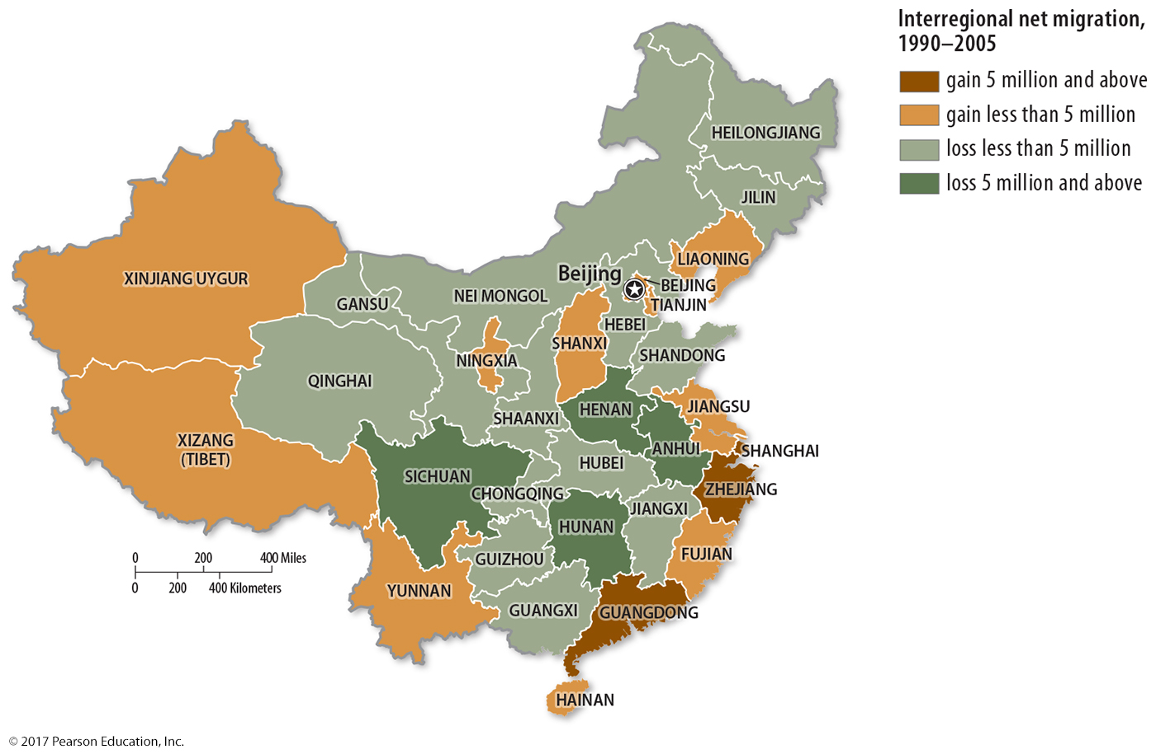
2.2 Interregional Migration in China
Figure 3-16: Interregional migration in China reflects movement towards large coastal cities.

Slide 20
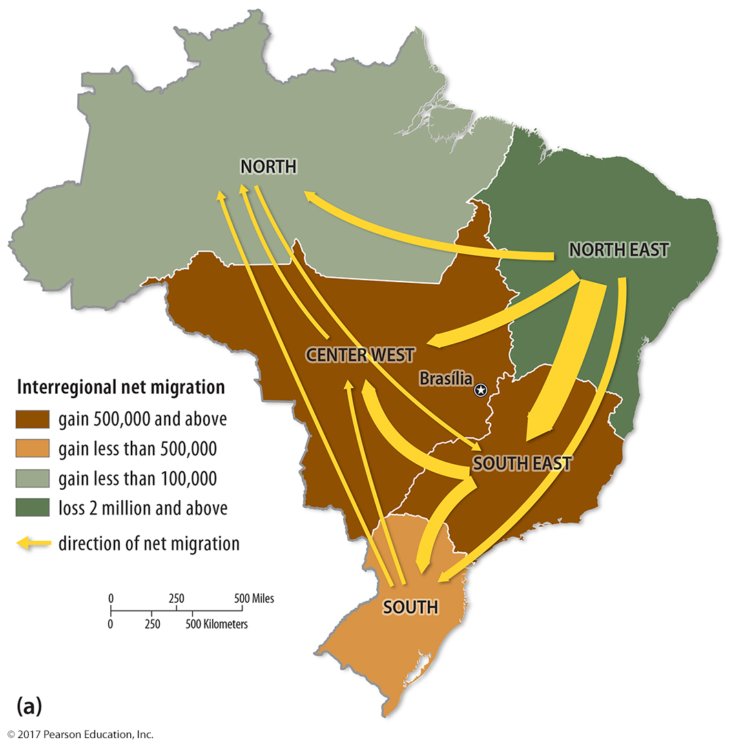
2.2 Interregional Migration in Brazil
Figure 3-17: Brazil’s interregional migrations show evidence of development of the interior.

Slide 21
2.3 Intraregional Migration
Rural to urban migration most common in developing countries.
Urban to suburban common in developed countries.
Urban to rural (counterurbanization) observed in some cases.

Slide 22
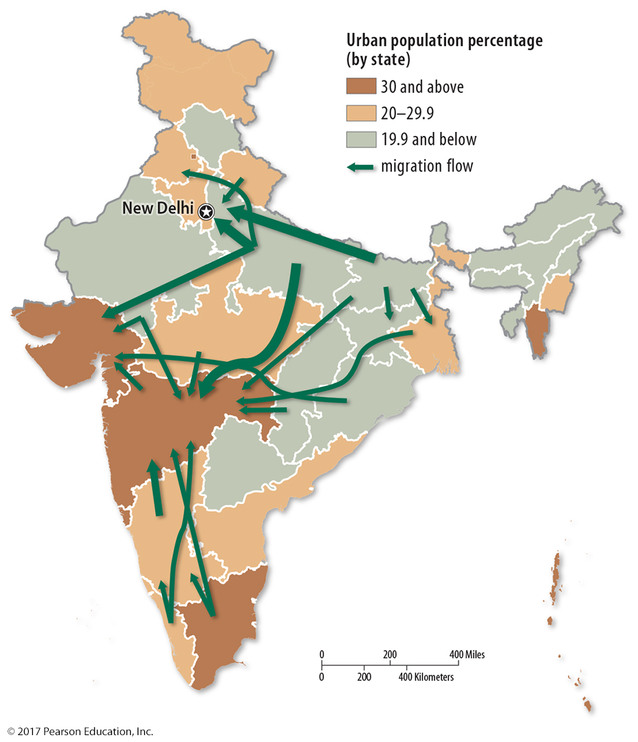
2.3 Internal Migration in India
Figure 3-19: Migration flows in India are mostly from rural states (green) to more urbanized states (dark brown).

Slide 23
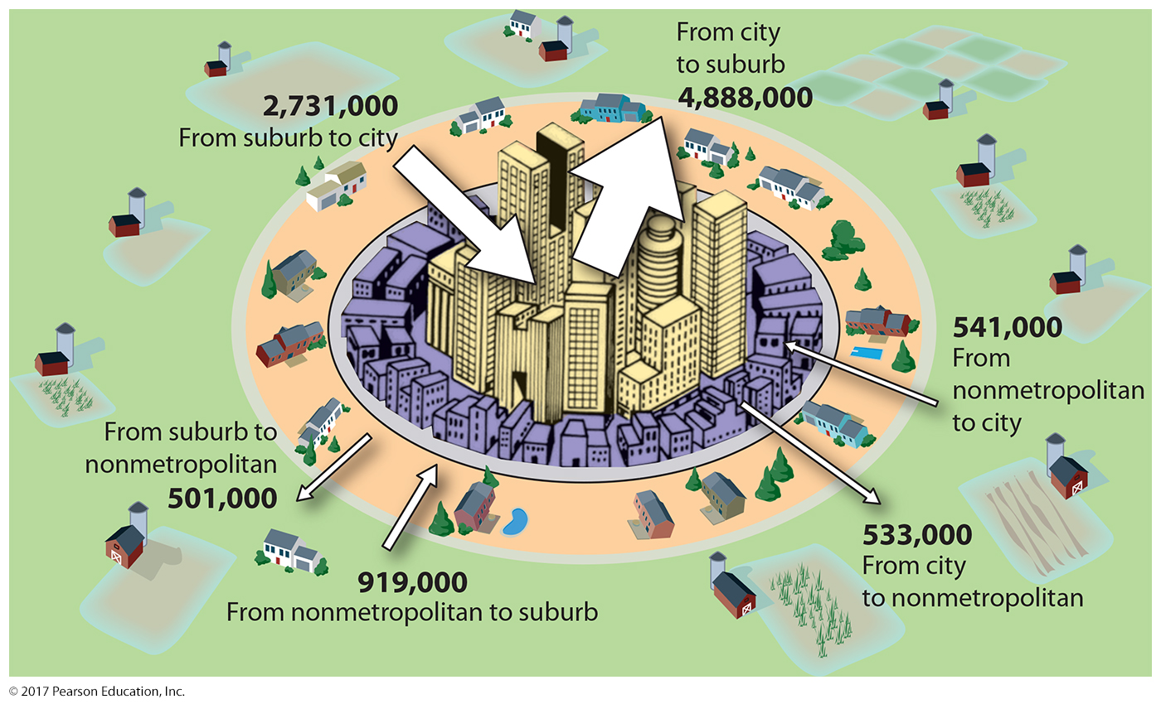
2.3 Intraregional Migration: United States
Figure 3-20: The largest U.S. intraregional migration flow is from the city to the suburbs.

Slide 24
Key Issue 3: Why Do People Migrate?
3.1 Cultural Reasons for Migrating
3.2 Environmental Reasons for Migrating
3.3 Migrating to Find Work
3.4 Gender and Age of Migrants

Slide 25
3.1 Why Do People Migrate?
Combination of push and pull factors
Cultural push: fleeing violent conflict/persecution
refugees, internally displaced persons, asylum seekers
Environmental push: floods, droughts
Pull factors: better cultural, environmental conditions

Slide 26
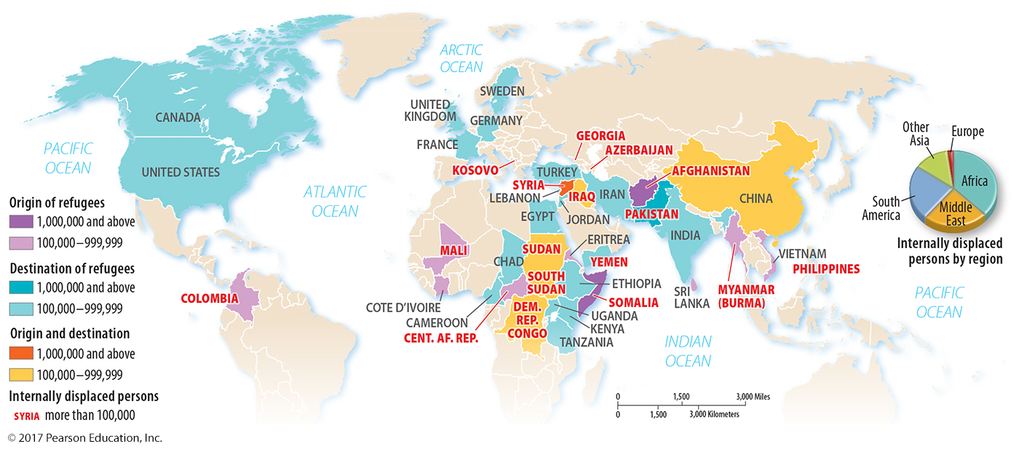
3.1 Refugees and Internally Displaced Persons
Figure 3-22: Afghanistan and Syria are presently the sources of the largest numbers of refugees.

Slide 27
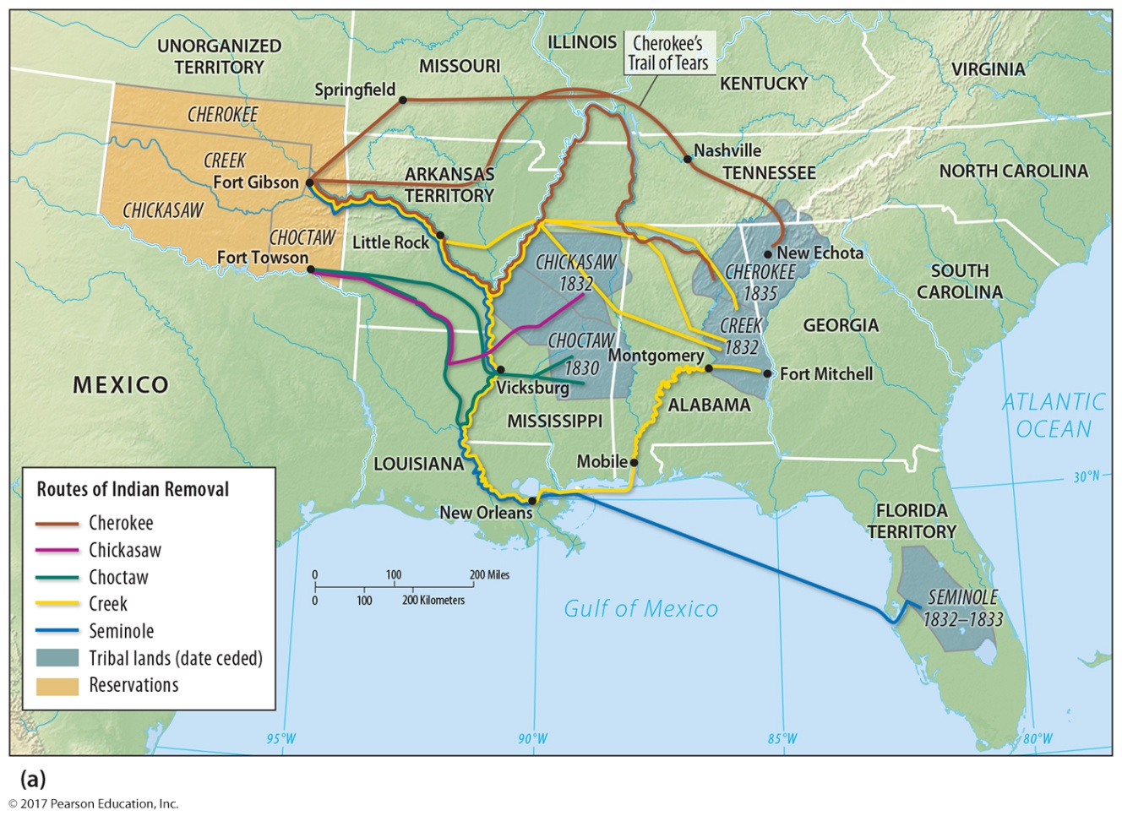
3.1 Trail of Tears
Figure 3-23: The forced migration of Native Americans took place in the 1830s.

Slide 28
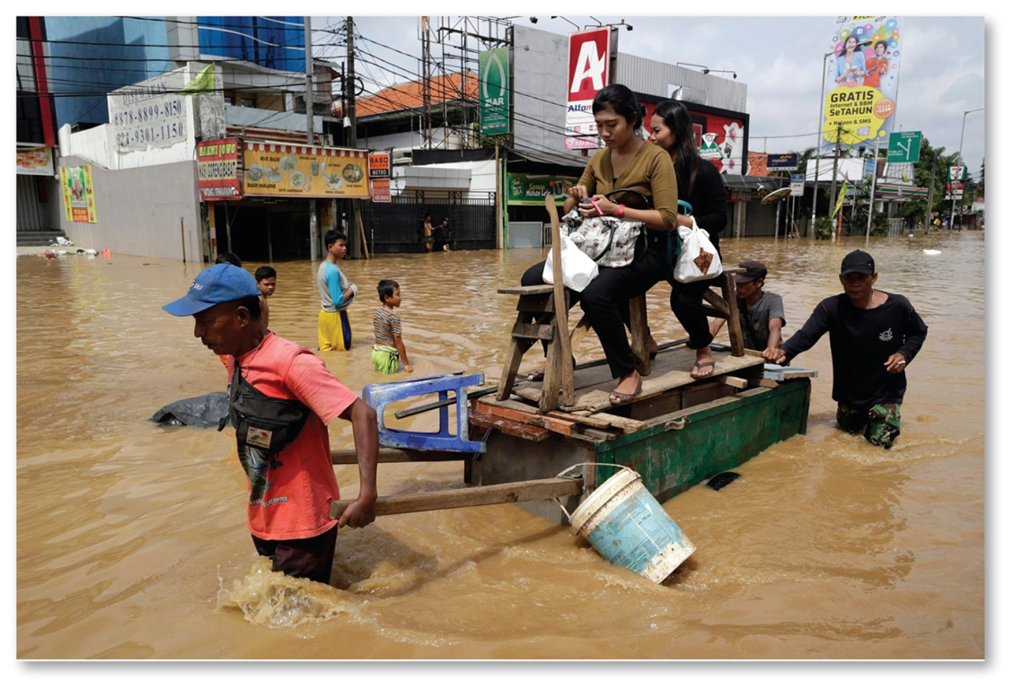
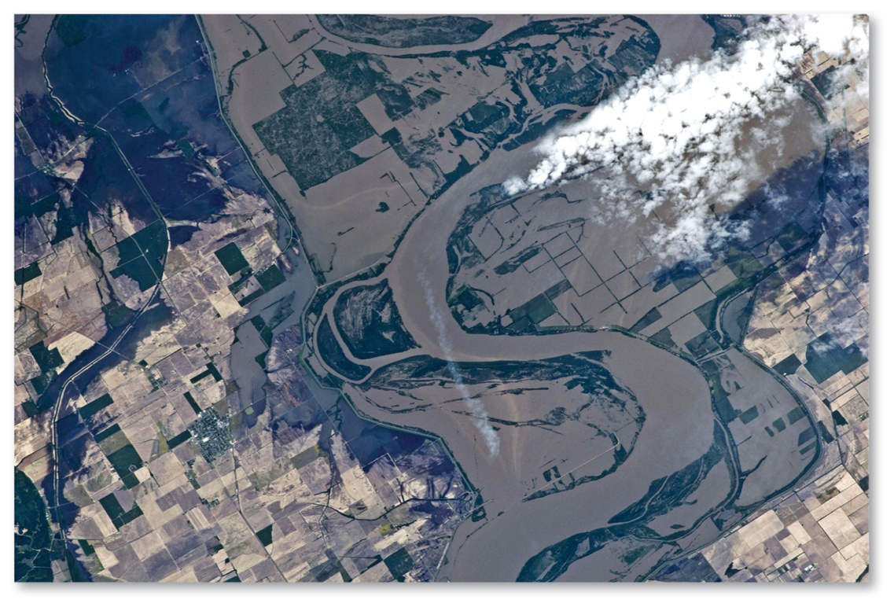
3.2 Environmental Push Factors
Figures 3-24 and 3-25: Flooding in Jakarta, Indonesia (top) and the Mississippi River, U.S. (bottom)

Slide 29
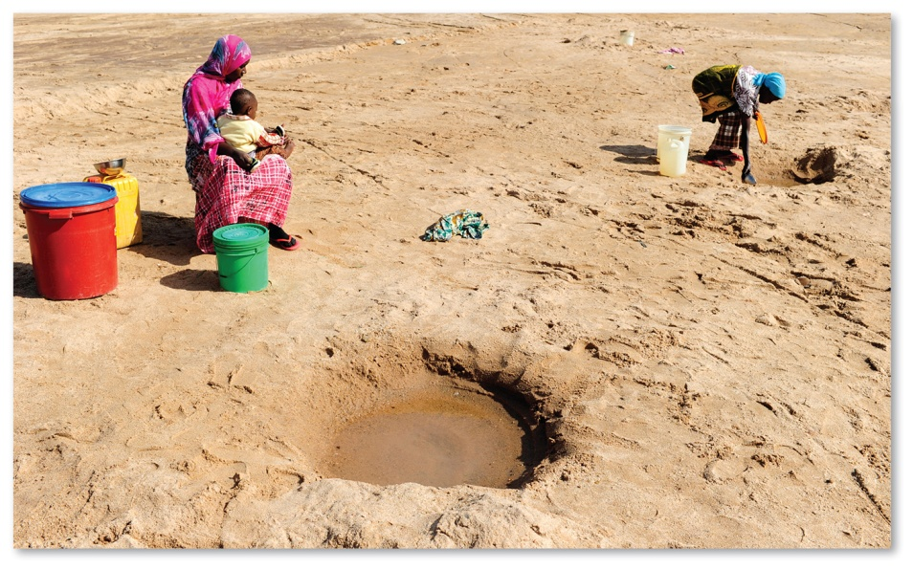
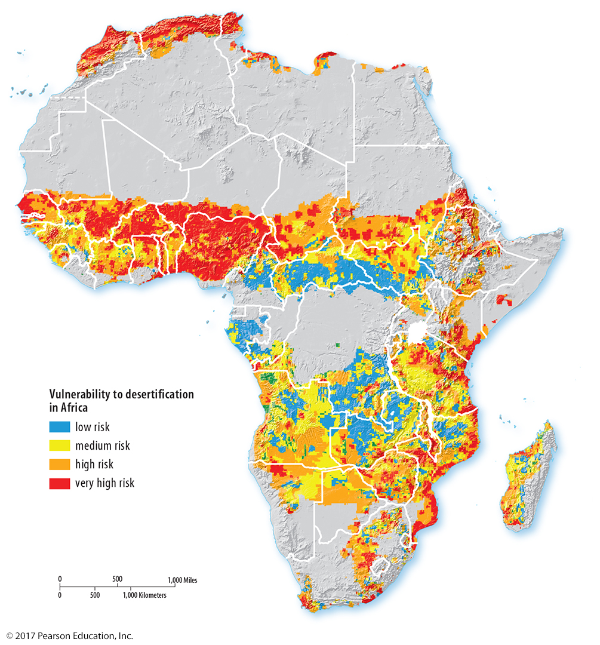
3.2 Environmental Push Factors
Figures 3-26 and 3-27: Desertification risk in Africa (left) and water sources in the dry season in Tanzania (right)

Slide 30
3.3 Migrating to Find Work
Economic push and pull factors cause majority of migration.
Major flows of migration are between Asian countries and out of Asia.
Remittances: payments sent home by migrants

Slide 31
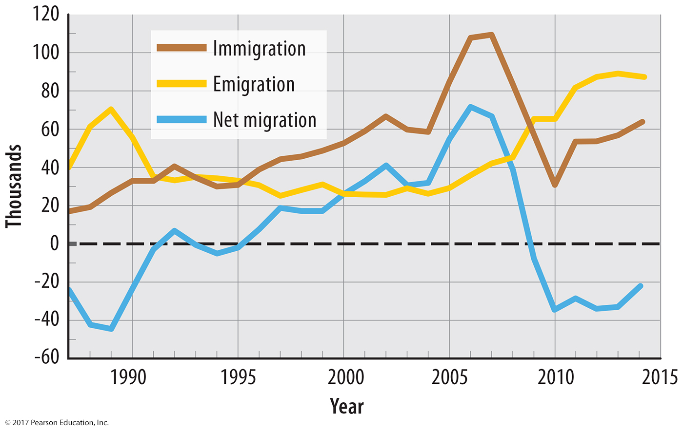
3.3 Net Migration in Ireland
Figure 3-28: Economic recession transformed economic pull factors into push factors.

Slide 32
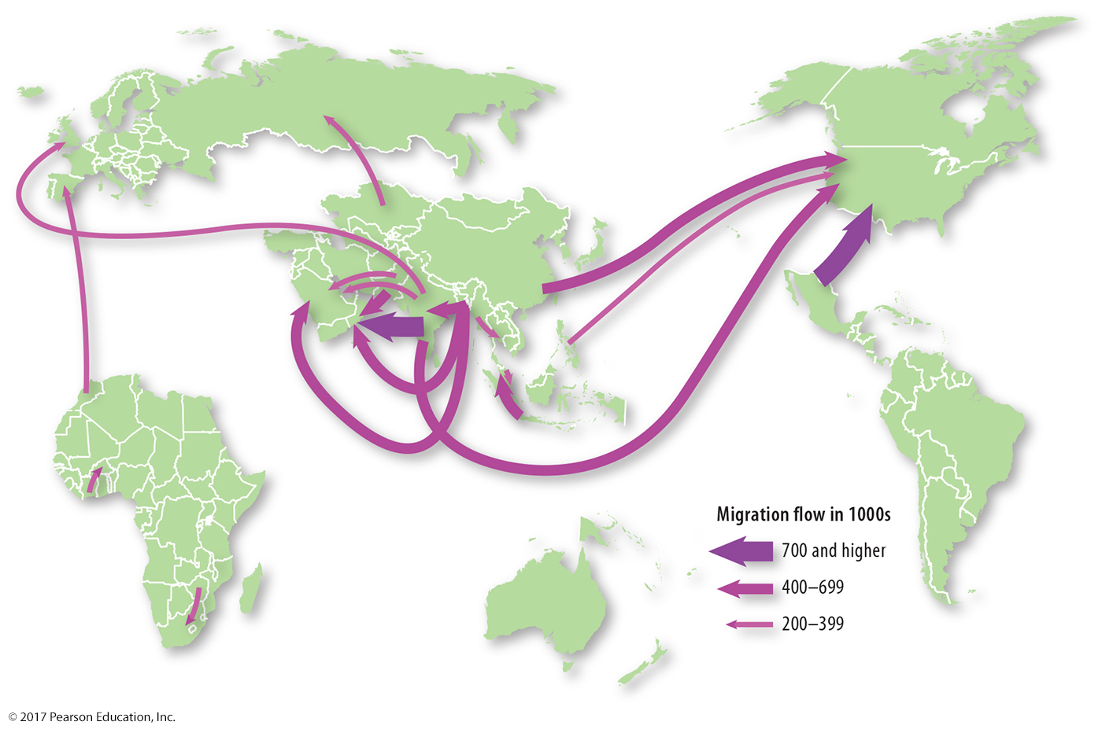
3.3 International Migration Flows, 2005–2010
Figure 3-29: Large migration flows are between countries in Asia and out of Asia, with the exception of Latin America to North America.

Slide 33
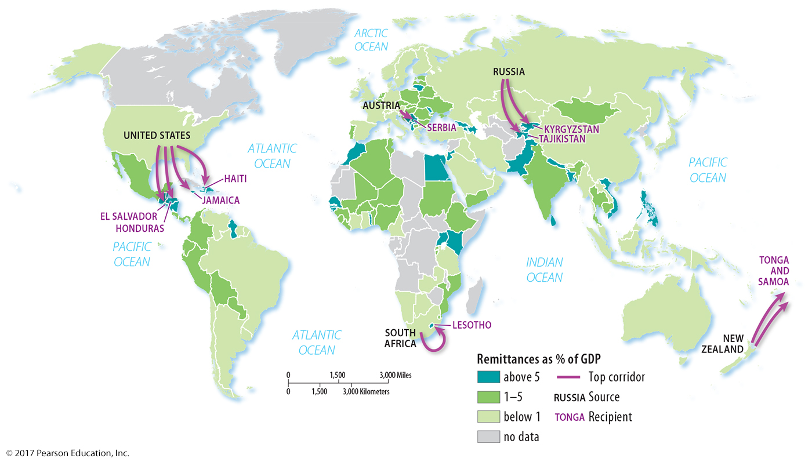
3.3 International Migration Flows, 2005–2010
Figure 3-31: India and China receive the largest total value of remittances; the largest sources are the United States, Russia, and New Zealand.

Slide 34
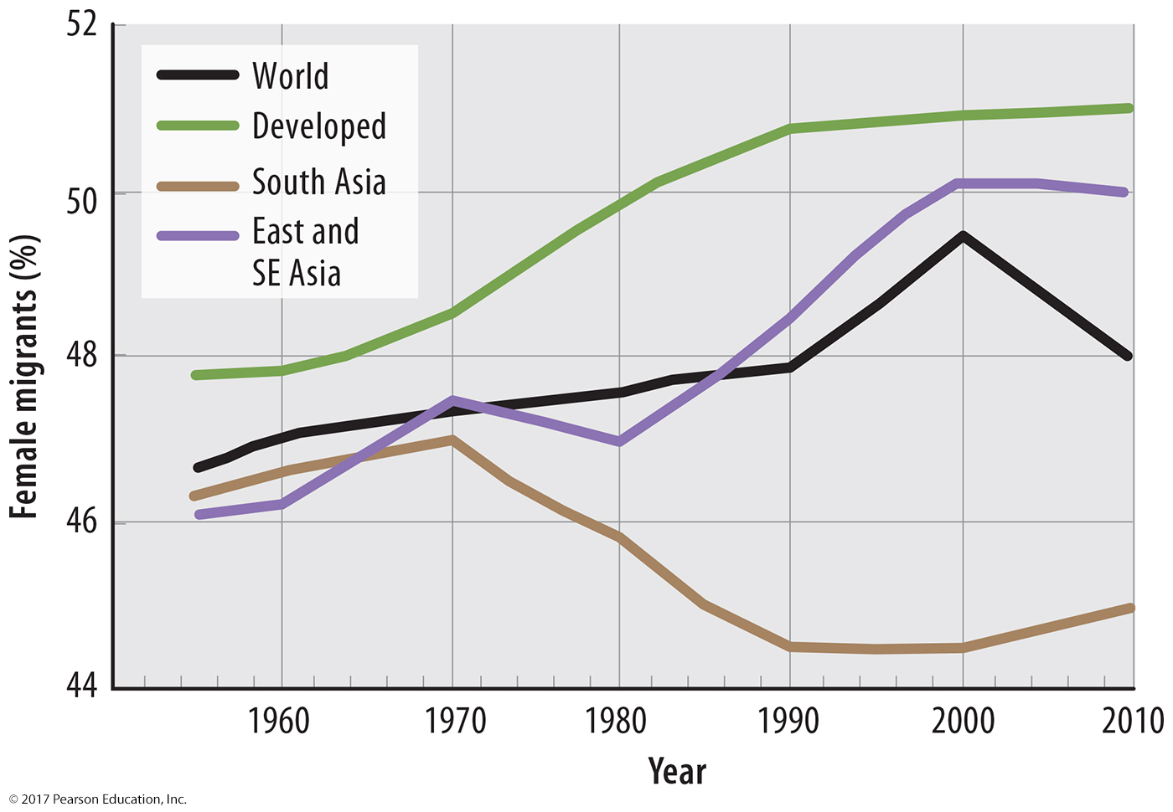
3.4 Gender and Age of Migrants
Figure 3-32: Slightly more than half of migrants to developed countries are female. Migrants to South Asia are more likely to be male.

Slide 35
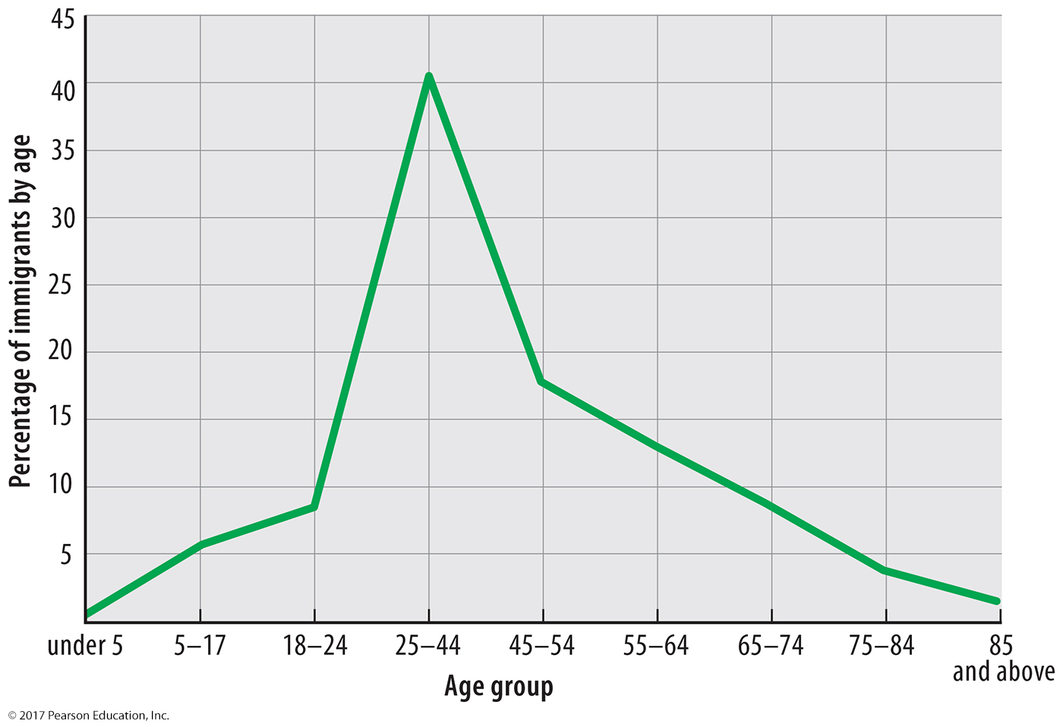
3.4 Gender and Age of Migrants
Figure 3-34: International migrants to the United States are disproportionately between ages 20 and 39.

Slide 36
Key Issue 4: Why Do Migrants Face Challenges?
4.1 Government Immigration Policies
4.2 U.S. Quota Laws
4.3 U.S.–Mexico Border Issues
4.4 Europe’s Immigration Crisis

Slide 37
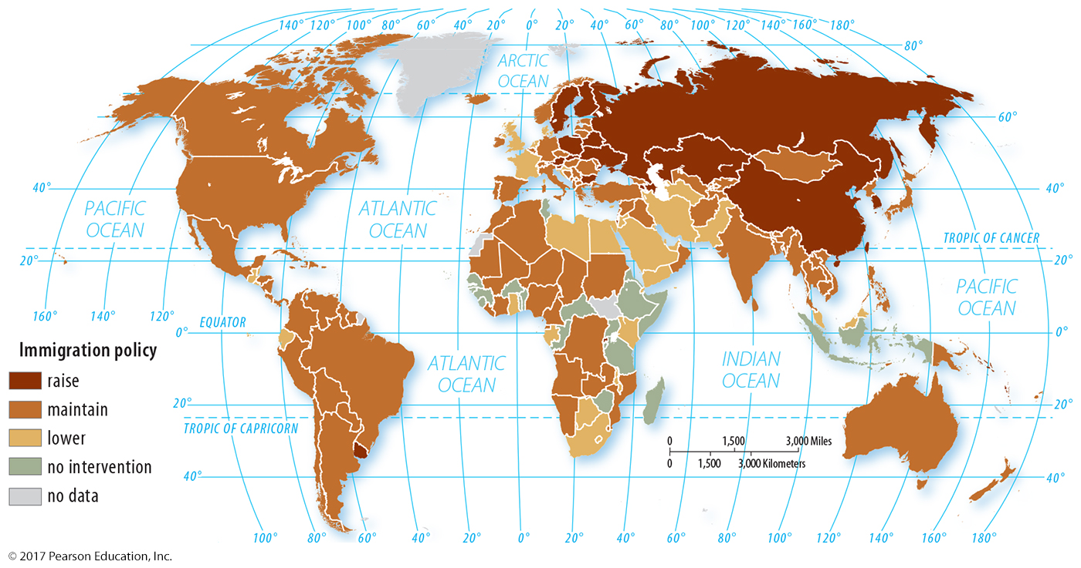
4.1 Government Immigration Policies
Figure 3-36: Immigration policies vary around the world, but few countries have targeted increasing immigration.

Slide 38
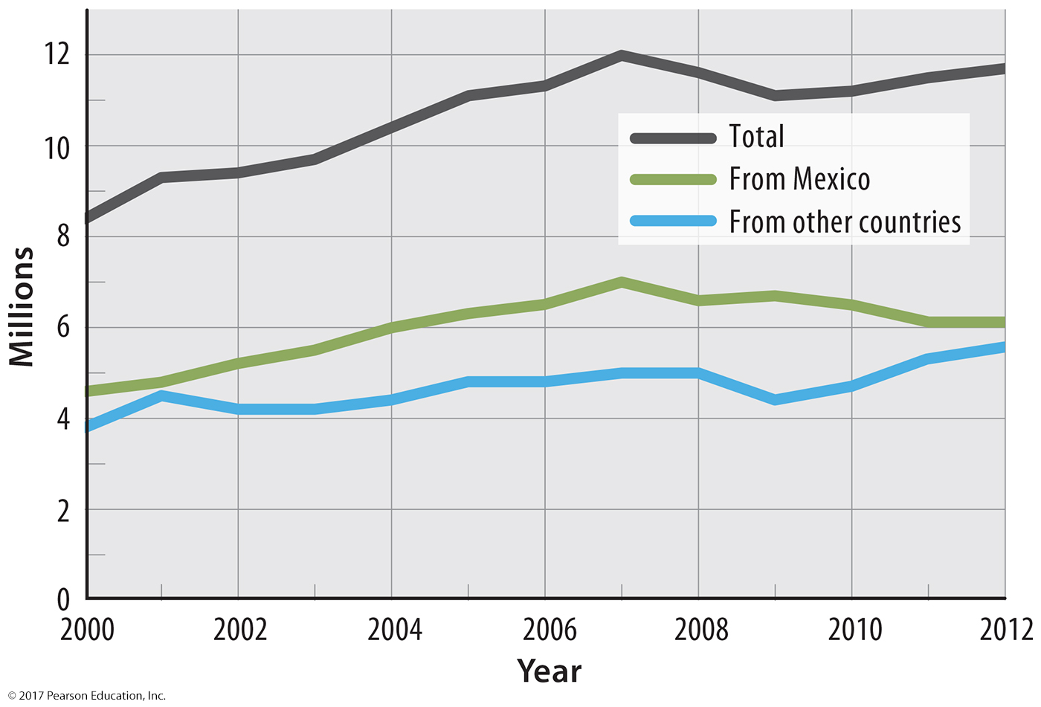
4.1 Unauthorized Immigrants in the U.S.
Figure 3-37: Slightly more than half of unauthorized immigrants are from Mexico.

Slide 39
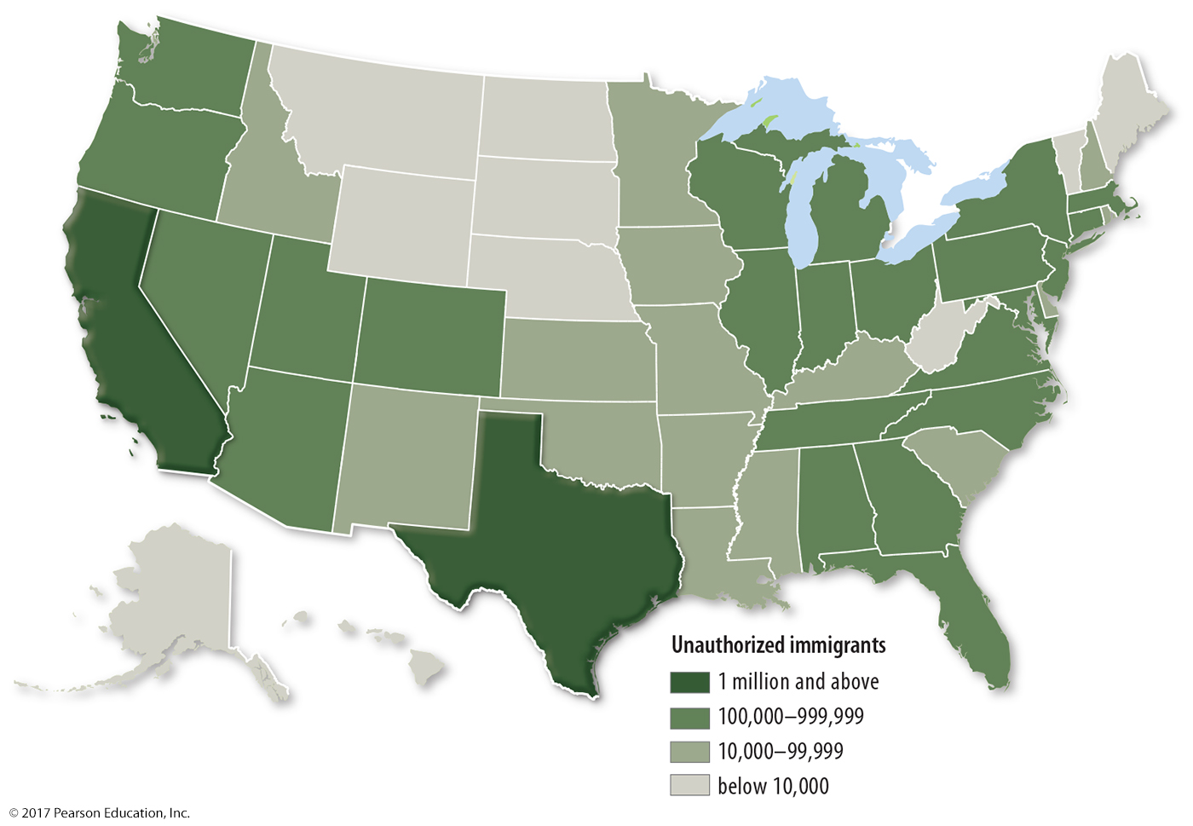
4.1 Unauthorized Immigrants in the U.S.
Figure 3-38: Texas and California have the largest numbers of unauthorized immigrants.

Slide 40
4.2 U.S. Quota Laws
1924: 2% of U.S. base population by country
1965: quotas by hemisphere (Eastern and Western) totaling 290,000 per year
1978: global quota of 290,000 per year
1990: quota raised to 700,00 per year
Preferences for family reunification, skilled workers, and diversity criterion
Skilled worker preference criticized for “brain drain.”

Slide 41
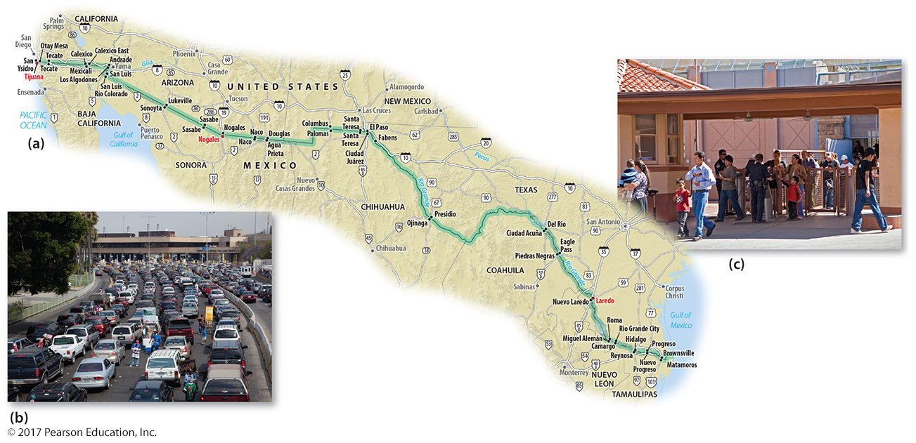
4.3 U.S.–Mexico Border Issues
Figure 3-41: Policy concerning unauthorized migration from Mexico is a contentious topic. Debate includes the level of border enforcement, the role of unauthorized workers in the economy, and protecting the civil rights of U.S. citizens.

Slide 42
4.4 Europe’s Immigration Crisis
Europe home to many migrants from North Africa and Eastern Europe
guest worker programs 1960s–70s
New influxes of refugees from Southwest Asia
Increased hostility to immigrants in many European countries

Slide 43
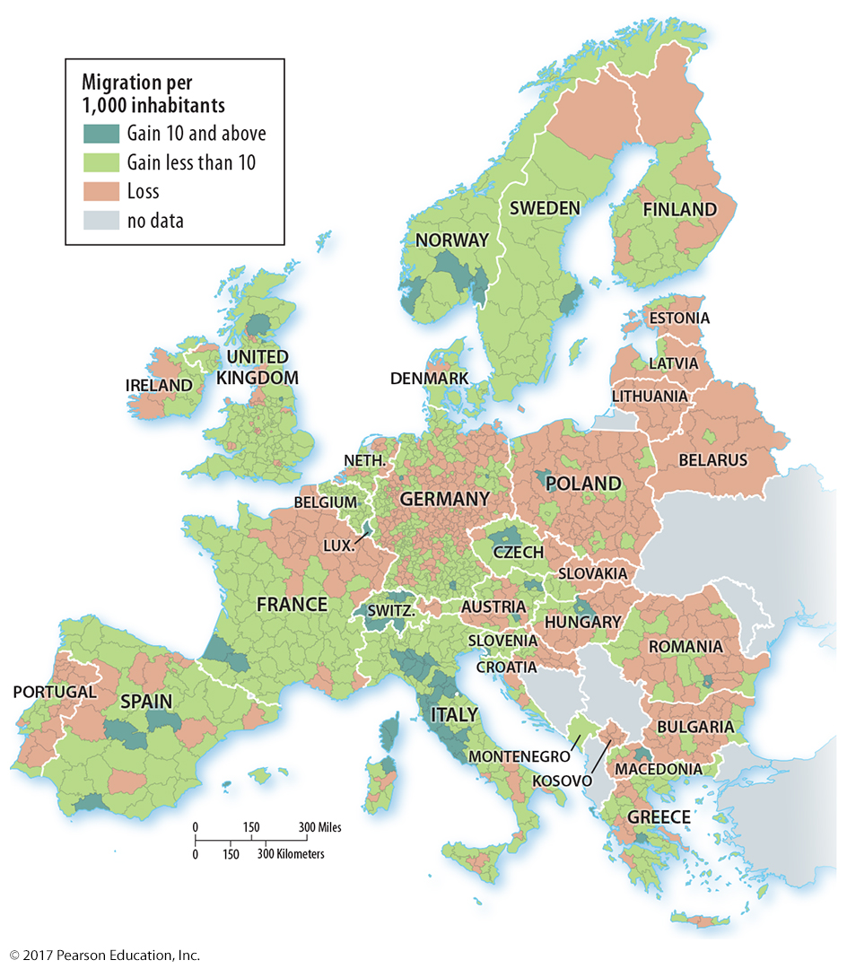
4.4 Net Migration in Europe
Figure 3-44: Eastern Europe is a source region of migrants moving to Western and Northern Europe.

Slide 44
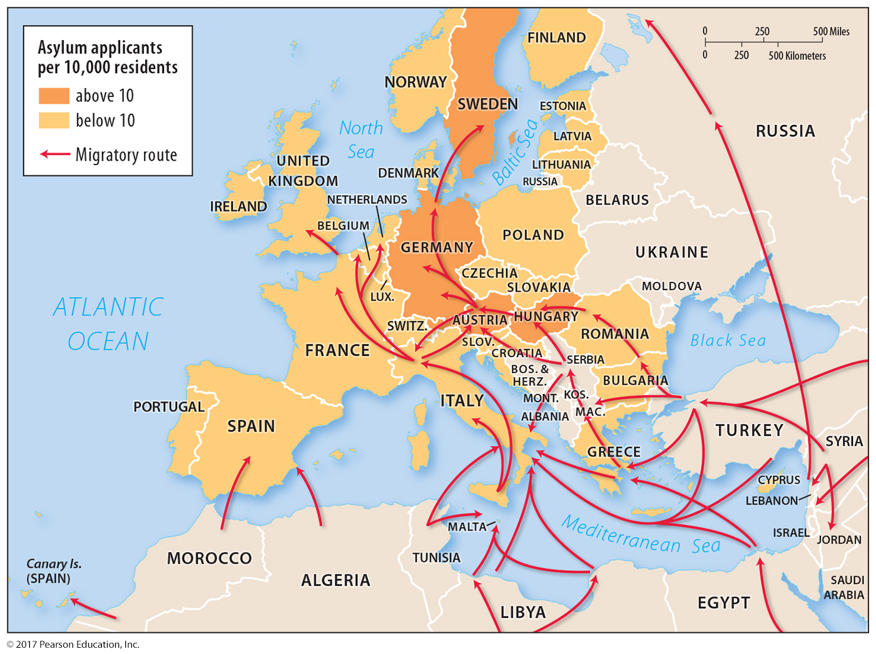
4.4 Refugee Flows in Europe
Figure 3-45: Eastern European countries are along the route of refugees traveling to Western and Northern Europe.

Slide 45
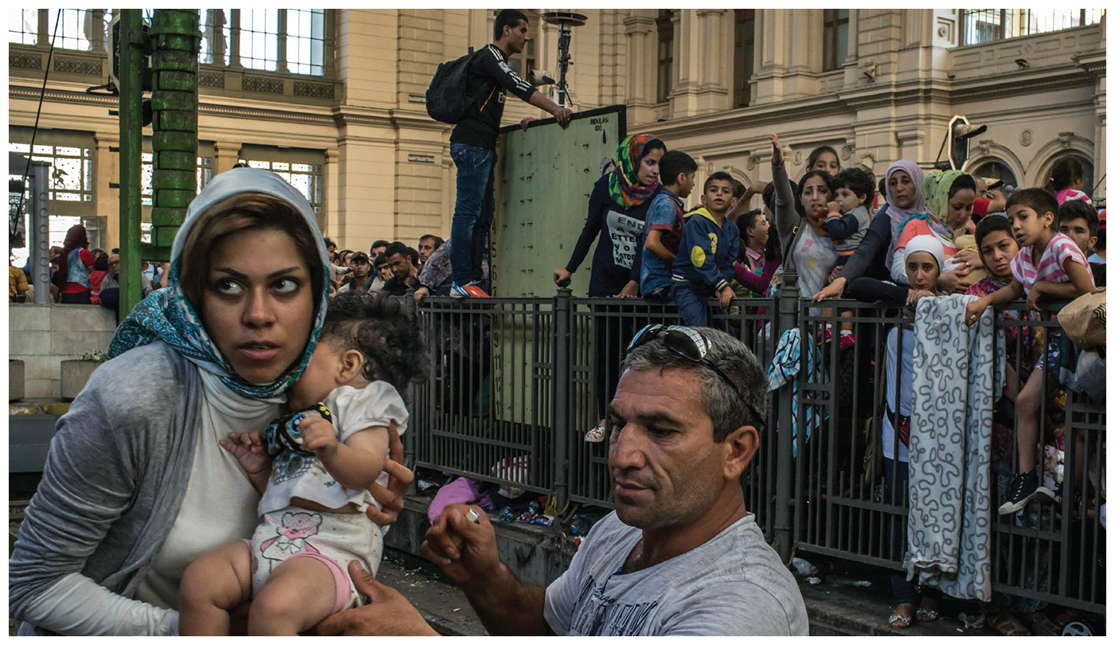
Chapter 3 End

