Slide 1
Chapter 2 Lecture
Chapter 2
Population and Health
Tim Scharks Green River College

Slide 2
Population and Health: Key Issues
Where Are the World’s People Distributed?
Why is World Population Increasing?
Why Do Some Places Face Health Challenges?
Why Might Population Increase in the Future?

Slide 3
Key Issue 1. Where Are the World’s People Distributed?
1.1 Introducing Population and Health
1.2 Population Concentration
1.3 Population Density

Slide 4
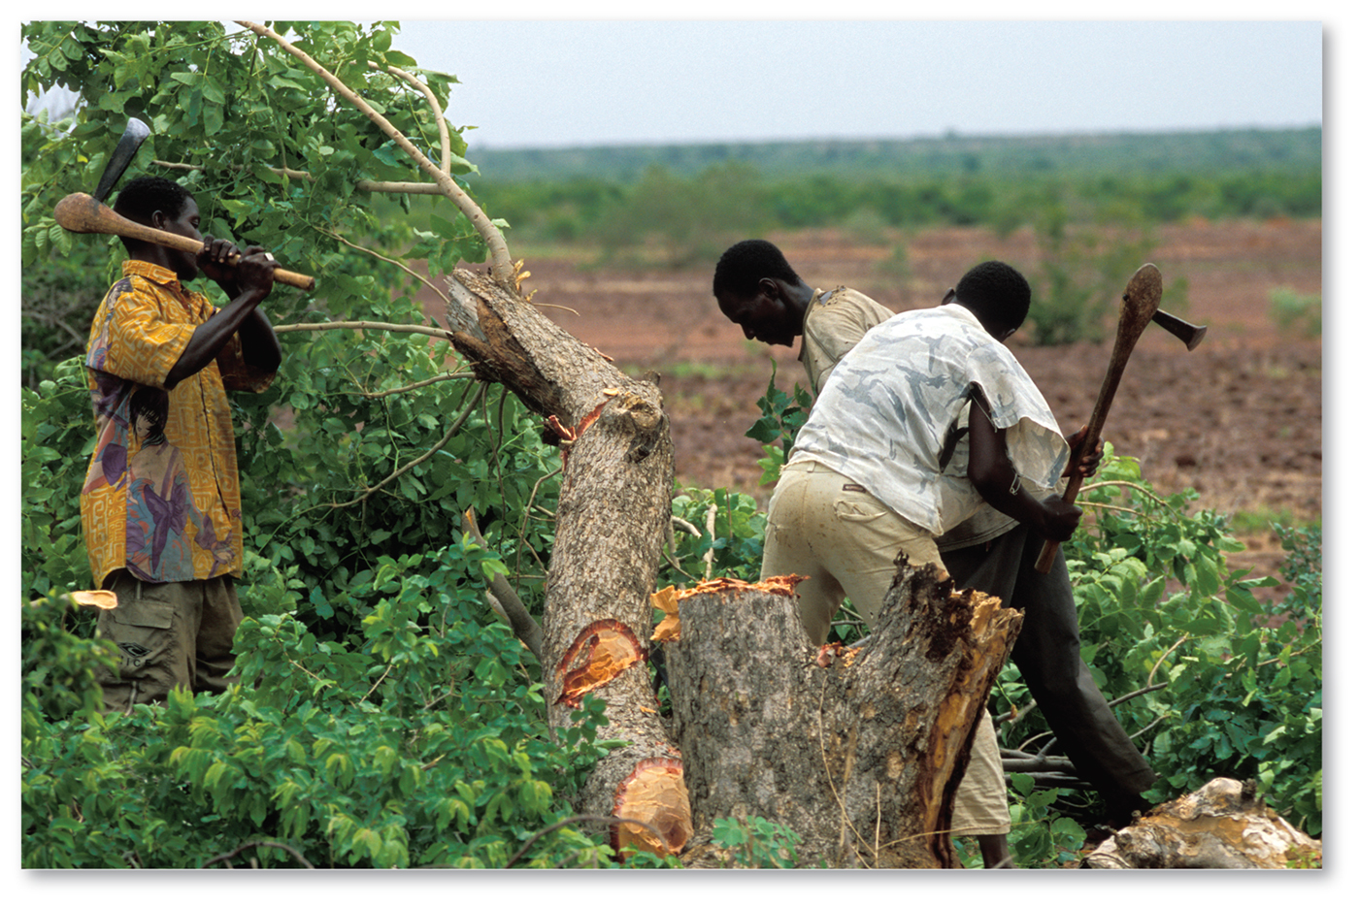
1.1 Introducing Population and Health
Overpopulation: more people than environmental carrying capacity
Figure 2-1 Overpopulation in Mali

Slide 5
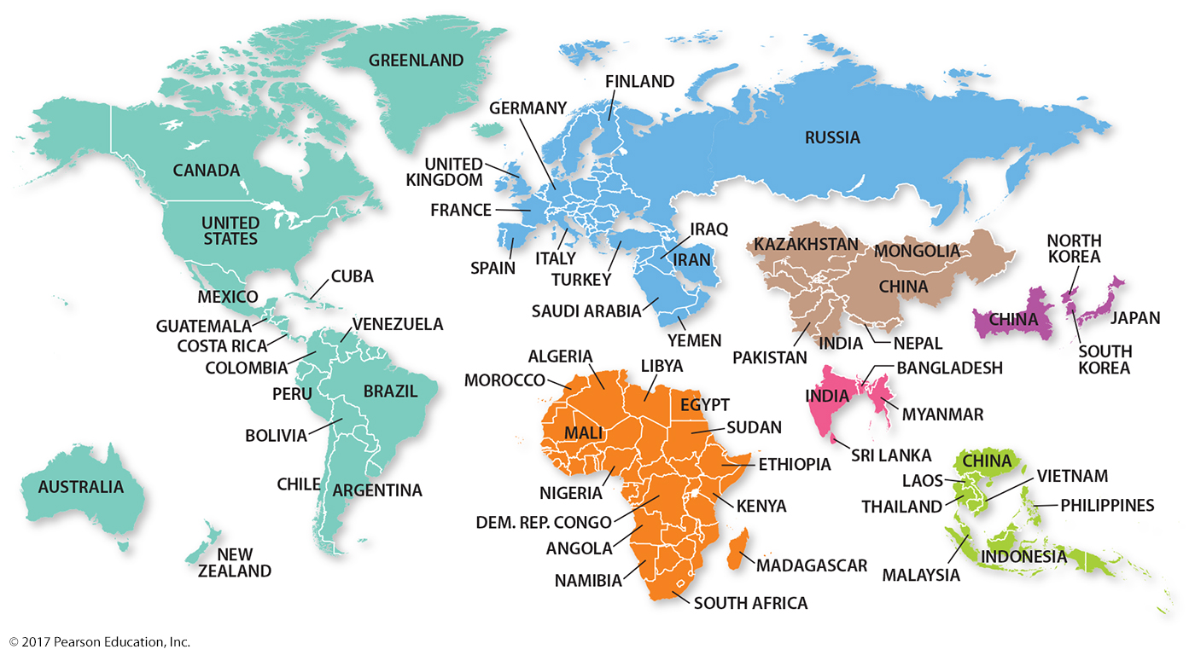
1.1 Distribution of the World’s Peoples
Figure 2-2 World Population Portions: Each color has approximately 1 billion total population.

Slide 6
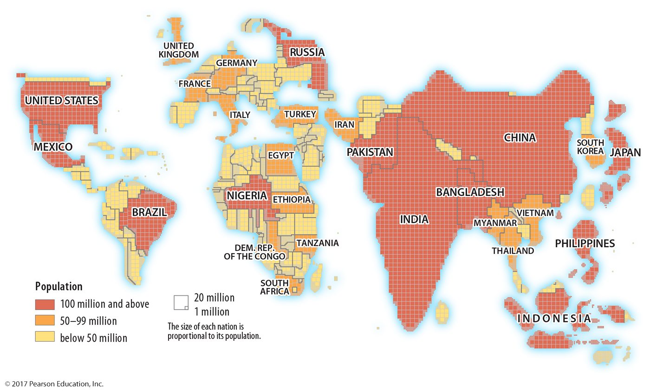
1.1 Distribution of the World’s Peoples
Figure 2-3 World Population Cartogram: Country size proportional to population size.

Slide 7
1.2 Population Concentrations
Four major clusters:
East Asia
South Asia
Europe
Southeast Asia
Sparsely populated regions:
too dry (e.g. Sahara)
too wet (e.g. Amazon)
too cold (e.g. Arctic)
too high (exception: Andes)

Slide 8
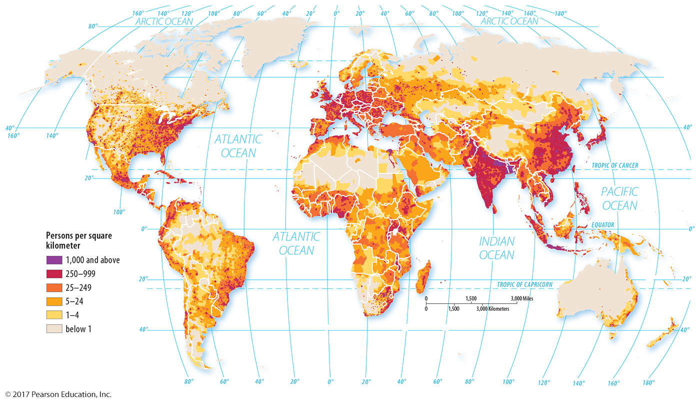
1.2 World Population Distribution
Figure 2-4: Clusters in East Asia, South Asia, Europe, and Southeast Asia are apparent.

Slide 9
1.2 Ecumene
Figure 2-5: Ecumene 5000 B.C.–A.D. 1900. Very dry, wet, cold, or high areas are generally sparsely populated.

Slide 10
1.3 Population Density
Changing the numerator or denominator tells us about a country’s population, food security, and development.
Arithmetic: people/land area
Physiological: people/arable land
Agricultural: farmers/arable land

Slide 11
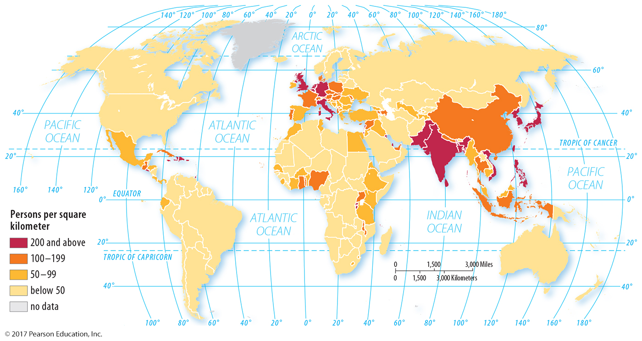
1.3 Arithmetic Density
Figure 2-6: note four population clusters still visible (compare to Figure 2-4)

Slide 12
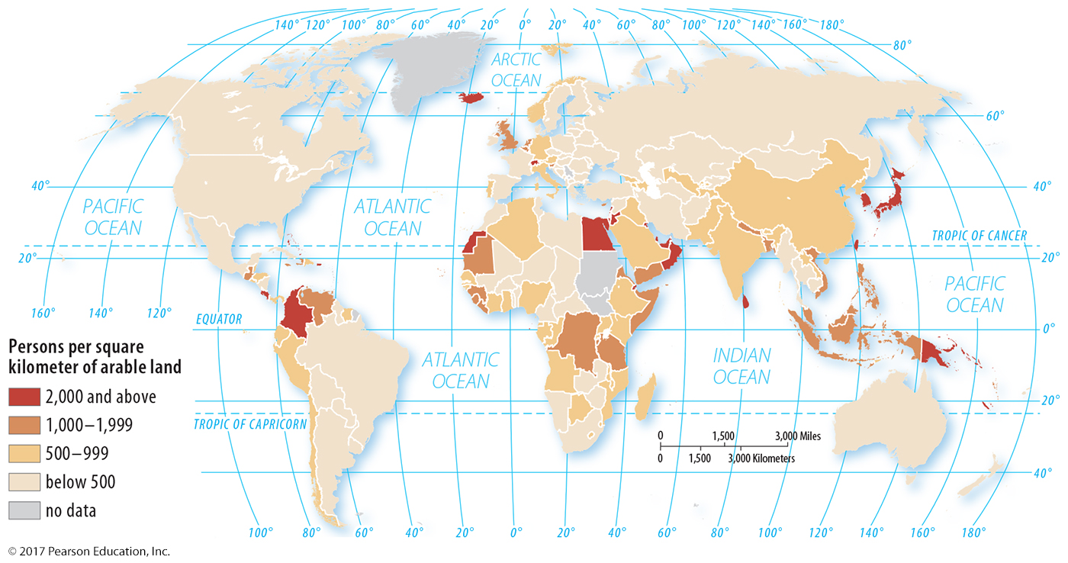
1.3 Physiological Density
Figure 2-7: Some countries have much higher densities of people per farmland than others.

Slide 13
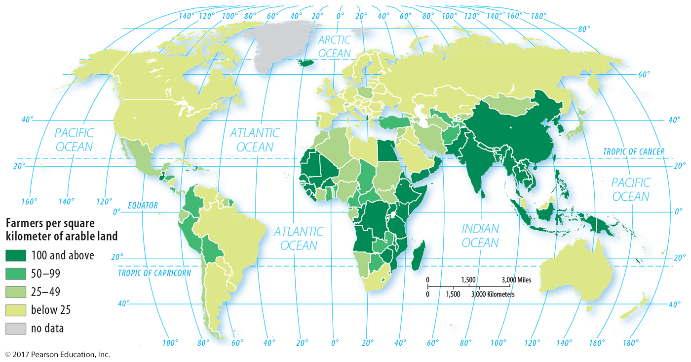
1.3 Agricultural Density
Figure 2-8: Agricultural density represents the extent to which agriculture is labor-intensive.

Slide 14
Key Issue 2: Why Is World Population Increasing?
2.1 Natural Increase
2.2 Births and Deaths
2.3 The Demographic Transition

Slide 15
2.1 Natural Increase
75 million more births than deaths worldwide every year
Natural increase rate: percentage growth in population without immigration
NIR varies from higher than 2.0% to slightly negative
Life expectancy: average number of years at death

Slide 16
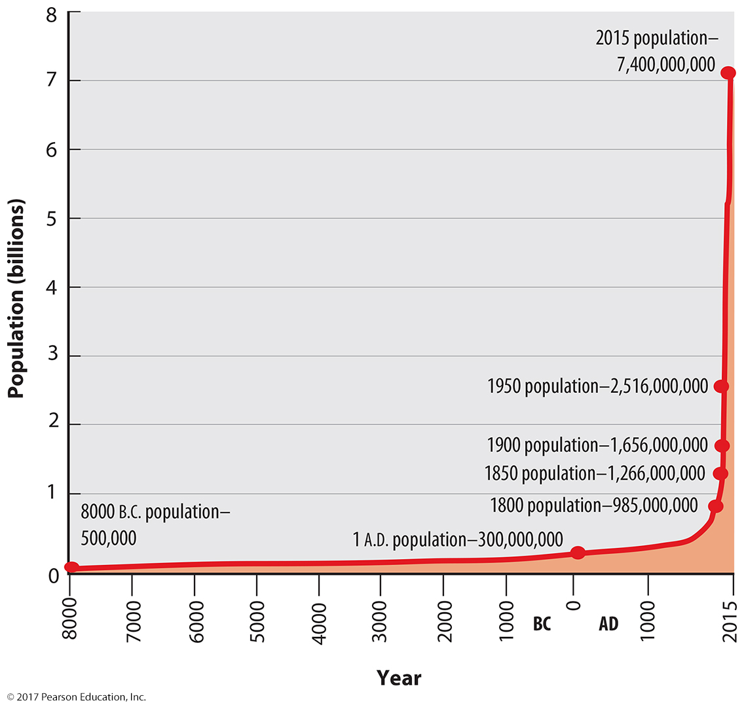
2.1 World Population Through History
Figure 2-9: Human population grew very slowly until the 1700s.

Slide 17
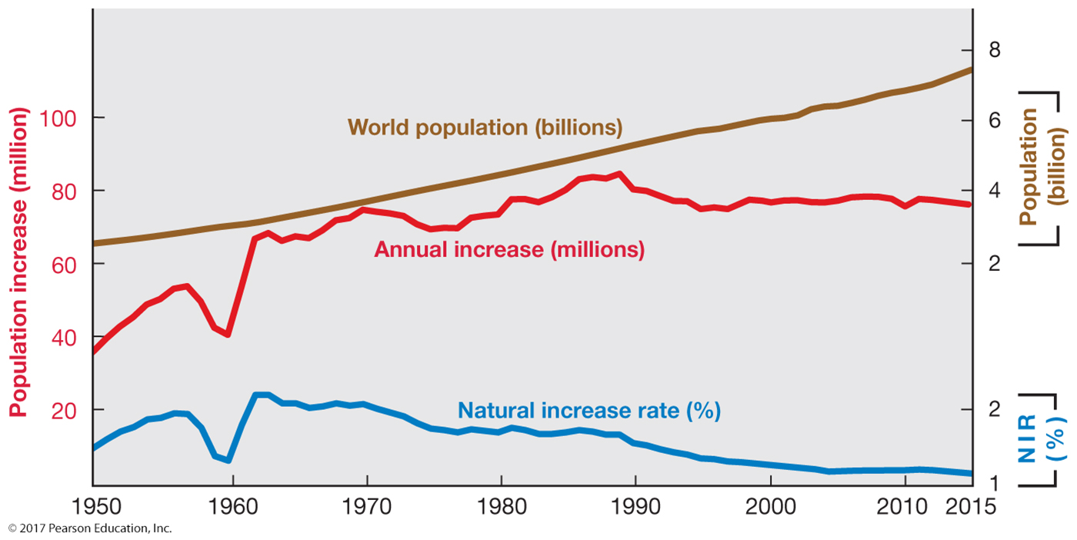
2.1 World Population Growth, 1950–2015
Figure 2-10: Even with a declining NIR, annual increase is about 75 million per year.

Slide 18
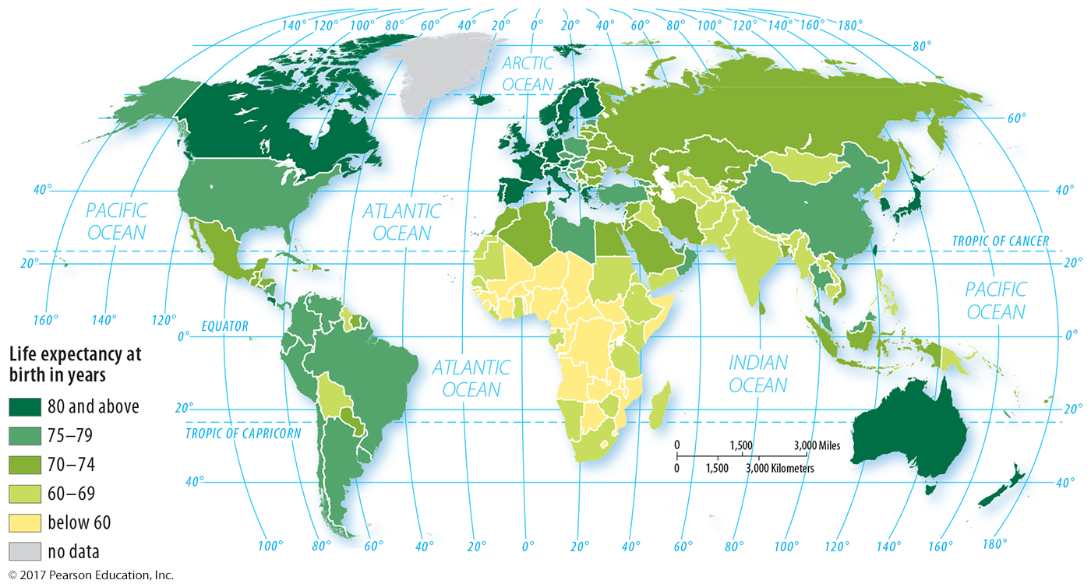
2.1 Life Expectancy at Birth
Figure 2-11: Worldwide there is more than a 20 year difference between the shortest- and longest-lived countries.

Slide 19
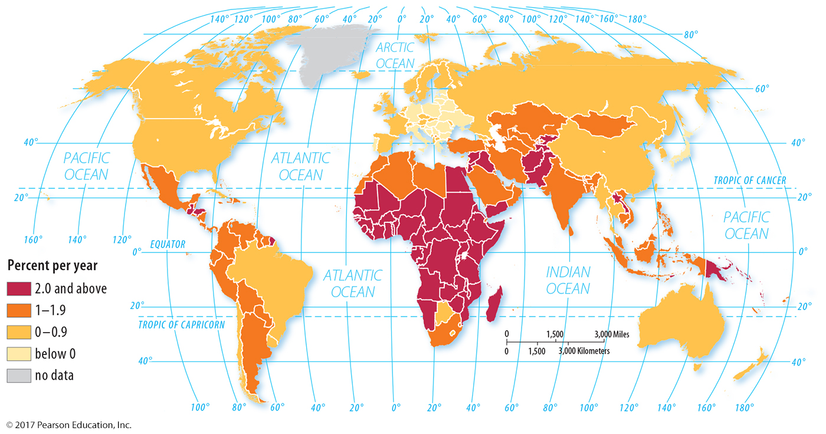
2.1 Natural Increase Rate
Figure 2-12: The highest rates of growth are in Africa and Southwest Asia.

Slide 20
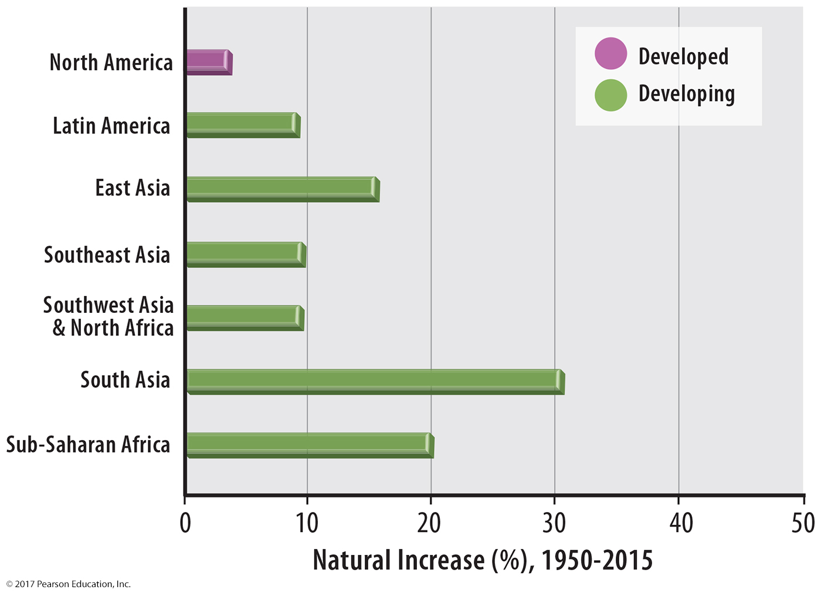
2.1 Regional Distribution of Natural Increase, 1950–2015
Figure 2-13

Slide 21
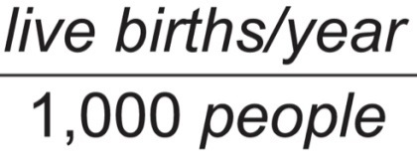
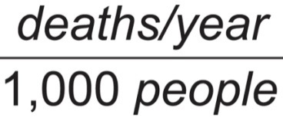
2.2 Births and Deaths
Natural increase is composed of births and deaths.
Does not include migration
Crude Birth Rate (CBR):
Crude Death Rate (CDR):
Total Fertility Rate (TFR): Average # of children per woman

Slide 22
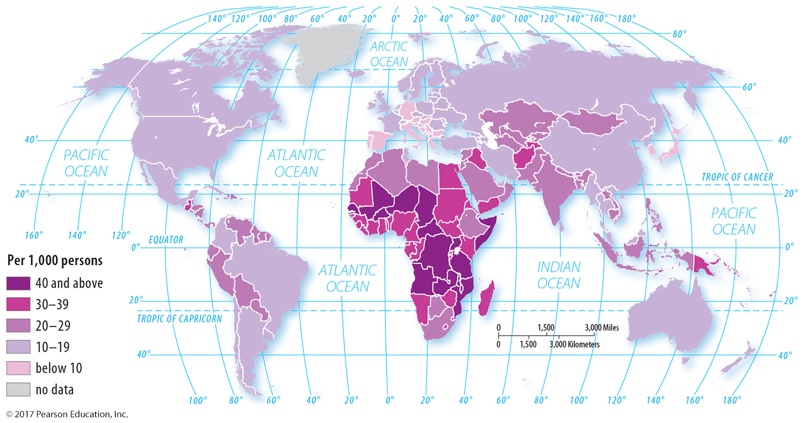
2.2 Crude Birth Rate (CBR)
Figure 2-14: As with natural increase, the highest birth rates are concentrated in Africa and Southwest Asia.

Slide 23
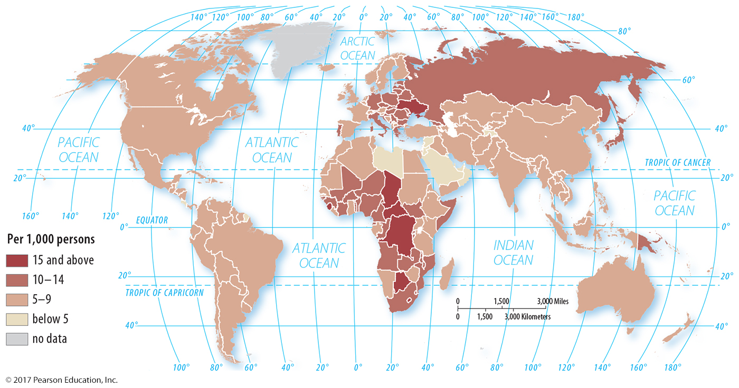
2.2 Crude Death Rate (CDR)
Figure 2-15: Crude death rates do not follow the pattern of many other demographic statistics.

Slide 24
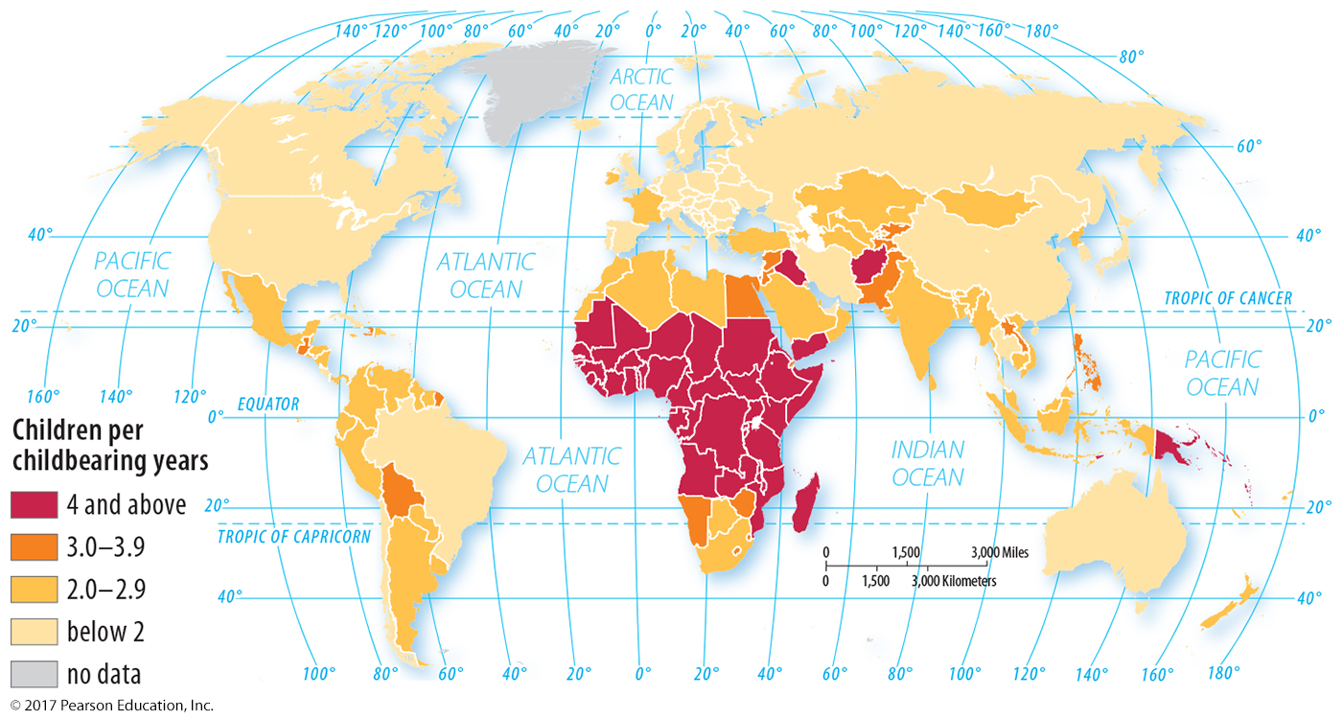
2.2 Total Fertility Rate (TFR)
Figure 2-16: Like NIR and CBR, high TFRs are clustered in Africa and Southwest Asia.

Slide 25
2.3 The Demographic Transition
Process of change in society’s birth and death rates
Four stages; possible fifth stage expected

Slide 26
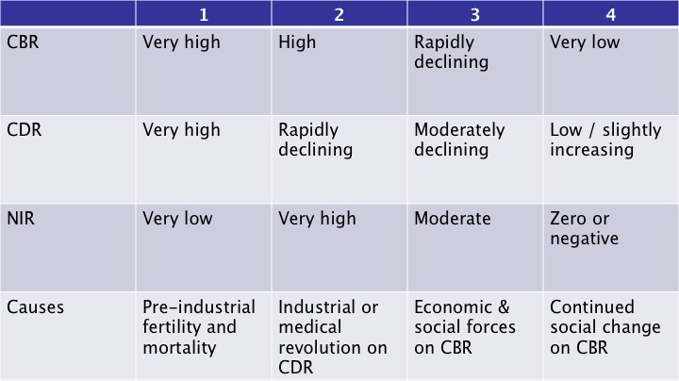
2.3 The Demographic Transition

Slide 27
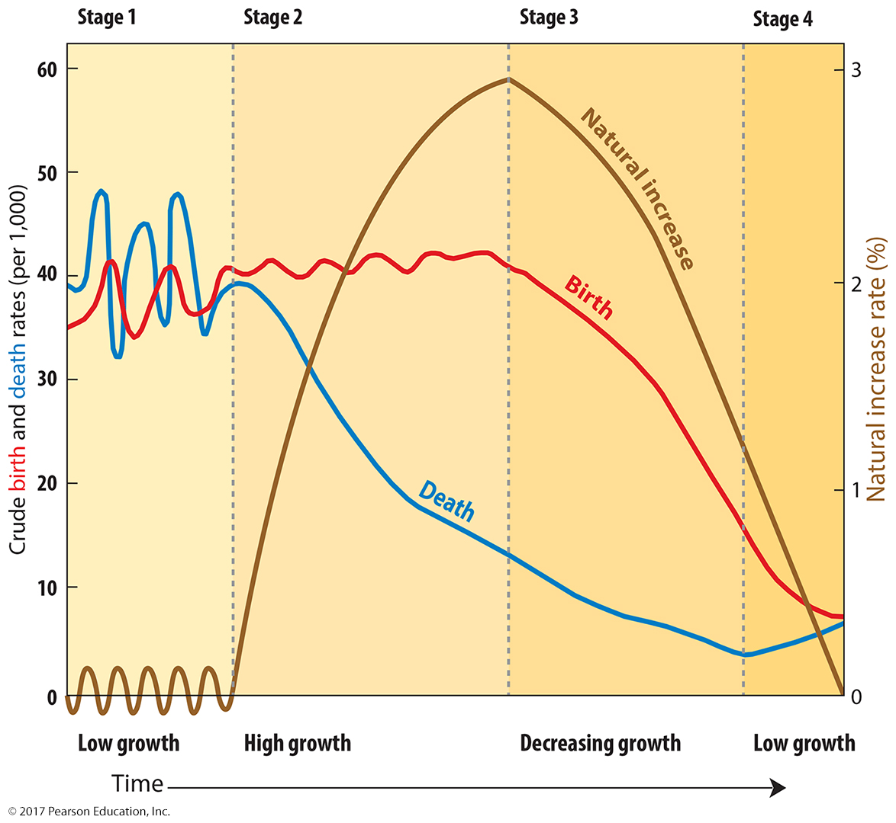
2.3 The Demographic Transition
Figure 2-17

Slide 28
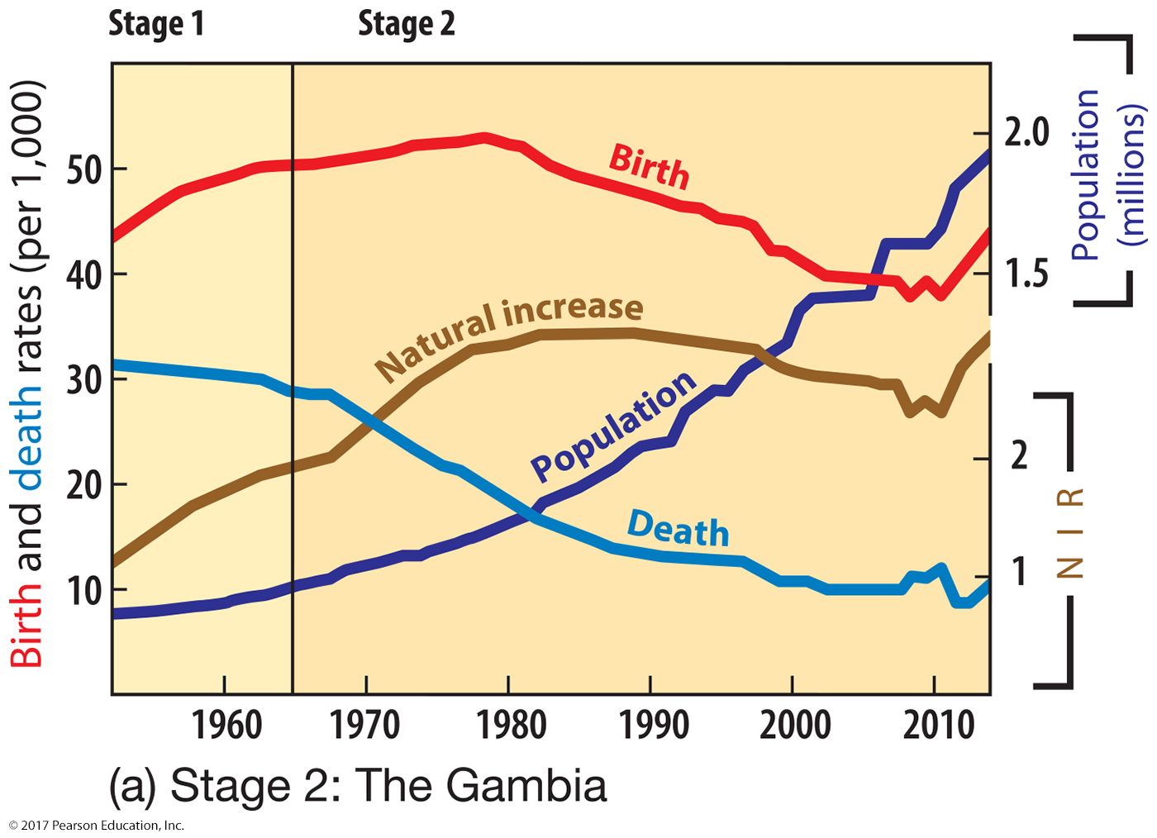
2.3 The Demographic Transition—Gambia
Figure 2-18

Slide 29
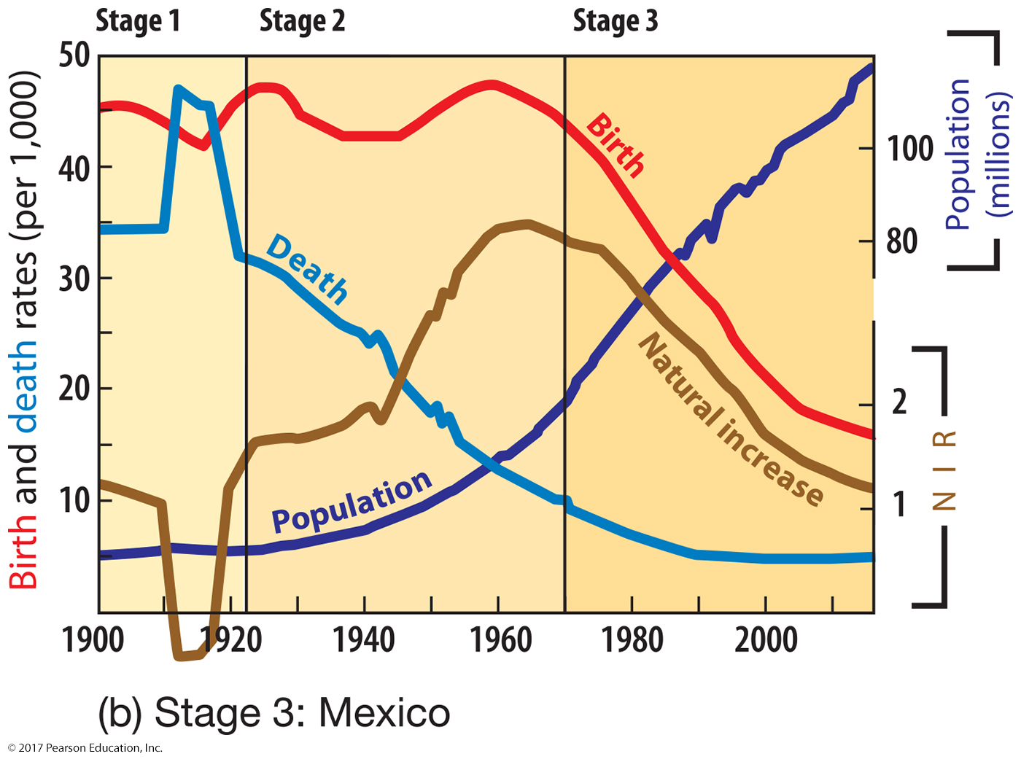
2.3 The Demographic Transition—Mexico
Figure 2-18

Slide 30
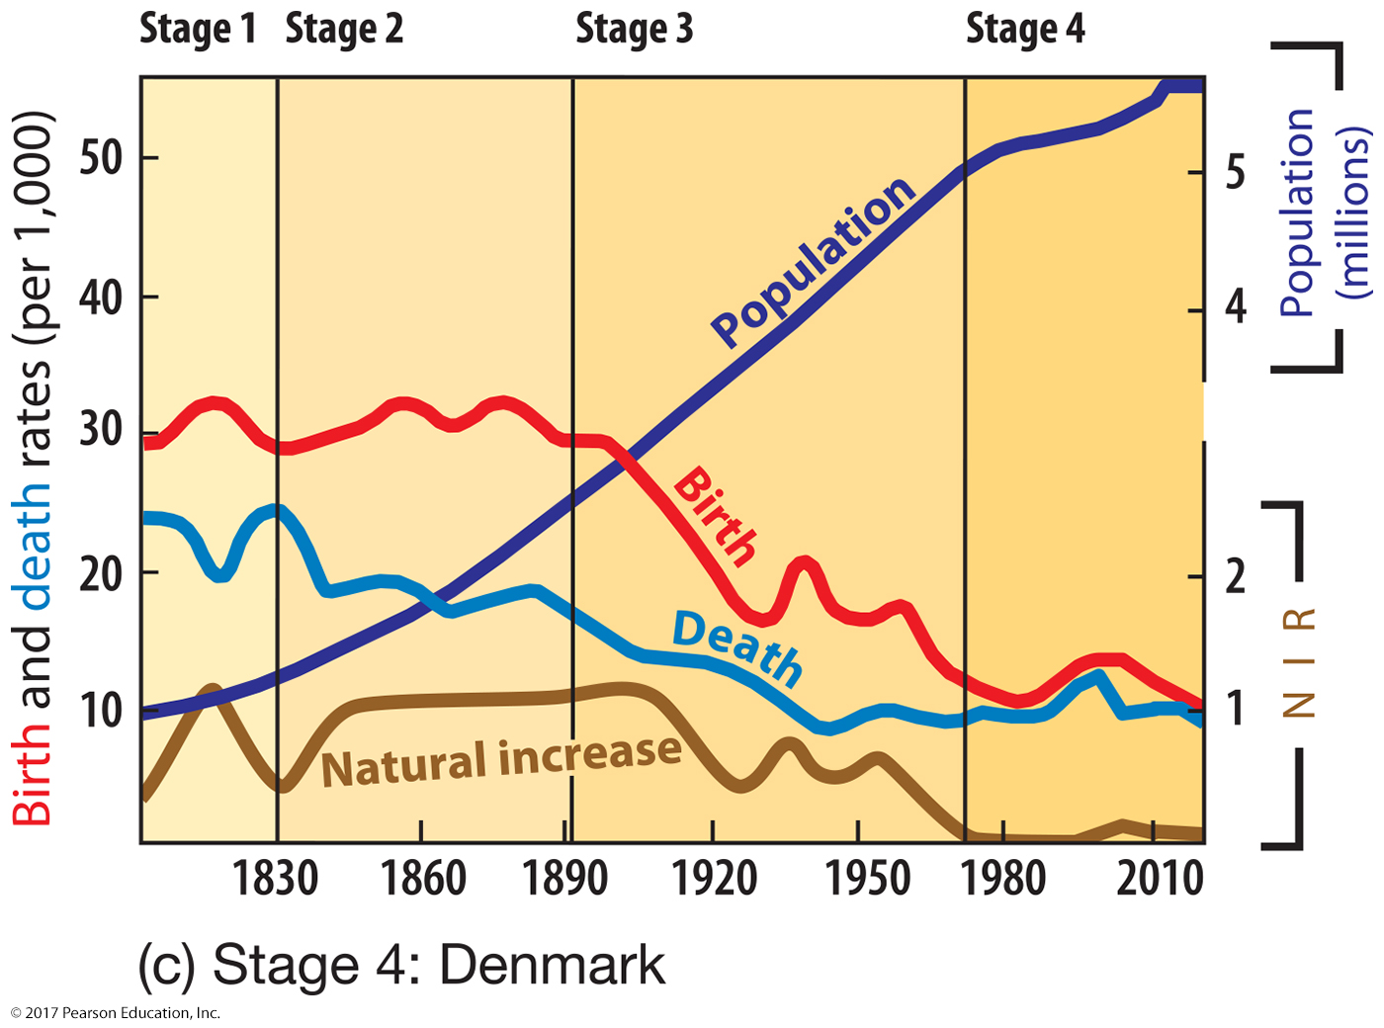
2.3 The Demographic Transition—Denmark
Figure 2-18

Slide 31
Key Issue 3: Why Do Some Places Face Health Challenges?
3.1 Health and Gender
3.2 Health and Aging
3.3 Medical Services
3.4 The Epidemiologic Transition

Slide 32
3.1 Health and Gender
Cultural and economic factors put women at risk.
More males than expected in places
Sex ratio:
Pregnancy and childbirth riskier in some places
Maternal mortality rate:

Slide 33
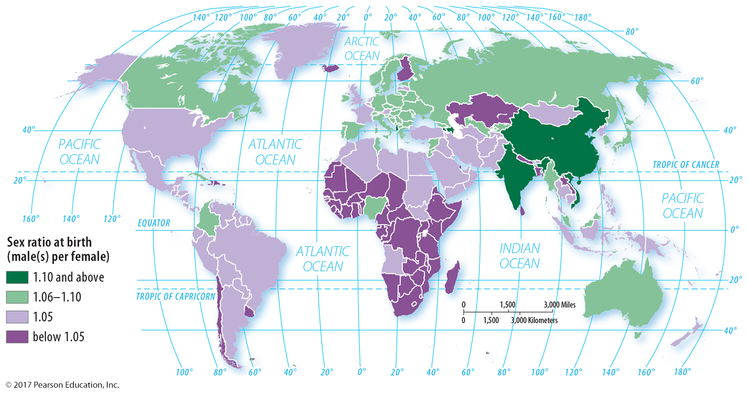
3.1 Sex Ratio at Birth
Figure 2-19: Lavender (1.05) represents what we would expect from standard biology, green represents more male children than expected.

Slide 34
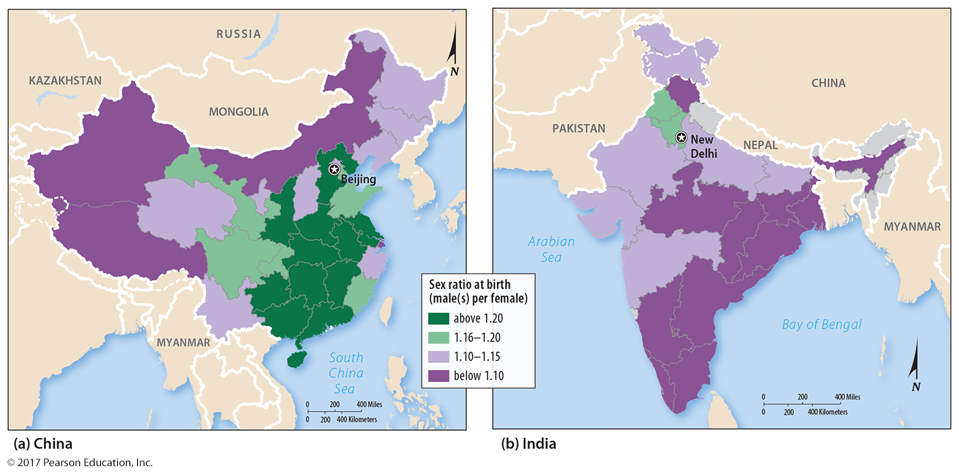
3.1 Sex Ratio at Birth—China and India
Figure 2-20: Both countries have higher than expected sex ratios at birth. Regional analysis reveals some areas have even higher ratios of males per female.

Slide 35
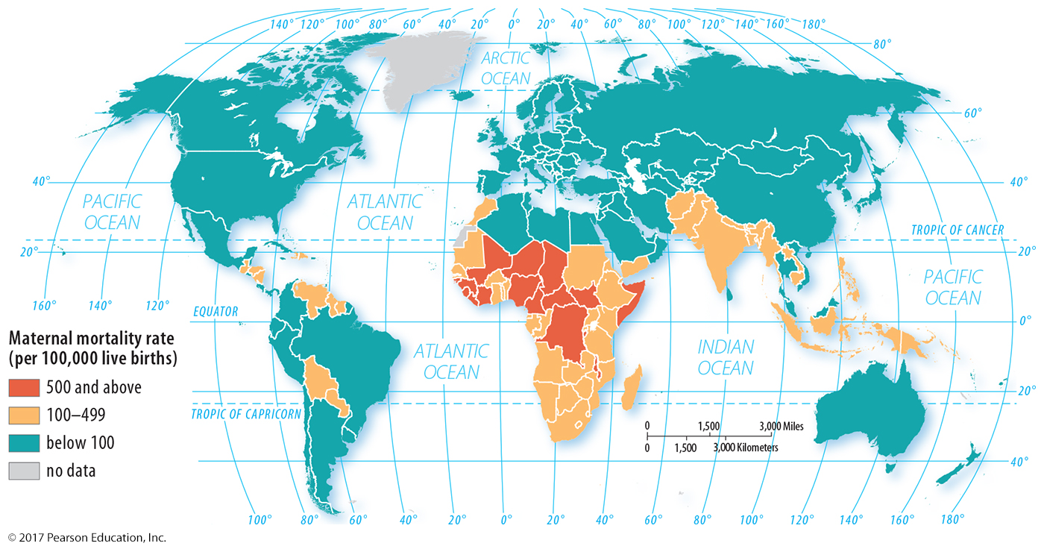
3.1 Maternal Mortality Rate
Figure 2-21: Worldwide the range is approximately 50-fold, from fewer than 10 deaths to more than 500 per 100,000 live births.

Slide 36
3.2 Health and Aging
Population pyramid displays age and sex structure.
Dependency ratio:
Stage 2 countries have many under 15.
Late stage 4 have many older than 65.
Infant Mortality Rate (IMR):

Slide 37
3.2 Health and Aging: Population Pyramids
Figure 2-22: Population pyramids display a population’s age and sex structure.

Slide 38
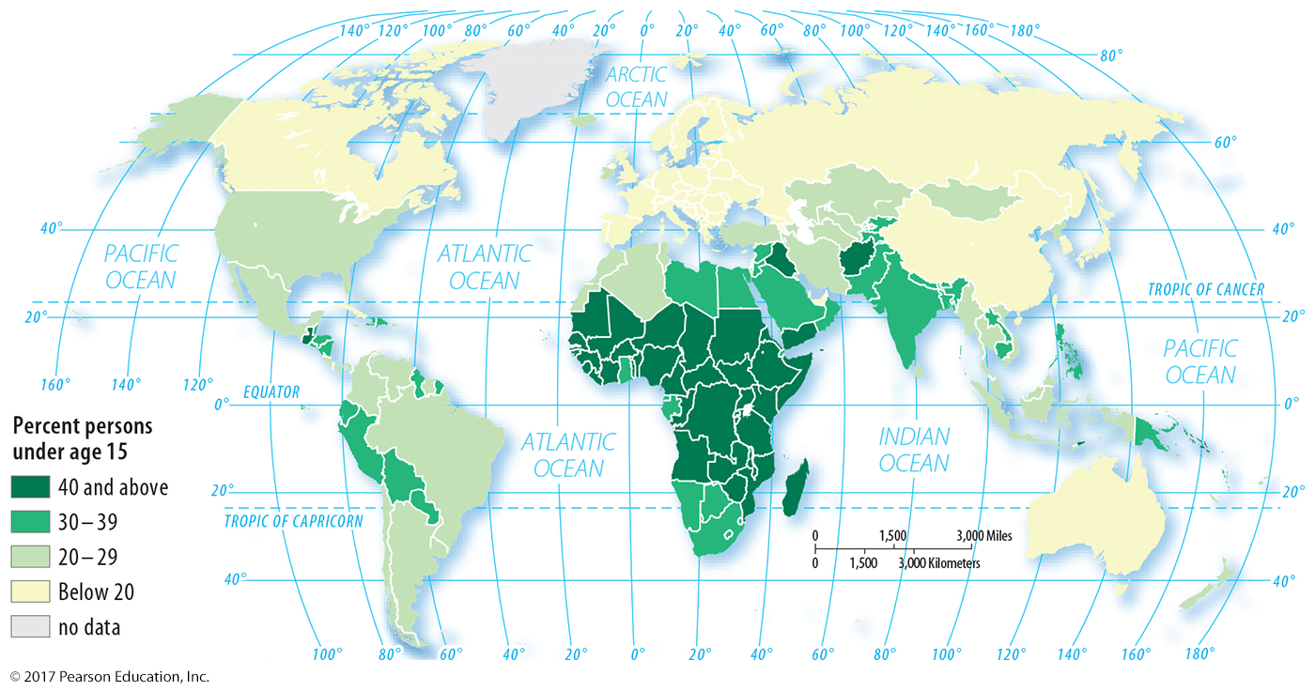
3.2 Health and Aging: Population < 15 years
Figure 2-23: Africa south of the Sahara has high percentages of the population under age 15.

Slide 39
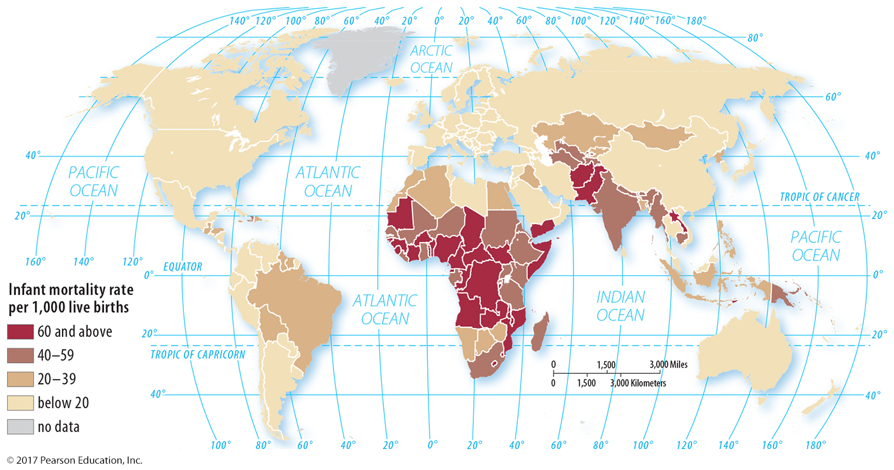
3.2 Health and Aging: Infant Mortality Rate
Figure 2-24: High IMRs are common in sub-Saharan Africa and also from Southwest to Southeast Asia.

Slide 40
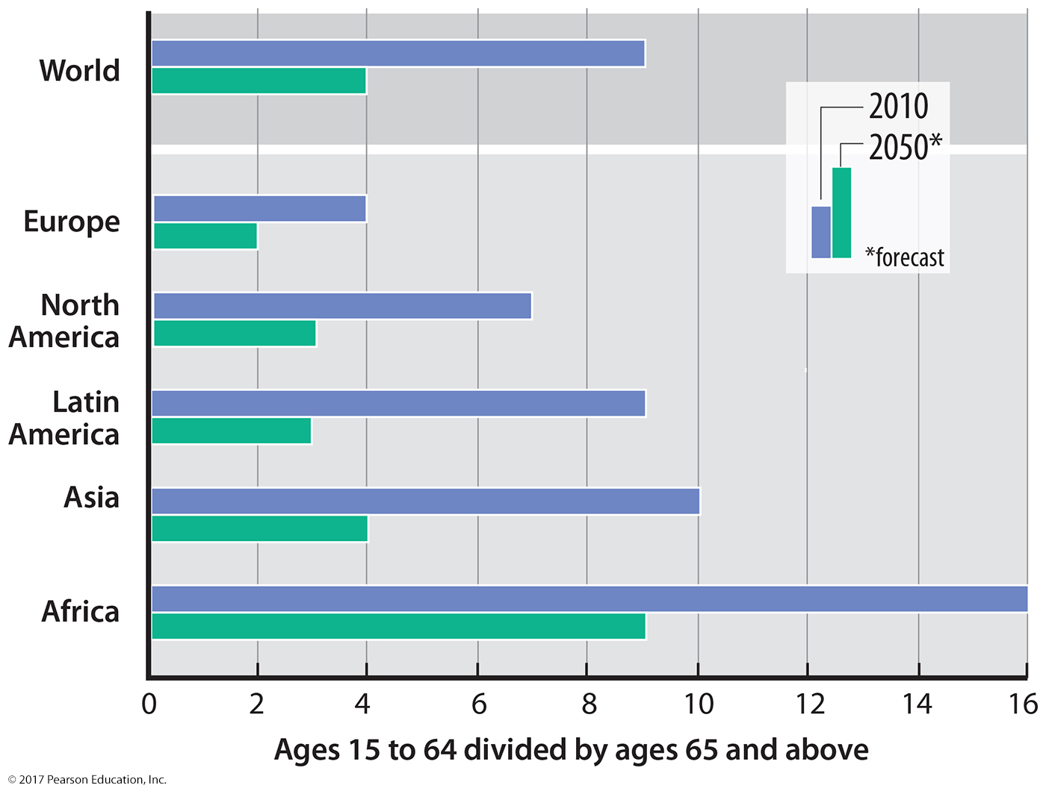
3.2 Health and Aging: Elderly Support Ratio
Figure 2-25

Slide 41
3.3 Medical Services
Health conditions vary.
health care expenditures
private and government
medical facility availability
hospital beds and physicians

Slide 42
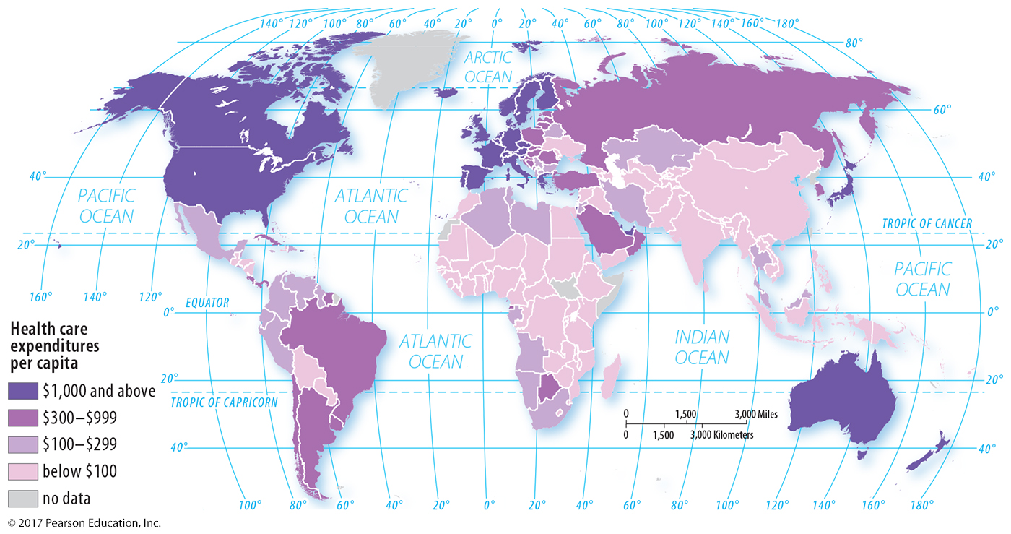
3.3 Medical Services: Health Expenditures
Figure 2-26: Health care expenditures are generally associated with longer life expectancies.

Slide 43
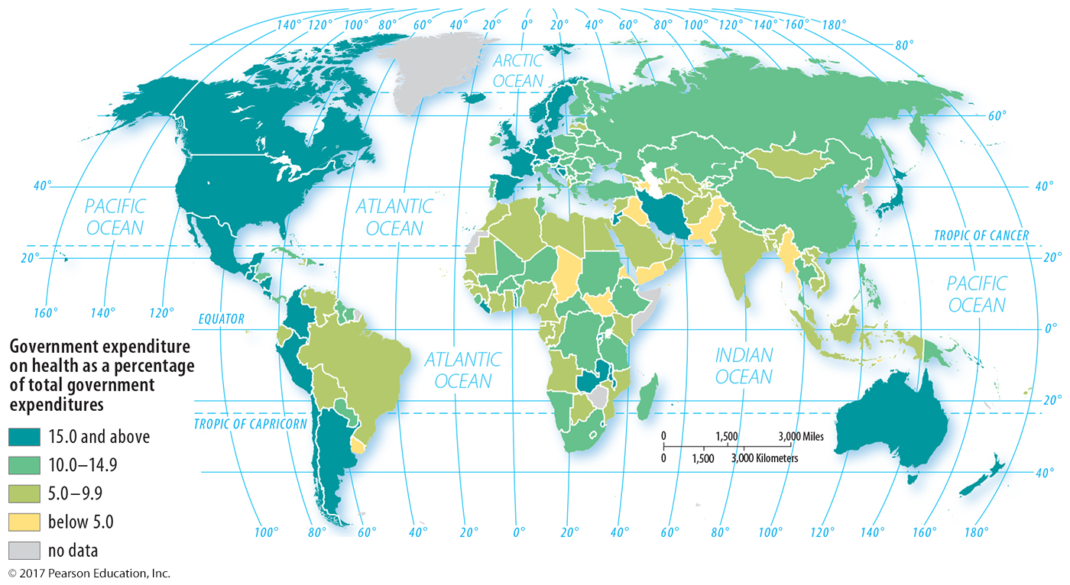
3.3 Medical Services: Gov’t Health Expenses
Figure 2-27: Countries with higher health expenditures generally also have more government support for health care.

Slide 44
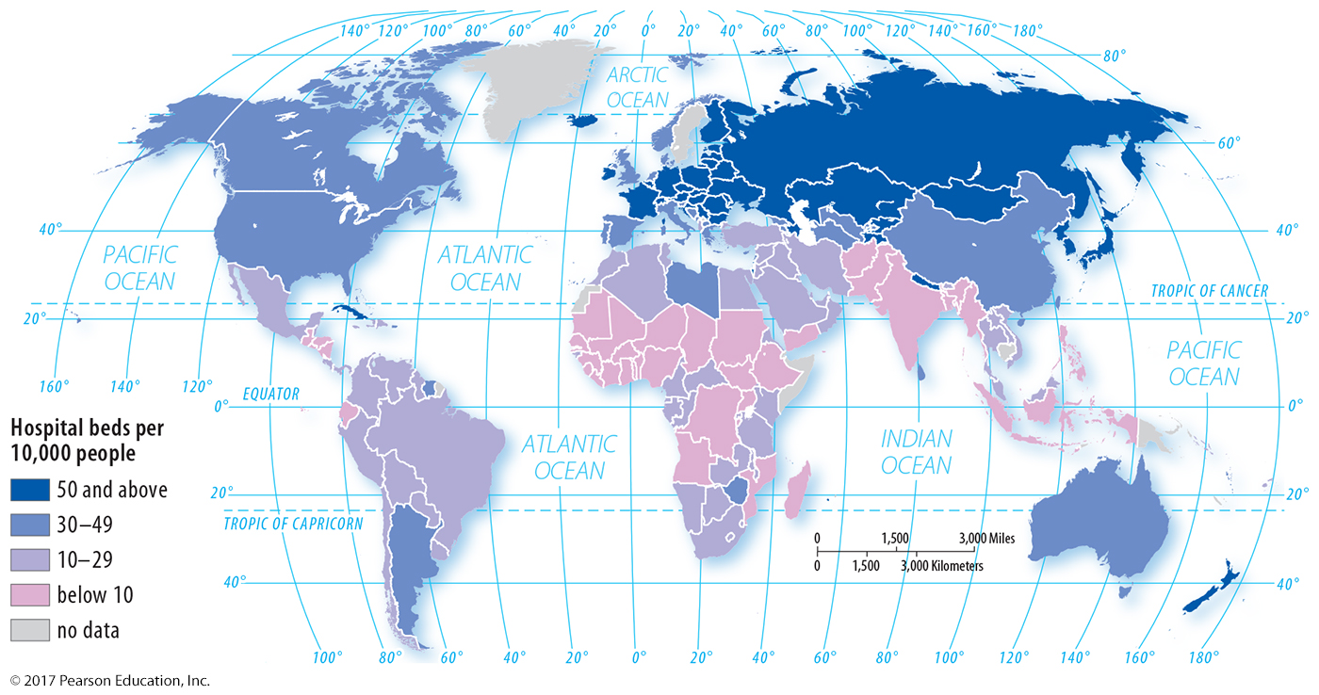
3.3 Medical Services: Hospital Beds
Figure 2-28: Hospital beds per 10,000 people provides an estimate of medical care availability.

Slide 45
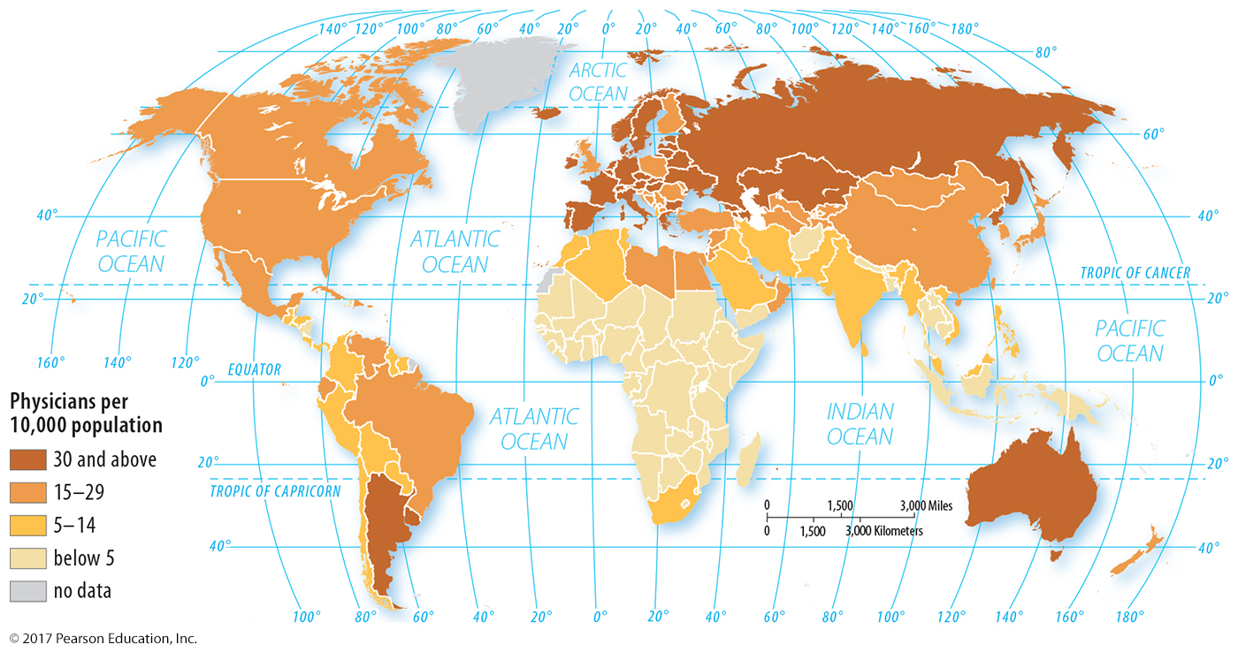
3.3 Medical Services: Physicians per 10,000
Figure 2-29: Physicians per 10,000 people is another estimate of medical care availability.

Slide 46
3.4 The Epidemiologic Transition
Characterizes health threats at each stage of demographic transition
Stage 1: Pestilence and Famine
Stage 2: Receding Pandemics
Stage 3: Degenerative Diseases
Stage 4: Delayed Degenerative Diseases

Slide 47
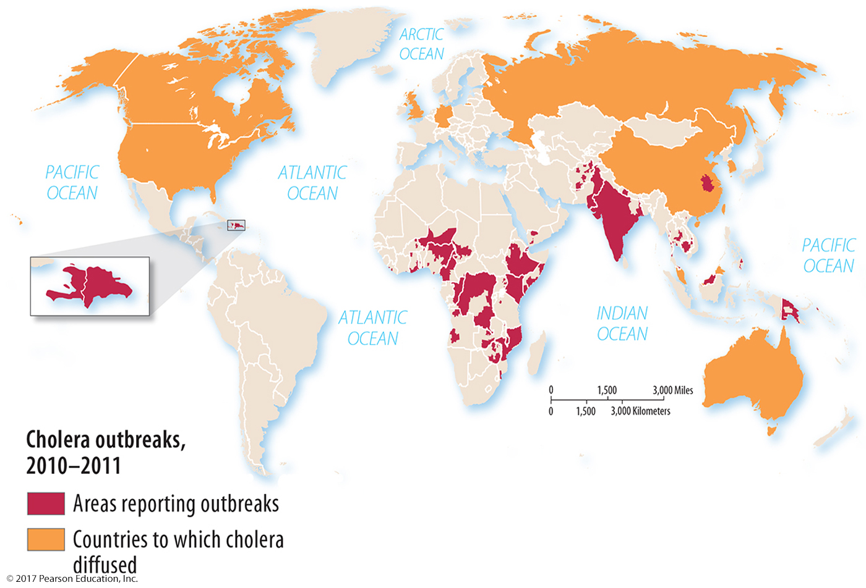
3.4 Stage 2 Disease: Cholera
Figure 2-30: Countries experiencing recent cholera outbreaks are largely in stage 2 or early stage 3 of the demographic transition.

Slide 48
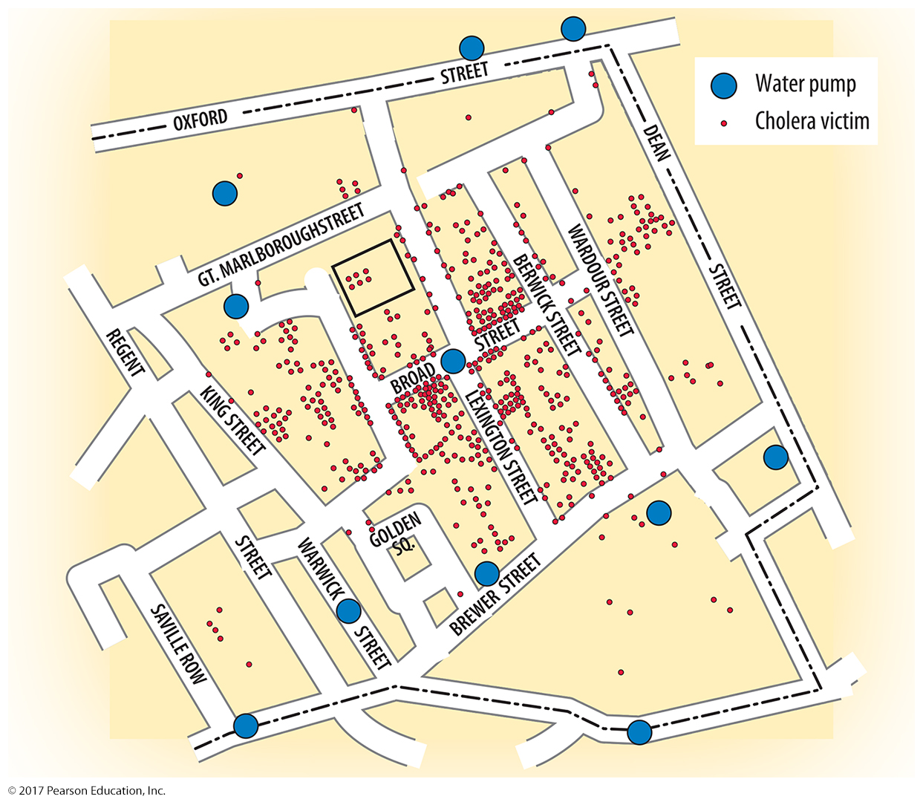
3.4 Sir John Snow’s Cholera Map
Figure 2-31: The Broad Street pump was identified as the source of the disease.

Slide 49
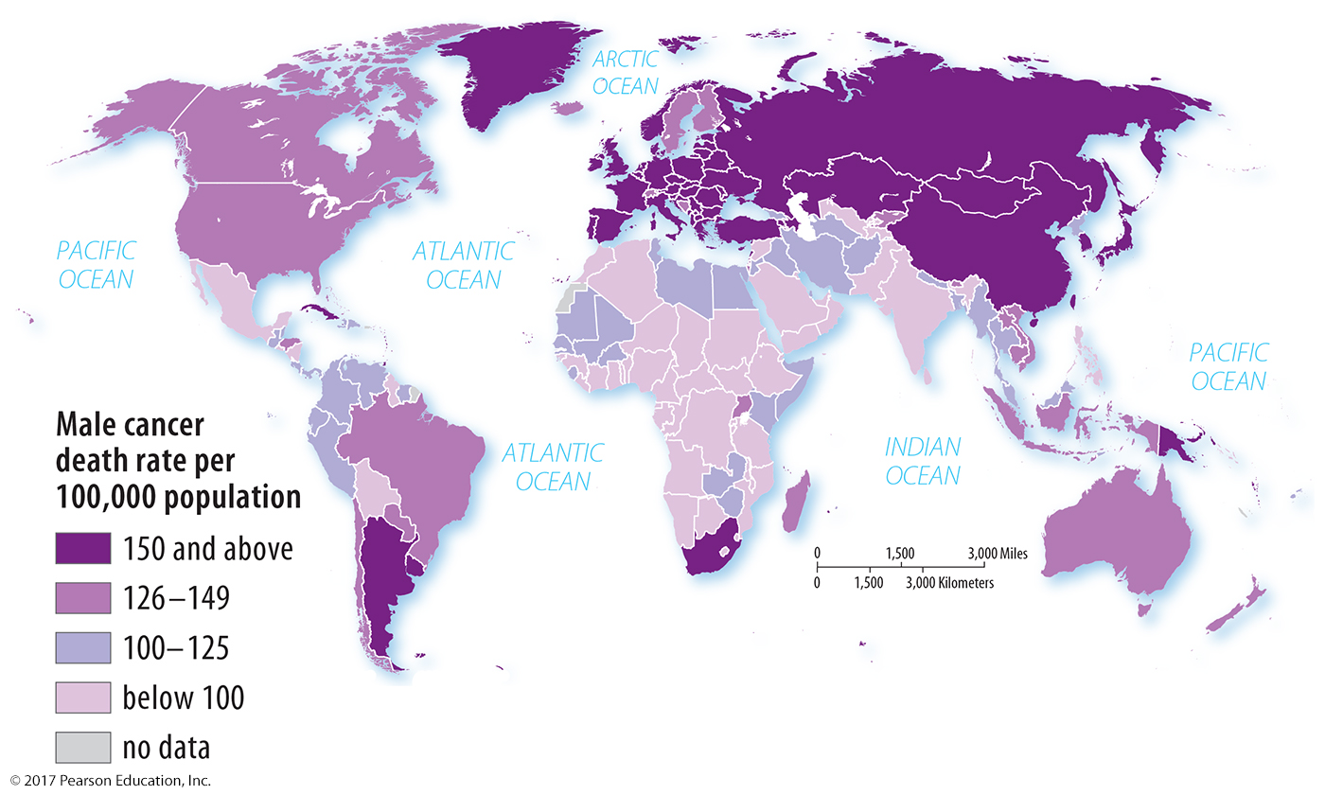
3.4 Stage 3 Disease: Male Cancer
Figure 2-32: Cancer is a more common cause of death in countries that are in stage 3 or later of the demographic transition.

Slide 50
Key Issue 4: Why Might Population Increase in the Future?
4.1 Population and Resources
4.2 Population Futures
4.3 Epidemiologic Futures
4.4 Family Futures

Slide 51
4.1 Population and Resources
Malthus 1798: Population will exceed food supply.
Neo-Malthusians today: Population will exceed food or another resource.

Slide 52
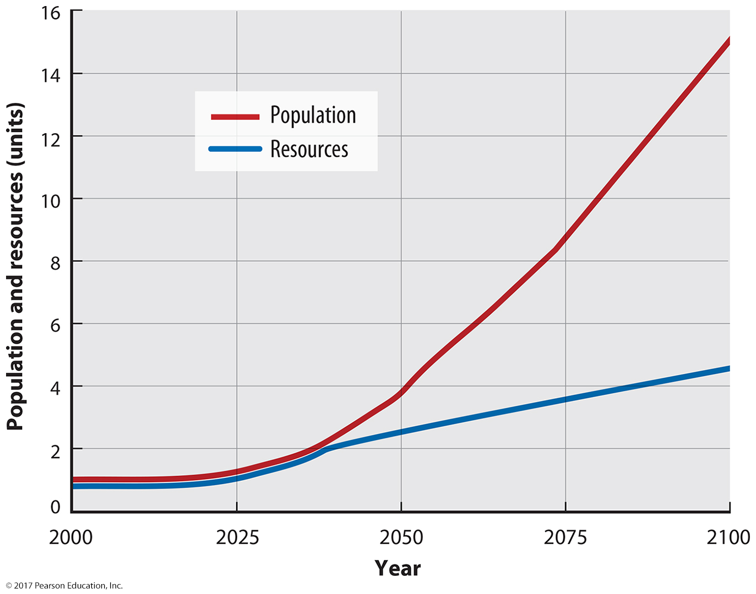
4.1 Population and Resources: Malthus’s Theory Figure
Figure 2-34: Malthus predicted population would grow faster than the resource of food.

Slide 53
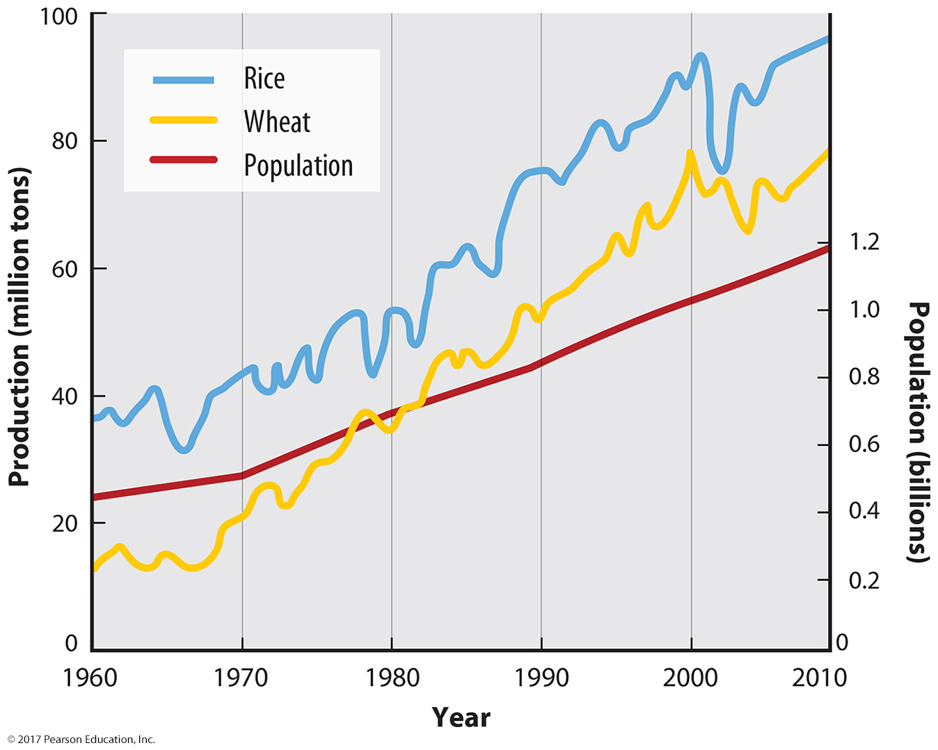
4.1 Population and Resources: Malthus’s Theory Applied to India
Figure 2-37: India’s food production has outpaced population growth.

Slide 54
4.2 Population Futures
Possible stage 5 of demographic transition
World population decline
Very low CBR
Increasing CDR
Declining NIR

Slide 55
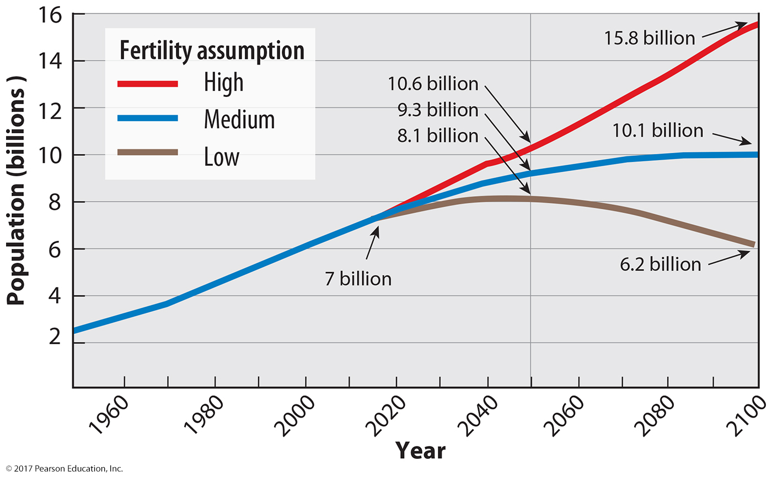
4.2 United Nations Estimate of Future Population
Figure 2-38: Projections are based on three possible future world TFRs.

Slide 56
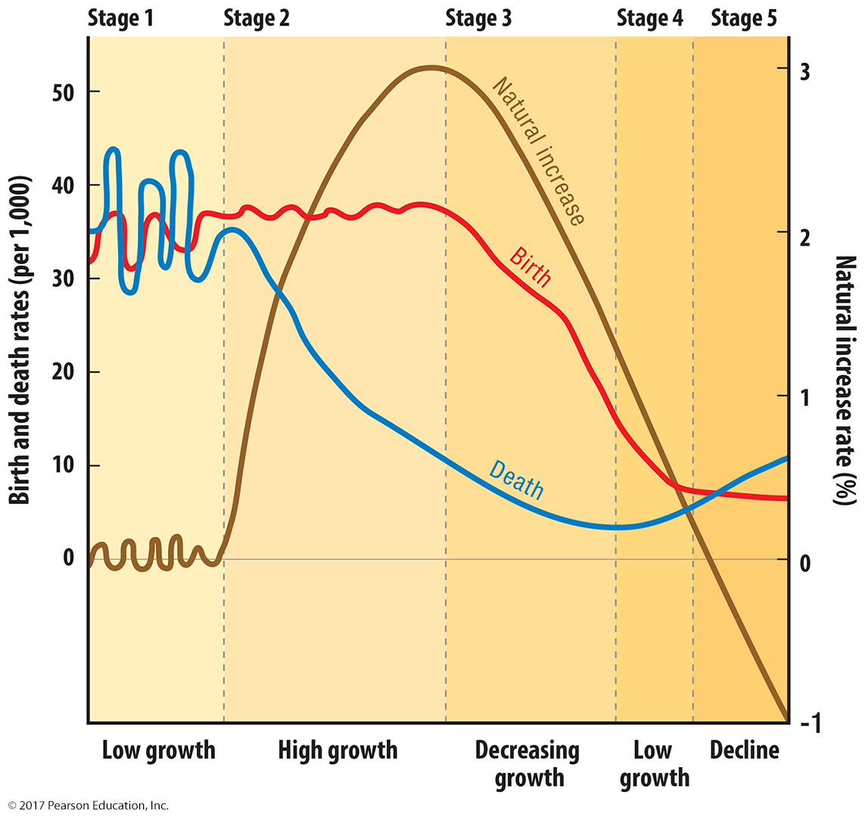
4.2 Five-Stage Demographic Transition
Figure 2-39

Slide 57
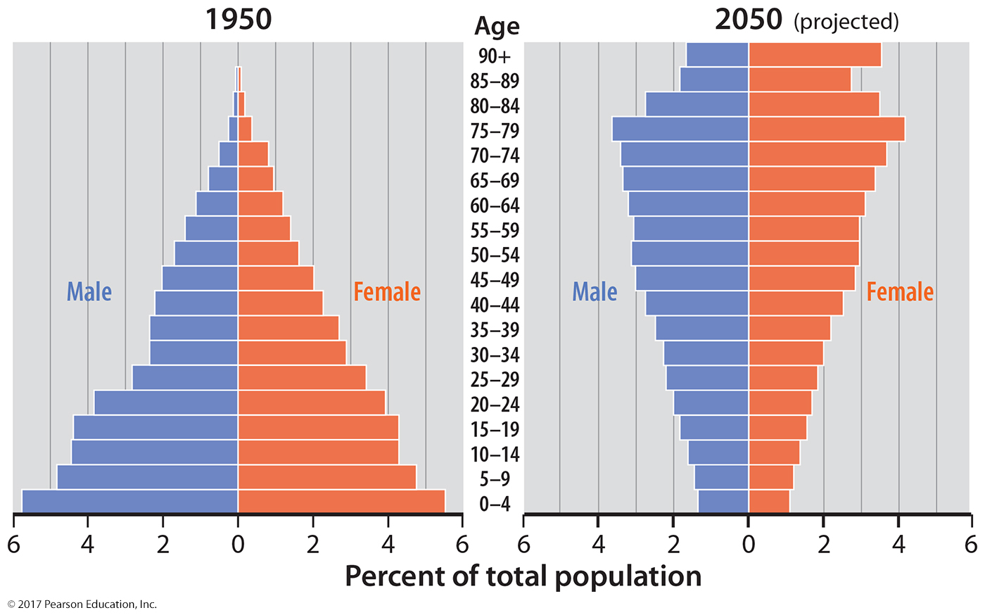
4.2 Japan’s Changing Population Pyramids
Figure 2-40: Japan faces a population structure with many older people and few of working age.

Slide 58
4.3 Epidemiologic Futures
Stage 5 of epidemiologic transition: infections and parasitic diseases re-emerge
Evolution: antibiotic resistance
Poverty: lack access to medicine
Connections: globalization helps transmission

Slide 59
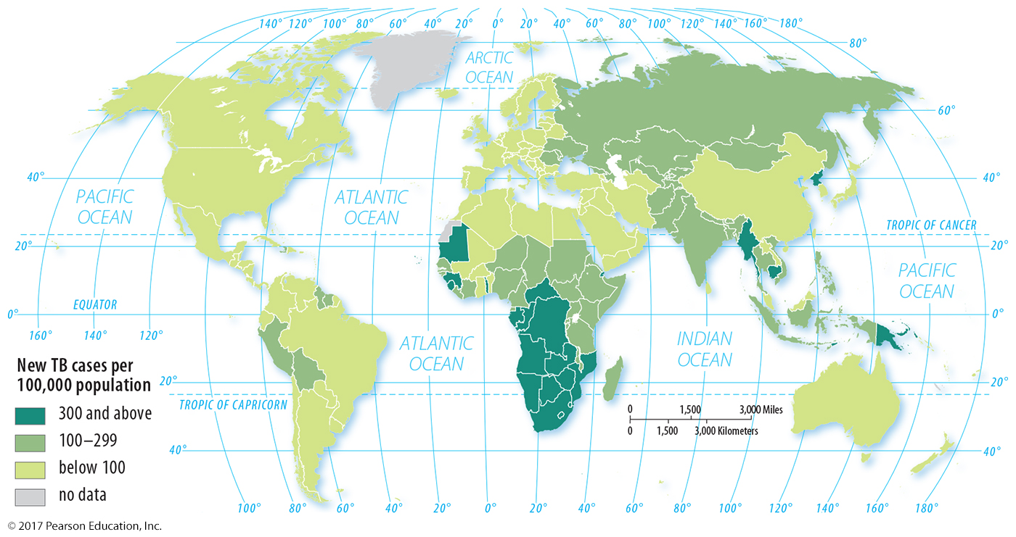
4.3 Poverty: Tuberculosis Deaths
Figure 2-42: Tuberculosis is expensive to treat, so deaths are concentrated in the world’s poorer regions.

Slide 60
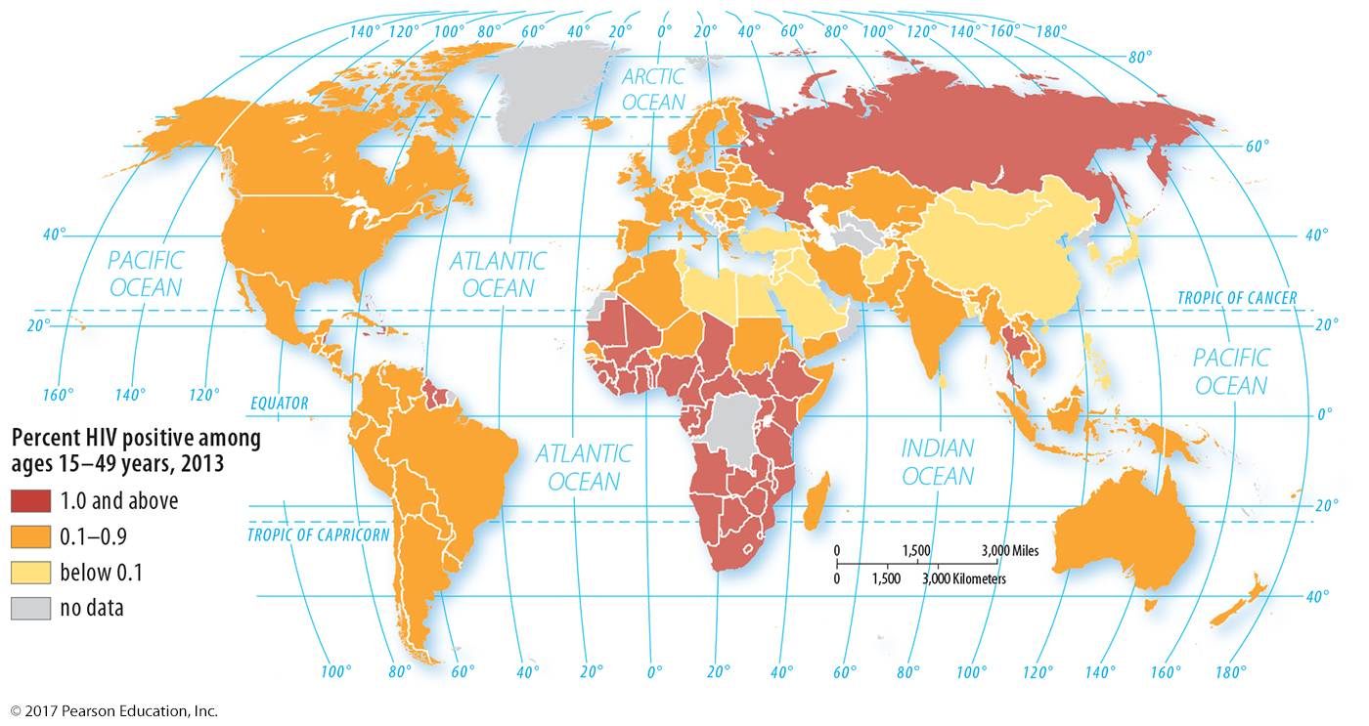
4.3 Connections: AIDS
Figure 2-43: HIV has diffused around the world through people moving and traveling.

Slide 61
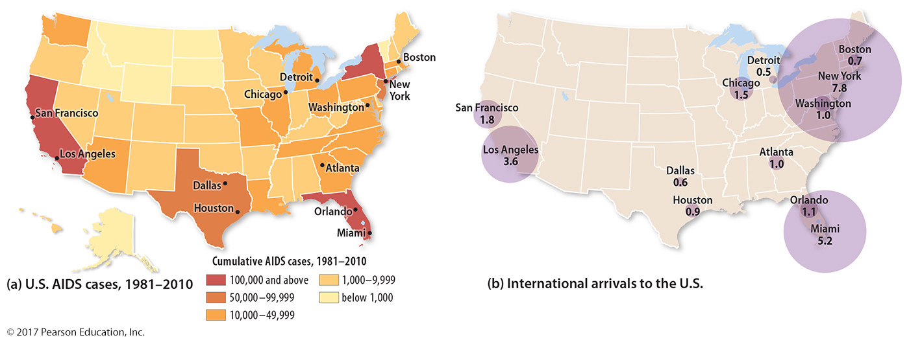
4.3 Connections: U.S. AIDS and International Arrivals
Figure 2-44: HIV diffused through the U.S. through major international connections.

Slide 62
4.4 Family Futures
What causes CBR to decrease?
Education and health care: women empowered; higher investment in each child
Contraception: not always available; supply can help decrease CBR

Slide 63
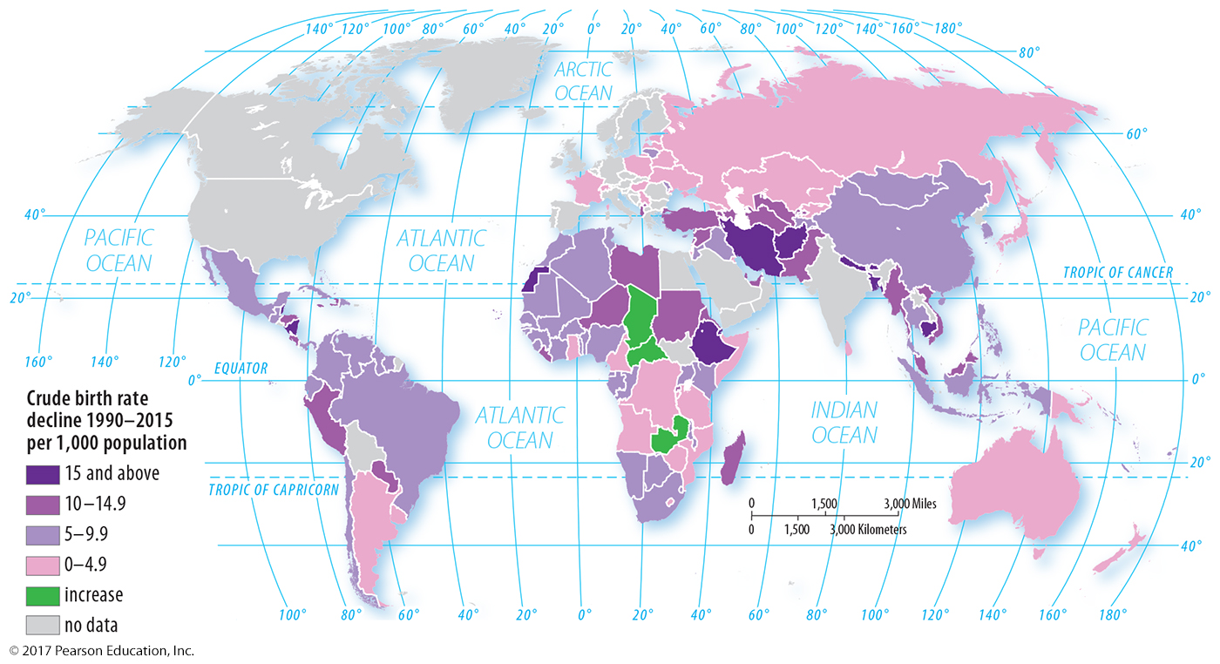
4.4 CBR Change 1990–2015
Figure 2-45: CBRs have declined around the world with few exceptions.

Slide 64
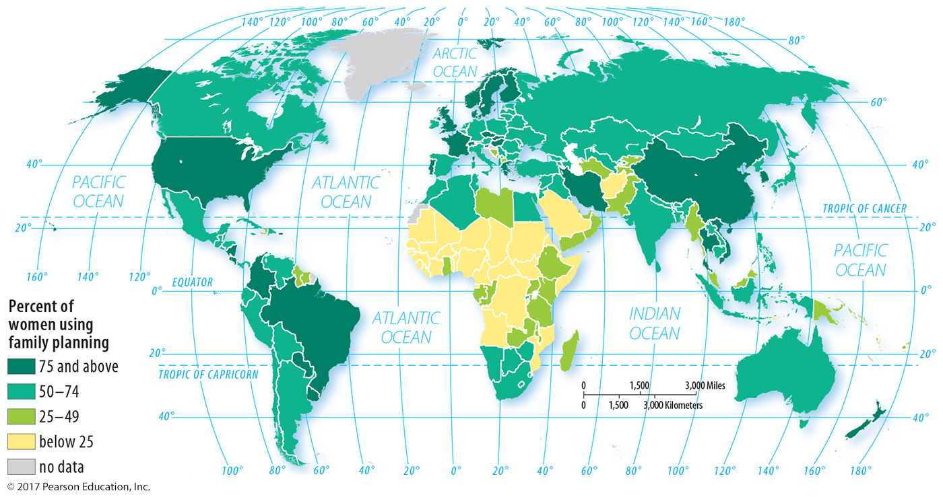
4.4 Women Using Family Planning
Figure 2-47: The lowest rates of family planning correlate with the highest NIRs, CBRs, and TFRs.

Slide 65
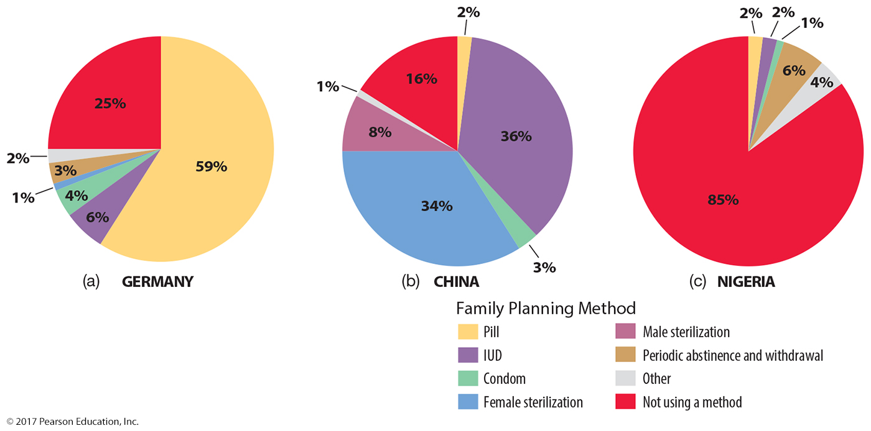
4.4 Family Planning Methods
Figure 2-48: Preferred methods of family planning vary from place to place.

Slide 66
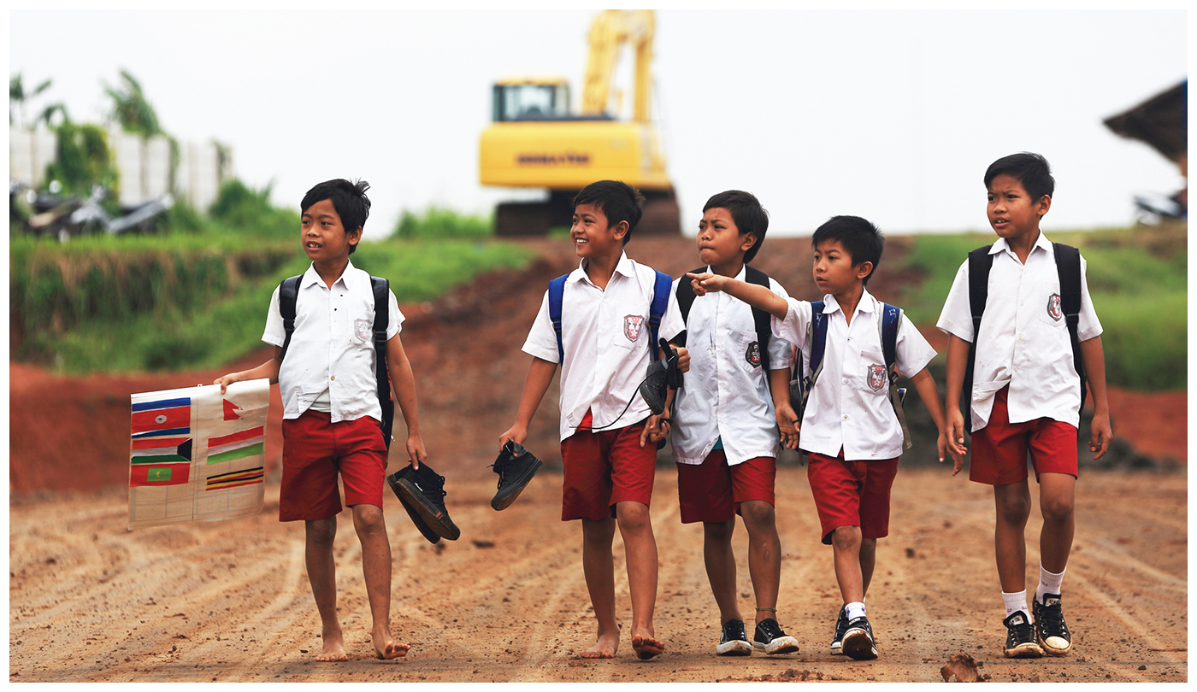
Chapter 2 End

