Slide 1
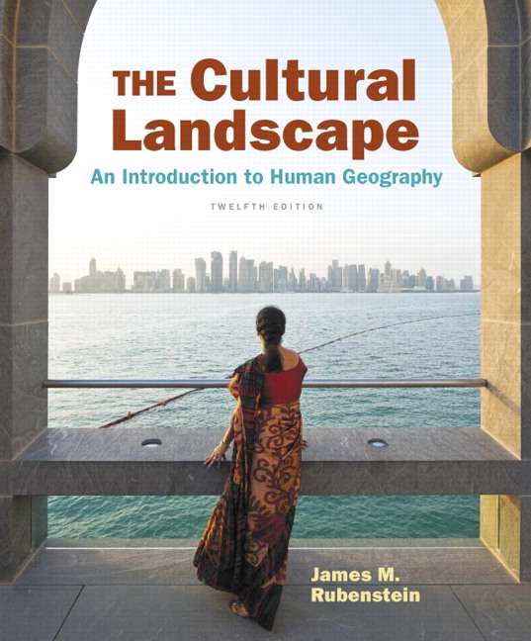
Chapter 1 Lecture
Chapter 1 This Is Geography
Tim Scharks Green River College

Slide 2
This Is Geography: Key Issues
Why Is Geography a Science?
Why Is Each Point on Earth Unique?
Why Are Different Places Similar?
Why Are Some Actions Not Sustainable?

Slide 3
Key Issue 1: Why Is Geography a Science?
1.1 Introducing Geography
1.2 Cartography: The Science of Mapmaking
1.3 Contemporary Geographic Tools
1.4 Interpreting Maps
1.5 The Geographic Grid

Slide 4
1.1 Introducing Geography
Place: one point on Earth
Region: an area with something distinctive
Scale: how small or large something is relative to the entire Earth
Space: how far apart two things are
Connection: relationships between people or things across space

Slide 5
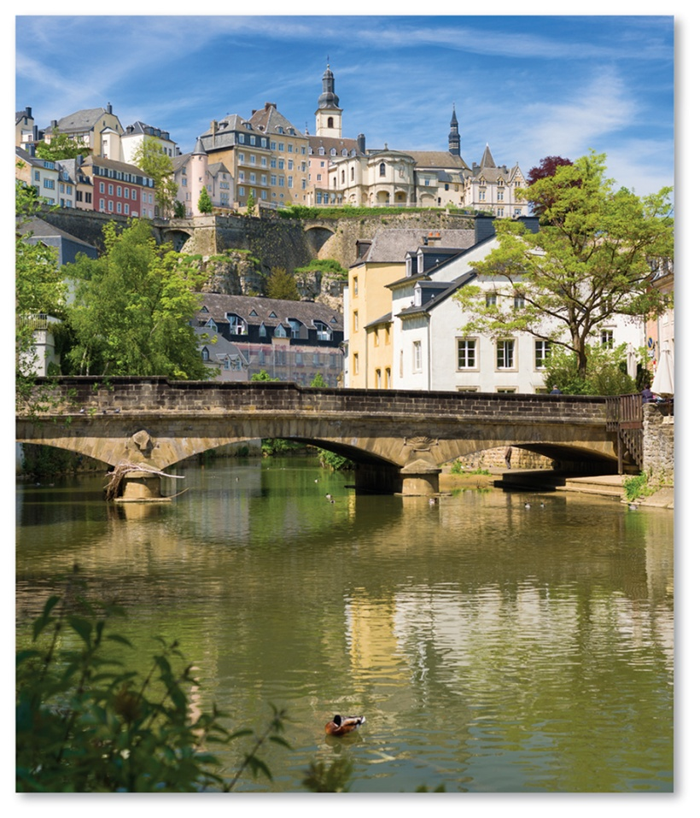
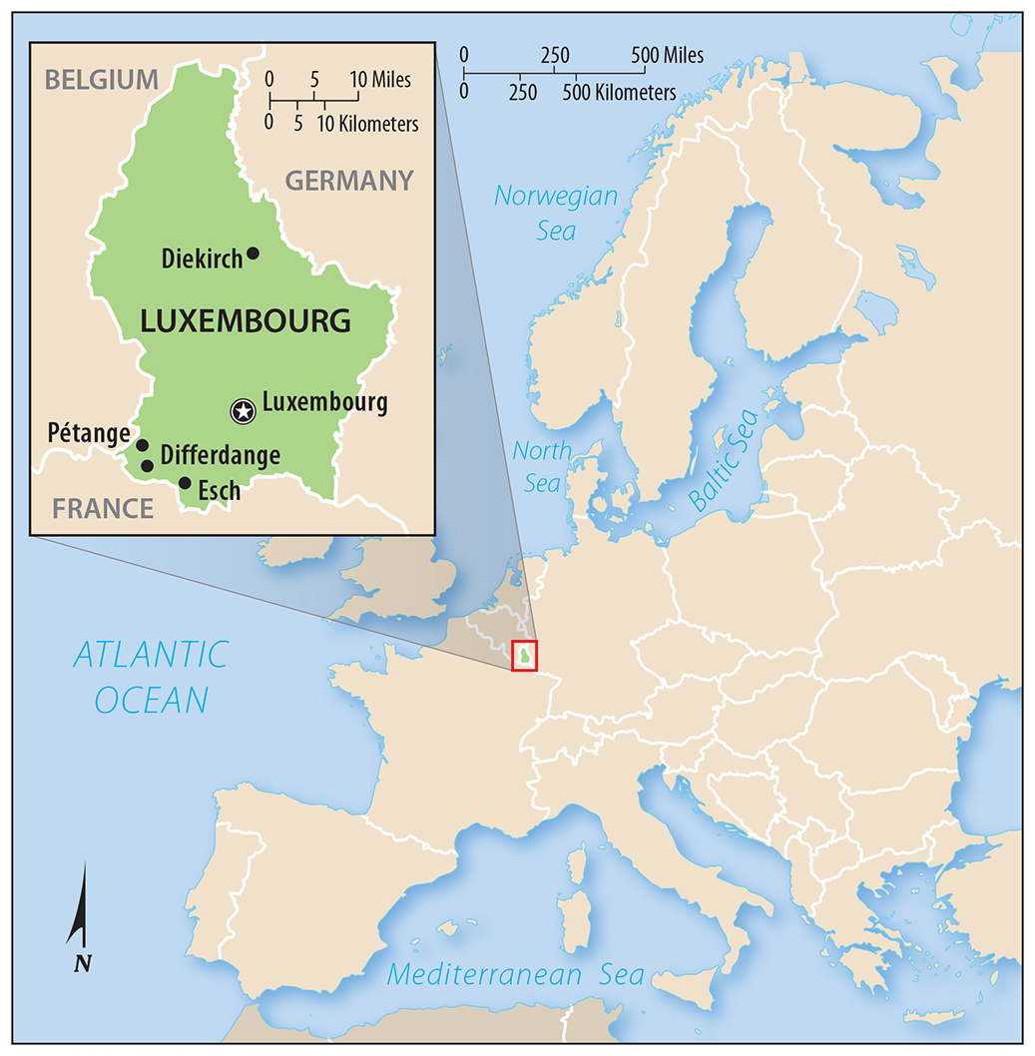
1.1 Introducing Geography
Figure 1-1 (above): Place: the city of Luxembourg, and Figure 1-2 (right): Region: Luxembourg within Europe as a region

Slide 6
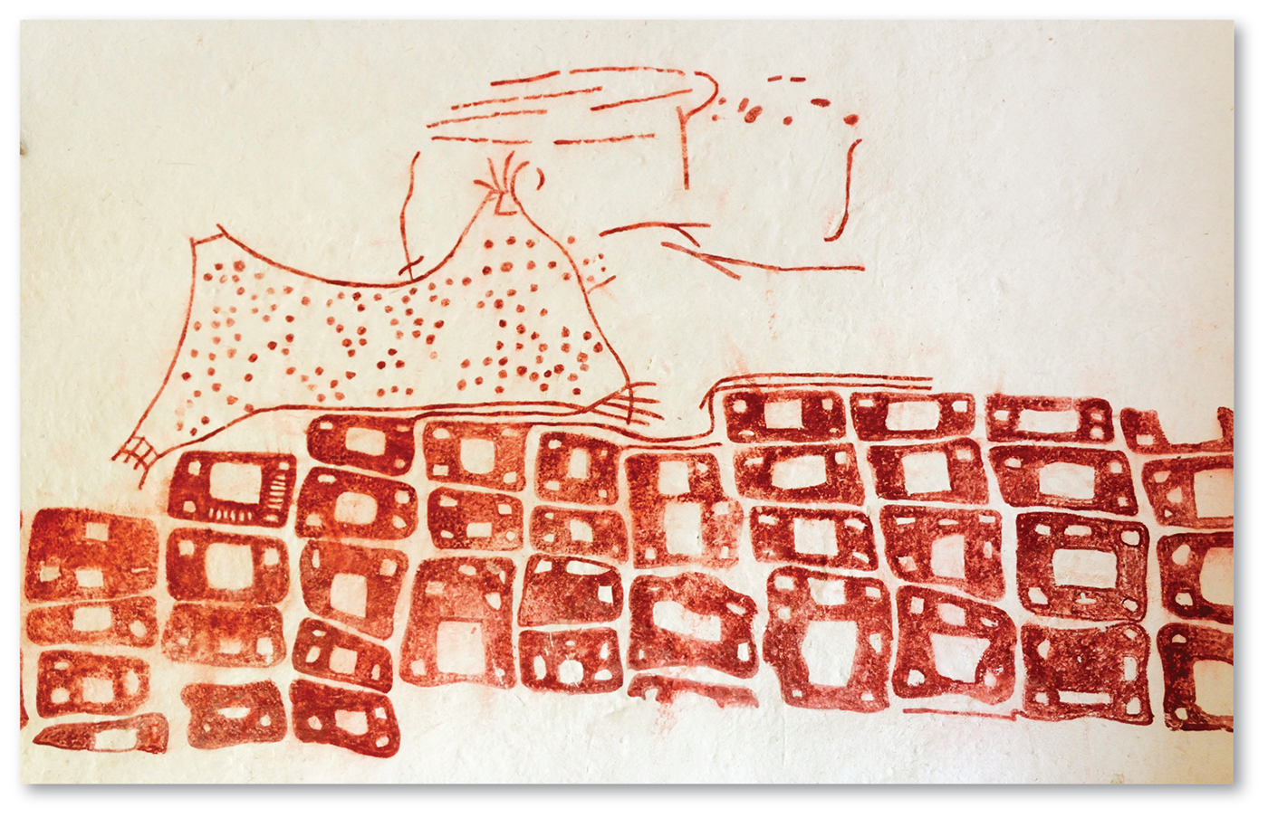
1.2 Cartography: The Science of Mapmaking
Figure 1-6: Earliest surviving map from 6200 B.C. depicts a town and erupting volcano in what is present-day Turkey.

Slide 7
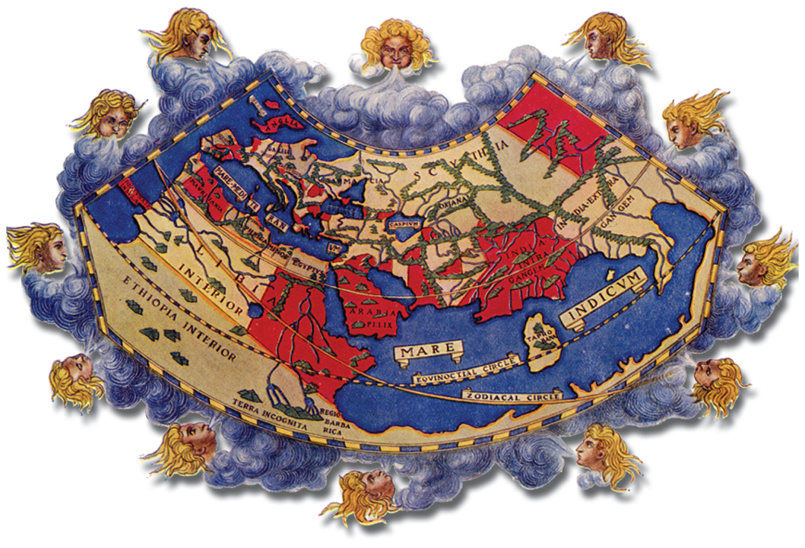
1.2 World Maps Over Time
Figure 1-7: World map by Ptolemy, CA. A.D. 150, depicts Europe, North Africa, and South Asia.

Slide 8
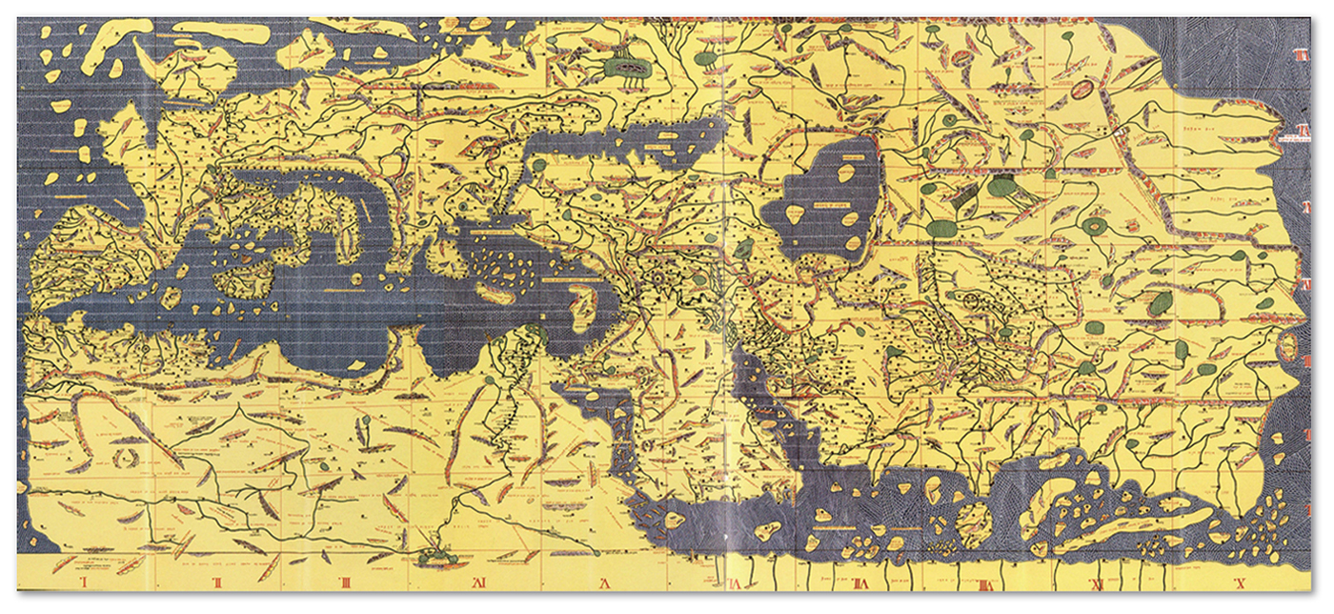
1.2 World Maps Over Time
Figure 1-8: World map by Al-Idrisi, 1154, includes East Asia

Slide 9
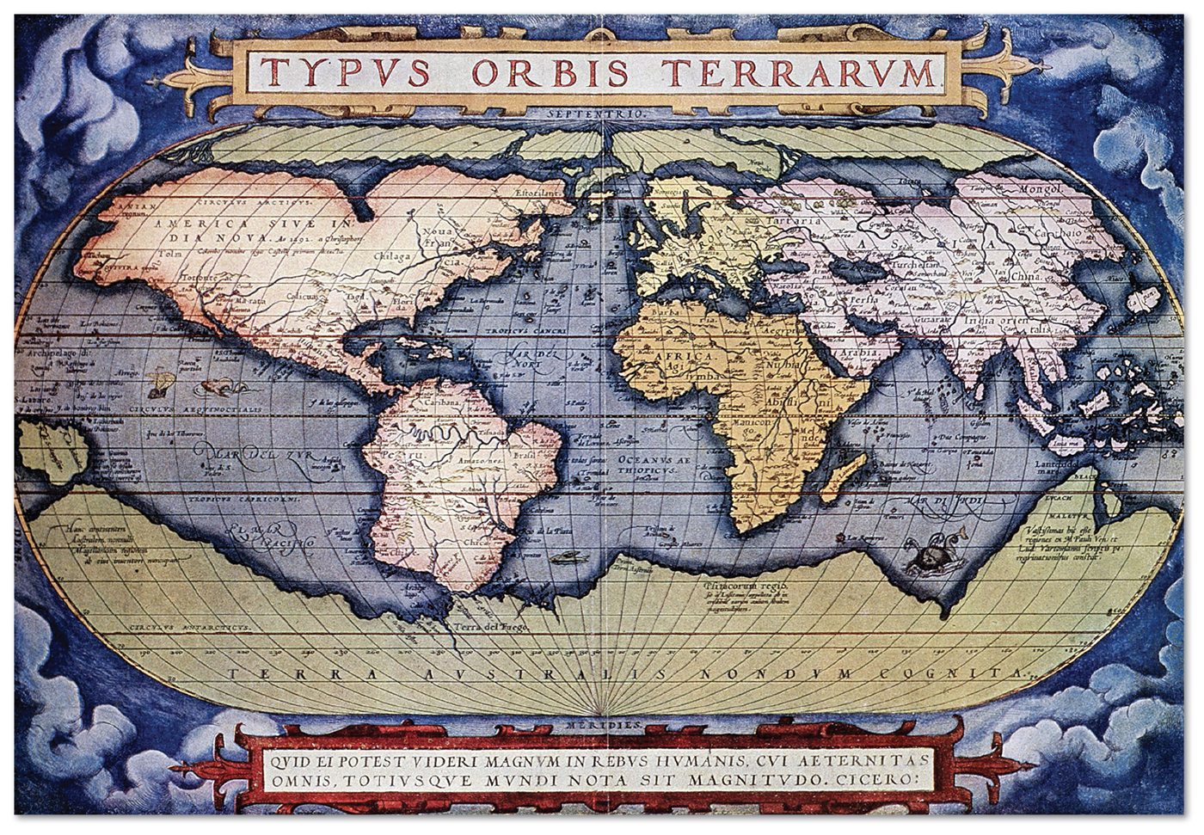
1.2 World Maps Over Time
Figure 1-9: World map by Ortelius, 1571, includes Western Hemisphere

Slide 10
1.3 Contemporary Geographic Tools
Global Positioning System (GPS): satellite-enabled technology giving precise locations
Geographic Information System (GIS): stores and analyzes geographic information
Remote sensing: observing Earth from afar (plane, satellite)
Volunteered Geographic Information (VGI): geographic data volunteered by the public

Slide 11
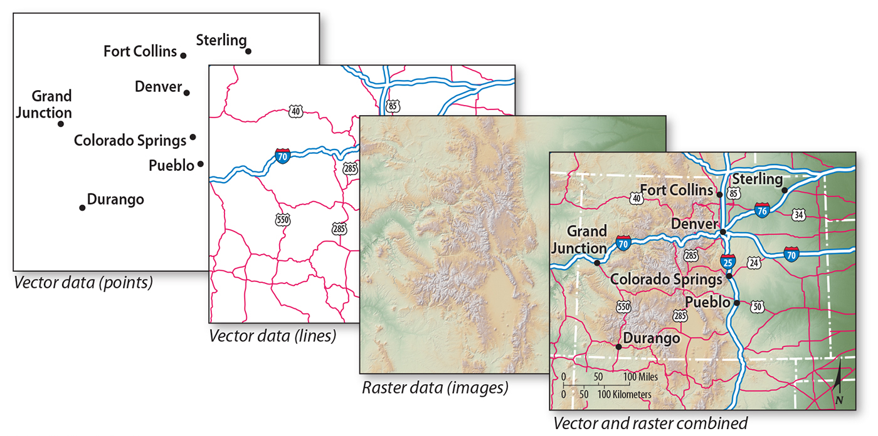
1.3 Geographic Information System
Figure 1-11: A GIS stores different types of geographic information in layers.

Slide 12
1.4 Interpreting Maps
Map scale: ratio of map units to land units
Projection: choice of how to transform Earth’s sphere to a flat map

Slide 13
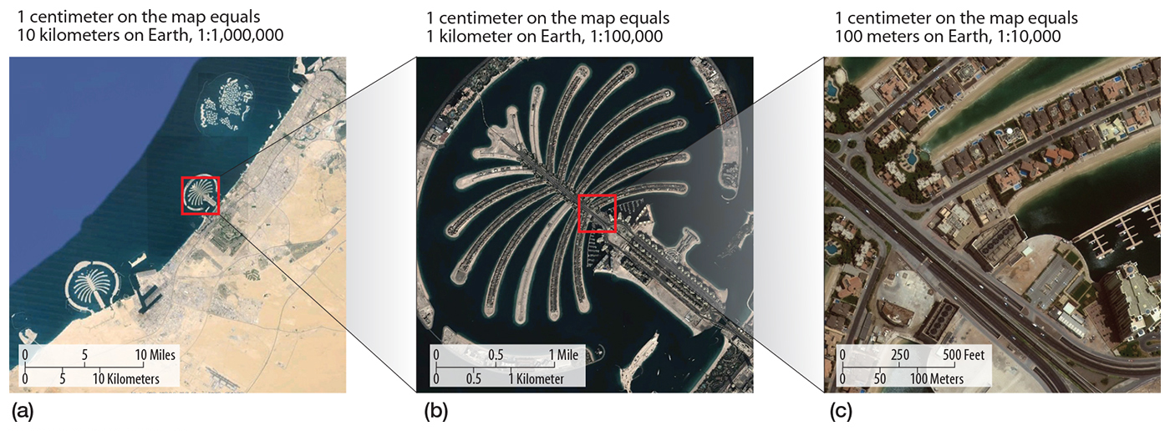
1.4 Satellite Imagery at Three Scales
Figure 1-12: Each scale presents a different total area and level of detail.

Slide 14
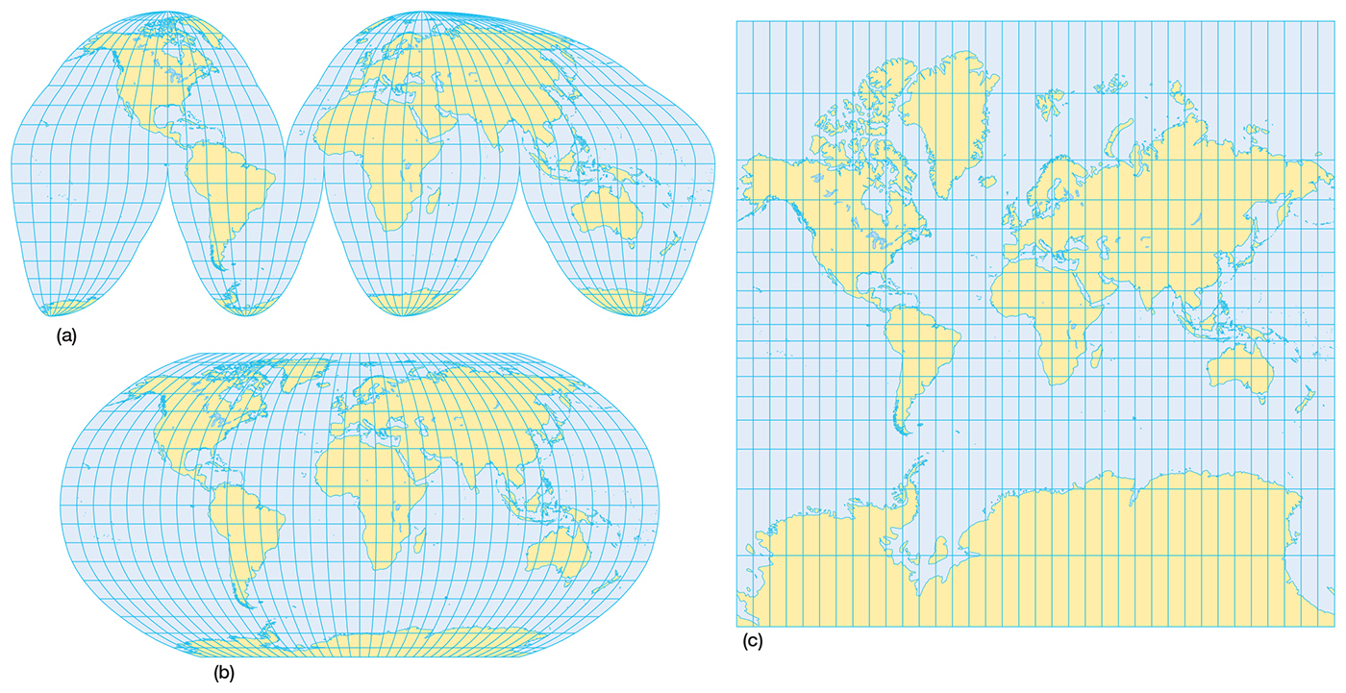
1.4 Map Projection
Figure 1-13: Each projection represents a compromise between distorting shape, distance, relative size, and direction.

Slide 15
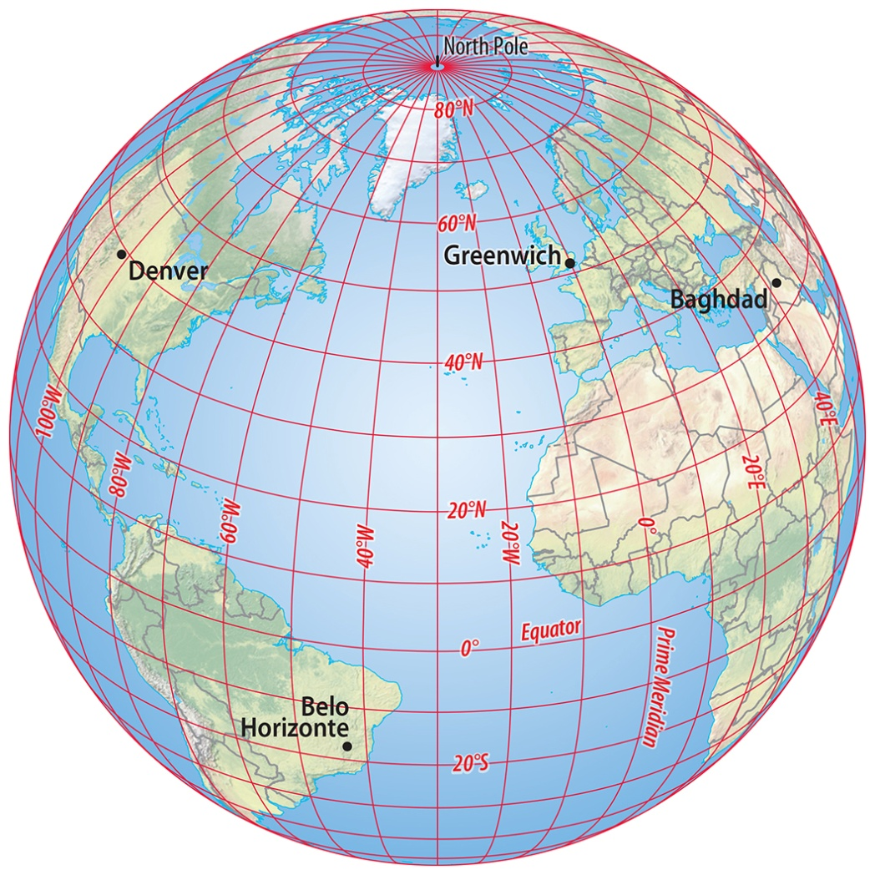
1.5 The Geographic Grid
Latitude and longitude: Every point on Earth has unique coordinates.
Longitude is the basis for calculating time.
Figure 1-14: The geographic grid covers Earth with parallels and meridians.

Slide 16
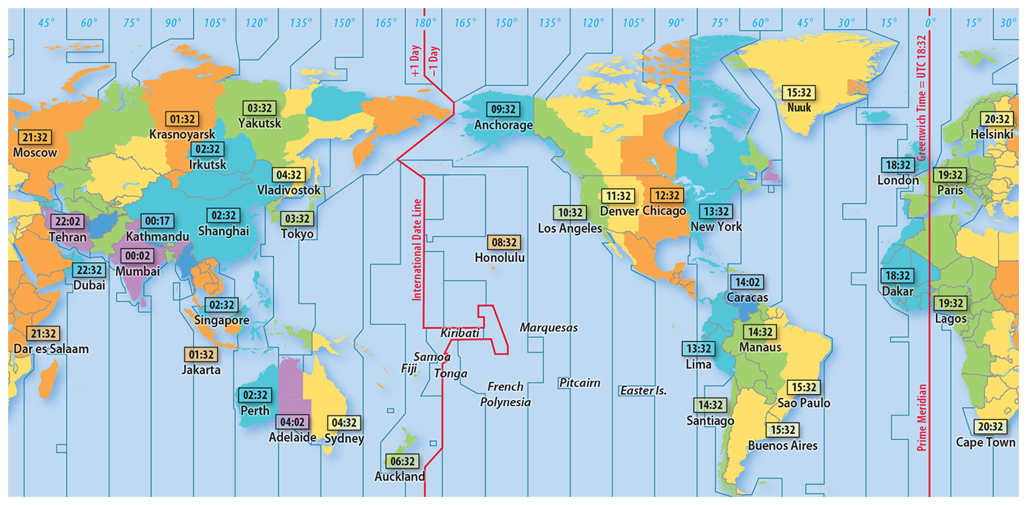
1.5 Time Zones
Figure 1-15: Time zones roughly follow longitude but vary for political and functional reasons.

Slide 17
Key Issue 2: Why Is Each Point on Earth Unique?
2.1 Place: A Unique Location
2.2 Region: A Unique Area
2.3 Culture Regions

Slide 18
2.1 Place: A Unique Location
Place names
Site: physical character of a place
Situation: a place’s location relative to other places

Slide 19
2.1 Place Name
Figure 1-16: World’s longest place name

Slide 20
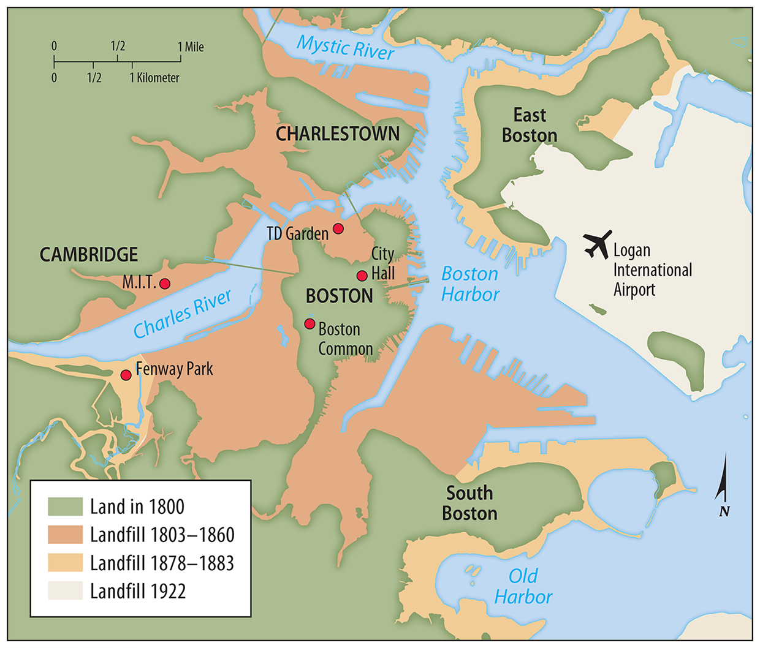
2.1 Changing Site of Boston
Figure 1-17: Boston’s land area has been increased by fill.

Slide 21
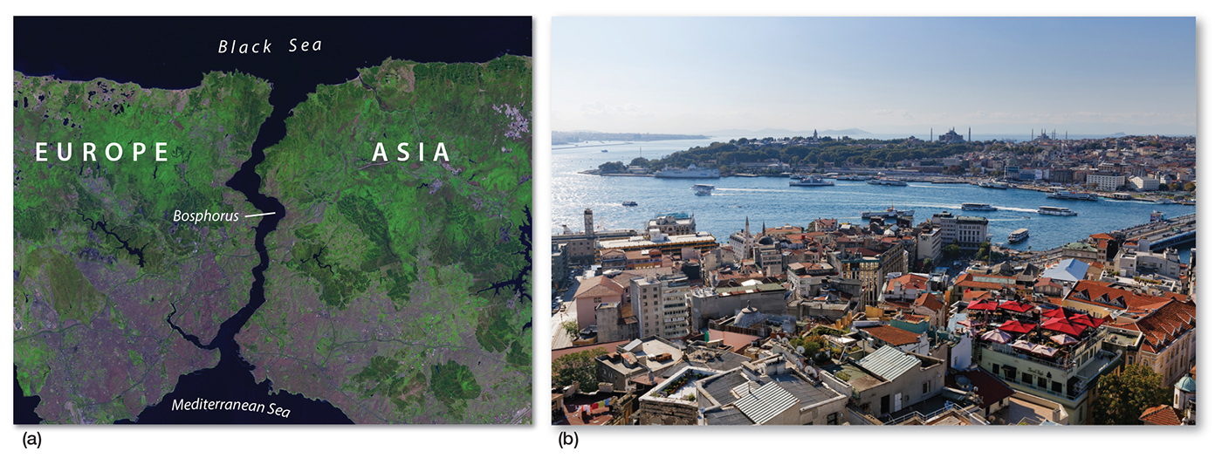
2.1 Situation of Istanbul
Figure 1-18: Istanbul is situated on a narrow strait that separates Europe and Asia.

Slide 22
2.2 Region: A Unique Area
Formal region: one or more distinctive characteristics present throughout area
Functional region: distinctive characteristic strongest at center, fades farther away
Vernacular region: people define a region through cultural perceptions

Slide 23
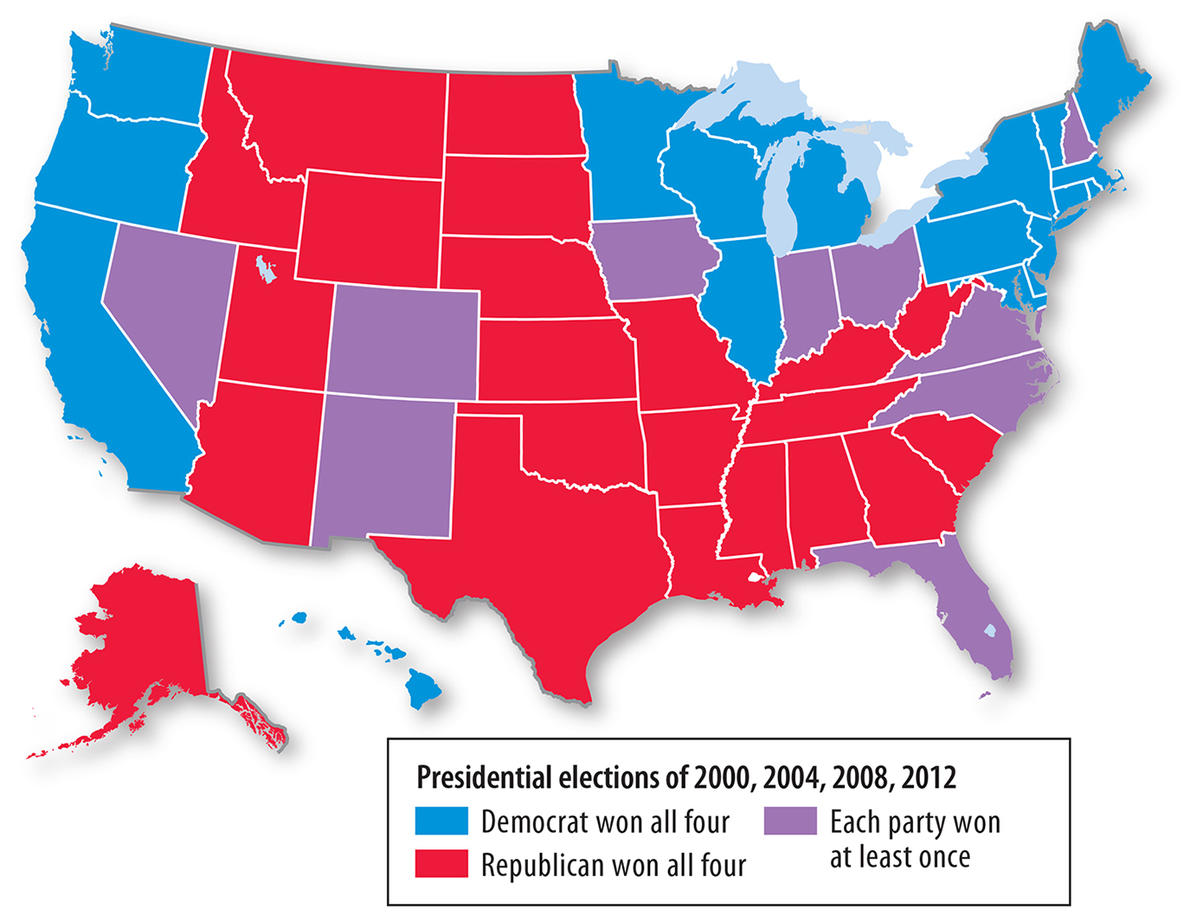
2.2 Formal Region
Figure 1-19: All of a state’s electoral votes are allocated to the candidate who wins a simple majority in that state.

Slide 24
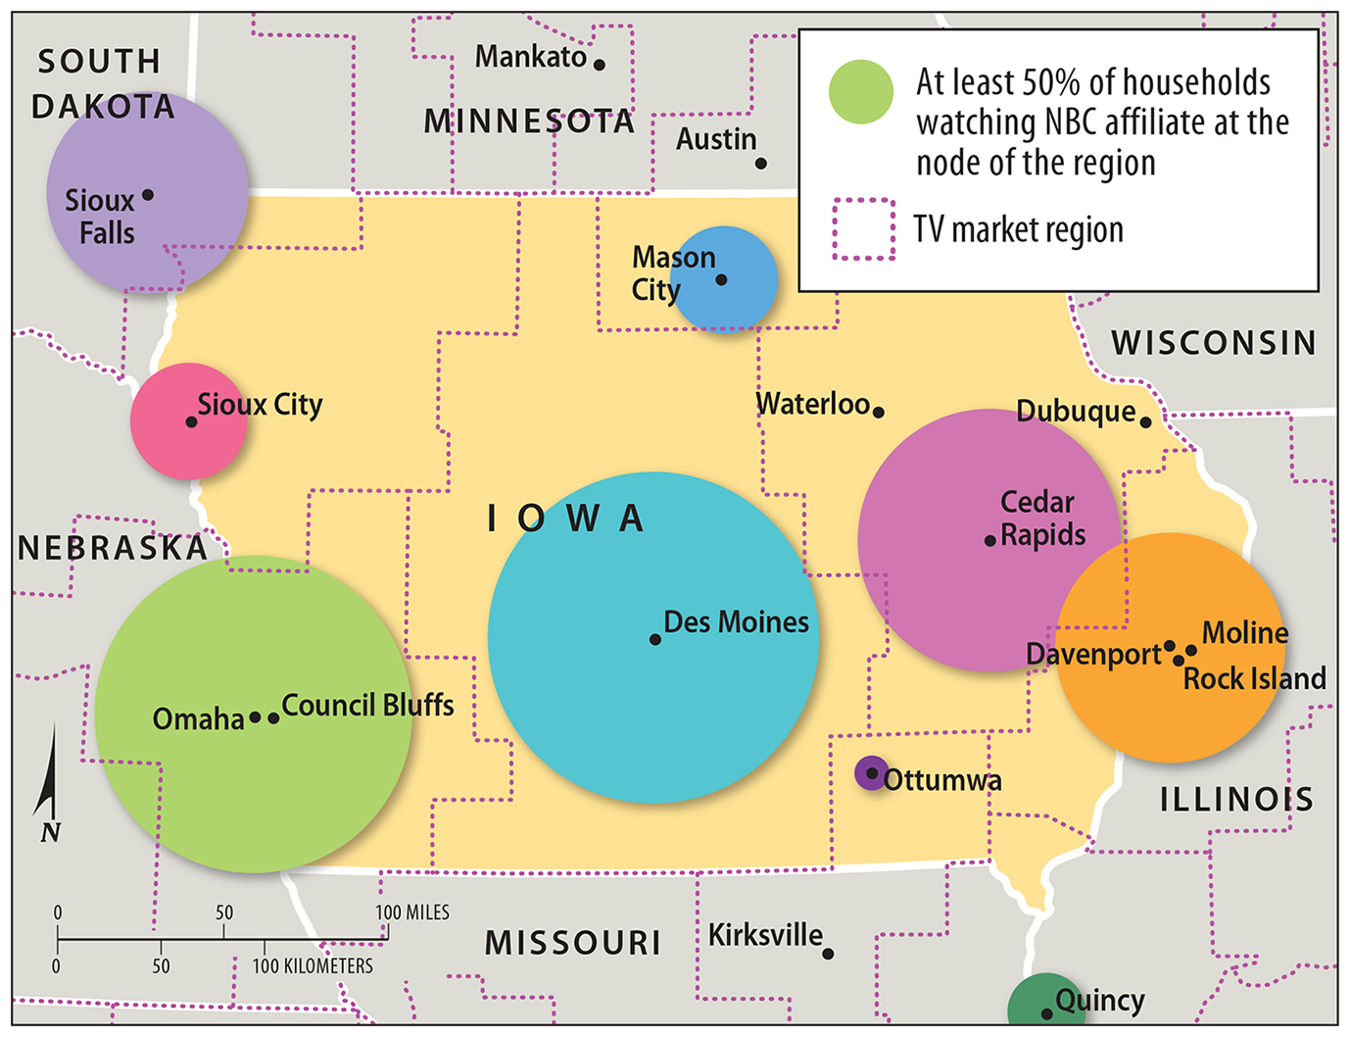
2.2 Functional Region
Figure 1-20: Market areas are strongest at their centers.

Slide 25
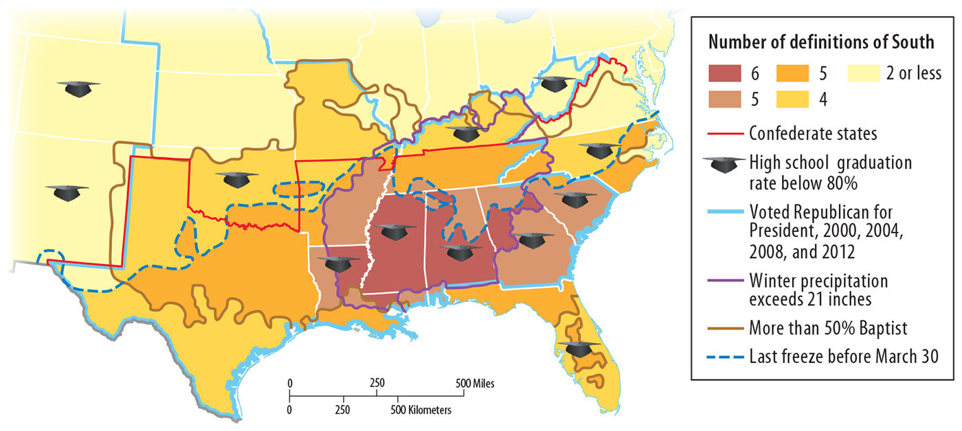
2.2 Vernacular Region
Figure 1-21: The U.S. South as a vernacular region.

Slide 26
2.2 Culture Regions
Culture is both
what people care about
what people take care of
Spatial association: the degree to which features co-occur in space

Slide 27
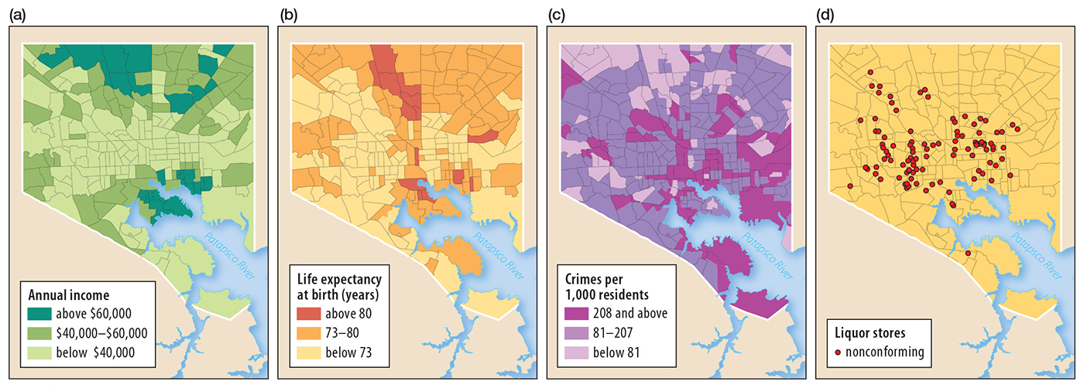
2.2 Spatial Association in Baltimore
Figure 1-24: (a) income, (b) life expectancy at birth, (c) crime, and (d) nonconforming liquor stores

Slide 28
Key Issue 3: Why Are Different Places Similar?
3.1 Scale: Global and Local
3.2 Space: Distribution of Features
3.3 Space: Cultural Identity
3.4 Space: Inequality
3.5 Connections: Diffusion
3.6 Connections: Spatial Interaction

Slide 29
3.1 Scale: Global and Local
Economic globalization
Cultural globalization vs. local diversity

Slide 30
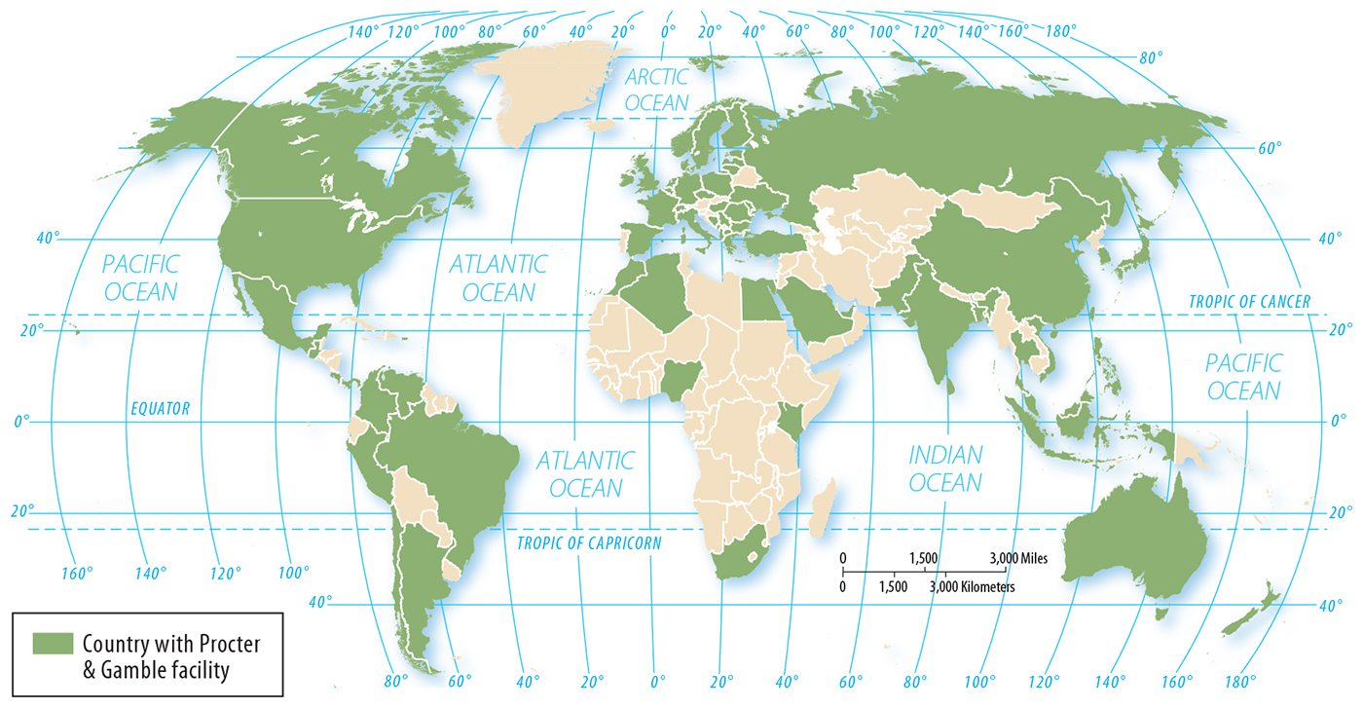
3.1 Economic Globalization
Figure 1-25: Procter & Gamble’s facilities have a global extent.

Slide 31
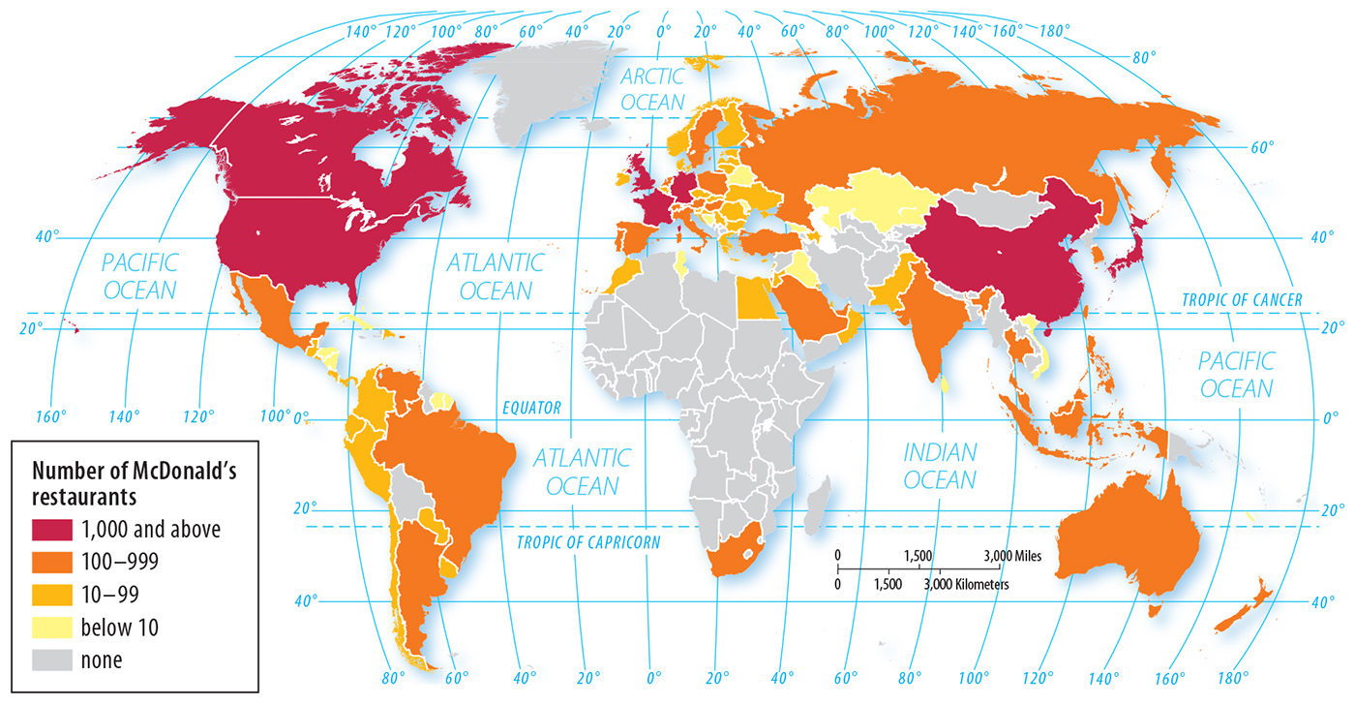
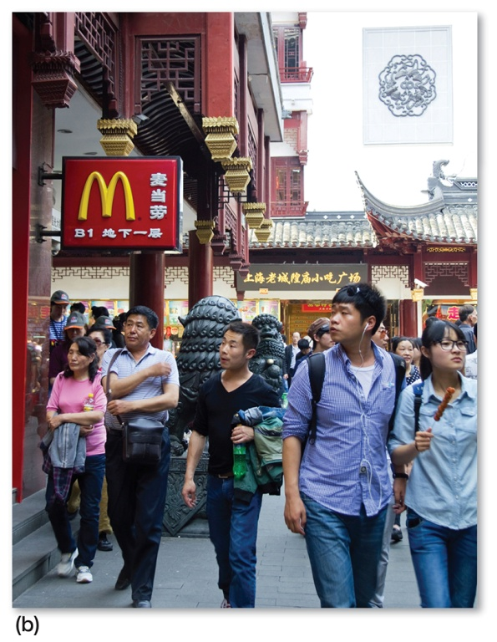
3.1 Economic Globalization
Figures 1-26 & 1-27b: McDonald’s is part of a uniform landscape.

Slide 32
3.2 Space: Distribution of Features
Density: number of features per area
Concentration: clustered or dispersed
Pattern: grid, linear, web

Slide 33
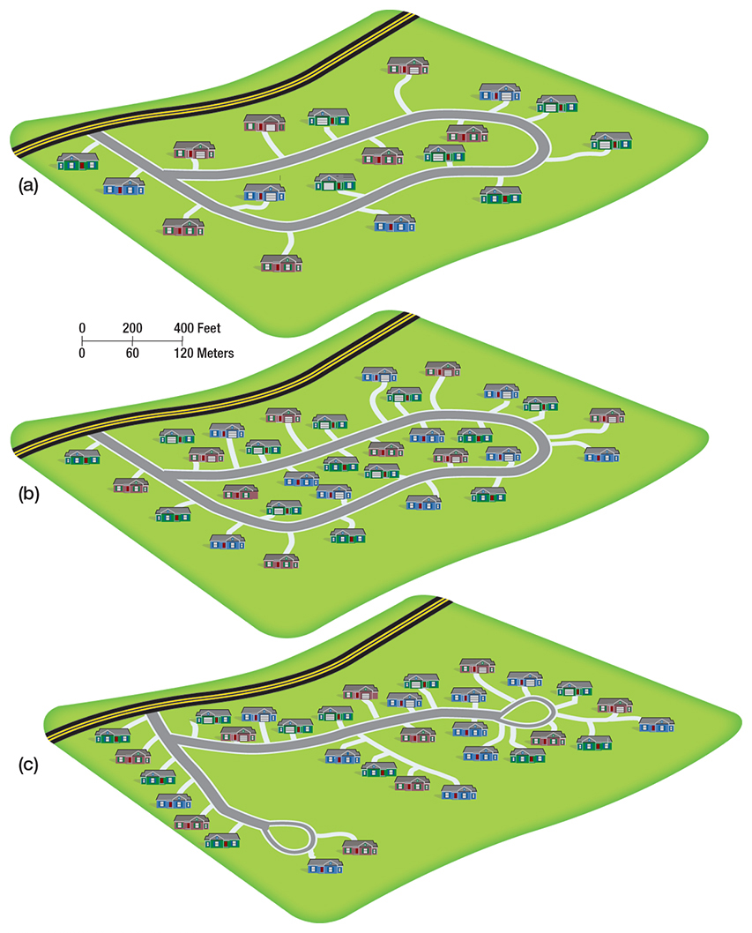
3.2 Density and Concentration of Houses
Figure 1-28: (a) has the lowest density and a dispersed concentration. (b) and (c) have the same density but different concentrations.

Slide 34
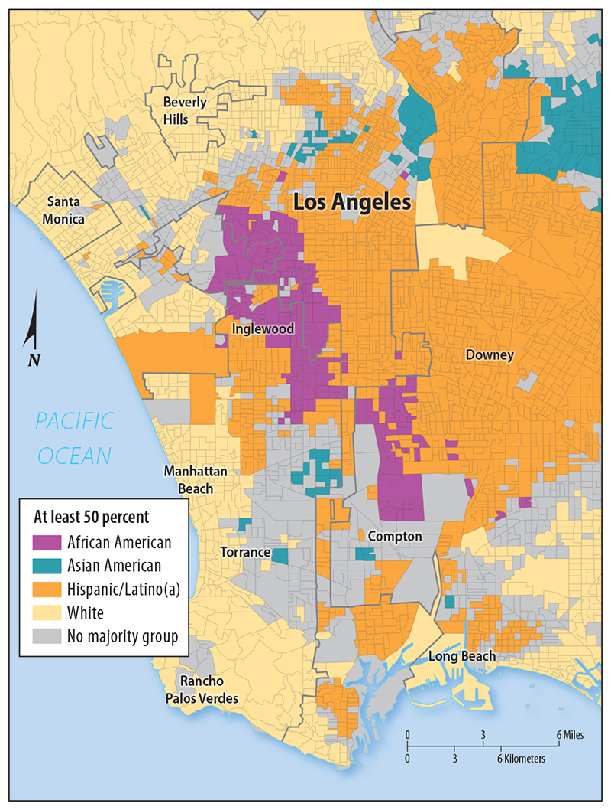
3.3 Cultural Identity Across Space
Figure 1-31: The distribution of ethnicities in Los Angeles displays clustering; grey areas are those with no majority group.

Slide 35
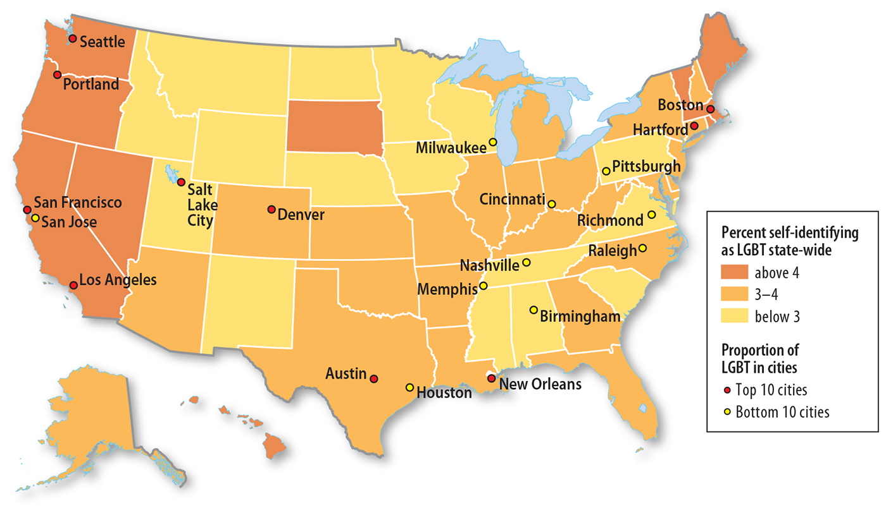
3.3 Cultural Identity Across Space
Figure 1-32: The distribution of LGBT people in the U.S. is not uniform.

Slide 36
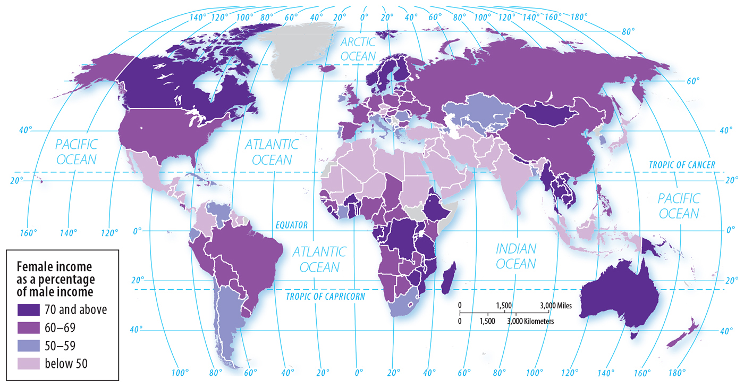
3.3 Cultural Identity Across Space
Figure 1-34: The average income of women is lower than men everywhere in the world, with greater inequality in some places.

Slide 37
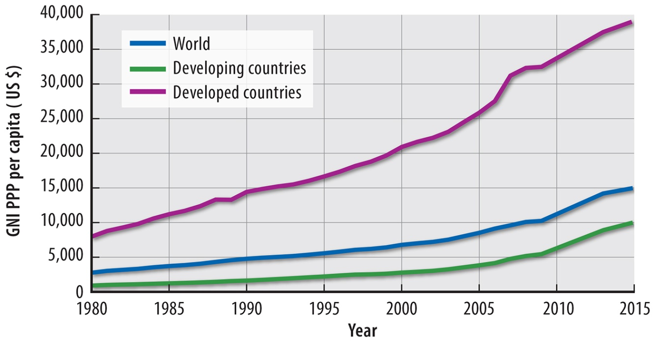
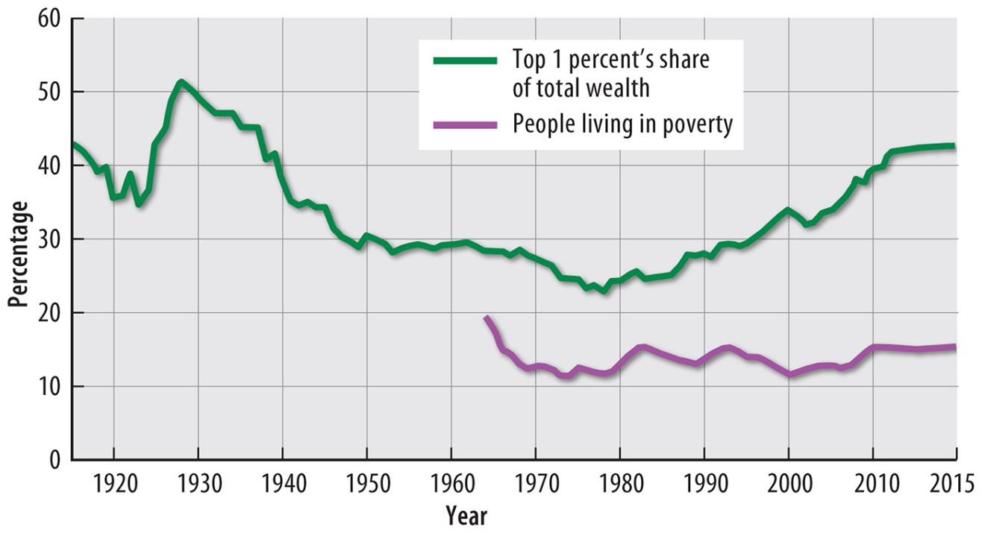
3.4 Space: Inequality
Figures 1-35 and 1-36: Inequality is growing both internationally (top) and in the U.S. (right).

Slide 38
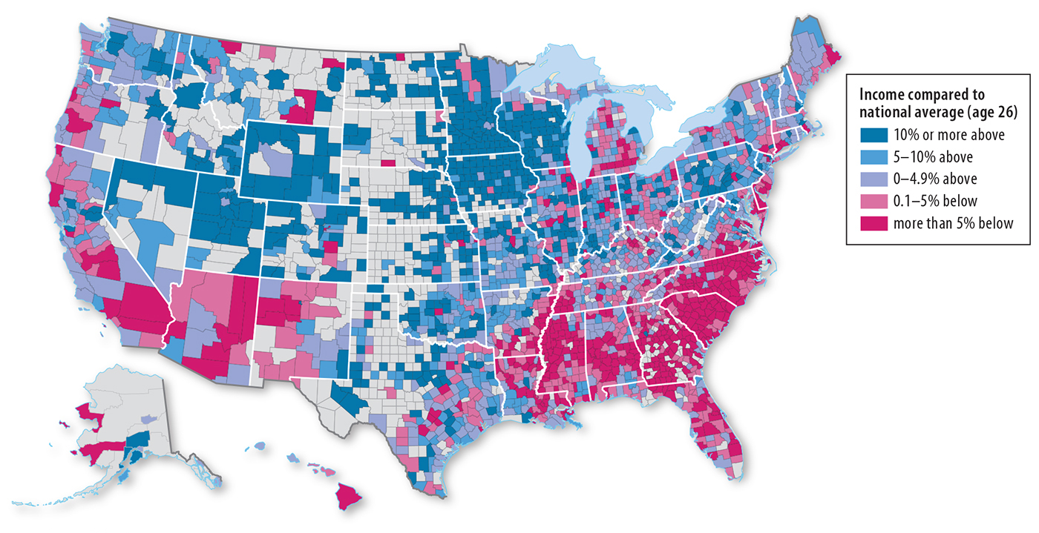
3.4 Space: Inequality
Figure 1-37: Children born to low-income households experience inequality of opportunity based on their location.

Slide 39
3.5 Connections: Diffusion
Types of diffusion
Relocation: movement of people or things
Expansion: outward spread of a feature
Hierarchical: follows network
Contagious: rapid and widespread
Stimulus

Slide 40
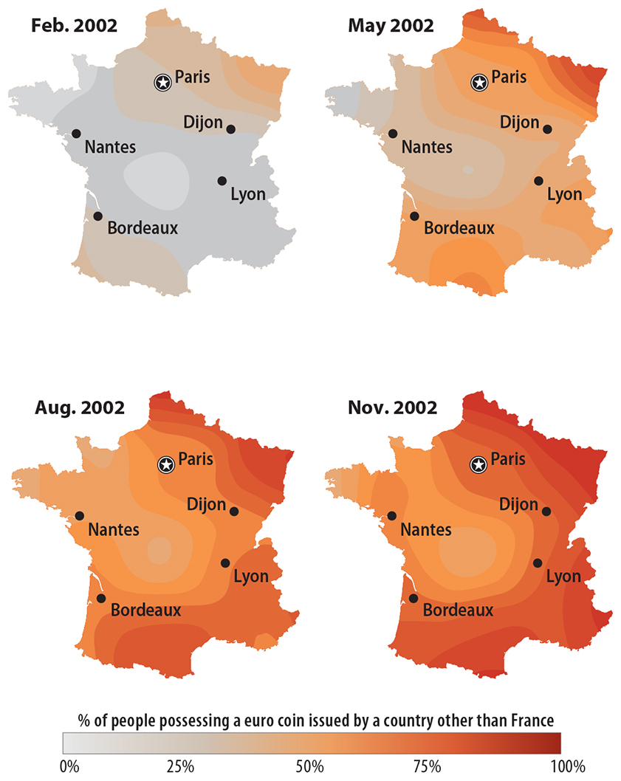
3.5 Relocation Diffusion of the Euro
Figure 1-38: Euro coins from outside France entered from the borders and became more and more common.

Slide 41
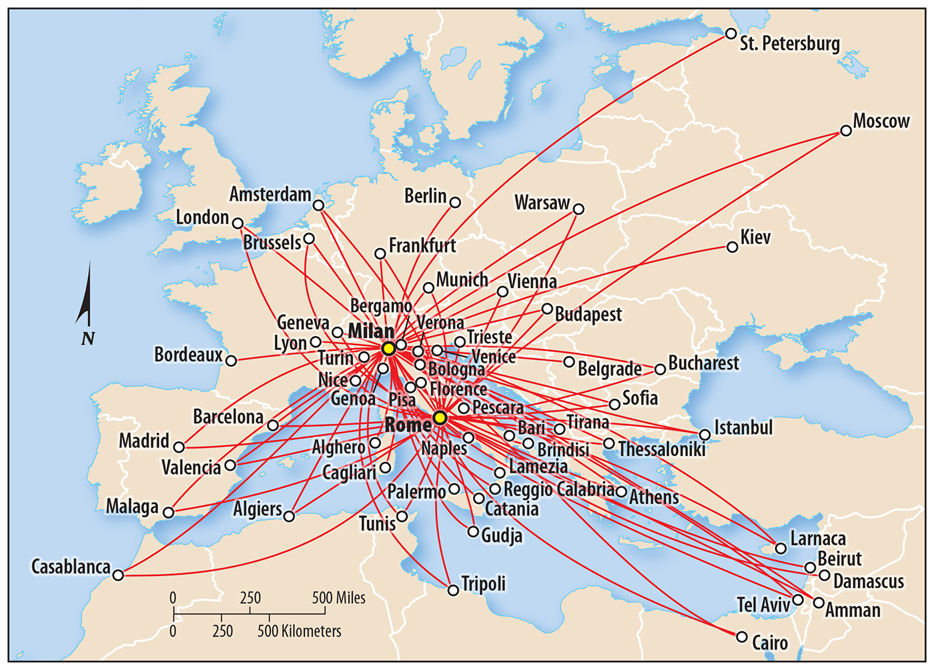
3.6 Connections: Spatial Interaction
Figure 1-41: Airline hub-and-spoke networks (Alitalia in this case) show that some places are more central and others are less connected.

Slide 42
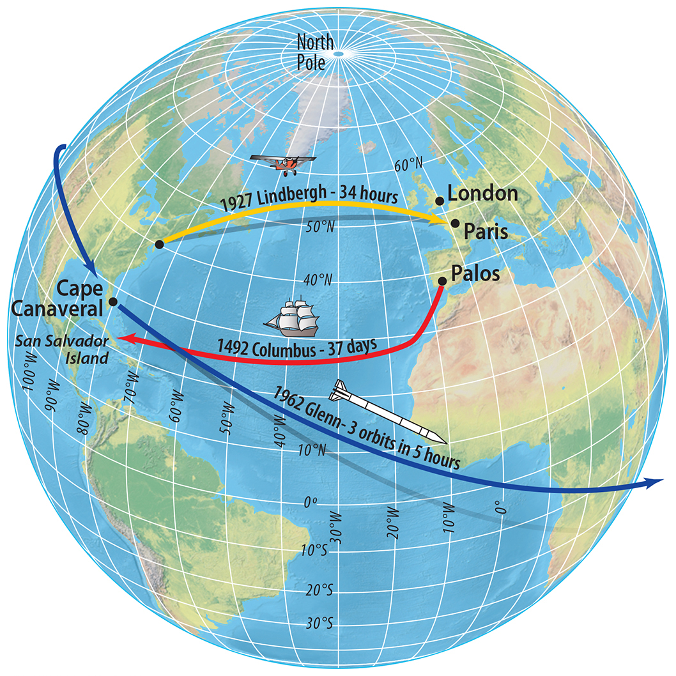
3.6 Space-Time Compression
Figure 1-42: Places in the world have become effectively closer together as transportation and communication have become faster.

Slide 43
Key Issue 4: Why Are Some Actions Not Sustainable?
4.1 Geography, Sustainability, and Resources
4.2 Sustainability and Earth’s Physical Systems
4.3 Geography, Sustainability, and Ecology
4.4 Sustainable Environmental Change

Slide 44
4.1 Geography, Sustainability, and Resources
Some resources are renewable, others nonrenewable
Sustainability: using resources while thinking of the future
Three pillars of sustainability
environment
society
economy

Slide 45
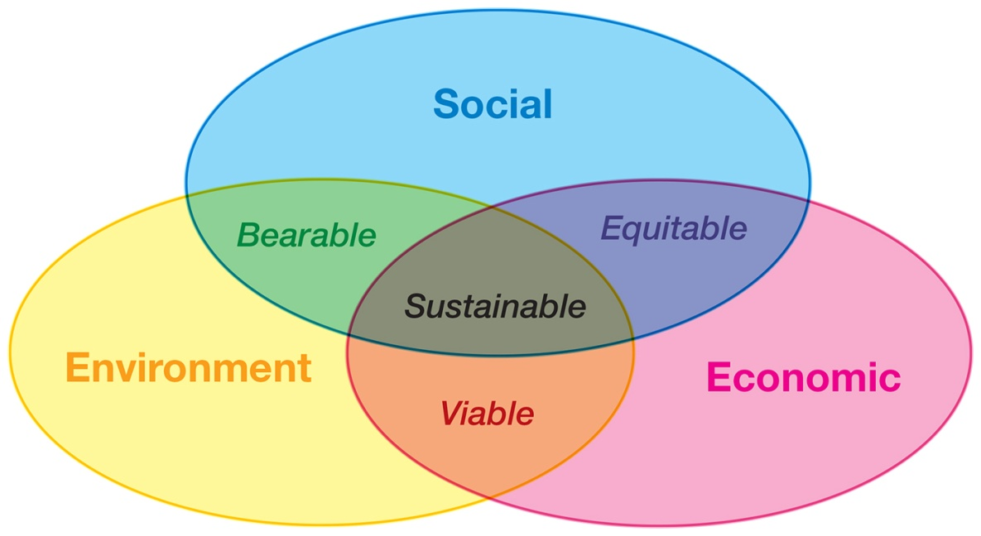
4.1 Three Pillars of Sustainability
Figures 1-45 and 1-46: The UN considers sustainability as the intersection of environmental, social, and economic sustainability

Slide 46
4.2 Sustainability and Earth’s Physical Systems
Earth’s physical systems influence human activity.
Three abiotic (nonliving) systems:
Atmosphere
Hydrosphere
Lithosphere
One biotic system, the biosphere

Slide 47
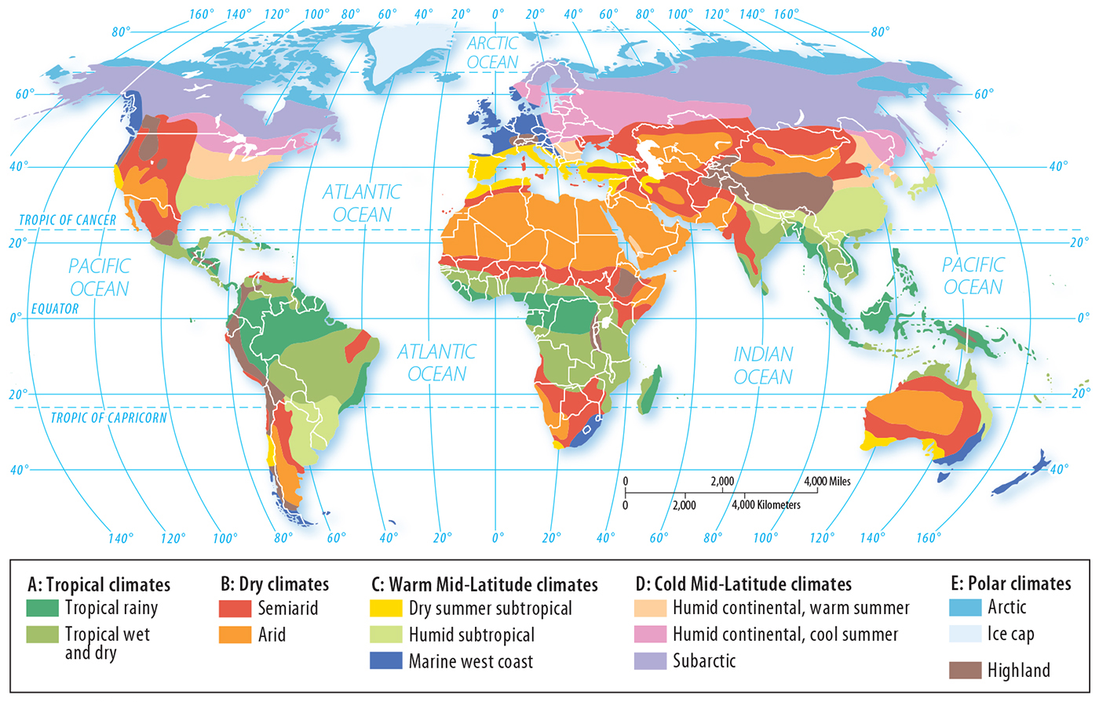
4.2 Climate Regions
Figure 1-47: Different climates present different challenges and opportunities for human habitation.

Slide 48
4.3 Geography, Sustainability, and Ecology
Ecology: study of ecosystems
Cultural ecology: study of human-environment interactions
environmental determinism: The environment causes human culture.
possibilism: The environment sets some limits, but people can adapt in many ways.

Slide 49
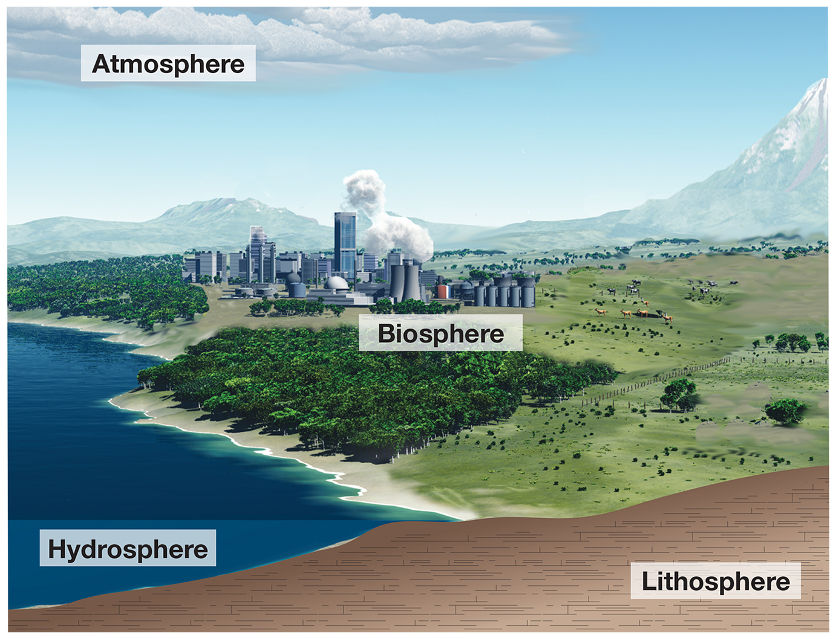
4.3 Ecosystems
Figure 1-50: The biosphere and its ecosystems exist mostly at the interface of the three abiotic systems.

Slide 50
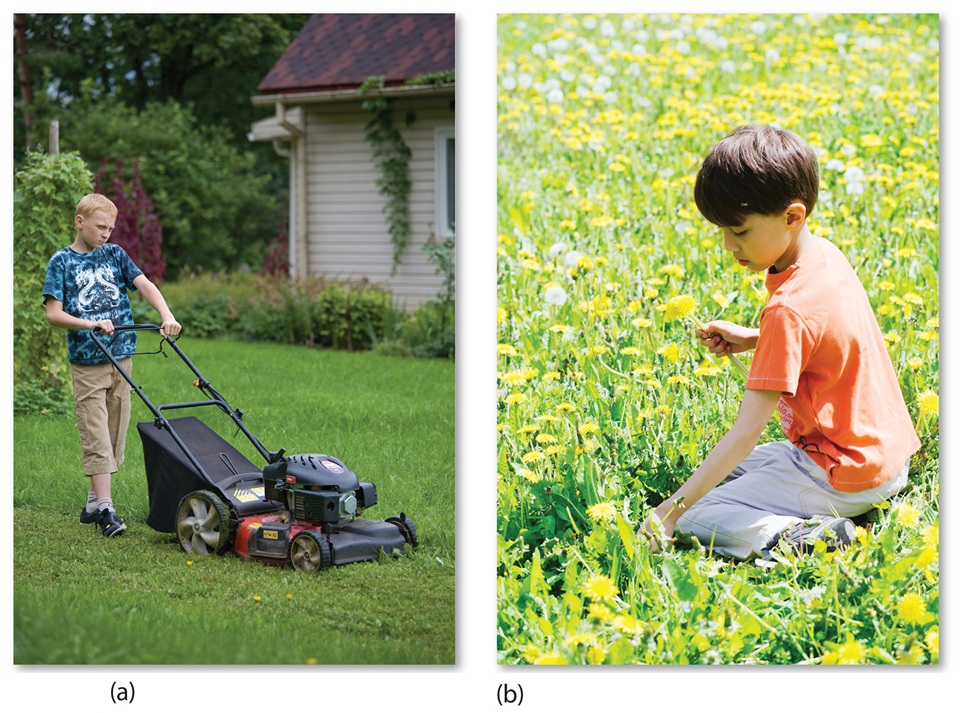
4.3 Cultural Ecology
Figure 1-51: Possibilism argues there are multiple ways for culture to interact with any particular environment.

Slide 51
4.4 Sustainable Environmental Change
Contrasts in sustainability: Netherlands vs. California
Dutch modification of the environment has addressed sustainability.
California faces unsustainable demands for water.
Florida Everglades modification of low-lying lands is less sustainable too.

Slide 52
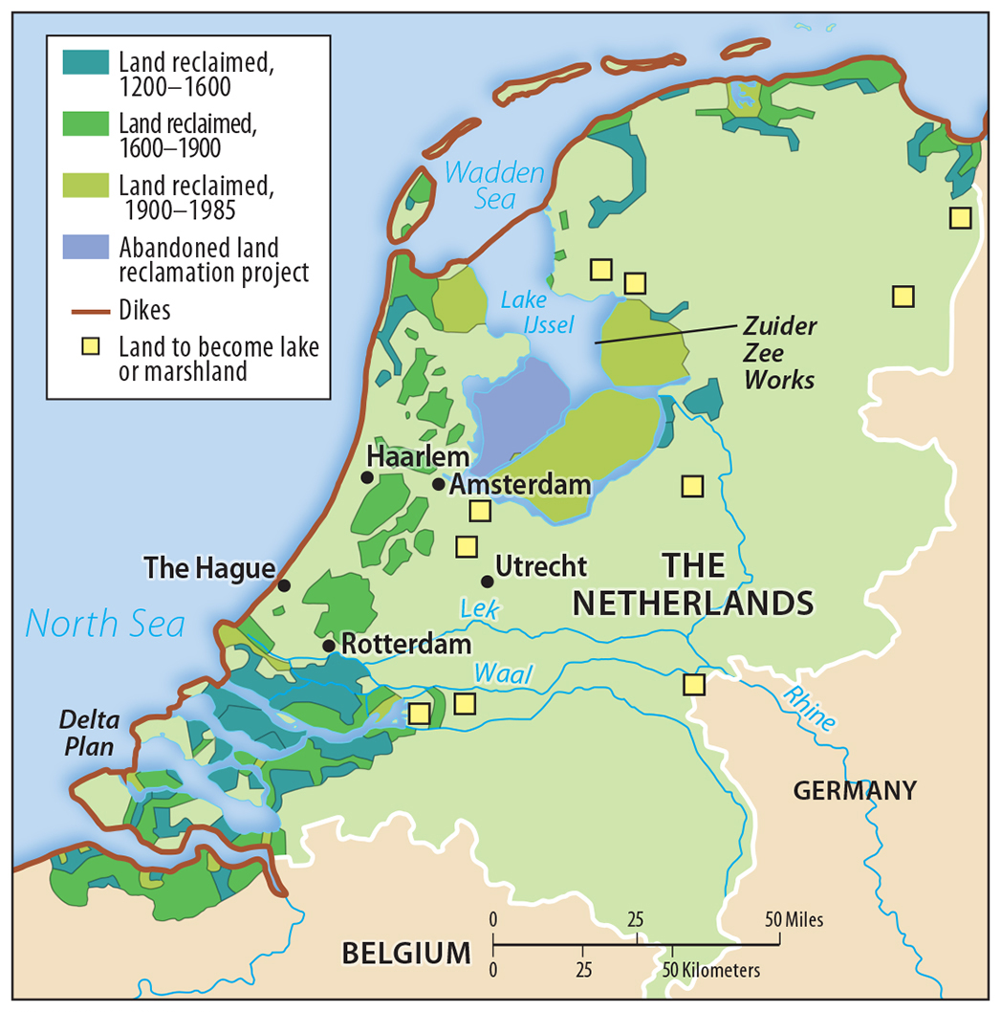
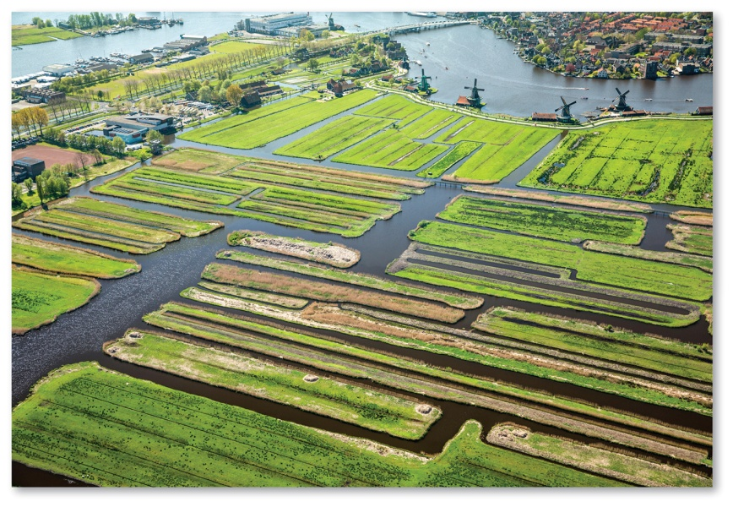
4.4 Dutch Land Use
Figures 1-52 and 1-53: The Netherlands has built extensive dikes to develop farmland called polders (below).

Slide 53
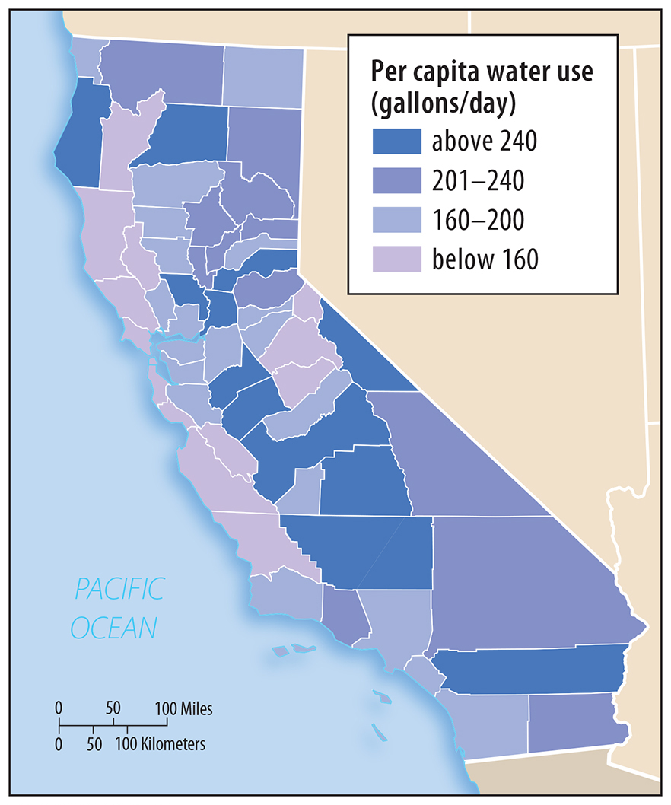
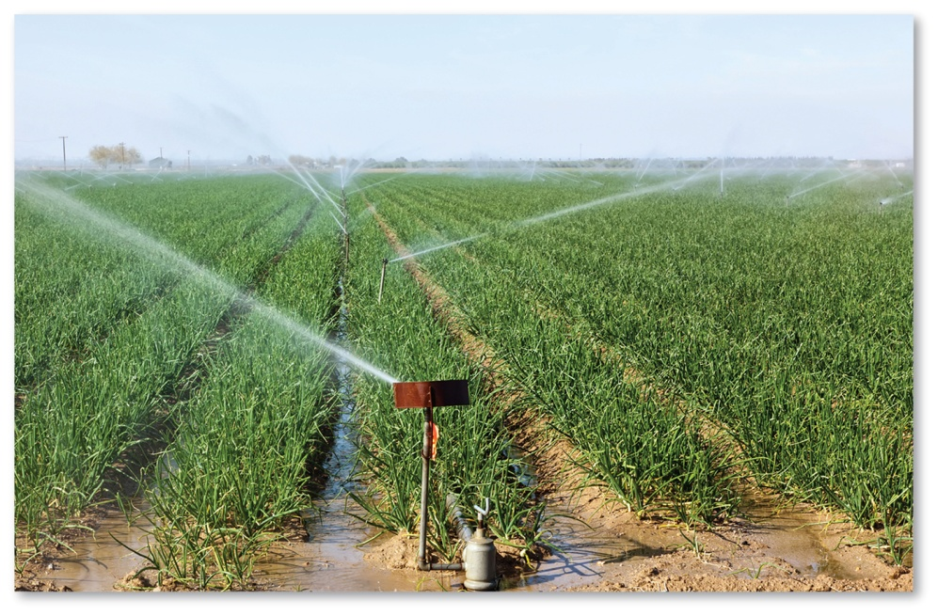
4.4 California Water Use per capita
Figures 1-54 and 1-55: The highest uses per capita are in agricultural counties with lots of irrigation and lower populations. Agriculture uses 80% of water in California (below).

Slide 54
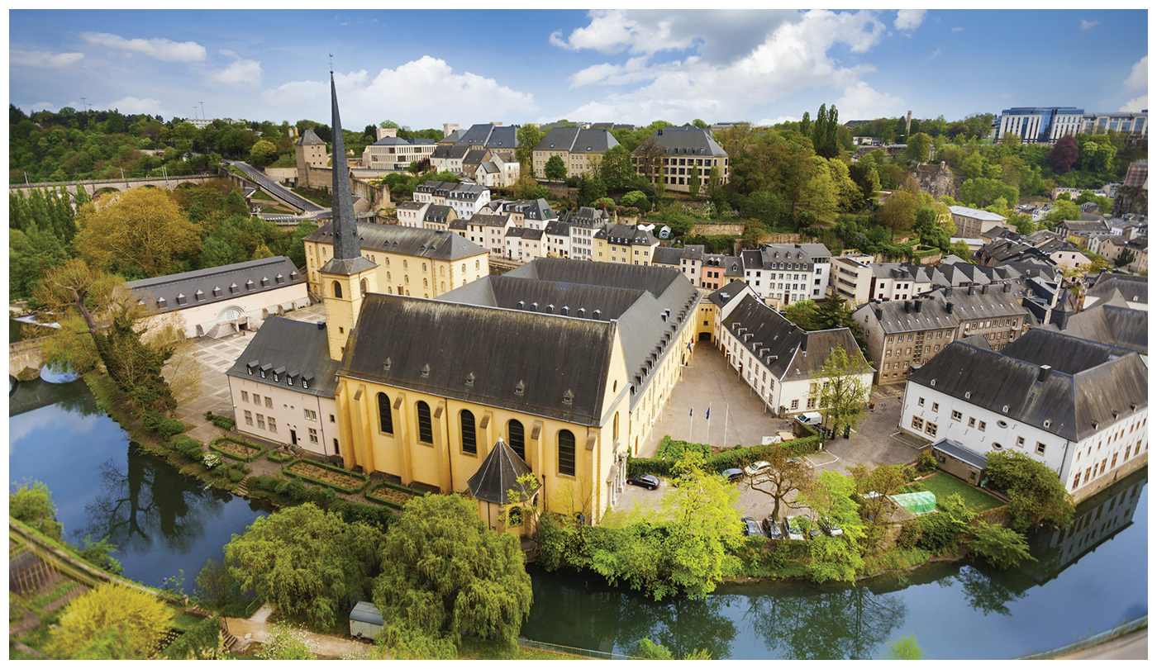
Chapter 1 End

