Slide 1
Chapter 13 Lecture
Chapter 13
Urban Patterns
Tim Scharks Green River College

Slide 2
Urban Patterns: Key Issues
Why Are Downtowns Distinctive?
Where Are People Distributed in Urban Areas?
Why Do Urban Areas Expand?
Why Do Cities Face Sustainability Challenges?

Slide 3
Key Issue 1: Why Are Downtowns Distinctive?
1.1 Introducing Urban Patterns
1.2 The Central Business District
1.3 Competition for Space in CBDs

Slide 4
1.1 Introducing Urban Patterns
Different ways to define an urban area:
Central city: municipal city limits
Urbanized area: central city and surrounding suburbs 50,000+ residents
Urban cluster: 2,500–50,000 residents

Slide 5
1.1 Introducing Urban Patterns
Metropolitan Statistical Area (MSA):
urbanized area 50,000+ population
county of that urbanized area
adjacent counties with high density and interaction with central county
Micropolitan Statistical Area (μSA): like MSA but central city has 10,000–50,000
Combinations of MSAs and μSAs

Slide 6
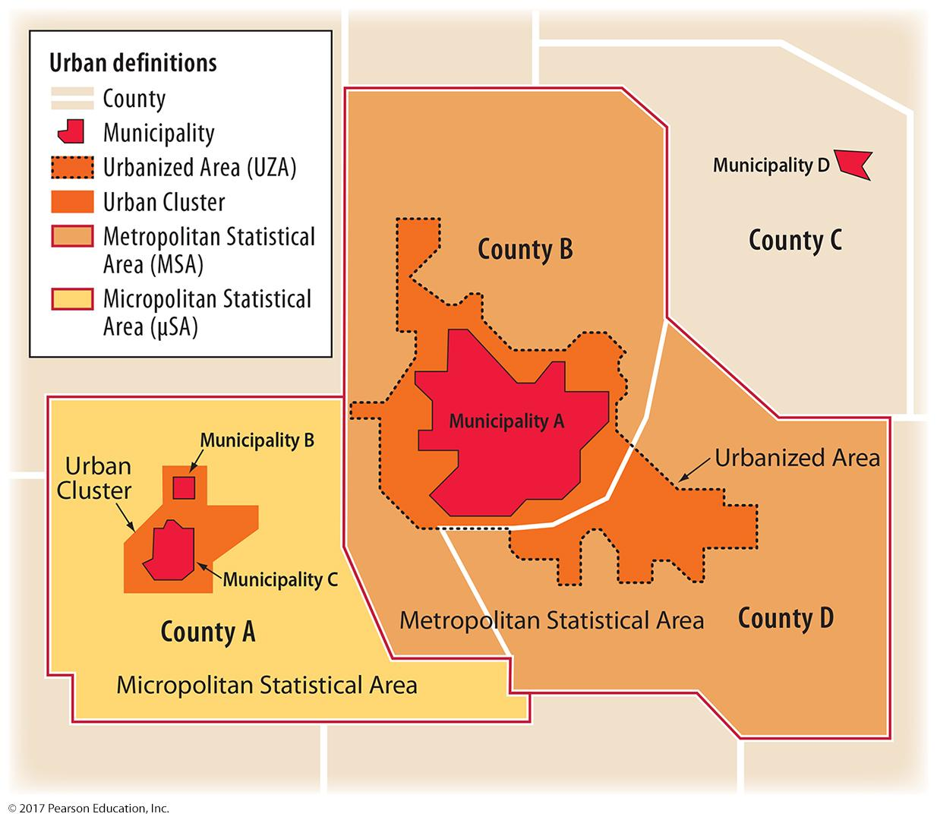
1.1 Census Definitions of Urban Settlements
Figure 13-2: The U.S. Census defines urban areas depending on the size and number of municipalities and their interaction.

Slide 7
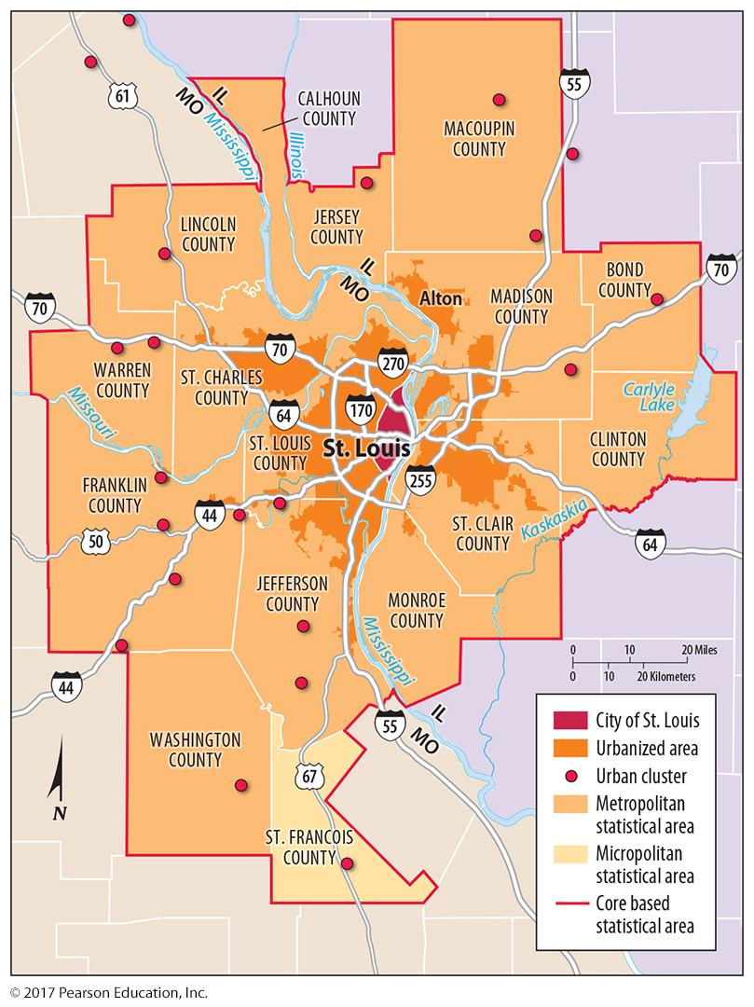
1.1 Census Definitions of Urban Settlements
Figure 13-3: statistical area of St. Louis

Slide 8
1.2 The Central Business District (CBD)
CBD, or downtown, is most central place in a city, with a high concentration of:
Public services
Business services
Consumer services
high threshold and range retail
retail serving CBD workers

Slide 9
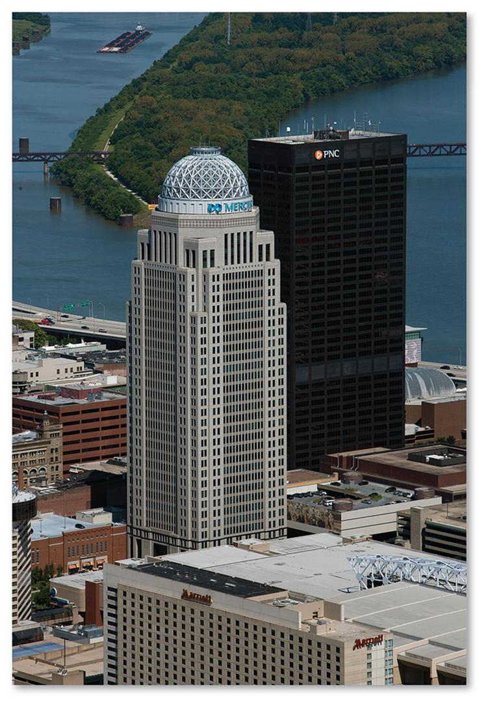
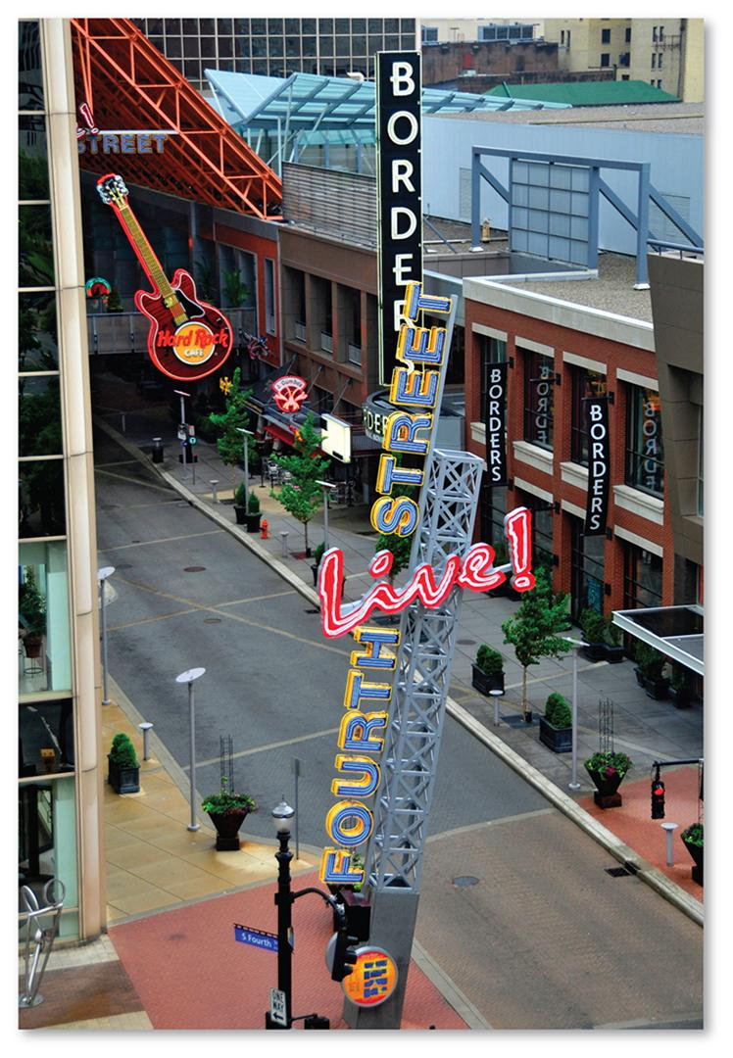
1.2 Louisville, Kentucky CBD
Figures 13-7 and 13-8: The CBD features office buildings for business services as well as consumer services with high thresholds and ranges.

Slide 10
1.3 Competition for Space in CBDs
High demand for limited land in CBD:
Vertical development to maximize space:
underground spaces
skyscrapers
Some activities excluded:
manufacturing
residences
though changing

Slide 11
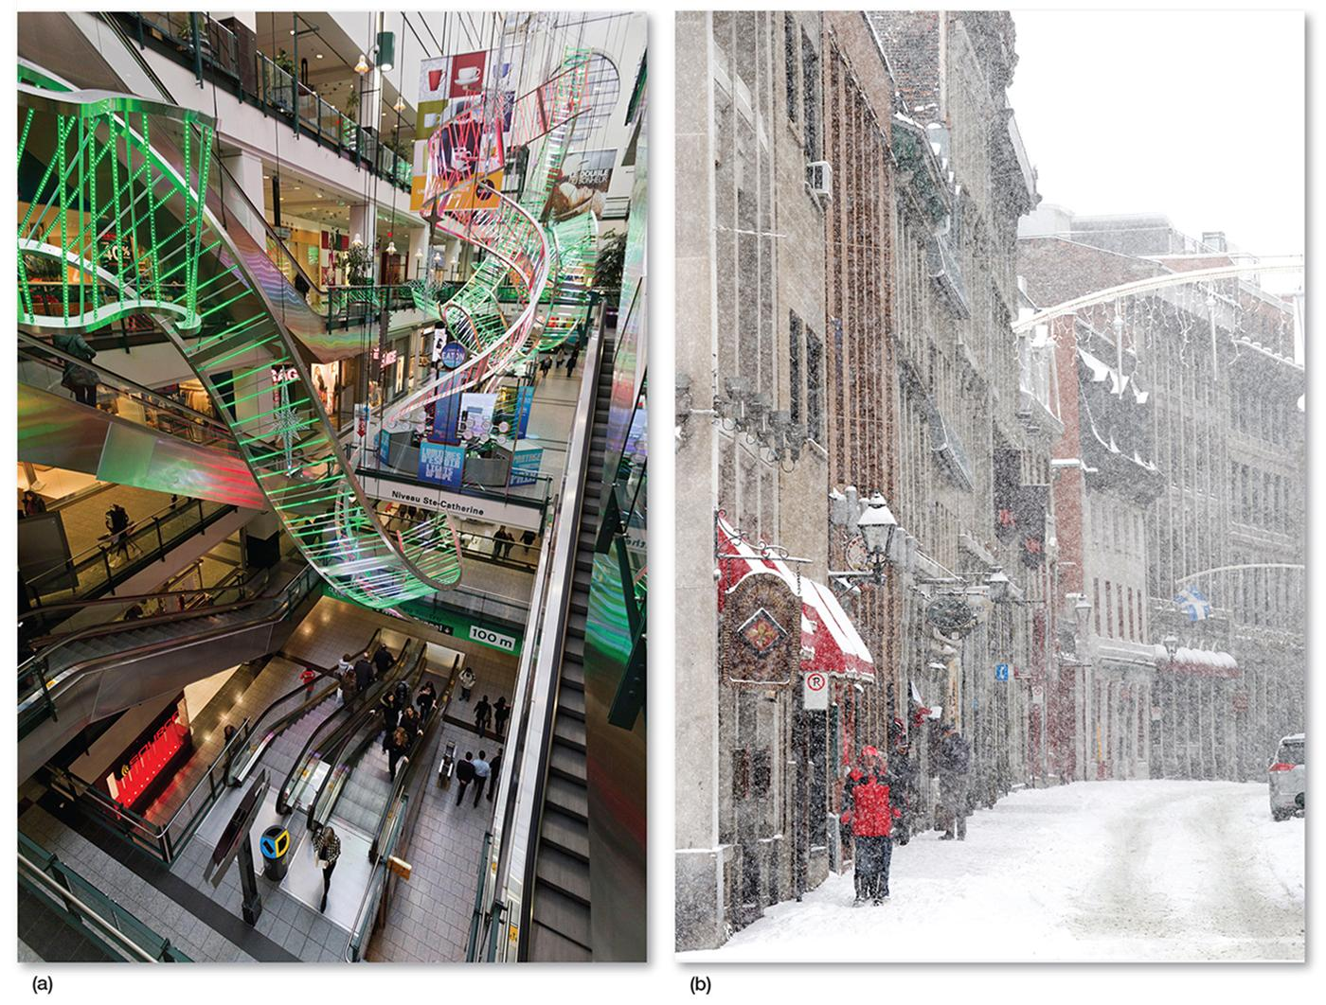
1.3 Underground Montréal
Figure 13-10: Montréal, Canada’s Underground City (a) maximizes the use of land in the city center and allows shoppers to avoid winter weather (b).

Slide 12
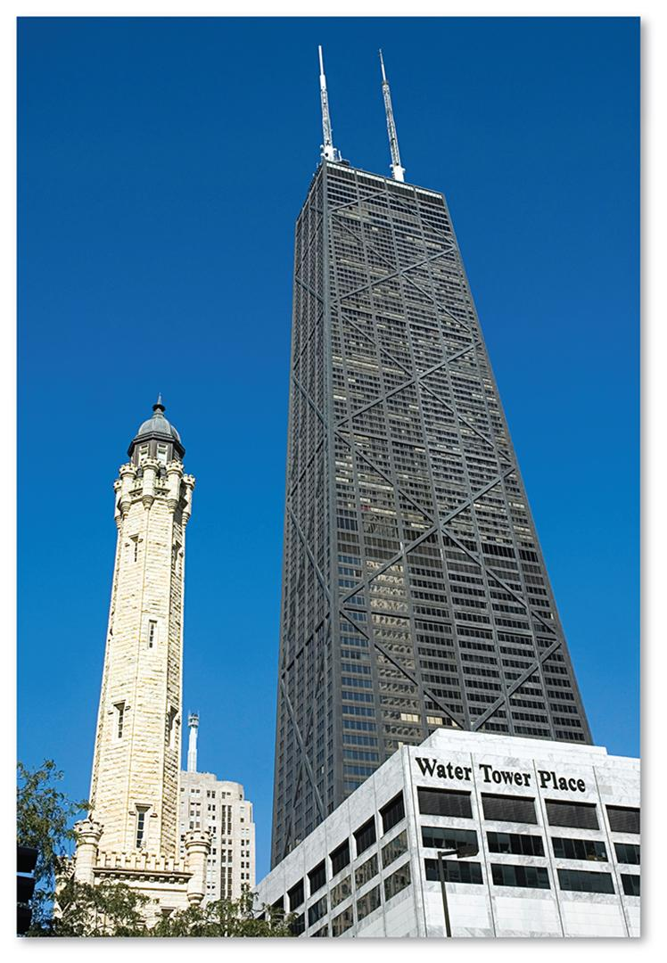
1.3 John Hancock Center, Chicago
Figure 13-11: The John Hancock Center and neighboring buildings have commercial services on the lowest floors, offices on middle floors, and apartments and commercial activities again on the topmost floors.

Slide 13
Key Issue 2: Where Are People Distributed in Urban Areas?
2.1 Models of Urban Structure
2.2 Applying the Models in North America
2.3 Applying the Models in Europe
2.4 Pre-modern Cities in Developing Countries
2.5 Applying the Models in Developing Countries
2.6 Changing Urban Structure of Mexico City

Slide 14
2.1 Models of Urban Structure
Three models developed to explain patterns in cities:
Concentric zone model
Sector model
Multiple nuclei model

Slide 15
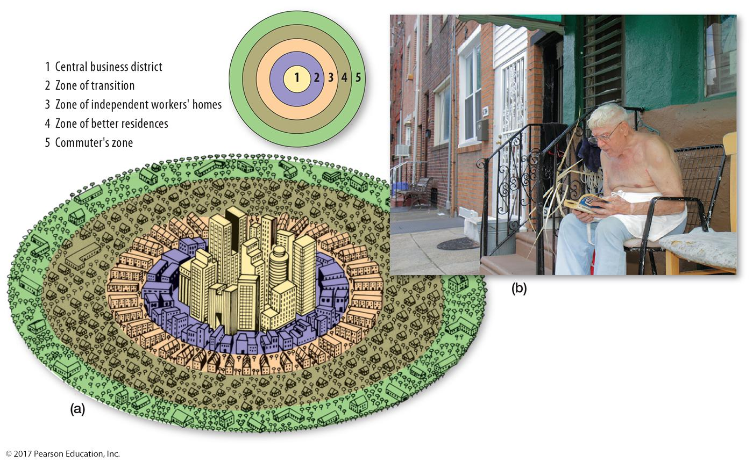
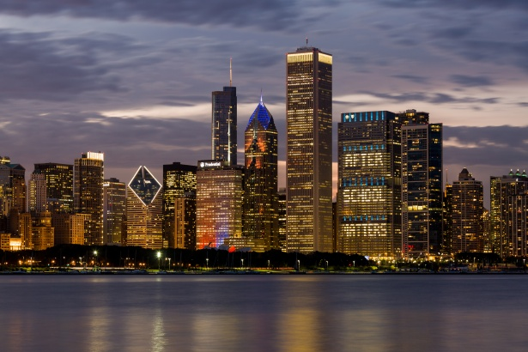
2.1 Concentric Zone Model
Figure 13-12: This model shows the city as a series of concentric rings of different activities like working-class homes in Philadelphia (b), zone number 3 in diagram (a).

Slide 16
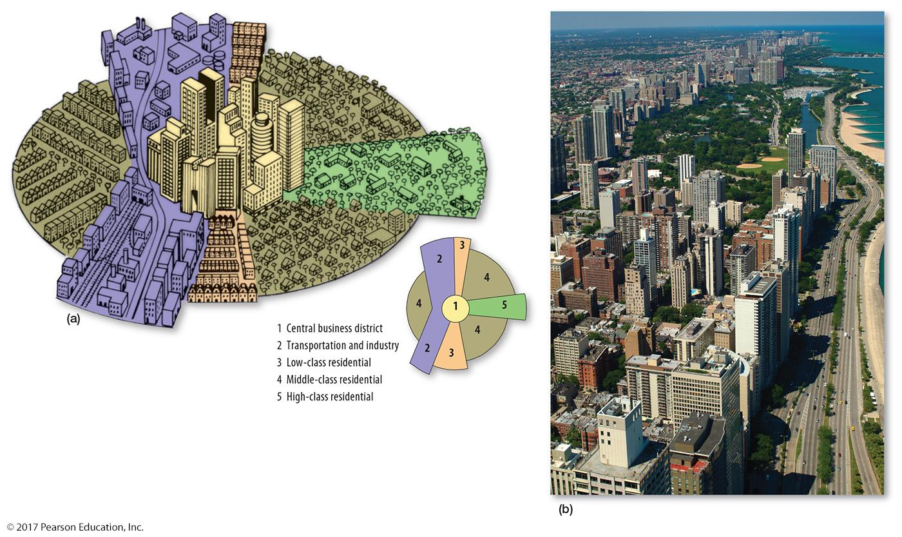
2.1 Sector Model
Figure 13-13: This model shows the city developing with wedges or corridors radiating from the CBD, as seen in Chicago’s strip of high-class residential housing (b).

Slide 17
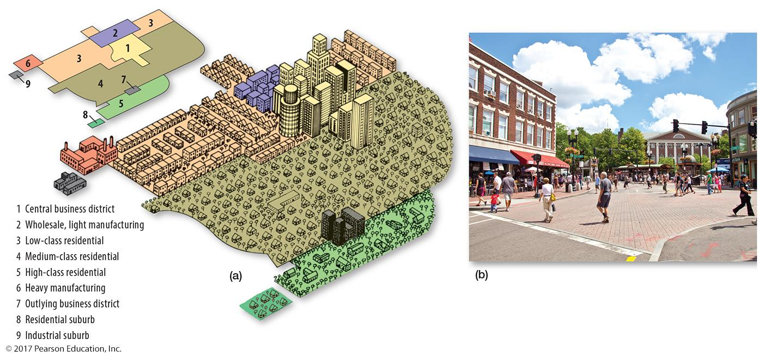
2.1 Multiple Nuclei Model
Figure 13-14: This model displays different activities in different nodes, like Harvard Square serving as a center of services for students in Cambridge, near Boston (b).

Slide 18
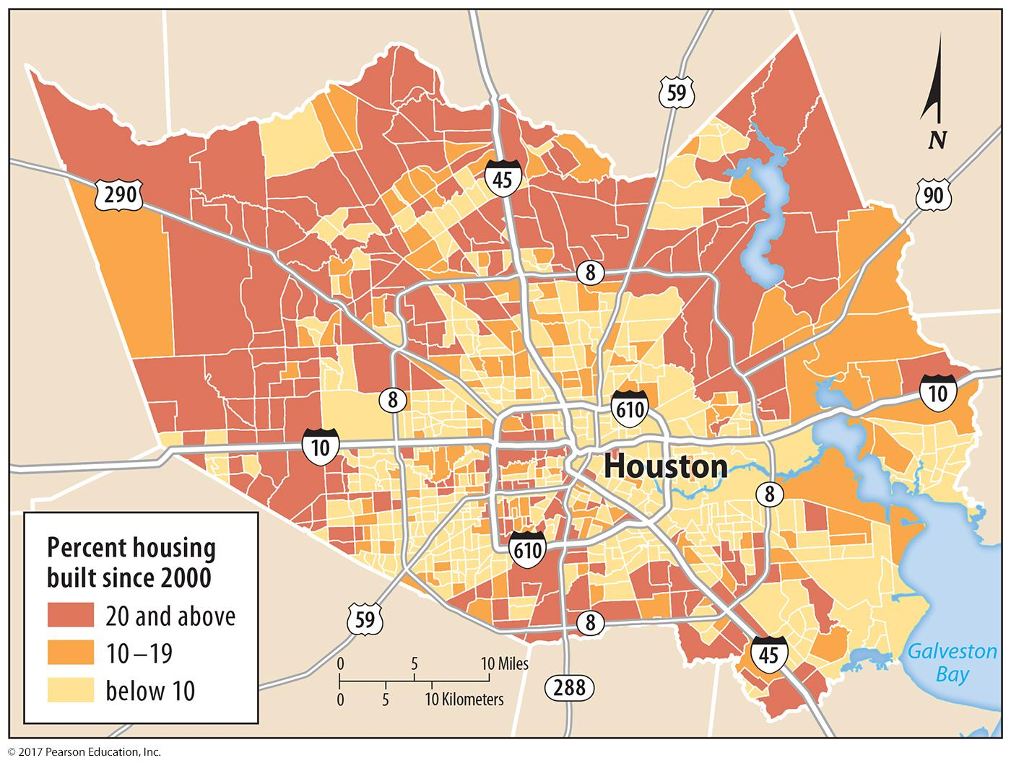
2.2 Applying the Models in North America
Figure 13-15: Examining the age of housing in Houston, Texas, reveals a concentric pattern.

Slide 19
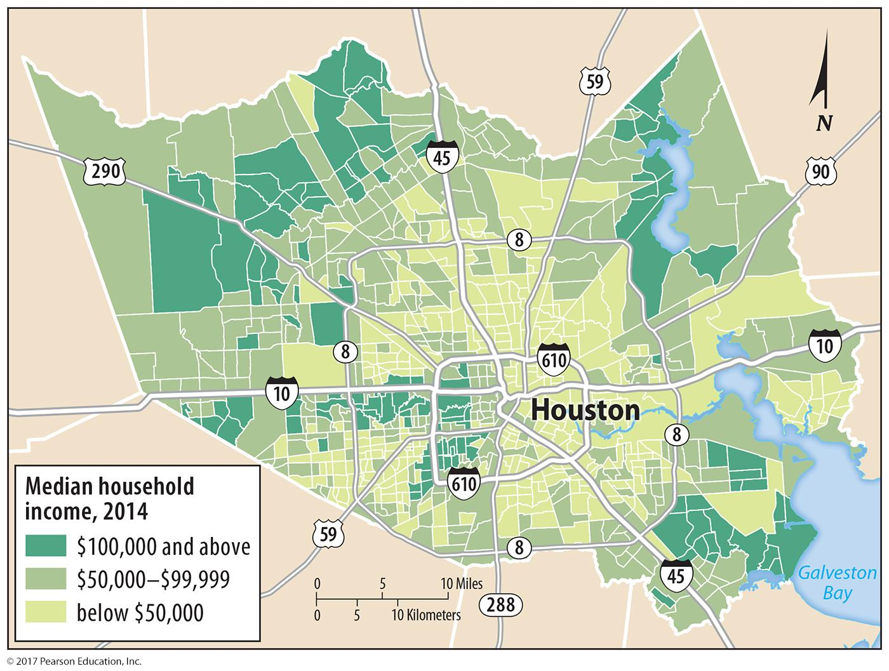
2.2 Applying the Models in North America
Figure 13-16: Examining the median income in Houston, Texas, reveals a sector pattern.

Slide 20
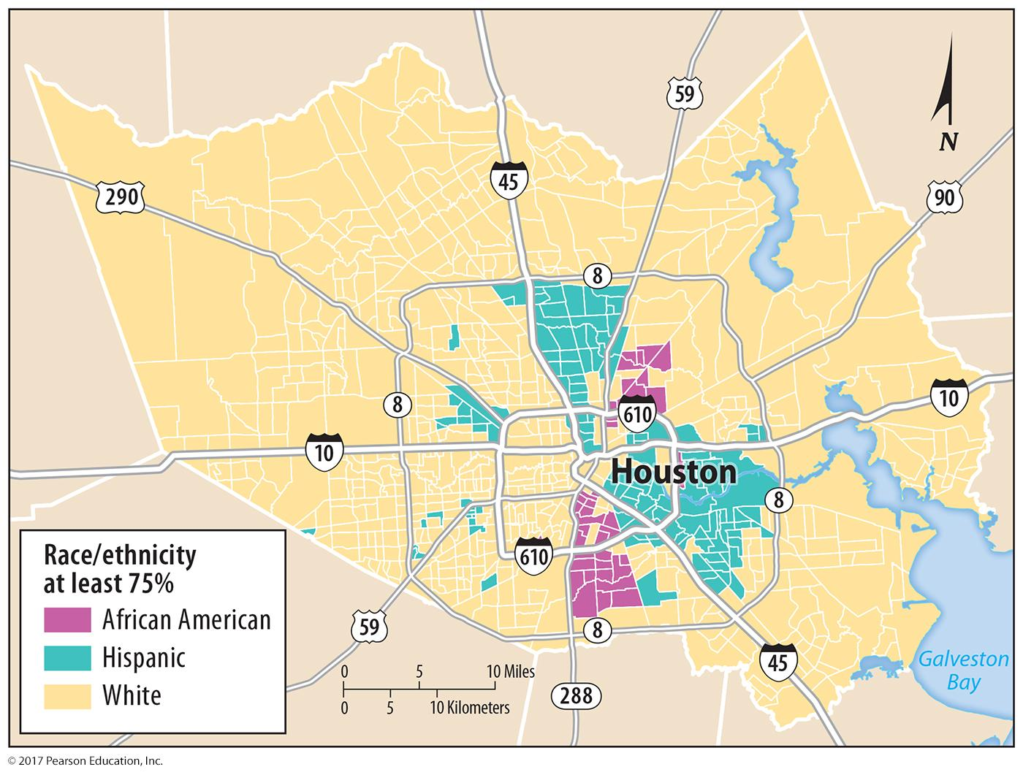
2.2 Applying the Models in North America
Figure 13-17: Examining the distribution of ethnicities in Houston, Texas, reveals multiple nuclei.

Slide 21
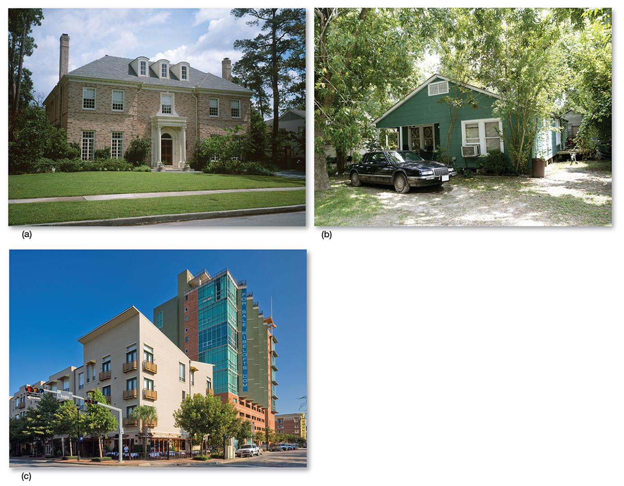
2.2 Considering Multiple Models
Figure 13-18: (a) represents a newly built ring in a high-income sector; (b) is a house in the same ring but lower income, and (c) is in the same high-income sector as (a) but nearer to the CBD.

Slide 22
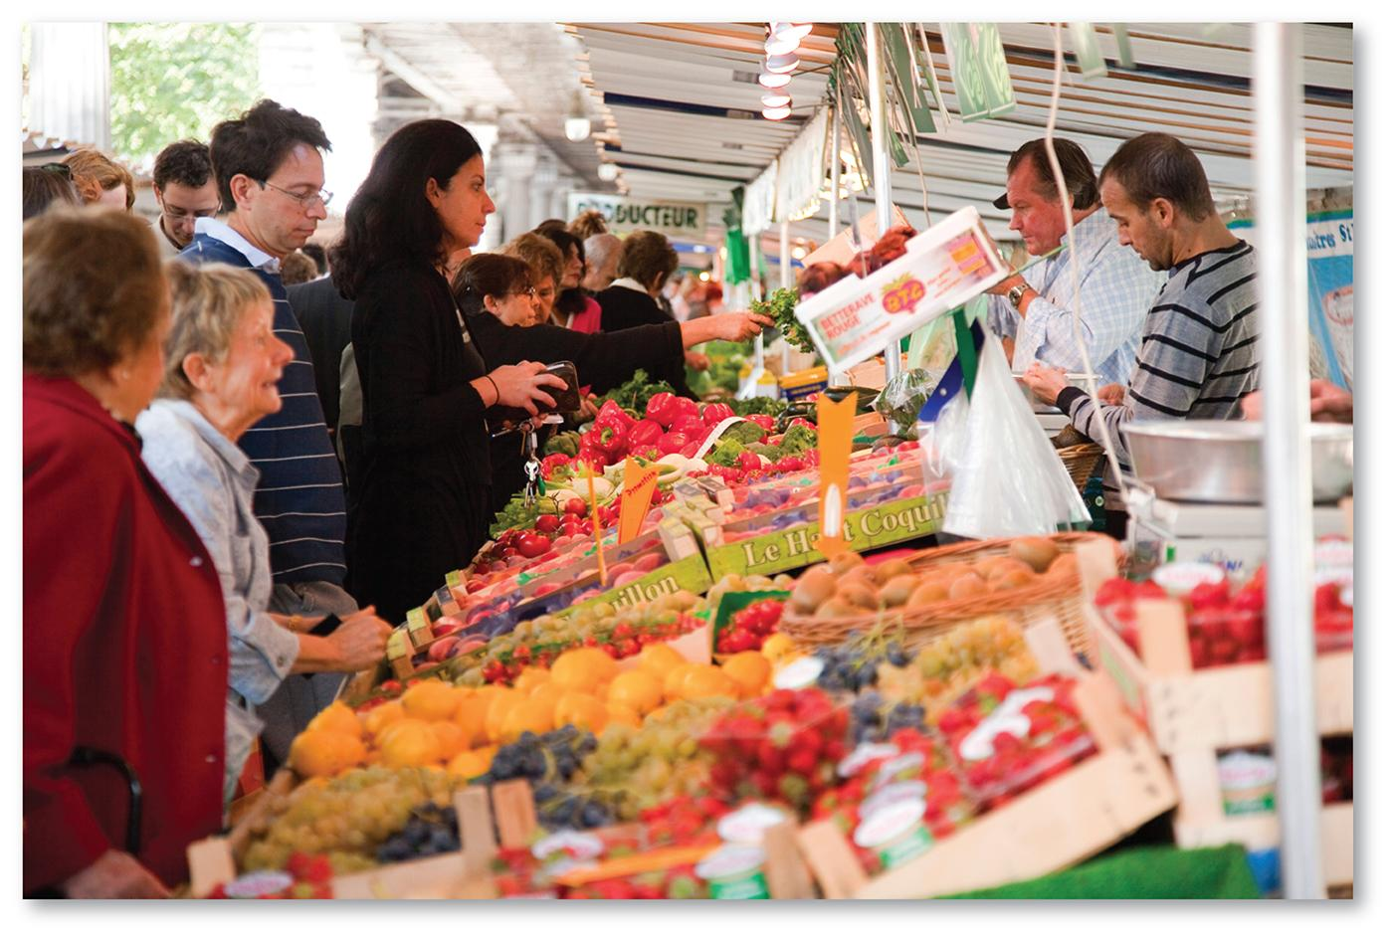
2.3 Applying the Models in Europe
Figure 13-19: A street market in Paris reflects the higher number of wealthy residents in and near the CBD when compared to North America.

Slide 23
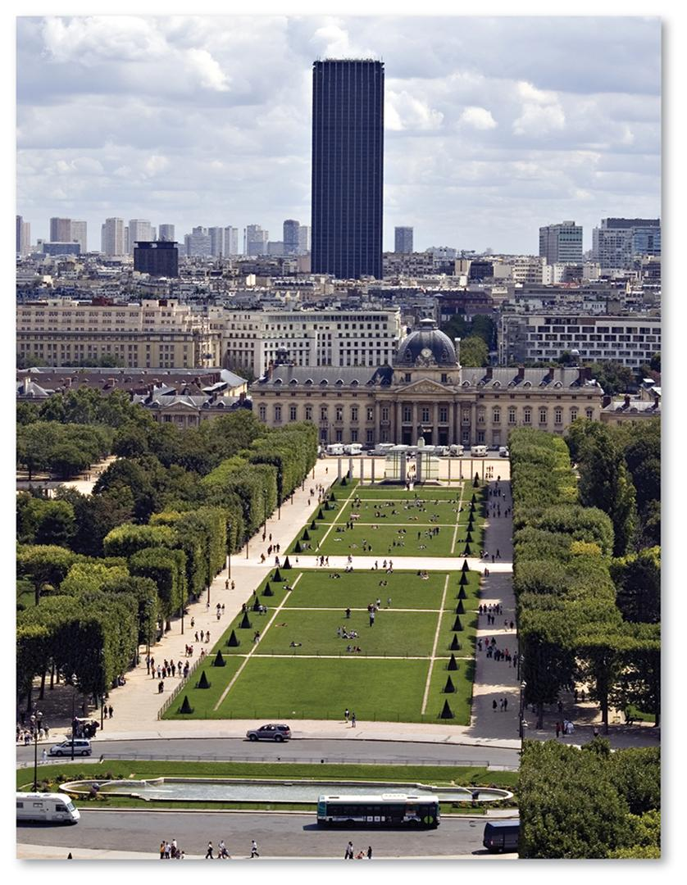
2.3 Applying the Models in Europe
Figure 13-20: Like many other European cities, Paris does not have many skyscrapers; the one in this photo was so unpopular when built that no others were allowed.

Slide 24
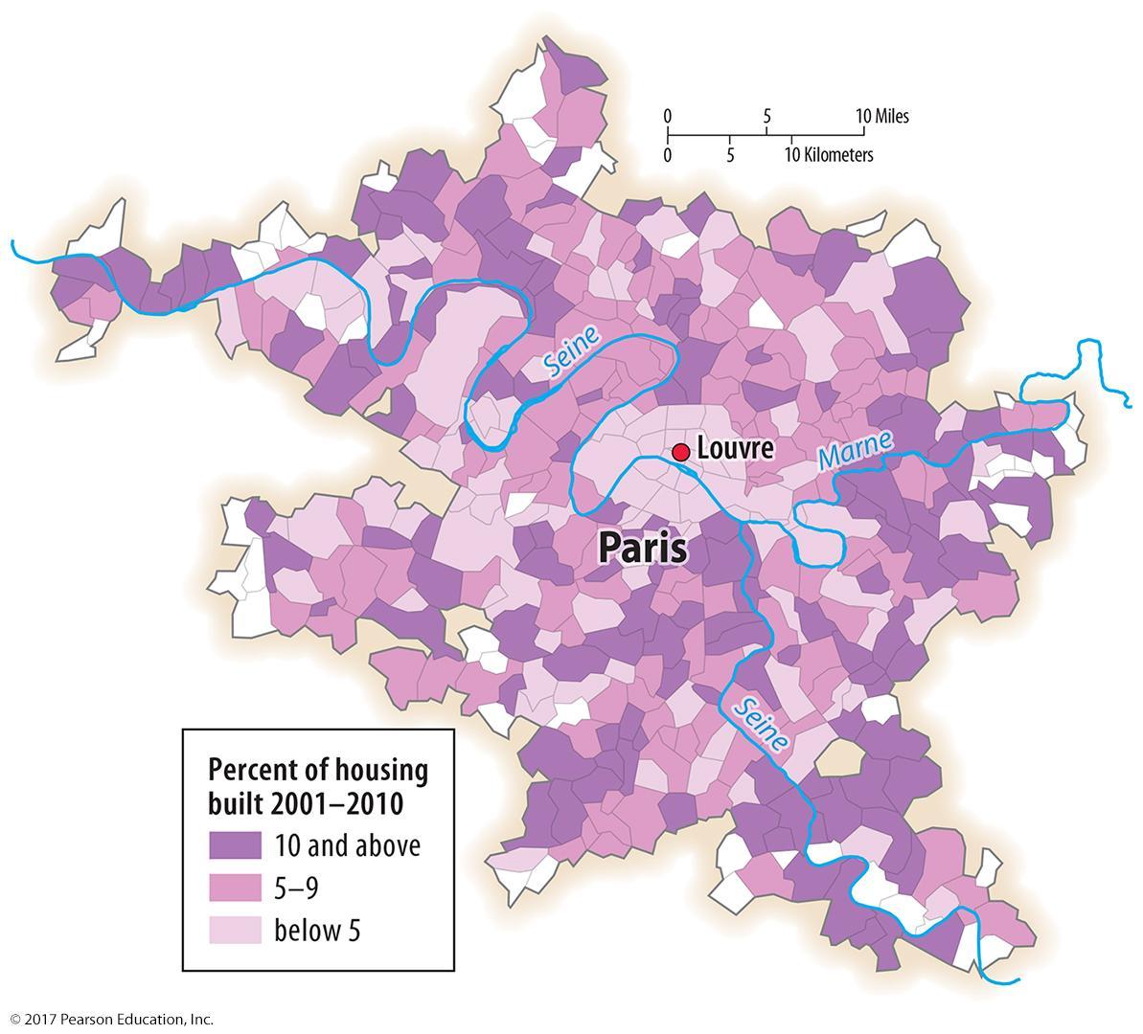
2.3 Applying the Models in Europe
Figure 13-21: Age of housing in Paris follows a concentric zone model.

Slide 25
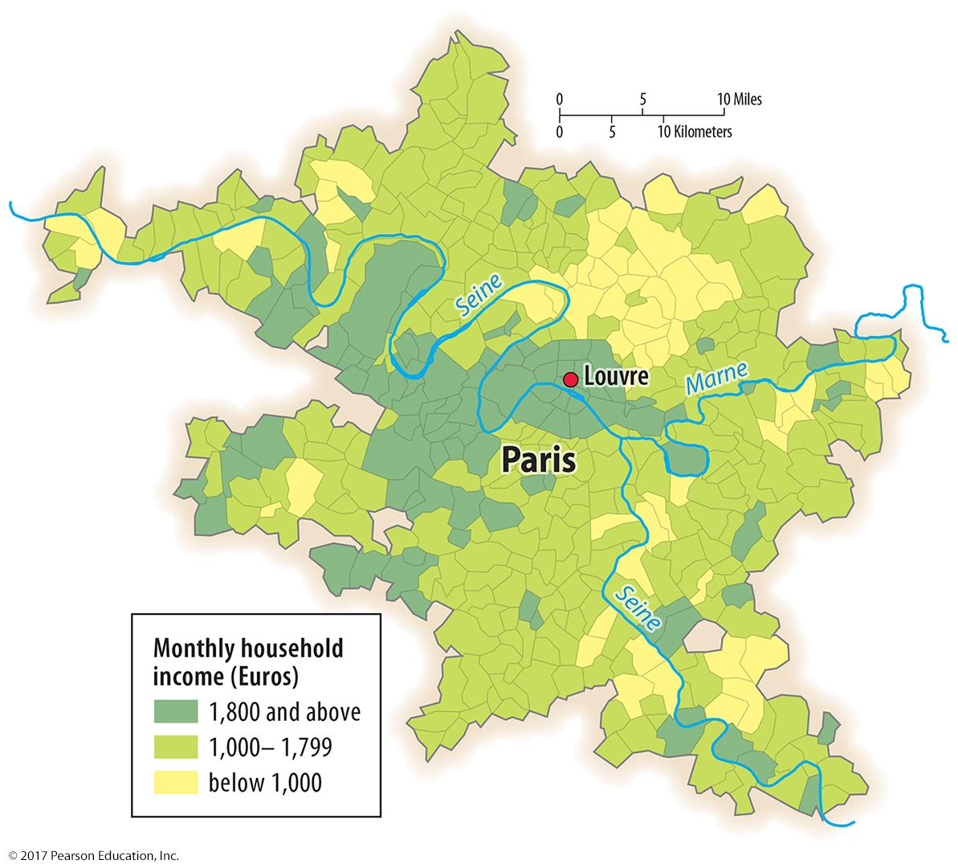
2.3 Applying the Models in Europe
Figure 13-22: Household income in Paris follows a sector model.

Slide 26
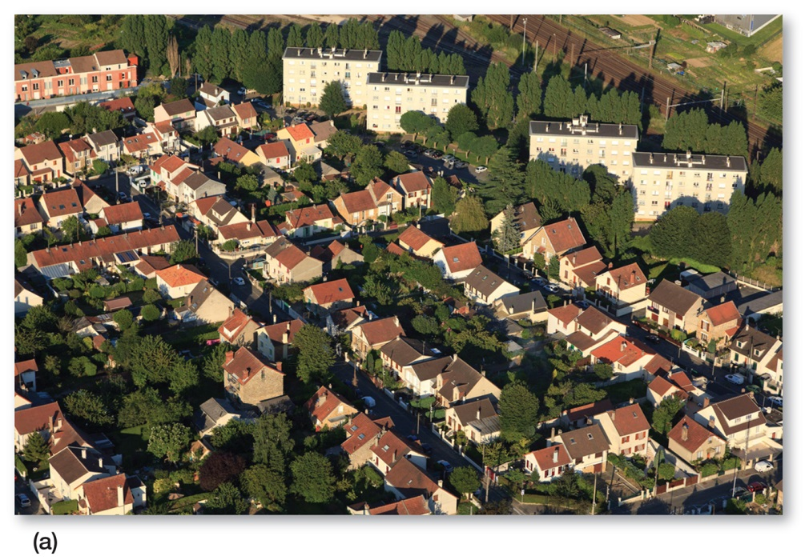
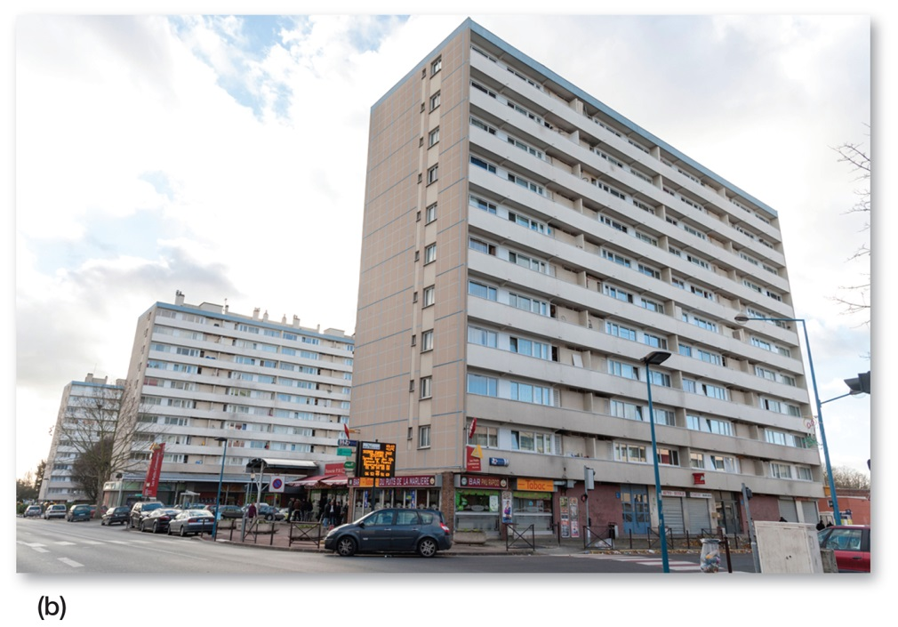
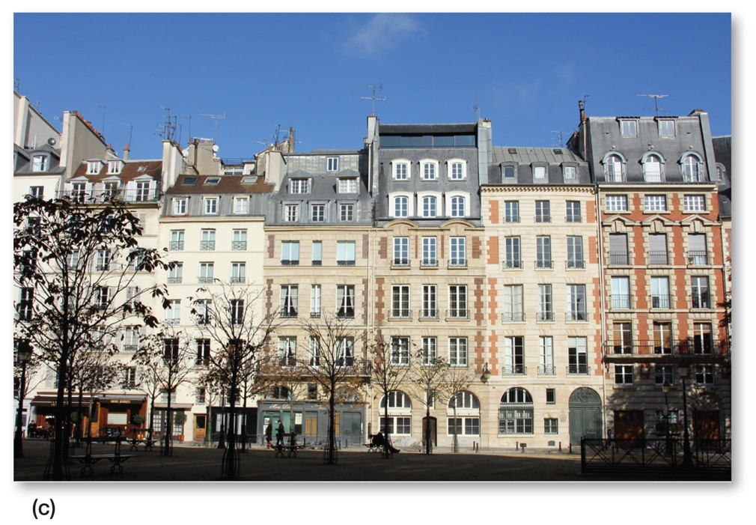
2.3 Applying the Models in Europe
Figure 13-23: (a) housing in the outer (newer) ring in a high-income sector; (b) apartments in the same ring as (a) but lower income sector; and (c) housing in the same high-income sector as (a) but inner (older) ring

Slide 27
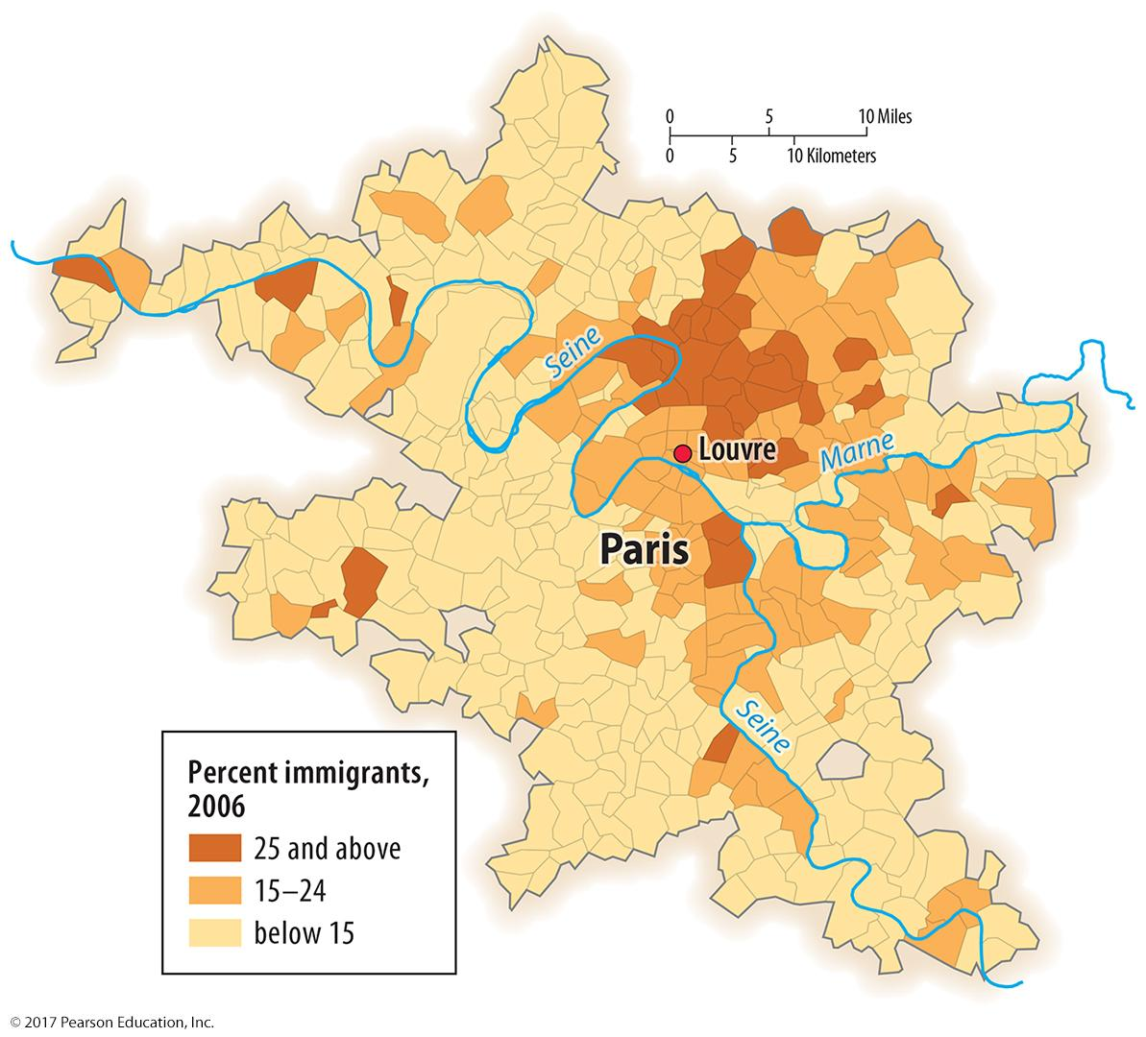
2.3 Applying the Models in Europe
Figure 13-24: Immigrant neighborhoods in Paris follow a multiple nuclei model.

Slide 28
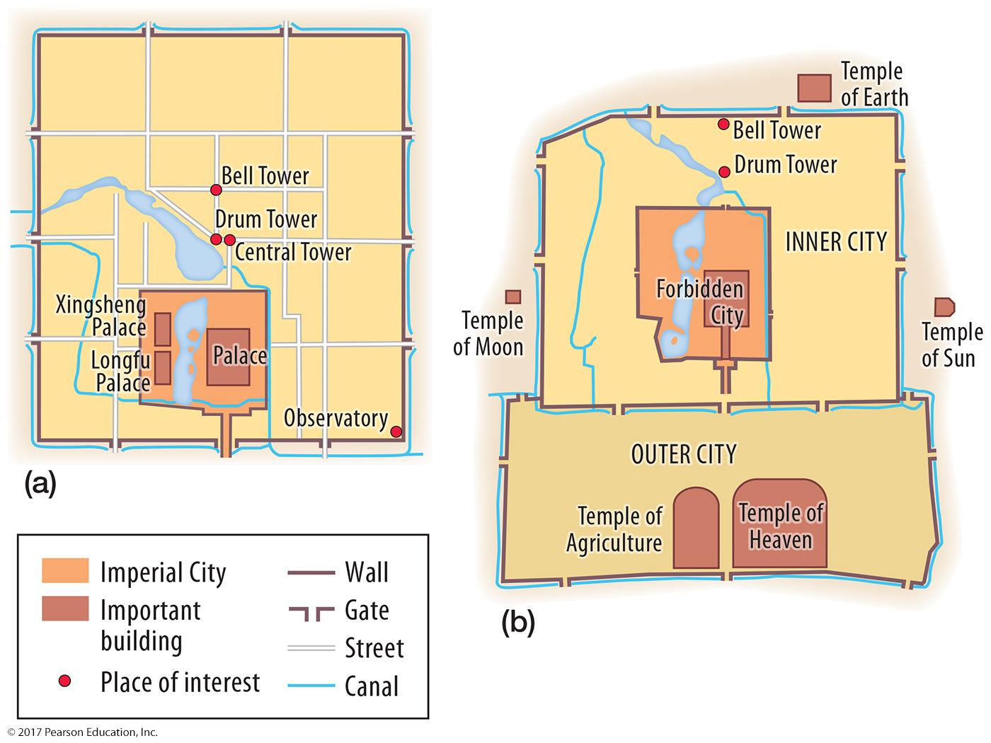
2.4 Pre-modern Cities in Developing Countries: Beijing
Figure 13-25: (a) Dadu in the Yuan dynasty, A.D. 1267–1368, (b) renamed Beijing in the Ming Dynasty, 1368–1644, featured palaces in the center and double walls

Slide 29
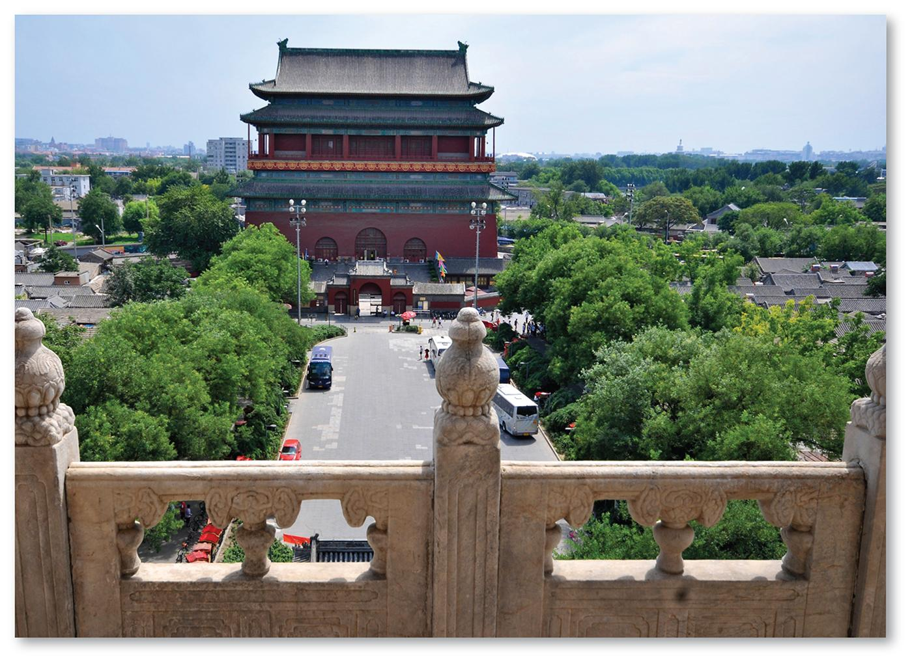
2.4 Yuan Dynasty Beijing
Figure 13-26: The Drum Tower was the center of Dadu, the city that became Beijing.

Slide 30
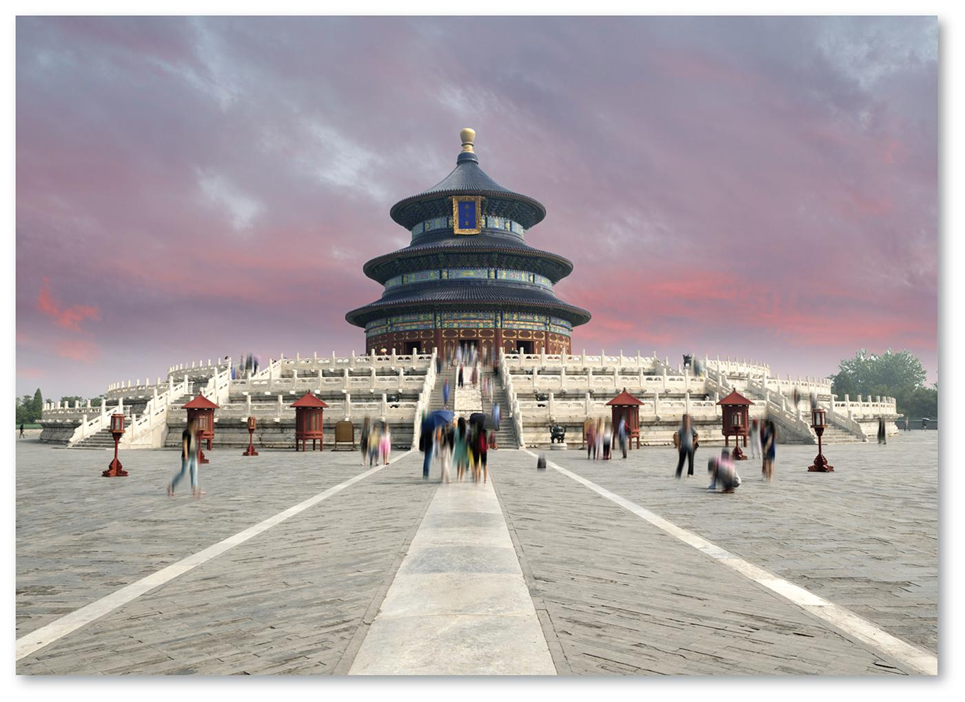
2.4 Ming Dynasty Beijing
Figure 13-27: The Temple of Heaven was built in the outer city of Beijing in the 1400s.

Slide 31
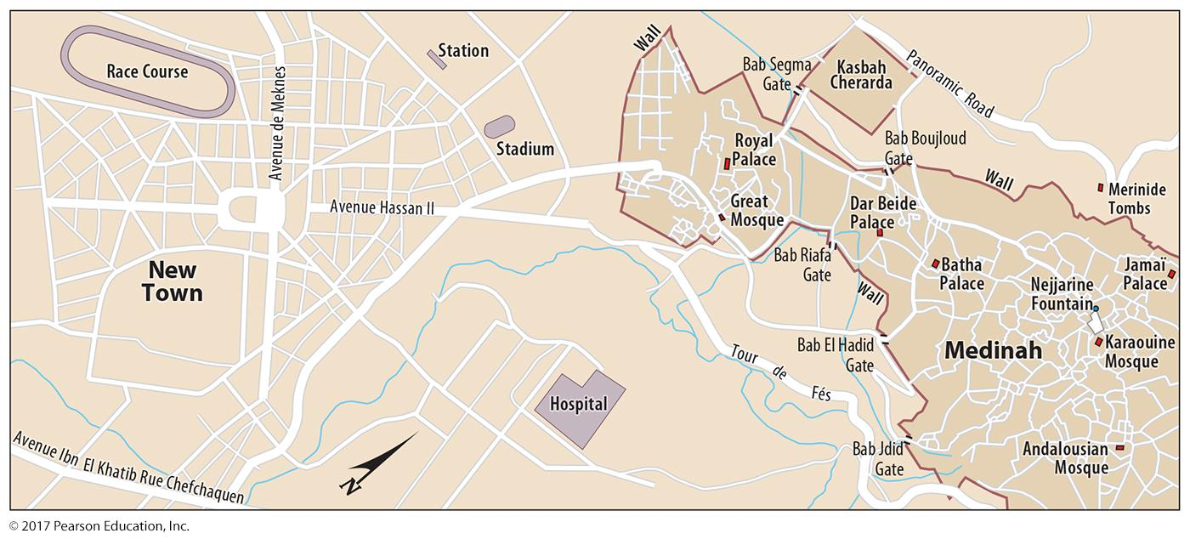
2.4 Colonial Legacies: Fez, Morocco
Figure 13-28: French colonial authorities built a new town to the southwest of the precolonial city of Fez, Morocco. Compare the street density and pattern between sections.

Slide 32
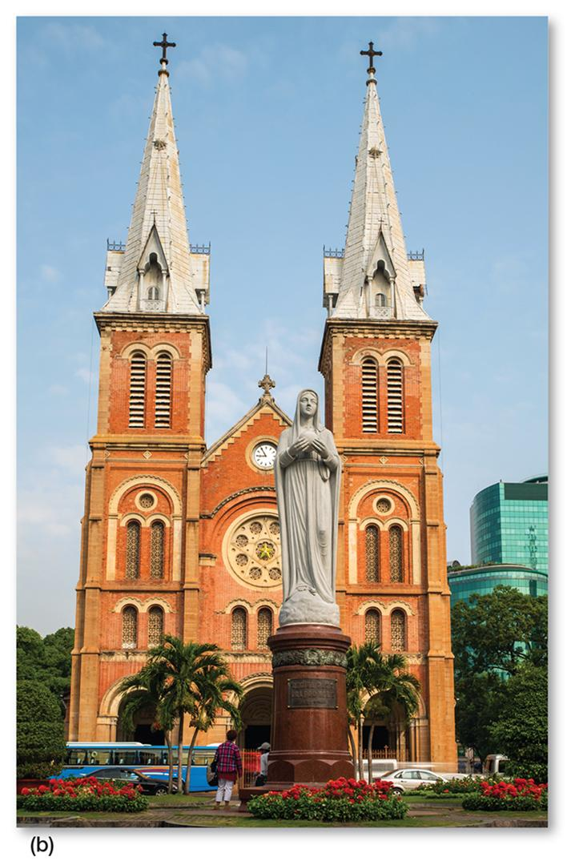
2.4 Colonial Legacies: Ho Chi Minh City
Figure 13-30: In Vietnam, French colonial authorities demolished the old city and imposed their own ideals of urban form (a), including buildings like the Cathedral of Notre Dame (b).

Slide 33
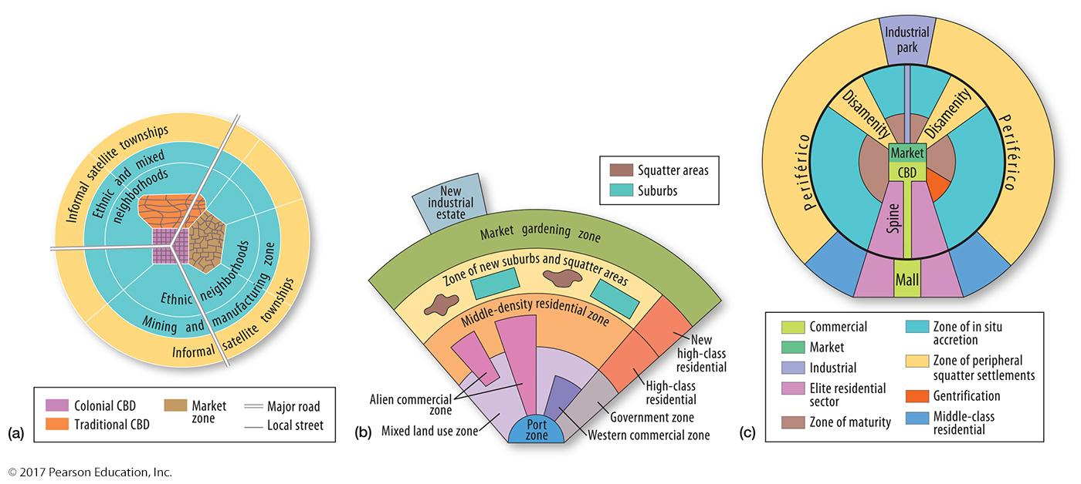
2.5 Applying the Models in Developing Countries
Figure 13-31: Models of urban structure have been adapted to fit different developing countries. In (a), the concentric zone model was modified by de Blij to model cities in sub-Saharan Africa; in (b), McGee modeled a Southeast Asian city with multiple nuclei, and in (c) Griffin-Ford applied a sector model to Latin American cities.

Slide 34
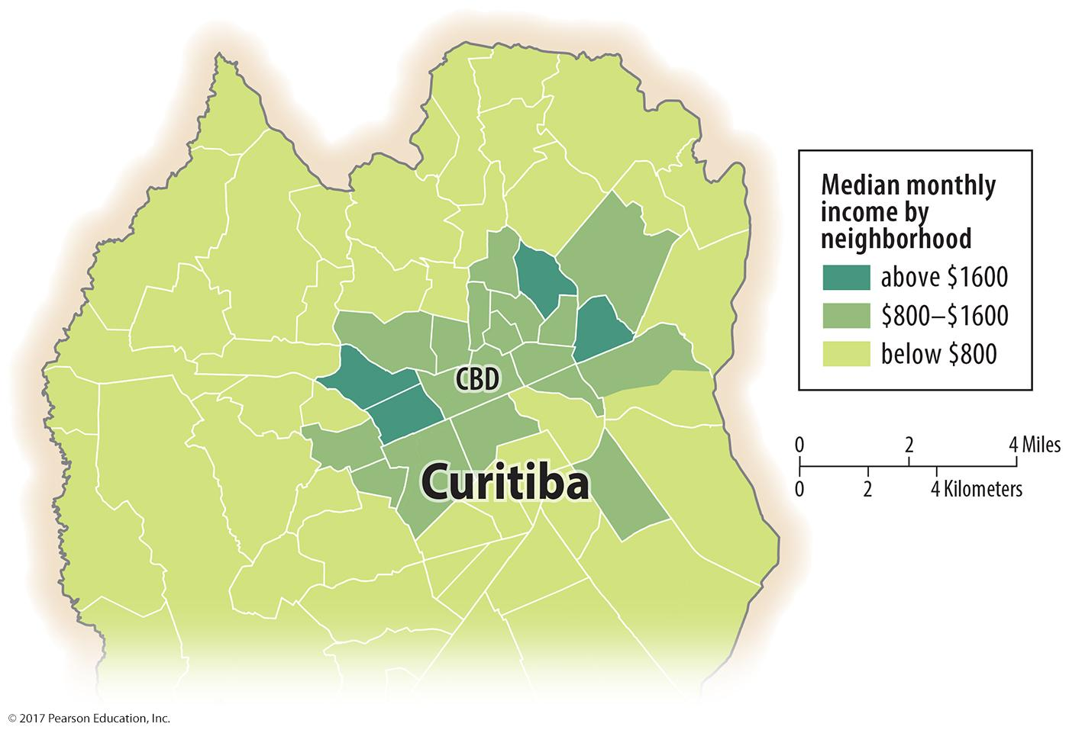
2.5 Concentric Zones in Curitiba, Brazil
Figure 13-32: Curitiba’s income follows a concentric zone model.

Slide 35
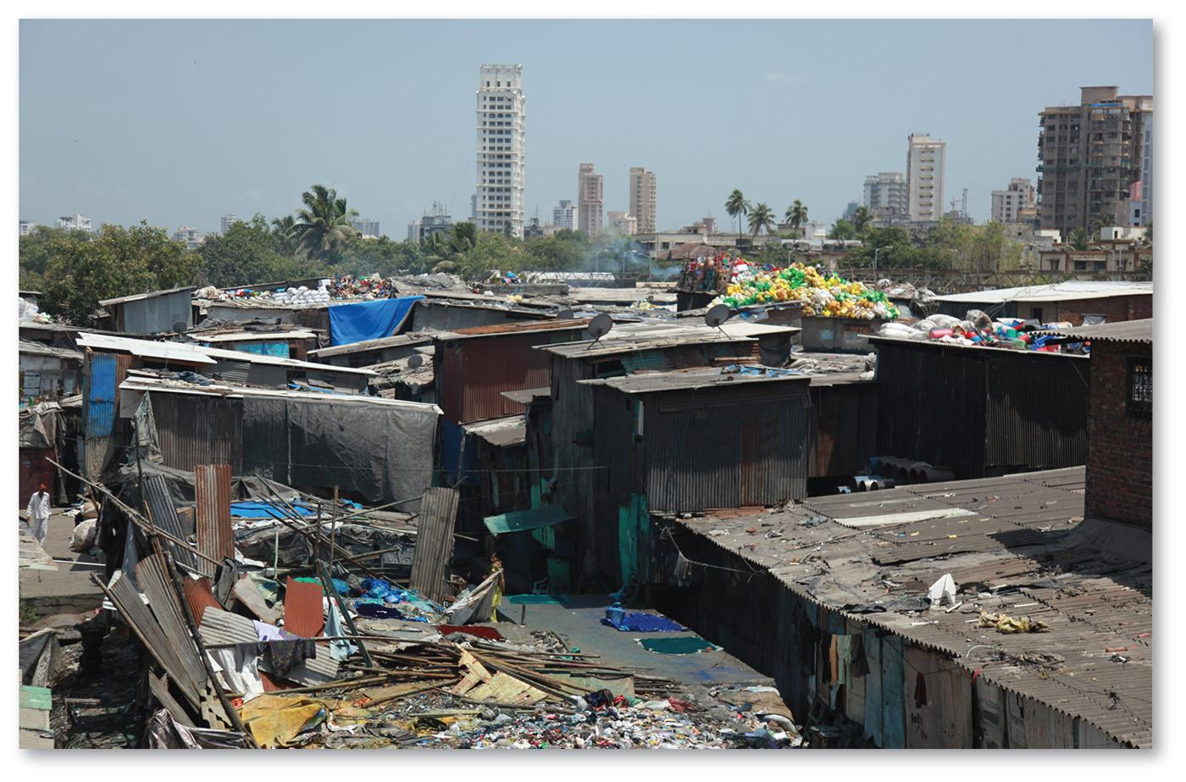
2.5 Informal Settlements
Figure 13-33: Informal settlements are frequently found in large urban settlements in developing countries.

Slide 36
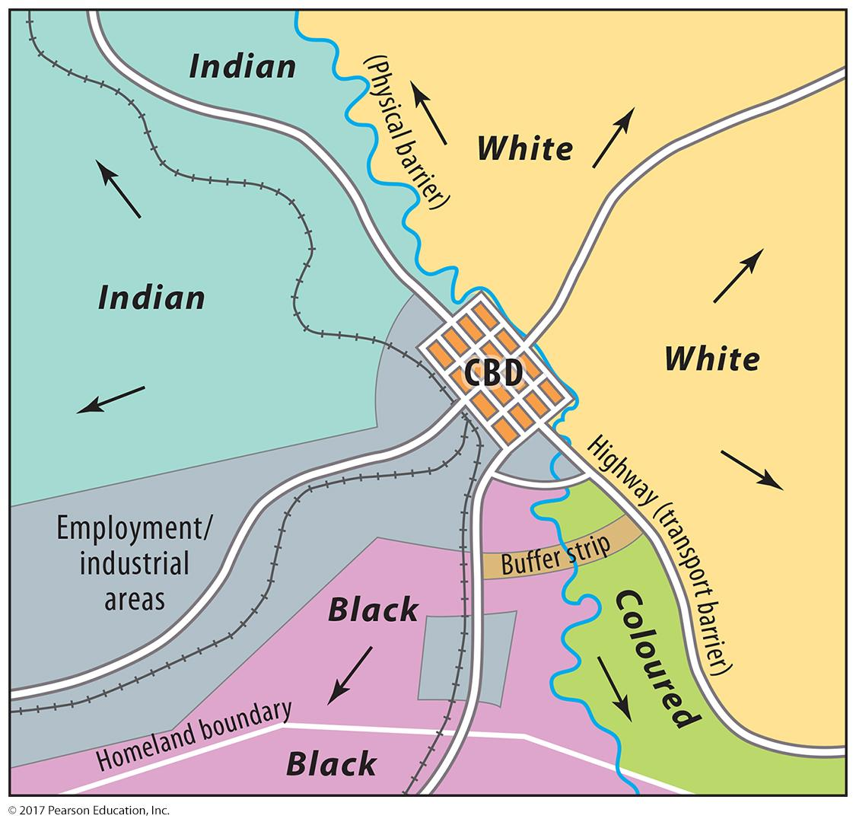
2.5 Multiple Nuclei in South Africa
Figure 13-34: The division of races in Pietermaritzburg under apartheid followed a multiple nuclei model.

Slide 37
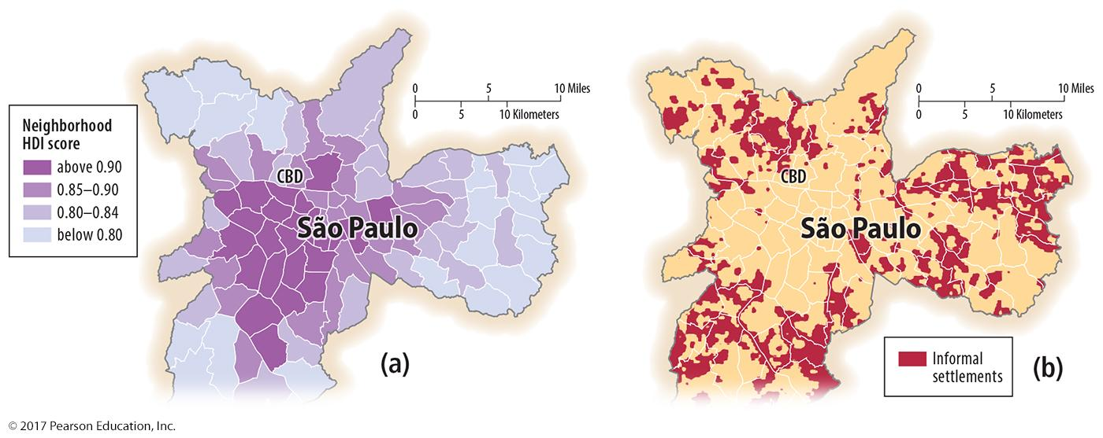
2.5 Sectors and Concentric Zones in Brazil
Figure 13-35: São Paulo’s development (a) follows a sector model, while informal settlements (b) occur in a concentric zone away from the center.

Slide 38
2.6 Changing Urban Structure in Mexico City
Three stages of development/form:
Precolonial Tenochtitlán: island in Lake Texcoco
Colonial Mexico City: demolished, rebuilt in Spanish model
Since independence: rapid growth

Slide 39
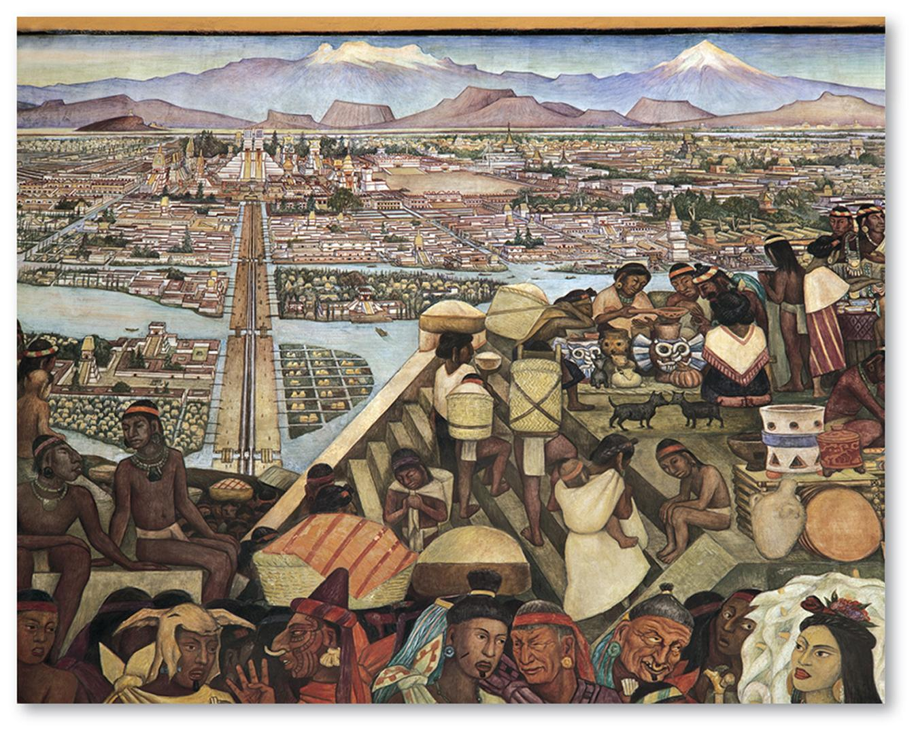
2.6 Pre-colonial Mexico City
Figure 13-36: The site of Tenochtitlán was an island in a lake and marsh.

Slide 40
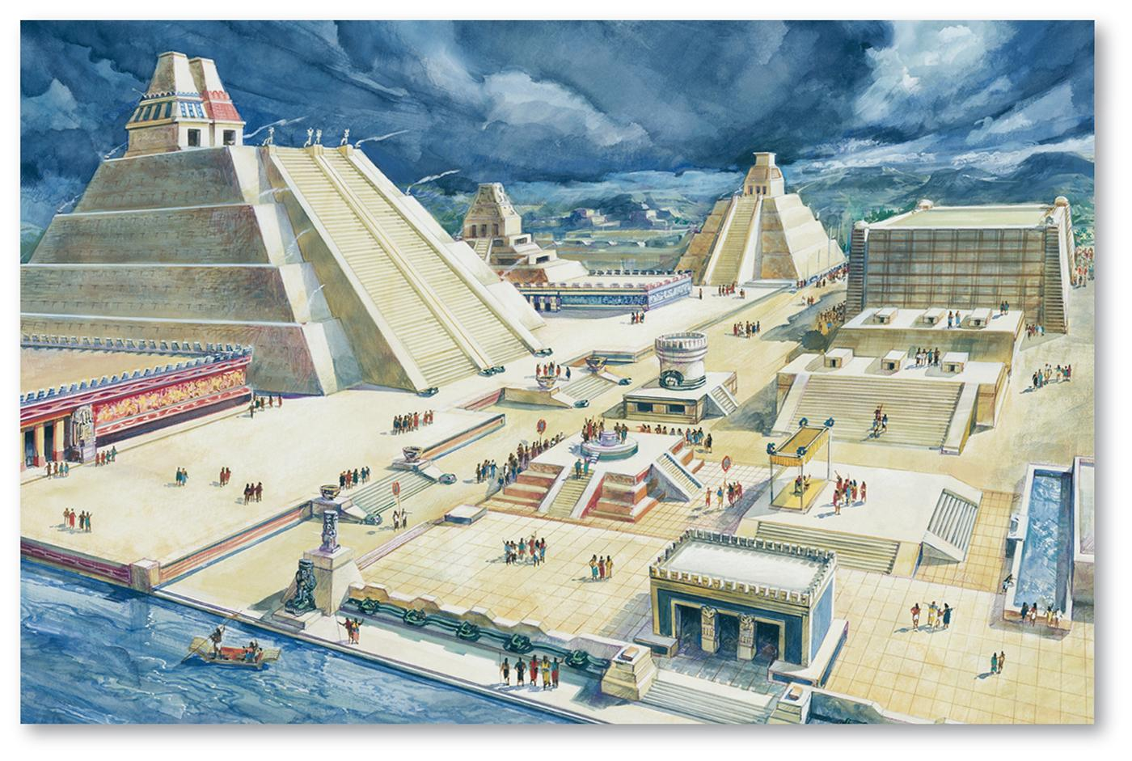
2.6 Pre-colonial Mexico City
Figure 13-37: The center of Tenochtitlán held the Templo Mayor and shrines.

Slide 41
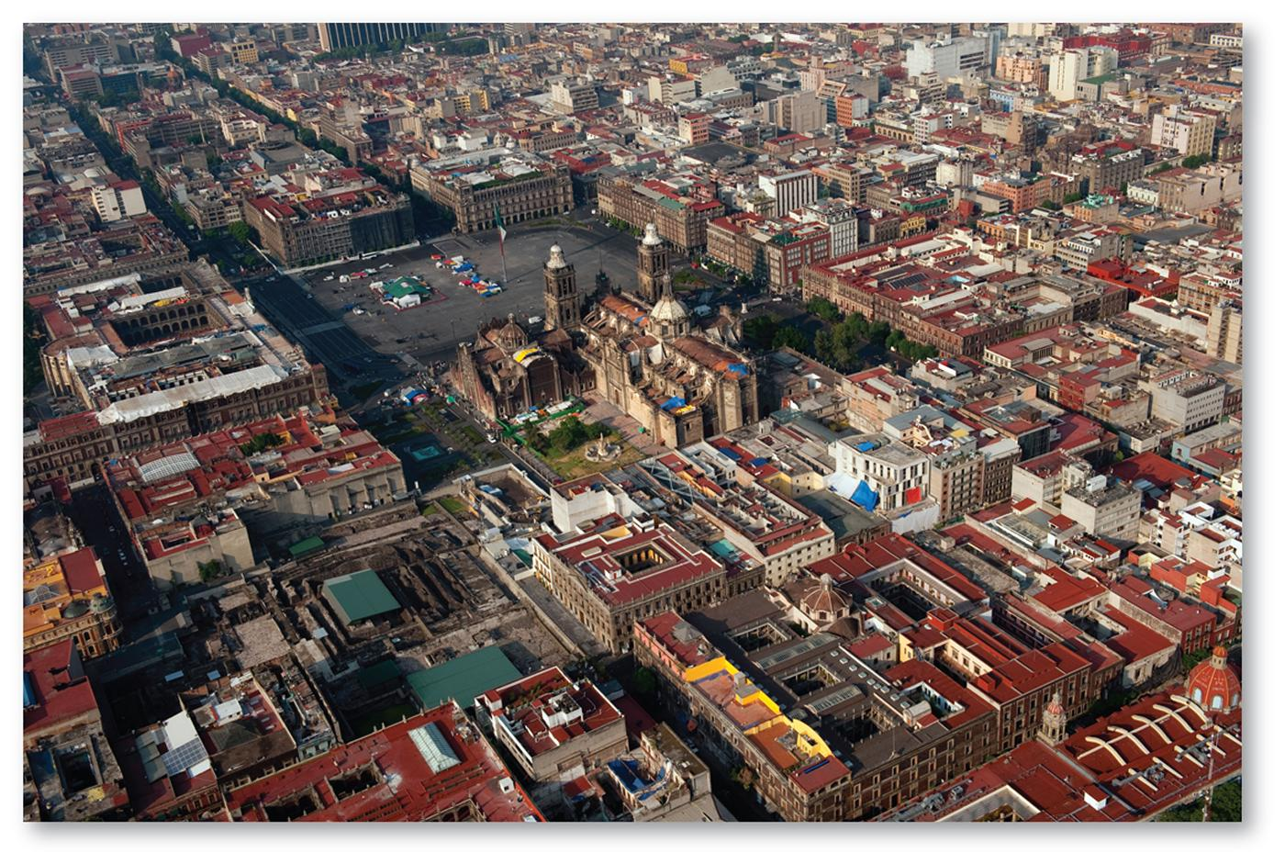
2.6 Colonial Mexico City
Figure 13-38: The center of colonial Mexico City was the main square, located near the site of the demolished Templo Mayor.

Slide 42
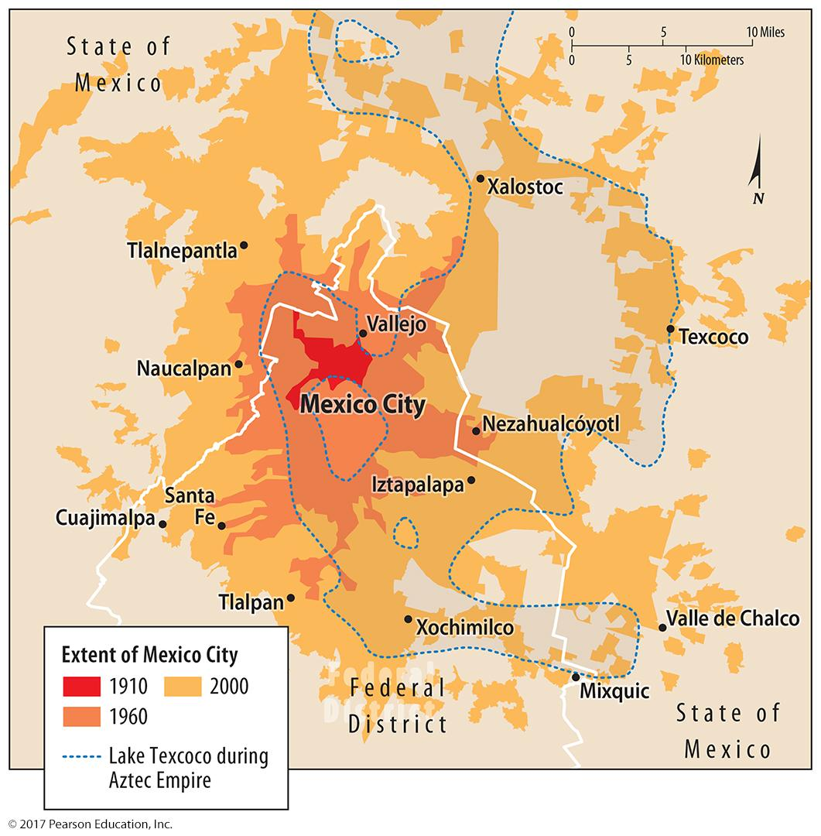
2.6 Modern Mexico City
Figure 13-39: Mexico City has grown rapidly in the last century.

Slide 43
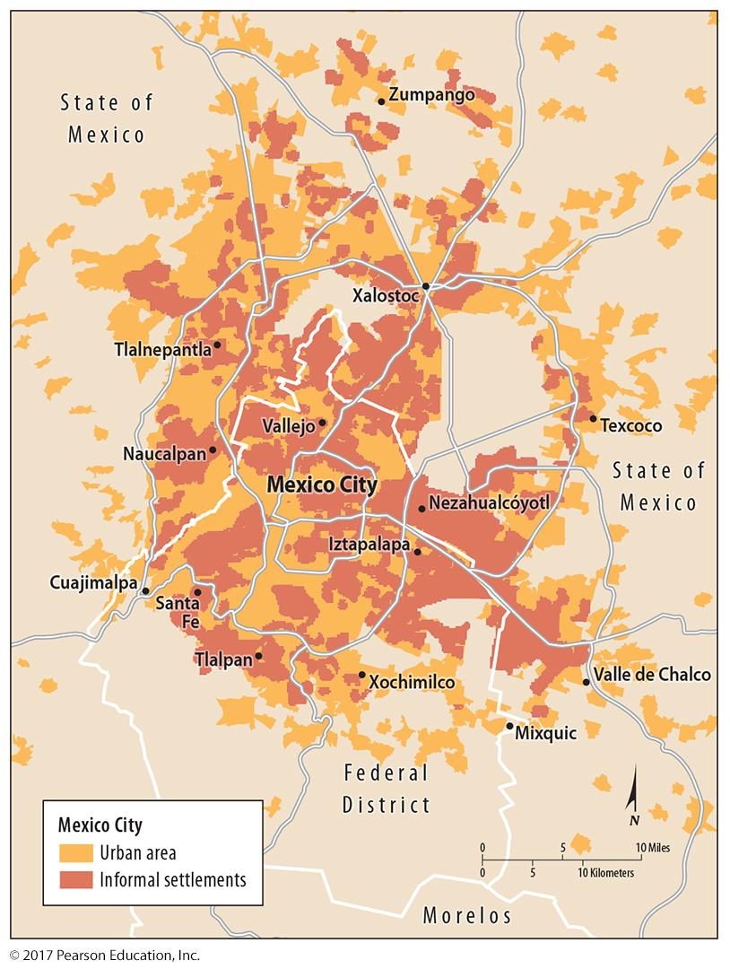
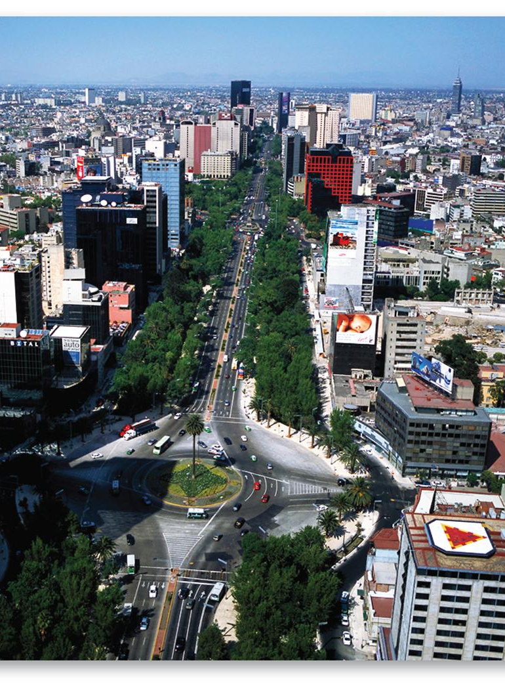
2.6 Modern Mexico City
Figures 13-40 and 13-41: Mexico City’s informal settlements are in an outer ring (left). The Paseo de la Reforma represents a wealthy sector extending out from the city center (right).

Slide 44
Key Issue 3: Why Do Urban Areas Expand?
3.1 Origin and Growth of Suburbs
3.2 Suburban Sprawl
3.3 Suburban Segregation
3.4 Legacy of Public Transport
3.5 Reliance on Motor Vehicles

Slide 45
3.1 Origin and Growth of Suburbs
Suburb: urban residential area outside central city
Annexation: legally adding land to a city
once popular
now common for peripheral areas to organize own municipalities
Issues:
local government fragmentation
smart growth

Slide 46
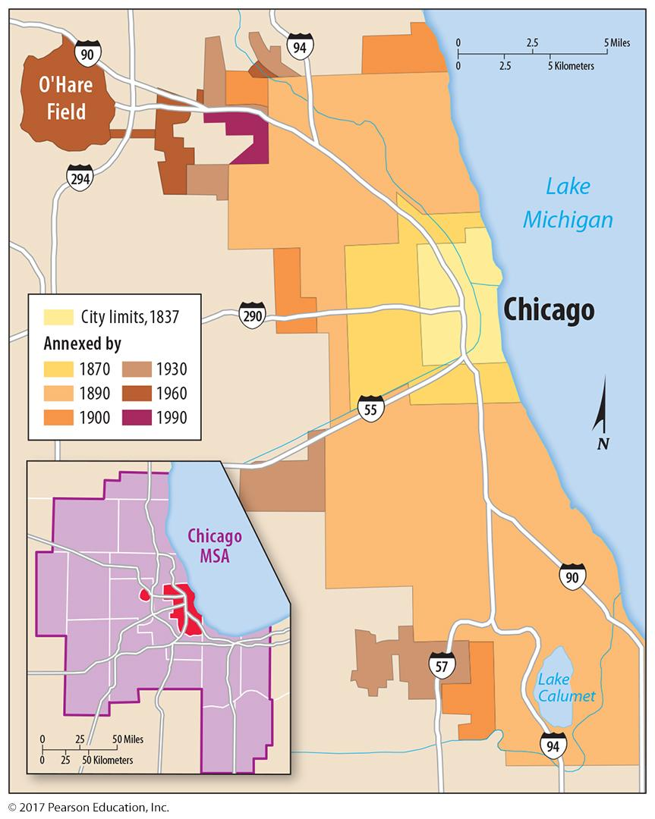
3.1 Annexation in Chicago
Figure 13-42: Chicago’s annexation of surrounding areas was rapid in the 1800s, but slowed in the 1900s.

Slide 47
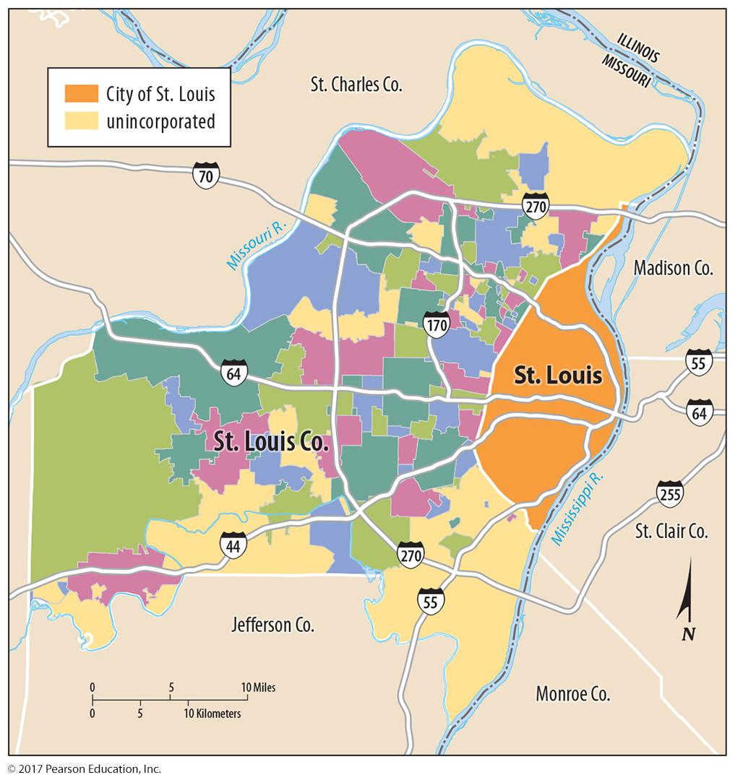
3.1 Municipalities in St. Louis County
Figure 13-43: Instead of the possibility of being annexed by St. Louis, many residents of St. Louis County have incorporated their own municipalities.

Slide 48
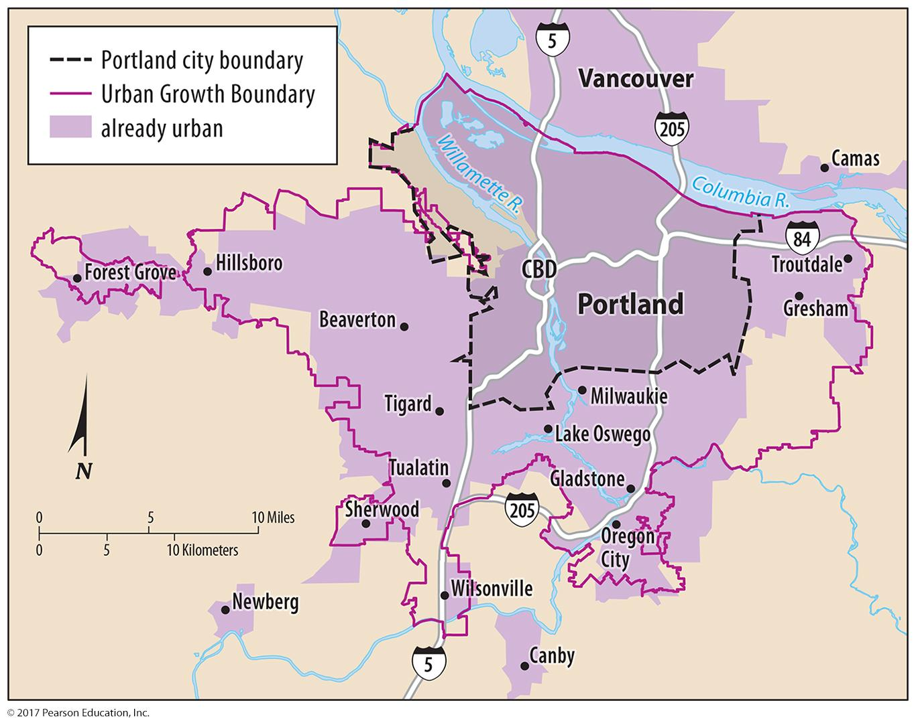
3.1 Portland Urban Growth Boundary
Figure 13-44: New development must take place inside Portland, Oregon’s urban growth boundary.

Slide 49
3.2 Suburban Sprawl
Sprawl: relatively low-density suburbs, not contiguous with city
Peripheral model: variation on multiple nuclei model
Density gradient: changing from urban core to periphery
Megalopolis: continuous area of urbanization in Northeast United States

Slide 50
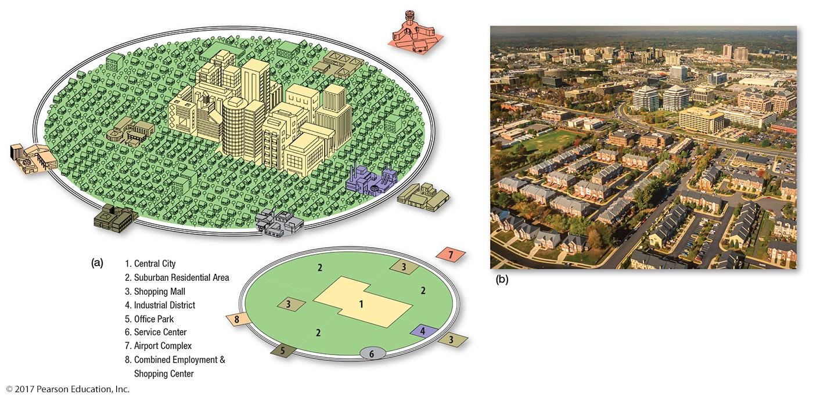
3.2 Peripheral Model
Figure 13-45: The peripheral model is similar to the multiple nuclei model, with more area devoted to suburbs and nuclei including edge cities linked by a ring road.

Slide 51
3.2 Density Gradient in Cleveland
Figure 13-46: In 1900, Cleveland had a strong density gradient, with high densities at the center and low densities farther out. Suburbanization flattened that density gradient.

Slide 52
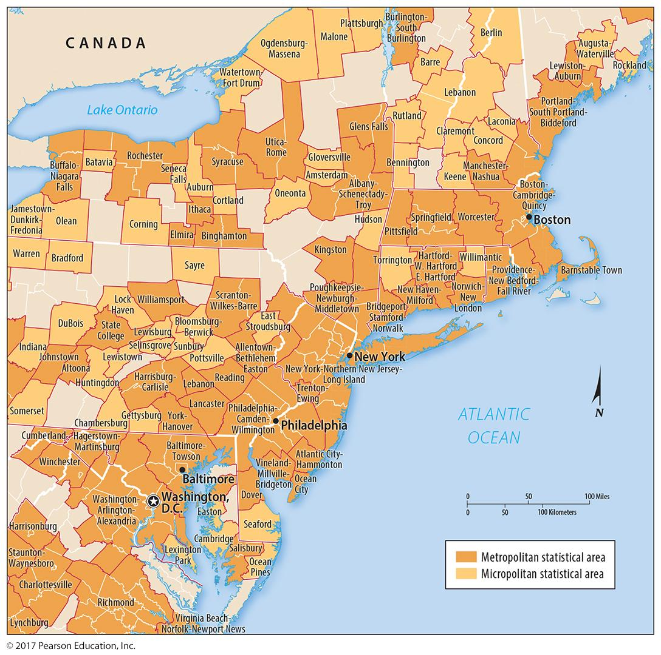
3.2 Megalopolis
Figure 13-47: A long stretch of contiguous urbanization stretches from Boston to Washington.

Slide 53
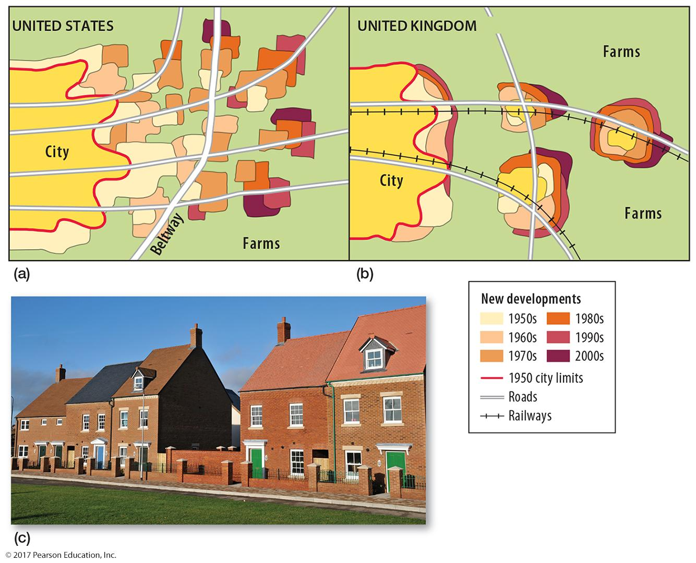
3.3 U.S. vs. U.K. Suburbs
Figure 13-48: Land use planning in the U.K. directs new development to be contiguous with existing urbanization (b, c), whereas the U.S. model allows greater sprawl (a).

Slide 54
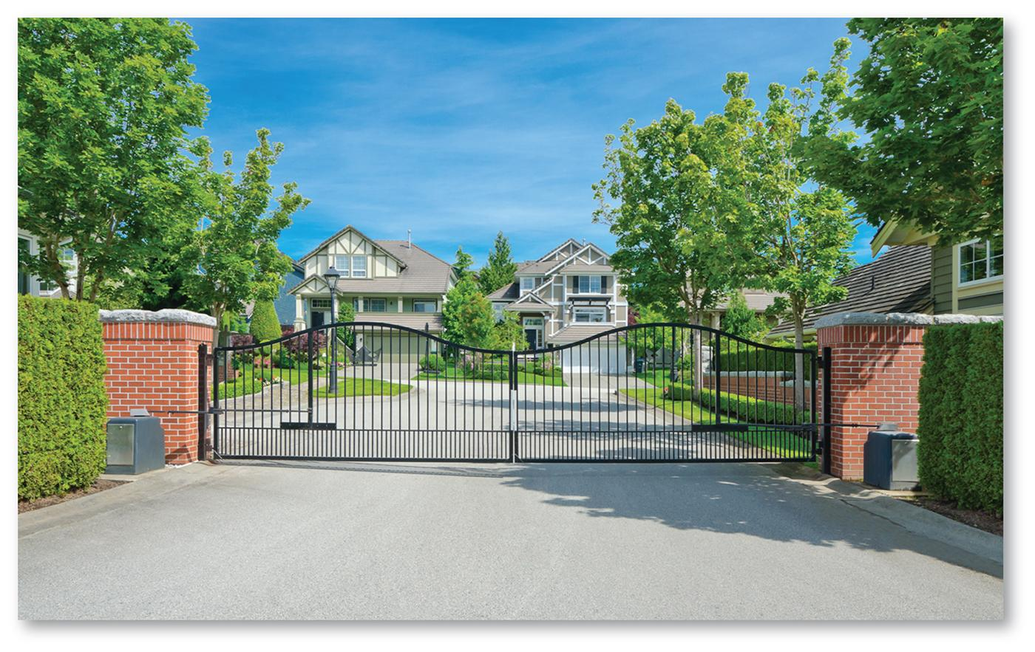
3.3 Suburban Segregation
Figure 13-49: A gated community in Orlando, Florida, represents one form of residential segregation: low-income people cannot purchase homes or travel without invitation here.

Slide 55
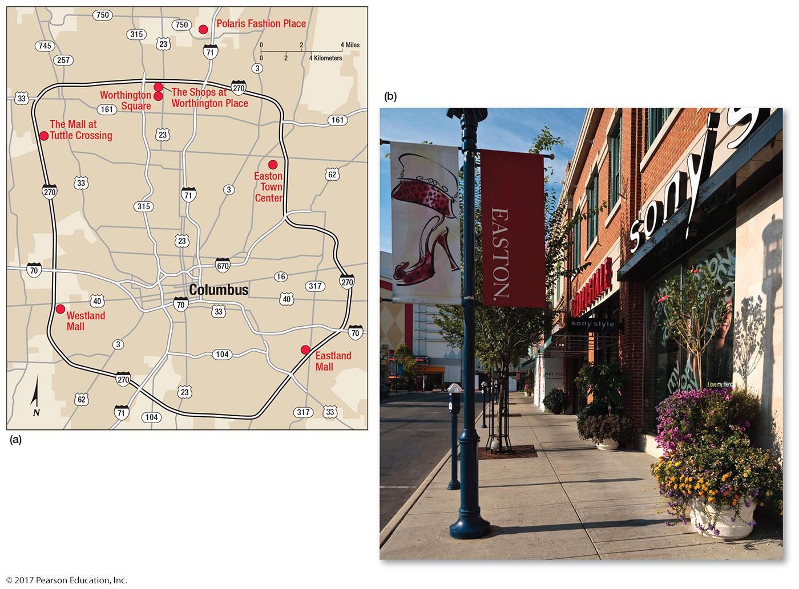
3.3 Suburbanization of Consumer Services
Figure 13-50: Retail services once located in or near the CBD have followed wealthy residents to the suburbs, like these in Columbus, Ohio. Some business services have also relocated.

Slide 56
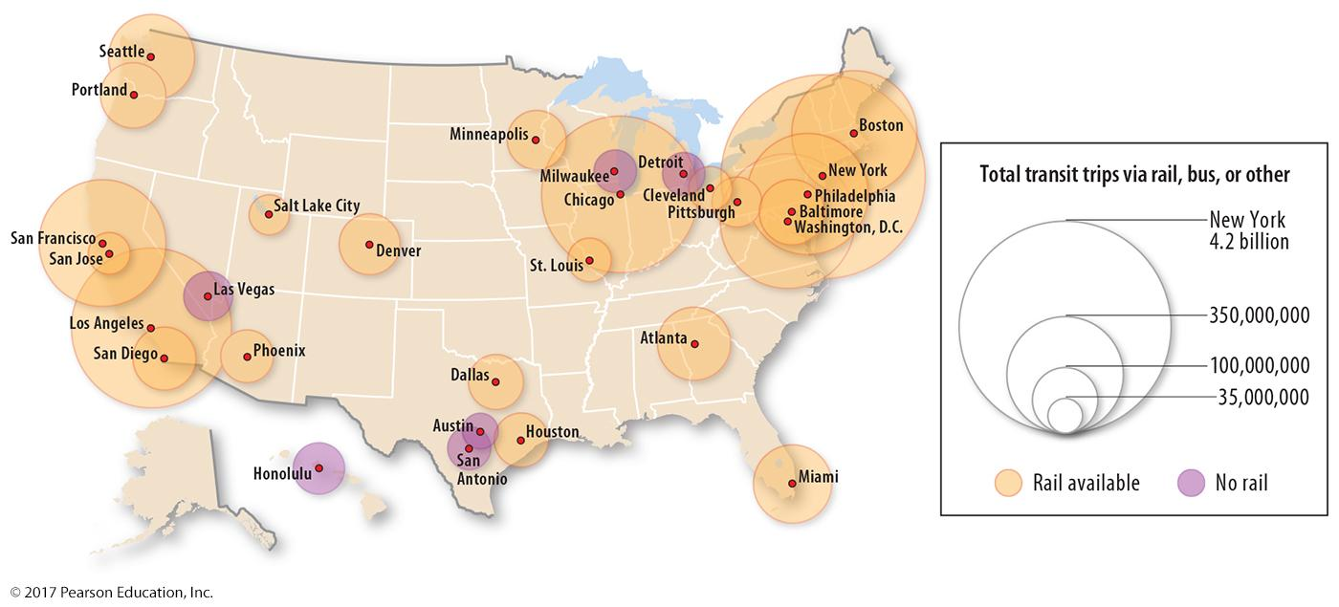
3.4 Suburbanization and Public Transport in the United States
Figure 13-51: Suburbanization in the United States has relied on motor vehicles. Public transport peaked in the 1940s; today ridership pales in comparison to many other developed countries.

Slide 57
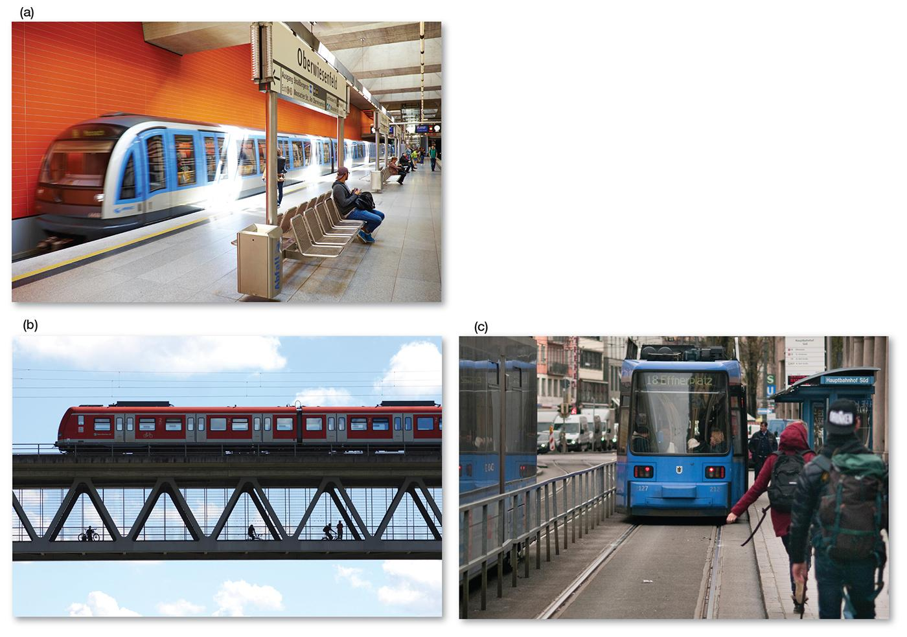
3.4 Public Transport in Other Countries
Figure 13-53: Munich, Germany, is typical of many public transport-oriented cities in developed countries. Shown here are its underground rail (a), elevated rail (b), and street car (c) systems.

Slide 58
3.5 Transportation Epochs
Five eras of U.S. urban areas from dominant transportation:
Sail-Wagon
Iron Horse
Steel Rail
Auto-Air-Amenity
Satellite-Electronic-Jet Propulsion

Slide 59
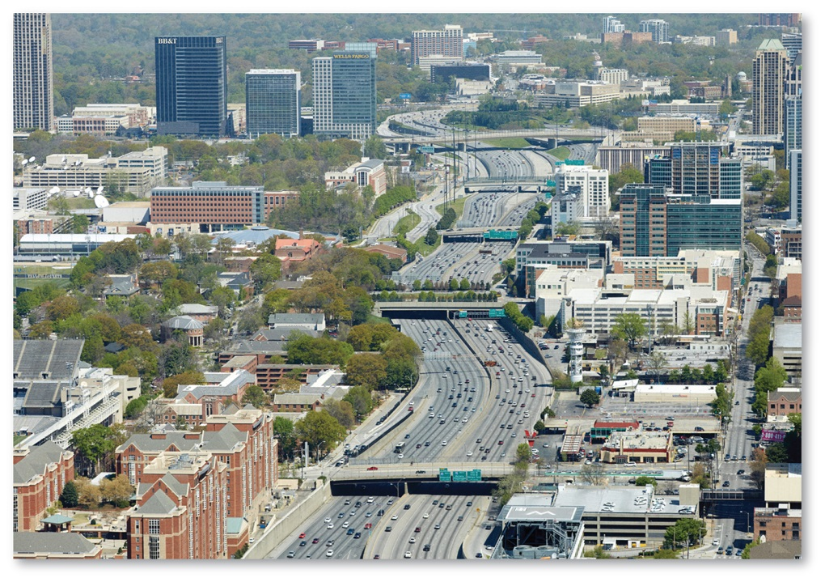
3.5 Benefits and Costs of Motor Vehicle
Benefits:
Comfort, choice, flexibility
Low perceived cost
Costs:
Consumption of land
Traffic congestion
Figure 13-54: an urban freeway in Atlanta

Slide 60
Key Issue 4: Why Do Cities Face Sustainability Challenges?
4.1 The City Challenged
4.2 The City Renewed
4.3 The City Contrasted
4.4 The City Cleaned
4.5 The City Controlled

Slide 61
4.1 Social and Physical Challenges
Social challenges associated with underclass residents of inner cities:
Inadequate job skills
Culture of poverty
Homelessness
Drugs
Crime
Inadequate services
Municipal finance shortage
Physical challenges: filtering, redlining

Slide 62
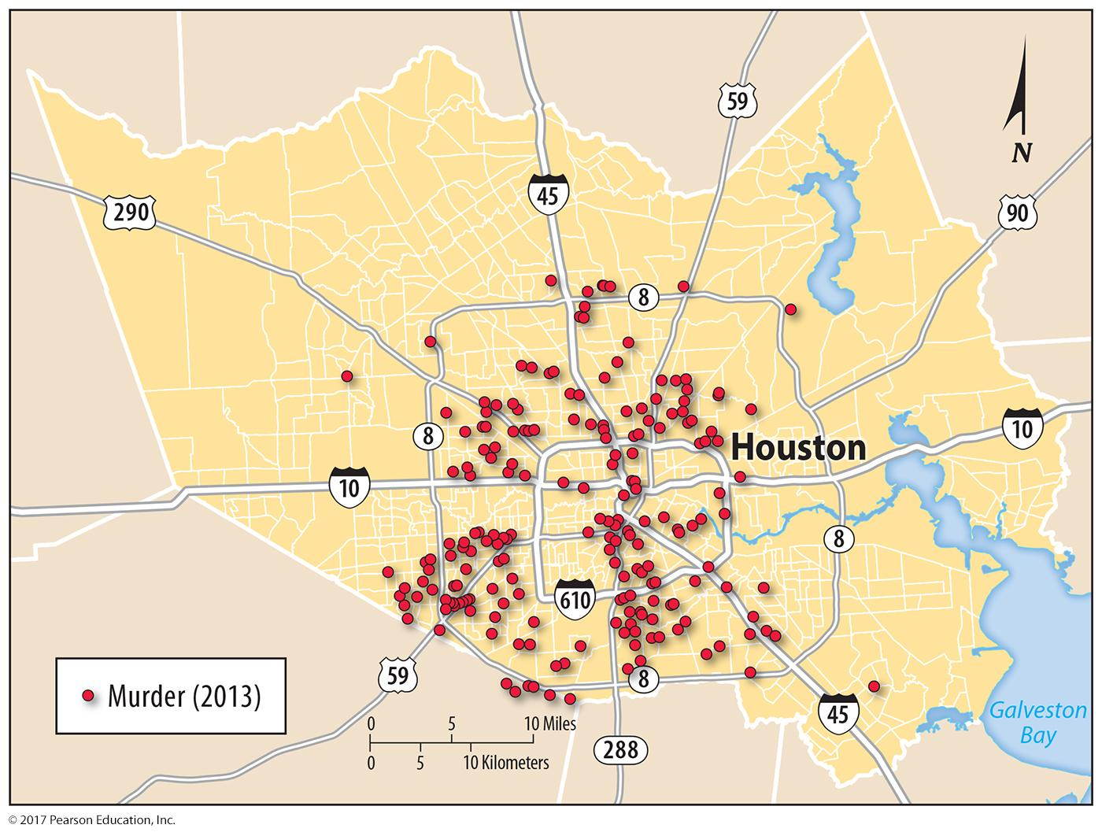
4.1 Social Challenges: Crime
Figure 13-57: Murders in Houston: Compare with Figures 13-15, 13-16, and 13-17.

Slide 63
4.2 Urban Renewal: Gentrification
Figure 13-58: Gentrification in Cincinnati: Critics of gentrification argue that the community becomes too expensive and pushes out poor residents.

Slide 64
4.2 Urban Renewal: Public Housing
Figure 13-60: Large, high-rise subsidized housing projects (background) in the United States, now considered unsatisfactory, are being leveled and replaced with middle-class housing (foreground).

Slide 65
4.2 Urban Renewal: Consumer Services
Figure 13-61: Many U.S. cities have redeveloped consumer services like retail and leisure services in their CBDs, like the ferry terminal building in San Francisco.

Slide 66
4.3 Urban Demographic Change: Chicago
Figure 13-63: Chicago’s African American and Hispanic populations are increasing in more suburban locations, while whites are moving back toward the city center.

Slide 67
4.3 Urban Demographic Change: Detroit
Figure 13-64: Detroit covers a large area compared to several other cities of similar size or larger in population (a); this difference in density is reflected in the large number of vacant houses in Detroit (b).

Slide 68
4.4 Sustainable Development
Figure 13-65: Developed countries produce more carbon dioxide per capita.

Slide 69
4.4 Sustainable Development
Figure 13-67: The United Nations target for the U.S. carbon dioxide emissions, by source: Most reductions are forecast through reducing the use of fossil fuels.

Slide 70
4.4 Sustainable Development
Figure 13-68: Electricity generation source by U.S. state: Electric cars are less polluting when powered by energy generated from lower carbon-emitting sources.

Slide 71
4.5 Controlling Congestion and Air Pollution
Road congestion controlled through:
Congestion charges
Tolls
Permits
Bans
Air pollution controlled through technology:
Diesel
Hybrid
Ethanol
Electric
Plug-in hybrid
Hydrogen fuel cell

Slide 72
4.5 Congestion Pricing
Figure 13-69: Drivers in London’s central zone face a special congestion charge during peak driving hours.

Slide 73
4.5 No-car Zone
Figure 13-70: A main street in Copenhagen is closed to vehicles so pedestrians can walk freely.

Slide 74
Chapter End

