Slide 1
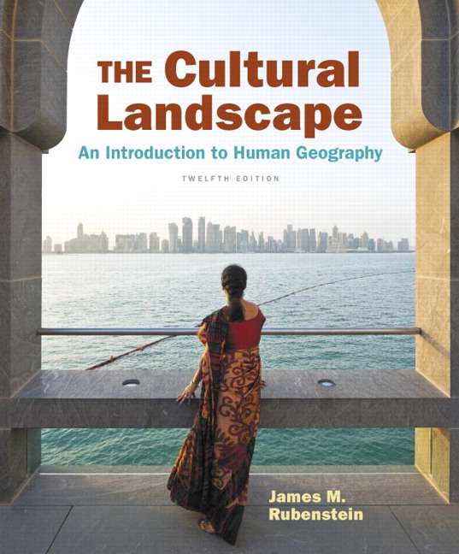
Chapter 12 Lecture
Chapter 12
Services and Settlements
Tim Scharks Green River College

Slide 2
Services and Settlements: Key Issues
Where Are Services Distributed?
Where Are Consumer Services Distributed?
Where are Business Services Distributed?
Why Do Services Cluster in Settlements?

Slide 3
Key Issue 1: Where Are Services Distributed?
Service: activity to fulfill human want or need for sale
Settlement: permanent collection of buildings where people reside
Services cluster in settlements, especially in developed countries.
Three types of services
consumer
business
public

Slide 4
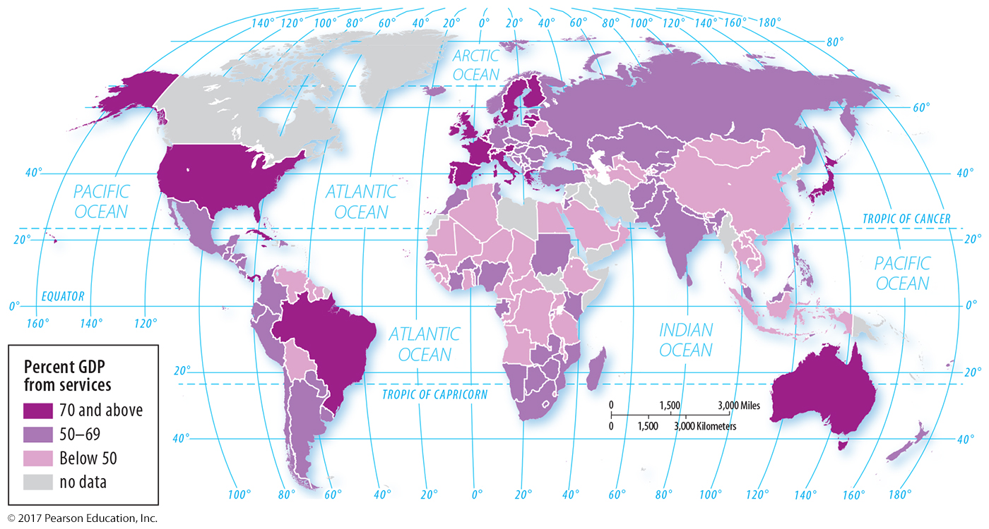
1.1 Percentage of GDP from Services
Figure 12-1: Services are the major contributor to GDP in developed countries.

Slide 5
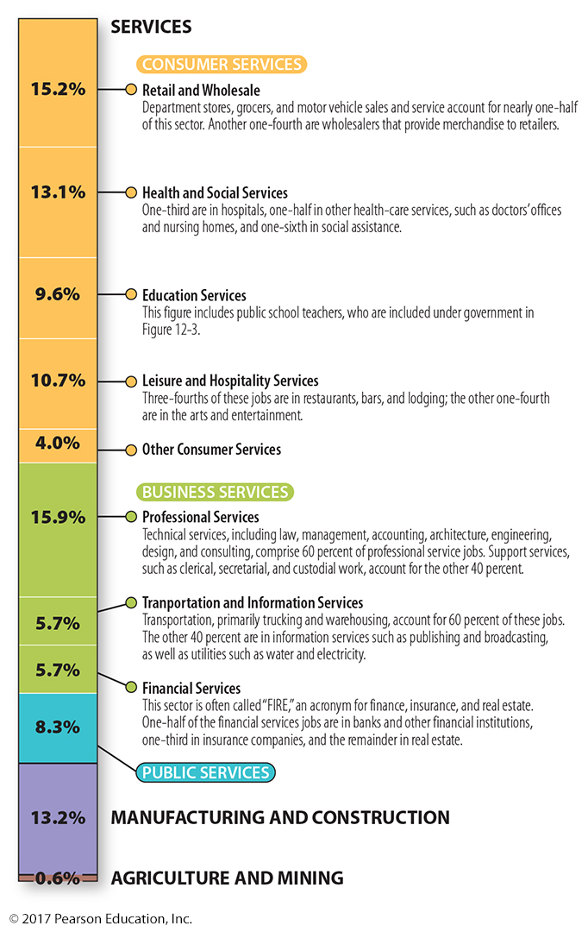
1.1 U.S. Employment
Figure 12-2: More than 85 percent of all jobs in the United States are some form of service. Half are consumer services, and one quarter are business services.

Slide 6
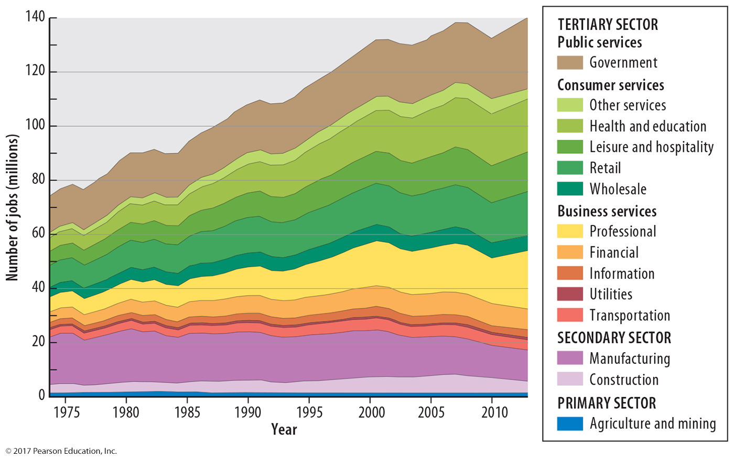
1.1 U.S. Employment Growth
Figure 12-3: Recent employment growth in the United States has been in the tertiary (service) sector, especially consumer services.

Slide 7
Key Issue 2: Where Are Consumer Services Distributed?
2.1 Central Place Theory
2.2 Hierarchy of Consumer Services
2.3 Market Area Analysis
2.4 Periodic Markets

Slide 8
2.1 Central Place Theory
Central place: market center where people exchange goods and services
Market area: region surrounding central place
Range: how far people will travel for a service
more basic services have shorter ranges
Threshold: minimum number of people to support a service
must be enough potential customers

Slide 9
2.1 Market Areas as Hexagons
Figure 12-4: Hexagons approximate a circle without leaving gaps, so are used to symbolize market areas in central place theory.

Slide 10
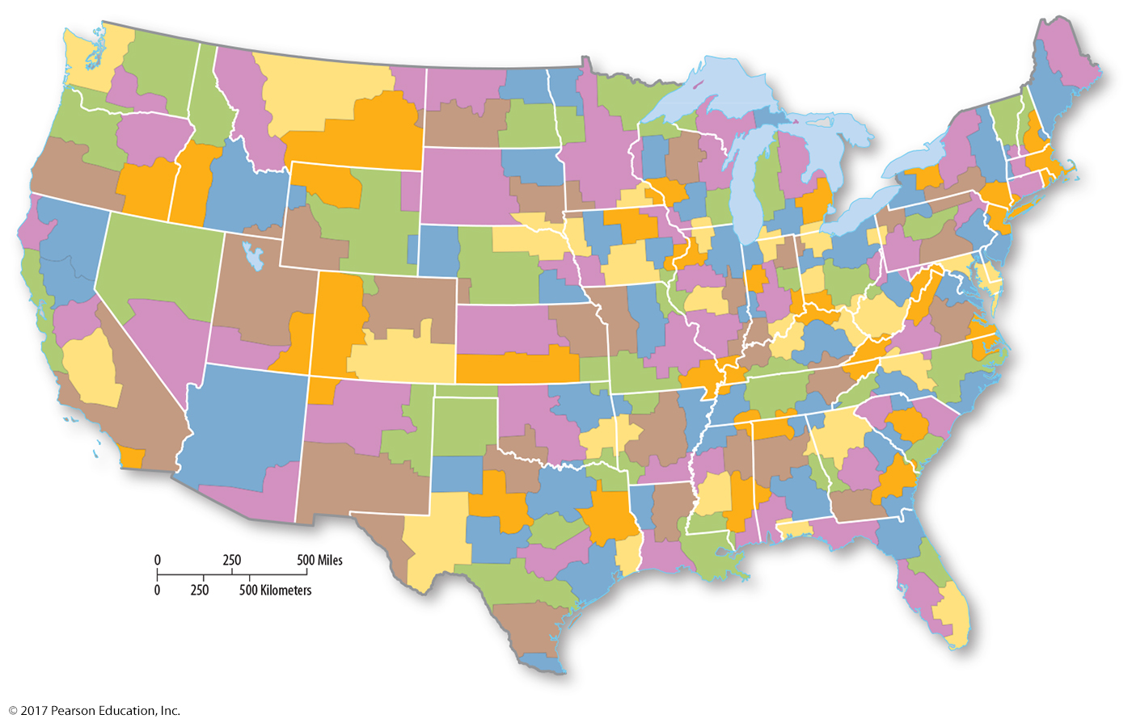
2.1 Daily Urban Systems
Figure 12-5: Daily urban systems regions represent functional ties, which can be considered market areas for some services.

Slide 11
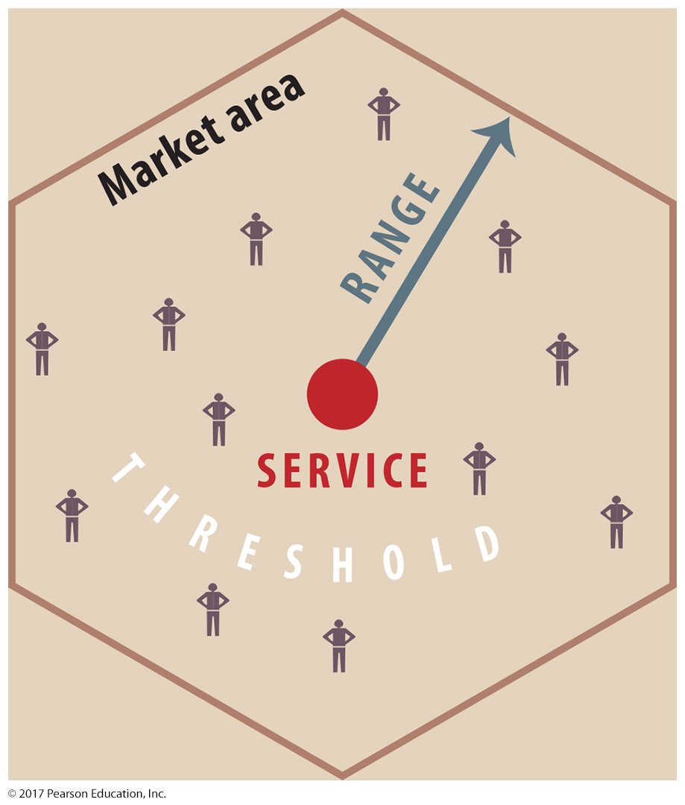
2.1 Threshold, Range, and Market Area
Figure 12-6: Threshold is the number of people required to support a particular service, and range is the maximum distance a person is willing to travel for that distance.

Slide 12
2.2 Hierarchy of Consumer Services
Central place theory predicts
Many small settlements with small threshold/range services
Fewer large settlements, services with large thresholds and ranges
Developed countries often follow the rank-size rule:
n^{th} -largest settlement is 1/n the population of largest settlement.
Exception: primate cities

Slide 13
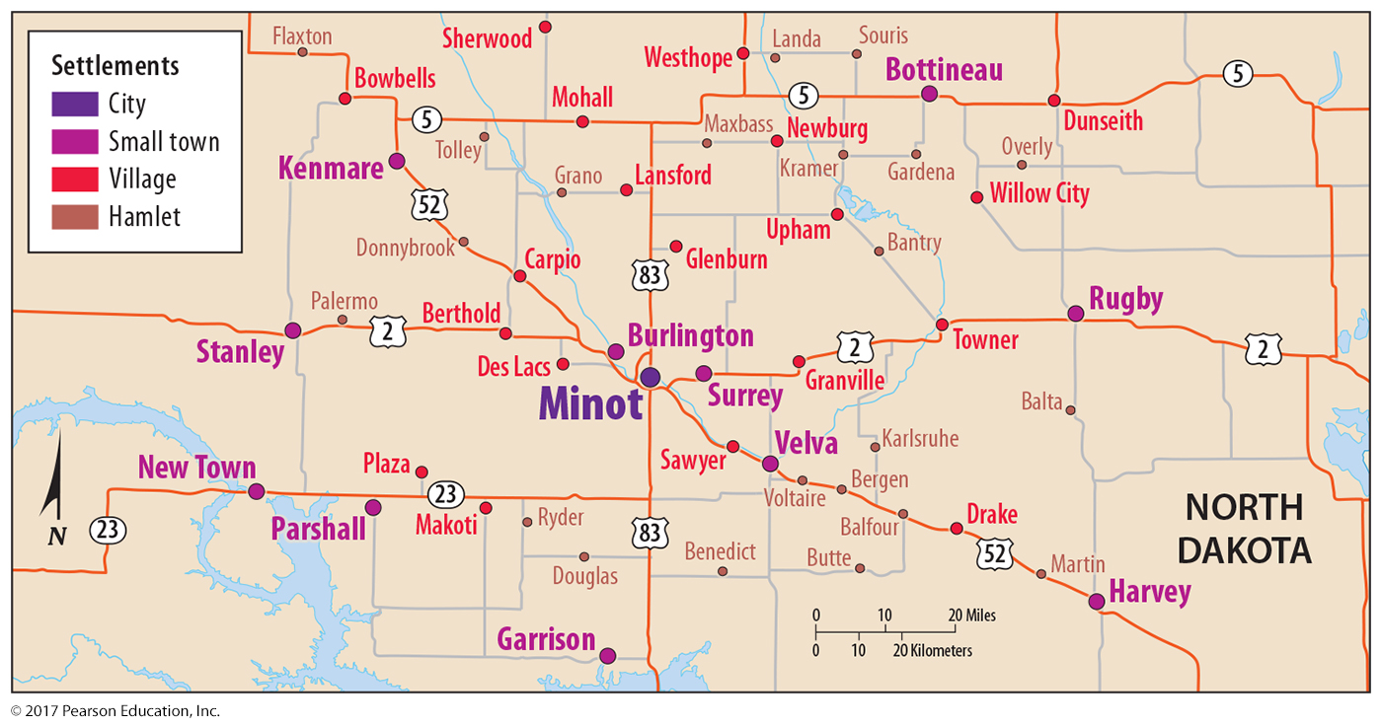
2.2 Central Place Theory in North Dakota
Figure 12-7: Following the predictions of central place theory, there are many hamlets, fewer villages, even fewer small towns, and only one city in the region mapped here.

Slide 14
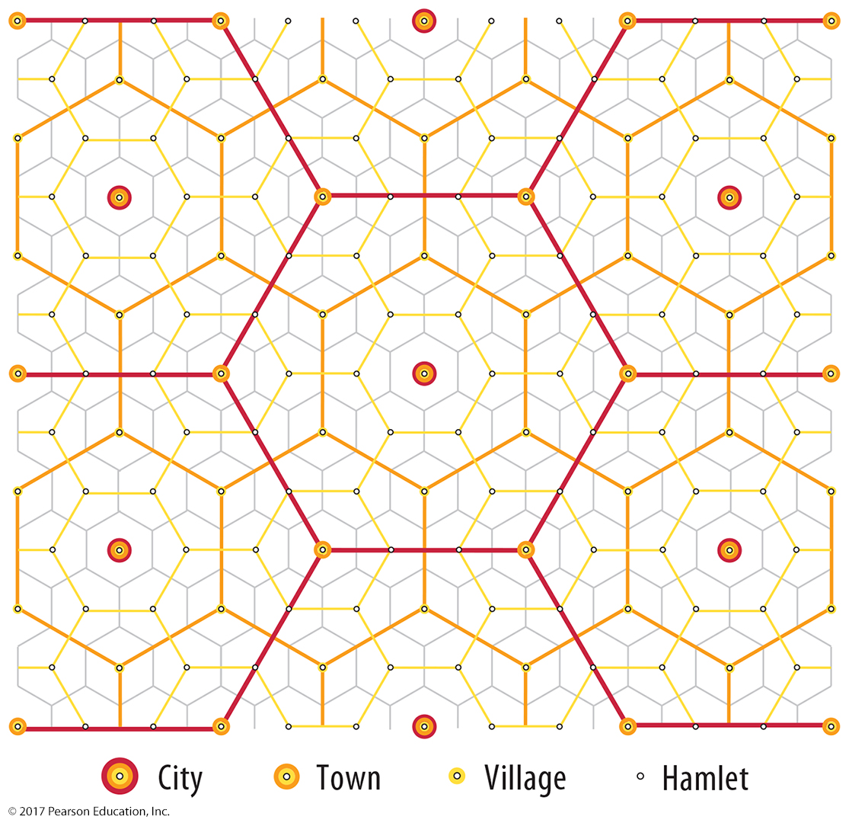
2.2 Central Place Theory in North Dakota
Figure 12-9: An abstract model of central place theory shows the market areas of small settlements are nested within the market areas of larger settlements, and so on.

Slide 15
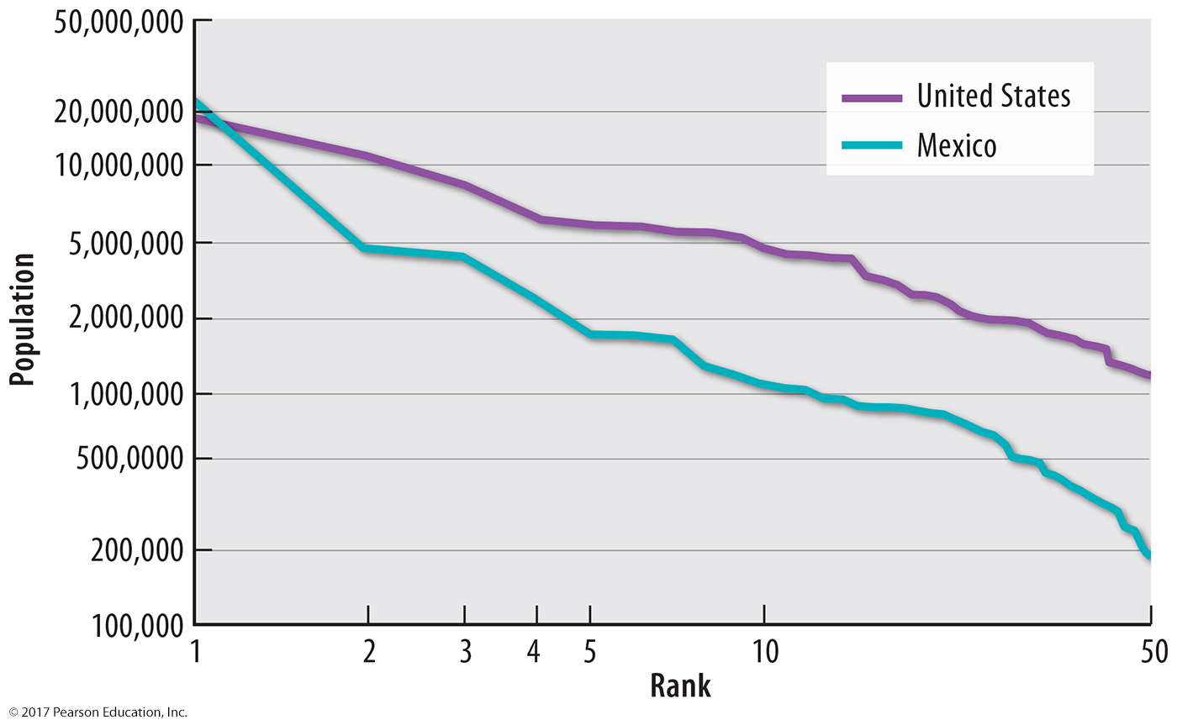
2.2 Rank-size Distribution of Settlements
Figure 12-10: Rank-size rule predicts the 10th largest city should have about 1/10th the population of the largest city. This is observed in the United States, but not as closely in Mexico.

Slide 16
2.3 Debate It!: Walmart and Settlements
Benefits
Lower prices
Employment to low-skill workers
Locations often in areas with few other options
Harms
Wages too low for workers to prosper
Imported products hurt American industry.
Locally owned shops forced out of business
Figures 12-13 and 12-14: Walmart provides jobs, but its business practices are controversial.

Slide 17
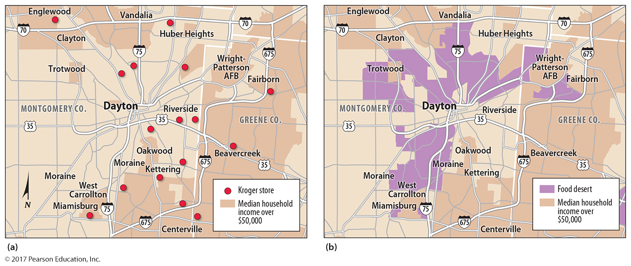
2.3 Market Area Analysis: Food Deserts
Figure 12-15: Supermarkets tend to be located near high-income neighborhoods. Food deserts are defined as areas with low-income residents and poor access to groceries.

Slide 18
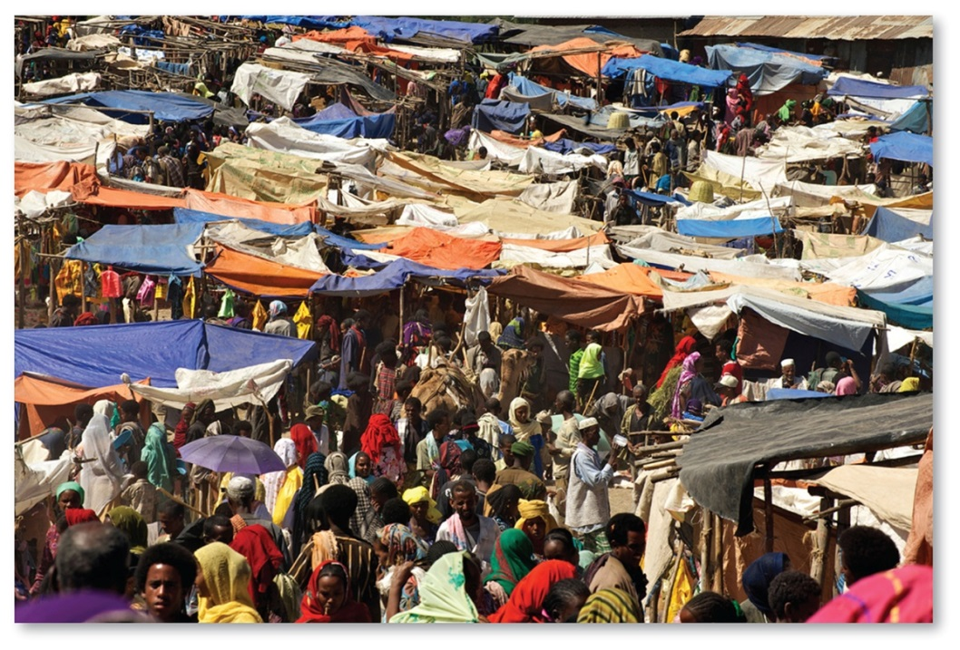
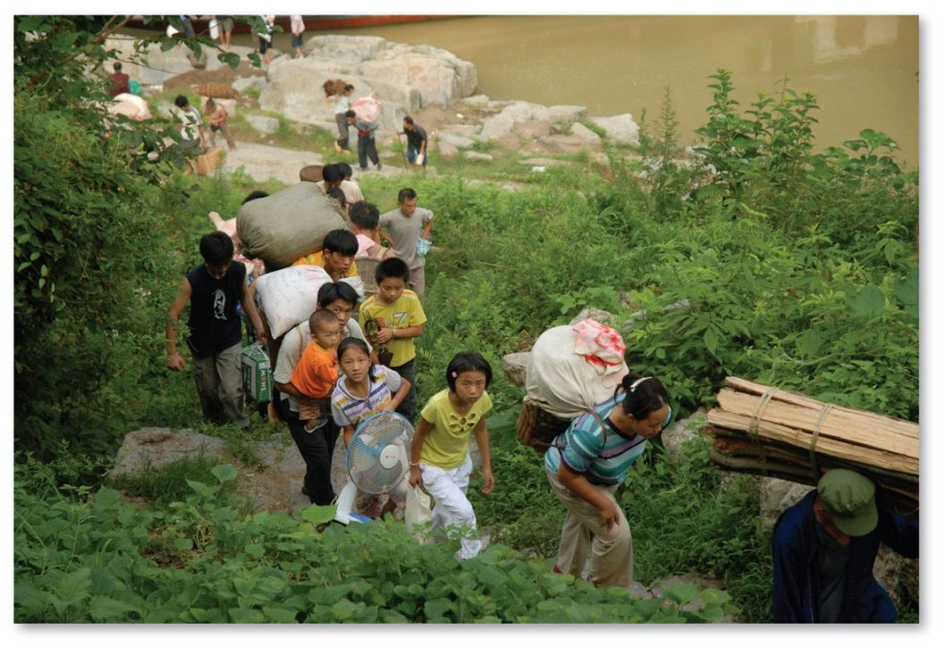
2.4 Periodic Markets
Figures 12-16 and 12-17: Periodic markets allow small settlements to have access to more services a few days per week or month, like in Ethiopia (left). Merchants travel to another village in China for a periodic market (right).

Slide 19
Key Issue 3: Where are Business Services Distributed?
3.1 Hierarchy of Business Services
3.2 Business Services in Developing Countries
3.3 Economic Specialization of Settlements

Slide 20
3.1 Hierarchy of Business Services
Business services cluster in global cities:
Financial institutions
Corporate headquarters
Law, accounting, and other professional services
Global cities defined by combination of factors on their importance (not just size)
Commonly centers of large threshold/range consumer and public services

Slide 21
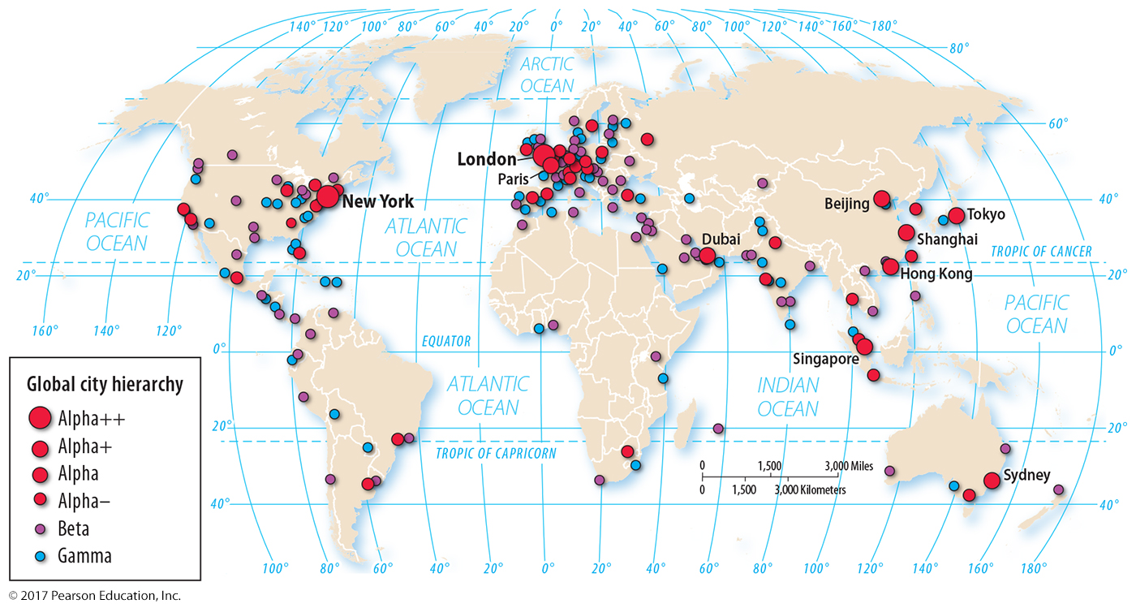
3.1 Global Cities
Figure 12-20: Global cities follow a hierarchy where the most globally influential world cities, London and New York, are ranked highest.

Slide 22
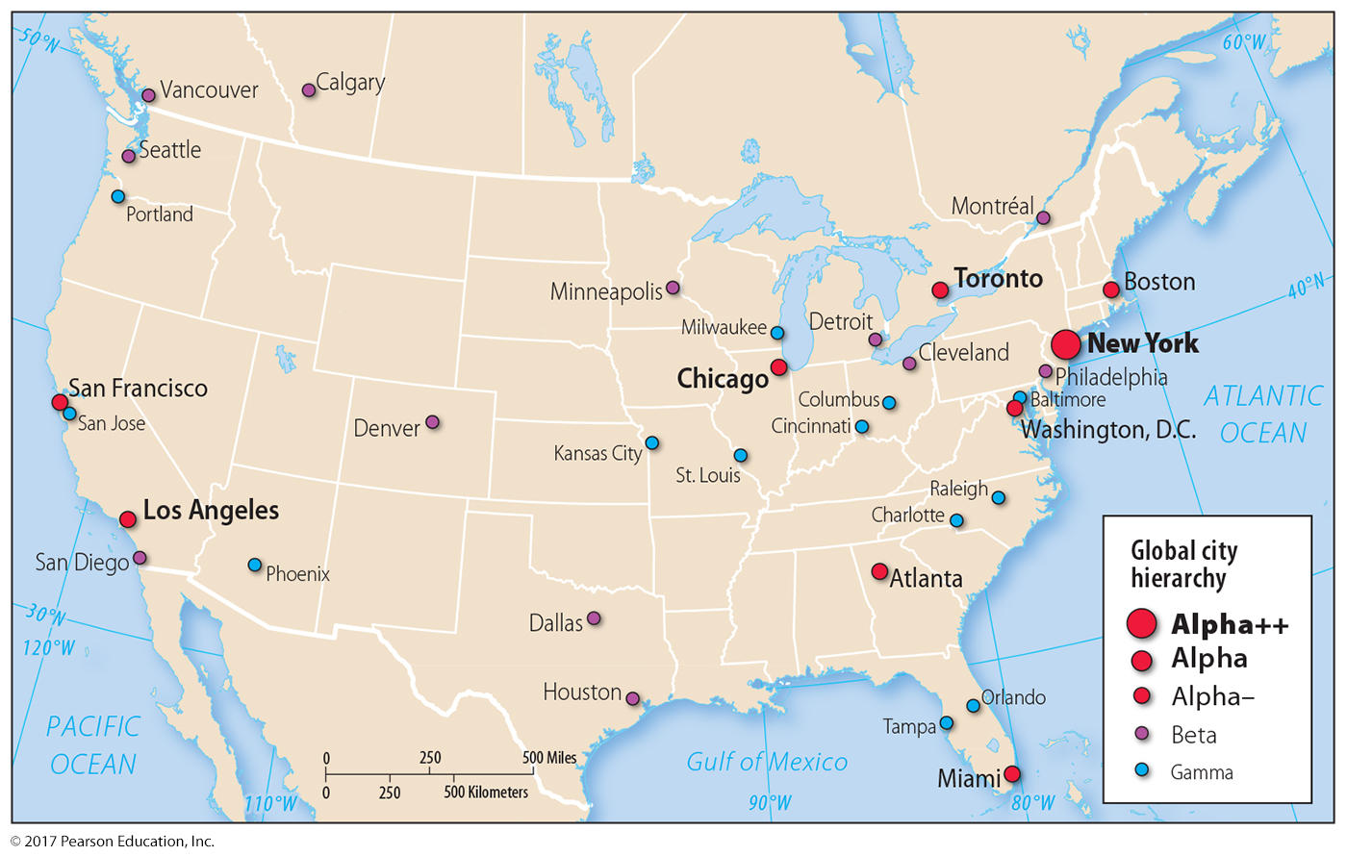
3.1 Global Cities in North America
Figure 12-21: As with central place theory, there are more lower-order global cities and few higher-order global cities.

Slide 23
3.2 Business Services in Developing Countries
Offshore financial services for:
Taxes
Privacy
Business-process outsourcing locations selected for:
Low wages
English-speaking ability

Slide 24
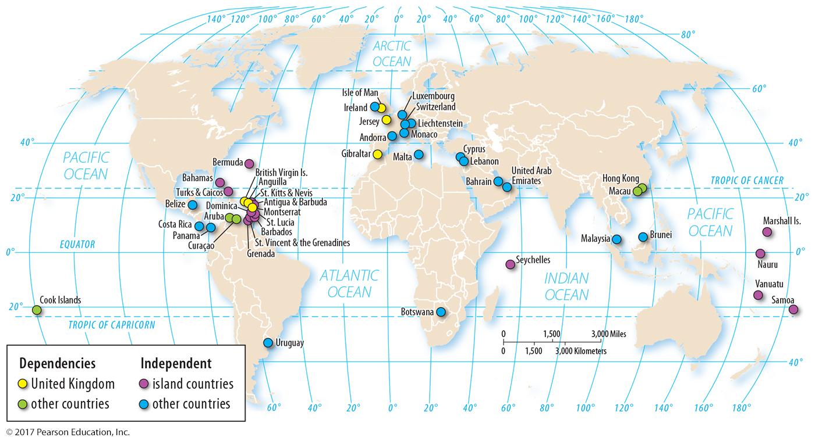
3.2 Offshore Financial Service Centers
Figure 12-23: Offshore financial service centers are mostly microstates or dependencies, and most microstates are small islands.

Slide 25
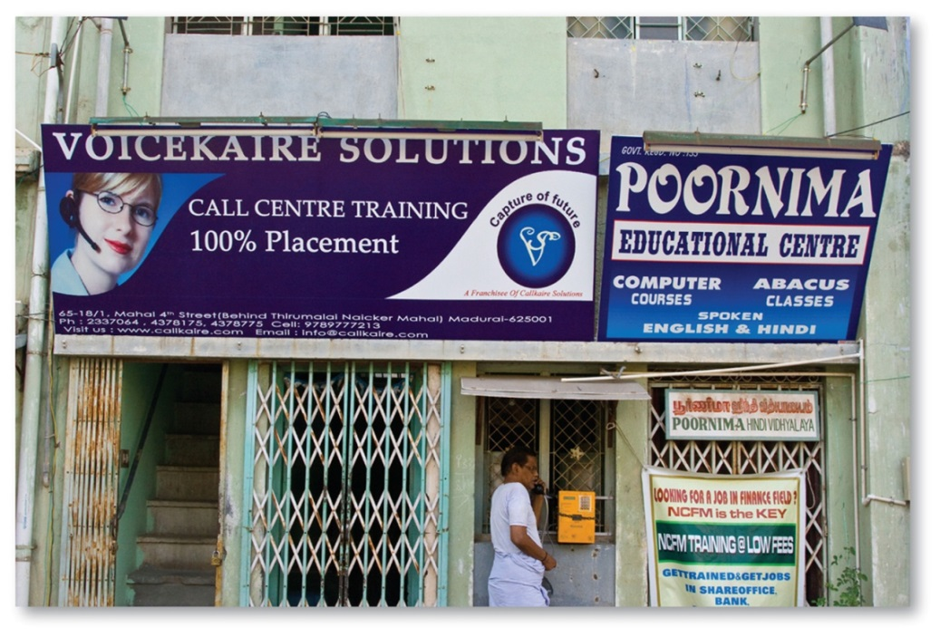
3.2 Call Centers
Figures 12-24 and 12-25: India is a popular location for businesses to outsource their call center work (above) because of low wages and workers who speak English (right).

Slide 26
3.3 Economic Specialization of Settlements
Settlements specialize in economic activities:
Basic business: exports outside settlement
Nonbasic business: serves customers in settlement
Talented workers not randomly distributed:
Attracted to job opportunities
Cultural factors most important

Slide 27
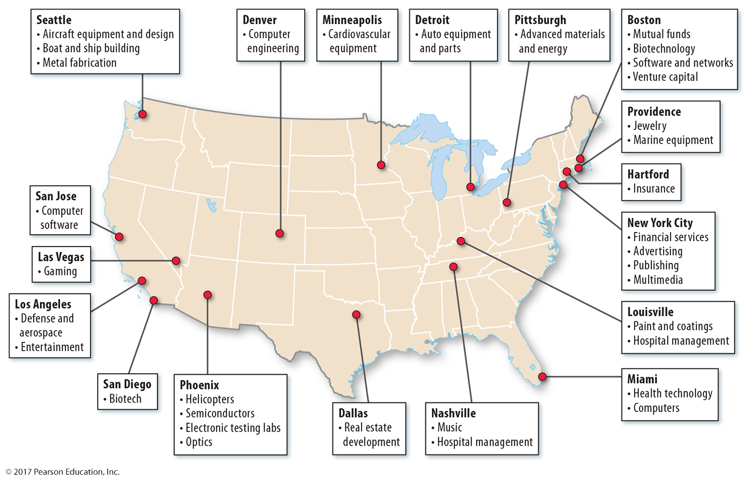
3.3 Economic Base of U.S. Settlements
Figure 12-26: Settlements specialize in different economic activities.

Slide 28
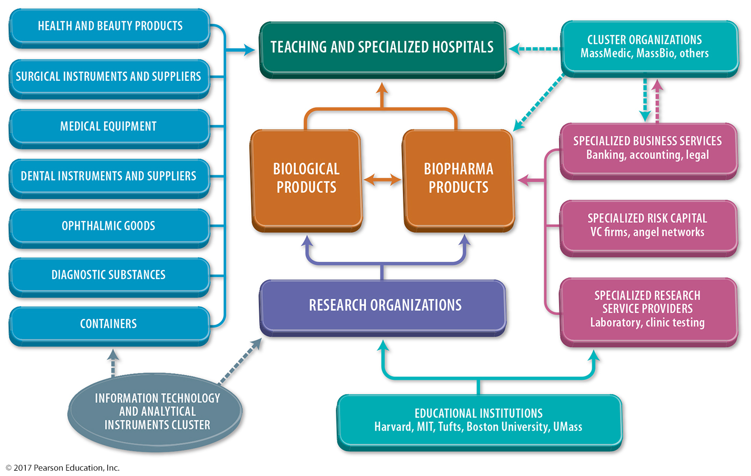
3.3 Economic Base of Boston
Figure 12-28: Boston’s economic base of biotechnology leads to returns for other businesses.

Slide 29
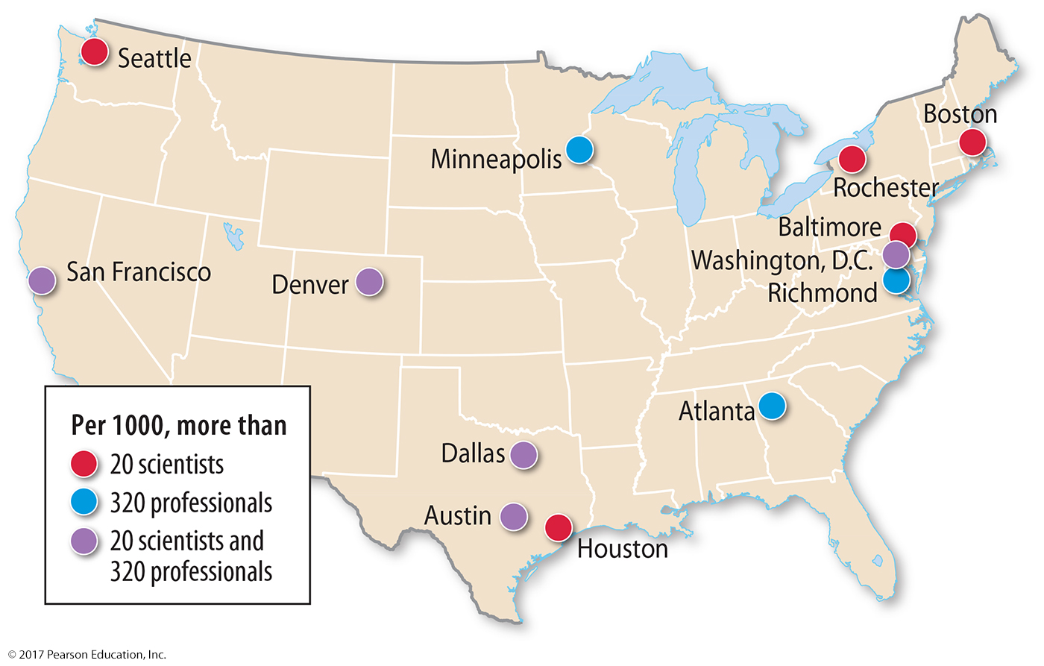
3.3 Scientists and Professionals in the U.S.
Figure 12-29: Scientists and professionals cluster in some U.S. cities more than others.

Slide 30
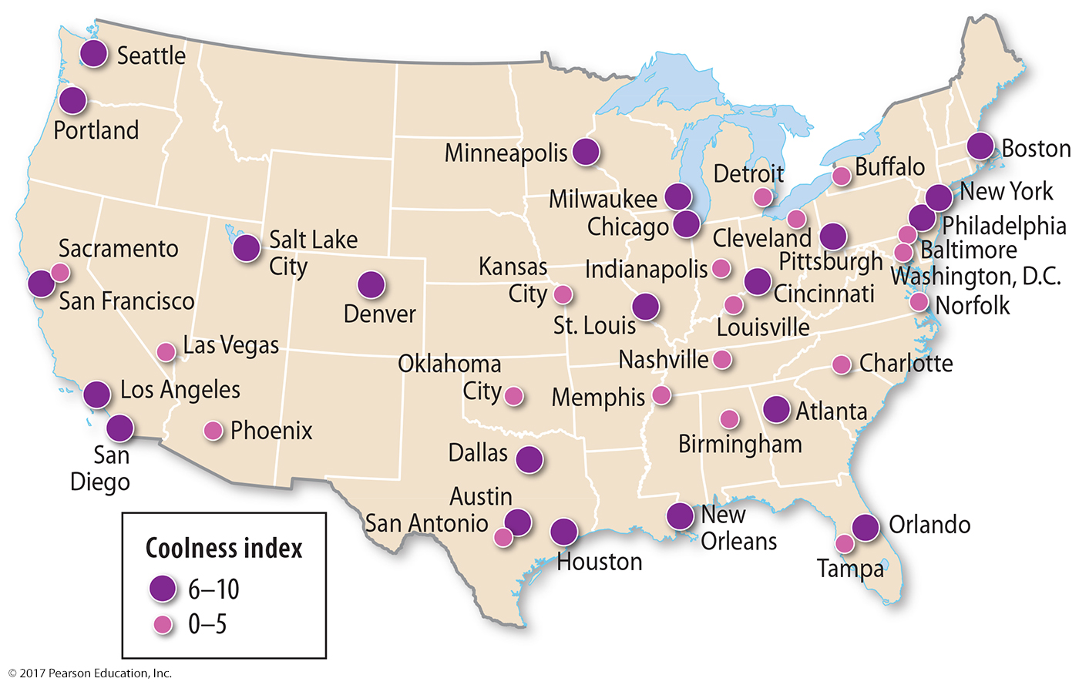
3.3 Coolness Index
Figure 12-30: Richard Florida found talented professionals preferred cities ranked high in “coolness” by POV Magazine.

Slide 31
Key Issue 4: Why Do Services Cluster in Settlements?
4.1 Services in Rural Settlements
4.2 Services in Early Urban Settlements
4.3 Percent Urban
4.4 Size of Urban Settlements

Slide 32
4.1 Services in Rural Settlements
Two types of rural settlements:
Clustered: families live in close proximity, fields surround settlement
circular clustered
linear clustered
Dispersed: isolated farms, especially in the United States

Slide 33
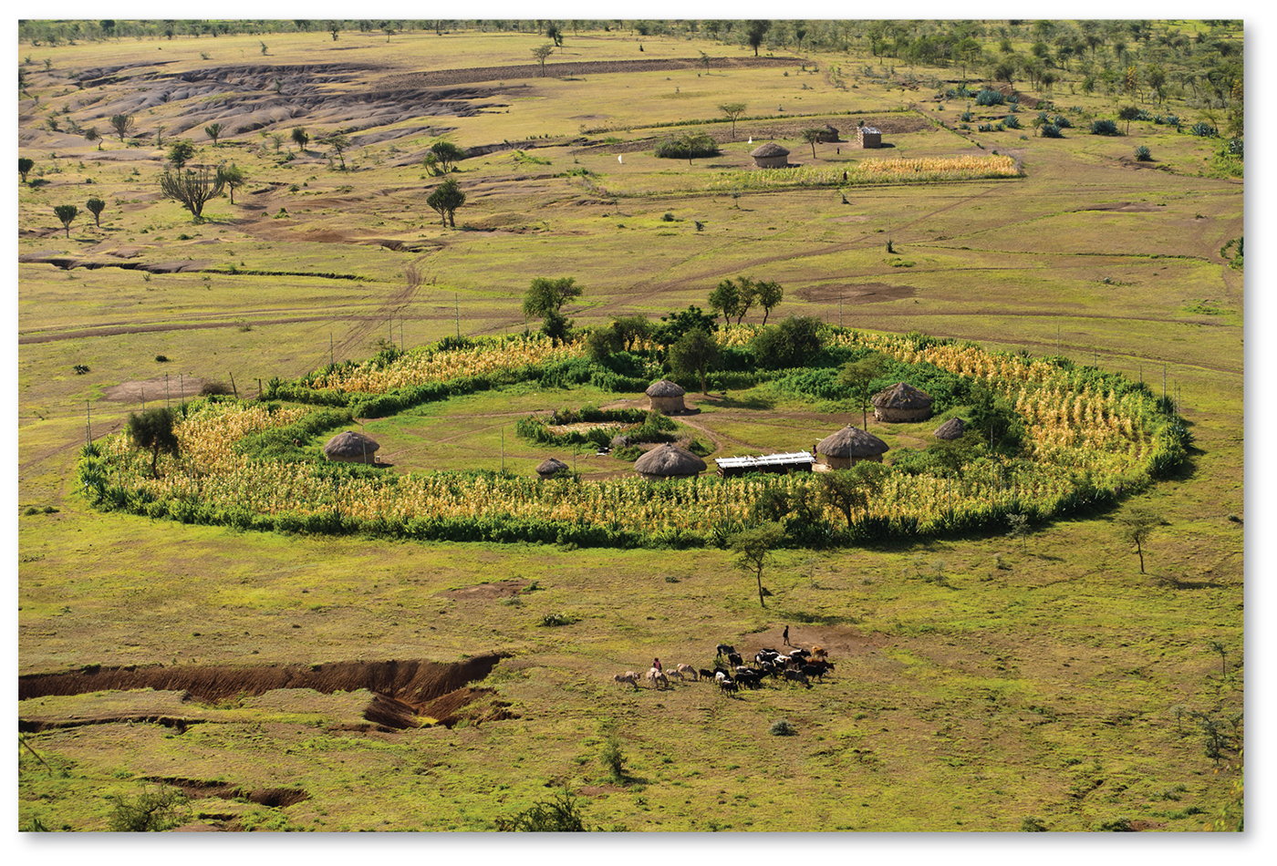
4.1 Circular Rural Settlement
Figure 12-31: A small circular rural settlement in Tanzania is called a boma.

Slide 34
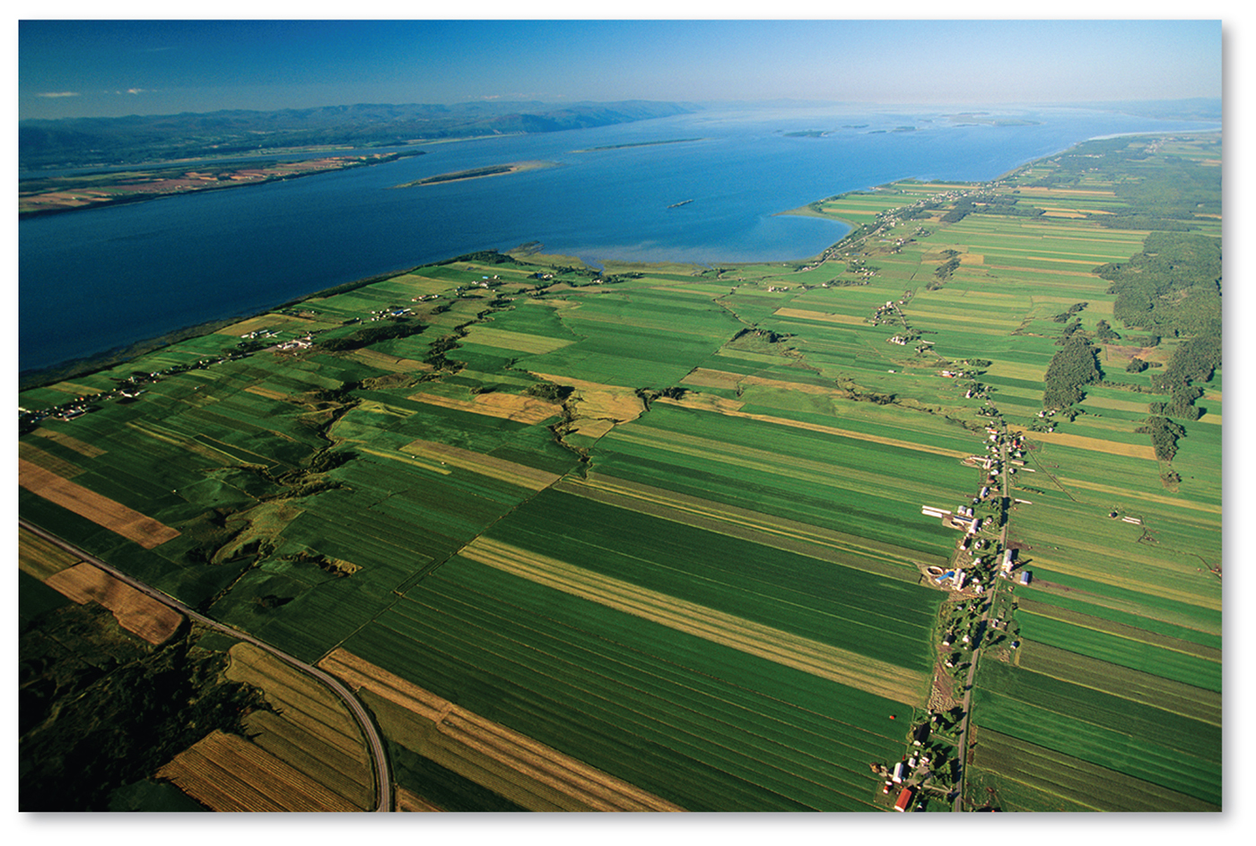
4.1 Linear Rural Settlement
Figure 12-32: a linear rural settlement in Quebec, which follows the French long-lot tradition

Slide 35
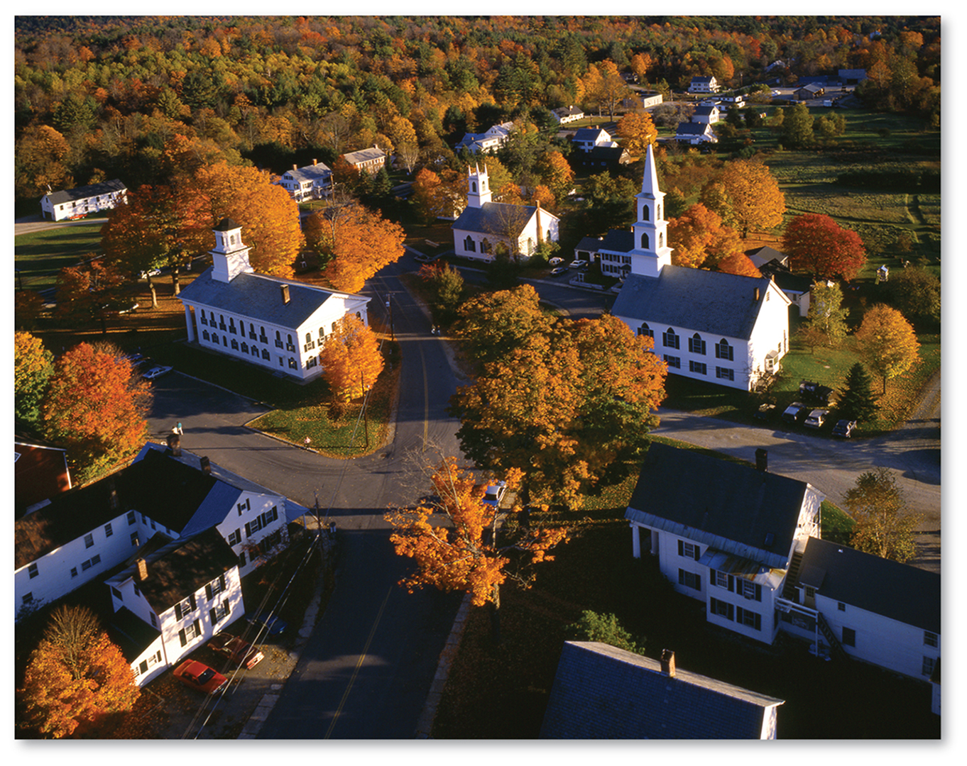
4.1 Clustered U.S. Rural Settlement
Figure 12-33: a clustered rural settlement in Newfane, Vermont

Slide 36
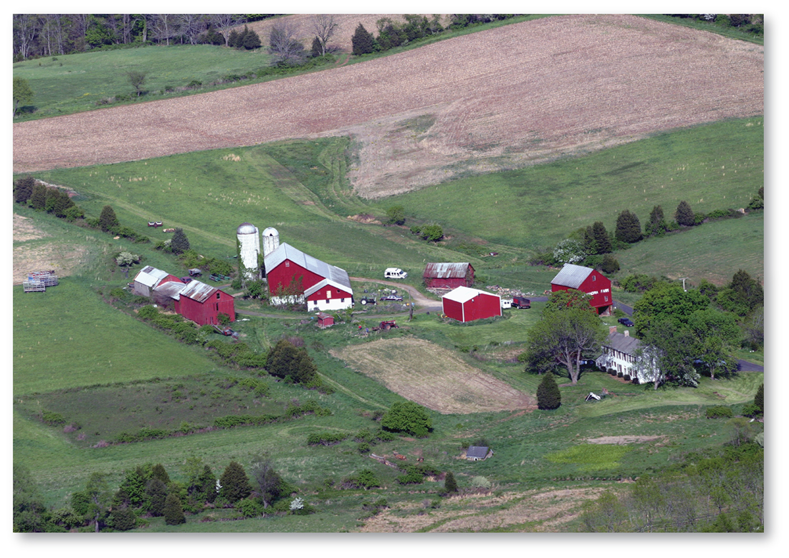
4.1 Dispersed U.S. Rural Settlement
Figure 12-34: an isolated farm in New Jersey

Slide 37
4.2 Services in Early Urban Settlements
Prehistoric urban settlements:
consumer services: likely religious
business services: trade of foods, clothing, tools
public services: political leaders, defense
Ancient urban settlements: trading, public, and consumer services
peak Roman Empire
Medieval urban settlements
renewed emphasis on trade and public services

Slide 38
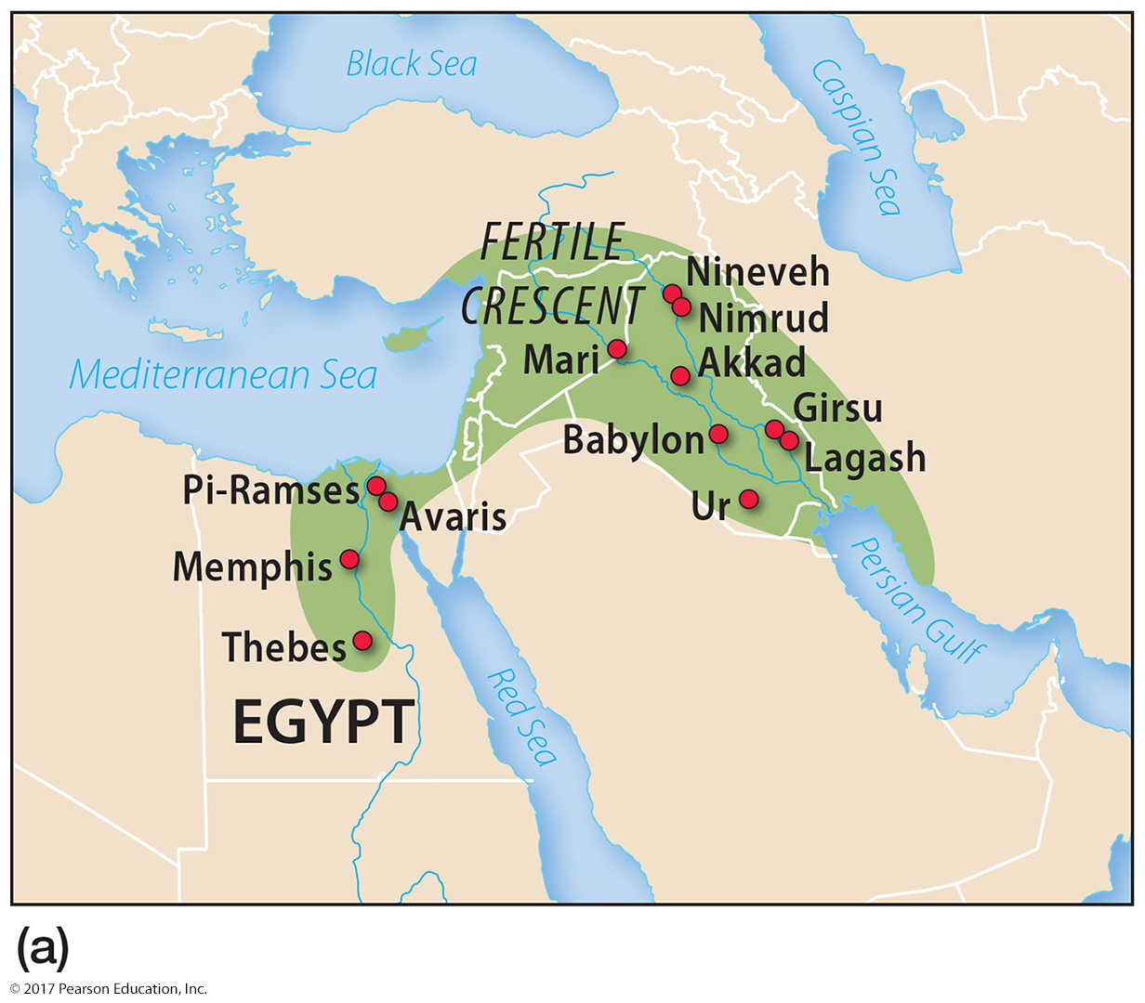
4.2 Largest Urban Settlements 3000–500 B.C.
Figure 12-36(a): Large urban settlements before the time of Christ were located in the Fertile Crescent.

Slide 39
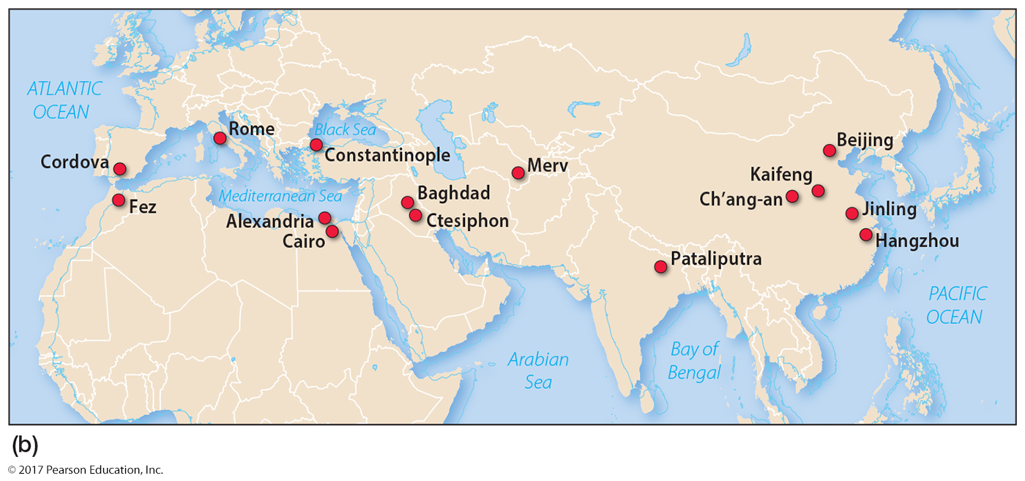
4.2 Largest Urban Settlements 500 B.C.–A.D. 1800
Figure 12-36(b)

Slide 40
4.3 Percent Urban
Urbanization has two dimensions:
number of people living in urban settlements
percentage of population living in urban settlements
Urban settlements differ from rural:
large size
high density
social heterogeneity
Percent urban has increased and continues

Slide 41
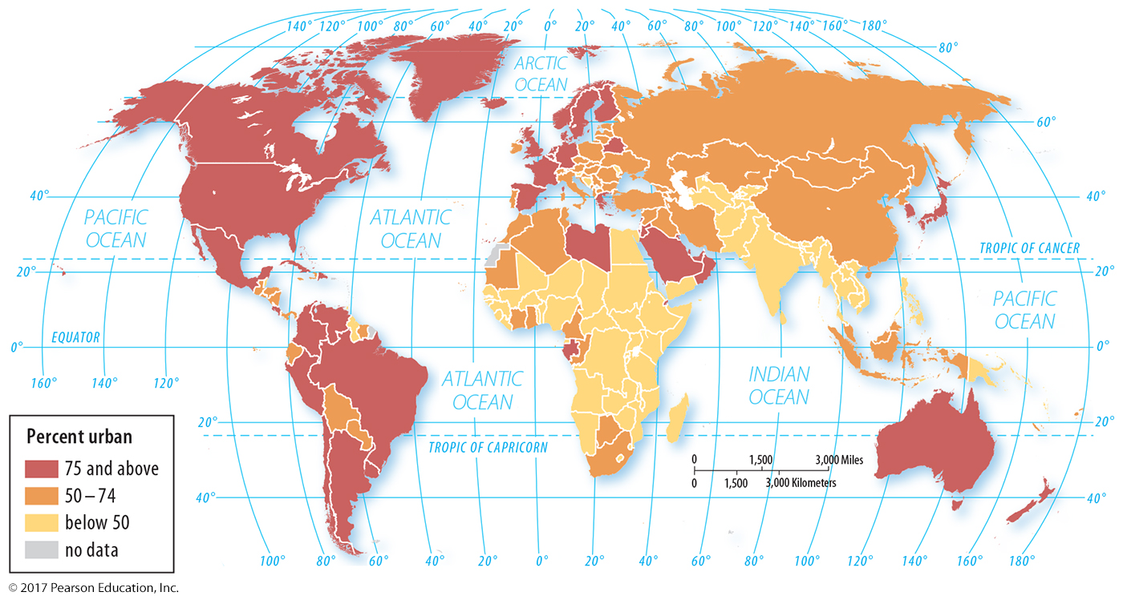
4.3 Percent Urban by Country
Figure 12-40: The world is on average more than half urbanized; developed countries are generally more urbanized than developing countries.

Slide 42
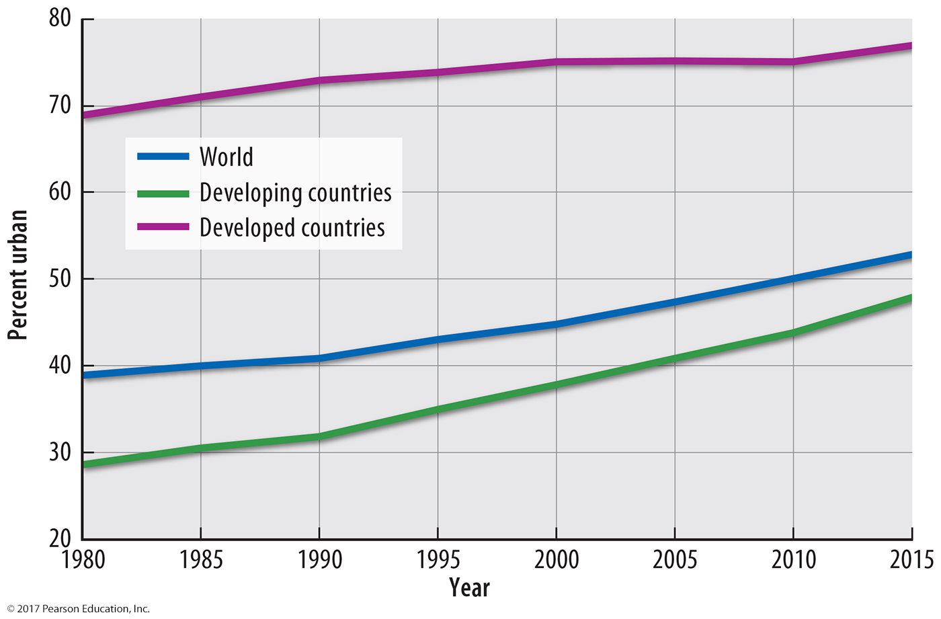
4.3 Urbanization Trends
Figure 12-41: Urbanization has increased in both developed and developing countries.

Slide 43
4.4 Size of Urban Settlements
Urban settlements growing larger
More of world’s largest cities in developing countries
Fastest-growing urban settlements in developing countries

Slide 44
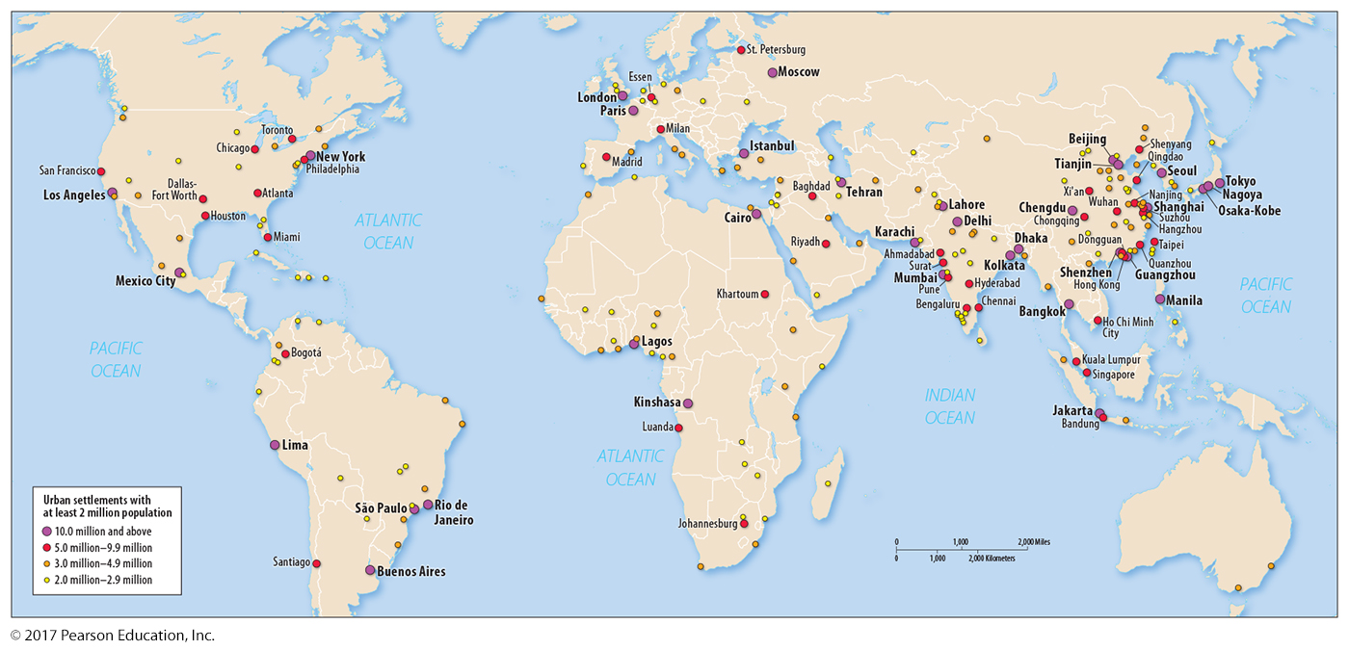
4.4 Urban Settlements of 2+ Million
Figure 12-42: While developed countries are generally more urban as a percentage, most of the world’s largest settlements are in developing countries.

Slide 45
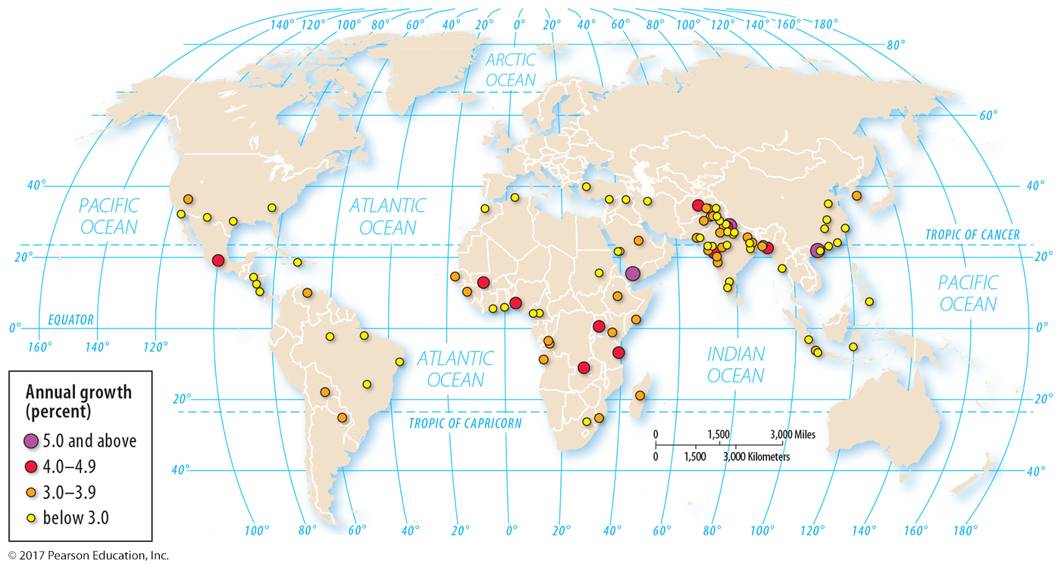
4.4 World’s 100 Fastest Growing Cities
Figure 12-43: Nearly all are in developing countries.

Slide 46
4.4 World’s Largest City: Tokyo
Figure 12-44: Toyko-Yokohama has about 38 million inhabitants.

Slide 47
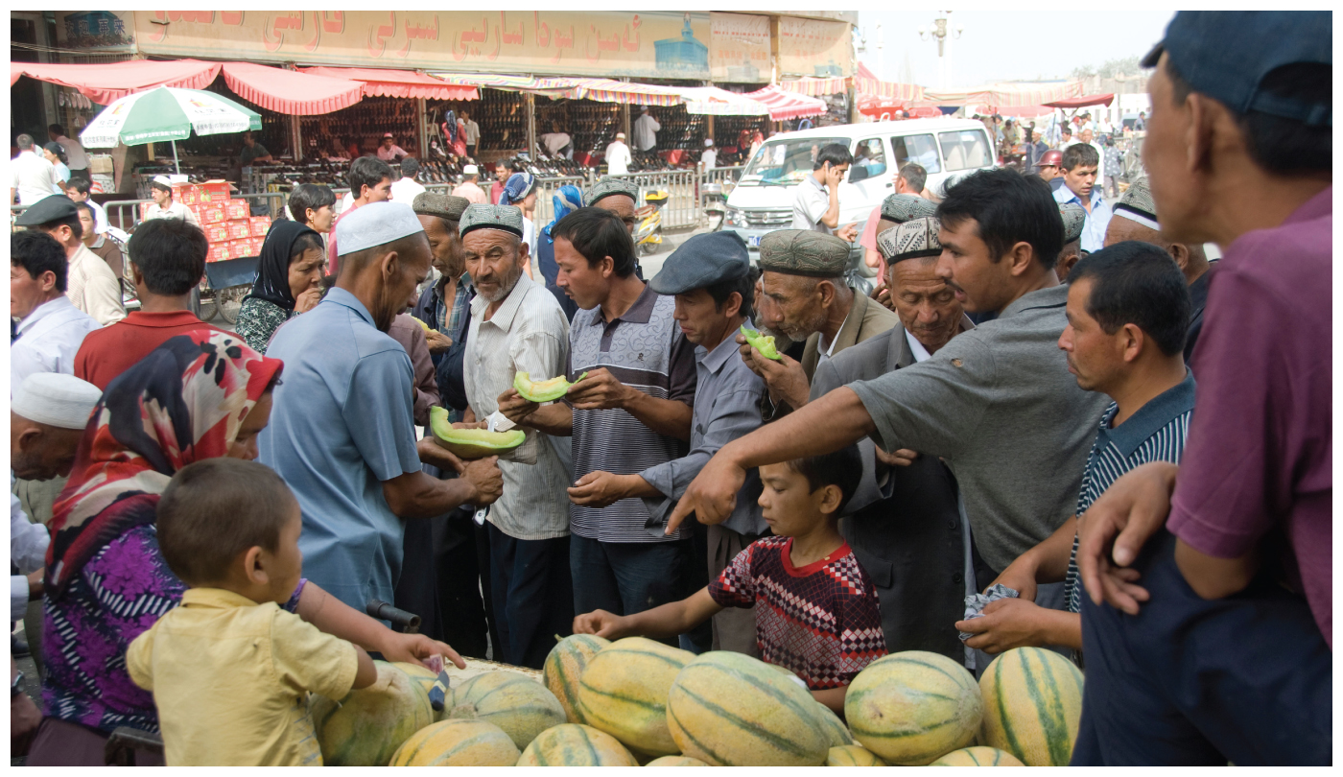
Chapter End

