Slide 1
Chapter 11 Lecture
Chapter 11
Industry and Energy
Tim Scharks Green River College

Slide 2
Industry and Energy: Key Issues
Where Is Industry Distributed?
Why Are Situation and Site Factors Important?
Why Do Industries Face Resource Challenges?
Why Are Industries Changing Locations?

Slide 3
Key Issue 1: Where Is Industry Distributed?
1.1 Introducing Industry and Energy
1.2 Industrial Regions

Slide 4
1.1 Introducing Industry and Energy
Industrial Revolution led to innovations in
iron
transportation
textiles
chemicals
food processing
Fossil fuels have become primary source of energy
coal
petroleum
natural gas

Slide 5
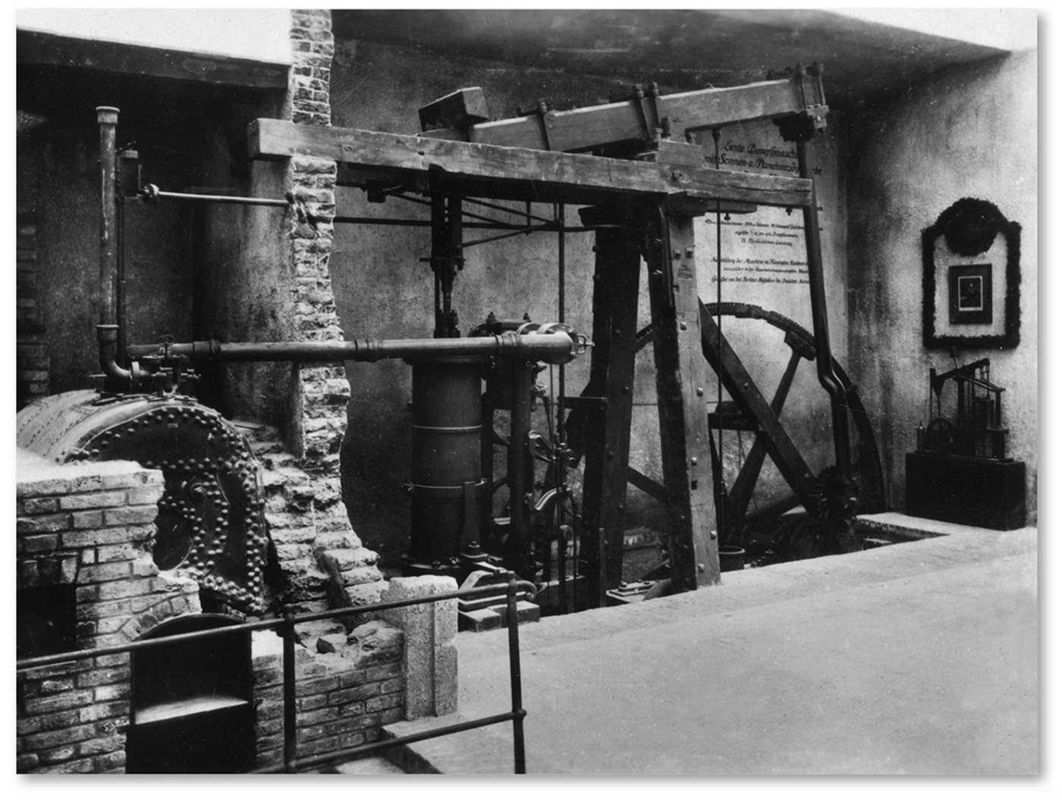
1.1 James Watt’s Steam Engine
Figure 11-1: Watt’s engine was effective at transforming heat energy into mechanical power.

Slide 6
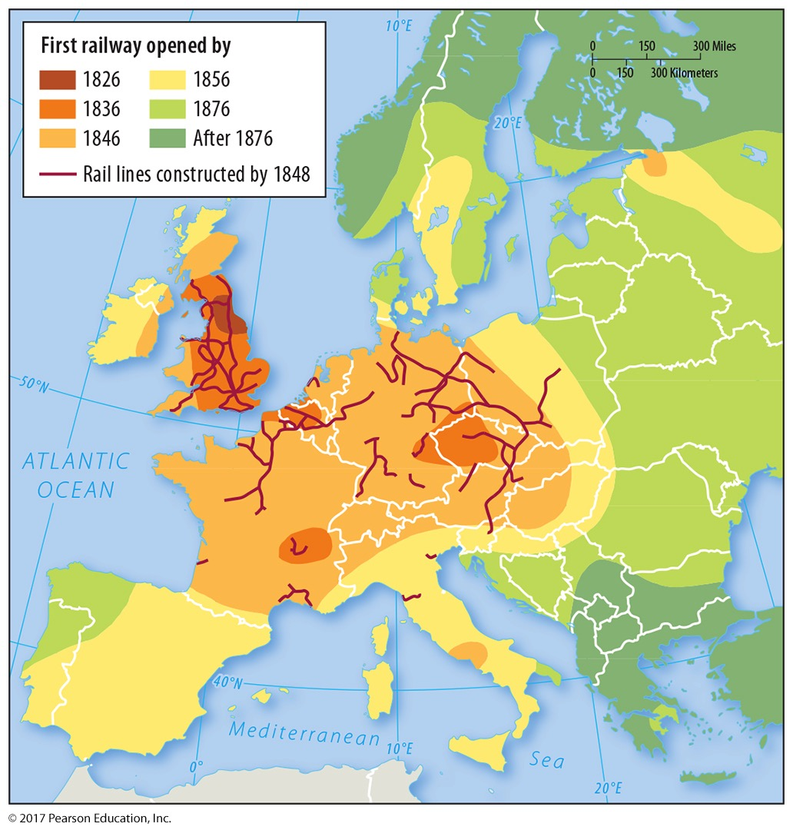
1.1 Diffusion of the Industrial Revolution
Figure 11-2: The development of railways traces the diffusion of the Industrial Revolution across Europe.

Slide 7
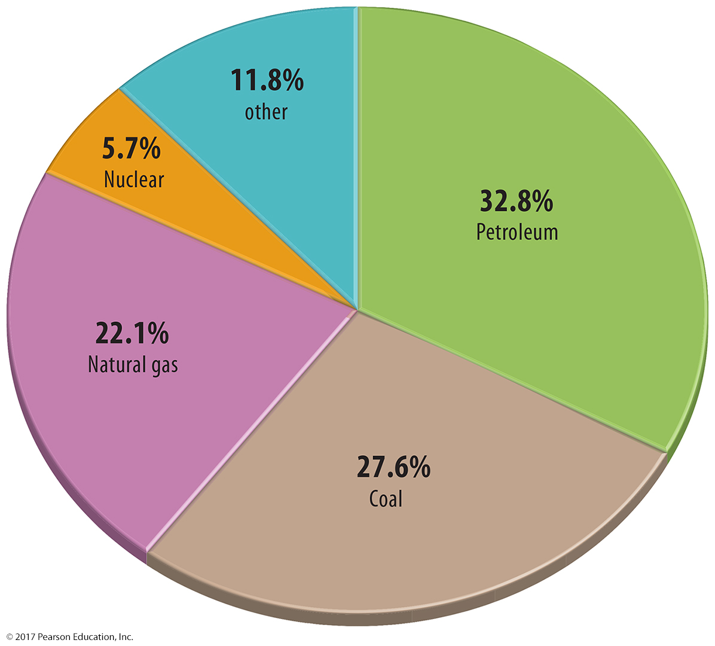
1.1 Energy Consumption
Figure 11-3: Petroleum, coal, and natural gas (fossil fuels) are together the largest sources of energy in the world.

Slide 8
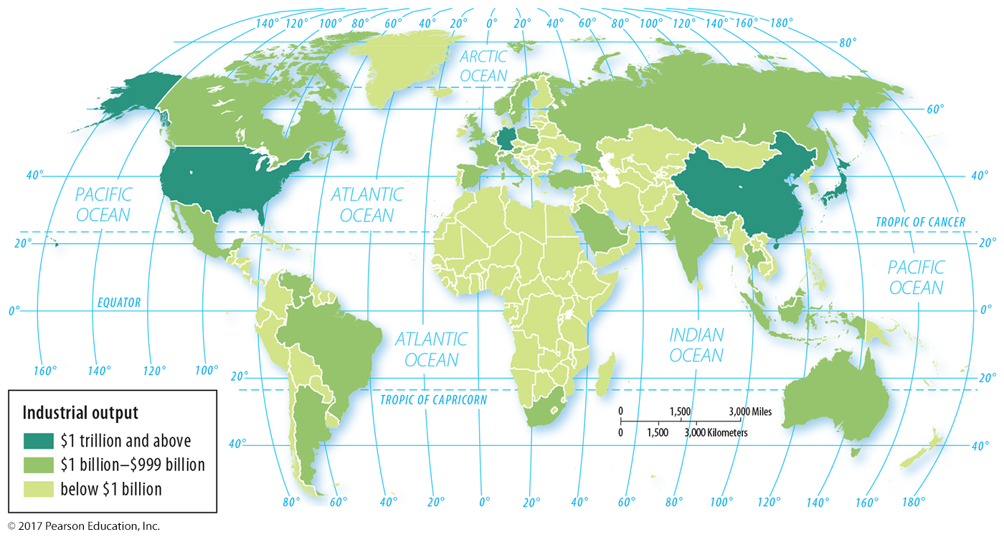
1.2 Industrial Regions
Figure 11-4: Industry is concentrated in Europe, North America, and East Asia.

Slide 9
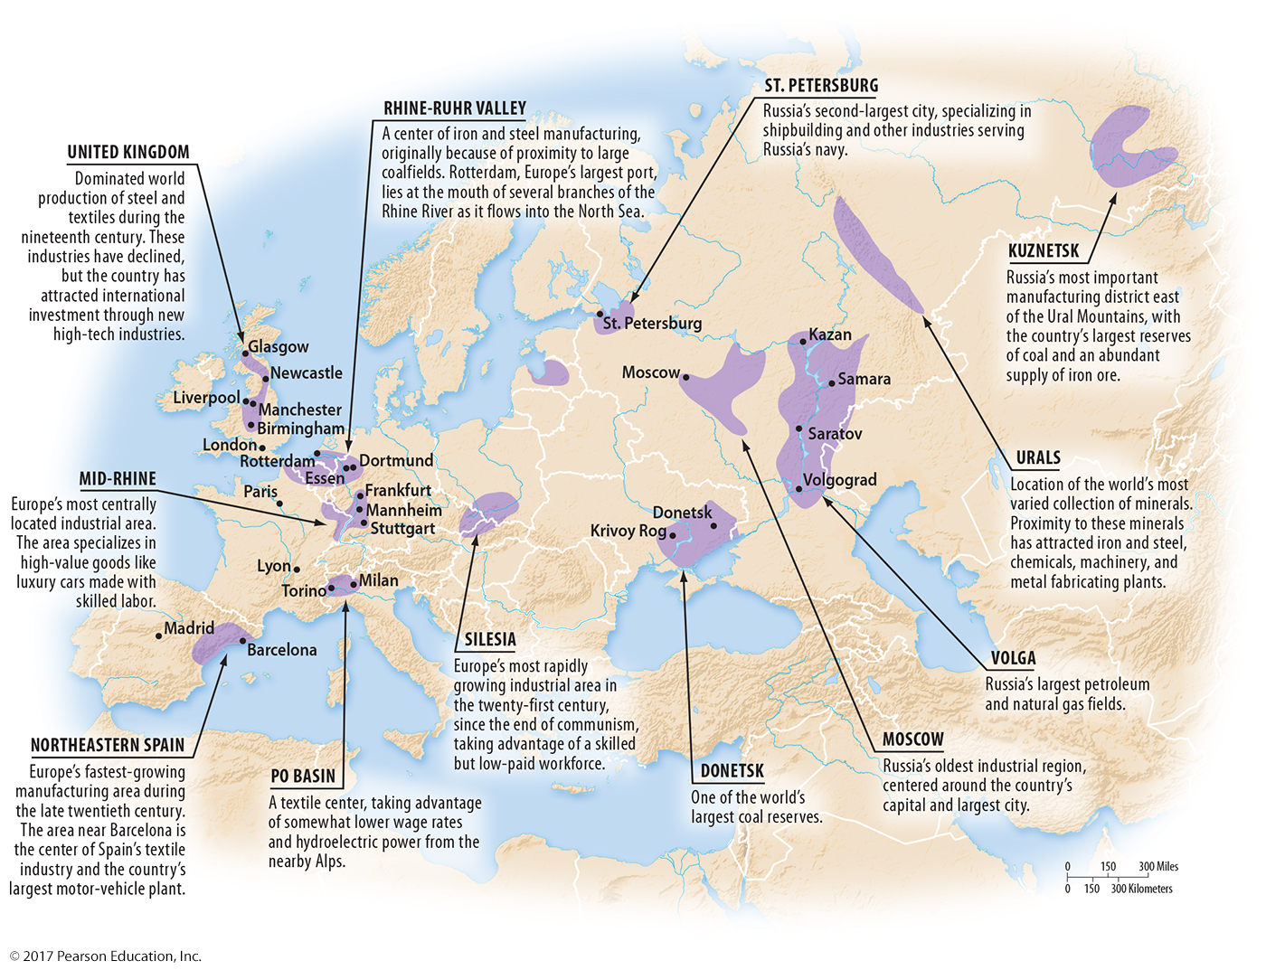
1.2 Europe’s Industrial Regions
Figure 11-5

Slide 10
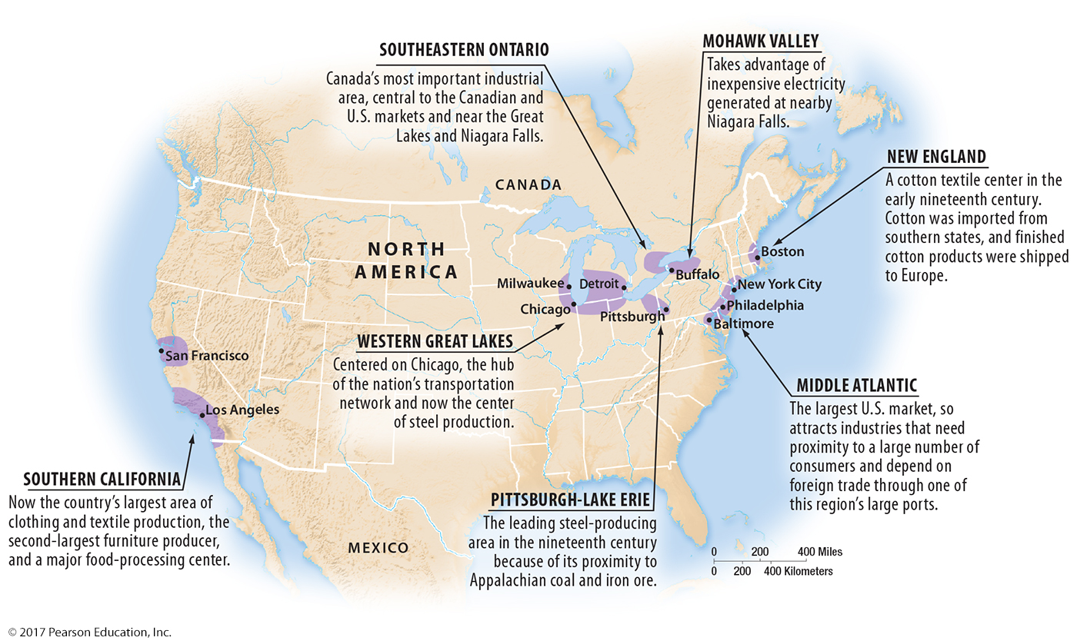
1.2 North America’s Industrial Regions
Figure 11-6

Slide 11
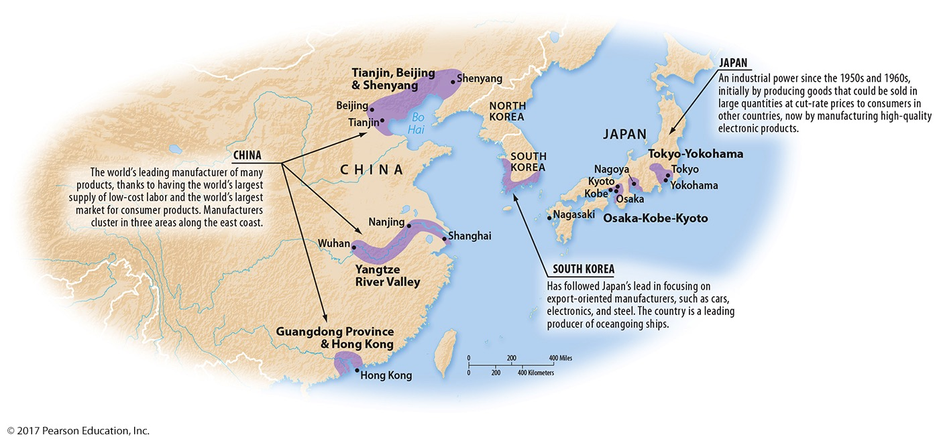
1.2 East Asia’s Industrial Regions
Figure 11-7

Slide 12
Key Issue 2: Why Are Situation and Site Factors Important?
2.1 Situation Factors: Proximity to Inputs
2.2 Situation Factors: Proximity to Markets
2.3 Changing Situation Factors: Steel
2.4 Truck, Train, Ship, or Plane?
2.5 Site Factors in Industry
2.6 Changing Site Factors: Clothing

Slide 13
2.1 Situation and Site Factors
Situation factors: costs of transporting inputs vs. finished goods
location close to inputs or markets
Site factors: labor, capital, and land characteristics
more important than situation factors for some industries

Slide 14
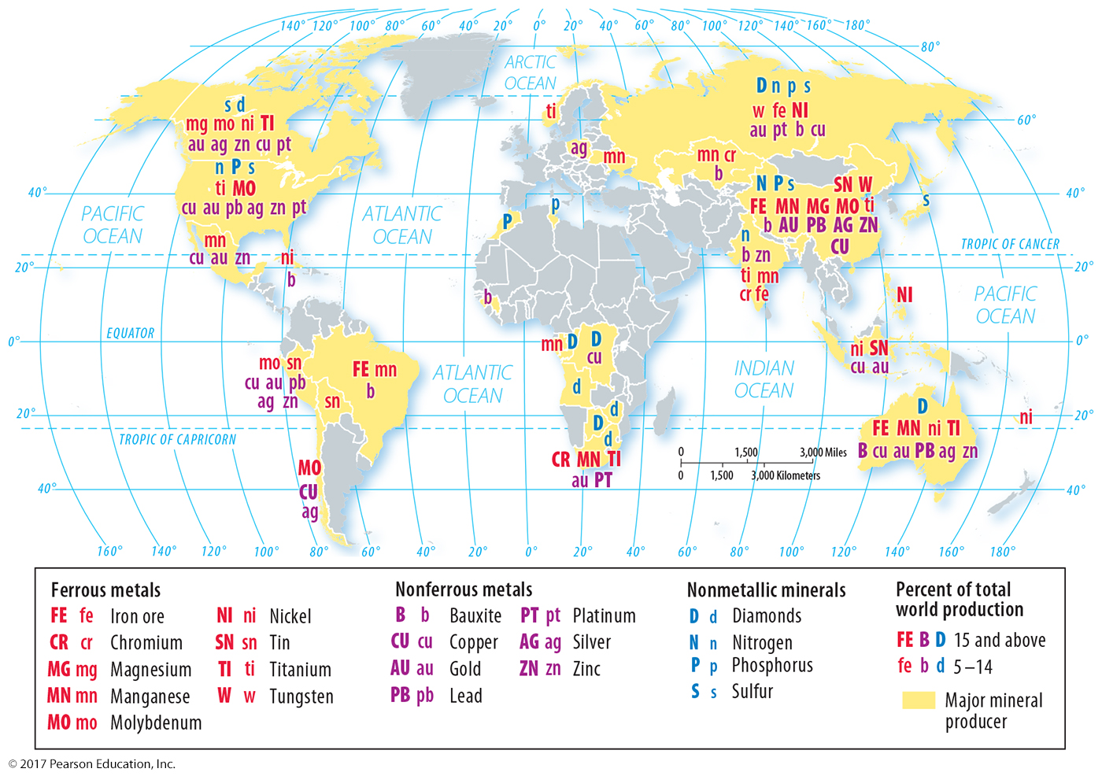
2.1 Distribution of Minerals
Figure 11-9: Important minerals for industry are found in Earth’s crust, but not uniformly.

Slide 15
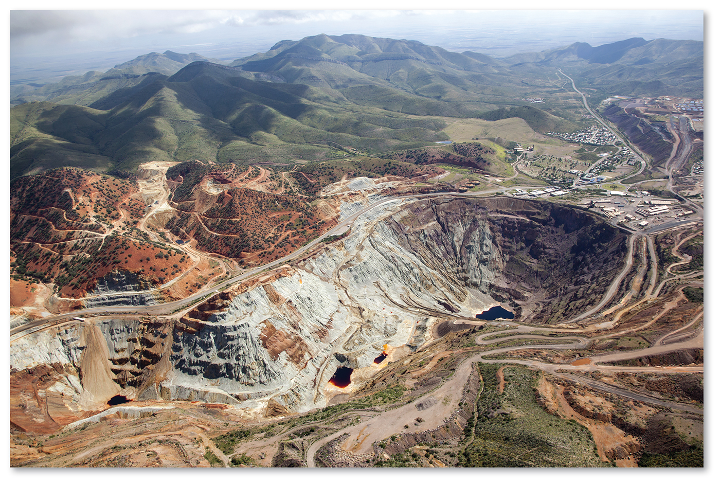
2.1 Location Close to Inputs: Copper
Figure 11-10: Only a fraction of ore mined is copper. A concentration mill is located close to the mine to increase the value per weight by removing non-copper rock from the ore.

Slide 16
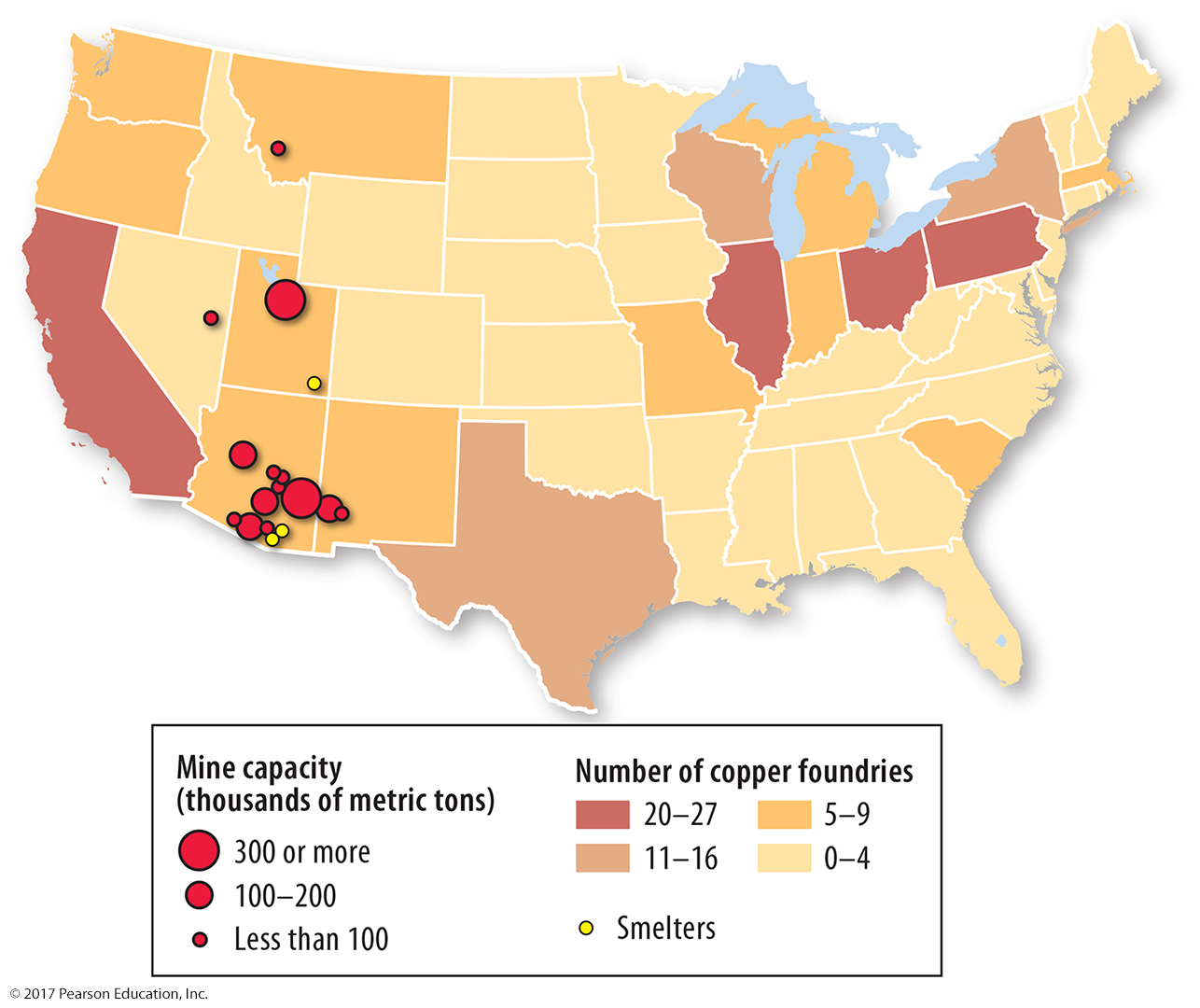
2.1 Location Close to Inputs: Copper
Figure 11-11: Concentration and smelting are located near mines because they reduce bulk and increase value per weight. Manufacturing in foundries is not bulk reducing.

Slide 17
2.2 Location Close to Markets
Bulk-gaining industries: gain weight or bulk during production
Location close to markets
single-market manufacturers
perishable products
motor vehicles

Slide 18
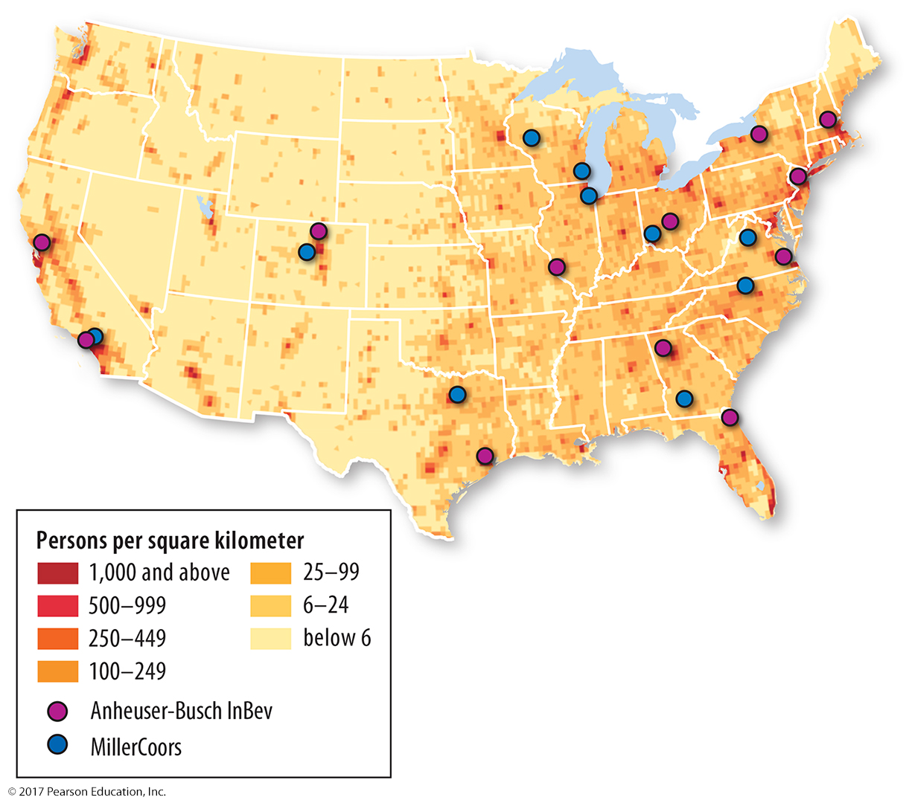
2.2 Bulk-gaining Industry: Beverage Production
Figure 11-12: Beer production is a bulk-gaining industry, so bottling takes place near large population clusters.

Slide 19
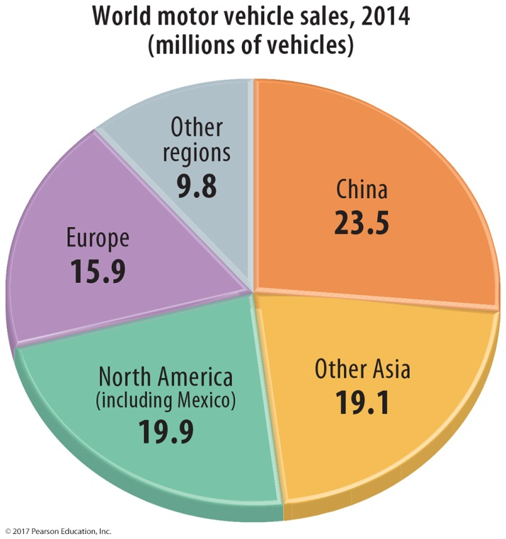
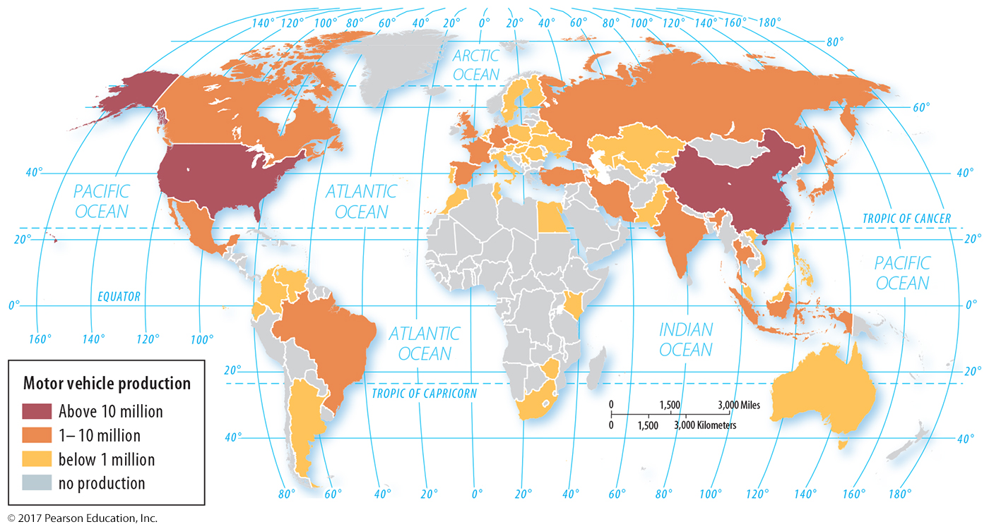
2.2 Motor Vehicle Production and Sales
Figures 11-13 & 11-14: Vehicles are mostly produced (right) in areas where they are sold (top left), representing a bulk-gaining industry.

Slide 20
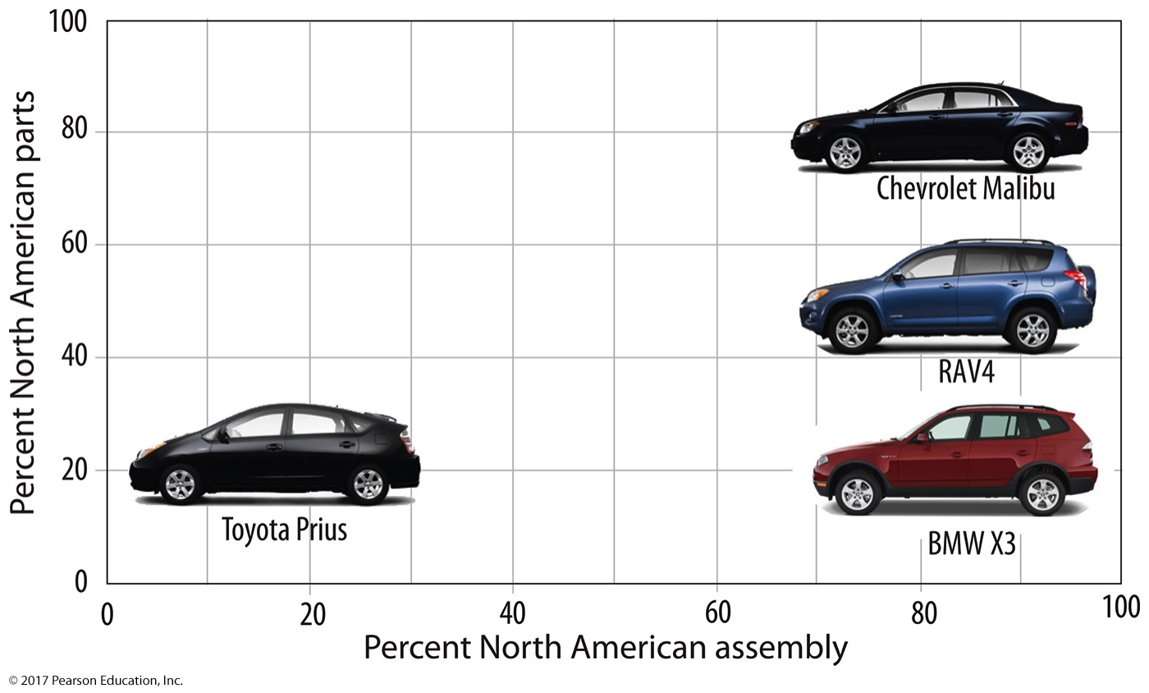
2.2 Motor Vehicle Production in North America
Figure 11-15: Cars sold in North America may not be assembled in North America, and those assembled in North America use different proportions of North American parts.

Slide 21
2.3 Changing Situation Factors: Steel
Steel mills in the United States changed location based on changing sources of raw materials.
Steel minimills now based on proximity to sources of recycled metal
Worldwide, production has shifted to developing countries, especially China.

Slide 22
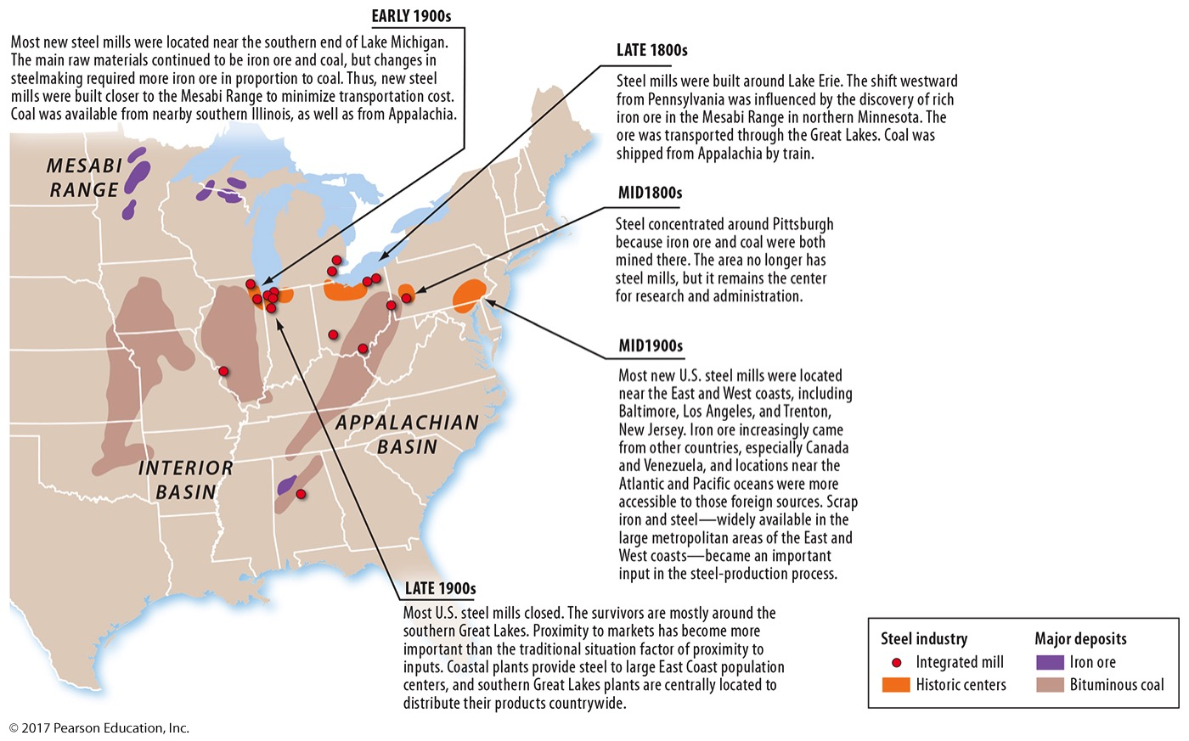
2.3 Changing Situation Factors: Steel
Figure 11-16: Integrated steel mills are clustered near the southern Great Lakes. Historically, steel mills were located near inputs to minimize transportation costs of raw materials.

Slide 23
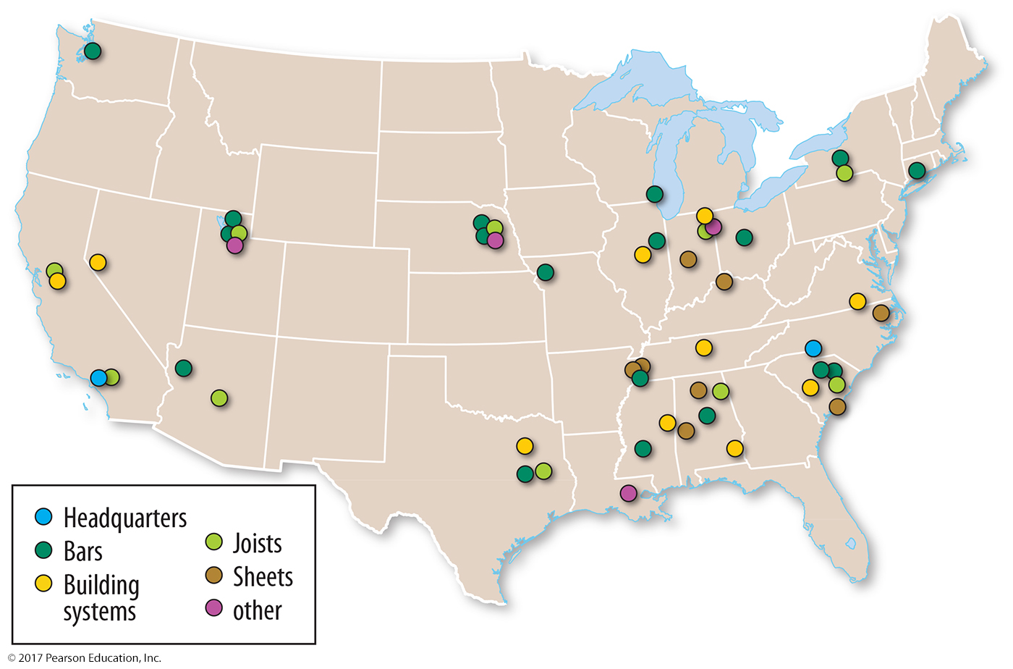
2.3 Changing Situation Factors: Steel
Figure 11-17: Steel minimills are located closer to markets, which also serve as a source of scrap metal.

Slide 24
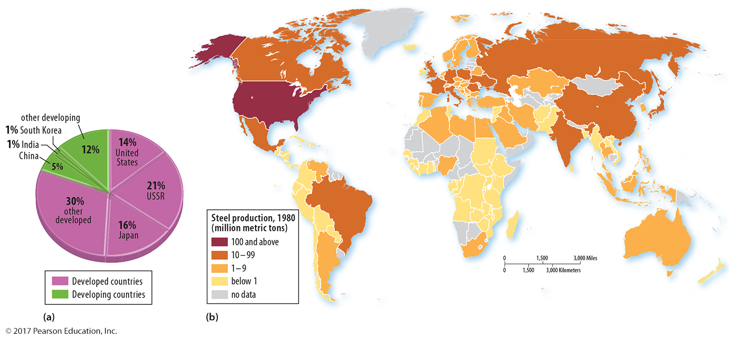
2.3 Changing Situation Factors: Steel
Figure 11-18: In 1980, world steel production was concentrated in developed countries.

Slide 25
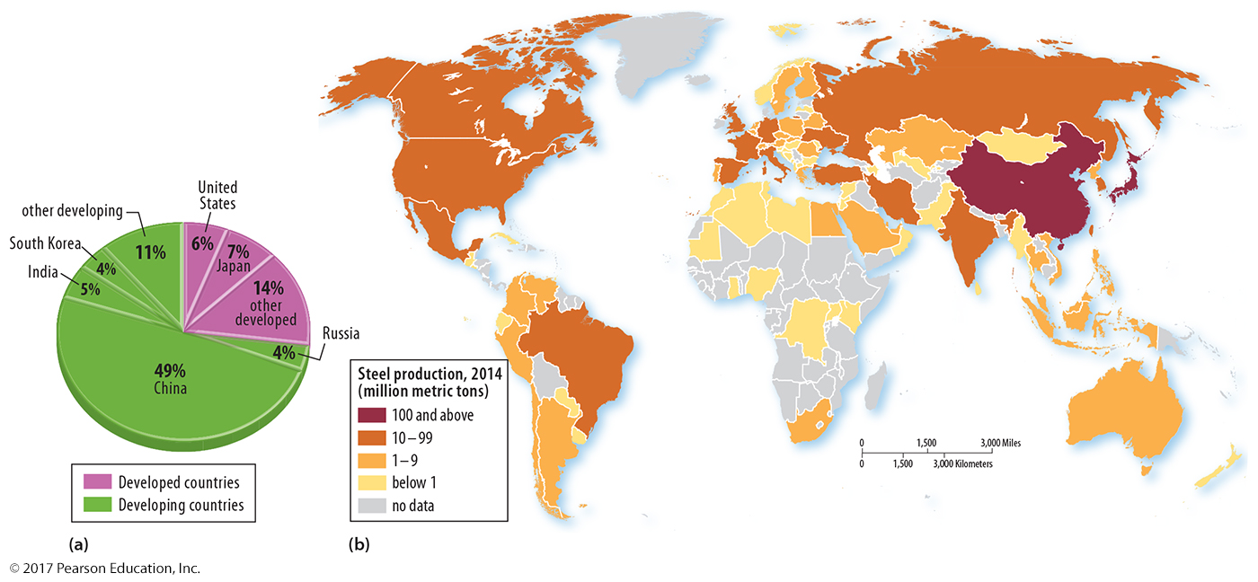
2.3 Changing Situation Factors: Steel
Figure 11-19: By 2013, world steel production had shifted to developing countries.

Slide 26
2.4 Truck, Train, Ship, or Plane?
Trucks used for short-distance delivery (faster loading)
Trains more efficient for longer distances
Ships most cost efficient for very long distances
Airplanes used for speed with high-value, low-bulk items
Some industries located at break-of-bulk points
Others located for just-in-time delivery

Slide 27
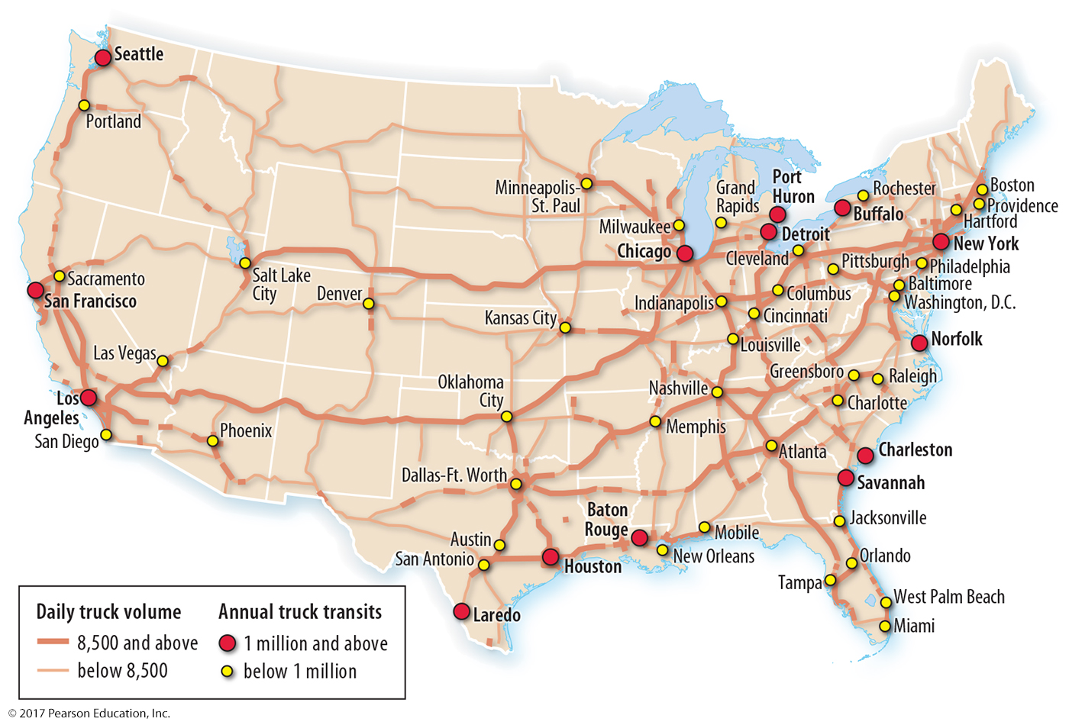
2.4 U.S. Truck Freight Corridors
Figure 11-20: Truck freight movements are concentrated in the eastern U.S.

Slide 28
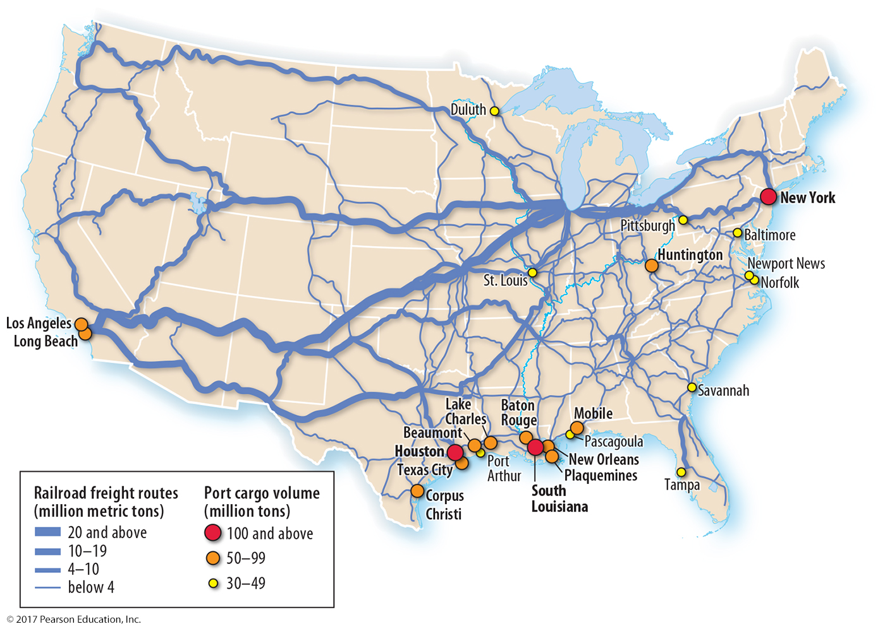
2.4 U.S. Train Freight Corridors
Figure 11-21: Most rail freight movements are between the East and West.

Slide 29
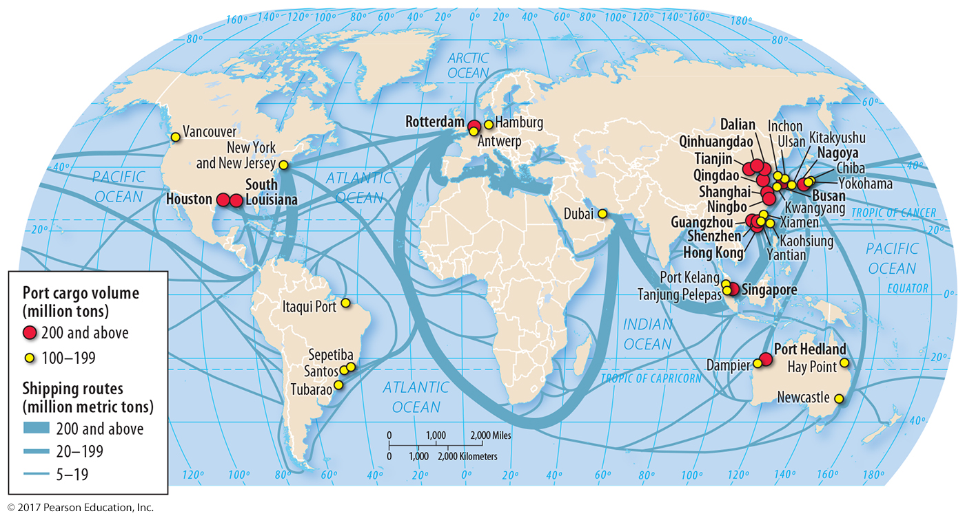
2.4 World Shipping Routes
Figure 11-22: Shipping occurs between North America, Europe, and industrial centers in Asia.

Slide 30
2.5 Site Factors in Industry
Labor: price and skill level especially important for labor-intensive industries
Capital: ability to borrow varies
Land: price, access

Slide 31
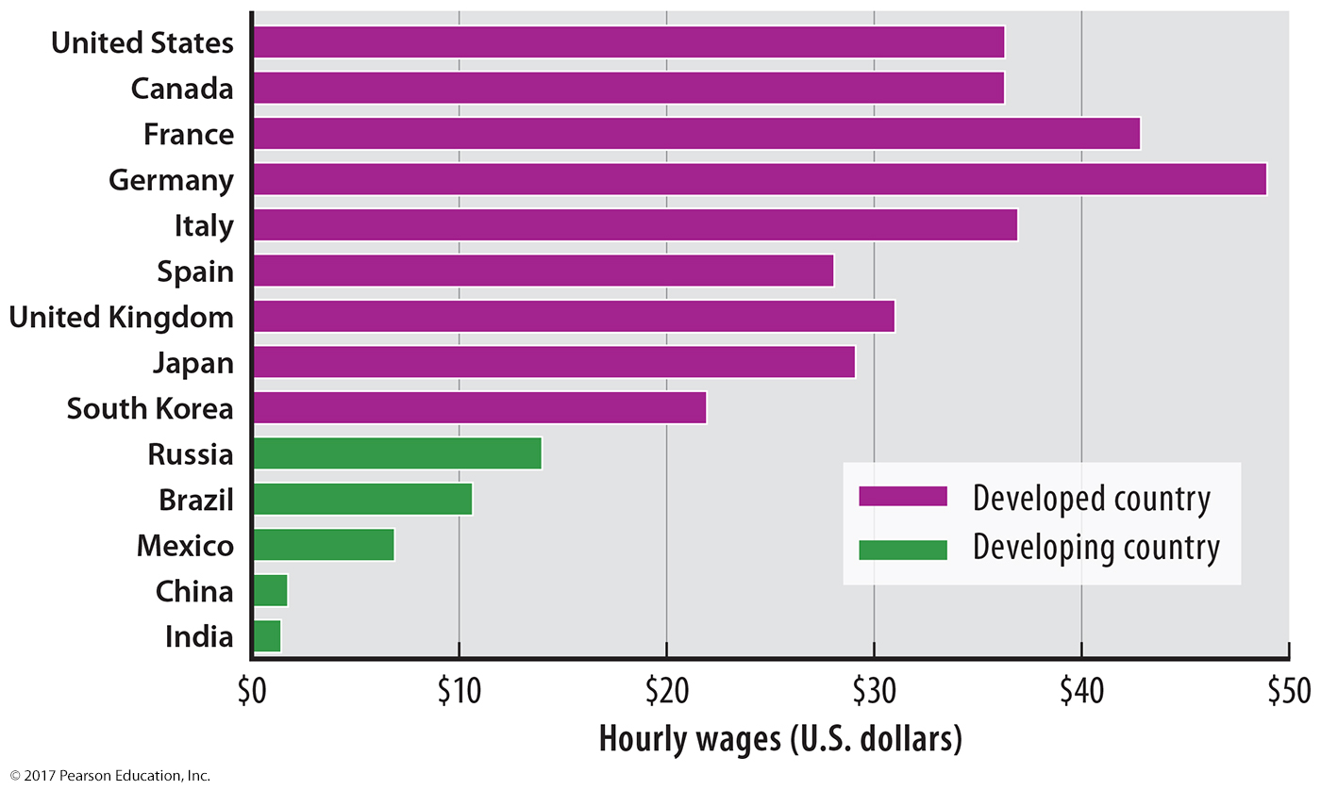
2.5 Site Factors: Labor
Figure 11-23: Average hourly manufacturing wages in 14 of the 15 largest industrial countries.

Slide 32
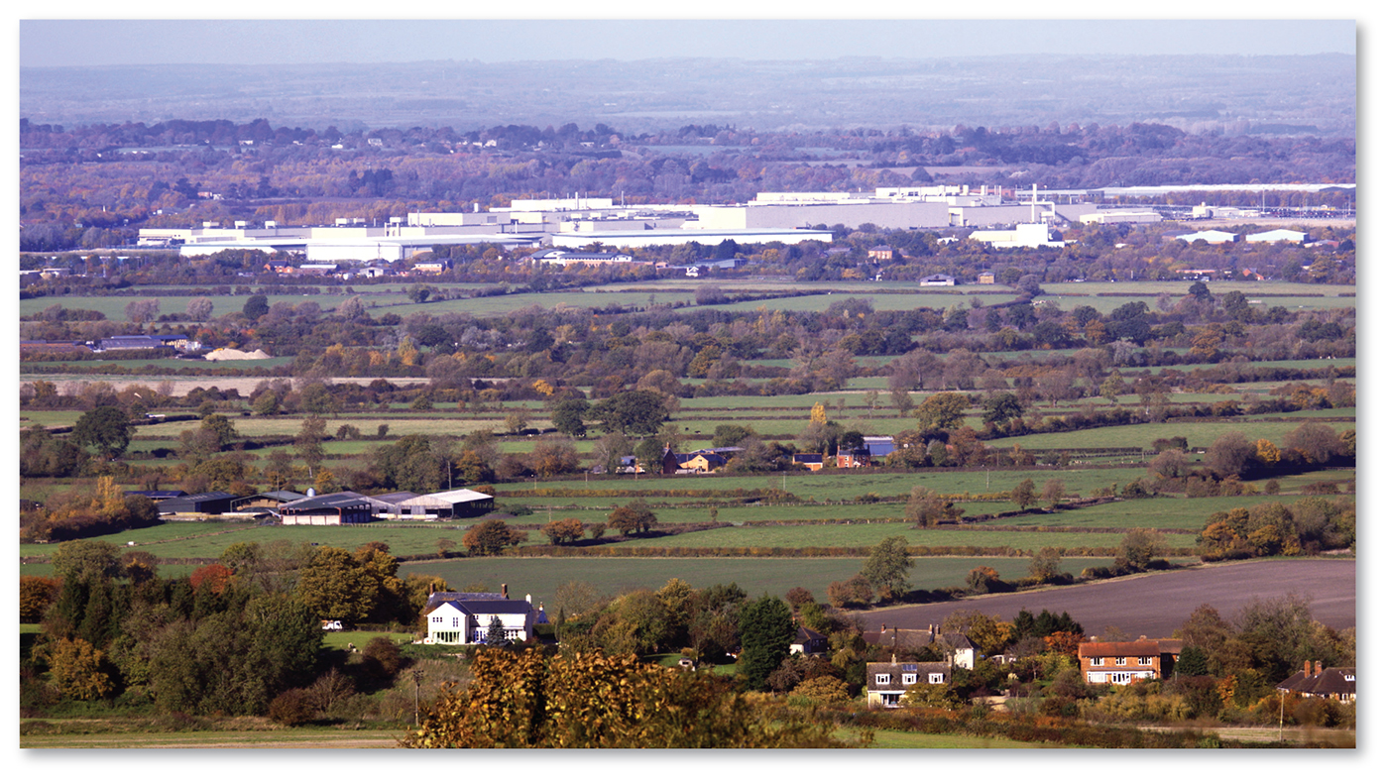
2.5 Site Factors: Land
Figure 11-26: This Honda assembly plant in Swindon, U.K., is one story and located outside of the city.

Slide 33
2.6 Changing Site Factors: Clothing
Spinning yarn is labor-intensive, so increasingly done in developing countries
Weaving yarn into fabric also labor-intensive
Majority of assembly in developing countries, but developed countries play larger role

Slide 34
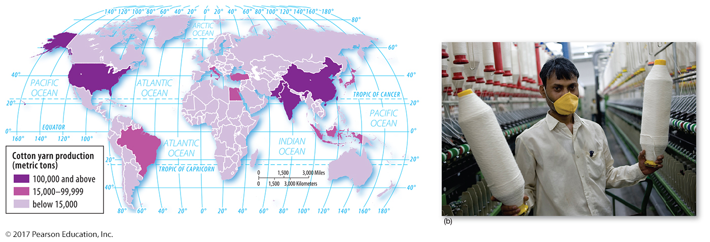
2.6 Cotton Spinning
Figure 11-27: Close to one-half of all cotton yarn is spun in China and India.

Slide 35
2.6 Cotton Weaving
Figure 11-28: Ninety percent of all cotton is woven in China and India.

Slide 36
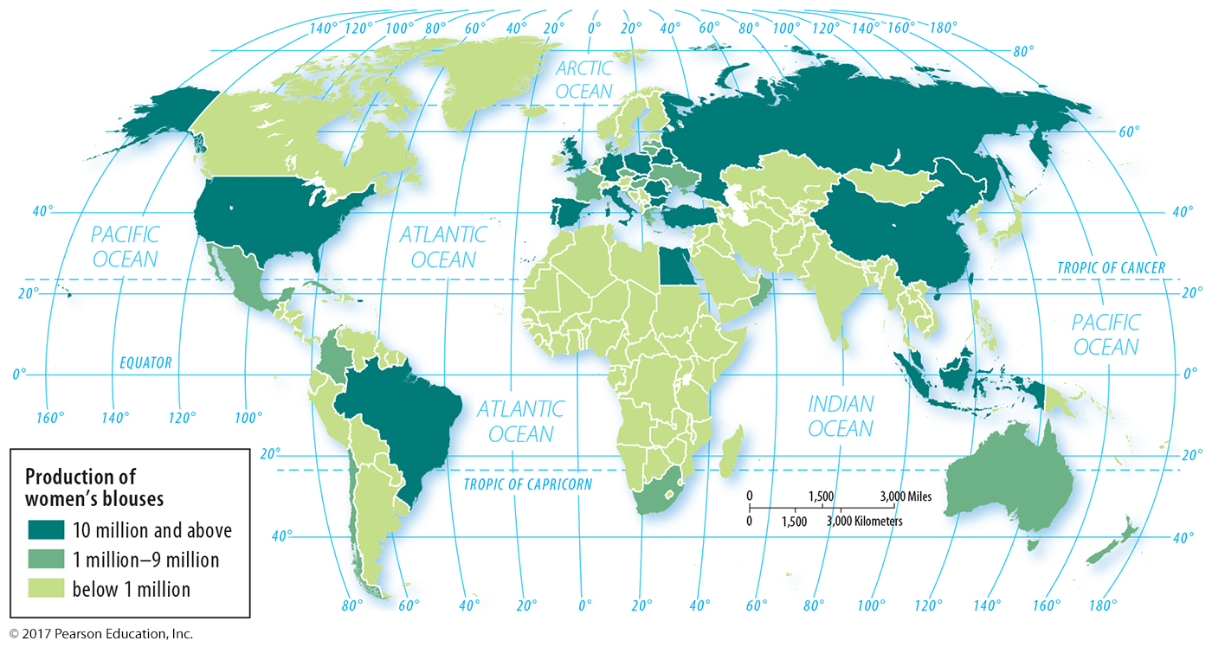
2.6 Women’s Blouse Production (Assembly)
Figure 11-29: Proximity to markets is an important consideration for some clothing assembly.

Slide 37
Key Issue 3: Why Do Industries Face Resource Challenges?
3.1 Energy Supply
3.2 Demand for Energy
3.3 Fossil Fuel Reserves
3.4 Petroleum Futures
3.5 Nuclear Energy
3.6 Energy Alternatives

Slide 38
Key Issue 3: Why Do Industries Face Resource Challenges?
3.7 Solar Energy
3.8 Air Pollution
3.9 Water Pollution
3.10 Solid Waste Pollution

Slide 39
3.1 Energy Supply
Fossil fuel resources are not uniformly distributed.
Demand and supply not always spatially matched

Slide 40
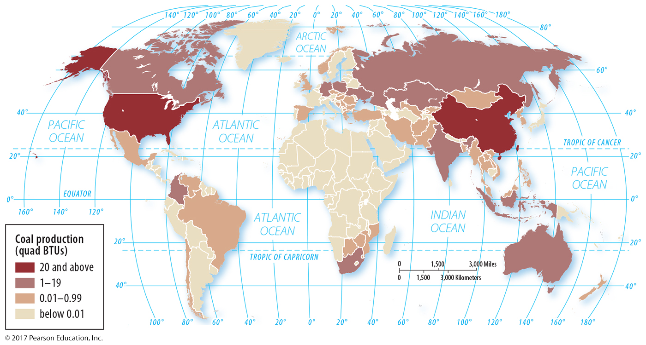
3.1 Coal Production
Figure 11-31: The United States and China lead in coal production.

Slide 41
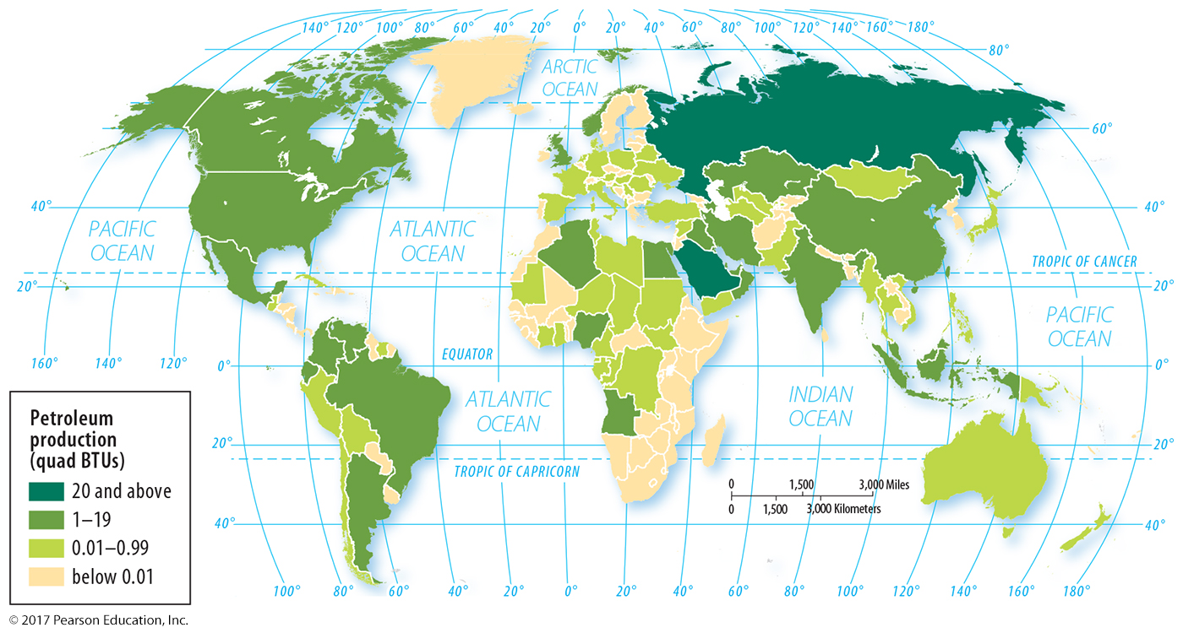
3.1 Petroleum Production
Figure 11-32: Russia, Saudi Arabia, and the United States are leading petroleum producers.

Slide 42
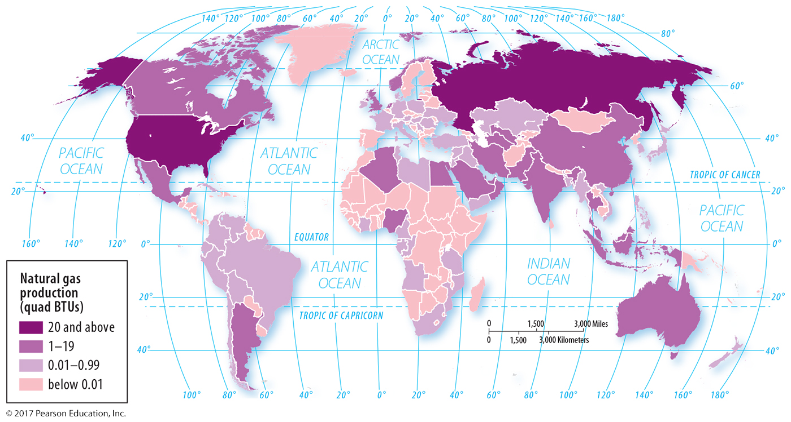
3.1 Natural Gas Production
Figure 11-33: The United States and Russia are the leading producers of natural gas.

Slide 43
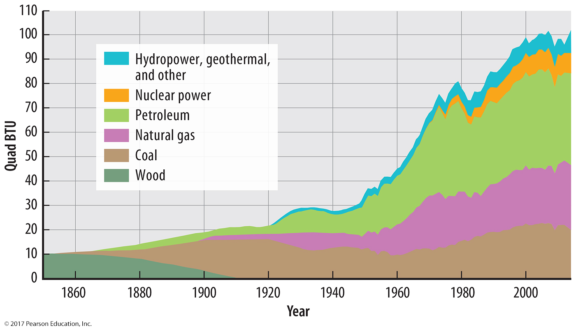
3.1 U.S. Energy Supply
Figure 11-34: Fossil fuels make up about 90 percent of energy use in the United States.

Slide 44
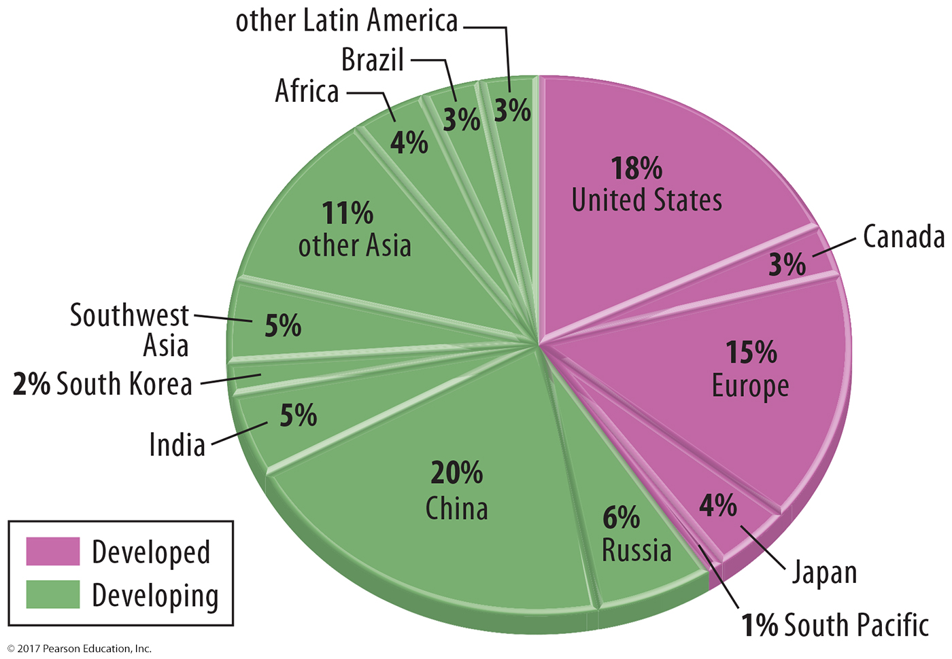
3.2 World Energy Demand
Figure 11-35: Developing countries consume less fossil fuels than their population would predict, but demand is growing.

Slide 45
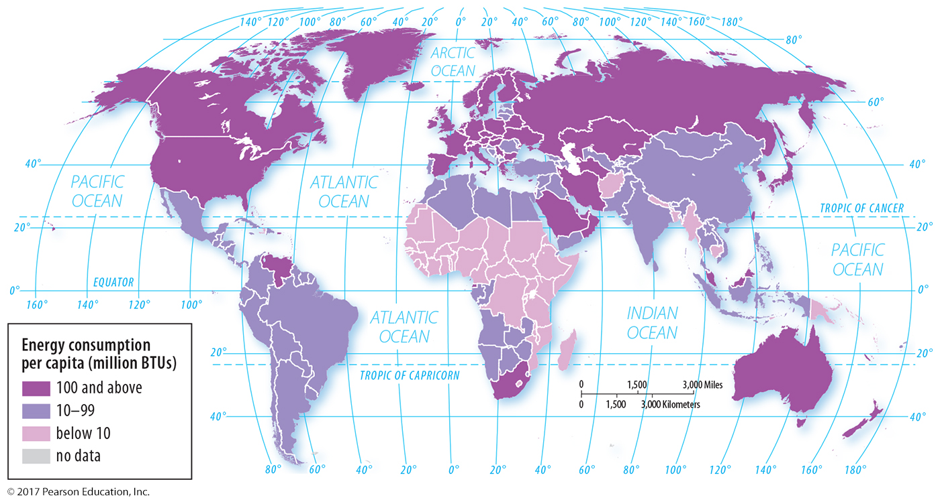
3.2 World Energy Use Per Capita
Figure 11-36: The developed world consumes the most energy resources on a per capita basis.

Slide 46
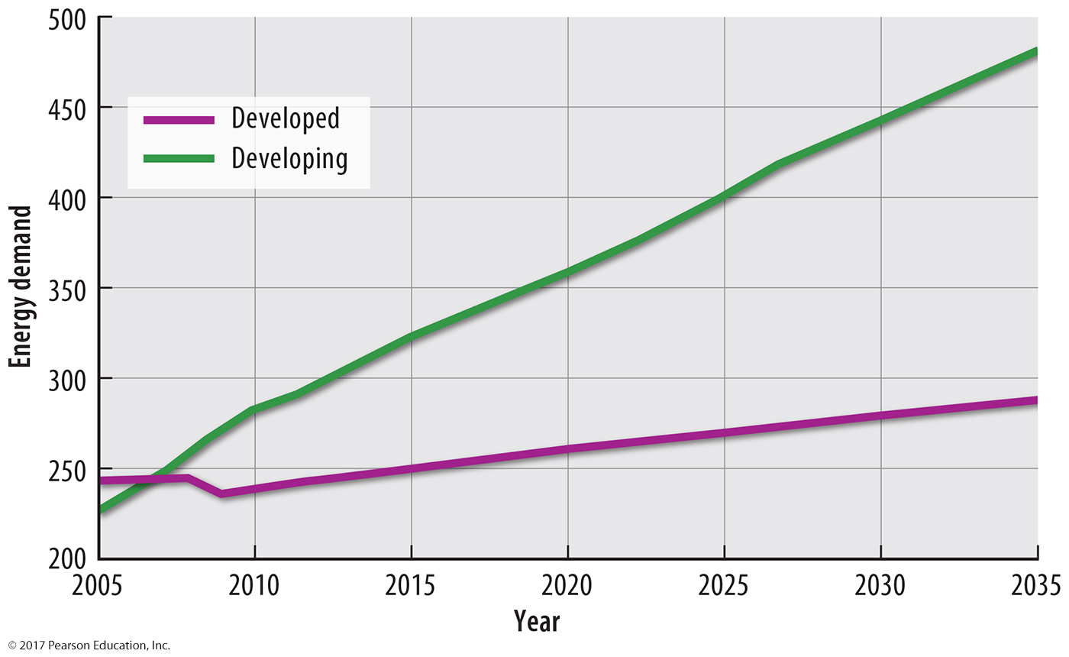
3.2 Future Energy Demand
Figure 11-37: The developing world is projected to increase its energy demand faster than the developed world.

Slide 47
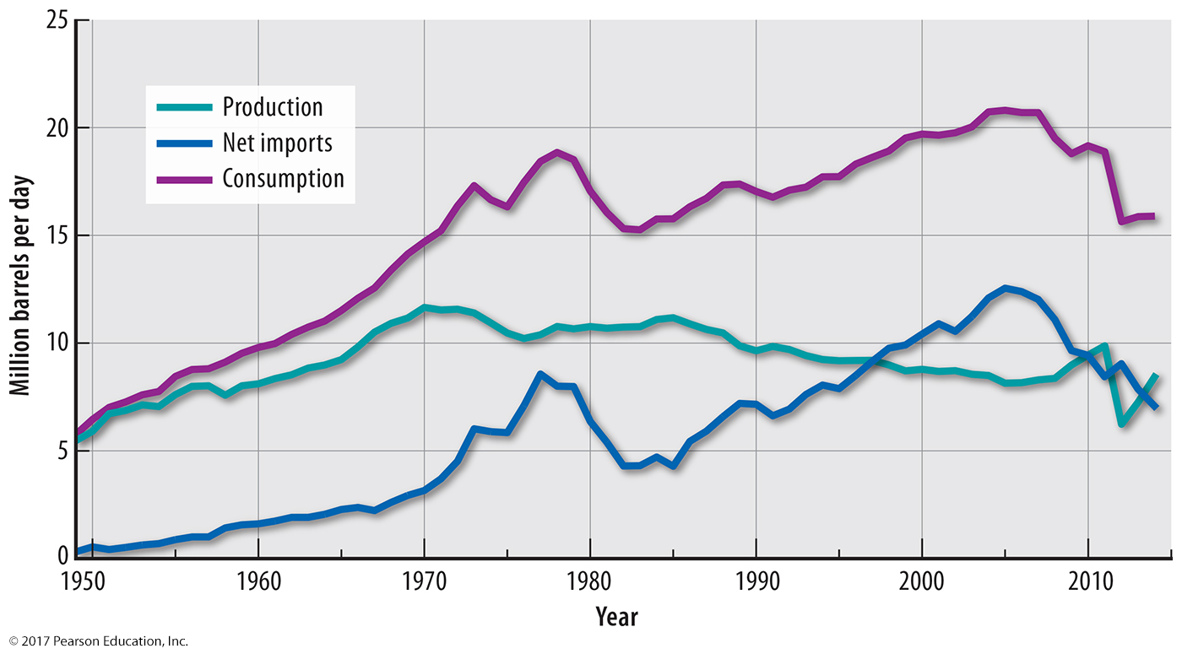
3.2 U.S. Petroleum Supply and Demand
Figure 11-38: The United States has faced difficulty meeting its demand for petroleum with domestic production, relying instead on imports.

Slide 48
3.3 Fossil Fuel Reserves
Proven reserves: already discovered
Potential reserves: thought to exist
Unconventional resources: not thought a resource until price and technology allow
oil sands
hydraulic fracturing

Slide 49
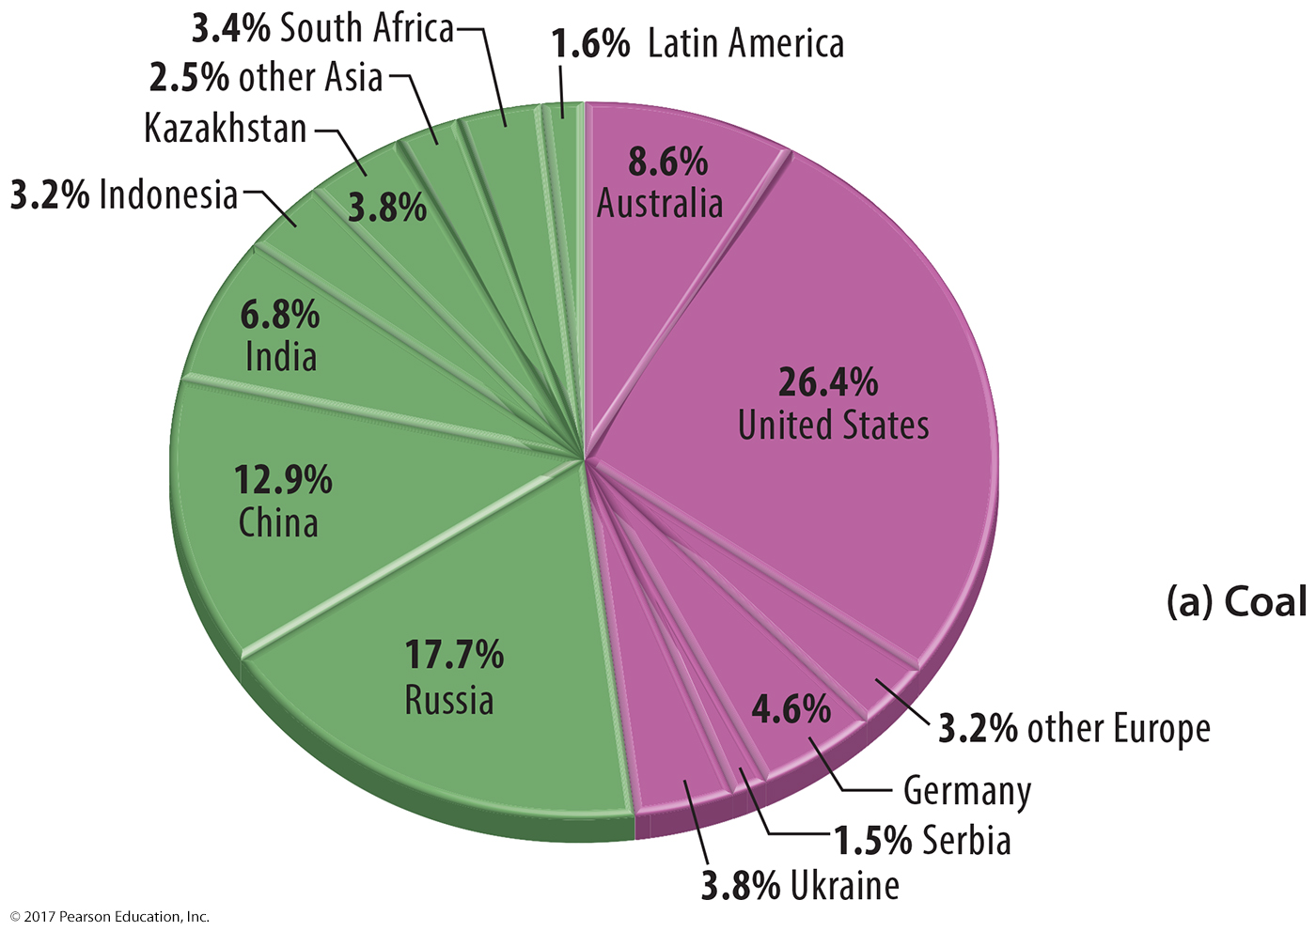
3.3 Proven Reserves: Coal
Figure 11-40(a): Proven reserves of coal are largest in the United States, Russia, and China.

Slide 50
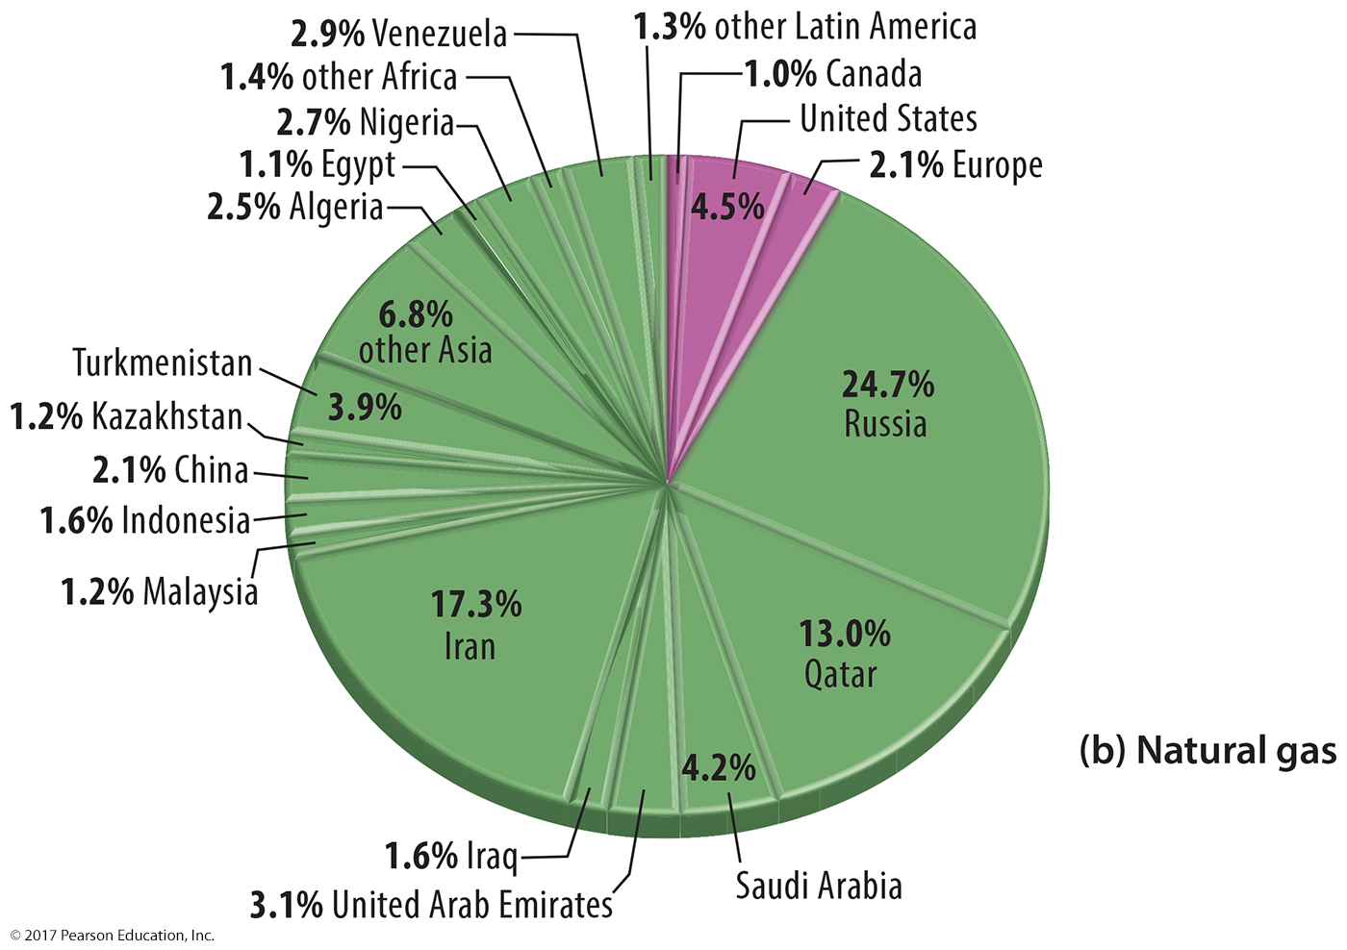
3.3 Proven Reserves: Natural Gas
Figure 11-40(b): Proven reserves of natural gas are largest in Russia, Iran, and Qatar.

Slide 51
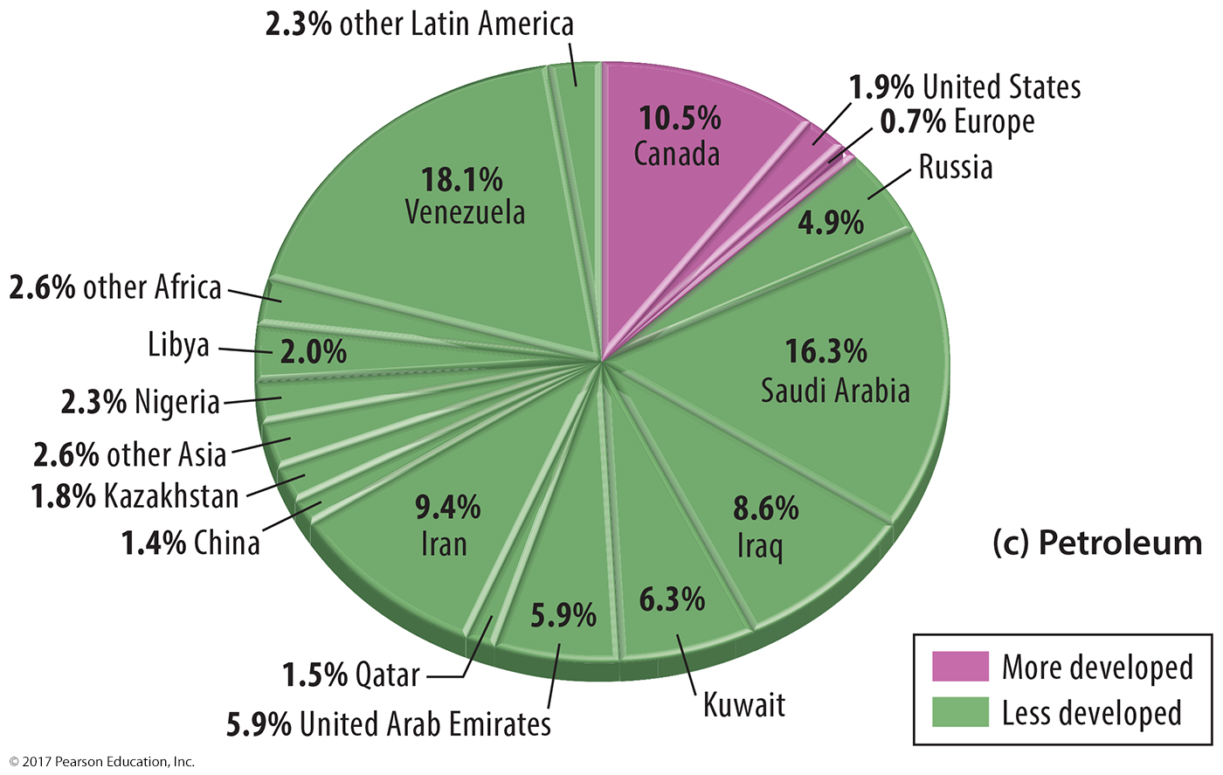
3.3 Proven Reserves: Petroleum
Figure 11-40(c): Proven reserves of petroleum are largest in Venezuela, Saudi Arabia, Iran, and Iraq.

Slide 52
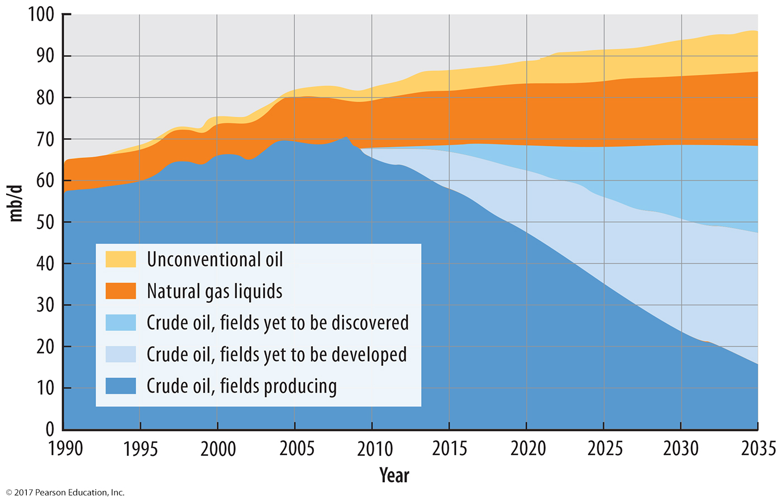
3.3 Petroleum Production Outlook
Figure 11-41: Growth in petroleum production is forecast from potential reserves.

Slide 53
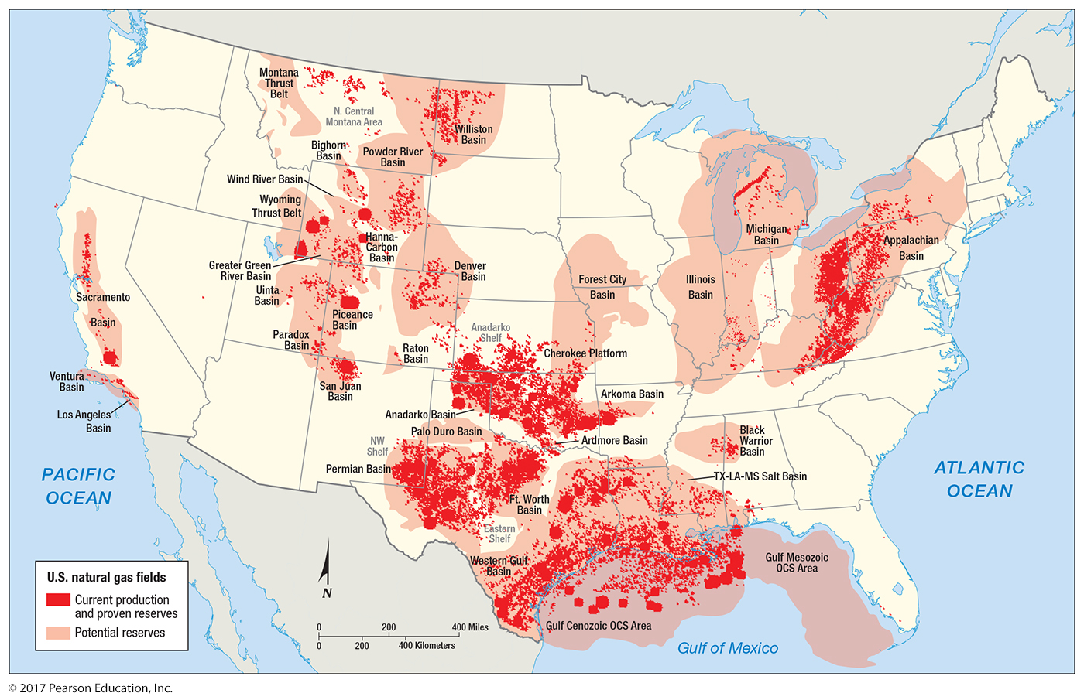
3.3 Natural Gas Fields in the United States
Figure 11-42: Natural gas production has increased through the development of fracking technology.

Slide 54
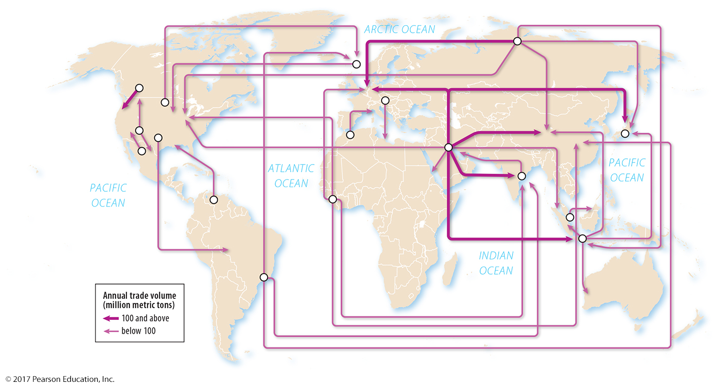
3.4 Petroleum Trade
Figure 11-44: The largest flows of petroleum internationally are out of Southwest Asia and into other parts of Asia and into Europe.

Slide 55
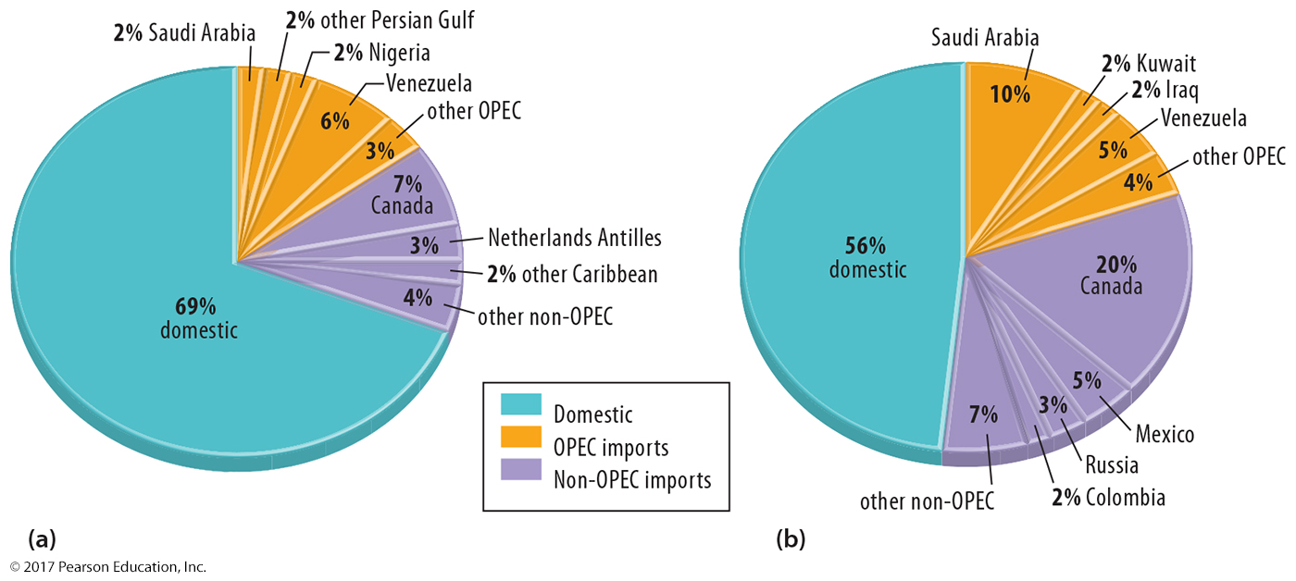
3.4 U.S. Petroleum Sources
Figure 11-45: The United States has become more reliant on imported petroleum (b) than in the 1970s (a).

Slide 56
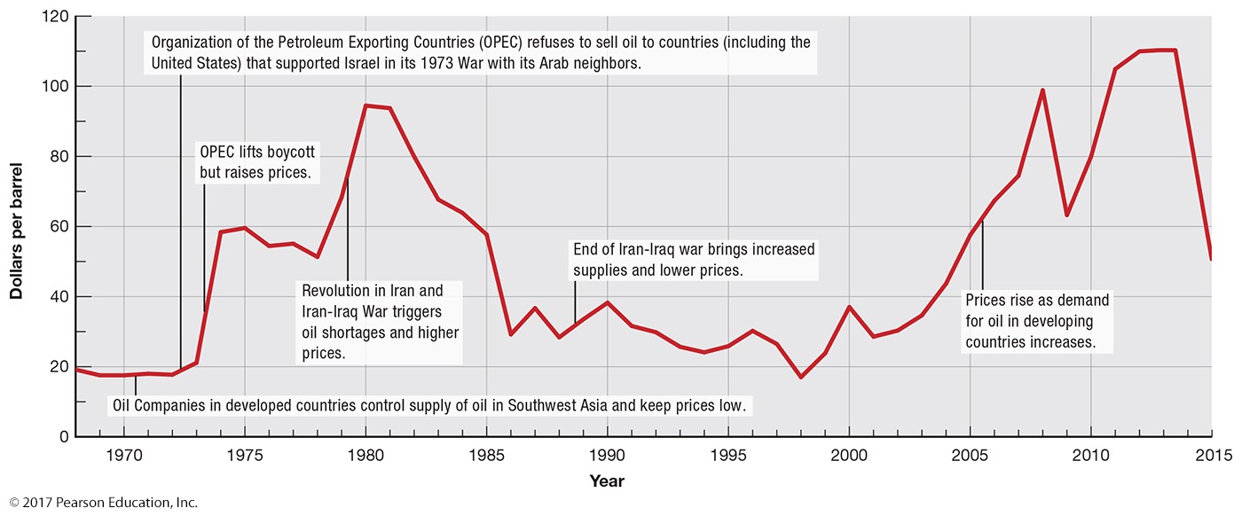
3.4 Petroleum Prices
Figure 11-46: Oil prices reflect demand and international events; declining demand due to conservation has reduced the price of oil.

Slide 57
3.5 Nuclear Energy
Concerns over nuclear power including
Potential accidents
Safe disposal of nuclear waste
Bomb material
Limited reserves
High cost

Slide 58
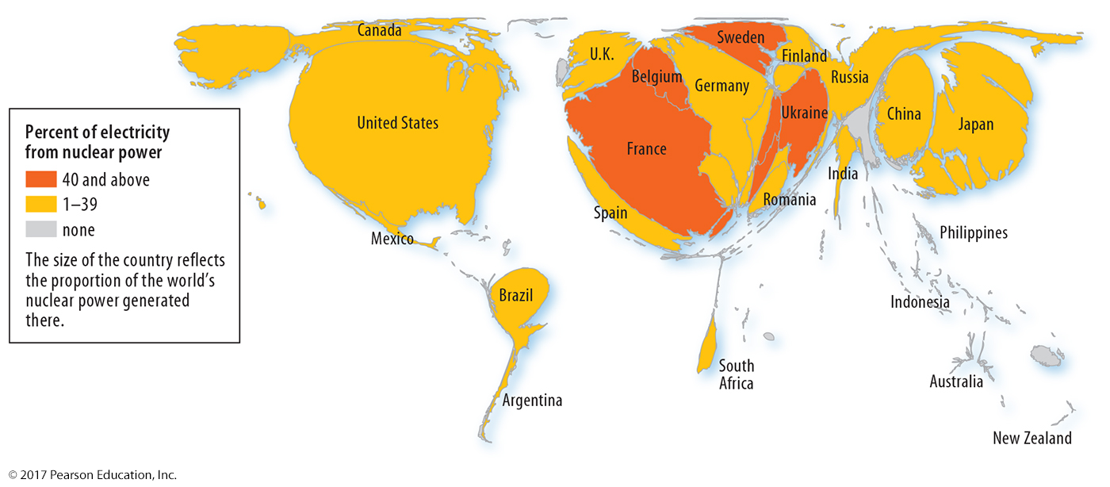
3.5 Nuclear Energy
Figure 11-47: Europe, Japan, and the United States account for the majority of the world’s nuclear power.

Slide 59
3.6 Energy Alternatives
Hydroelectric power
Biomass
Wind power
Geothermal energy

Slide 60
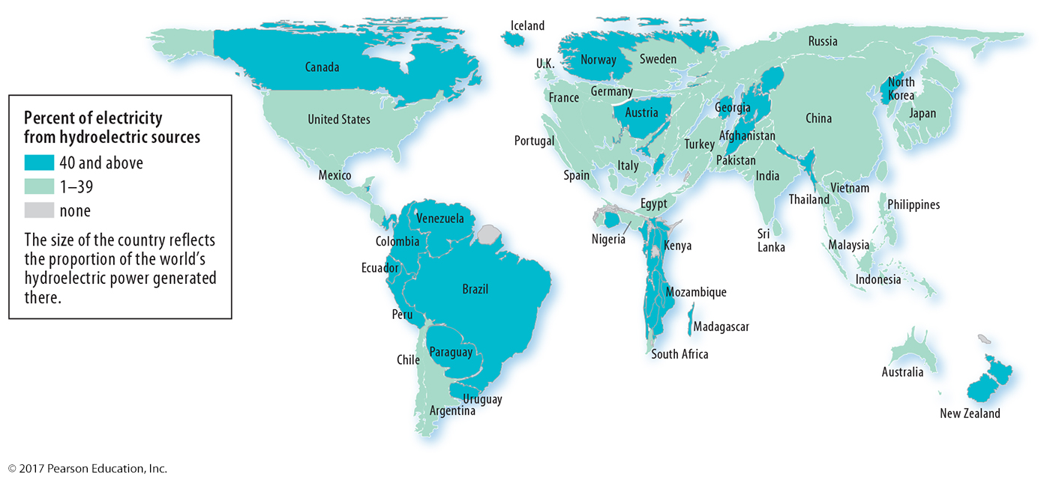
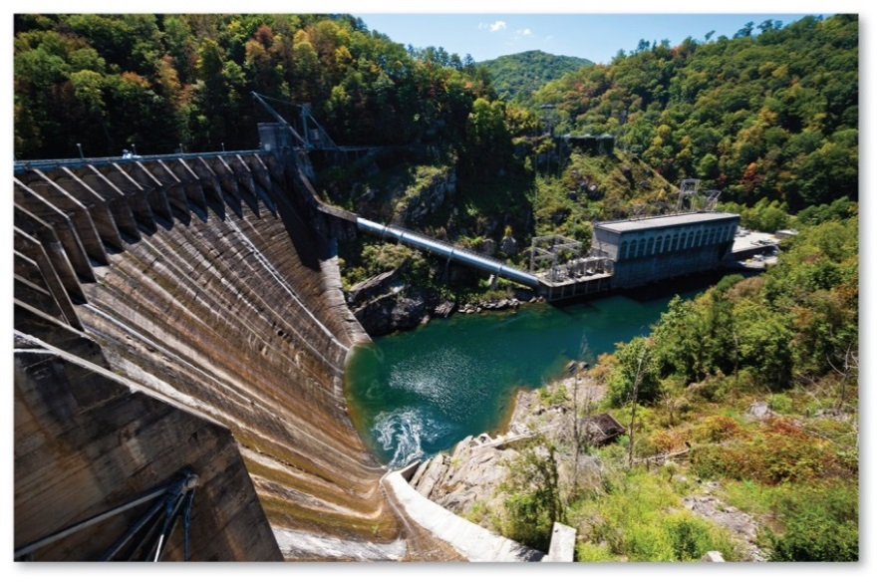
3.6 Energy Alternatives: Hydroelectric
Figures 11-50 and 11-51: The production of hydroelectric power depends in part on the availability of acceptable sites.

Slide 61
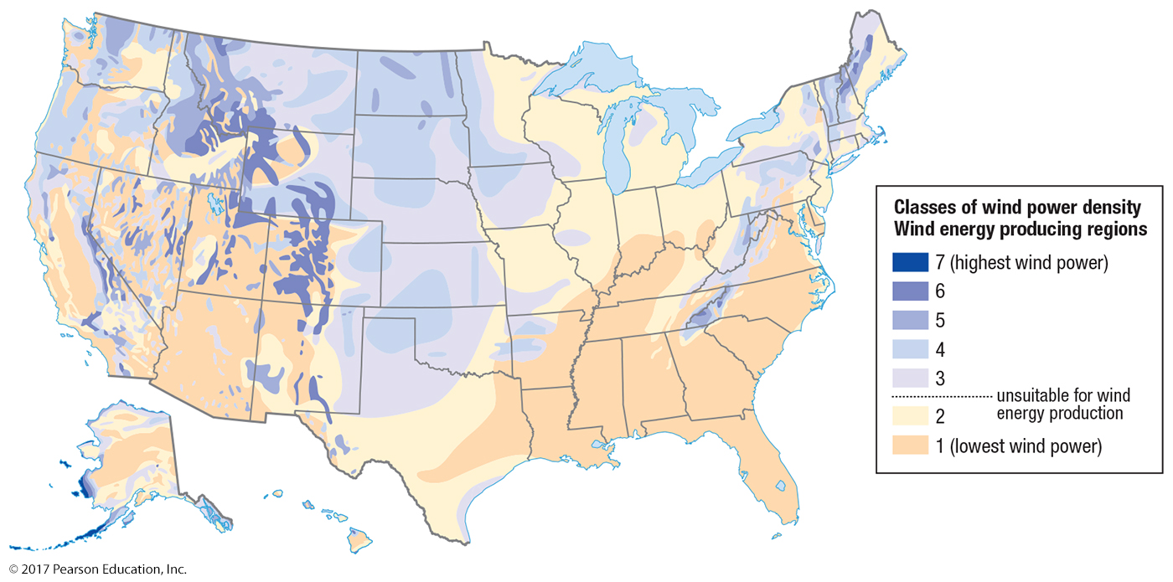
3.6 Energy Alternatives: Wind
Figure 11-52: Wind power potential is high in the Rocky Mountains and Great Plains.

Slide 62
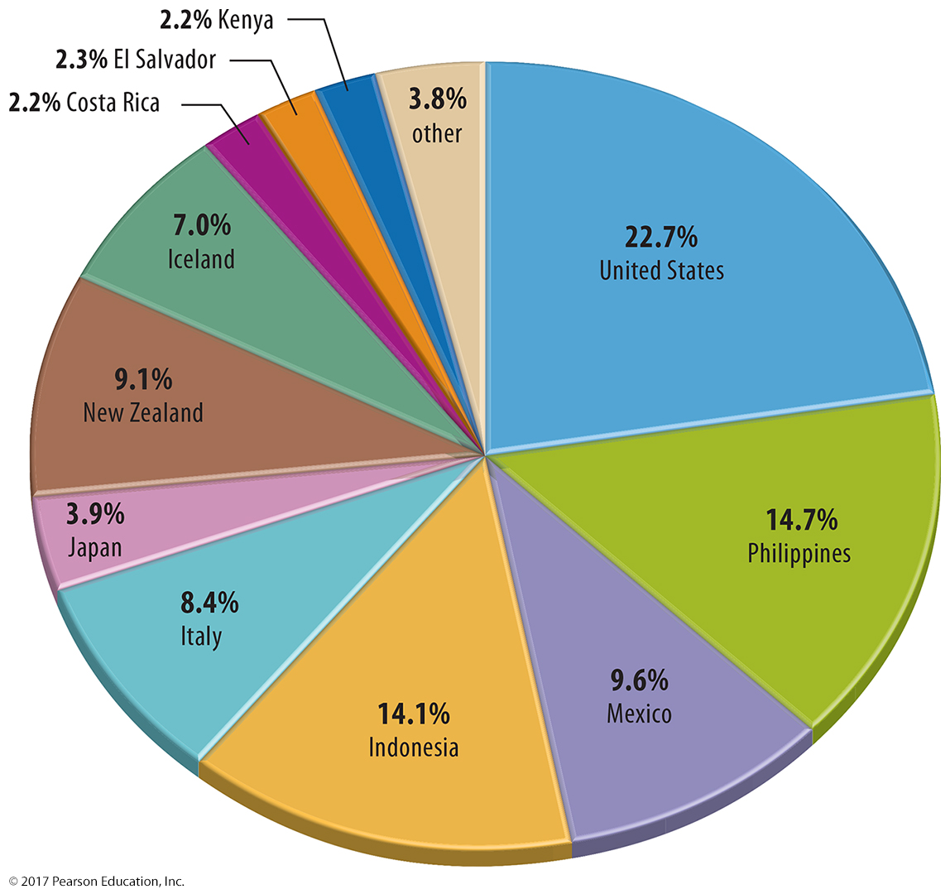
3.6 Energy Alternatives: Geothermal
Figure 11-54: Geothermal energy requires appropriate geologic conditions.

Slide 63
3.7 Solar Energy
Passive solar: using Sun energy for heating
Active solar: converting Sun energy to electricity
Solar power can charge electric cars, electrify remote villages

Slide 64
3.7 Solar Energy
Figure 11-56: Solar energy heats water on this rooftop in Jerusalem.

Slide 65
3.8 Air Pollution
Global scale: climate change, ozone damage
Regional scale: acid deposition
Local scale: urban air pollution

Slide 66
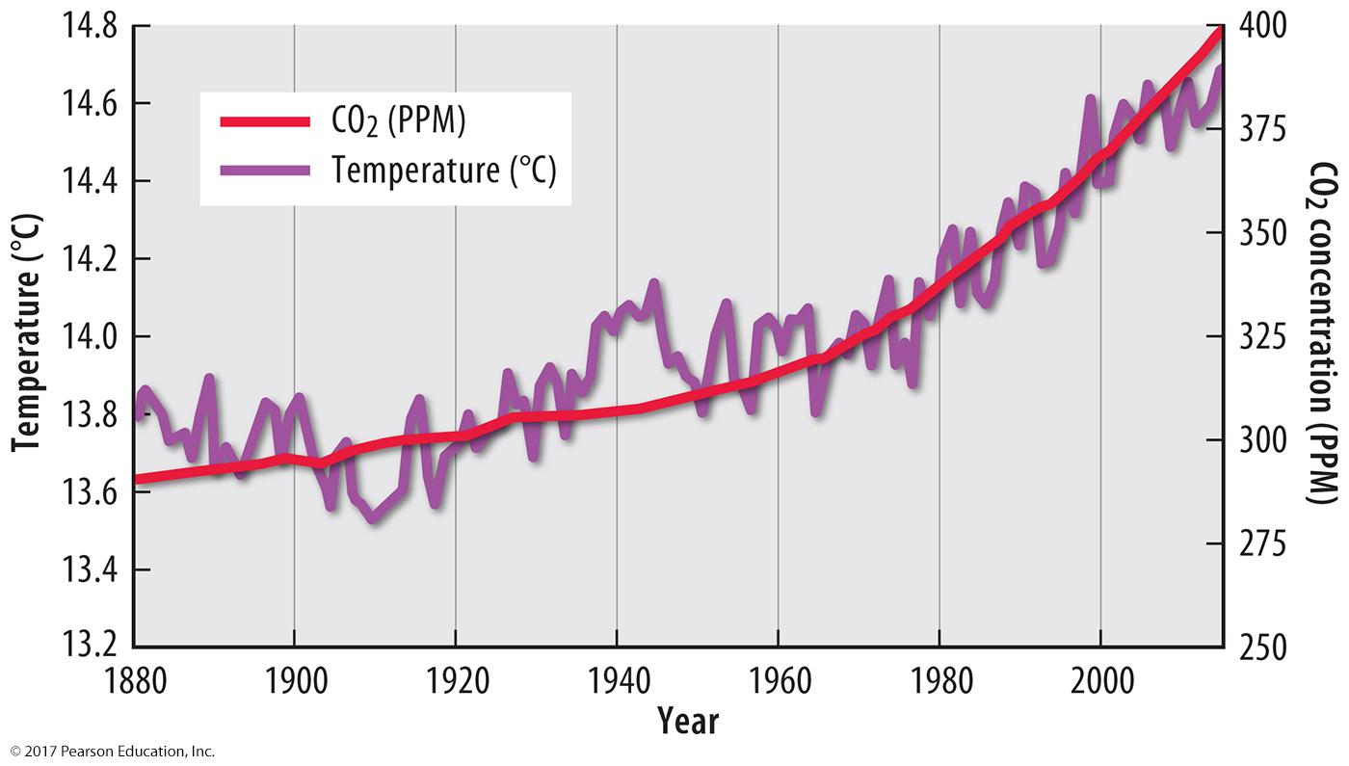
3.8 Air Pollution: Climate Change
Figure 11-57: Human-caused increases of carbon dioxide have increased global temperatures.

Slide 67
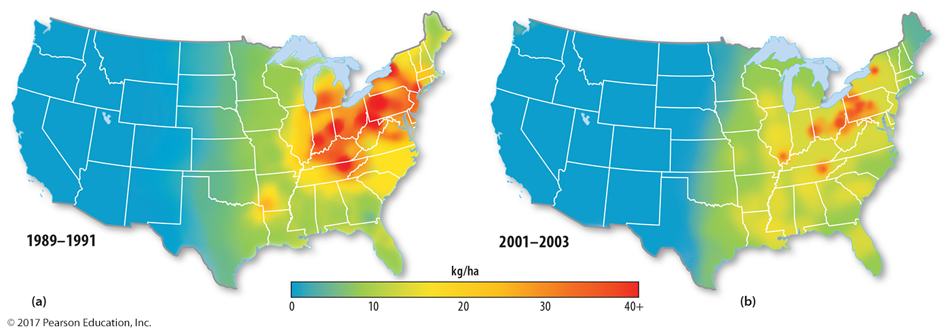
3.8 Air Pollution: Acid Deposition
Figure 11-59: Acid deposition was increasing in the United States until the 1990s.

Slide 68
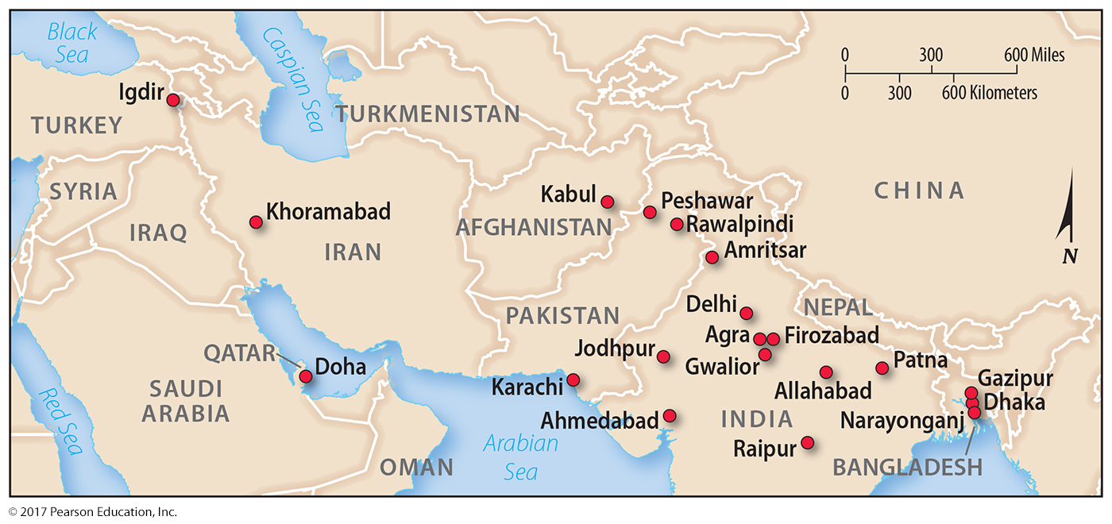
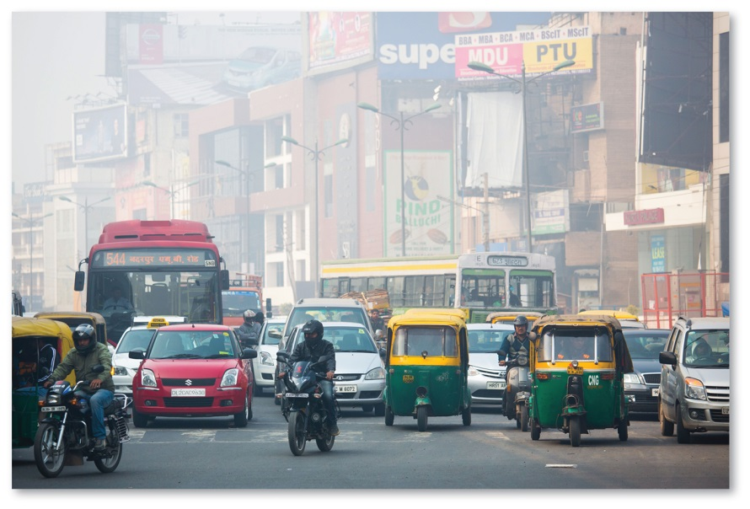
3.8 Urban Air Pollution
Figures 11-60 and 11-61: Urban air pollution is worst in South Asia, like in Delhi, India (right).

Slide 69
3.9 Water Pollution
Water uses
Nonconsumptive: returned as liquid
Consumptive: evaporates, e.g., agriculture
Polluted water
Point source: from specific location
Nonpoint source: from diffuse area

Slide 70
3.9 Water Use
Figure 11-62: water withdrawal by use

Slide 71
3.9 Per Capita Water Use by World Region
Figure 11-63: per capita water withdrawal for world regions

Slide 72
3.9 Point Source Pollution
Figure 11-65: A factory in Wolfen, Germany discharges water. Water pollution from a single factory is point-source pollution.

Slide 73
3.9 Nonpoint Source Pollution
Figure 11-66: Pollution entering water from informal housing in Delhi, India represents a nonpoint source.

Slide 74
3.10 Solid Waste: Sanitary Landfills
Figure 11-67: Landfills store solid waste disposed of by Americans. Recycling has decreased the per capita contribution to landfills.

Slide 75
3.10 Solid Waste: Hazardous Waste
Figure 11-69: Industrial sites release toxic chemicals as hazardous waste. The largest emitters are mines in the West.

Slide 76
Key Issue 4: Why Are Industries Changing Locations?
4.1 Emerging Industrial Regions
4.2 Industrial Change in Developed Countries
4.3 Skilled or Unskilled Labor?
4.4 Recycling and Remanufacturing

Slide 77
4.1 Emerging Industrial Regions
New international division of labor: low-paid, low-skill jobs moved to developing countries
Mexico: North American Free Trade Agreement (NAFTA) created industrial growth
Brazil, Russia, India, China (BRIC): projected industrial growth

Slide 78
4.1 Manufacturing as Percentage of GNI
Figure 11-70: Manufacturing represents a declining share of GNI in developed countries; it has been fairly constant in developing countries since 1980.

Slide 79
4.1 Vehicle Production in Mexico
Figure 11-72: The North American Free Trade Agreement began in 1994.

Slide 80
4.1 U.S.–Mexico Vehicle Trade
Figure 11-73: Mexican industries have increased vehicle exports to the United States since NAFTA.

Slide 81
4.1 BRIC Countries, U.S., and Mexico
Figure 11-74: India is expected to match the GDP of the United States by the 2050s; China is expected to exceed it in the 2020s.

Slide 82
4.2 Industrial Change: United States
Figure 11-75: Industry in the United States has shifted to the South, in part because of right-to-work laws in southern states.

Slide 83
4.2 Industrial Change: North America
Figure 11-76: Motor vehicle production has shifted to Mexico and the U.S. South.

Slide 84
4.2 Industrial Change: Europe
Figure 11-77: Motor vehicle production has shifted to Eastern Europe.

Slide 85
4.3 Skilled or Unskilled Labor?
Skilled labor has some advantages over cheaper, less skilled labor.
Lean production
teams with flexible tasks
problem solving
leveling: less hierarchy
productivity from skilled operators

Slide 86
4.4 Recycling in the United States
Figure 11-82: Recycling has increased in the United States, though the total waste per capita has also increased.

Slide 87
4.4 Recycling in the United States
Figure 11-83: solid waste composition before and after recycling

Slide 88
4.4 Remanufacturing
Figure 11-85: Junked car bodies will be transformed into steel that may be used again in vehicle manufacturing.

Slide 89
Chapter End

