Slide 1
Chapter 10 Lecture
Chapter 10
Development
Tim Scharks Green River College

Slide 2
Development: Key Issues
Why Does Development Vary Among Countries?
Where Are Inequalities in Development Found?
Why Do Countries Face Challenges to Development?
Why Are Countries Making Progress in Development?

Slide 3
Key Issue 1: Why Does Development Vary Among Countries?
1.1 Introducing Development
1.2 A Decent Standard of Living
1.3 Access to Knowledge
1.4 Health and Wealth

Slide 4
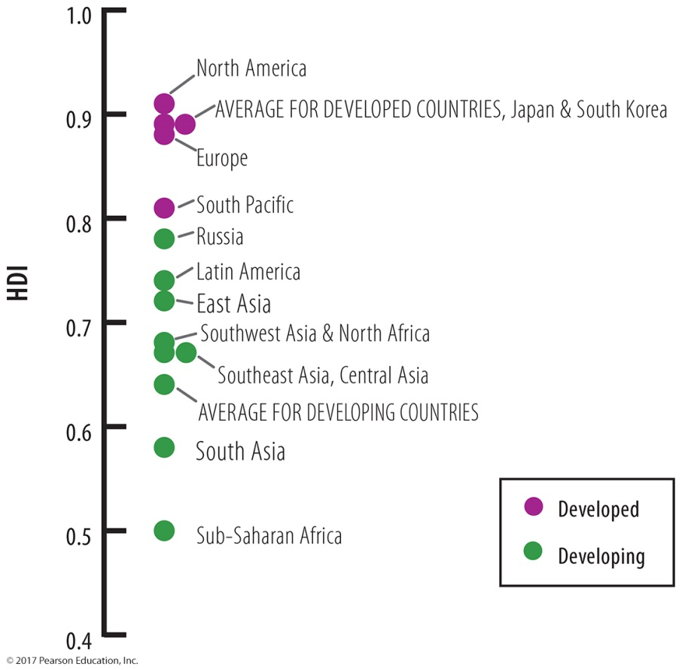
1.1 Introducing Development
Countries and regions ranked by development
Human Development Index (HDI) measures development:
decent standard of living
long and healthy life
access to knowledge
Figure 10-3: HDI BY REGION

Slide 5
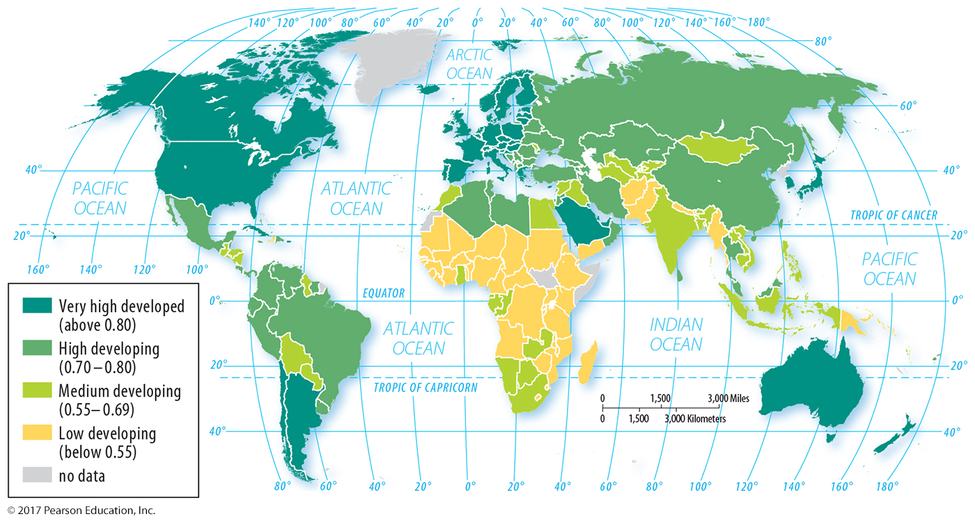
1.1 Human Development Index
Figure 10-1: The Human Development Index measures development by country around the world.

Slide 6
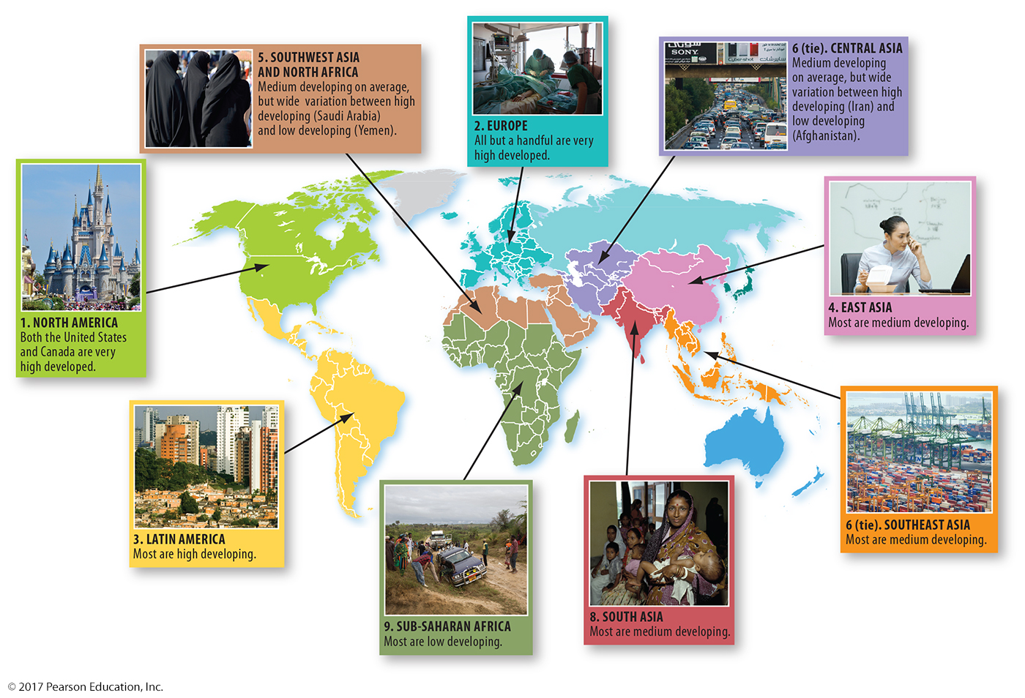
1.1 Development Regions
Figure 10-2: World regions vary in development; some have greater intra-regional variation than others.

Slide 7
1.2 A Decent Standard of Living
Standard of living in HDI:
Gross national income (GNI) adjusted for purchasing power parity (PPP) per capita
Other measures of standard of living:
Primary, secondary, tertiary economic structure
Productivity

Slide 8
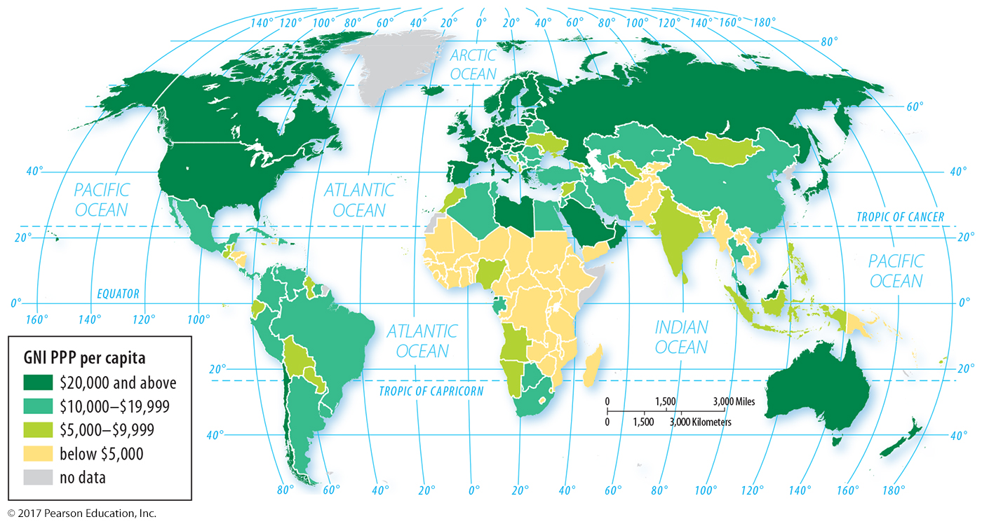
1.2 GNI PPP Per Capita
Figure 10-4: Gross national income per capita, adjusted for purchasing power parity.

Slide 9
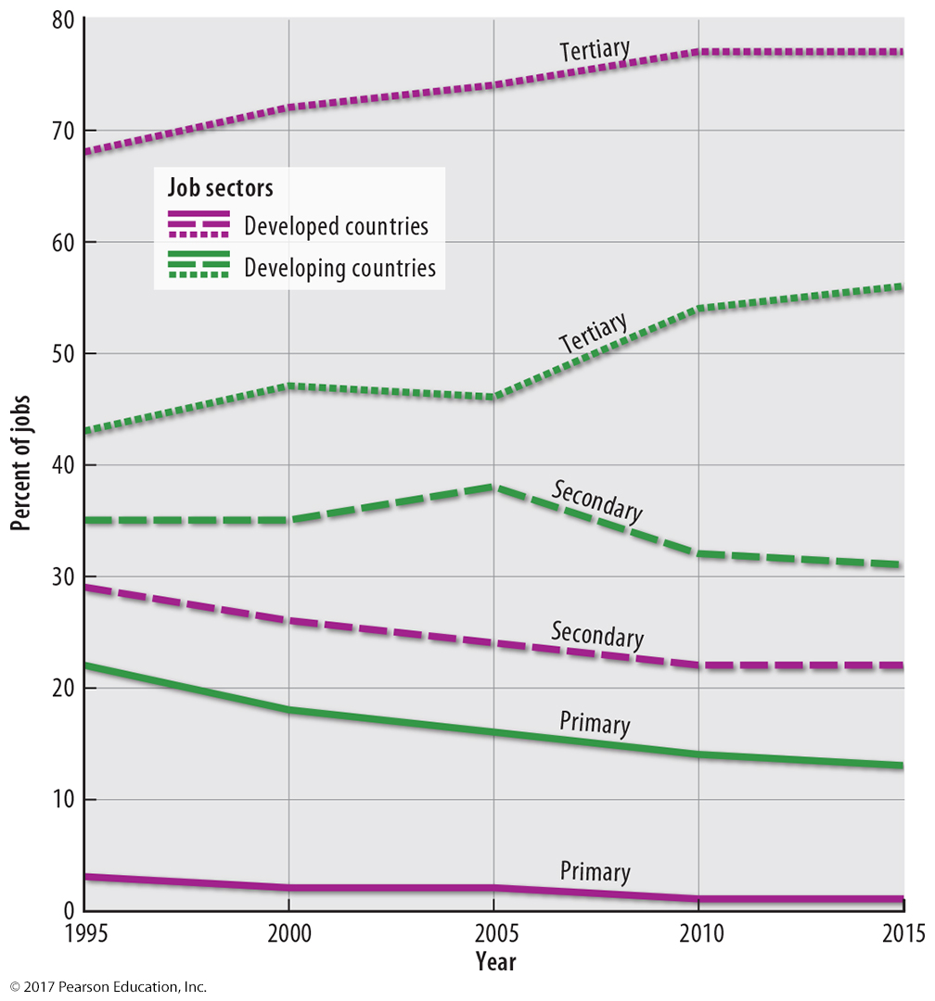
1.2 Economic Structure
Figure 10-5: Employment in the tertiary sector (services) has grown in both developed and developing countries while the primary and secondary sectors have declined.

Slide 10
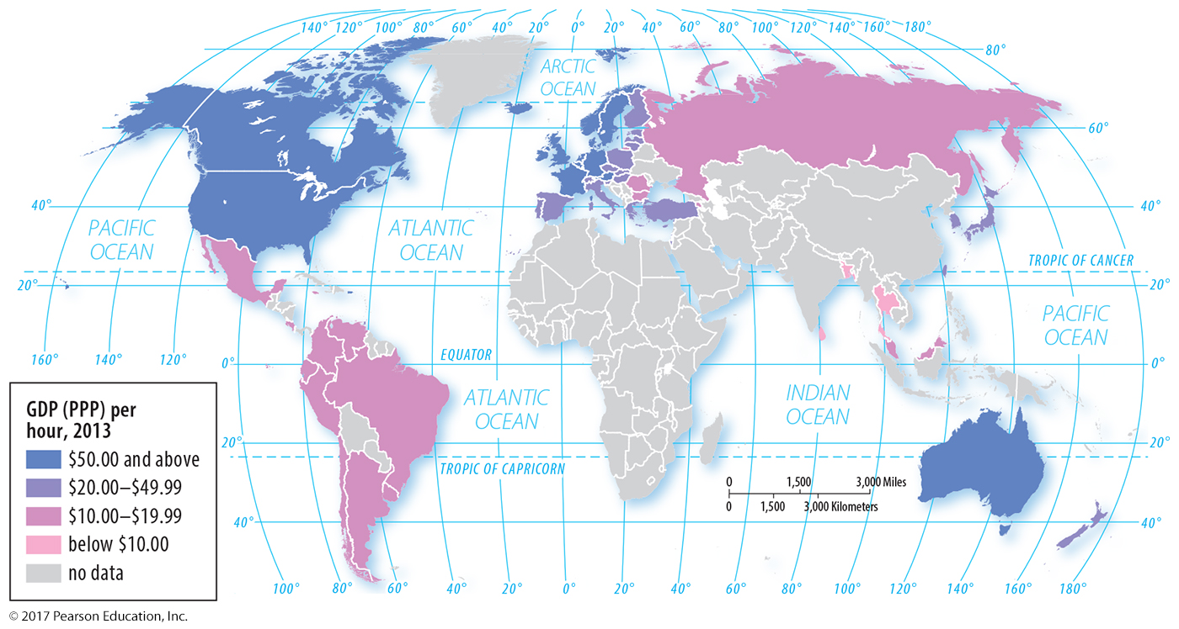
1.2 Productivity
Figure 10-6: Workers contribute more to a nation’s GDP per hour in developed countries than developing countries, representing a higher value added.

Slide 11
1.3 Access to Knowledge
Access to knowledge in HDI:
Years of school for adults
Expected years schooling for youth
Other measures of access to knowledge:
Pupil/teacher ratio
Literacy rate

Slide 12
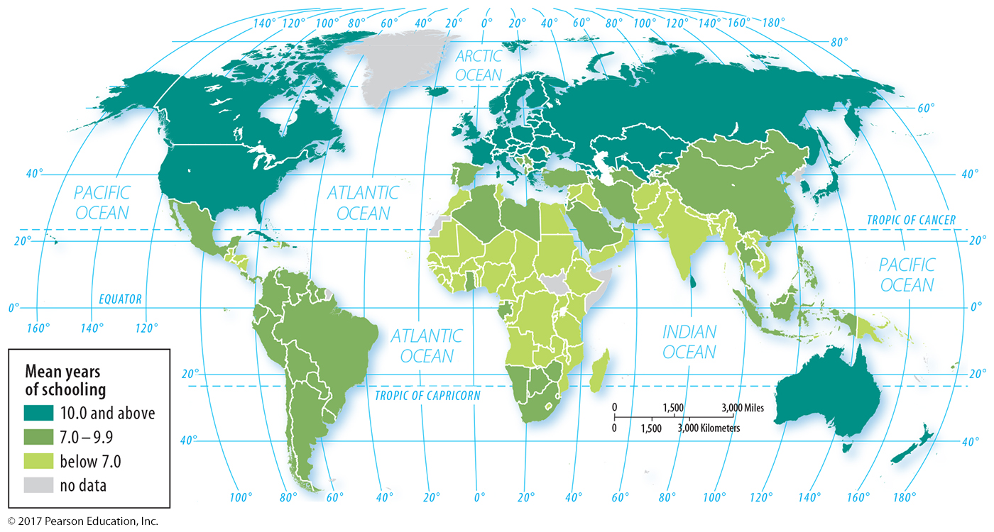
1.3 Mean Years of Schooling
Figure 10-7: Mean years of schooling is the average number of years people aged 25 or older have spent in school.

Slide 13
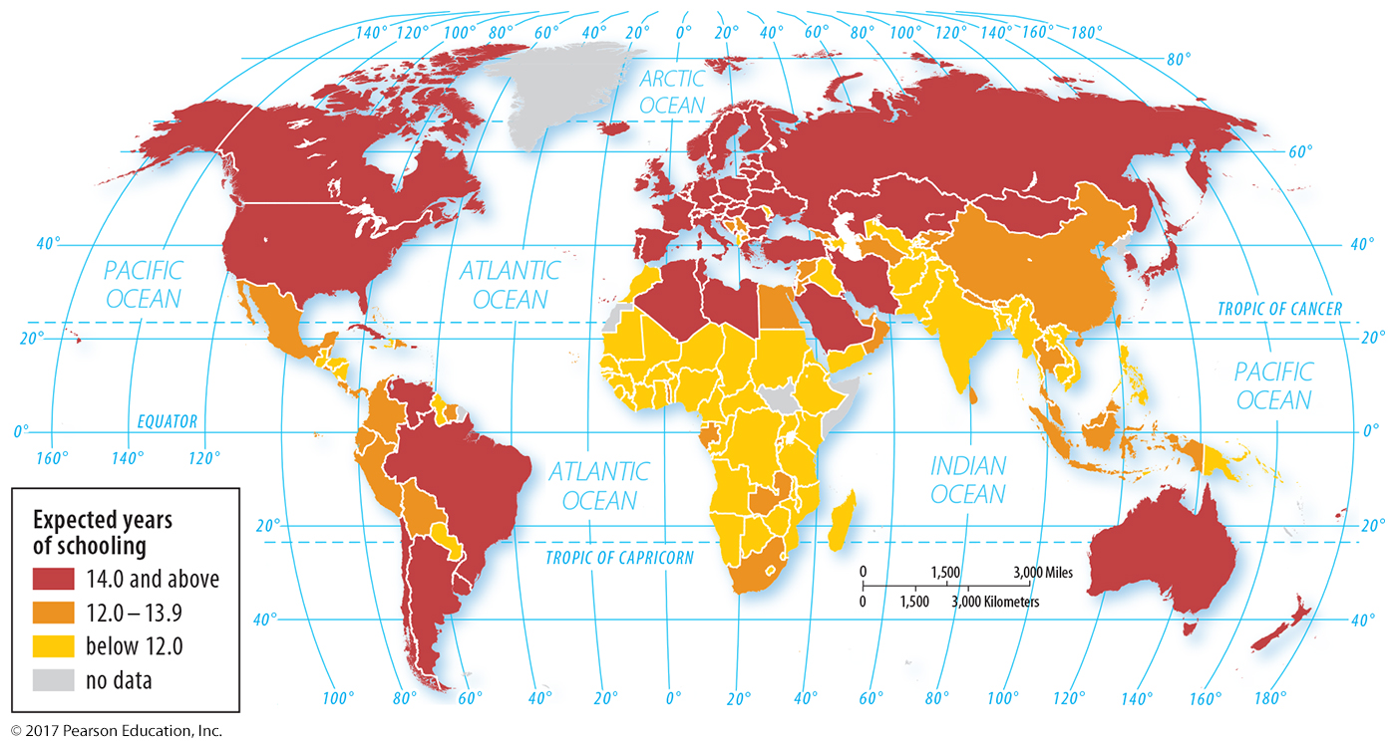
1.3 Expected Years of Schooling
Figure 10-8: Expected years of schooling is the average number of years today’s 5-year-olds are expected to be in school.

Slide 14
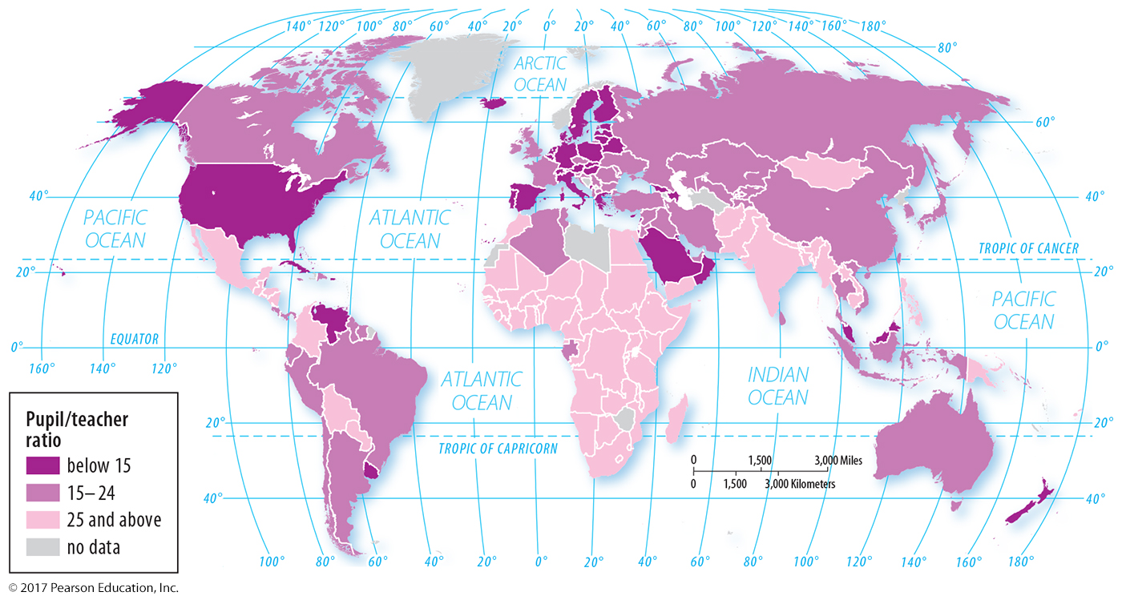
1.3 Pupil/Teacher Ratio
Figure 10-9: The pupil/teacher ratio is another measure of access to knowledge.

Slide 15
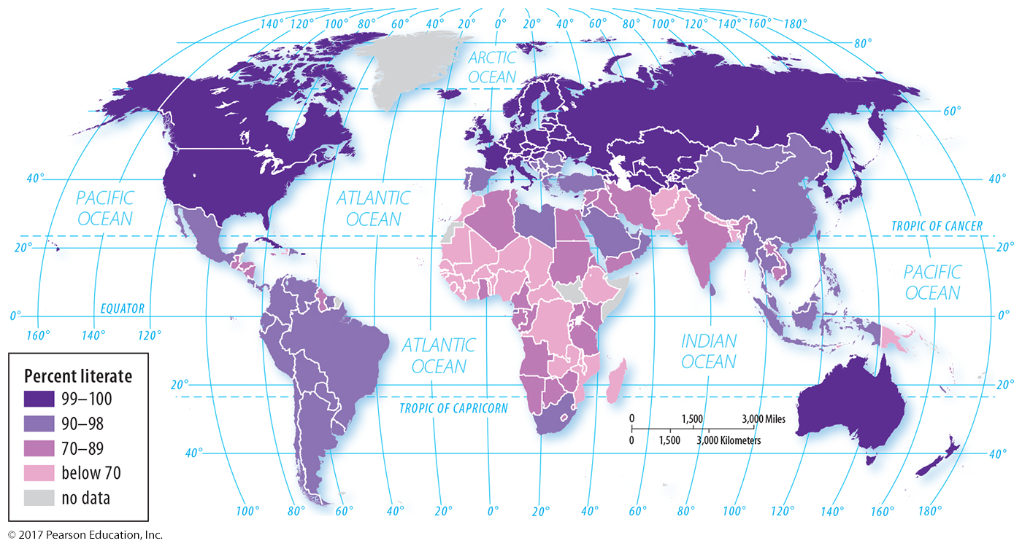
1.3 Literacy Rate
Figure 10-10: The literacy rate is another measure of access to knowledge.

Slide 16
1.4 Health and Wealth
Health in HDI:
Life expectancy at birth
Other measures of wealth:
Consumer goods
Motor vehicles per 1,000 persons
Literacy rate

Slide 17
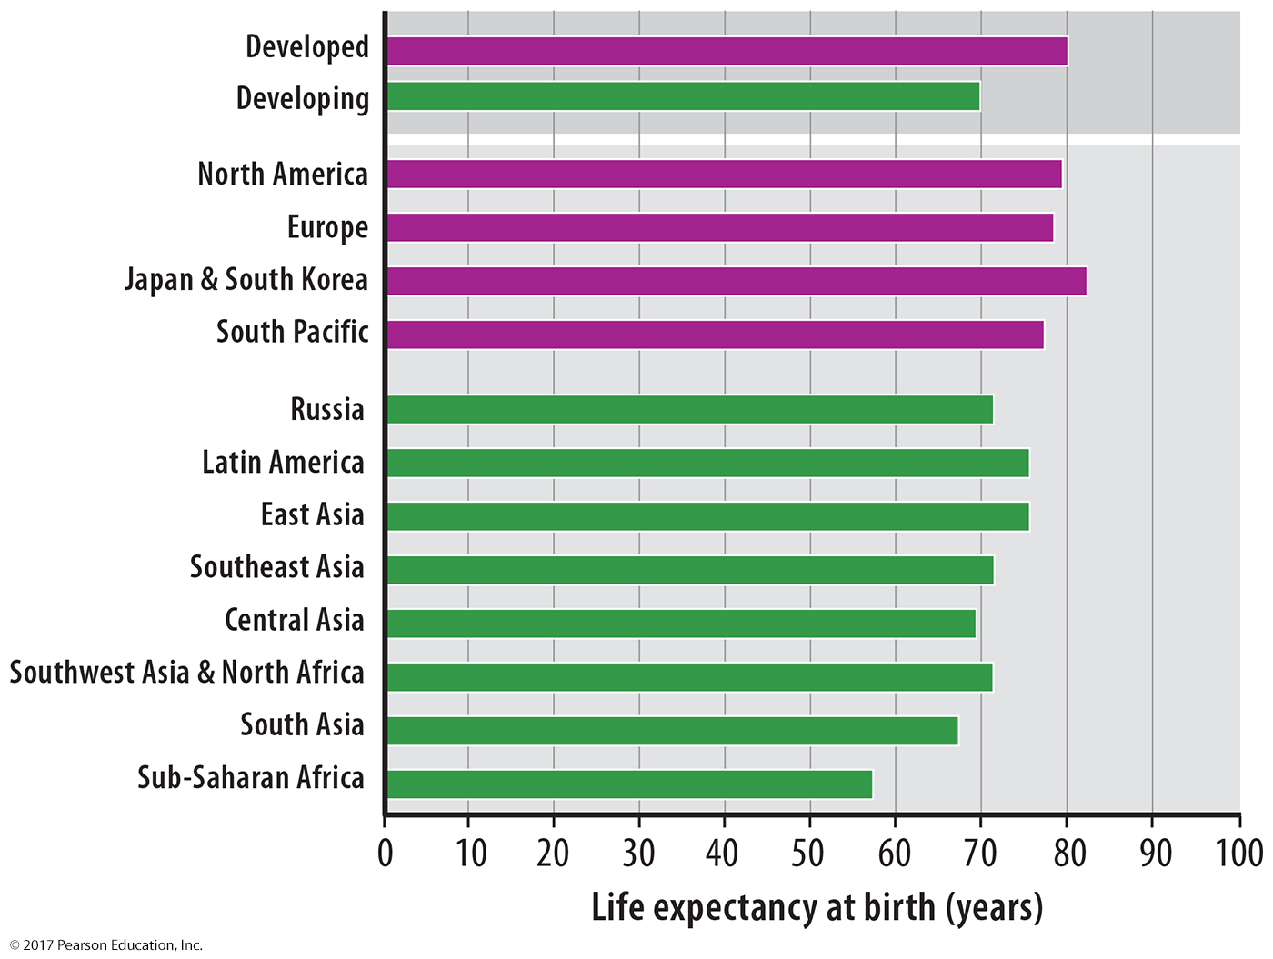
1.4 Life Expectancy at Birth
Figure 10-11: By world region, life expectancy at birth ranges from the mid-50s to early 80s.

Slide 18
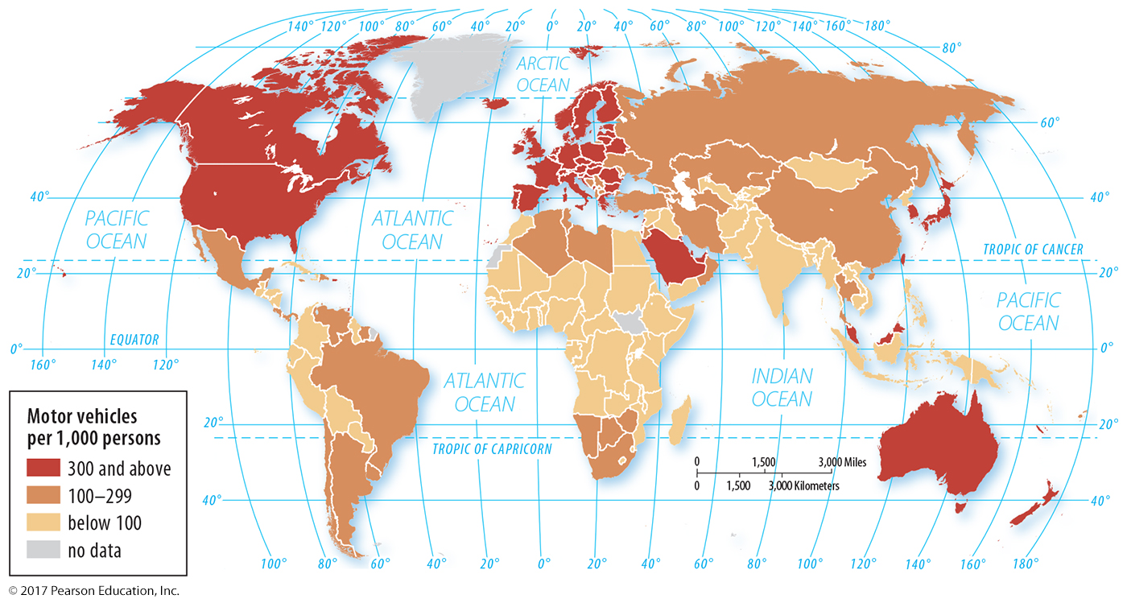
1.4 Motor Vehicles
Figure 10-12: Motor vehicles are a consumer good that helps trade and allows access to jobs.

Slide 19
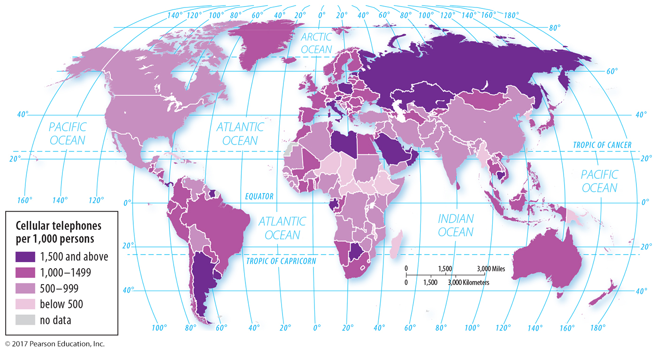
1.4 Cellular Telephones
Figure 10-13: Cell phones are a consumer good that aids communication.

Slide 20
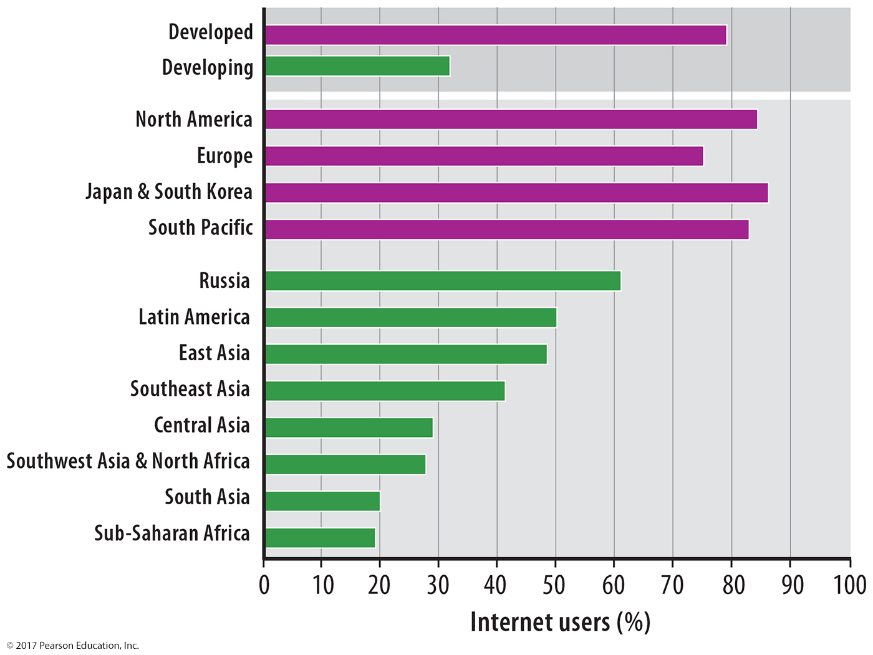
1.4 Internet Users
Figure 10-14: Access to the Internet allows for greater sharing of information.

Slide 21
Key Issue 2: Where Are Inequalities in Development Found?
2.1 Unequal and Uneven Development
2.2 Gender Inequality
2.3 Gender Empowerment and Employment
2.4 Reproductive Health
2.5 HDI and Gender Inequality

Slide 22
2.1 Unequal and Uneven Development
Inequality-adjusted HDI accounts for inequality within a country.
Inequality within developed countries: example of Turkey vs. Brazil
Inequality in developed countries: increasing since 1980 in many countries

Slide 23
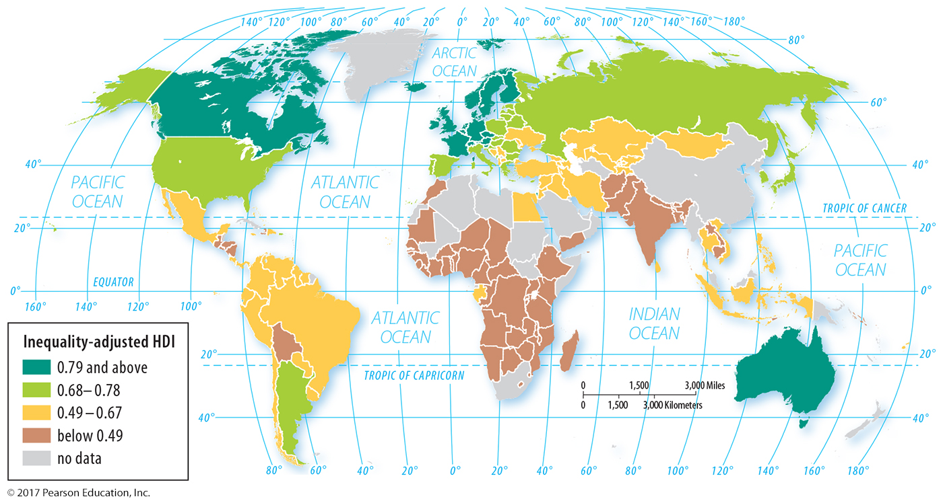
2.1 Inequality-adjusted HDI
Figure 10-15: Compare to Figure 10-1; many countries are ranked much lower after considering inequality.

Slide 24
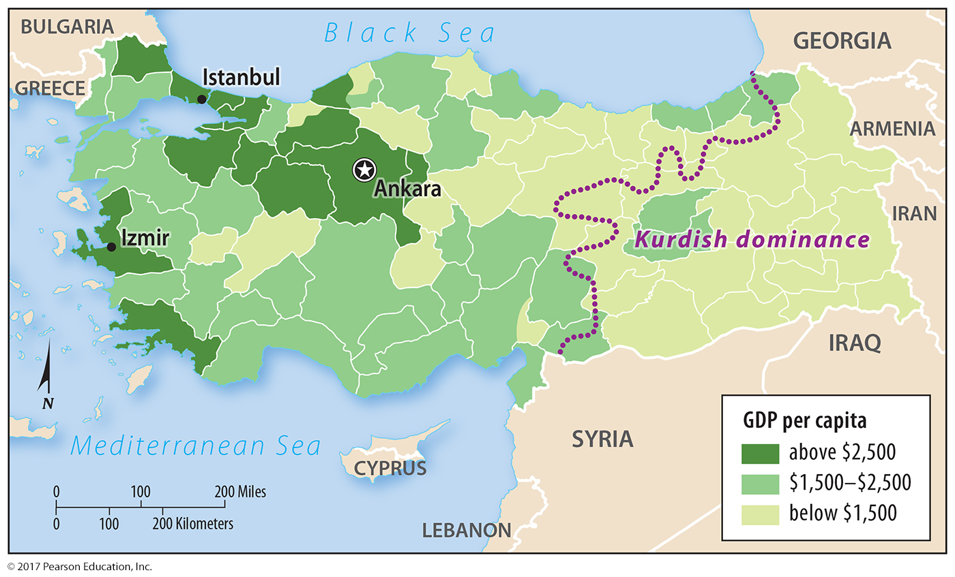
2.1 Inequality Among Regions in Turkey
Figure 10-16: Turkey’s wealthiest regions are in the west; the eastern area is poorer on average.

Slide 25
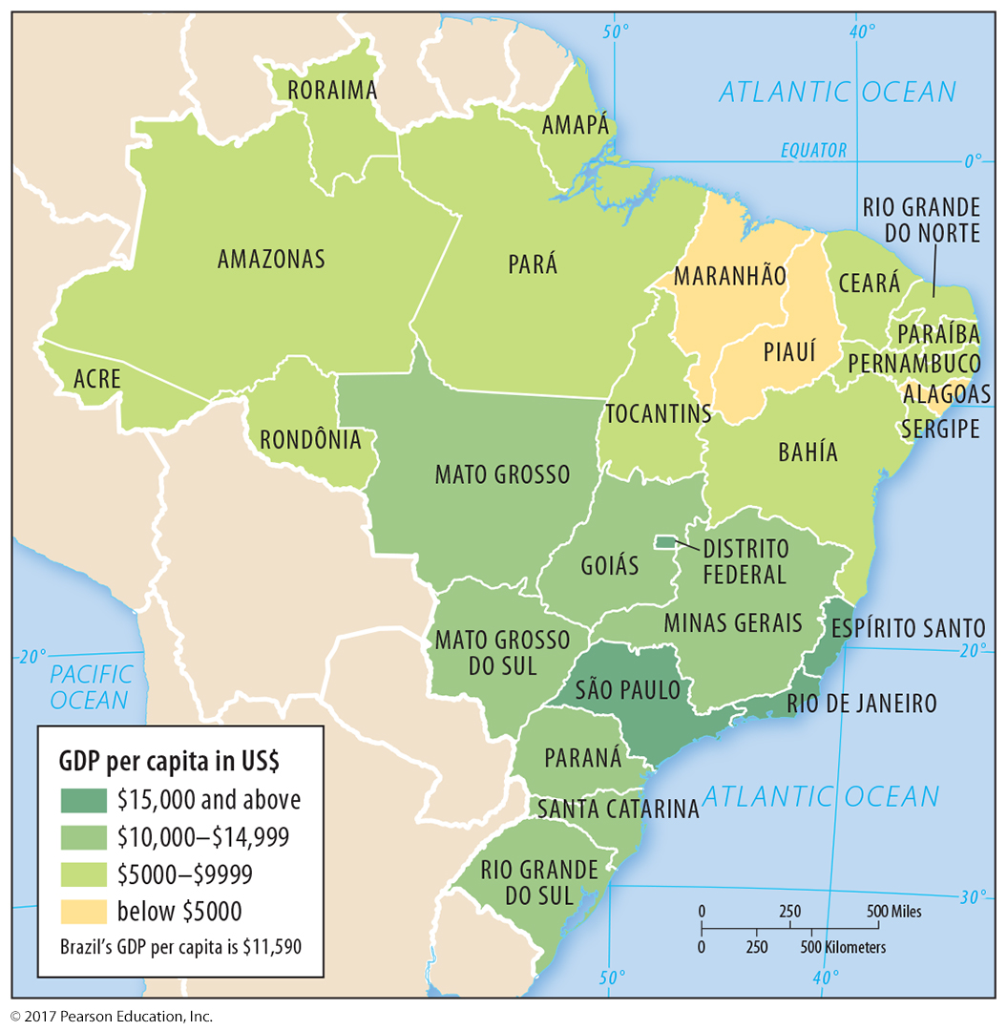
2.1 Inequality Among Regions in Brazil
Figure 10-17: Brazil’s wealth is concentrated in the south and east, especially along the coast.

Slide 26
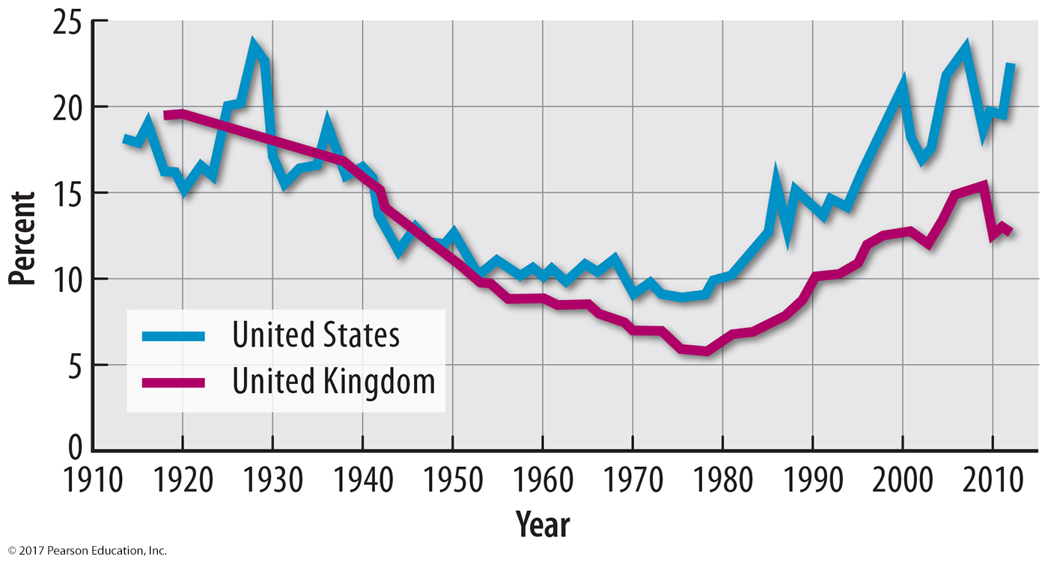
2.1 Inequality in the United States and United Kingdom
Figure 10-18: The share of wealth held by the richest 1% has increased in the United States and United Kingdom since about 1980.

Slide 27
2.2 Gender Inequality
Gender-related Development Index (GDI): Same measures as HDI but by sex.
Gender Inequality Index (GII) measured through:
Reproductive health
Female empowerment
Female labor force participation

Slide 28
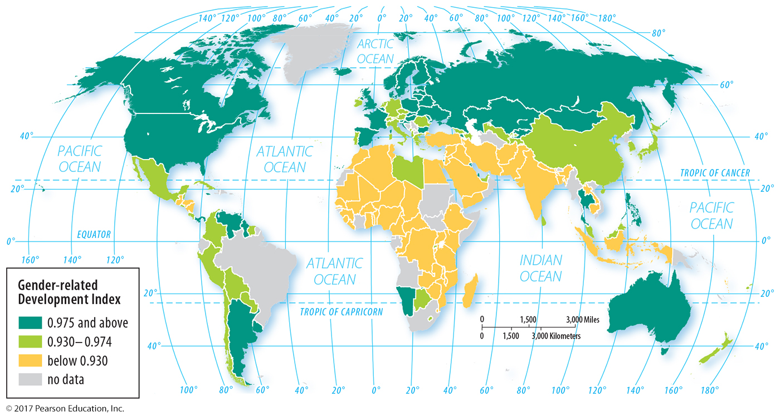
2.2 Gender-related Development Index
Figure 10-19: The GDI is a measure of how unequal women are relative to men on the measures used in the HDI.

Slide 29
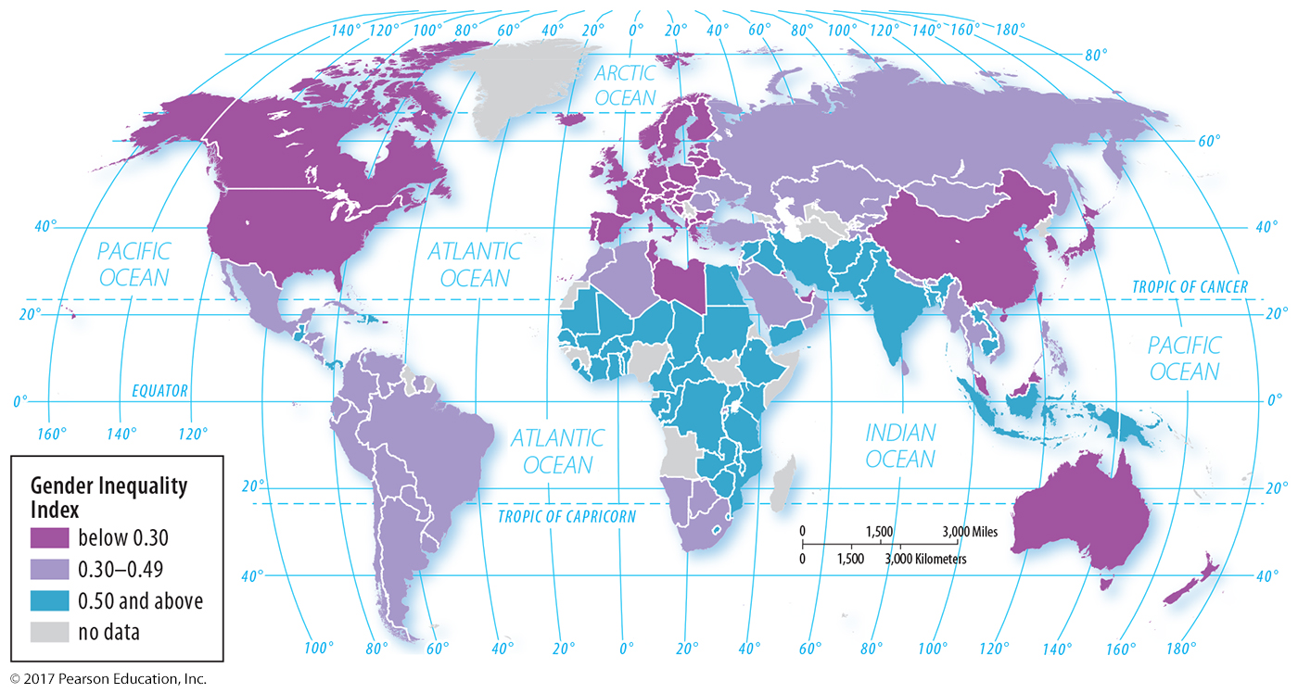
2.2 Gender Inequality Index
Figure 10-20: The GII is composed of measures of reproductive health, empowerment, and the labor market. Larger numbers indicate greater gender inequality.

Slide 30
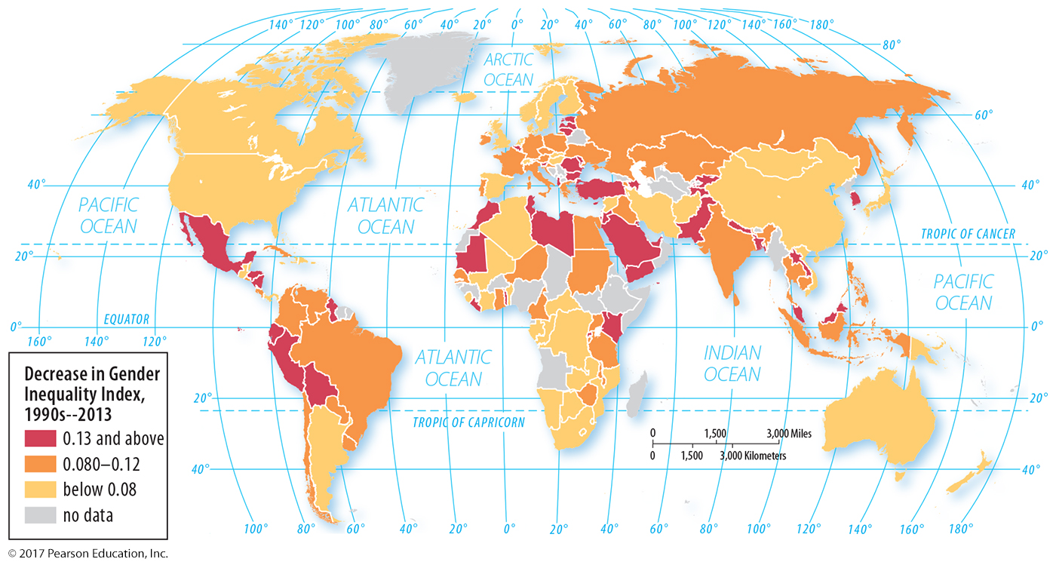
2.2 Decrease in Gender Inequality Index
Figure 10-21: Increased gender equality is a trend in most countries of the world.

Slide 31
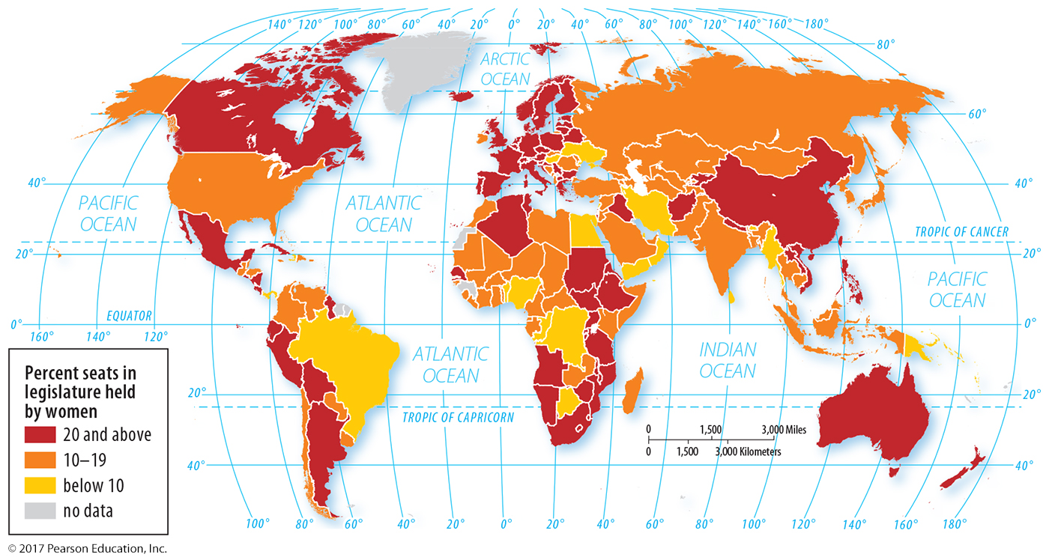
2.3 Gender Inequality Index: Empowerment
Figure 10-22: One measure of female empowerment is the percentage of seats held by women in a country’s national legislative body.

Slide 32
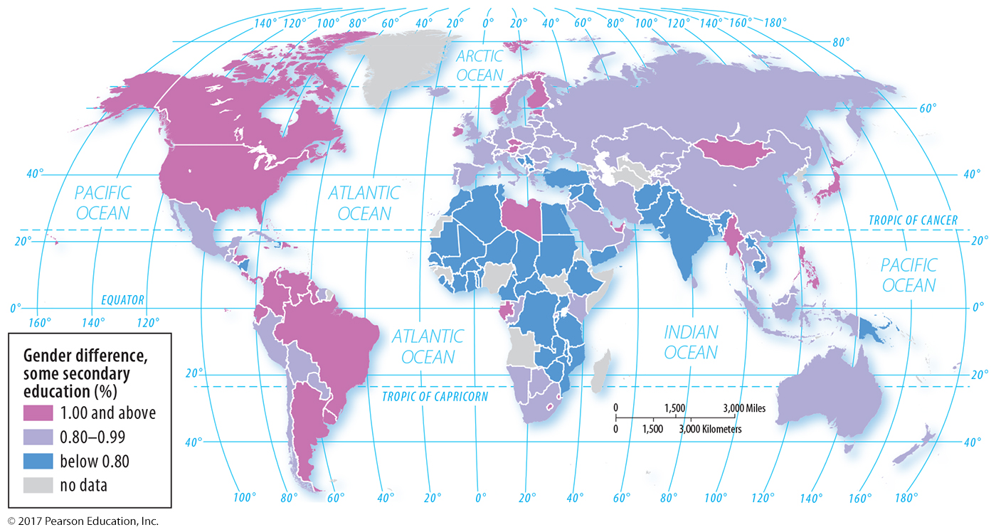
2.3 Gender Inequality Index: Empowerment
Figure 10-23: Another measure of female empowerment is the ratio of girls to boys in secondary school. Countries with ratios above 1 have more girls than boys enrolled.

Slide 33
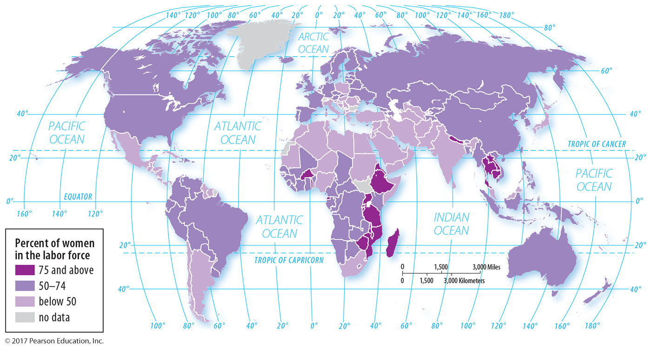
2.3 Gender Inequality Index: Employment
Figure 10-24: Female labor force participation as a percentage of male participation is a measure of gender inequality.

Slide 34
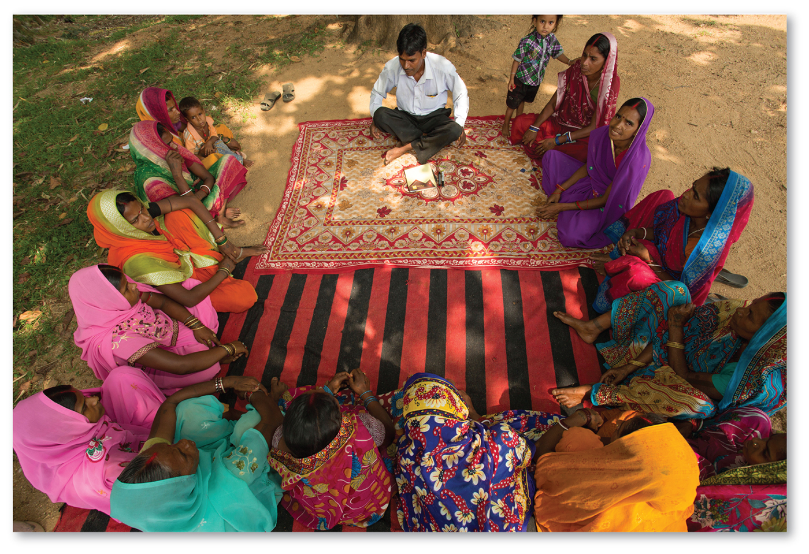
2.3 Gender Inequality Index: Employment
Figure 10-25: Women in India meet with a banker for business loans.

Slide 35
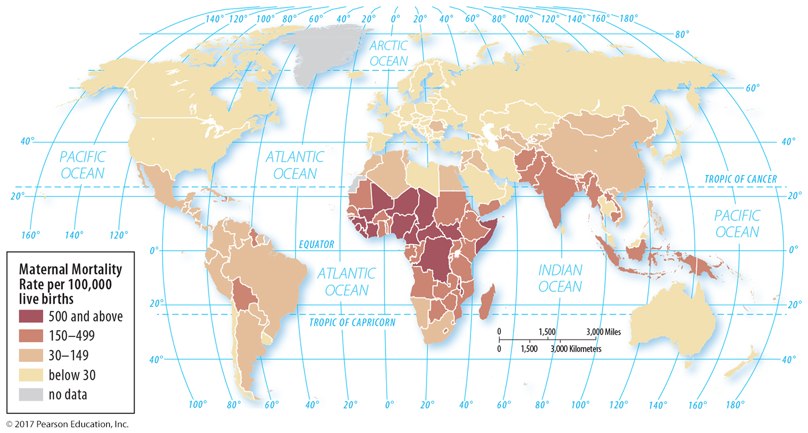
2.4 Gender Inequality Index: Reproductive Health
Figure 10-26: The maternal mortality rate is included in the GII.

Slide 36
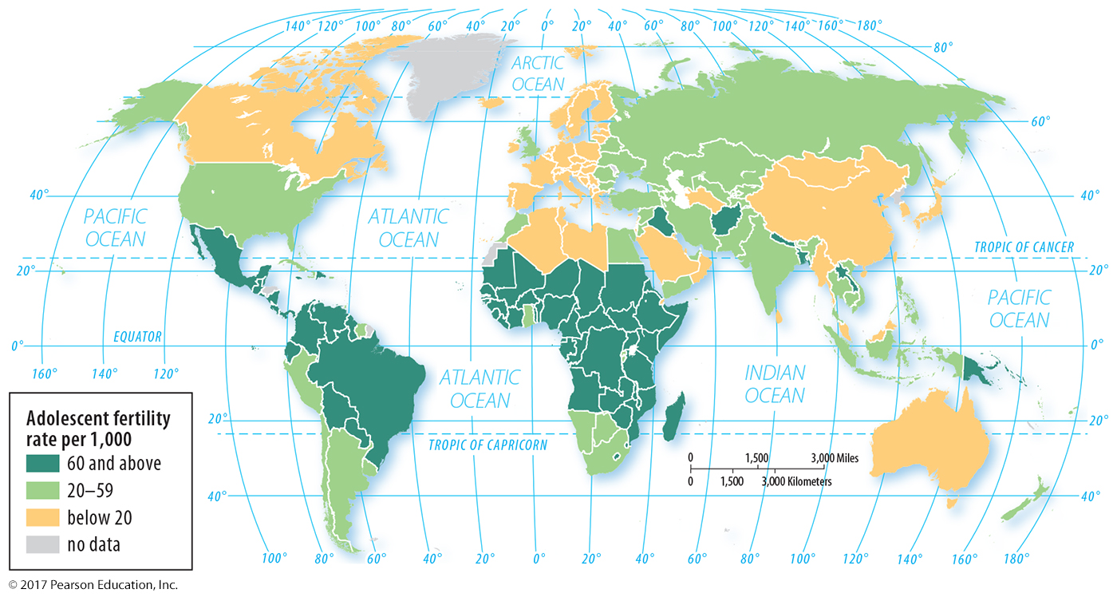
2.4 Gender Inequality Index: Reproductive Health
Figure 10-27: The adolescent fertility (births per 1,000 women aged 15 to 19) rate is included in the GII.

Slide 37
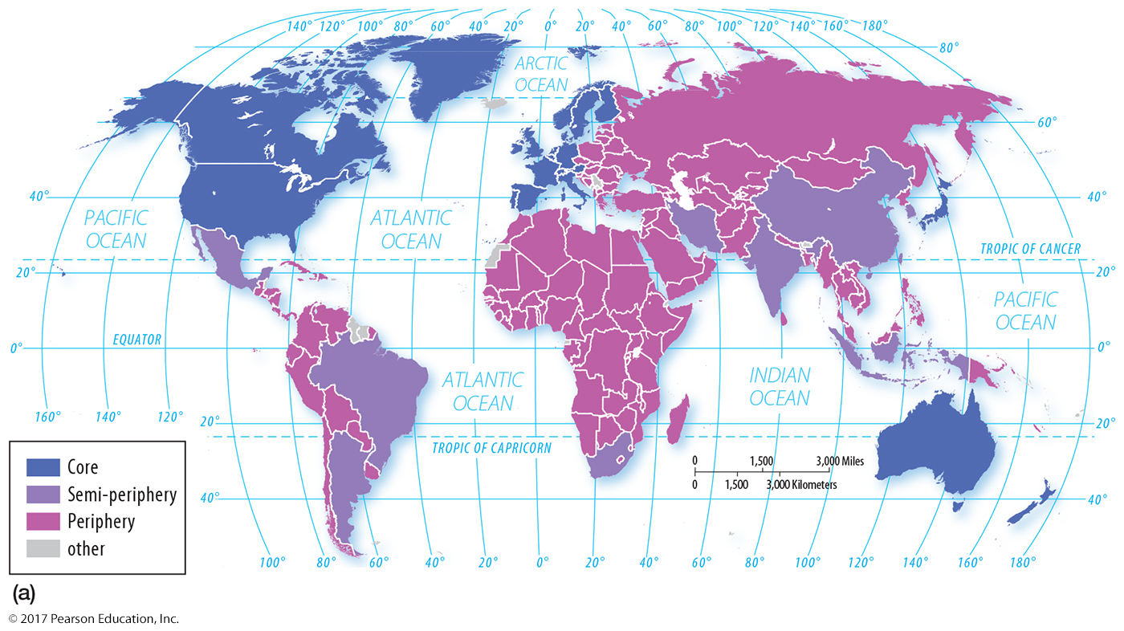
2.4 Core and Periphery
Figure 10-28a: In a world systems perspective, North America and Europe form the developed core, and the developing countries form the periphery.

Slide 38
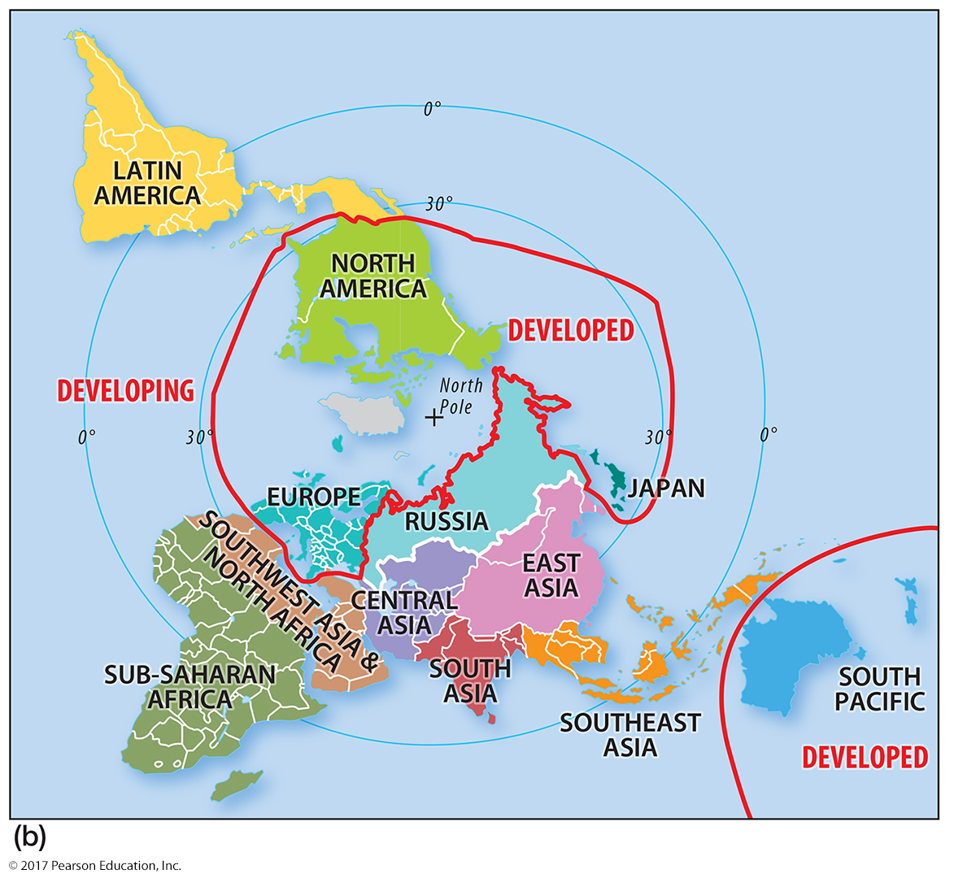
2.4 Core and Periphery
Figure 10-28b: The spatial relationship of the core and periphery is more apparent in a world map projection centered on the North Pole.

Slide 39
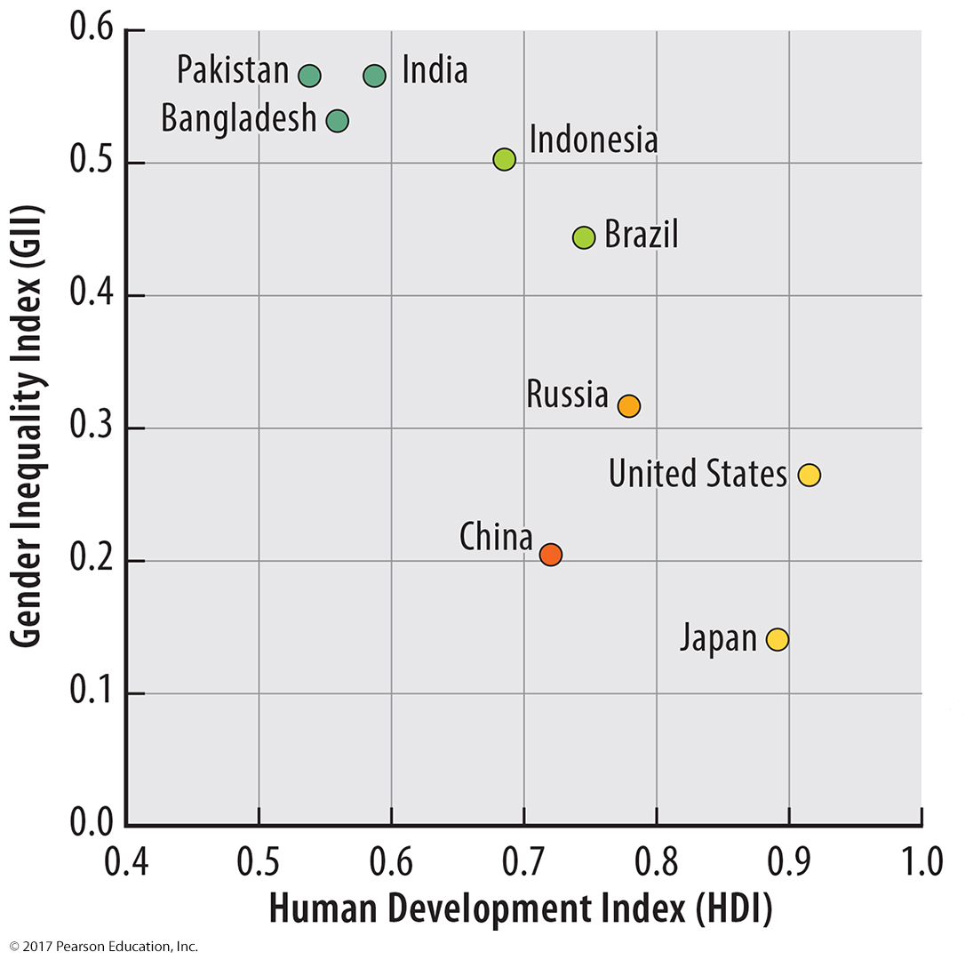
2.5 HDI and Gender Inequality
Figure 10-29: Countries in the top left have low levels of development and high levels of gender inequality; countries in the bottom right are developed and have greater gender equality.

Slide 40
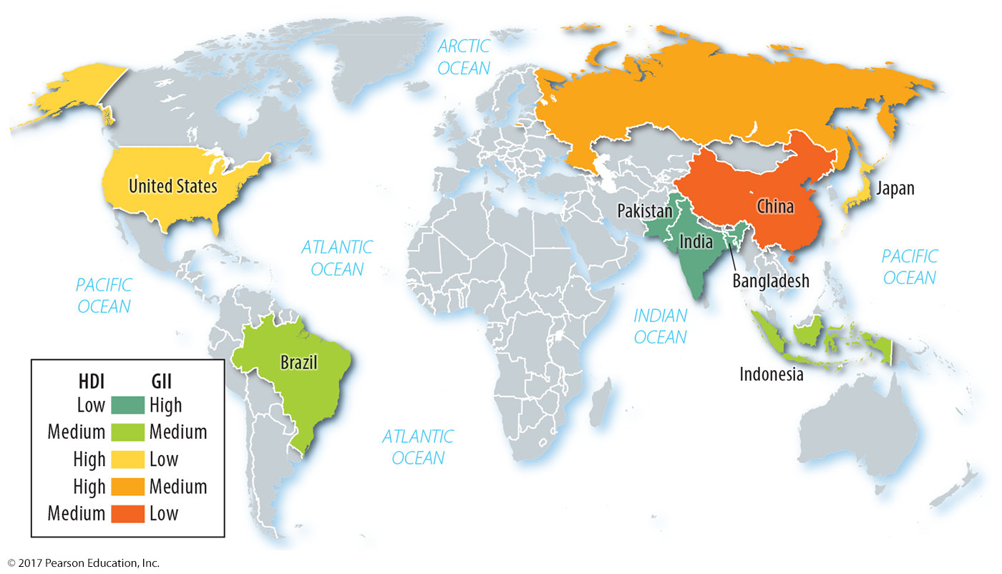
2.5 HDI and Gender Inequality
Figure 10-30: The general relationship observed in this map is countries high in gender inequality are lower in overall development.

Slide 41
Key Issue 3: Why Do Countries Face Challenges to Development?
3.1 Two Paths to Development
3.2 World Trade
3.3 Financing Development
3.4 Development Challenges During Hard Times

Slide 42
3.1 Two Paths to Development
Self-sufficiency: protect domestic production
Example: India
International trade: specialize and trade
Examples: Asian Dragons, Arabian Peninsula
Rostow’s model of international trade:
Traditional society
Preconditions for takeoff
Takeoff
Drive to maturity
Age of mass consumption

Slide 43
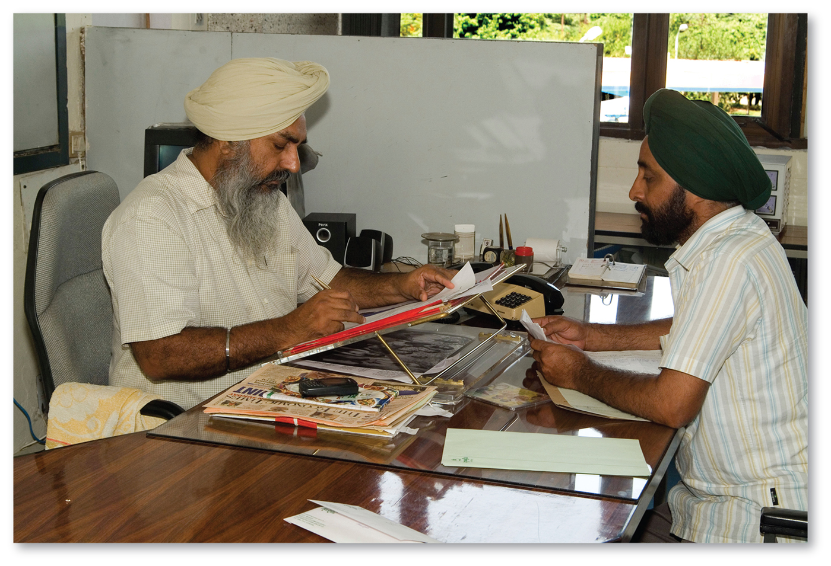
3.1 Self-Sufficiency: India
Figure 10-32: Under self-sufficiency in India, imports were limited, and the government regulated domestic industries.

Slide 44
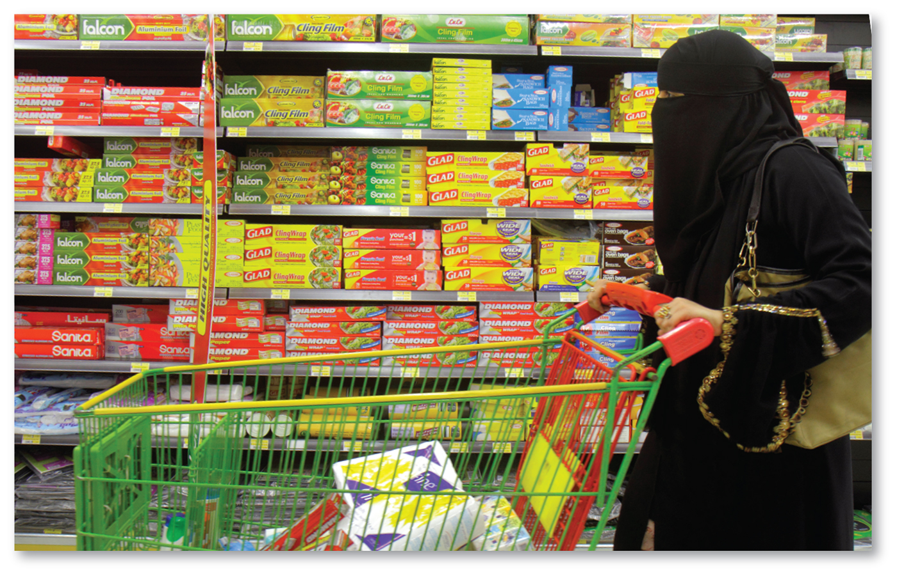
3.1 International Trade: United Arab Emirates
Figure 10-33: A shopper in the United Arab Emirates chooses from a variety of products imported from other countries.

Slide 45
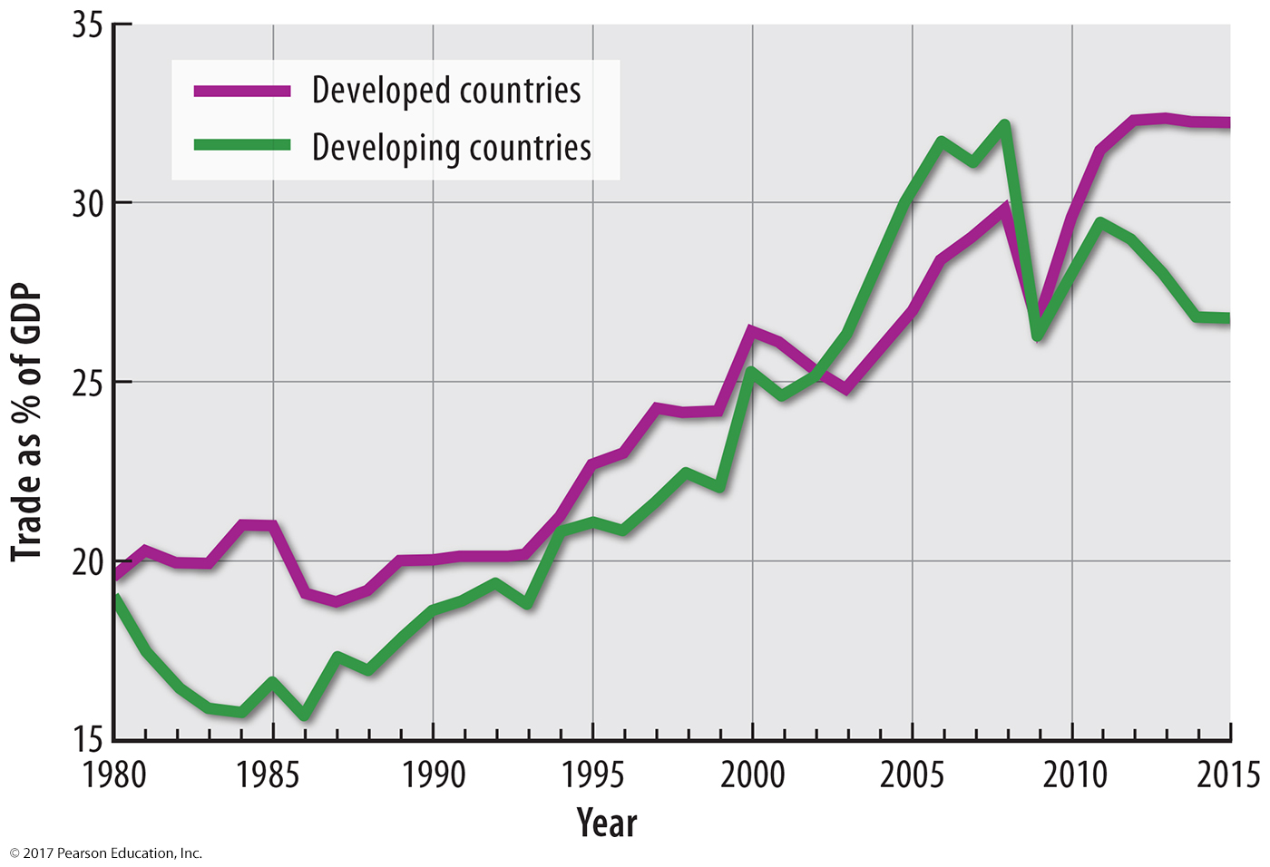
3.2 International Trade Triumphs
Figure 10-34: Both developed and developing countries are increasingly reliant on trade as a contributor to GDP.

Slide 46
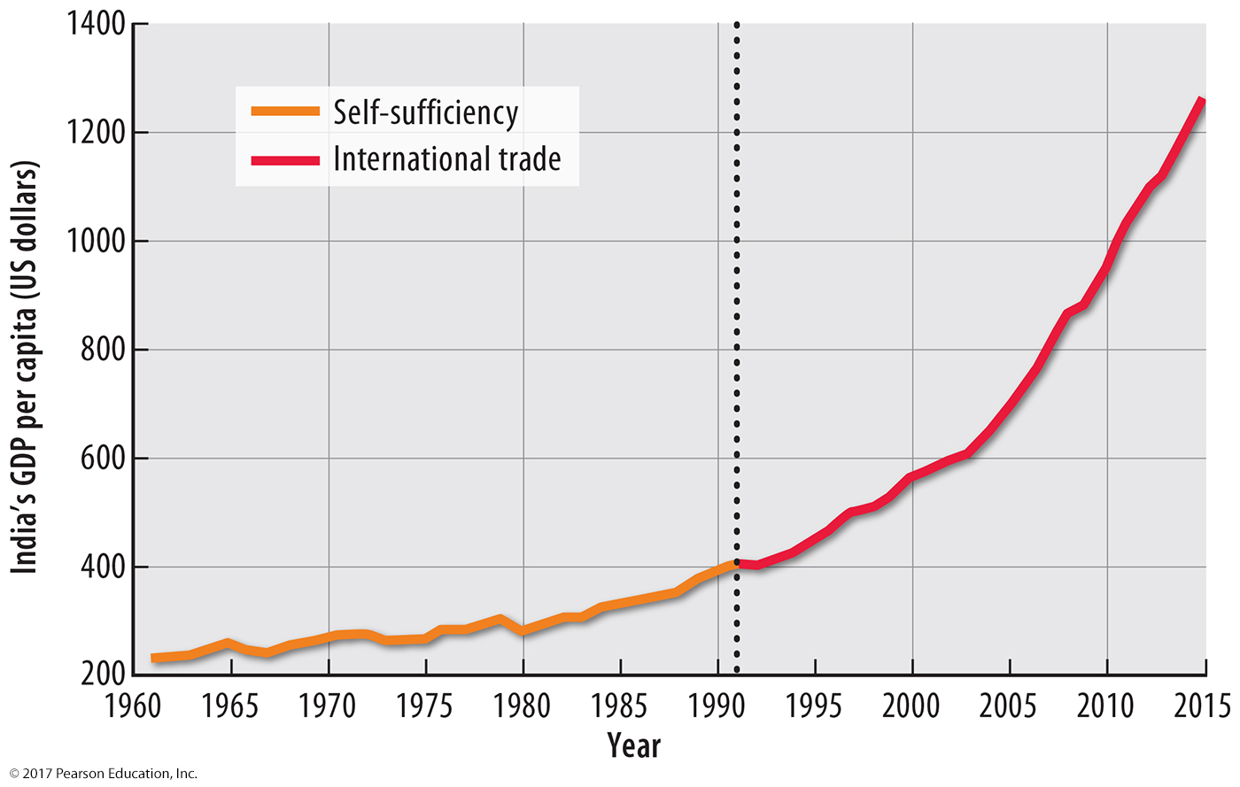
3.2 International Trade Triumphs
Figure 10-35: India’s GDP growth under self-sufficiency (left, before 1991) and under international trade (right).

Slide 47
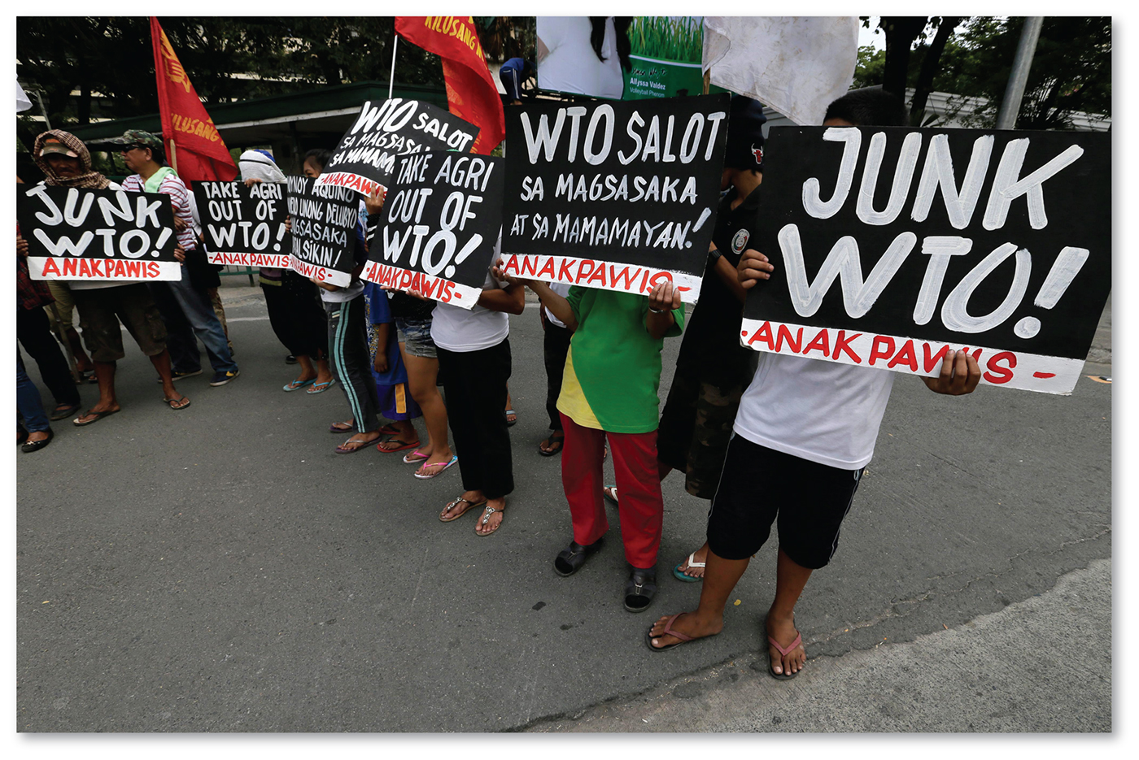
3.2 World Trade Organization and Critics
Figure 10-36: The World Trade Organization works to increase free trade between member countries. Critics like these pictured in the Philippines oppose the WTO for several reasons.

Slide 48
3.3 Financing Development
Countries wishing to develop may need money:
Foreign direct investment from corporations
Loans
World Bank
International Monetary Fund

Slide 49
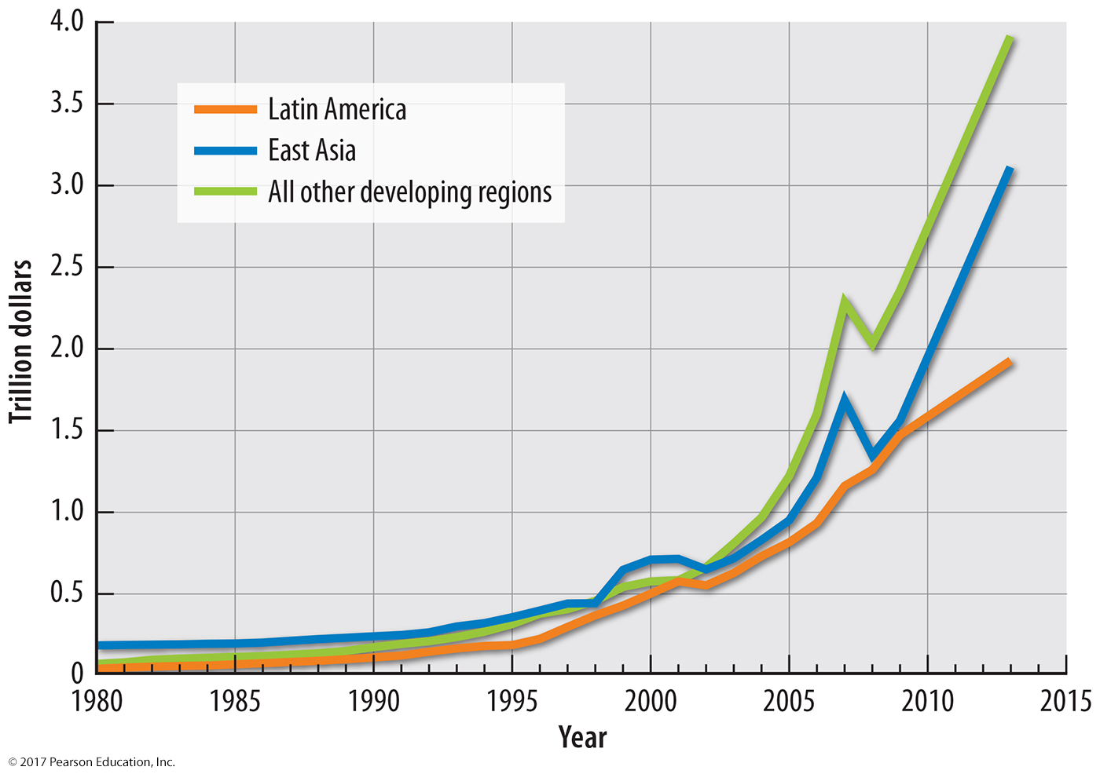
3.3 Growth in Foreign Direct Investment
Figure 10-39: Foreign direct investment in East Asia and Latin America has grown faster than other developing regions.

Slide 50
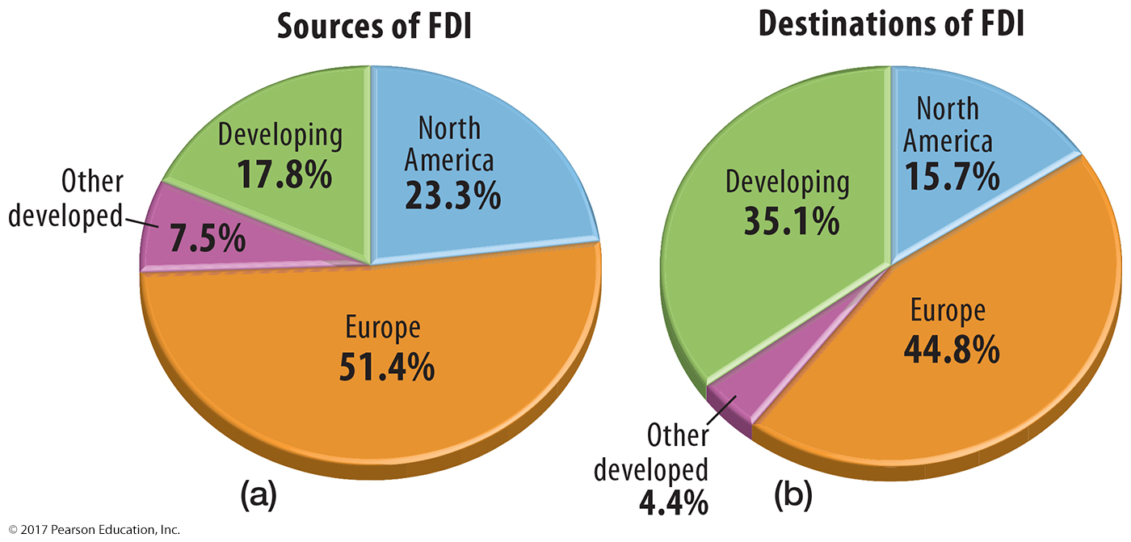
3.3 Foreign Direct Investment
Figure 10-40: Most foreign direct investment is out of and into developed countries in North America and Europe.

Slide 51
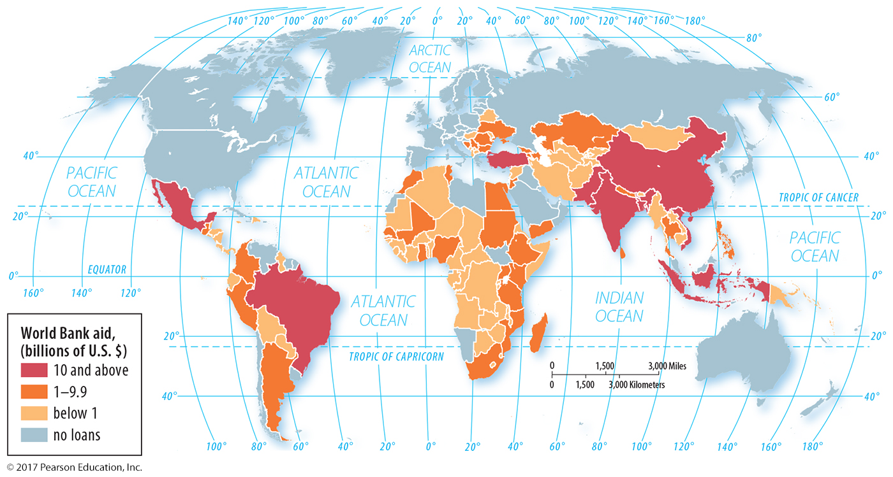
3.3 World Bank Development Assistance
Figure 10-41: The World Bank loans the most to countries in Asia.

Slide 52
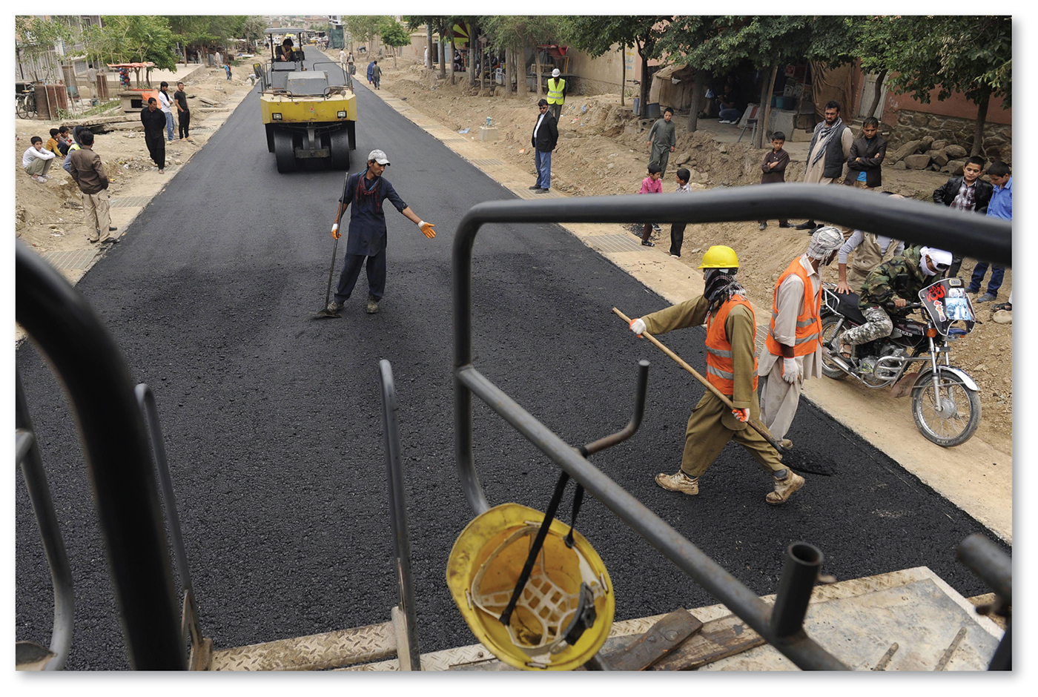
3.3 World Bank Development Assistance
Figure 10-42: A World Bank-funded road construction project in Kabul, Afghanistan.

Slide 53
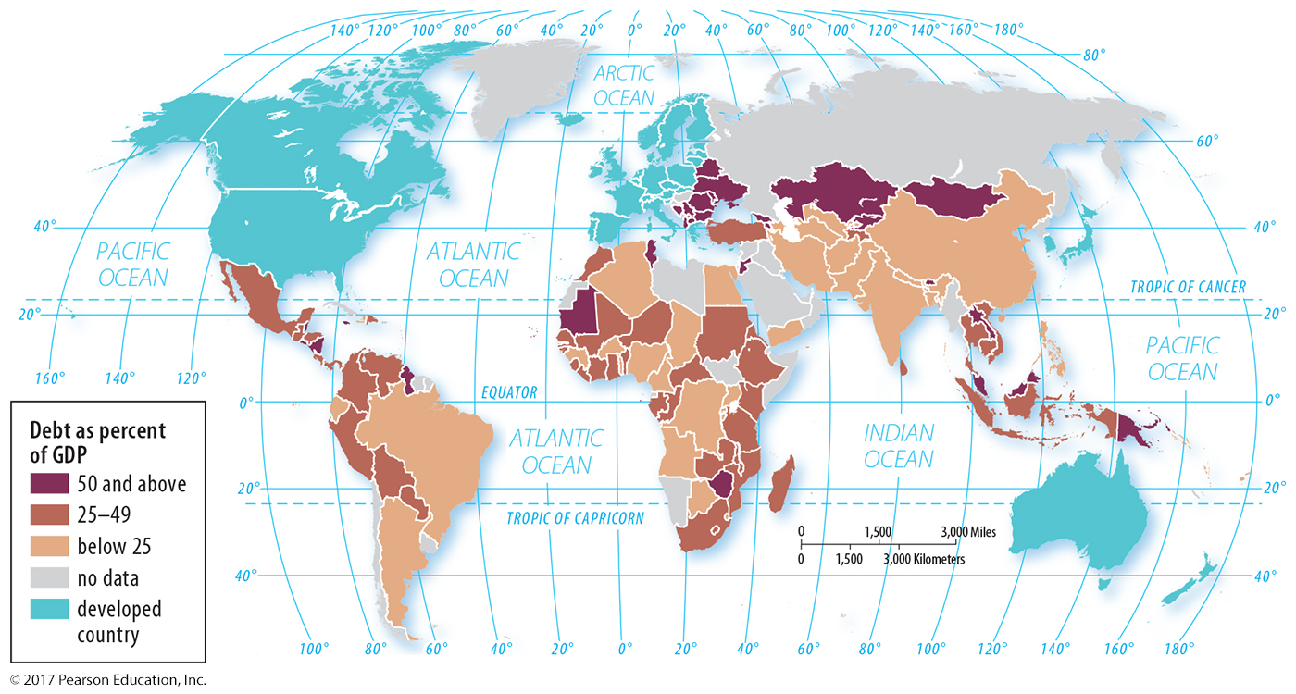
3.3 Debt as Percentage of GDP
Figure 10-43: Sometimes international borrowing leads to more debt than countries can repay.

Slide 54
3.4 Development Challenges During Hard Times
Debate over best way to deal with downturn:
Stimulus: government spending to stimulate economy
Austerity: spending cut dramatically
International Monetary Fund imposes structural adjustment programs
Disagreements in Europe over sovereign debt
Microfinance: access to loans in developing countries with poor banking

Slide 55
3.4 Anti-austerity Protest
Figure 10-44: Greek workers protest austerity measures put in place after the 2008 recession.

Slide 56
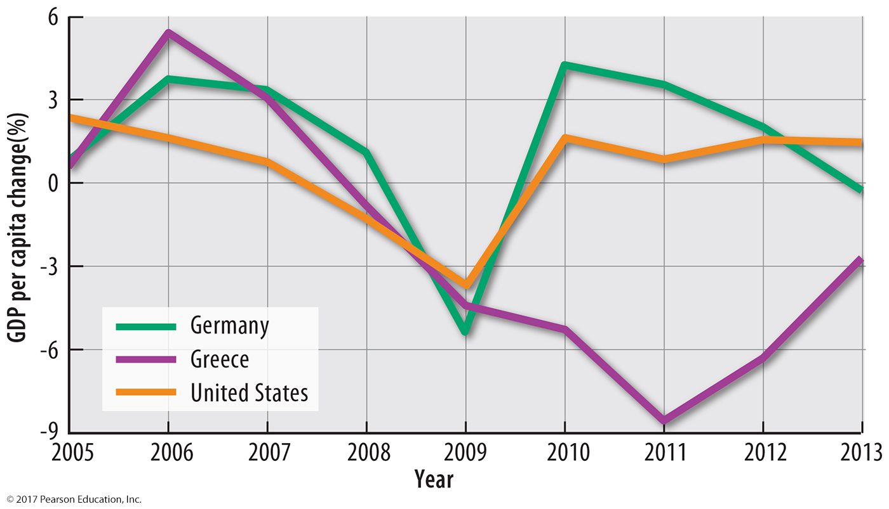
3.4 GDP Per Capita Change
Figure 10-45: Greece did not recover from the 2008 recession as quickly as the United States or Germany.

Slide 57
Key Issue 4: Why Are Countries Making Progress in Development?
4.1 Fair Trade Standards
4.2 Measuring Progress

Slide 58
4.1 Fair Trade Standards
Fair trade provides more equity for:
Producers: greater share of price
Workers: fair wages, rights
Consumers: cooperative stores

Slide 59
4.1 Fair Trade Producer Standards
Figure 10-46: Fair trade products include tea.

Slide 60
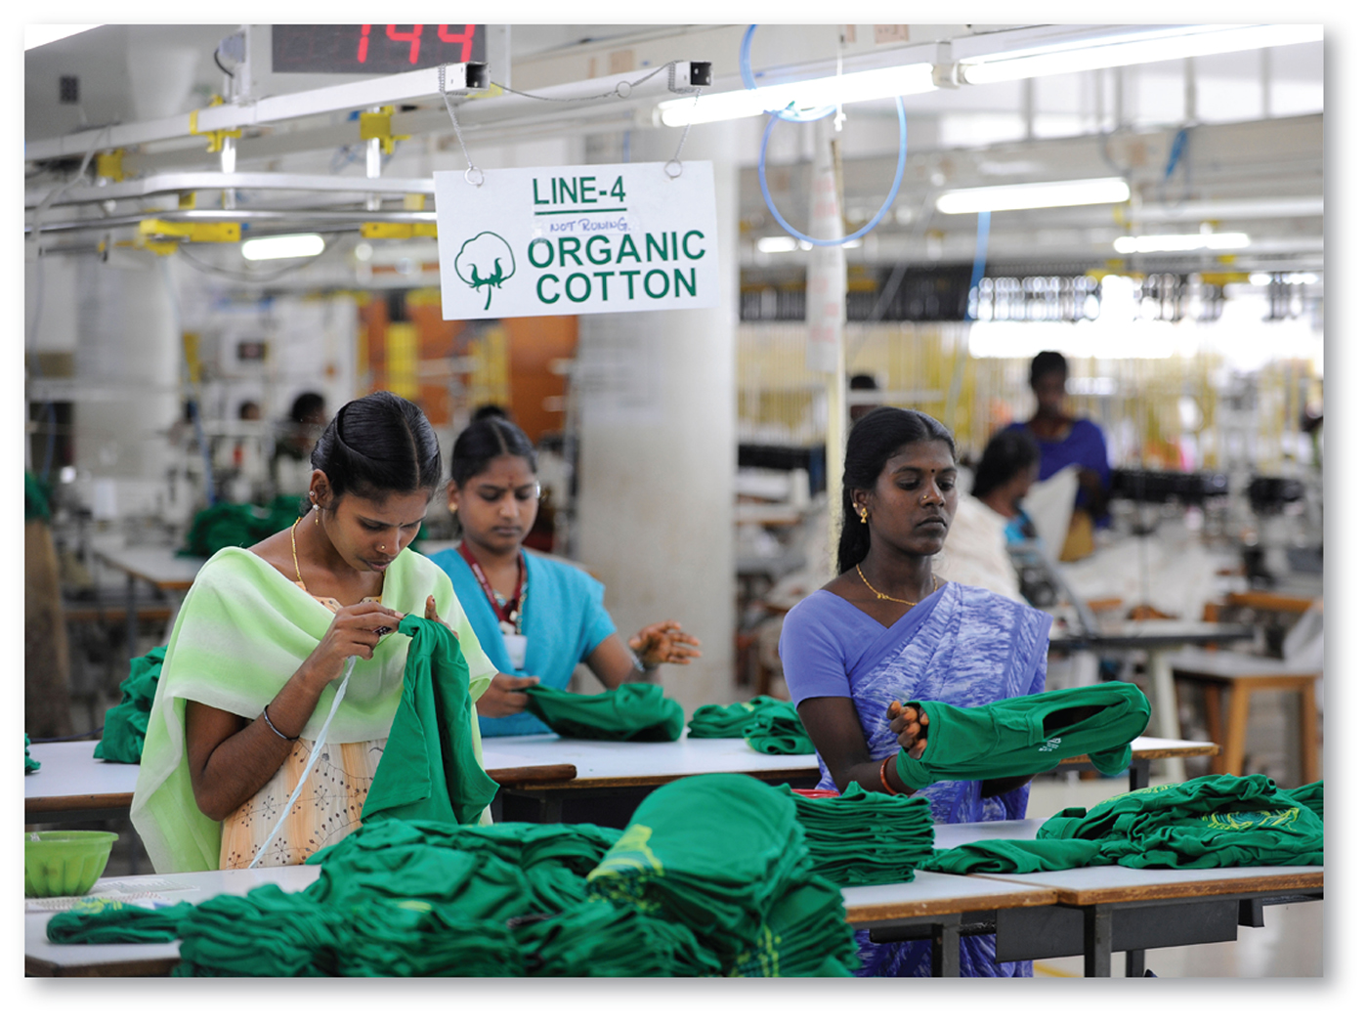
4.1 Fair Trade Worker Standards
Figure 10-47: Indian garment workers produce fair trade clothing from organic cotton.

Slide 61
4.1 Fair Trade and Consumers
Figure 10-48: Cooperative grocery stores like this one in the United Kingdom are likely to stock fair trade products.

Slide 62
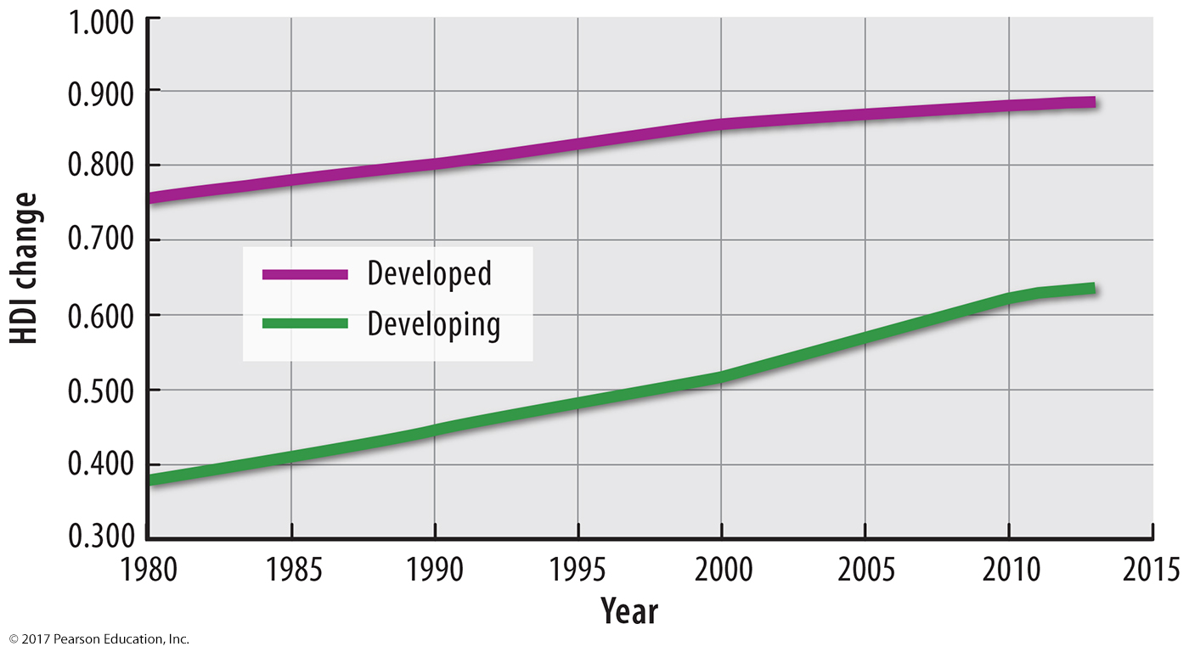
4.2 Measuring Progress: HDI
Figure 10-49: HDI in developed and developing countries has had a nearly parallel trend.

Slide 63
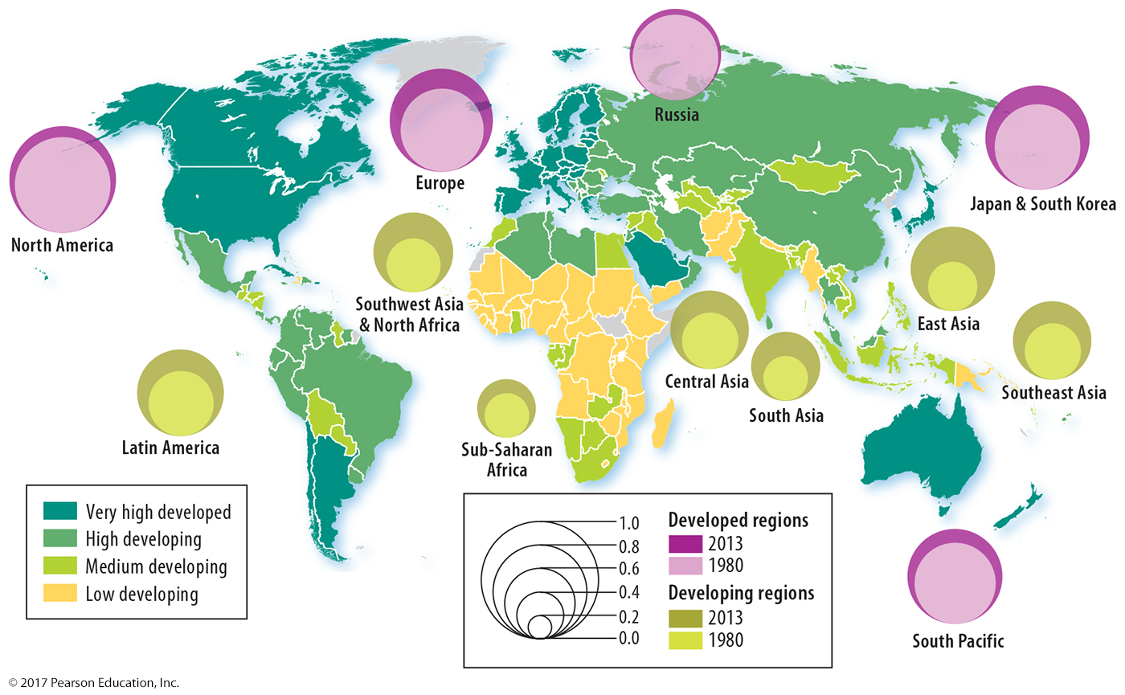
4.2 Measuring Progress: HDI by Region
Figure 10-50: The changing circle size shows the increase in development from 1980 to 2013.

Slide 64
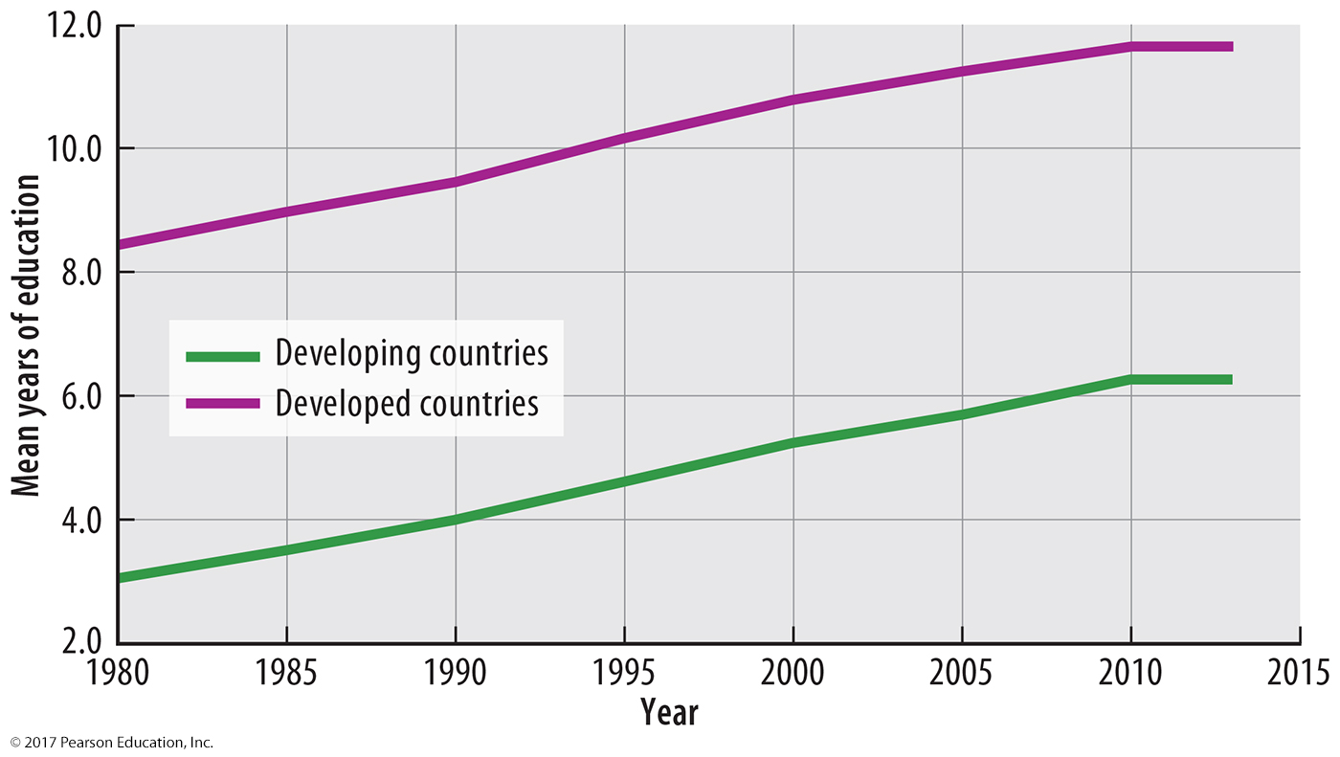
4.2 Measuring Progress: Education
Figure 10-51: Education in developed and developing countries has had a nearly parallel trend.

Slide 65
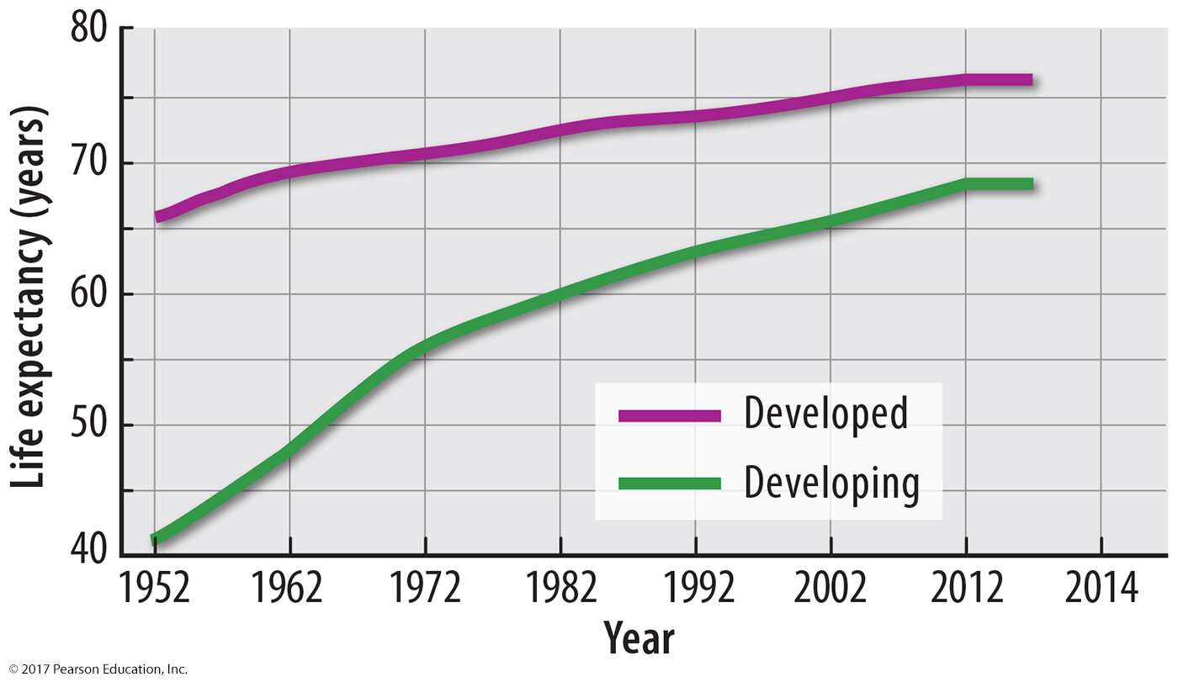
4.2 Measuring Progress: Life Expectancy
Figure 10-52: Life expectancy in developing countries has been increasing more rapidly.

Slide 66
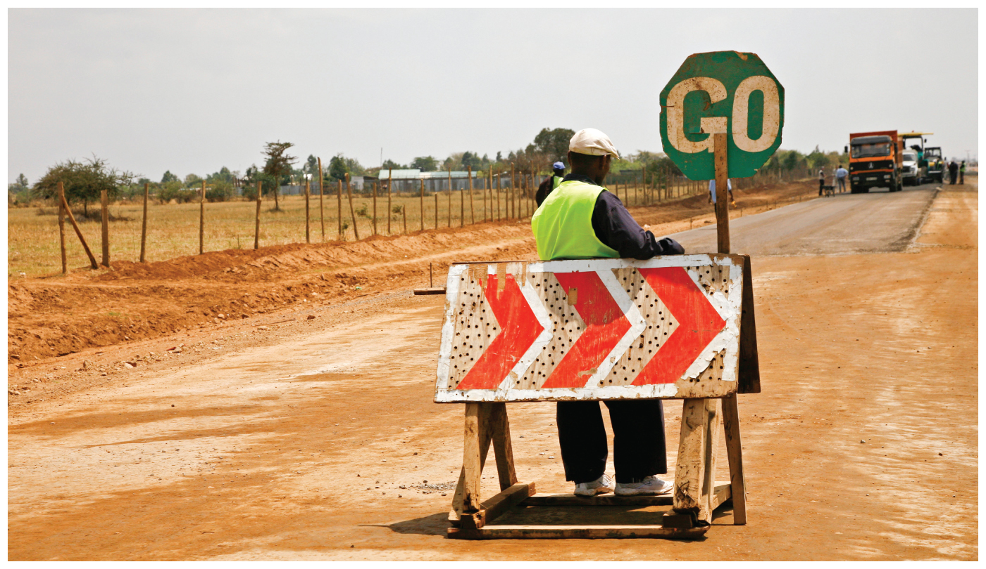
Chapter 10 End

