Slide 1
Unit 1:Geography: Its Nature and Perspectives

Slide 2
Unit 1:Geography: Its Nature and Perspectives
I. WHAT IS GEOGRAPHY?

Slide 3
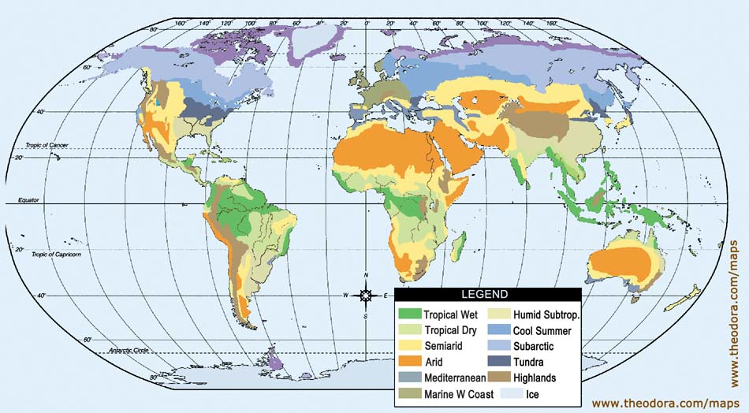
What is Geography?
From your experience with the “Material World” posters, what are some things that might be considered part of a definition of Geography?

Slide 4
What is Geography?
Read pages 1-8 on Awakening to World Hunger. Take C-notes on this section
Watch the National Geographic Video. Is there anything else you would like to add to your definition?

Slide 5
What is Geography?
View the image on your desk…. Record your thoughts about, “What is geography?”

Slide 6
Geography defined
The science that studies the lands, the features, the inhabitants, and the phenomena of the Earth. (wikipedia)
The study of the earth and its features and of the distribution of life on the earth, including human life and the effects of human activity (freeonlinedict.)
The study of the earth and its features and of the distribution of life on the earth, including human life and the effects of human activity (answers.com)

Slide 7
Geography defined
The study of how people make places, how we organize space and society, how we interact with each other in places and across space, and how we make sense of others and ourselves in our locality, region, and world (Deblij Text book)

Slide 8
Geography defined
The study of the earth and its people (Hohlen)

Slide 9
Parts of Geography
Physical Geography: Study of the physical phenomenon on the Earth….Landforms, climate, geology (Natural Geography)
Human Geography: Division of geography that focuses on how people a live and interact
Environmental Geography: Where human geo. And physical geo. collide. Their interaction and the outcomes

Slide 10
Unit 1:Geography: Its Nature and Perspectives
II. How did Geography Begin?

Slide 11
How did “Geography” begin?
Greeks coined the term… means “Earth writing.”
Spread via Silk Road
Grew in the Muslim city states
Zheng He and Chinese exploration
European Exploration and colonialism
Portugal’s Prince Henry the Navigator

Slide 12
Early Greeks
Geography = Earth Writing
Strabo: 17 volume “Geography”… Regional approach
Ptolemy: 8 volume “Guide to Geography” World view
Eratoshthenes: calculated the earth’s circumference…

Slide 13
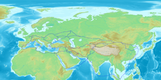
Silk Road
Named after valued Chinese good of Silk
Trade route that connected China via overland trade routes to Middle East, North Africa, & Europe
200 AD & thrived into the 12 and 1300’
Trade along the
Silk Road spreads
Knowledge and need
For knowledge!

Slide 14
Muslim City States
Most advanced civilizations from 900’s to 1300’s.
Because they are city states, travel between them is constant
Geography is necessary for navigation

Slide 15
Zheng He and China
China develops a very advanced civilization in 13 and 1400’s.
Explorer Zheng He traveled the world by sea connecting the world and improving world knowledge
1421?????????

Slide 16
European Explorers
Years in medieval times begin their end with the Crusades in 1200’s
Renaissance brings Europe back to life in 1400’s
Europeans awaken to the world and begin exploring.
Prince Henry of Portugal creates a navigation school!!!

Slide 17
Unit 1:Geography: Its Nature and Perspectives
III. THE EARTH, THE SUN, GLOBE, GRIDS, AND MAPS

Slide 18
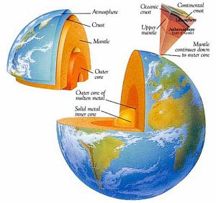
The Earth: It’s Make up
The Earth is made up of several layers:
Core
Mantle
Crust (lithosphere)
Atmosphere
Surface is 70% water

Slide 19
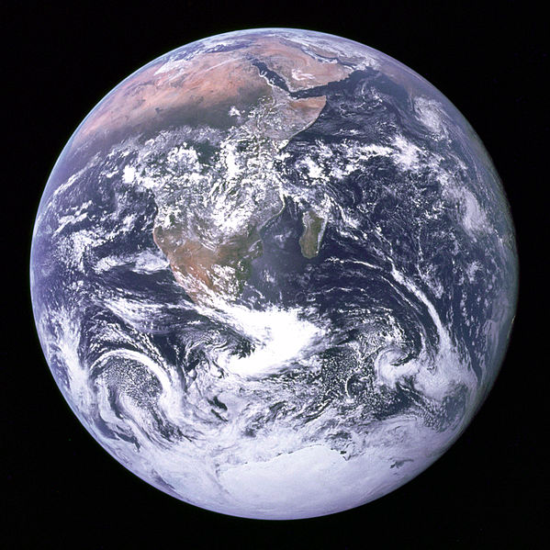
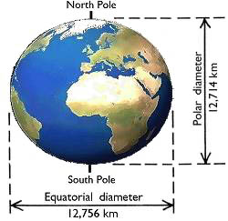
The Earth: Its Shape
It is not round… because it is 3-D
It is a sphere…sort of
It is actually an oblate spheroid.

Slide 20
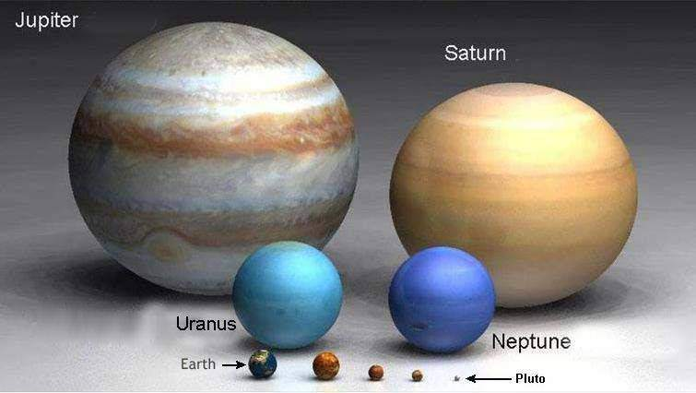
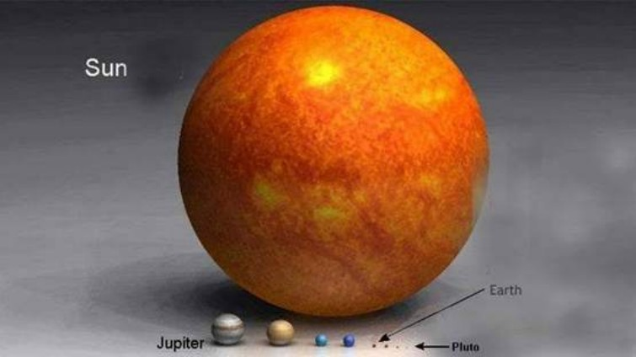
The Earth: Its Size
It is BIG
But not as big as the Sun
Diameter= 8,000 miles

Slide 21
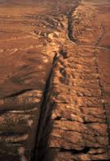
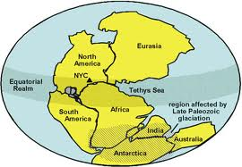
The Earth: Forces that Shape it
Internal Forces
Heat… 5-7000 degrees.
Places great force on the crust.
Causes volcanoes and plate movements called earthquakes (Folds Faults) (tsunamis)
Plate Tectonics: movement of plates of the earth’s crust
Alfred Wegener’s Pangaea
Hypothesis: Continental Drift

Slide 22
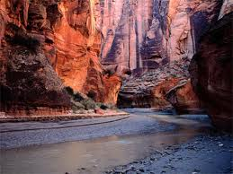
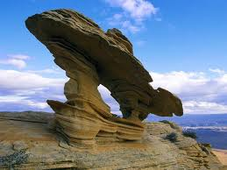
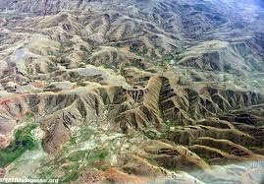
The Earth: Forces that Shape it
External Forces
Erosion.
Wind
Water
Glaciers

Slide 23
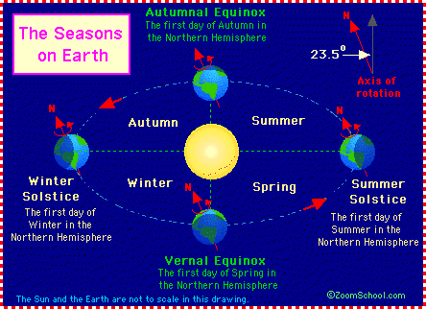
The Earth: Sun and Tilt:

Slide 24
The Earth: Sun and Tilt:
The Earth tilts 23.5º
The Earth rotates on its axis - once per day
The Earth revolves around the sun-once per year
Tilt Causes seasons
Solstice=longest or shortest day of the year
First day of summer or winter
Equinox=Equal day and night
First day of spring or autumn

Slide 25
The Earth: Latitude:
Key lines of latitude: Parellels
0º N or S = Equator
23.5º North = Tropic of Cancer
23.5 South = Tropic of Capricorn
60º N or S + Arctic Circles
Latitude and Climate
0-15º = tropical
15-30º = Desert
30-60º = 4 seasonal
60º-Poles = Permafrost

Slide 26
The Earth: Longitude
Key lines of longitude: Meridians
0º E or W = Prime Meridian
Passes through Greenwich, England
180º E or W = International Dateline
Passes through the pacific
Where the new day starts
Japan is called the land of the rising sun

Slide 27
The Earth: The Grid
Finding places with Latitude and longitude
From page A-3 in the DeBlij book, find the coordinates of London, and of Dublin, and of Amsterdam
From 423. find the coordinates of Singapore
From 296-7 Sao Paulo, Johannesburg and Melborne

Slide 28
The Earth: The Grid and Timezones
Turn to page ?? Of the blue atlas

Slide 29
The Earth: Globe and Projections
Study your “Understanding Maps WS”

Slide 30
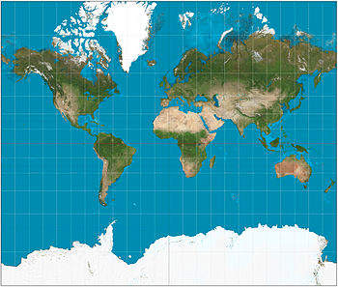

Slide 31
Mercator Projection
Cylindrical
Navigational… standard nautical map as direction and shape stay constant
Conformal projection as it maintains angles
Scale increases as you move farther form the poles

Slide 32
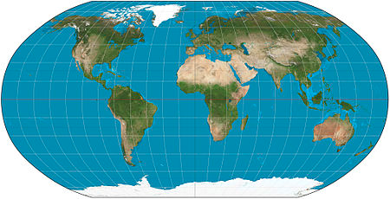

Slide 33
Robinson Projection
Not Equal area or conformal
Shows the whole world while attempting to minimize size, shape, and direction distortions
Uses curved meridians
Aesthetically pleasing and most often used in classrooms

Slide 34
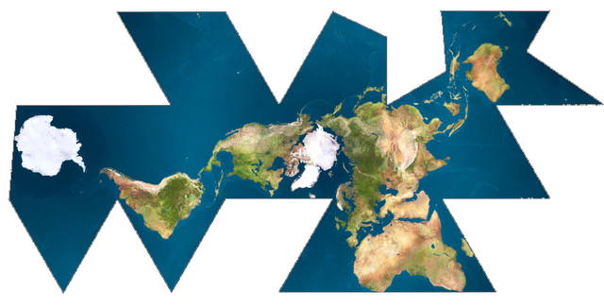

Slide 35
Fuller Projection
Projection created to maintain accurate size and shape land masses
Called a Dymaxion
Distorts location and direction and size of the oceans

Slide 36
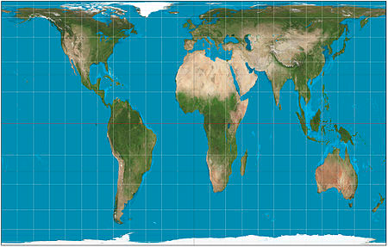

Slide 37
Peters Projection
Equal Area Projection
Distorts shapes near the poles in order to accurately depict sizes
Considered political statement as a representation of poor equatorial countries because they are shown more accurately in size to wealthier countries to the North
Cylindrical

Slide 38
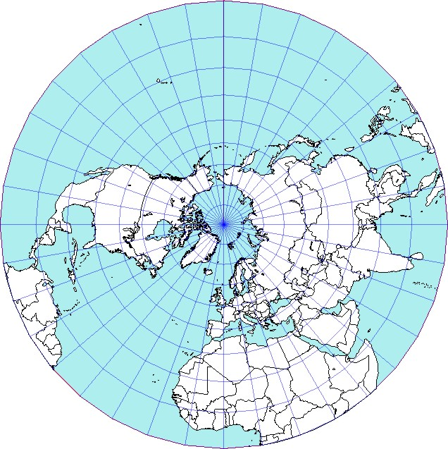

Slide 39
Azimuthal Projections
Planar projection. Taken on a flat image as though a light shines outward from the globe and is traced on the paper
Shows have the globe
Looks like a photograph
Usually centers one of the poles in the image

Slide 40
Unit 1:Geography: Its Nature and Perspectives
IV. Five Themes and Four Traditions

Slide 41
4 Traditions
W.D Pattison
Studied the history of Geography study. Determined that there were 4 areas of focus:
Earth/Science Tradition:
Physical Natural Geography
Locational Analysis: Spatial Tradition:
Where things are and what are they llike
Area Analysis:
Regional study of the world
Culture Environment Tradition
Study of Human impact on the world

Slide 42
5 Themes of Geography
Created by National Geographic in response to bad Geography test scores nation wide in the 1980’s to create better geography study in the US.
Location
Place
Movement
Region
Human Environment Interaction

Slide 43
5 Themes of Geography:LOCATION
Location: study of where things are
Absolute Location: where things are based on coordinates or addresses:
Grid system
GPS (Global Positioning systems)
Remote sensing: studying or observing from a distance
Satellites
Triangulation: 3 points of reference to create a location

Slide 44
5 Themes of Geography: LOCATION
Location: study of where things are
Absolute Location: Exact location using the grid system or addresses
GPS: Global Positioning System
Remote Sensing: observing from a distance (satellites)
Triangulation: Three points of reference needed for exact location of something
Relative Location: where something is in relationships to something else: “I live near Salk.”

Slide 45
5 Themes of Geography: LOCATION
Characteristics of Location:
Site: physical characteristics of a place:
Two rivers come together, good farm land, abundant trees
Situation: the qualities of a location in relation to other places (relative location)
It is near trade routes, near north woods and southern prairies, connecting point from Chicago to the West

Slide 46
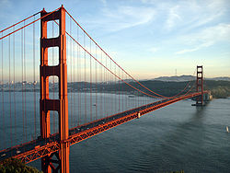
5 Themes of Geography: Place
Place asks the Question: What is it like there?
Some Places are very different and easily recognizable…. = Place Uniqueness

Slide 47
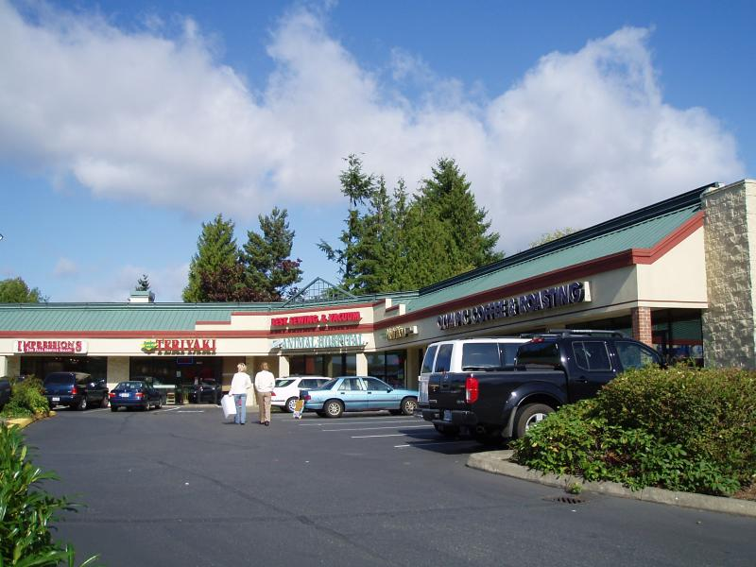
5 Themes of Geography: Place
Placelessness: Some places look like everywhere else… Meaning that they have no place uniqueness

Slide 48
5 Themes of Geography: Place
Places Change:
Cultural Landscape: (Carl Sauer): The combined work of nature and man.
Natural Landscape: No Human changes
Built Landscape: Human made landscape
Sequent Occupance: Evidence of multiple cultures in the landscape from a history of a variety of inhabitants

Slide 49
5 Themes of Geography: Place
Toponyms: Topo = place, nym = name… Place names:
Grand Canyon
New Prague
Mississippi
Los Angeles
Etc……

Slide 50
5 Themes of Geography: Place
Sense of place: One’s sense of meaning of a place based on direct interaction
Perception of place: belief or understanding of what a place is like, often based on books, movies, stories, or pictures.

Slide 51
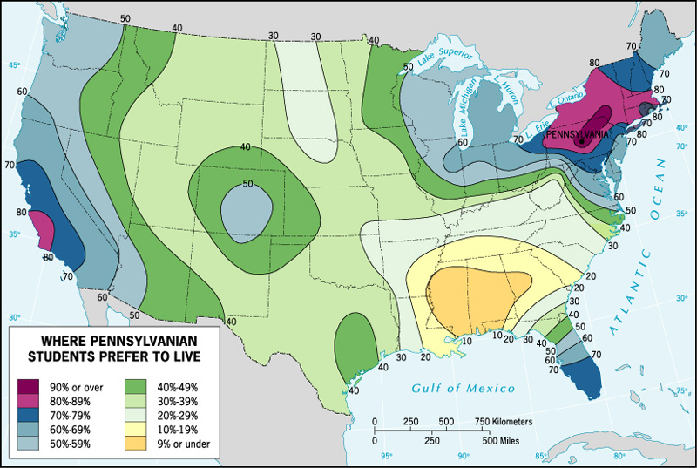
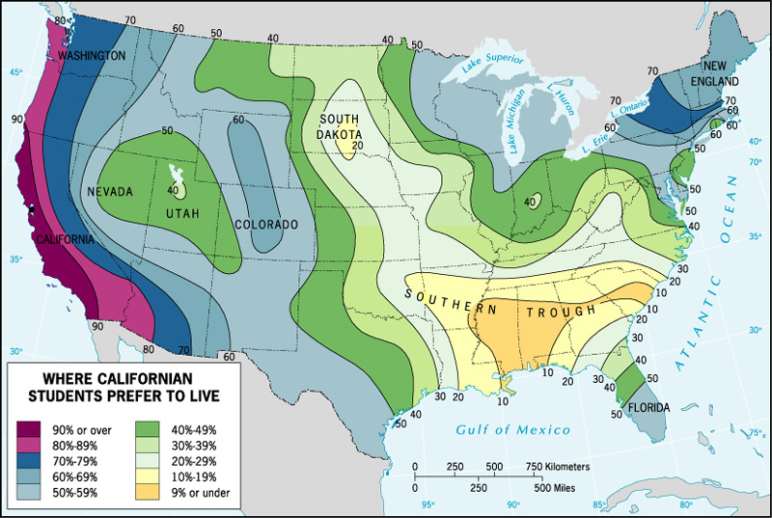
Perception
of Place
Where Pennsylvanian students prefer to live
Where Californian students prefer to live

Slide 52
5 Themes of Geography: Movement
Geographers, when studying the earth want to examine the movement of people, goods, and ideas….
Absolute Distance vs. Relative Distance:
Absolute=Miles… measurable
Relative=Time and convenience

Slide 53
5 Themes of Geography: Movement
Spatial Interaction: Geography term describing connectivity between places…
What things impact spatial interaction?
Distance
Size of places
Pull of a place
Who lives there
What goods are provided……

Slide 54
5 Themes of Geography: Movement
Terms of Spatial Interaction:
Connectivity vs. Accessibility
Connectivity: Degree by which two places are linked or bonded together.
What connects them? What Goods do they have?
Accessibility: How easy is it to get there?
How far? What Cost? Time?
Two places that have high connectivity and high accessibility are likely to have high amounts of spatial interaction.

Slide 55
Five themes of Geography: Movement
Transferability: ease with which something can be moved…
High transferability = low cost,
Low transferability = high cost

Slide 56
5 Themes of Geography: Movement
Network: The network is the structure that is used in movement.
Roads, airports, bus stations… Mostly a term about land travel… but what about moving stuff and ideas
Internet
Mail
TV
Phone

Slide 57
5 Themes of Geography: Movement
Time Space Compression: In terms of time, cost, and psychological understanding, movement is faster, easier, and cheaper, making the world, in practical terms…smaller
David Harvey
Globalization: globalization refers to the widening, deepening and speeding up of global interconnection.

Slide 58
5 Themes of Geography: Movement
How are Time Space Compression and Globalization changing the world?

Slide 59
5 Themes of Geography: Movement
How are Time Space Compression and Globalization changing the world?

Slide 60
5 Themes of Geography: Movement
Movement is limited by factors:
Distance: As distance increases, interaction decreases
Friction of Distance: Costs incurred for moving, ie. Gas, time, money. The greater the friction or higher the costs, the less the interaction.
Distance Decay: The distance decay effect states that the interaction between two locales declines as the distance between them increases. Once the distance is outside of the two locales' activity space, their interactions begin to decrease

Slide 61
5 Themes of Geography: Movement
Movement in geography is called: Diffusion
Hearth: birth place of a culture or trait
Trait: a single aspect of a culture
Expansion Diffusion Diffusion:
Contagious diffusion
Hierarchical Diffusion
Relocation diffusion
Stimulus diffusion

Slide 62
Types of Diffusion
Expansion Diffusion – idea or innovation spreads outward from the hearth
Contagious – spreads adjacently
Hierarchical – spreads to most linked people or places first.
Stimulus – idea promotes a local experiment or change in the way people do things.

Slide 63
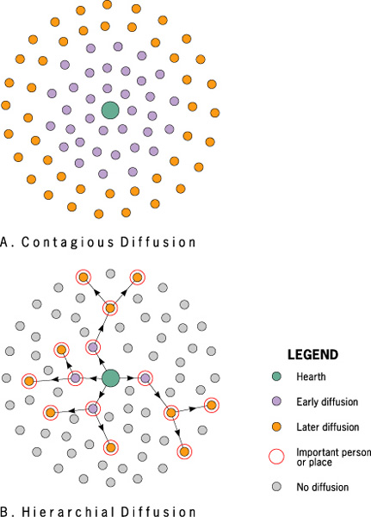

Slide 64
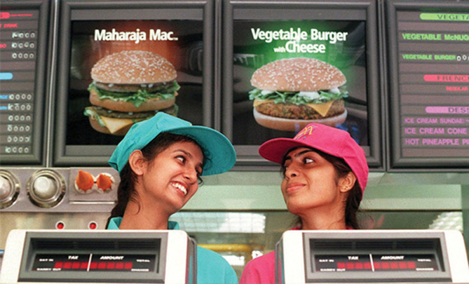
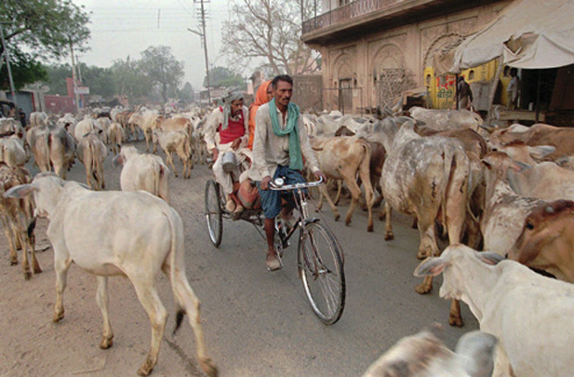
Stimulus Diffusion
Because Hindus believe cows are holy, cows often roam the streets in villages and towns. The McDonalds restaurants in India feature veggie burgers.

Slide 65
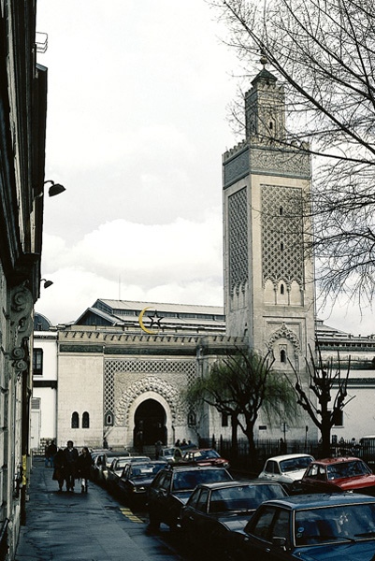
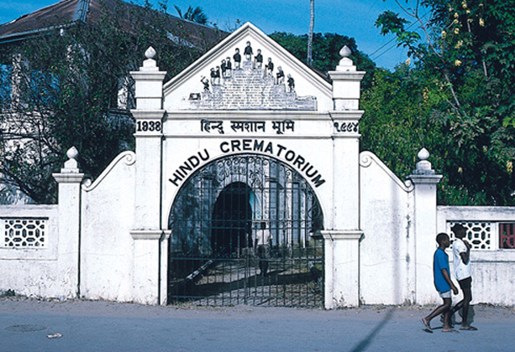
Types of Diffusion
Relocation diffusion – movement of individuals who carry an idea or innovation with them to a new, perhaps distant locale.
Paris, France
Kenya
Photo credit: H.J. de Blij
Photo credit: A.B. Murphy

Slide 66
Five Themes of Geography: Human Environment Interaction
Geographers study the impacts of humans on the Earth and the ways that the Earth impacts human activity.

Slide 67
Five Themes of Geography: Human Environment Interaction
Old approaches:
Environmental Determinism
Possibilism
New approaches:
Political ecology
Cultural ecology

Slide 68
Five Themes of Geography: Region
Region Studies: study the world in regions and apply learnings to broader places
Formal/Uniform Region: One marked by a common trait throughout the region: Islam in the Middle East
Functional/Nodal Region: One that is held together by similar activities: Seven County Metropolitan area
Perceptual/vernacular region: a region that exists as a concept in ones mind: Iron rage or the upper midwest

Slide 69
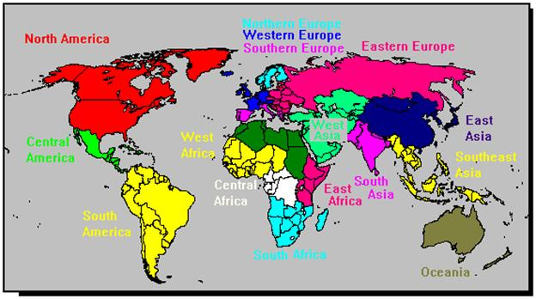
Five Themes of Geography: Region
Formal Regions

Slide 70
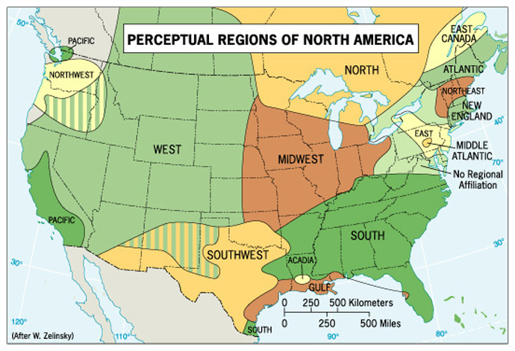
Five Themes of Geography: Region

Slide 71
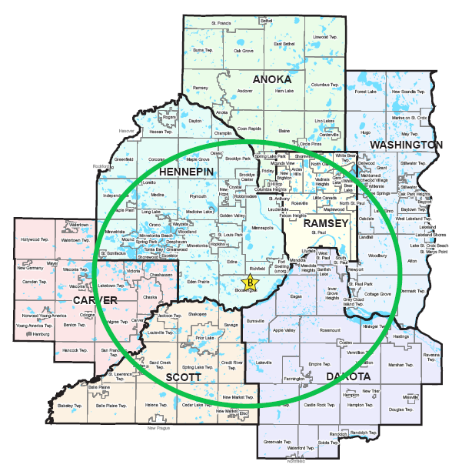
Five Themes of Geography: Region
Perceptual Region

Slide 72
Five Themes of Geography: Region
World Systems Theory: This model is an economic understanding of the world, but it is also a way to regionally view the world
Immanuel Wallerstein
1970’s and 1980’s

Slide 73
Five Themes of Geography: Region
World Systems Theory:
Based on economic divisions of labor
Core Countries:Core countries focus on higher skill and capital ($ and Machines) intensive production with higher levels of education, income and technology
World’s wealthiest countries
Periphery Countries: Marked by lower levels of education, lower salaries and less technology
World’s poorest countries

Slide 74
Five Themes of Geography: Region
World Systems Theory:
Based on economic divisions of labor
Periphery Countries: Marked by lower levels of education, lower salaries and less technology
World’s poorest countries

Slide 75
Five Themes of Geography: Region
World Systems Theory:
Based on economic divisions of labor
Semi-periphery Countries: places where both core and periphery process are going on. (Mexico, Brazil, China, Russia, India, Eastern Europe)

Slide 76
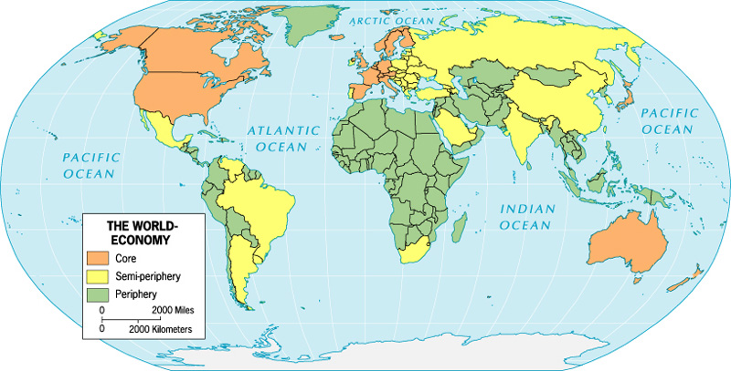
Five Themes of Geography: Region
World Systems Theory:

Slide 77
Unit 1:Geography: Its Nature and Perspectives
IV. Key Concepts underlying the geographical perspective:

Slide 78
IV. Key Concepts underlying the geographical perspective:
Scale:
Pattern:
Regionalization:
Globalization:

Slide 79
IV. Key Concepts underlying the geographical perspective:
Location
Space
Place

